Slide 1
Chapter 3
Internal Analysis: Distinctive Competencies, Competitive Advantage, and Profitability

Slide 2
Learning Objective
Discuss the source of competitive advantage
Identify and explore the role of efficiency, quality, innovation, and customer responsiveness in building and maintaining a competitive advantage
Explain the concept of the value chain
Understand the link between competitive advantage and profitability
Explain what impacts the durability of a company’s competitive advantage

Slide 3
Competitive advantage
Exists when a company’s profitability is greater than the average profitability of all companies in its industry
Sustained competitive advantage - Exists when a company maintains its competitive advantage over a number of years
  Primary objective of strategy

Slide 4
Distinctive competencies
Firm-specific strengths that allow a company to differentiate its products and/or achieve lower costs than its rivals
  Arise from resources and capabilities
Resources: Assets of a company
  Tangible resources: Physical entities
    Land, buildings, and inventory, and money
  Intangible resources: Nonphysical entities created by managers and other employees
    Brand names, company reputation, and intellectual property

Slide 5
Distinctive competencies
Capabilities: Company’s skills at coordinating its resources and putting them to productive use
  Reside in an organization’s rules, routines, and procedures
  Intangible
  Lead to sustained competitive advantage if they are rare and protected from copying

Slide 6
Distinctive competencies
Requirements
  Firm-specific and valuable resource, and the capabilities to take advantage of that resource, or
  Firm-specific capability to manage resources
    Distinctive competency is strongest when a company possesses both

Slide 7
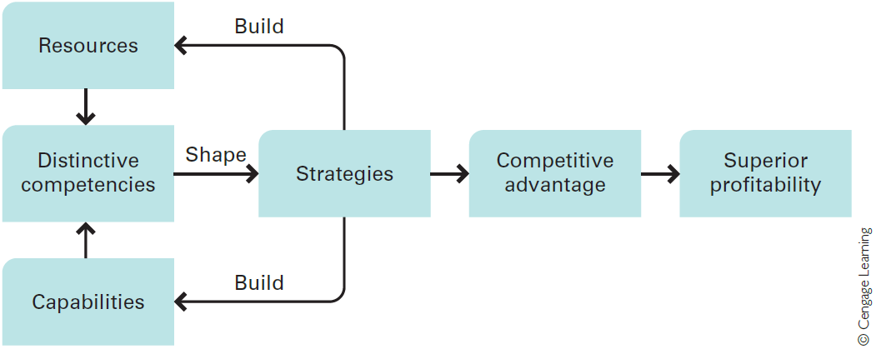
Figure 3.1 - strategy, resources, capabilities, and competencies

Slide 8
Competitive advantage, value creation, and profitability
Profitability of a company depends on the:
  Value customers place on its products
  Price it charges for its products
  Costs of creating those products
When a company strengthens the value of its products, it can:
  Raise prices to reflect the value
  Reduce prices to induce more customers to purchase its products

Slide 9
Competitive advantage, value creation, and profitability
Point-of-sale price is less than the utility value placed on the product by many customers, owing to:
  Consumer surplus - Customers capture some of that utility
    Customer’s reservation price - Each individual’s unique assessment of the value of a product
  Competition from rivals

Slide 10
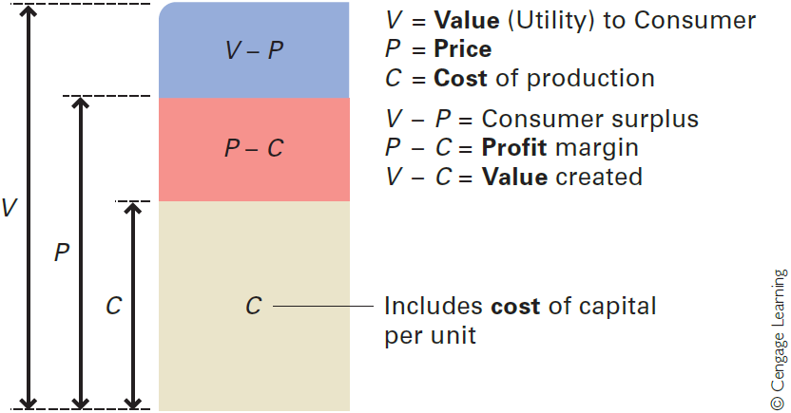
Figure 3.2 - value creation per unit

Slide 11
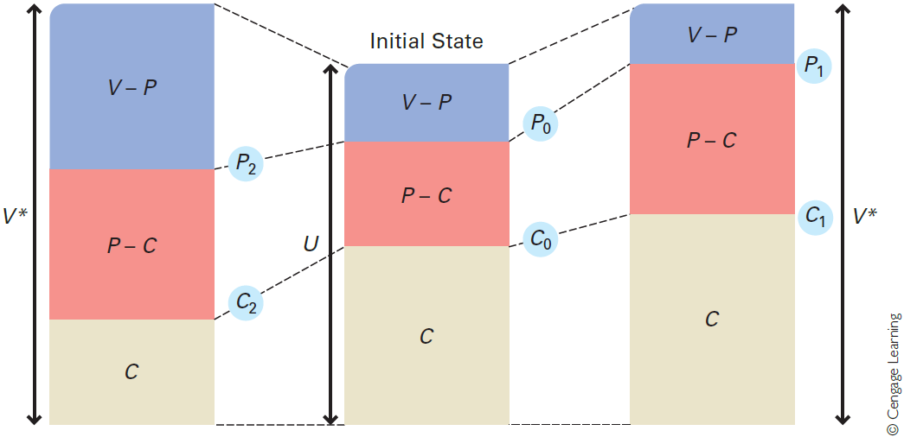
Figure 3.3 - value creation and pricing options

Slide 12
Value creation and pricing options
Managers must understand:
  Dynamic relationships among value, pricing, demand, and costs
    To maximize competitive advantage and profitability
  How value creation and pricing decisions affect demand
  How unit costs change with increases in volume

Slide 13
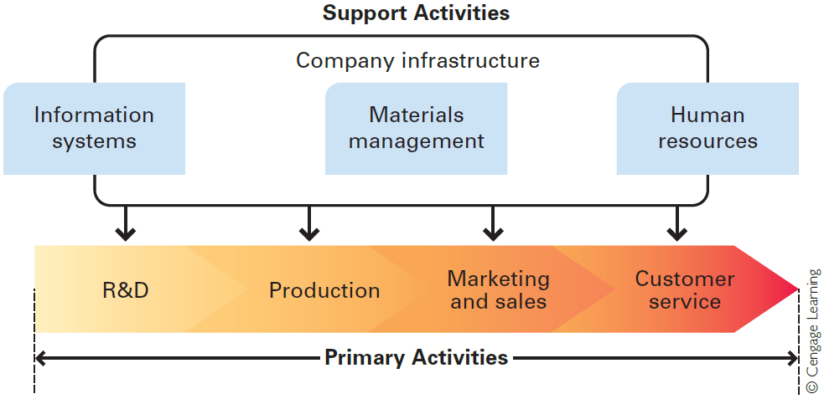
Figure 3.5 - the value chain

Slide 14
Primary activities
Relate to a product’s design, creation, delivery, marketing, support, and after-sales service
Research and development
  Design of products and production processes
  Superior product design increases a product’s functionality and add value
Production
  Creation process of a good or service
  Helps lower cost structure and leads to differentiation

Slide 15
Primary activities
Marketing and sales
  Brand positioning and advertising - Increase customers’ perceived value of a product
  Marketing and sales - Help create value by discovering customers’ needs
Customer service
  Provide after-sales service and support
  Create superior utility by solving customer problems and supporting customers after a purchase

Slide 16
support activities
Provide inputs that allow the primary activities to take place
Materials management
  Controls the transmission of physical materials through the value chain
  Lowers cost and creates more profit
Human resources
  Ensures value creation by making sure that the company has the right combination of skilled people

Slide 17
support activities
Information systems
  Electronic systems to improve efficiency and effectiveness of a company’s value creation activities
Company infrastructure
  Companywide context within which all the other value creation activities occur
    Organizational structure, control system and company culture

Slide 18
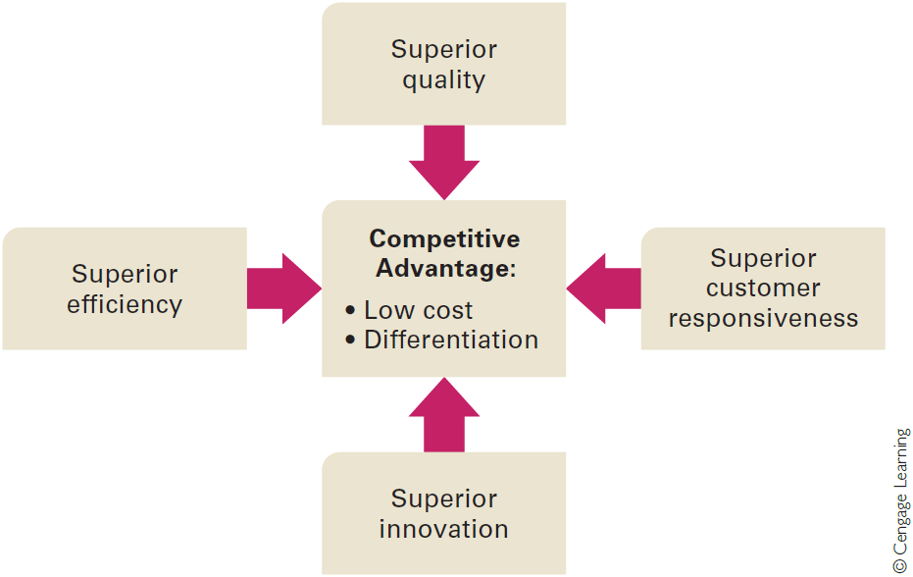
Figure 3.6 - building blocks of competitive advantage

Slide 19
BUILDING BLOCKS OF COMPETITIVE ADVANTAGE
Efficiency
  Measured by the quantity of inputs that it takes to produce a given output
  Employee productivity: Output produced per employee
    Helps attain competitive advantage through a lower cost structure
Quality
  Superior quality - Customers’ perception that a product’s attributes provide them with higher utility than those sold by rivals

Slide 20
BUILDING BLOCKS OF COMPETITIVE ADVANTAGE
  Quality as excellence - Product features and functions, and level of service associated with its delivery
  Quality as reliability - Occurs when a product consistently performs the function it was designed for, and seldom breaks down
Innovation
  Product innovation: Development of products that are new to the world or have superior attributes to existing products

Slide 21
BUILDING BLOCKS OF COMPETITIVE ADVANTAGE
  Process innovation: Development of a new process for producing products and delivering them to customers
Customer responsiveness
  Superior responsiveness - Achieved by identifying and satisfying customer needs better than one’s rivals
  Customer response time: Time that it takes for a good to be delivered or a service to be performed
  Other sources - Superior design, service, and after-sales service and support

Slide 22
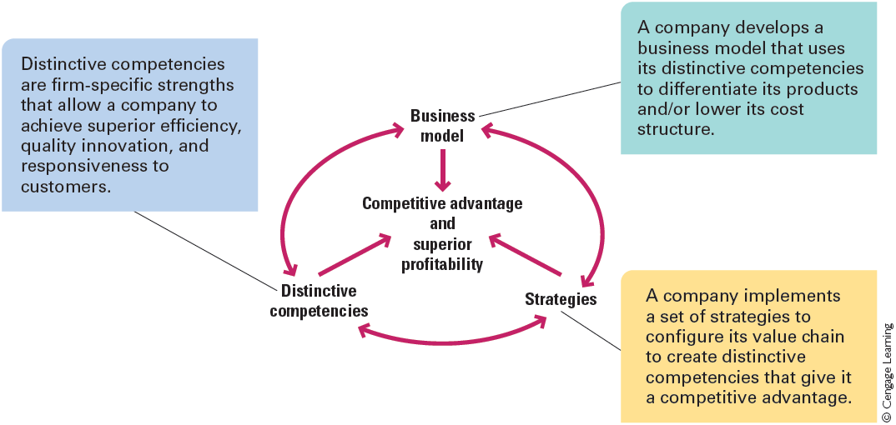
Figure 3.8 - competitive advantage and the value creation cycle

Slide 23
Definitions of basic accounting terms
Term | Definition | Source
Cost of Goods Sold (COGS) | Total costs of producing products | Income statement
Sales, General, and Administrative Expenses ( SG&A) | Costs associated with selling products and administering the company | Income statement
R&D Expenses (R&D) | Research and development expenditure | Income statement
Working Capital | Amount of money the company has to work with in the short term: Current assets – current liabilities | Balance sheet
Property, Plant, and Equipment (PPE) | Value of investments in the property, plant, and equipment that the company uses to manufacture and sell its products Also known as fixed capital | Balance sheet

Slide 24
Definitions of basic accounting terms
Term | Definition | Source
Return on Sales (ROS) | Net profit expressed as a percentage of sales Measures how effectively the company converts revenue into profits | Ratio
Capital Turnover | Revenues divided by invested capital Measures how effectively the company uses its capitals to generate revenue | Ratio
Return on Invested Capital (ROIC) | Net profit divided by invested capital | Ratio
Net Profit | Total revenues minus total costs before tax | Income statement
Invested Capital | Interest-bearing debt plus shareholders’ equity | Balance sheet

Slide 25
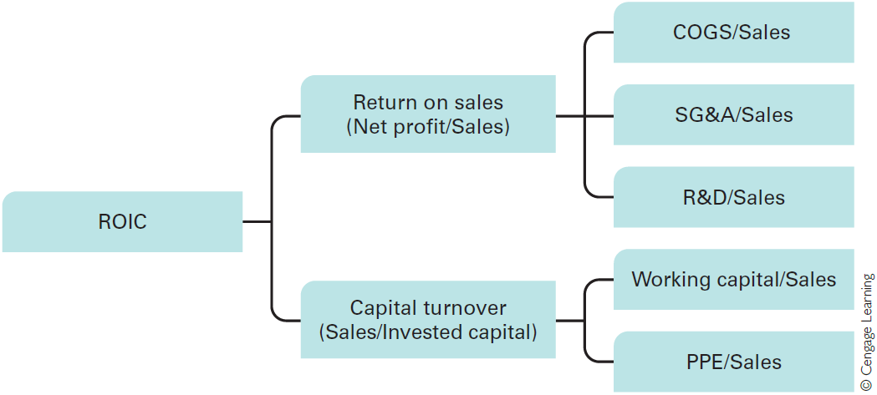
Figure 3.9 - drivers of profitability

Slide 26
Barriers to imitation
Make it difficult for a competitor to copy a company’s distinctive competencies
  Greater the barrier, more sustainable a company’s competitive advantage
Imitating resources
  Firm-specific and value tangible resources are the easiest to imitate
  Intangible resources
    Brand names - Imitating them is prohibited by law

Slide 27
Barriers to imitation
    Marketing and technical knowhow - Easy to imitate owing to movement of skilled personnel between companies and visibility of strategies to competitors
    Technological knowhow - Easy to imitate as patents do not provide complete protection
Imitating capabilities - Difficult as:
  They are not visible to outsiders
  No one individual has access to all the internal operating routes and procedures of a company

Slide 28
Capability of competitors and industry dynamism
Capability of competitors is determined by:
  Nature of the competitors’ prior strategic commitments
    Strategic commitment - Company’s commitment to a particular way of doing business
  Absorptive capacity - Ability of an enterprise to identify, value, assimilate, and use new knowledge
Most dynamic industries are those with a very high rate of product innovation
  Where product life cycles and competitive advantages are short-lived

Slide 29
Reasons for failure of companies
Inertia - Companies find it difficult to adapt to changing competitive conditions
  Power struggles and hierarchical resistance make change difficult
Prior strategic commitments - Limit a company’s ability to imitate rivals
  Cause competitive disadvantage
The Icarus paradox - Companies become very specialized and myopic
  Lose sight of market realities

Slide 30
Steps to avoid failure
Focus on the building blocks of competitive advantage
Institute continuous improvement and learning
Track best industrial practice and use benchmarking
Overcome inertia
The role of luck

