Slide 1
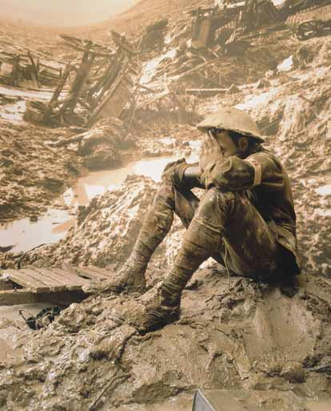
World War I – 1914 -1918

Slide 2
Four Major Questions:
Why did war break out in Europe in August 1914?
How did the United States respond to the European War?
Why did the United States support the Allies (Great Britain and France)?
What did Woodrow Wilson hope to achieve during and after the war?

Slide 3
So What?
U.S. emerges as a world power.
U.S. introduces an “American style” of foreign policy that remains with us today (for good or ill).
World War I unleashes forces that continue to cause bloody conflicts in the 21st Century.

Slide 4
Why did the war break out in Europe in August 1914?
Short term reasons
Long term reasons

Slide 5
Assassination of Archduke Franz Ferdinand
- Threat to the Austro-Hungarian Empire
- Catalyst for broader European conflict

Slide 6
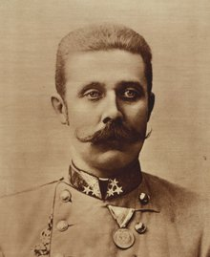
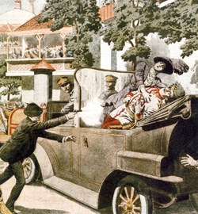
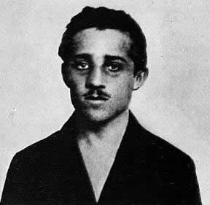

Slide 7
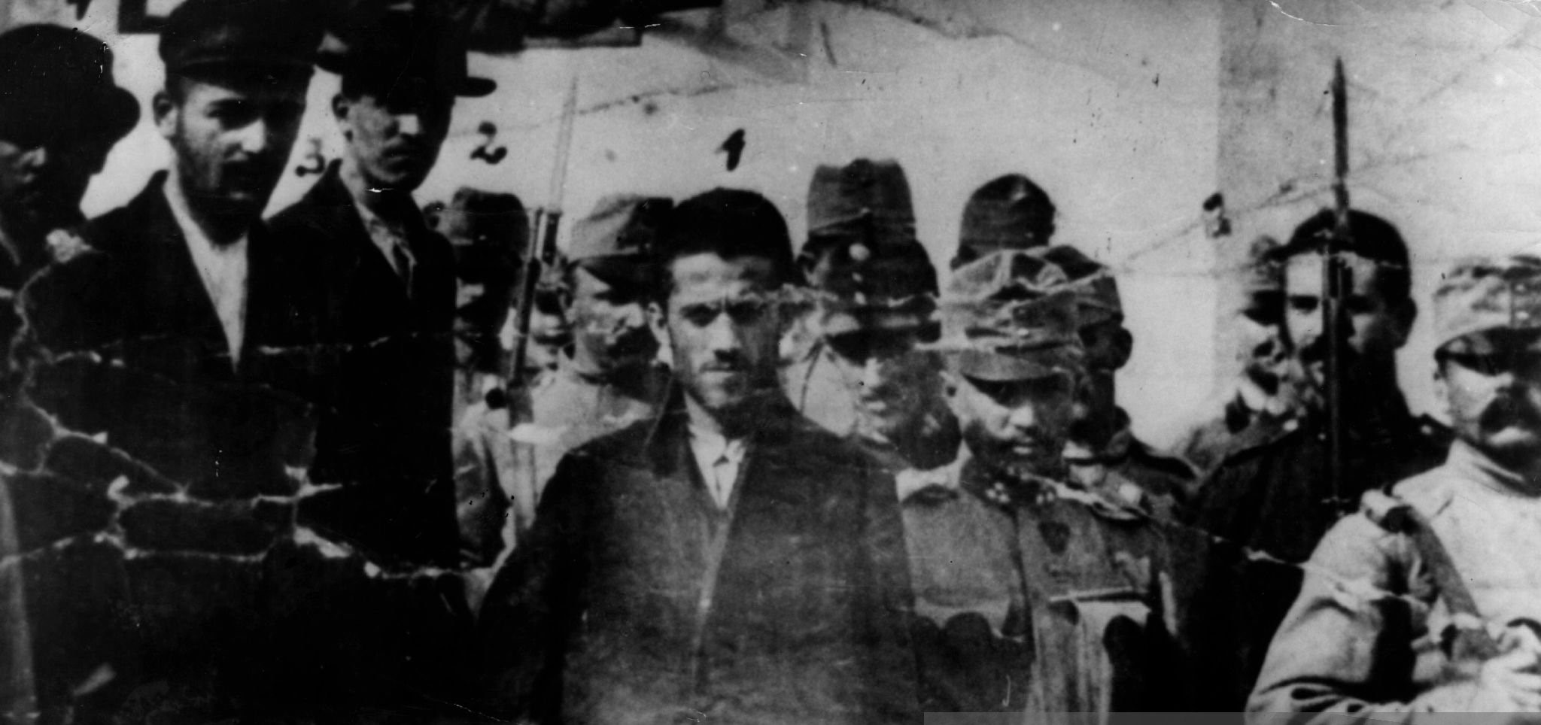
“Assassins of poorer quality”

Slide 8
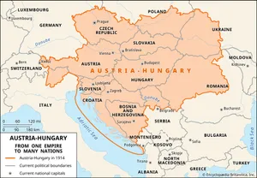

Slide 9
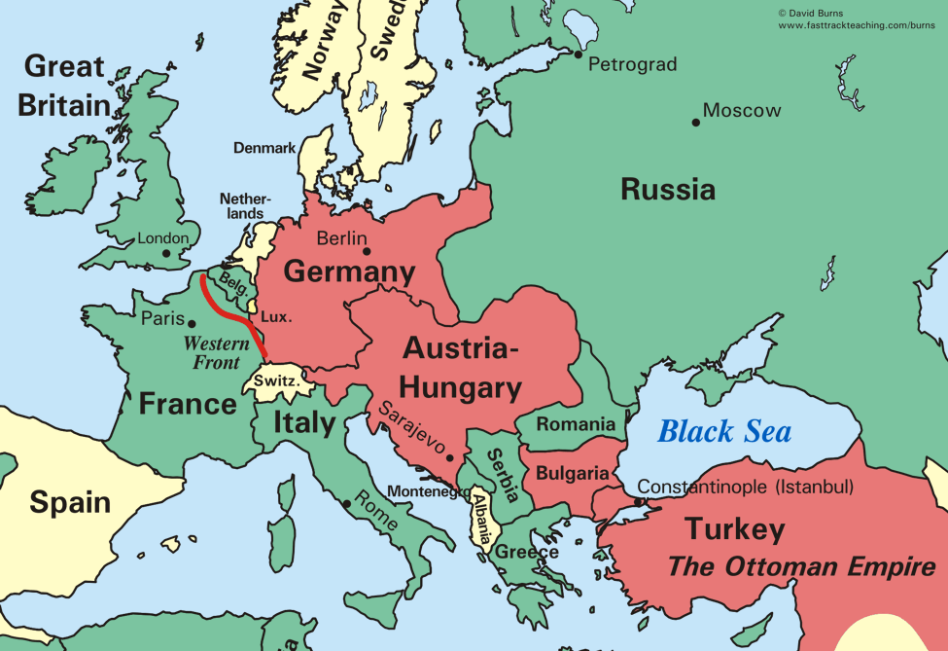

Slide 10
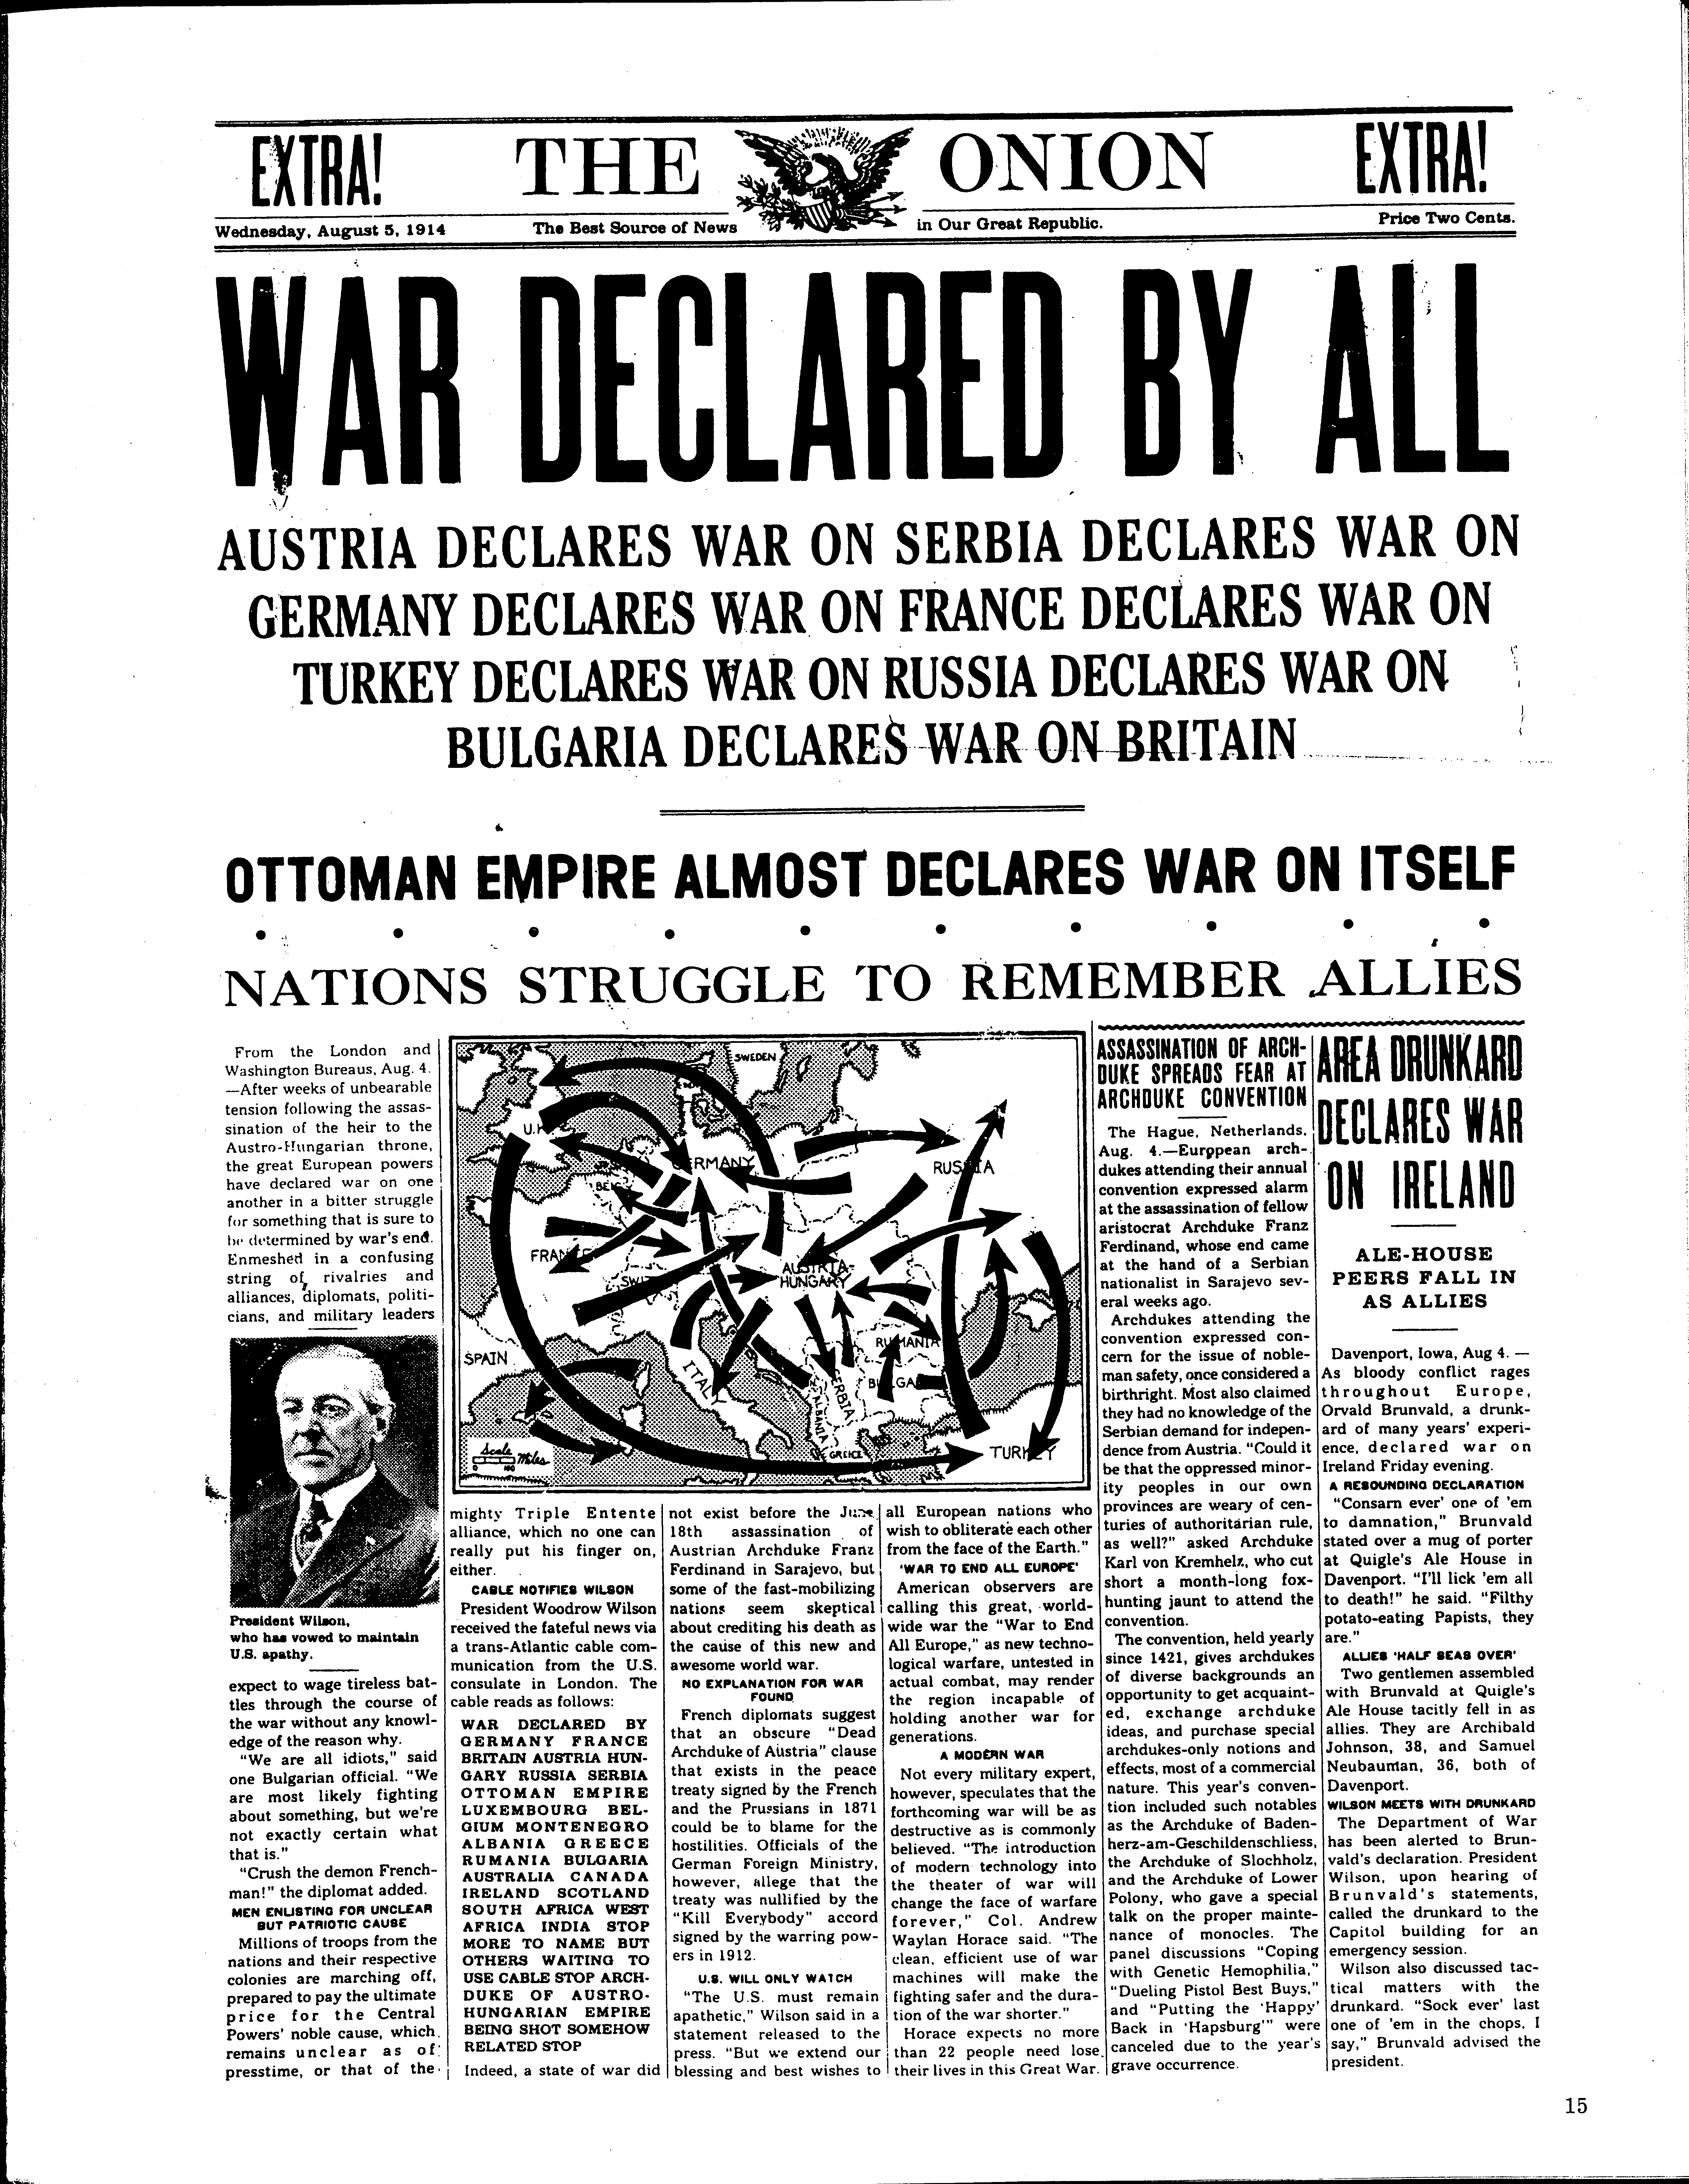

Slide 11
“The lamps are going out all over Europe, we shall not see them lit again in our life-time.”
-- British Foreign Secretary Sir Edward Grey

Slide 12
Long-term Causes
Germany “left behind” in scramble for colonies
British apprehension about Germany navy
Lingering resentment of France against Germany

Slide 14
NOT “home by Christmas”
-- Trench warfare
-- Weapons technology outpaces the advance of medicine

Slide 15
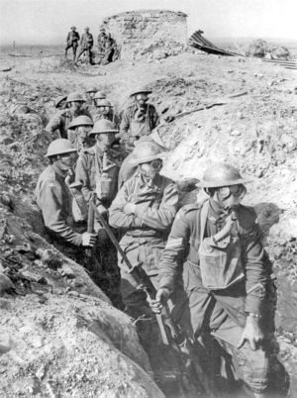

Slide 16
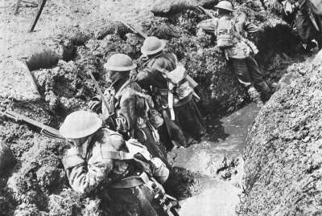

Slide 17
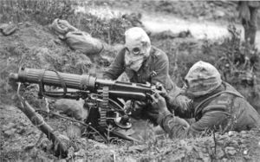

Slide 18
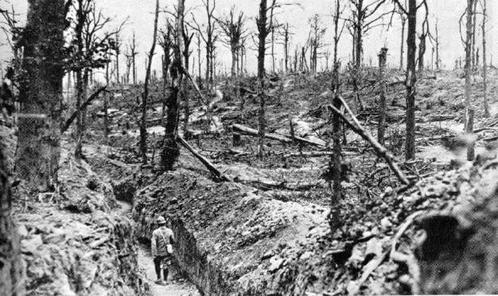

Slide 19
How did the U.S. respond to the European war?

Slide 20
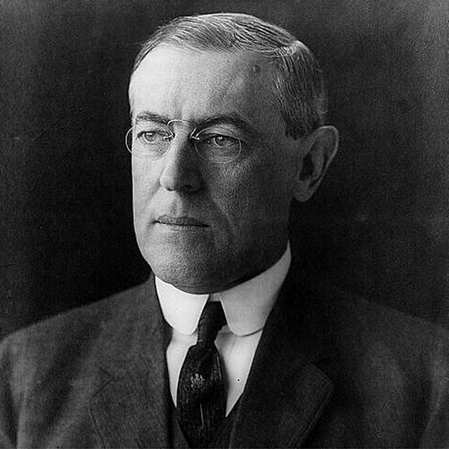

Slide 21
“It would be the irony of fate if my administration had to deal chiefly with foreign affairs.”
― Woodrow Wilson

Slide 22
“Wilsonian” Foreign Policy
Progressives set out to “reform” the world.

Slide 23
“Like a troubled man angered by his own uncertainty, the country aggressively demanded international conformity to democratic goals it now believed might be slipping out of domestic reach.”
-Robert Dallek

Slide 24
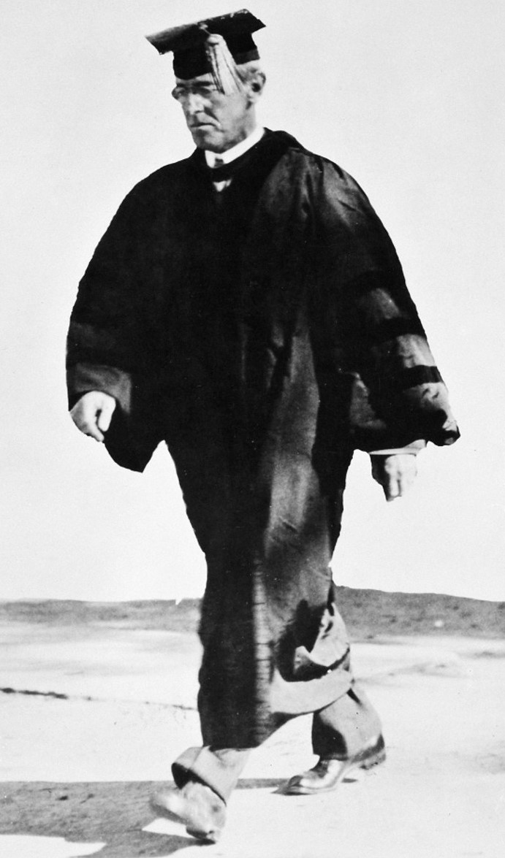
“The United States was chosen …to show the way to the nations of the world how they shall walk in the paths of liberty.”
“We shall teach the
republics of South America
to elect good men.”
-Woodrow Wilson

Slide 25
Making “Them” more like “Us”

Slide 26
“Old World” Tyranny vs
“New World” Democracy

Slide 27
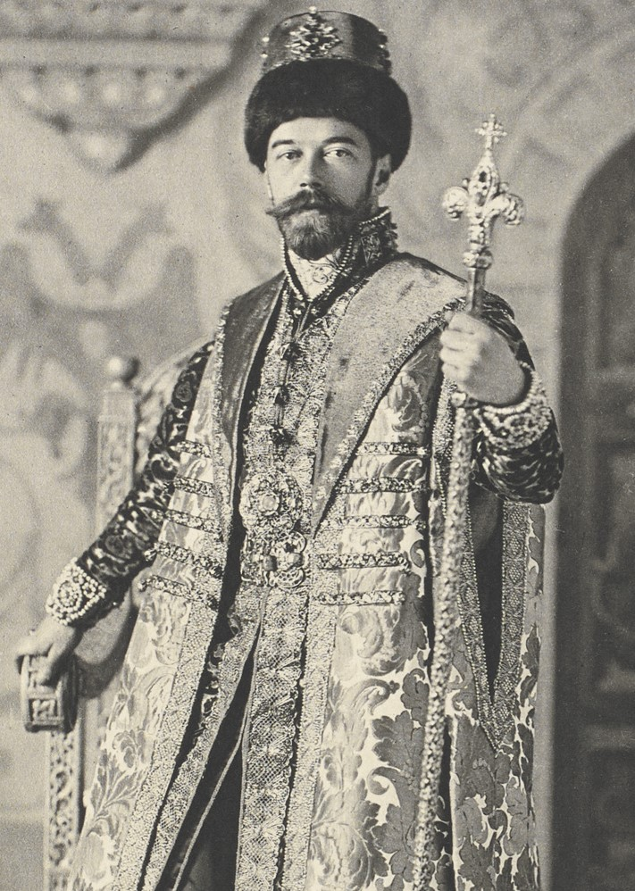
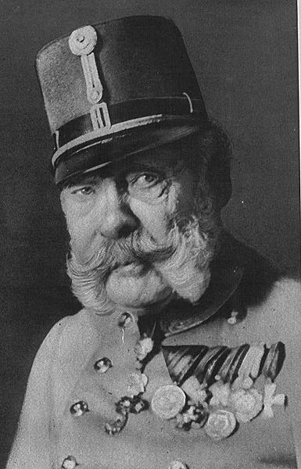
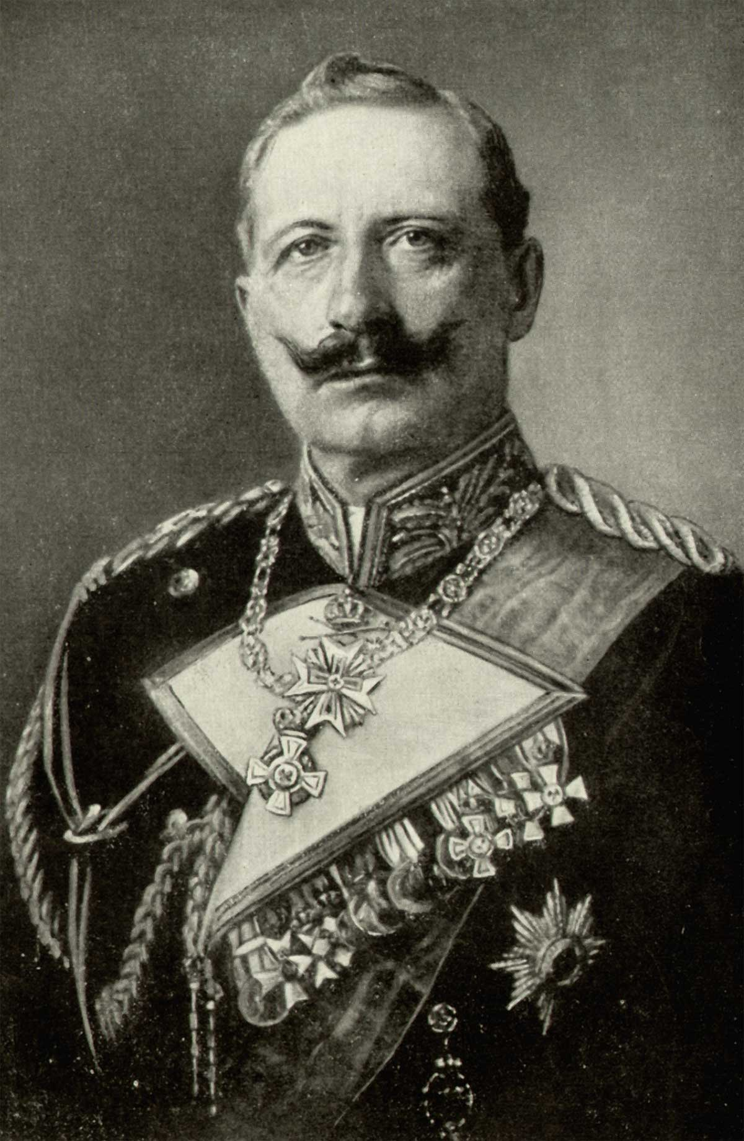

Slide 29
Neutrality:
Idealism or Naivete?

Slide 30
Why can’t we trade with everyone?

Slide 31
Is trade with the British and French a good thing?

Slide 32
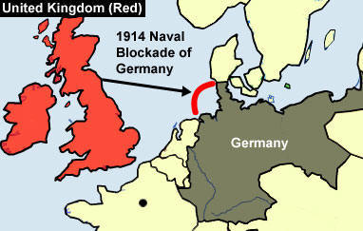

Slide 33
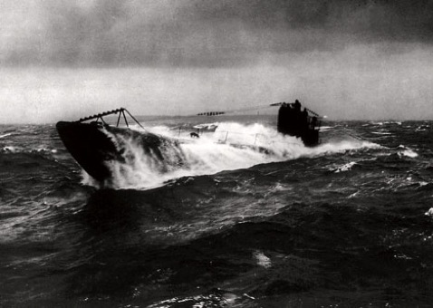
How do the Germans Respond?

Slide 34
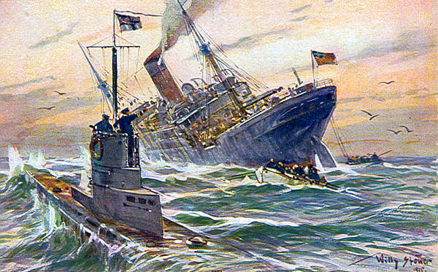

Slide 35
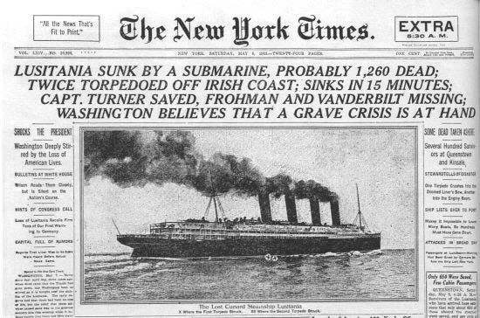

Slide 36
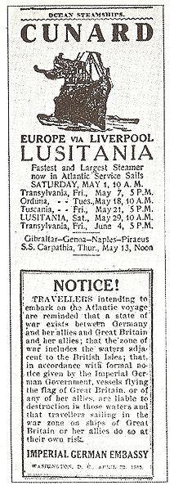

Slide 37
“Sussex Pledge”

Slide 38
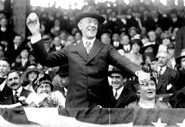

1916 Presidential Election

Slide 39
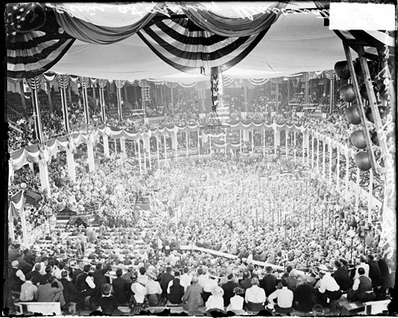
“He kept us out of war!”

Slide 41
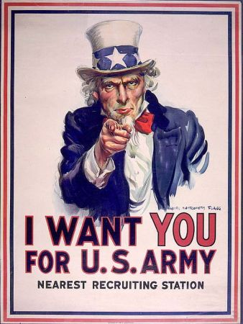
After staying out so long, why are we getting in?

Slide 42
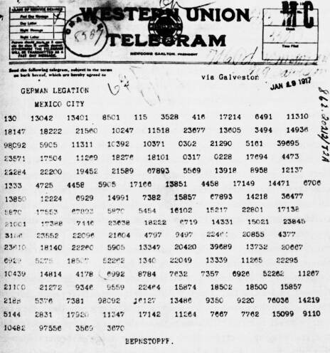
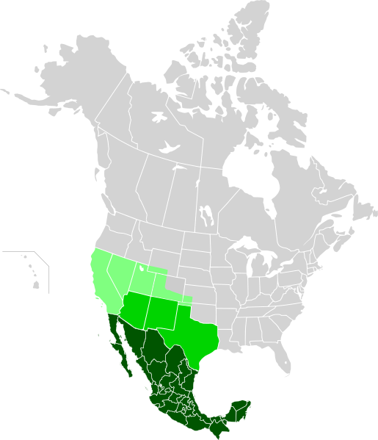
Zimmermann Telegram

Slide 43
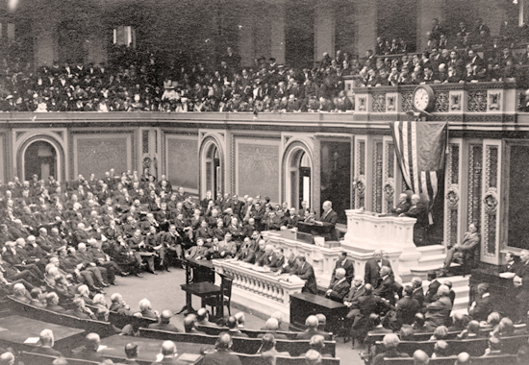
Unrestricted Submarine Warfare

Slide 45
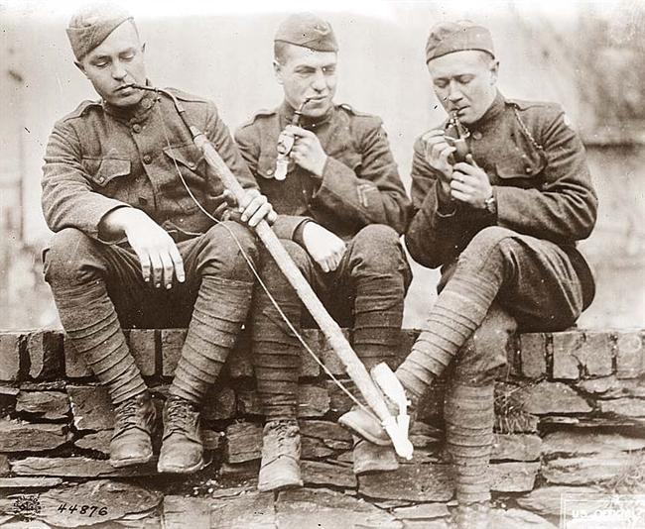
American Expeditionary Force
“Doughboys”

Slide 46
What did Woodrow Wilson hope to achieve during and after the war?

Slide 47
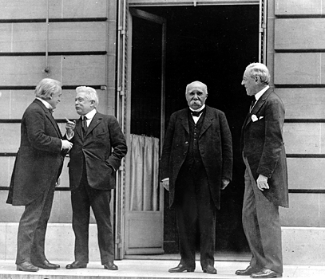
Treaty of Versailles

Slide 48
Lives Lost:
Russians – 3.3 million
Germans – 2.6 million
French – 1.9 million
Austro-Hungarians – 1.5 million
British 1.2 million
USA – 117,000

Slide 49
The Fourteen Points
1-8
Recommendations for New Boundaries in Europe

Slide 50
The Fourteen Points
9-13
Open Diplomacy
Freedom of Navigation
Removal of Trade Barriers
Arms Reductions
Self-Determination for Nations and Colonies

Slide 51
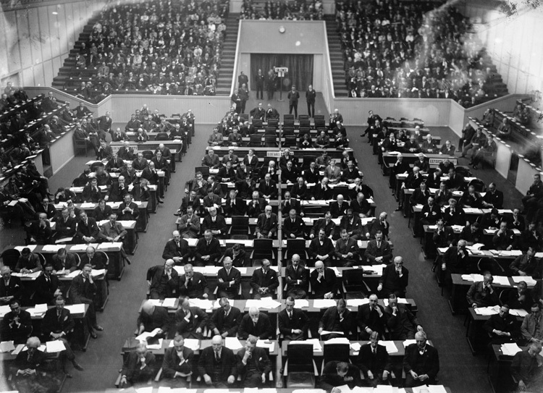
The Fourteenth Point
A League of Nations

Slide 52
What’s Wrong With The 14 points?

Slide 53
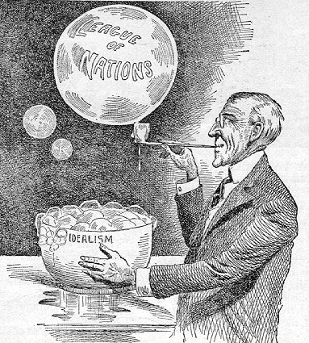

Slide 54
"God gave us the ten commandments and we broke them. Now Mr. Wilson has given us the Fourteen Points. We shall see."
--Georges Clemenceau

Slide 55
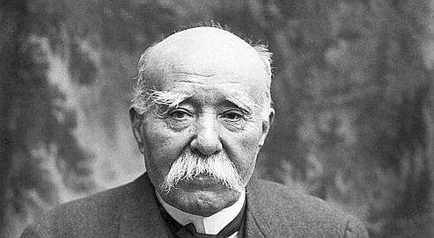

Slide 56
“There are twenty million Germans too many!”

Slide 57
Reparations?
War Guilt?

Slide 58
Article X
If one League member is attacked by another, all League members are obliged to come to the defense of the nation that has been attacked.

Slide 59
Legacies of World War I
- Disillusionment with Progressivism and crusading idealism
- Treaty of Versailles sets up economic instability

