Slide 1
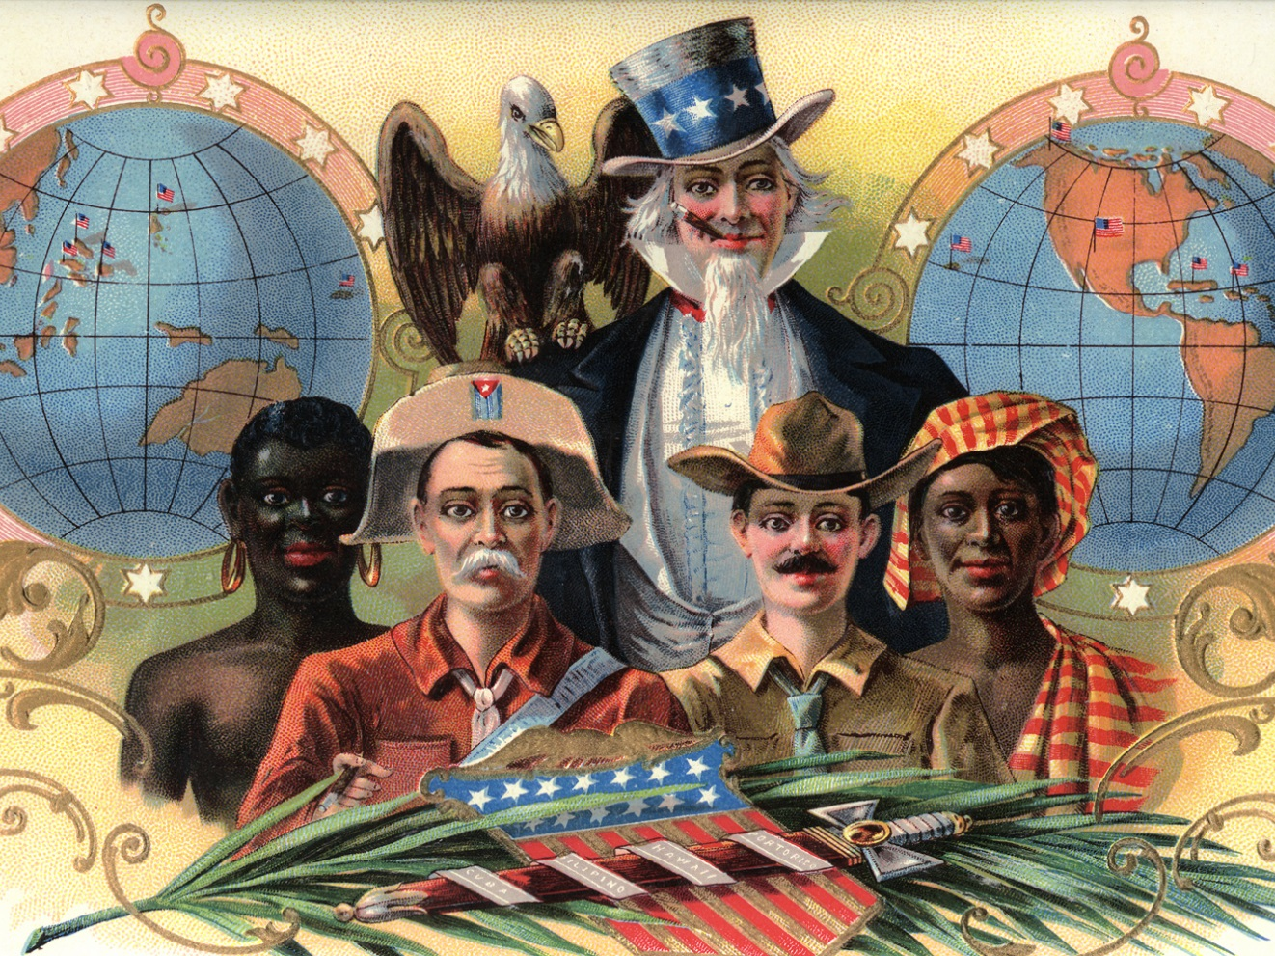
The Origins of American Empire

Slide 2
Timing for expansionist foreign policy:
Why now?

Slide 3
Economics
An Industrial Economy Needs “Markets”

Slide 4
Why does Depression of 1893 fuel the desire for foreign markets?

Slide 5
Unemployment Rate: 1890-1900
Year | Unemployment %
1890 | 4.0%
1891 | 5.4
1892 | 3.0
1893 | 11.7
1894 | 18.4
1895 | 13.7
1896 | 14.5
1897 | 14.5
1898 | 12.4
1899 | 6.5
1900 | 5.0

Slide 6
Geopolitics
“Great Powers” Compete for Global Influence

Slide 7
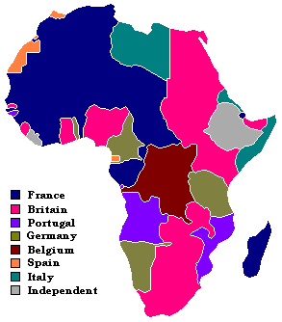

Slide 8
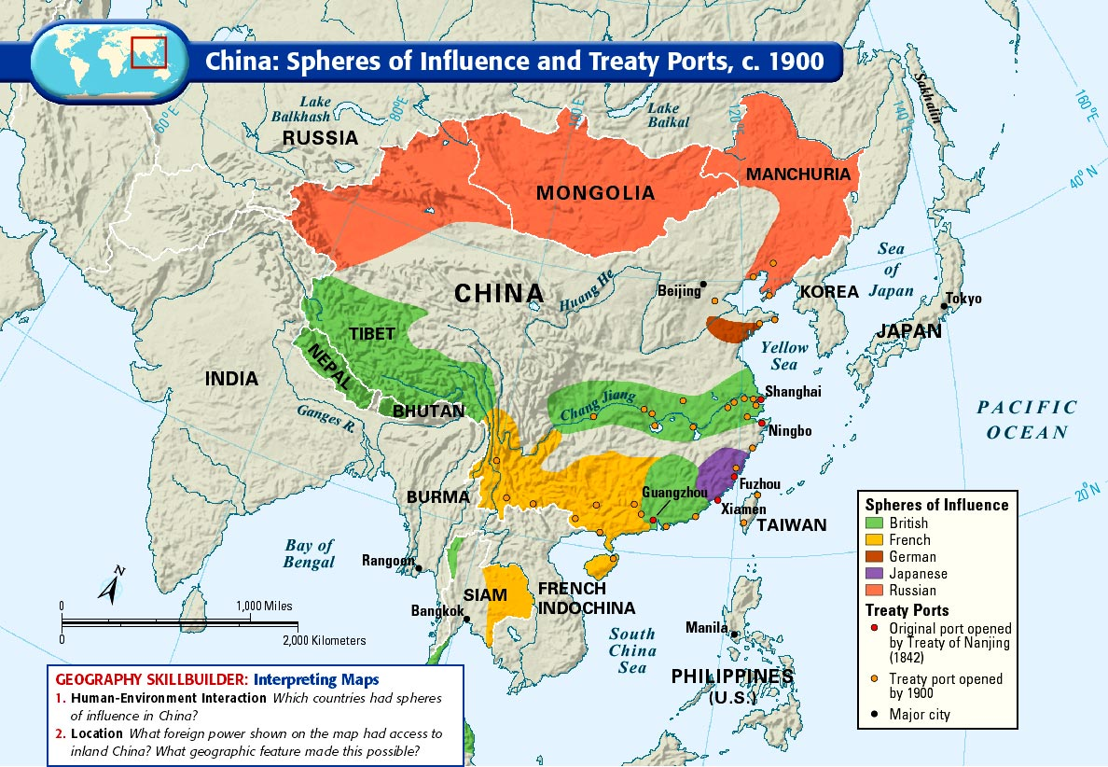

Slide 9
Politics
“Nothing solves a domestic problem better than a foreign crisis.”

Slide 10
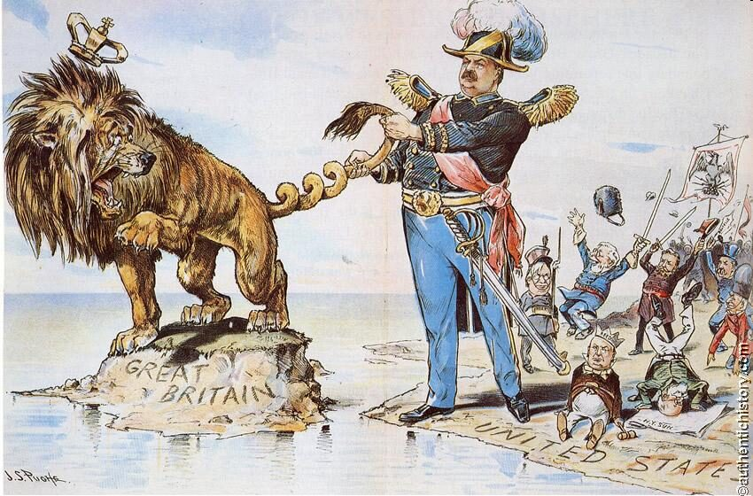

Slide 11
Gender
A “Crisis of Masculinity”

Slide 12
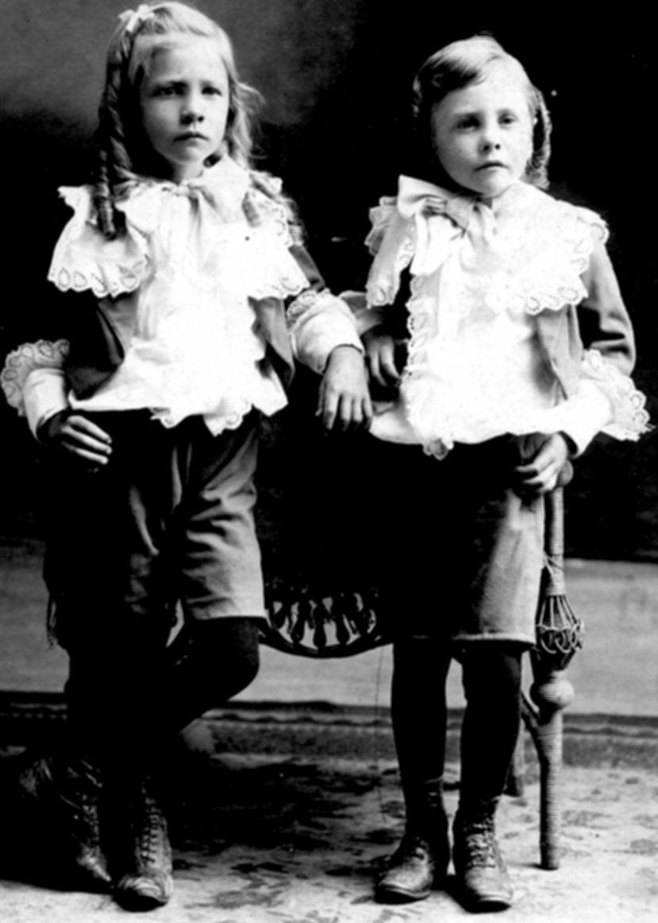
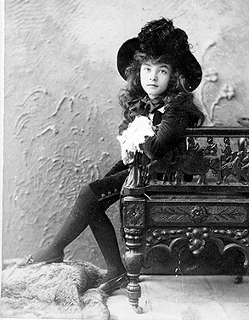

Slide 13
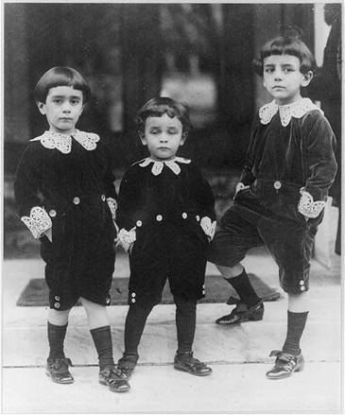

Slide 14
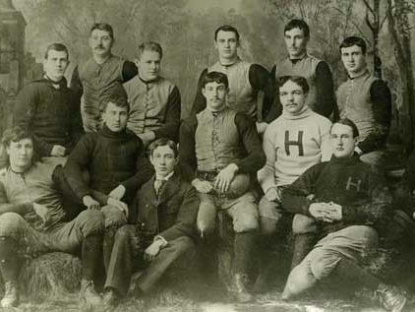

Slide 15
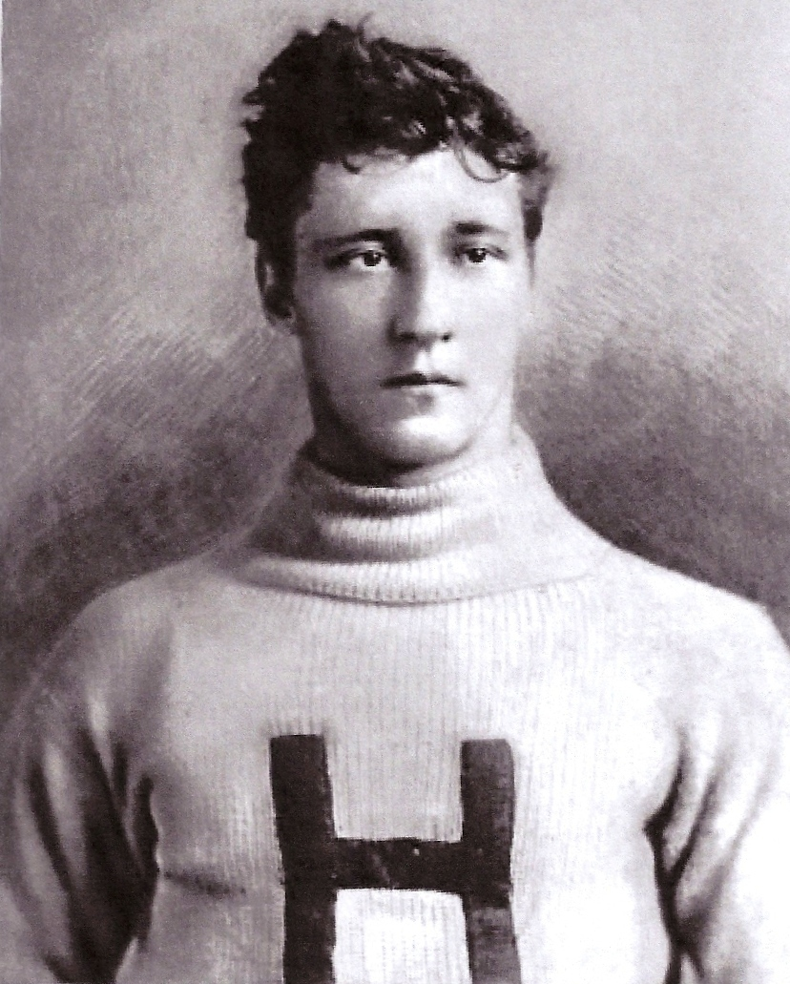

Slide 16
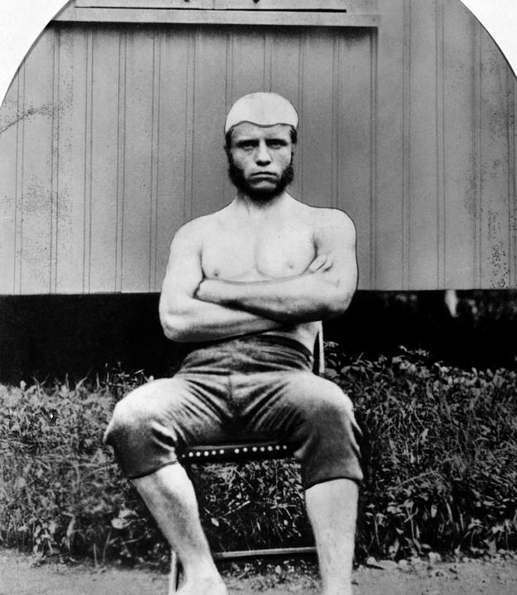

Slide 17
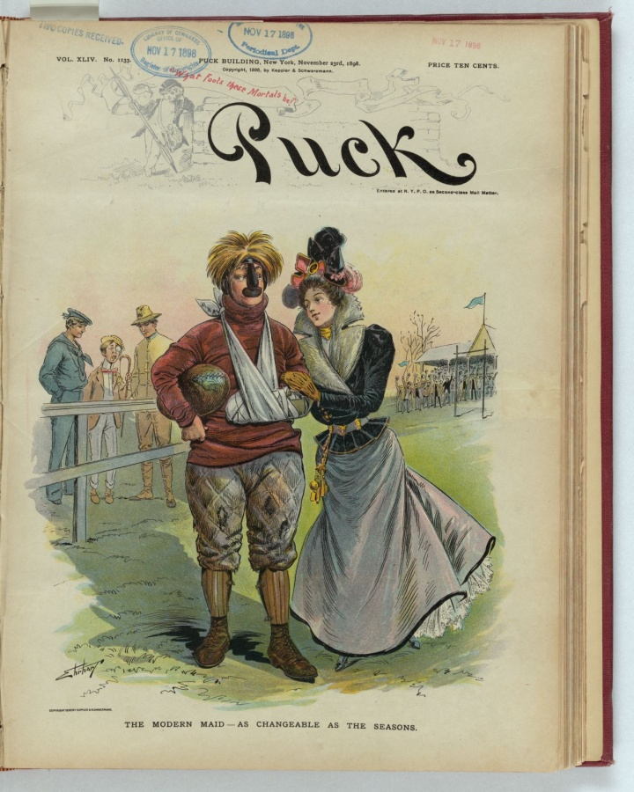

Slide 18
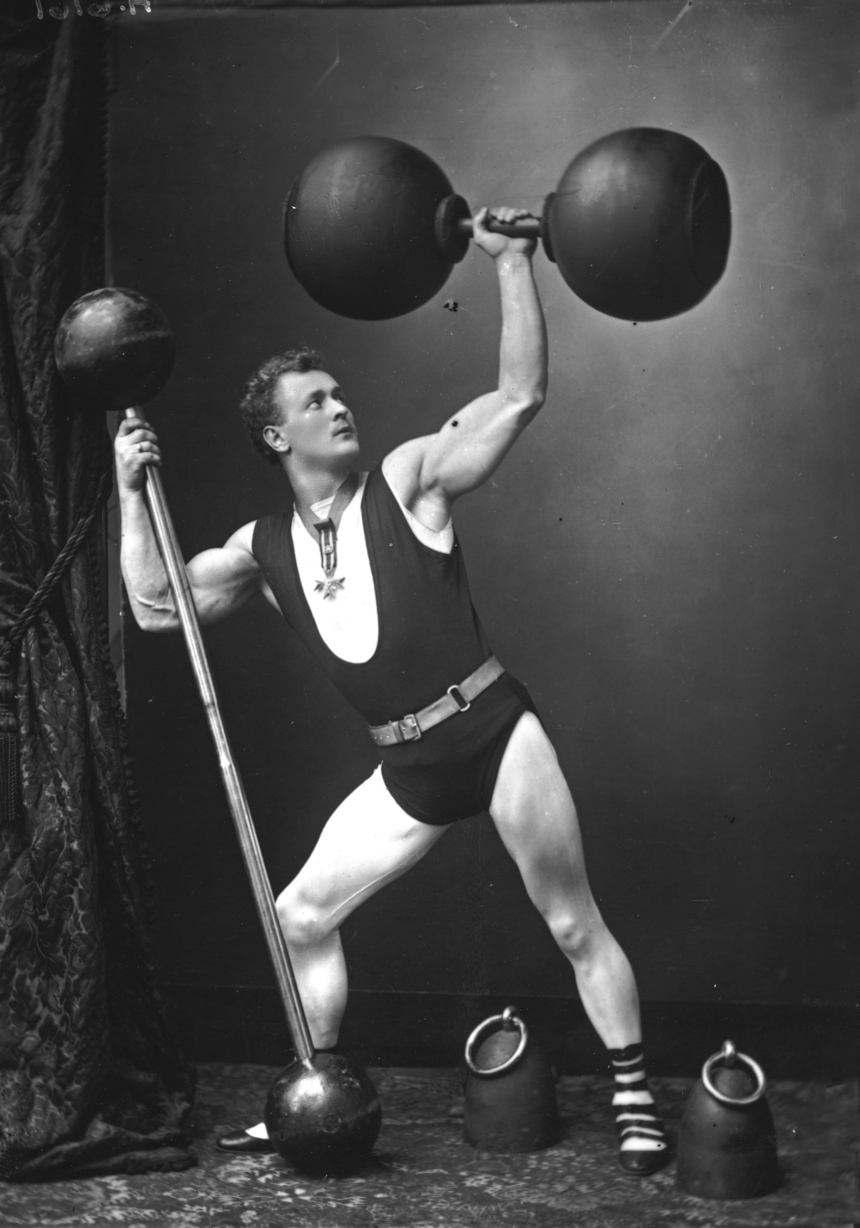

Slide 19
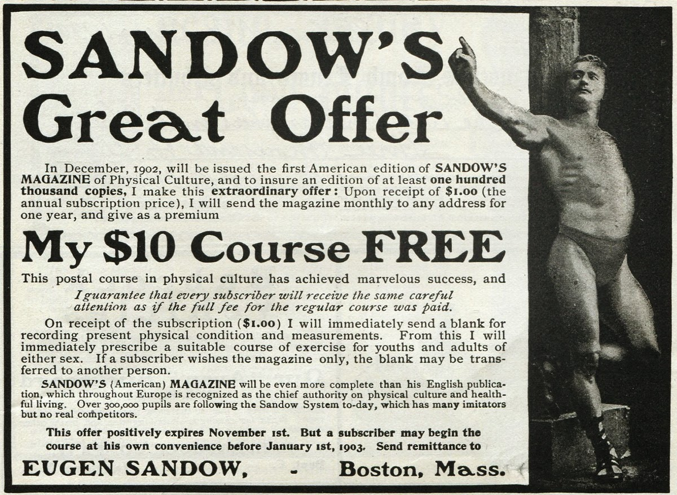

Slide 20
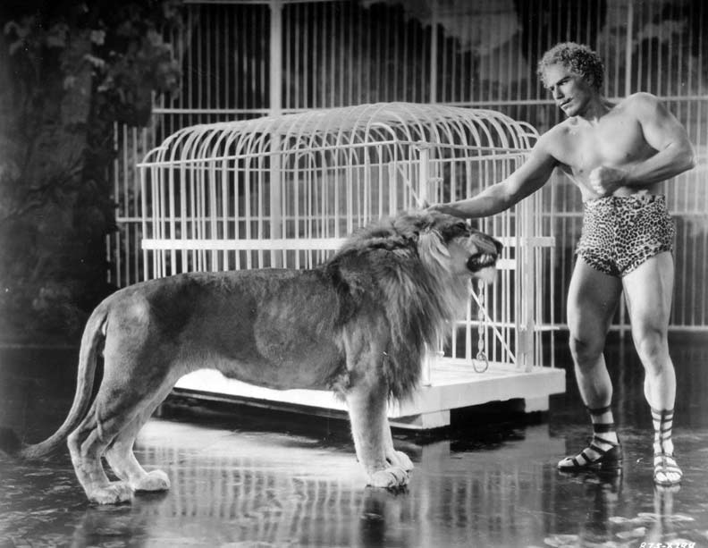

Slide 21
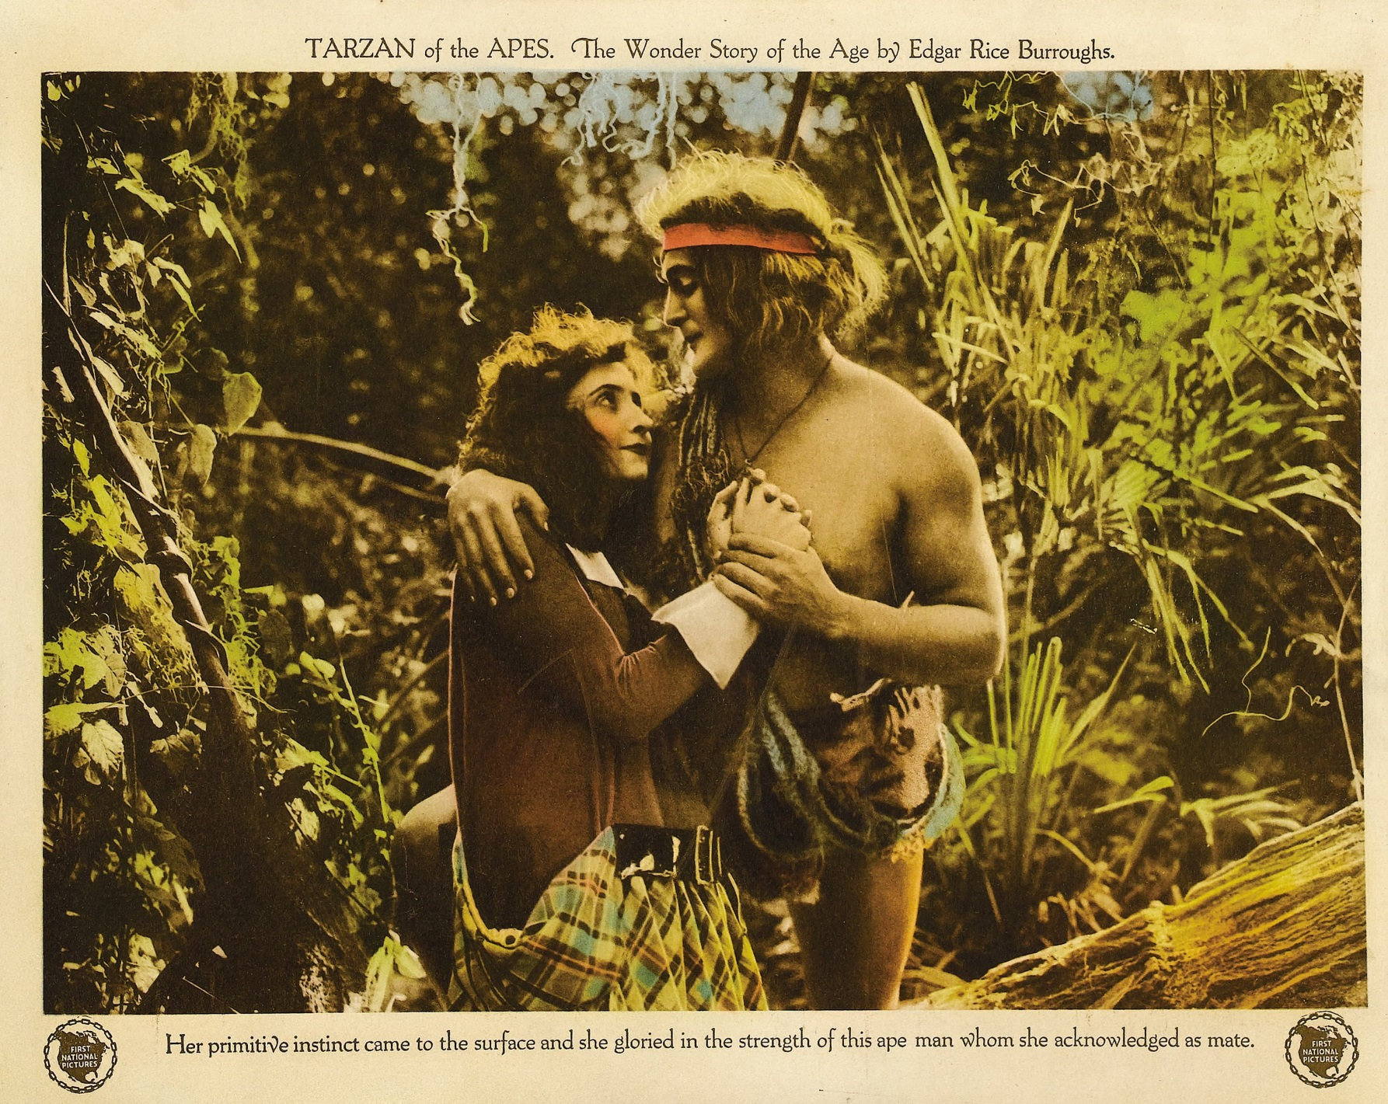

Slide 22
Religion
“A God-given civilizing mission”

Slide 23
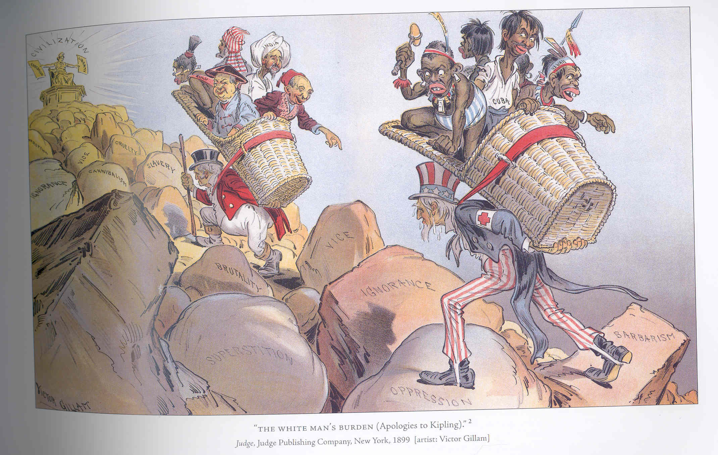

Slide 24
So…Why now?
Economics
Geopolitics
Politics
Gender
Religion

Slide 25
The Spanish-American War
Origins – “Cuba Libre!”
-- First Ten-years war 1868-1878
-- Second war begins, 1895

Slide 26
“Work is a crime against the Revolution. Blessed be the torch!”
-- Maximo Gomez

Slide 27
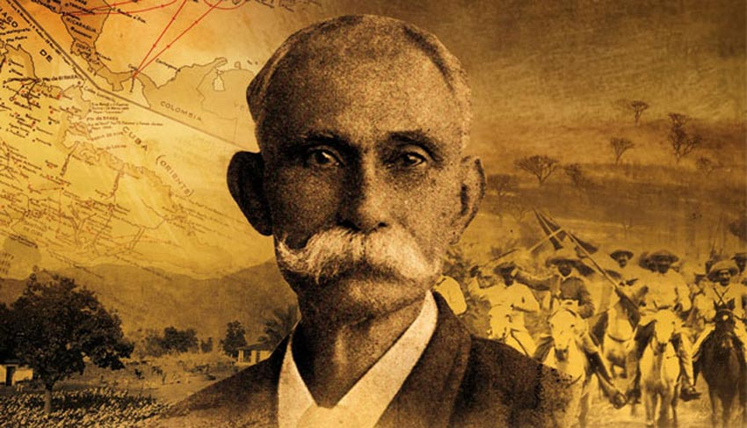

Slide 28
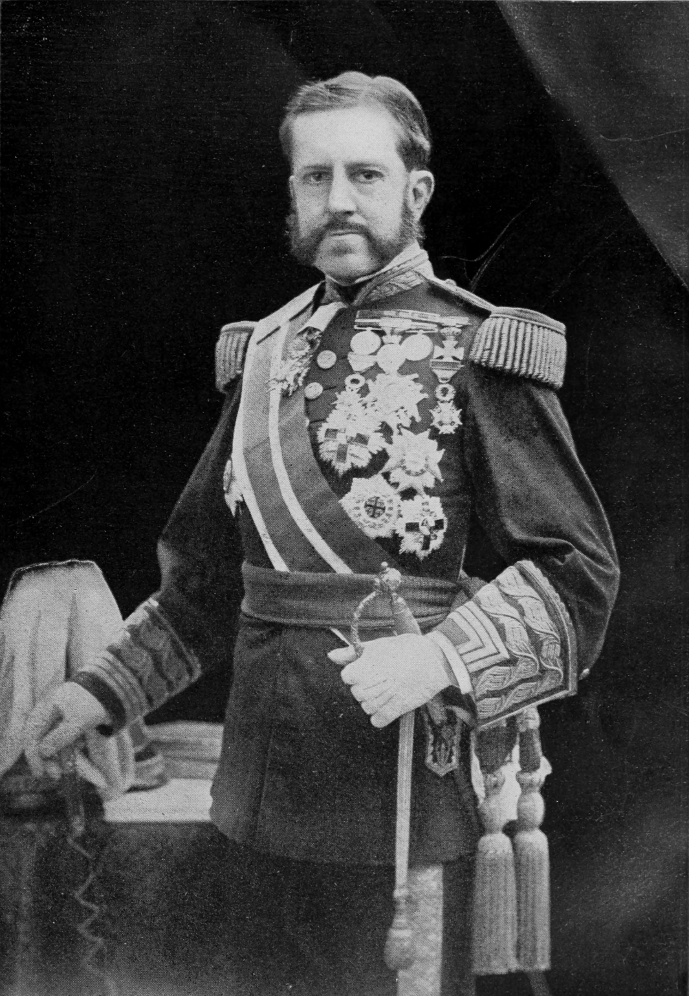

Slide 29
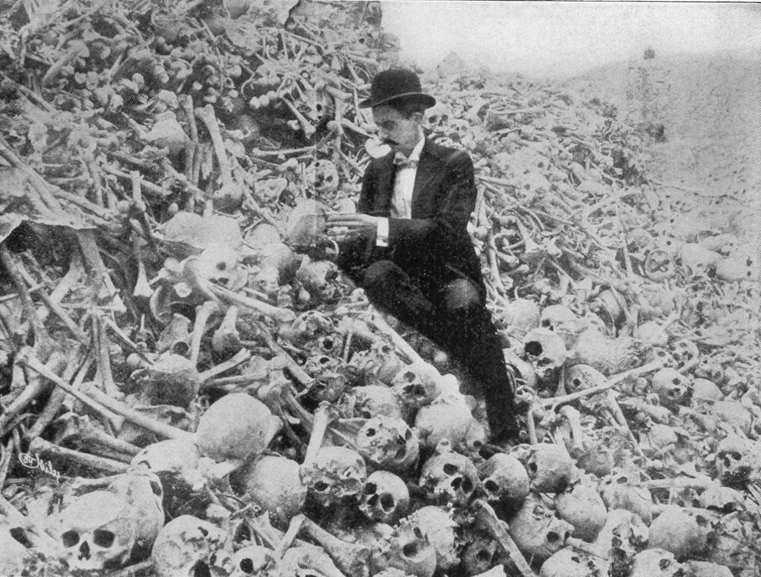
“Butcher” Weyler

Slide 30
Why was Weyler’s “reconcentration” policy not only immoral, but counterproductive?

Slide 31
What is the United States position on Cuba?

Slide 32
-- McKinley’s postion
-- the newspapers’ position
-- “Big Business’s” position
--The “jingoes’” position

Slide 33
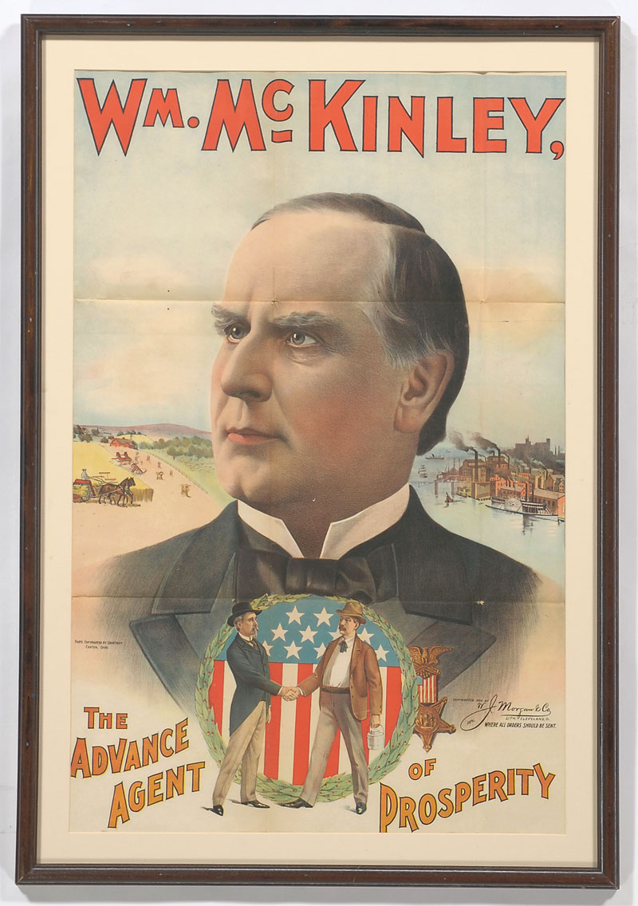

Slide 34
1. Spain must restore order on the island of Cuba.
2. To do so, Spain should grant Cuba self-government .
3. If Spain cannot restore order, the U.S. will mediate the conflict.

Slide 35
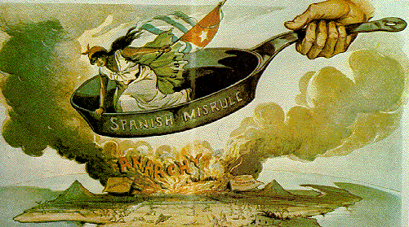

Slide 36
“Peace is preferable to war in almost every contingency.”
-- William McKinley, Inaugural Address, 1897

Slide 37
The position of the press:
Did the “yellow press” lead the U.S. into war?

Slide 38
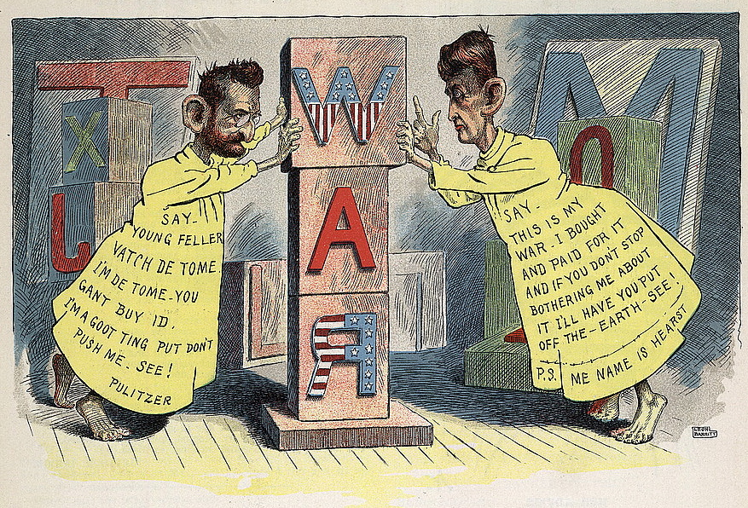

Slide 39
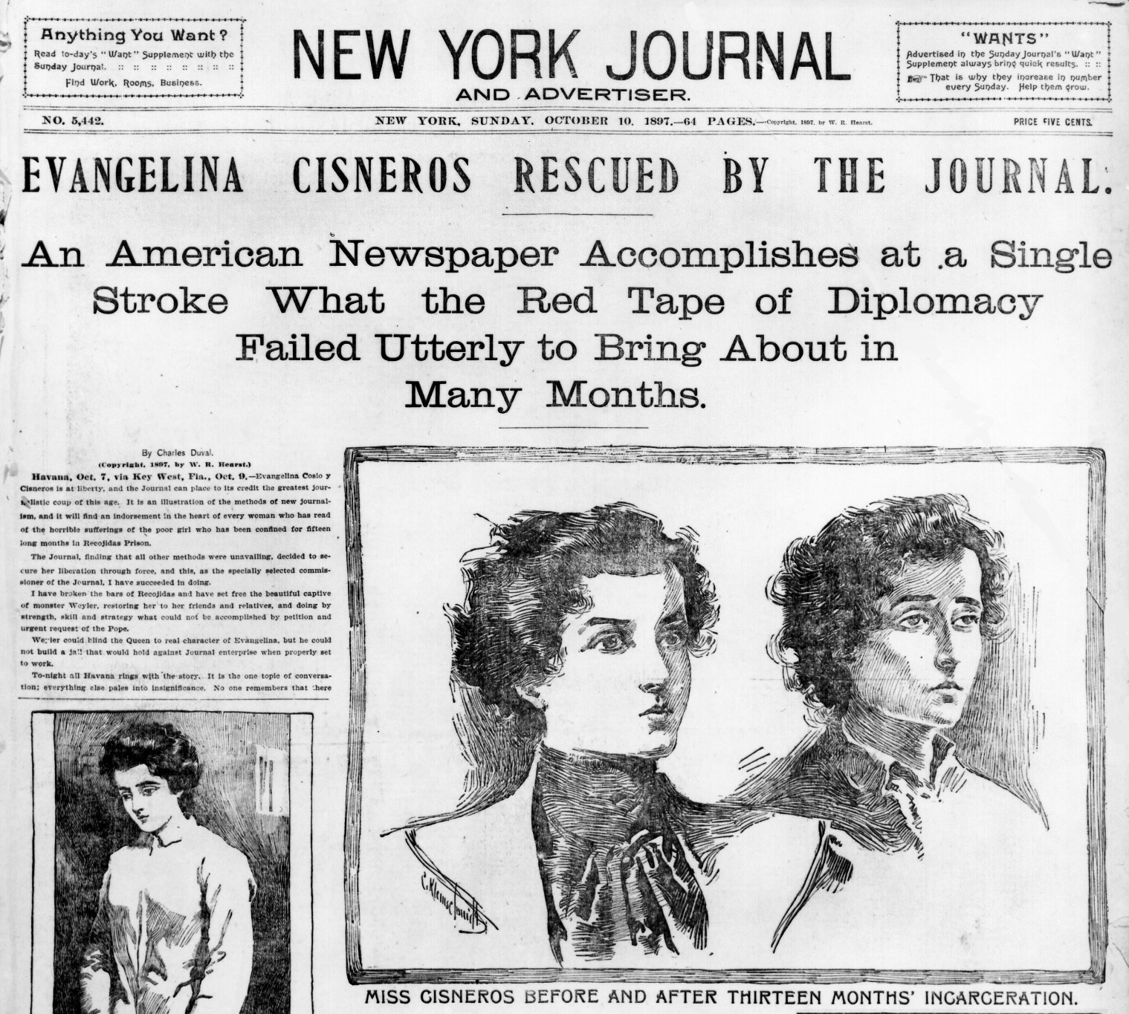

Slide 40
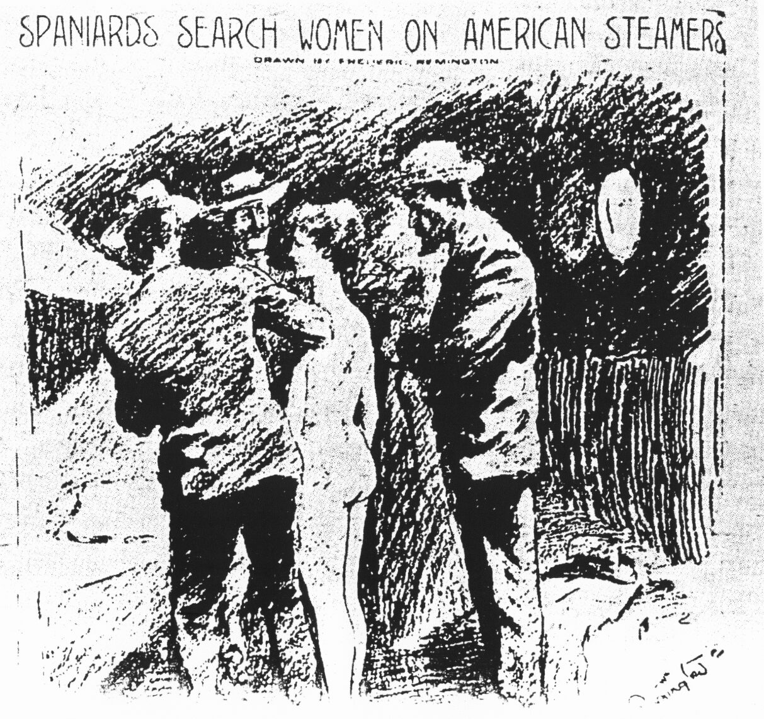

Slide 41
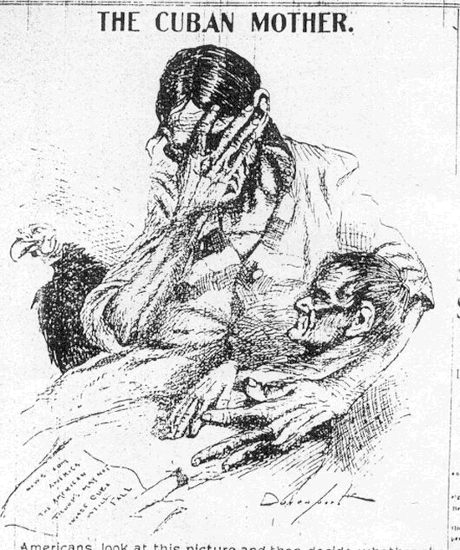

Slide 42
The position of business:
Was U.S. intervention a “big business conspiracy”?

Slide 43
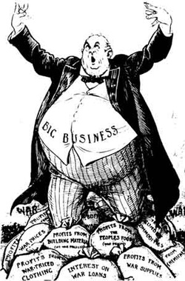

Slide 44
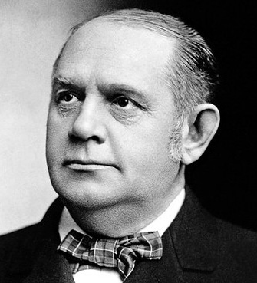
“There are two things that are important in politics. The first is money and I can’t remember what the second one is.” – “Dollar”Mark Hanna

Slide 45
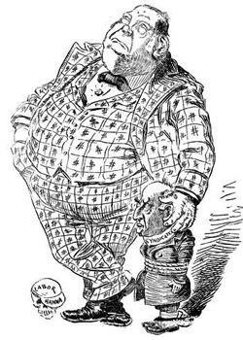

Slide 46
“War is just a damn nuisance!”
-- Mark Hanna

Slide 47
The jingoes’ position:
Did hyper-masculine “jingoism” push the U.S. into war?

Slide 48
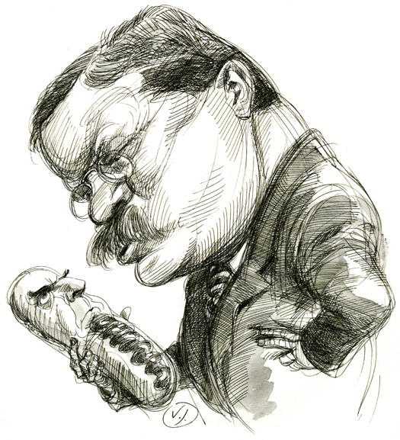
"McKinley has no more backbone than a chocolate eclair."- Teddy Roosevelt

Slide 49
“No triumph of peace is quite so great as the supreme triumph of war.”
-- Theodore Roosevelt, 1897

Slide 50
“Peace is preferable to war in almost every contingency.”
-- William McKinley, Inaugural Address, 1897

Slide 51
"We will have this war for the freedom of Cuba in spite of the timidity of the commercial classes!"
--Theodore Roosevelt, 1898

Slide 52
1898 – War Clouds Gathering

Slide 53
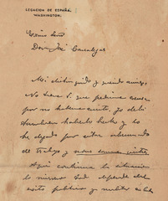

Slide 54
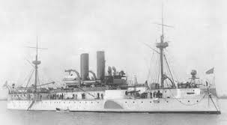
USS Maine

Slide 55
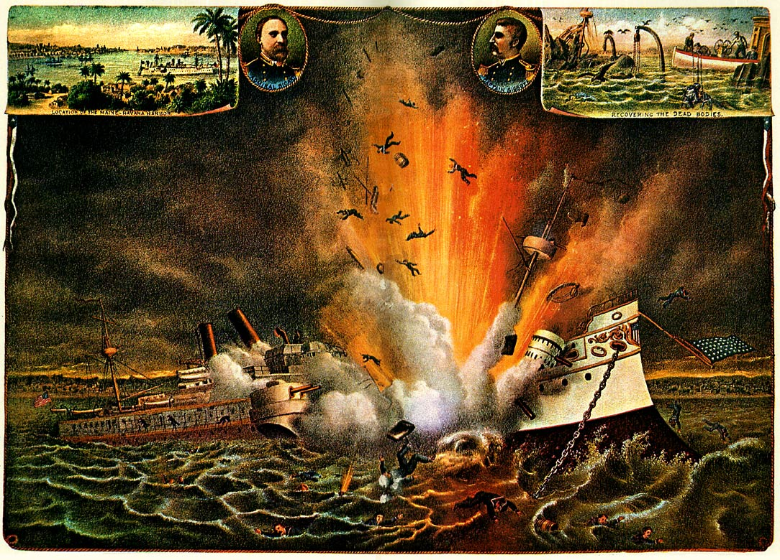

Slide 56
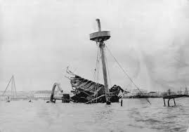

Slide 57
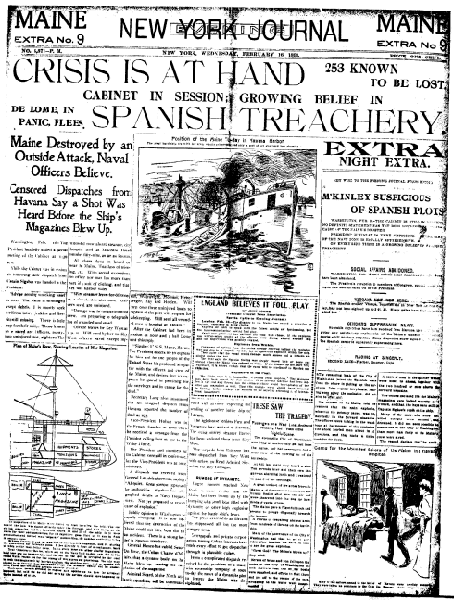

Slide 58
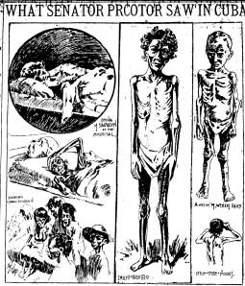

Slide 59
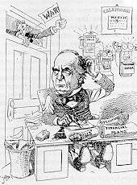

Slide 60
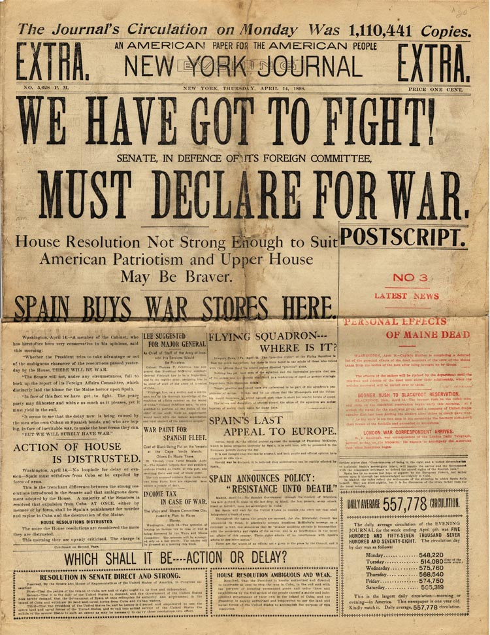

Slide 61
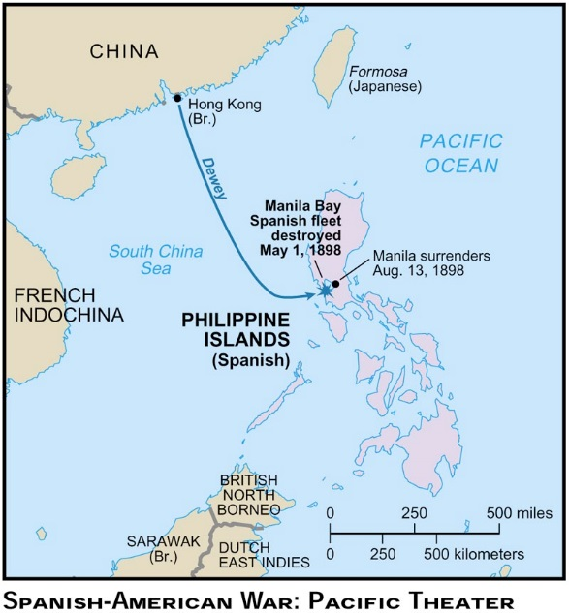

Slide 62
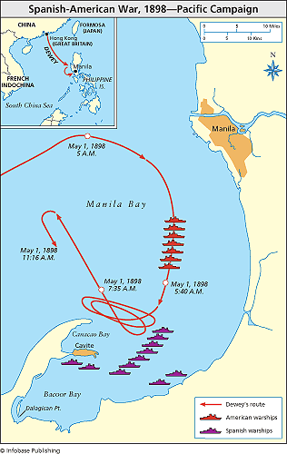

Slide 63
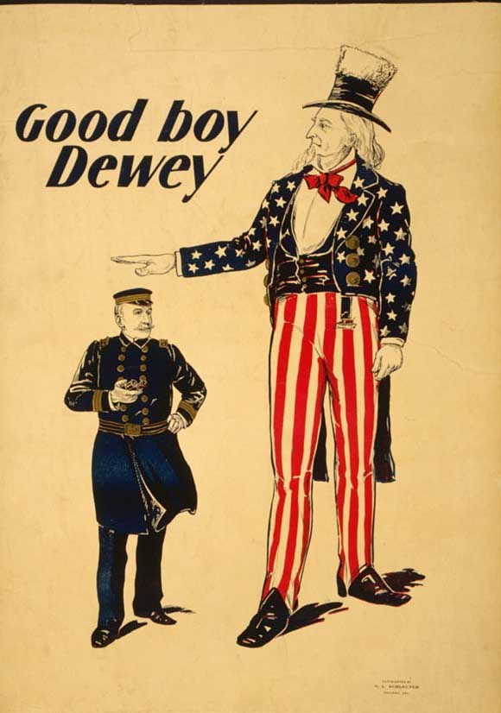

Slide 64
OH DEWEY WAS THE MORNING
UPON THE FIRST OF MAY
AND DEWEY WAS THE ADMIRAL
DOWN IN MAILLA BAY
AND DEWEY WERE THE REGENT’S EYES
THOSE ORBS OF ROYAL BLUE
AND DO WE FEEL DISCOURAGED?
I DO NOT THINK WE DO!

Slide 65
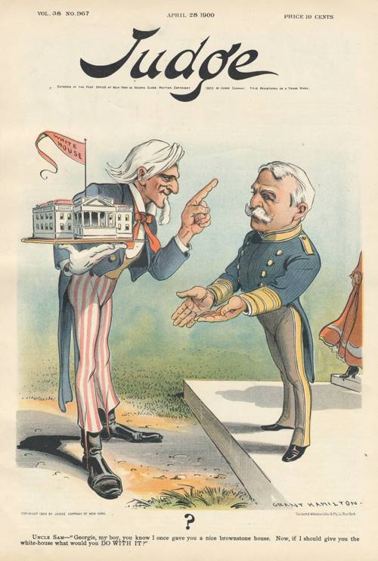

Slide 66
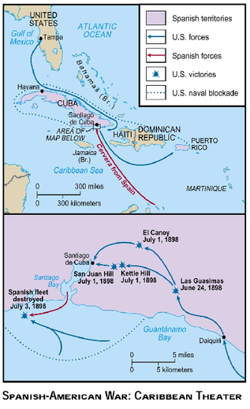

Slide 67
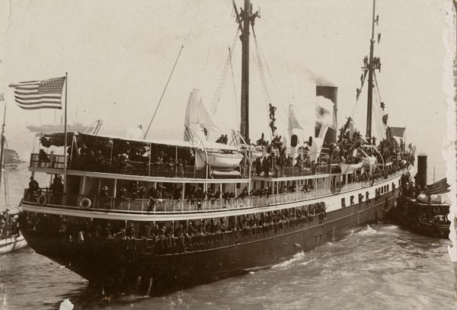

Slide 68
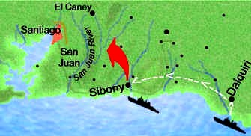

Slide 69
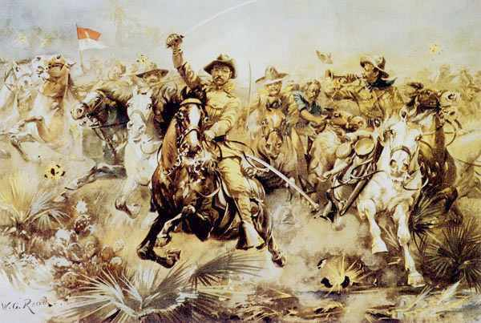

Slide 70
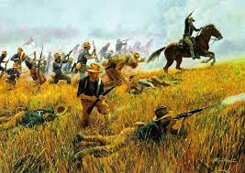

Slide 71
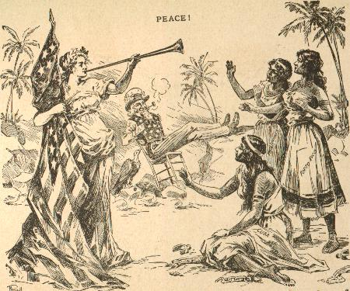

Slide 72
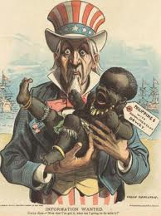

Slide 73
McKinley’s Policy:
Finding the “Sensible Center”

Slide 74
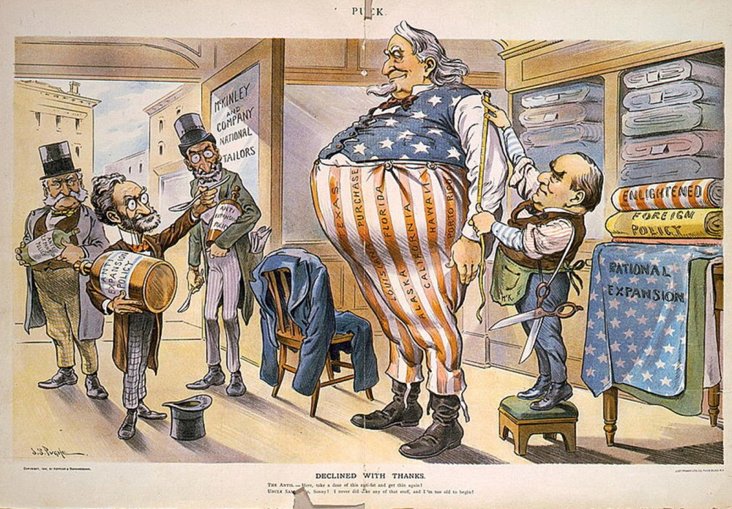

Slide 75
Motivations for Empire?

Slide 76
The Four “D”s
Duty
Destiny
Defense
Dollars

Slide 77
Duty
“White Man’s Burden”

Slide 78
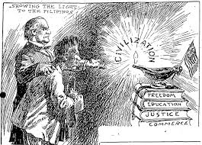

Slide 79



Slide 80
Destiny
“The Irony of Fate”

Slide 81


Slide 82
Defense
“The Projection of Power”

Slide 83


Slide 84
Dollars
“Market Mania”

Slide 85


Slide 86
Realism vs. Idealism
Interest vs Principle

Slide 87
Coda: The Philippine Insurrection
“Empire Can Wait”

Slide 88


Slide 89


Slide 90
Imperialists vs. Anti-Imperialists
(Beveridge vs Twain)

Slide 91
Redefining “Masculinity”
Flipping the Script

Slide 92
“This shooting human beings is a ‘hot game’ and beats rabbit hunting all to pieces.”
-- letter home from US solider serving
in the Philippines

Slide 93
“We have met the enemy…and they are us.”
-Pogo

Slide 94
The Crusading Spirit Turned Inward
The Advent of the Progressive Era

