Slide 1
Bayesian Classification
Week 9 and Week 10

Slide 2
Announcement
Midterm II
  4/15
  Scope
    Data warehousing and data cube
    Neural network
  Open book
Project progress report
  4/22

Slide 3
Team Homework Assignment #11
Read pp. 311 – 314.
Example 6.4.
Exercise 1 and 2 (page 22 and 23 in this slide)
Friday April 8th by email

Slide 4
Team Homework Assignment #12
Exercise 6.11
beginning of the lecture on Friday April 22nd.

Slide 5
Bayesian Classification
Naïve Bayes Classifier
Bayesian Belief Network
Notes:
Conditionally independent

Slide 6
Background Knowledge
An experiment is any action or process that generates observations.
The sample space of an experiment, denoted by S, is the set of all possible outcomes of that experiment.
An event is any subset of outcomes contained in the sample space S.
Given an experiment and a sample space S, probability is a measurement of the chance that an event will occur. The probability of the event A is denoted by P(A).
Notes:
The simplest experiment is one with two possible outcome

Slide 7
Background Knowledge
The union of two events A and B, denoted by A U B is the event consisting of all outcomes that either in A or in B or in both events.
The intersection of two events A and B, denoted by A ∩ B is the event consisting of all outcomes that are in both A and B.
The complement of an event, denoted by A′, is the set of all outcomes in S that are not contained in A.
When A and B have no outcomes in common, they are said to be mutually exclusive or disjoint events.

Slide 8
Probability Axioms
All probability should satisfy the following axioms:
For any event A, P(A) ≥ 0 and P(S) = 1
If A₁, A₂, …. , A_{n} is a finite collection of mutually exclusive events, then
If A₁, A₂, A₃, …. is a infinite collection of mutually exclusive events, then

Slide 9
Properties of Probability
For any event A, P(A) = 1 – P(A′)
If A and B are mutually exclusive, then P(A ∩ B) = 0
For any two events A and B,
  P(A U B) = P(A) + P(B) - P(A ∩ B)
P(A U B U C) = ???

Slide 10
Random Variables
A random variable represents the outcome of a probabilistic experiment. Each random variable has a range of possible values (outcomes).
A random variable is said to be discrete if its set of possible values is discrete set.
  Possible outcomes of a random variable Mood: Happy and Sad
  Each outcome has a probability. The probabilities for all possible outcomes must sum to 1.
  For example:
    P(Mood=Happy) = 0.7
    P(Mood=Sad) = 0.3

Slide 11
Multiple Random Variables & Joint Probability
Joint probabilities are probabilities which includes more than one random variable.
The Mood can take 2 possible values: happy, sad. The Weather can take 3 possible vales: sunny, rainy, cloudy. Lets say we know:
  P(Mood=happy ∩ Weather=rainy) = 0.25
  P(Mood=happy ∩ Weather=sunny) = 0.4
  P(Mood=happy ∩ Weather=cloudy) = 0.05

Slide 12
Joint Probabilities
P(Mood=Happy) = 0.25 + 0.4 + 0.05 = 0.7
P(Mood=Sad) = ?
Two random variables A and B
  A has m possible outcomes A₁, . . . ,A_{m}
  B has n possible outcomes B₁, . . . ,B_{n}
Notes:
Can you compute:
P(Mood=happy)?
P(Mood=sad)?
P(Weather=rainy)?

Slide 13
Joint Probabilities
P(Weather=Sunny)=?
P(Weather=Rainy)=?
P(Weather=Cloudy)=?
Notes:
0.05 0.1 0.15

Slide 14
Conditional Probability
For any two events A and B with P(B) > 0, the conditional probability of A given that B has occurred is defined by
or

Slide 15
Conditional Probability
P(A = A_{i} | B = B_{j}) represents the probability of A = A_{i} given that we know B = B_{j}. This is called conditional probability.

Slide 16
Conditional Probability
P(Happy|Sunny) = ?
P(Happy|Cloudy) = ?
P(Cloudy|Sad) = ?

Slide 17
Basic Formulas for Probabilities
Conditional probability:
Product rule:

Slide 18
Conditional Probability
P(A | B) = 1 is equivalent to B ⇒ A.
  Knowing the value of B exactly determines the value of A.
For example, suppose my dog rarely howls:
  P(MyDogHowls) = 0.01
But when there is a full moon, he always howls:
  P(MyDogHowls | FullMoon) = 1.0

Slide 19
Independent
Two random variables A and B are said to be independent if and only if P(A ∩ B) = P(A)P(B).
Conditional probabilities for independent A and B:
Knowing the value of one random variable gives us no clue about the other independent random variable.
If I toss two coins A and B, the probability of getting heads for both is P(A = heads, B = heads) = P(A = heads)P(B = heads)

Slide 20
The Law of Total Probability
Let A₁, A₂, …, A_{n} be a collection of n mutually exclusive and exhaustive events with P(A_{i}) > 0 for i = 1, … , n. Then for any other event B for which P(B) > 0

Slide 21
Conditional Probability and The Law of Total Probability
→ Bayes’ Theorem
Let A₁, A₂, …, A_{n} be a collection of n mutually exclusive and exhaustive events with P(A_{i}) > 0 for i = 1, … , n. Then for any other event B for which P(B) > 0
Notes:
Pr(A) is the prior probability or marginal probability of A. It is "prior" in the sense that it does not take into account any information about B.
Pr(A|B) is the conditional probability of A, given B. It is also called the posterior probability because it is derived from or depends upon the specified value of B.
Pr(B|A) is the conditional probability of B given A.
Pr(B) is the prior or marginal probability of B, and acts as a normalizing constant.

Slide 22
Exercise 1
Only one in 1000 adults is afflicted with a rare disease for which a diagnostic test has been developed. The test is such that, when an individual actually has the disease, a positive result will occur 99% of the time, while an individual without the disease will show a positive test result only 2% of the time. If a randomly selected individual is tested and the result is positive, what is the probability that the individual has the disease?

Slide 23
Exercise 2
Consider a medical diagnosis problem in which there are two alternative hypotheses: (1) that the patient has a particular form of cancer, and (2) that the patient does not. The available data is from a particular laboratory with two possible outcome: positive and negative. We have prior knowledge that over the entire population of people only .008 have this disease. Furthermore, the lab test is only an imperfect indicator of the disease. The test returns a correct positive result in only 98% of the case in which the disease is actually present and a correct negative result in only 97% of the cases in which the disease is not present. In other cases, the test returns the opposite result. Suppose we now observe a new patient for whom the lab test returns a positive result. Should we diagnose the patient as having cancer or not?

Slide 24
Naïve Bayesian Classifier
Let D be a training set of tuples and their associated class labels, and each tuple is represented by an n-D attribute vector X = (x₁, x₂, …, x_{n})
Suppose there are m classes C₁, C₂, …, C_{m}
Classification is to derive the maximum posteriori, i.e., the maximal P(C_{i}|X)
Notes:
Since P(X) is constant for all classes, only needs to be maximized
Maximum A Posteriori (MAP) Hypothesis

Slide 25
Naïve Bayesian Classifier
A simplified assumption: attributes are conditionally independent (i.e., no dependence relation between attributes):
This greatly reduces the computation cost.

Slide 26
Naïve Bayesian Classifier: Training Dataset
Table 6.1 Class-labeled training tuples from AllElectronics customer database.

Slide 27
Naïve Bayesian Classifier: Training Dataset
Class:
C1:buys_computer = yes
C2:buys_computer = no
Data sample
X = (age =youth, income = medium, student = yes, credit_rating = fair)

Slide 28
Naïve Bayesian Classifier: An Example
P(C_{i}): P(buys_computer = yes) = 9/14 = 0.643
P(buys_computer = no) = 5/14= 0.357
Compute P(X|C_{i}) for each class
P(age = youth | buys_computer = yes) = 2/9 = 0.222
P(income = medium | buys_computer = yes) = 4/9 = 0.444
P(student = yes | buys_computer = yes) = 6/9 = 0.667
P(credit_rating = fair | buys_computer = yes) = 6/9 = 0.667
P(age = youth | buys_computer = no) = 3/5 = 0.6
P(income = medium | buys_computer = no) = 2/5 = 0.4
P(student = yes | buys_computer = no) = 1/5 = 0.2
P(credit_rating = fair | buys_computer = no) = 2/5 = 0.4

Slide 29
Naïve Bayesian Classifier: An Example
X = (age = youth, income = medium, student = yes, credit_rating = fair)
P(X|C_{i}) : P(X|buys_computer = yes) = 0.222 x 0.444 x 0.667 x 0.667 = 0.044
P(X|buys_computer = no) = 0.6 x 0.4 x 0.2 x 0.4 = 0.019
P(X|C_{i})xP(C_{i}) :
P(X|buys_computer = yes) x P(buys_computer = yes) = 0.044 x 0.643 = 0.028
P(X|buys_computer = no) x P(buys_computer = no) = 0.019 x 0.357 = 0.007
Therefore, X belongs to class (buys_computer = yes) !!

Slide 30
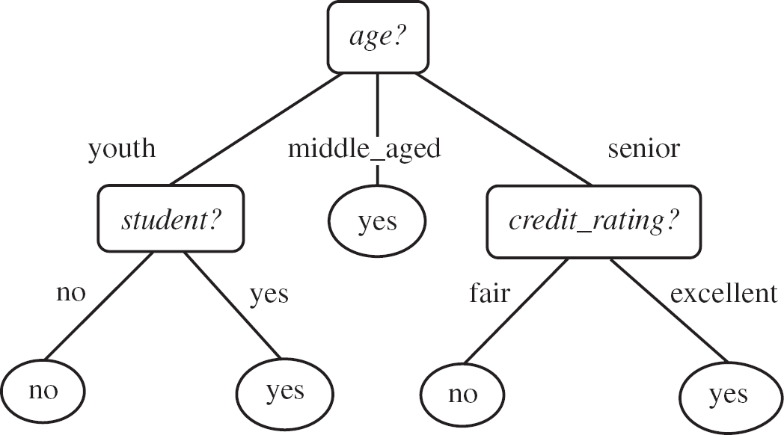
A decision tree for the concept buys_computer

Slide 31
a₁= 0
0.0945
0.1945
a₂ = 0.5
0.5
0.56
-0.7
-0.6
-0.55
0.4
a₃ = 1
0.1645
0.5
0.5
0.56
a₄ = 0
-0.5
A neural network for the concept buys_computer

Slide 32
Naïve Bayesian Classifier: Comments
Advantages
  Easy to implement
  Good results obtained in most of the cases

Slide 33
Naïve Bayesian Classifier: Comments
Disadvantages
  Assumption: class conditional independence, therefore loss of accuracy
  Practically, dependencies exist among variables
    patients profile: age, family history, etc.
    symptoms: fever, cough etc.
    disease: lung cancer, diabetes, etc.
  Dependencies among these cannot be modeled by Naïve Bayesian Classifier
How to deal with these dependencies?
  Bayesian Belief Networks

Slide 34
Bayesian Belief Network
In contrast to the naïve Bayes classifier, which assumes that all the variables are conditional independent given the value of the variables, Bayesian belief network allows a subset of the variables conditionally independent
A graphical model of causal relationships
  Represents dependency among the variables
  Gives a specification of joint probability distribution

Slide 35
Bayesian Belief Networks
Nodes: random variables
Links: dependency
X and Y are the parents of Z, and Y is the parent of P
No dependency between Z and P
Has no loops or cycles
X
Y
Z
P

Slide 36
Bayesian Belief Network: An Example
Family
History
Smoker
Lung
Cancer
Emphysema
Positive
XRay
Dyspnea

Slide 37
Bayesian Belief Network: An Example
The conditional probability table (CPT) for variable LungCancer:
CPT shows the conditional probability for each possible combination of its parents
Derivation of the probability of a particular combination of values of X, from CPT:
(FH, S)
(FH, ~S)
(~FH, S)
(~FH, ~S)
LC
0.8
0.5
0.7
0.1
~LC
0.2
0.5
0.3
0.9

Slide 38
Training Bayesian Networks
Several scenarios:
  Given both the network structure and all variables observable: learn only the CPTs
  Network structure known, some hidden variables: gradient descent (greedy hill-climbing) method, analogous to neural network learning
  Network structure unknown, all variables observable: search through the model space to reconstruct network topology
  Unknown structure, all hidden variables: No good algorithms known for this purpose

