Slide 1
Neural Network I
Week 7

Slide 2
Team Homework Assignment #9
Read pp. 327 – 334 and the Week 7 slide.
Design a neural network for XOR (Exclusive OR)
Explore neural network tools.
beginning of the lecture on Friday March18th.

Slide 3
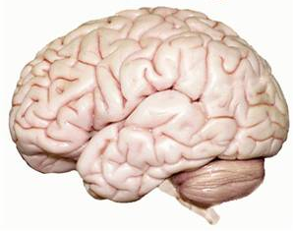
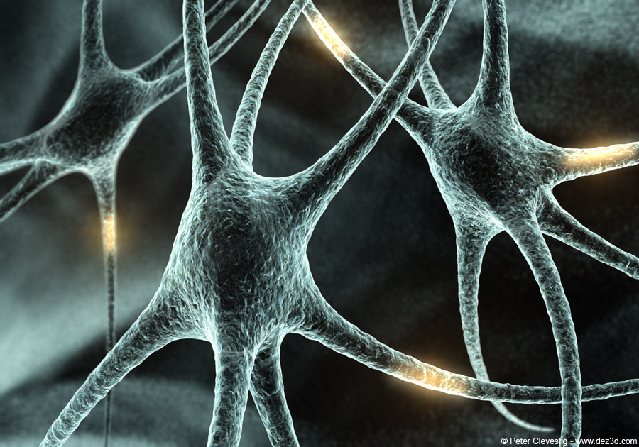
Notes:
Brain is highly complex, nonlinear, and parallel processing.

Slide 4
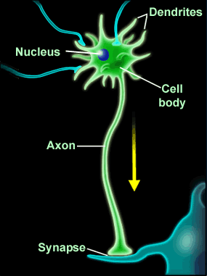

Slide 5
Neurons
Components of a neuron: cell body, dendrites, axon, synaptic terminals.
The electrical potential across the cell membrane exhibits spikes called action potentials.
Originating in the cell body, this spike travels down the axon and causes chemical neurotransmitters to be released at synaptic terminals.
This chemical diffuses across the synapse into dendrites of neighboring cells.

Slide 6
Neural Speed
Real neuron “switching time” is on the order of milliseconds (10⁻³ sec)
compare to nanoseconds (10⁻¹⁰ sec) for current transistors
transistors are a million times faster!
But:
Biological systems can perform significant cognitive tasks (vision, language understanding) in approximately 10⁻¹ second. There is only time for about 100 serial steps to perform such tasks.
Even with limited abilities, current machine learning systems require orders of magnitude more serial steps.
Notes:
Human brain has approximately 10¹¹ neurons each connected on average to 10⁴ others; it exploits massive parallelism.

Slide 7
ANN (1)
Rosenblatt first applied the single-layer perceptrons to pattern-classification learning in the late 1950s
ANN is an abstract computational model of the human brain
The brain is the best example we have of a robust learning system

Slide 8
ANN (2)
The human brain has an estimated 10¹¹ tiny units called neurons
These neurons are interconnected with an estimated 10¹⁵ links (each neuron makes synapses with approximately 10⁴ other neurons).
Massive parallelism allows for computational efficiency
Notes:
The study of ANNs has been inspired in part by the observation that human brain is build of very complex webs of interconnected neurons [Mitchell]
In rough analogy, artificial neural networks are build out of a densely interconnected set of simple units, where each unit takes a number of real-valued inputs and produces a single real-valued output [Mitchell]

Slide 9
ANN General Approach (1)
Neural networks are loosely modeled after the biological processes involved in cognition:
Real: Information processing involves a large number of neurons.
ANN: A perceptron is used as the artificial neuron.
Real: Each neuron applies an activation function to the input it receives from other neurons, which determines its output.
ANN: The perceptron uses an mathematically modeled activation function.

Slide 10
ANN General Approach (2)
Real: Each neuron is connected to many others. Signals are transmitted between neurons using connecting links.
ANN: We will use multiple layers of neurons, i.e. the outputs of some neurons will be the input to others.

Slide 11
Characteristics of ANN
Nonlinearity
Learning from examples
Adaptivity
Fault tolerance
Uniformity of analysis and design

Slide 12
Model of an Artificial Neuron
k_{th} artificial neuron
x₁
w_{k1}
∑
net_{k}
f(netk)
x₂
w_{k2}
.
.
.
y_{k}
.
.
.
x_{m}
w_{km}
b_{k}(=w_{k0} & x₀=1)
A model of an artificial neuron (perceptron)
A set of connecting links
An adder
An activation function
Notes:
A model of an artificial neuron (perceptron)
A set of connecting links
An adder
An activation function

Slide 14
Data Mining: Concepts, Models, Methods, And Algorithms [Kantardzic, 2003]
Notes:
Log-sigmoid (sigmoid, squashing function): note that output ranges between 0 and 1, increasing monotonically with its input. Because it maps a very large input domain to a small range of output, it is often referred to as the squashing function of the unit.

Slide 15
A Single Node
X₁ =0.5
0.3
∑
net₁
f(net1)
0.2
X₂ =0.5
y₁
0.5
X₃ =0.5
-0.2
f(net1):
(Log-)sigmoid
Hyperbolic tangent sigmoid
Hard limit transfer (threshold)
Symmetrical hard limit transfer
Saturating linear
Linear
…….
Notes:
A model of an artificial neuron (perceptron)
A set of connecting links
An adder
An activation function

Slide 16
A Single Node
X₁ =0.5
0.3
∑|f(net₁)
0.2
X₂ =0.5
y₁
0.5
X₃ =0.5
-0.2
f(net1):
(Log-)sigmoid
Hyperbolic tangent sigmoid
Hard limit transfer (threshold)
Symmetrical hard limit transfer
Saturating linear
Linear
…….
Notes:
A model of an artificial neuron (perceptron)
A set of connecting links
An adder
An activation function

Slide 17
Perceptron with Hard Limit Activation Function
x₁
w_{k1}
x₂
w_{k2}
.
.
.
.
.
.
y₁
x_{m}
w_{km}
b_{k}
Notes:
A model of an artificial neuron (perceptron)
A set of connecting links
An adder
An activation function

Slide 18
Perceptron Learning Process
The learning process is based on the training data from the real world, adjusting a weight vector of inputs to a perceptron.
In other words, the learning process is to begin with random weighs, then iteratively apply the perceptron to each training example, modifying the perceptron weights whenever it misclassifies a training data.

Slide 19
Backpropagation
A major task of an ANN is to learn a model of the world (environment) to maintain the model sufficiently consistent with the real world so as to achieve the target goals of the application.
Backpropagation is a neural network learning algorithm.

Slide 20
Learning Performed through Weights Adjustments
k_{th} perceptron
x₁
w_{k1}
-
+
∑
net_{k}
∑
x₂
w_{k2}
.
.
.
.
.
.
y_{k}
t_{k}
x_{m}
w_{km}
b_{k}
Weights adjustment
Notes:
A model of an artificial neuron (perceptron)
A set of connecting links
An adder
An activation function

Slide 21
Perceptron Learning Rule
input output
Sample_{k} x_{k0},x_{k1}, …, x_{km} y_{k}
Perceptron
Learning Rule

Slide 22
Perceptron Learning Process
X₁
0.5
-
+
∑|
∑
-0.3
X₂
0.8
y_{k}
t_{k}
X₃
b=0
Weights adjustment
n (training data) | x₁ | x₂ | x₃ | t_{k}
1 | 1 | 1 | 0.5 | 0.7
2 | -1 | 0.7 | -0.5 | 0.2
3 | 0.3 | 0.3 | -0.3 | 0.5
Learning rate η = 0.1

Slide 23
Adjustment of Weight Factors with the Previous Slide

Slide 24
Implementing Primitive Boolean Functions Using A Perceptron
AND
OR
XOR (￢OR)

Slide 25
AND Boolean Function
X₁
∑|
y_{k}
X₂
b=X₀
x₁ x₂ output
0 0 0
0 1 0
1 0 0
1 1 1
Learning rate η = 0.05
Notes:
W1 = 0.3 w2= 0.3 b = -0.5

Slide 26
OR Boolean Function
X₁
∑|
y_{k}
X₂
b
x₁ x₂ output
0 0 0
0 1 1
1 0 1
1 1 1
Learning rate η = 0.05
Notes:
W1 = 0.3 w2= 0.3 b = -0.2

Slide 27
Exclusive OR (XOR) Function
X₁
∑|
y_{k}
X₂
b
x₁ x₂ output
0 0 0
0 1 1
1 0 1
1 1 0
Learning rate η = 0.05

Slide 28
Exclusive OR (XOR) Problem
A single “linear” perceptron cannot represent XOR(x₁, x₂)
Solutions
Multiple linear units
Notice XOR(x₁, x₂) = (x₁∧￢x₂) ∨ (￢x₁∧ x₂).
Differentiable non-linear threshold units

Slide 29
Exclusive OR (XOR) Problem
Solutions
Multiple linear units
Notice XOR(x₁, x₂) = (x₁∧￢x₂) ∨ (￢x₁∧ x₂).
Differentiable non-linear threshold units

