Slide 1
Week 3 work with support provider
During this week February 16-18, participants work with their Support Providers to conduct
PROGRESS MONITORING as they use two Planning Forms to consider the Teaching Contexts
Form 1: The Classroom Profile enables you to learn about your students;
Form 2: Instructional Environment (A-2)

Slide 2
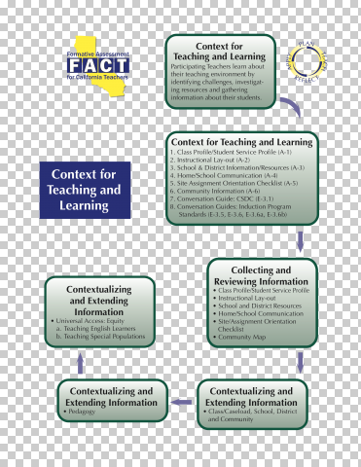

Slide 3
Week 3
Upon completion of the Planning Forms,
POST the forms on Moodle Week 4 February 16 -18
Enter the Forum to respond to the Discussion.

Slide 4
Week 3 Work – Objectives met
Objective #2: Induction Plans aligned with Standards: Teachers will develop an Individual Induction Plan, in conjunction with their employer, mentor and the university that is designed to enhance their teaching abilities and reflect inquiry-based methodology and reflective practice.
Objective #5: Demonstrate skills and knowledge that are aligned with the California Standards for the Teaching Profession and contained in the Commission on Teacher Credentialing Single and Multiple Subject Credential Standards.

