Slide 1
Week 2 Meets synchronously
Review the Revised Course Agenda: Note that “R.R” indicates there is a reading assignment to be followed with your response in the Week’s Moodle Forum).
Course Assignments and Assessments
Overview of Induction: BTSA; FACT
Your Context for Teaching and Learning, participating teachers learn about their teaching environment by identifying challenges, investigating resources, and gathering information about students. Identifying Strengths and Future Strengths

Slide 2
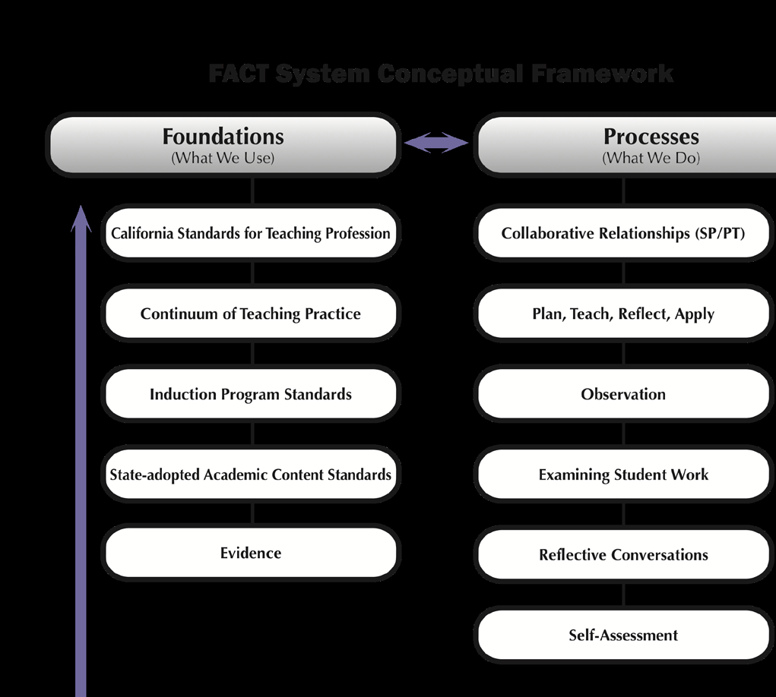

Slide 3
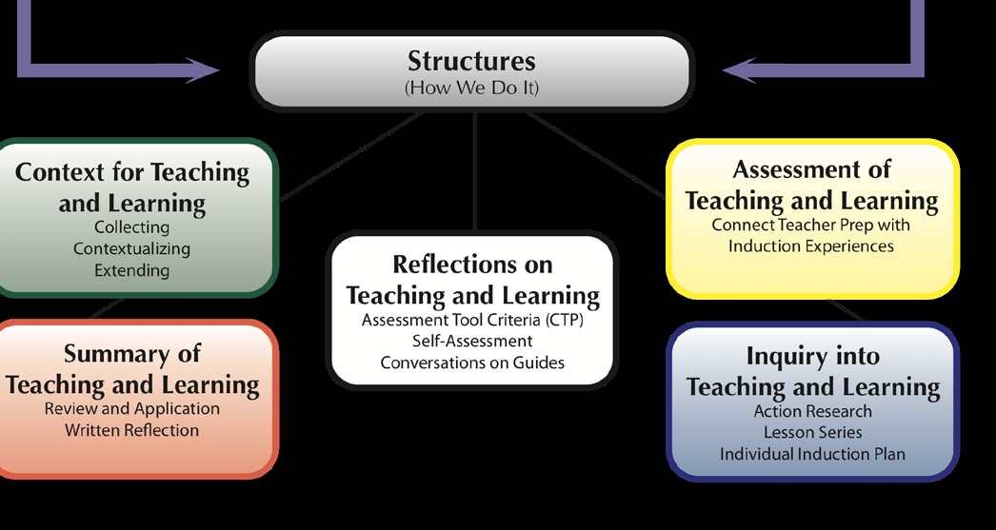

Slide 4
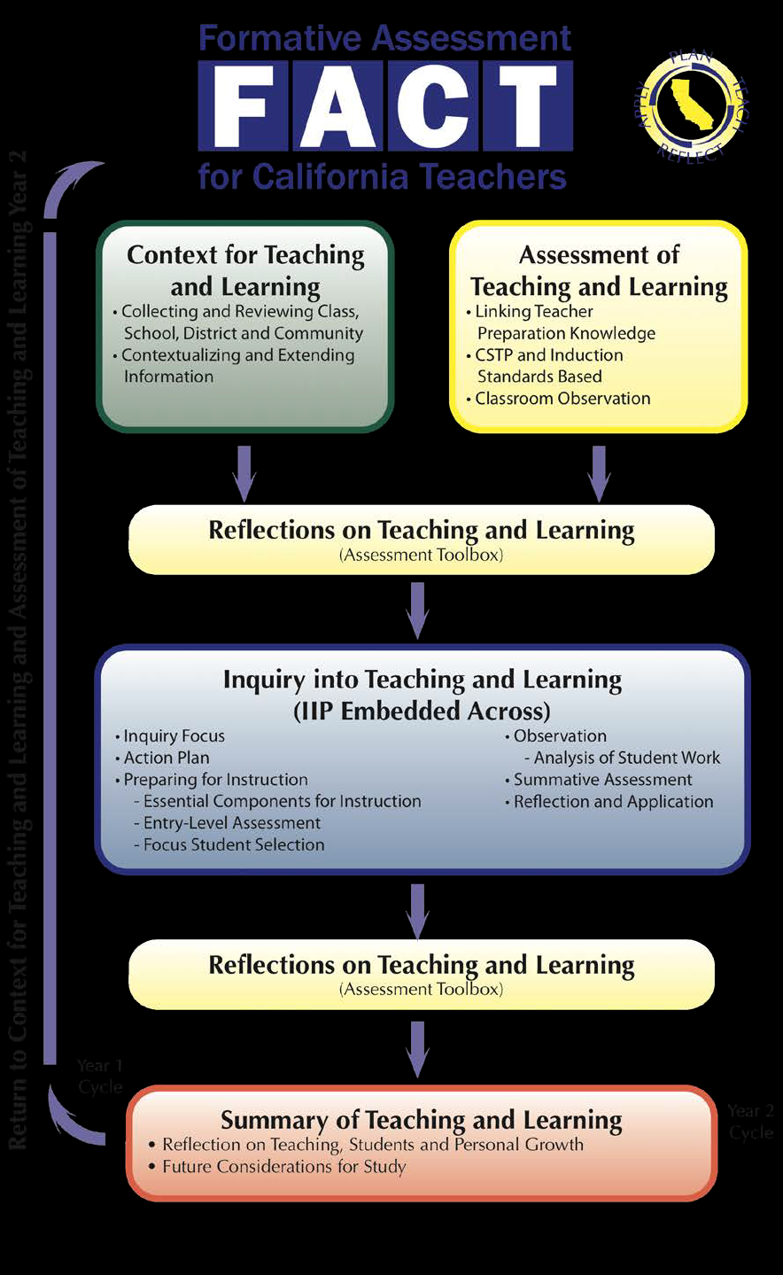

Slide 5
FACT USERS’ GUIDE
See Page 13 for a list of the Guide for
FACT System Modules and Documents

Slide 6
Week 2 - Asynchronous
View the Developmental Stages of Professional Development in the CSTPs as you begin reflections on your practice. Use the updated IIP Development Form.
View the FACT Forms Provided by the CTC.
(these will be sent to participants as a zip-folder)

Slide 7
Week 2 - Asynchronous
ASSIGNMENTS FOR WEEK 3
Assignments for February 9-11
Download/Print: FACT USER’S GUIDE
Review and complete Planning Forms: A1- The Classroom Profile and A2-The Instructional Environment
RR: Prepare questions you may have about creating an optimal environment that engages diverse students. Why does using these tools lead to better understanding of your Teaching Context? Due: 2/9-13 Submit in Moodle

