Slide 1


CSUN/CSUDH
Induction Support Provider
Orientation
March 18, 2015

Slide 2
Introductions
Dr. Beverly Cabello Associate Dean of Education
Tina Torres (tina.torres@csun.edu) Director, Credential Office
Estela Chacon (echacon@csun.edu) Assistant Director, Credential Office
Dr. Susan Belgrad (susan.belgrad@csun.edu) Professor, E ED 595J
Pam Sierra (pamela.scherban-sierra@csun.edu)
and Dr. Ivan Cheng (icheng@csun.edu)
CSUN Induction Coordinators

Slide 3
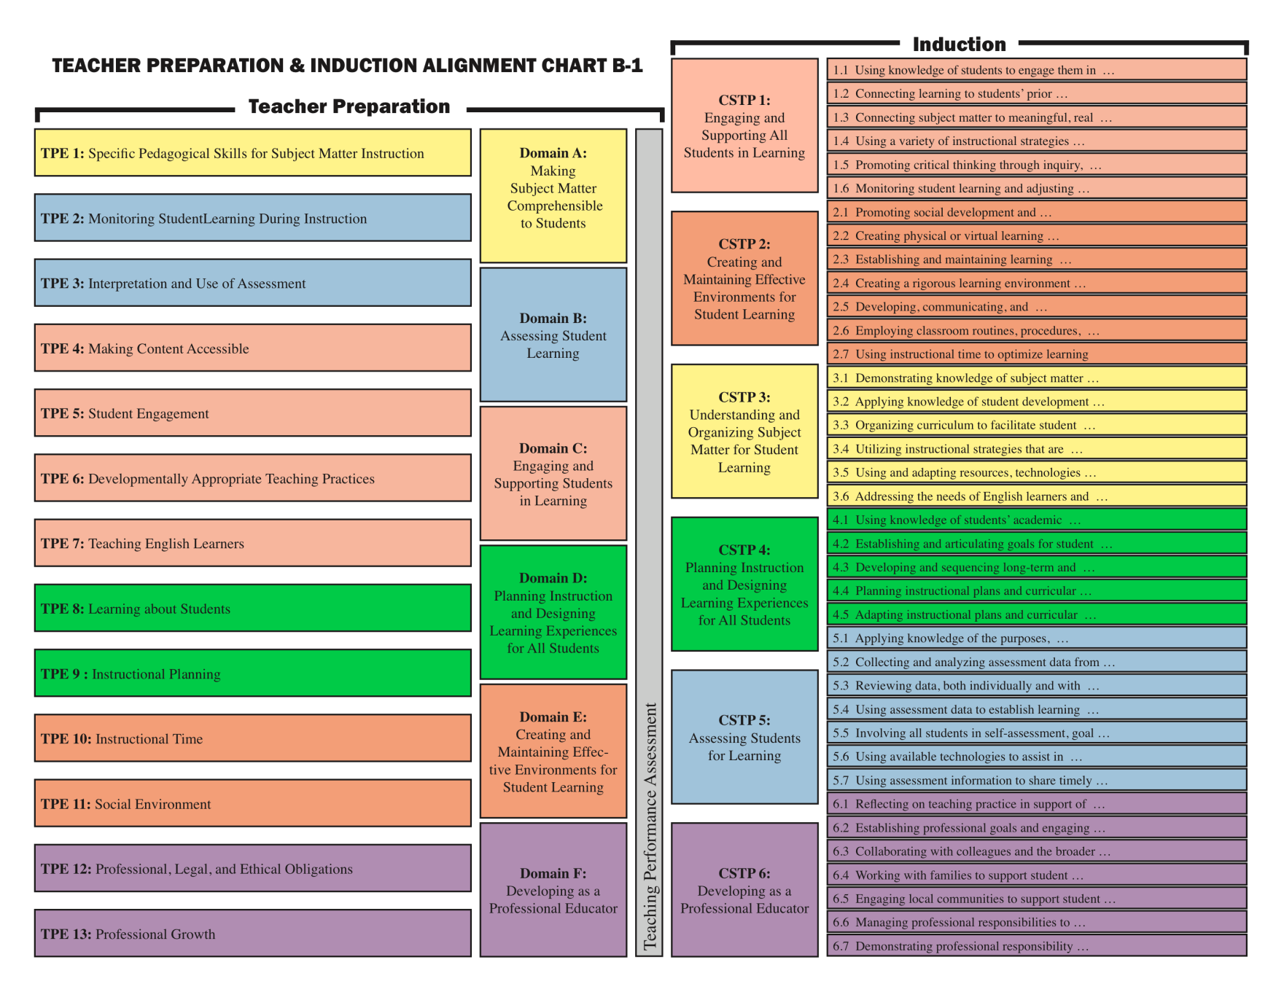
The Big Picture

Slide 4
Overview of Program
4 Courses
E ED 595J (“Course 1”)
Elective 1
Elective 2
S ED 595JG (“Course 4”)
Fieldwork component
Support Provider from school of employment
Assignments from Course 1

Slide 5
E ED 595J (“Course 1”)
Introduces BTSA–FACT
Begins induction process
Candidate works with Induction Coordinator to create Program Plan
Candidate drafts and completes IIP (C-1 Form)
Fieldwork component
Candidate identifies Support Provider
Candidate works with Support Provider to complete course assignments

Slide 6
Support Provider Qualifications
Valid CA Clear Credential in the same subject area as the candidate
Recommended by administrator
Cannot be a supervisor or principal
Familiar with CSTP
Has strong interpersonal skills
Attends training

Slide 7
Support Provider Roles
Practitioner
Mentor
Collaborator
Professional
Brainstorm and discuss what each of these might mean for you

Slide 8
Support Provider Roles
Use the skills of cognitive coaching, mentoring, and modeling to support candidates’ professional growth
Encourage candidates to visit the classrooms of other skilled veterans
Conduct 2 or more observations
Work with candidates on lesson planning
Conference together, share observation evidence, examine other classroom data (e.g., student work samples, lesson plans, etc.)

Slide 9
Support Provider Roles
Recommend resources
Provide mentoring and modeling
Provide feedback for candidates
Individual Induction Plan (IIP)
Lesson plans
Observations
Promote the FACT Plan
Plan, Teach, Reflect, Apply (PTRA) Cycle

Slide 10
Providing Support
PTRA Cycle
Plan
Apply Teach
Reflect

Slide 11
Providing Support
Examining student work
Guide the candidate to plan and teach with a focus on students’ achievement
Engage with the candidate following observation in an examination and analysis of student work
Support the candidate in gaining a greater understanding of differentiation and modification of instruction

Slide 12
Providing Support
Reflective conversations
Assist the candidate in stepping back from their practice to “thoughtfully examine what they do, how they do it, and how this affects student learning”
Support the candidate in gaining a greater understanding of the need for differentiation and modification of instruction

Slide 13
Providing Support
Facilitate candidates’ self-assessment
Use the CSTP as a “roadmap for candidates’ professional growth”
Focus on areas for improvement in instructional practice
Offer support in continuing reflection and self-assessment of progress

Slide 14
Providing Support
Where good ideas come from
We need others to identify our ideal self or find our real self, to discover our strengths and gaps, to develop an agenda for the future, and to experiment and practice. ... Others help us see things we are missing, affirm whatever progress we have made, test our perceptions, let us know how we are doing. They provide the context for experimentation and practice. Without others’ involvement, lasting change can’t occur.
From Boyatzis (2002), “Positive Resonance”
Notes:
Show Steven Johnson’s video “Where Good Ideas Come From”

Slide 15
Providing Support
Coaching conversation in planning a lesson:
What will the students learn (the ideal)?
Where are the students right now (the real)?
What are their strengths and abilities?
What are their gaps or struggles?
How might we use their strengths to bridge their gaps (plan of action)?
Notes:
How do we help teachers use their ideas and experiences to help generate new lessons? How do we brainstorm along side with them? How do we co-construct new ideas with teachers? (This requires both brainstorming and sharing expertise based on insights drawn from student work samples and teachers' own reflections of what occurred in the classroom).

Slide 16
Providing Support
Analyzing a lesson:
What was the goal of the lesson (the ideal)?
How did the lesson go (the real)?
What worked in the lesson? What did you like about the lesson?
What didn’t work in the lesson? What didn’t you like about the lesson?
How would you make the lesson better (plan of action)?
Notes:
How do we help teachers use their ideas and experiences to help generate new lessons? How do we brainstorm along side with them? How do we co-construct new ideas with teachers? (This requires both brainstorming and sharing expertise based on insights drawn from student work samples and teachers' own reflections of what occurred in the classroom).

Slide 17
Providing Support
Analyzing student thinking:
What was being assessed (the ideal)?
How did the students perform (the real)?
What did they do well?
What didn’t they do well? Why?
What needs to be done in the next lesson (plan of action)?
Notes:
How do we help teachers use their ideas and experiences to help generate new lessons? How do we brainstorm along side with them? How do we co-construct new ideas with teachers? (This requires both brainstorming and sharing expertise based on insights drawn from student work samples and teachers' own reflections of what occurred in the classroom).

Slide 18
Providing Support
Questions to promote experimenting:
I wonder what would happen if … ?
What is another way you might … ?
What might explain … ?
How did you decide to … ?
In your planning, did you consider … ?
Notes:
How do we help teachers use their ideas and experiences to help generate new lessons? How do we brainstorm along side with them? How do we co-construct new ideas with teachers? (This requires both brainstorming and sharing expertise based on insights drawn from student work samples and teachers' own reflections of what occurred in the classroom).

Slide 19
Providing Support
Coaching moves:
Help teachers clarify goals & remind them of guiding principles
Ask questions that focus on student learning
Invite teachers to share their ideas
Share ideas, but make them accessible
Be responsive to teachers’ concerns
Refocus the conversation when the discussion gets off track
Notes:
How do we help teachers use their ideas and experiences to help generate new lessons? How do we brainstorm along side with them? How do we co-construct new ideas with teachers? (This requires both brainstorming and sharing expertise based on insights drawn from student work samples and teachers' own reflections of what occurred in the classroom).

Slide 20
Questions?
Tina Torres (tina.torres@csun.edu) Director, Credential Office
Estela Chacon (echacon@csun.edu) Assistant Director, Credential Office
Dr. Susan Belgrad (susan.belgrad@csun.edu) Professor, E ED 595J
Pam Sierra (ps-sierra@sbcglobal.net)
and Dr. Ivan Cheng (icheng@csun.edu)
CSUN Induction Coordinators

Slide 21
Thank You
Tina Torres (tina.torres@csun.edu) Director, Credential Office
Estela Chacon (echacon@csun.edu) Assistant Director, Credential Office
Dr. Susan Belgrad (susan.belgrad@csun.edu) Professor, E ED 595J
Pam Sierra (ps-sierra@sbcglobal.net)
and Dr. Ivan Cheng (icheng@csun.edu)
CSUN Induction Coordinators

