Slide 1
Showing Evidence: Using Standards to Promote Excellence in Teaching
Enhancing Professional Practice
Looking at the work of
Charlotte Danielson and Bob Marzano

Slide 2
Key Sources of Evidence
Observation
Artifacts
State-Mandated Test Scores
Student and Parent Surveys

Slide 3
Strengths and Limitations of Potential Teacher Evaluation Tools
Evaluation Tool | Strengths | Limitations
Review Teachers’ Lesson Plans Adapted from EdSource's Envisioning New Directions in Teacher Evaluation. EdSource June 2011 | Lesson plans show how well prepared teachers are to deliver content, develop student skills, and manage the classroom. The level of planning has been shown to correlate with student learning. | Lesson plans are often adjusted as the lesson is taught; thus, the effectiveness of a lesson cannot be evaluated simply by looking at the plan.

Slide 4
Strengths and Limitations of Potential Teacher Evaluation Tools
Evaluation Tool | Strengths | Limitations
Classroom Observations Adapted from EdSource's Envisioning New Directions in Teacher Evaluation. EdSource June 2011 | This is the most commonly used tool because it is able to capture information about instructional practices. This can be used as both a formative and as a summative assessment tool. When used in formative evaluations, the observer can track a teacher’s growth and suggest needed professional development and then later observe whether changes in teaching have been made. | Poorly trained observers and/or inconsistent, brief observations can lead to biased or inaccurate results. However, when observations occur more frequently, their reliability improves. Observers often are not aware of the teacher’s lesson plan. If, for example, the plan requires student accommodations, it would be difficult for the evaluator to know if the accommo-dations were implemented appropriately.

Slide 5
Strengths and Limitations of Potential Teacher Evaluation Tools
Evaluation Tool | Strengths | Limitations
Self-Assessments Adapted from EdSource's Envisioning New Directions in Teacher Evaluation. EdSource June 2011 | Self-reflection during grade- or subject-area meetings, debriefings, or developing a portfolio or individual professional development plan may encourage teachers to continue to learn and grow. Videotaping class sessions allows teachers to review their performance. | Requires large amounts of time from the teacher.

Slide 6
Strengths and Limitations of Potential Teacher Evaluation Tools
Evaluation Tool | Strengths | Limitations
Portfolio Assessments Adapted from EdSource's Envisioning New Directions in Teacher Evaluation. EdSource June 2011 | Combines the usefulness of a variety of other evaluative tools, such as review of lesson plans, a video of classroom teaching, reflection, and examples of student work and teacher feedback. Promotes the active participation of teachers in the evaluation process. Allows evaluators to review non-classroom aspects of instruction. | No conclusive findings exist on the reliability of portfolios as part of an objective evaluation system. Time consuming for both teachers and administrators.

Slide 7
Strengths and Limitations of Potential Teacher Evaluation Tools
Evaluation Tool | Strengths | Limitations
Student Work-Sample Reviews Adapted from EdSource's Envisioning New Directions in Teacher Evaluation. EdSource June 2011 | May be able to identify which elements of teaching have a positive effect on learning better than standardized test scores. | Reviewing samples can be time consuming. More prone to issues of validity and reliability than test items that have been validated for similar comparisons across different students in different schools answering similar test items. However, a way to reduce such subjectivity would be to develop a research-informed scoring rubric and train those who use it.

Slide 8
Challenges of Using Data from State-Mandated Tests for Teacher Evaluation
What are four difficulties of test scores as sources of teacher evaluation?
1.
2.
3.
4.

Slide 9
What are the issues to be considered in the collection and use of evidence?
Formal vs. informal
Announced vs. unannounced observations
Collectors and providers of evidence
Consistency of scoring
Use of forms in a systematic or random manner

Slide 10
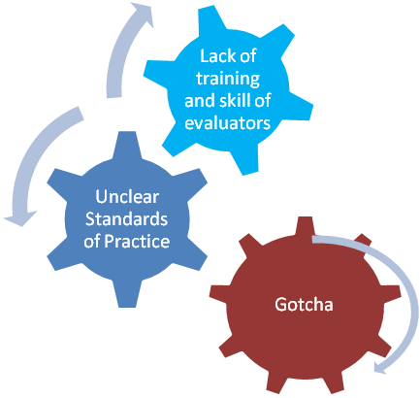
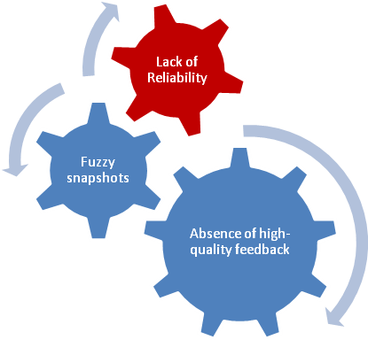

Teacher Evaluation Current Reality
From C. Danielson Webinar Series

Slide 11
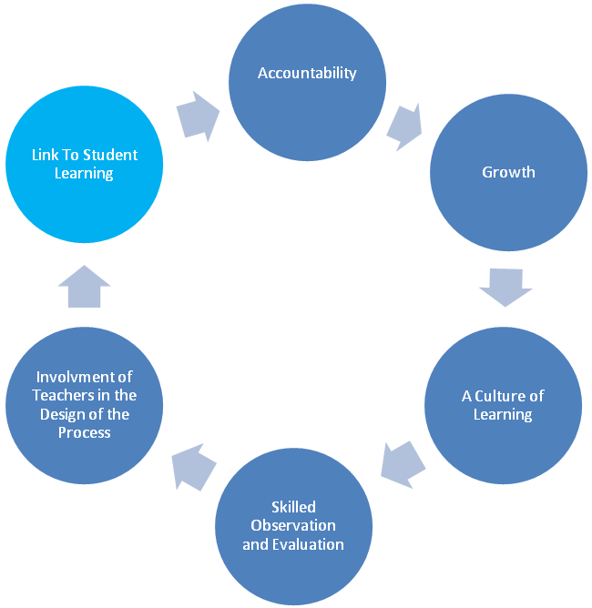
Teacher Evaluation – Desired Result
From C. Danielson Webinar Series

Slide 12
The Importance of Effective Teaching
Research tells us that the role of the teacher is the single greatest factor on student learning.(Sanders & Horn, 1998) .
Research also tells that one of the greatest factors central office [administrators] can contribute is to maintain a singular focus on improving instruction. (Marzano and Waters, 2009)
Research tells us that an improved focus on teacher evaluation and professional development will improve retention of teachers S.M. Johnson, J.H. Berg, M.L. Donaldson. (2005).

Slide 13
Here’s What We Know about the Importance of Effective Teaching
Student achievement will not improve unless teaching improves.
Teachers working alone without feedback will not be able to improve no matter how much professional development they receive.
The challenge is to create a system of continuous improvement of instruction, supervision and instructional leadership
Supervision needs to be frequent and focused on the improvement of instruction
Marzano Evaluation Model Implementation Services

Slide 14
Marzano Causal Teacher Evaluation Model
Communicate the common language of teaching efficiently
Facilitate the observation and feedback cycle
Promote teacher reflection and collaboration
Offer targeted & aligned professional development
Provide conditions for deliberate practice
Connect growth, development and performance management
www.MarzanoEvaluation.com

Slide 15
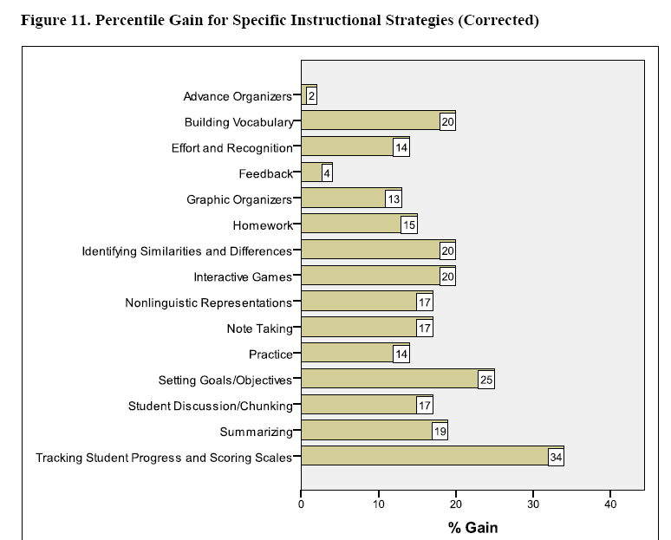
Common Language/Framework Based Upon Decades of Research

Slide 16
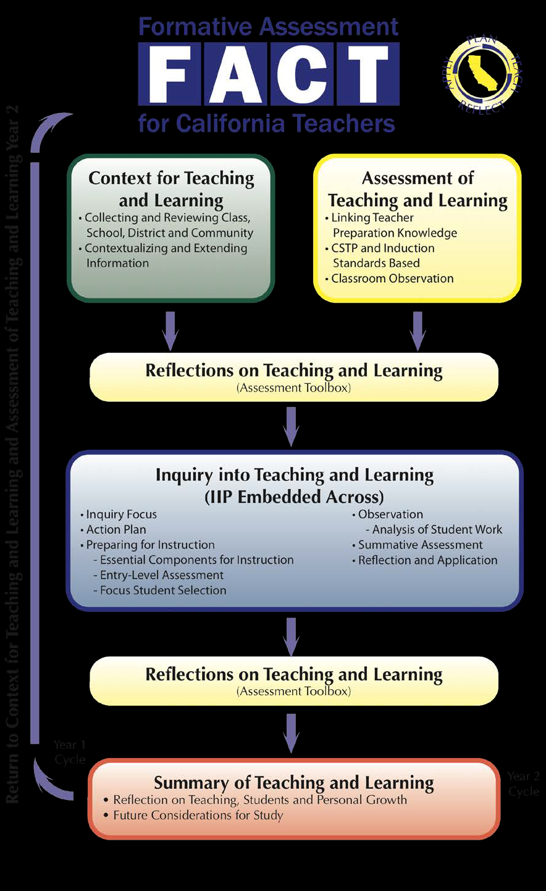

Slide 17
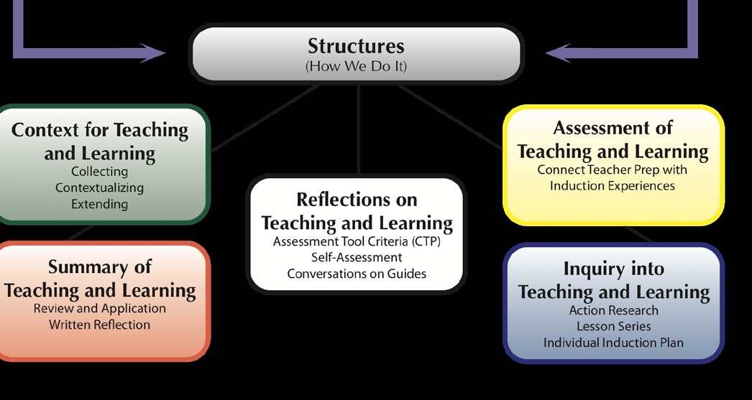

Slide 18
Showing Evidence: Using Standards to Promote Excellence in Your Teaching
Looking at the “Desired Results of Effective Teacher Evaluation “ as advanced by Danielson and Marzano, what do you see as important in showing evidence of your professional craft as a teacher?
Accountability
Growth
A Culture of Learning
Skilled Observation and Evaluation
Involvement of Teachers in the Design of the Process
Link To Student Learning

Slide 19
Showing Evidence: Using Standards to Promote Excellence in Your Teaching
Looking at the “Desired Results of Effective Teacher Evaluation “ as advanced by Danielson and Marzano, what do you see as important in showing evidence of your professional craft as a teacher?
Self Report of Practice
Observation
Evidence Binder/Portfolio
Student Survey
Artifact Analysis
Video Evidence

Slide 20
References
Danielson, C. (2007) Handbook on the Framework for Professional Development. Arlington VA: ASCD.
Marzano , R. and Waters, T. (2009) District Leadership That Works: Striking the Right Balance. Bloomington, IN: Solution Tree.
Sanders, W.L. & Horn, S.P. (1998). Research Findings from the Tennessee Value-Added Assessment System (TVAAS) Database:
Implications for Educational Evaluation and Research. Journal of Personnel Evaluation in Education,12(3),247-256.
SandersW. L, (2004) A summary of conclusions drawn from longitudinal analysis of student achievement data over the past 22 years. Paper presented to Governors Education Symposium, Ashville, NC.http://www.sas.com/govedu/edu/hunt_summary.pdf
S.M. Johnson, J.H. Berg, M.L. Donaldson. (2005, January).
Who Stays in Teaching and Why: A Review of the Literature on Teacher Retention. The Project on the Next Generation of Teachers, Harvard Graduate School of Education. http://assets.aarp.org/www.aarp.org_/articles/NRTA/Harvard_report.pdf

