Slide 1
LESSON DESIGN STUDY
ALIGNING LESSON STUDY WITH
TEACHER –DRIVEN PROFESSIONAL
GROWTH AND DEVELOPMENT

Slide 2
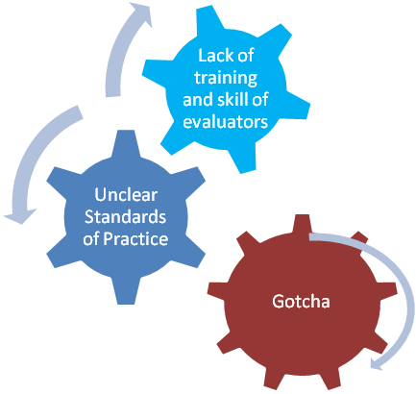
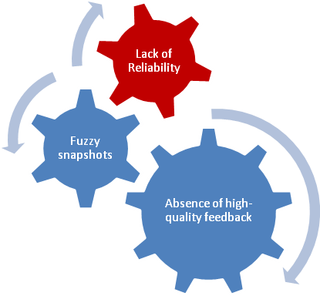
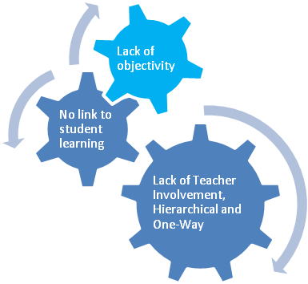
Teacher Evaluation Current Reality
From C. Danielson Webinar Series

Slide 3
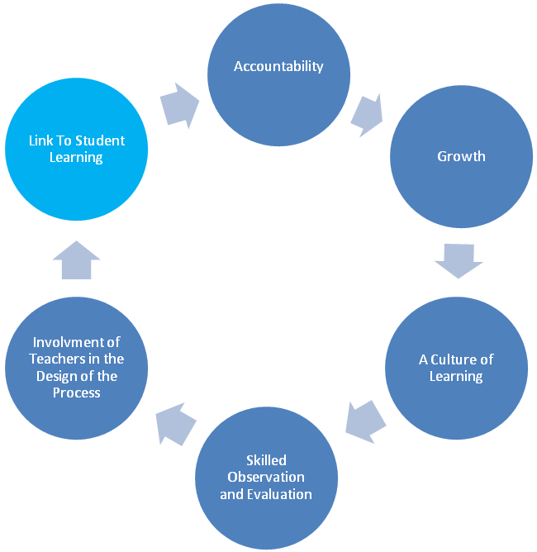
Lesson Study– Desired Result
From C. Danielson Webinar Series

Slide 4
Here’s What We Know about the
Importance of Effective Teaching
Student achievement will not improve unless teaching
improves.
Teachers working alone without feedback will not be able to improve no matter how much professional development they receive.
The challenge is to create a system of continuous improvement of instruction, supervision and instructional leadership
Collaboration/Supervision needs to be frequent and focused on the teacher’s goals for improvement of instruction.
Marzano Evaluation Model

Slide 5
Lesson Design Study’s Potential
Communicates the common language of teaching efficiently
Facilitates the observation and feedback cycle
Promotes teacher reflection and collaboration
Offers targeted & aligned professional development
Provides conditions for deliberate practice
Connects growth, development and performance
management for the individual practitioner.
Marzano Causal Teacher Evaluation Model MarzanoEvaluation.com

Slide 6
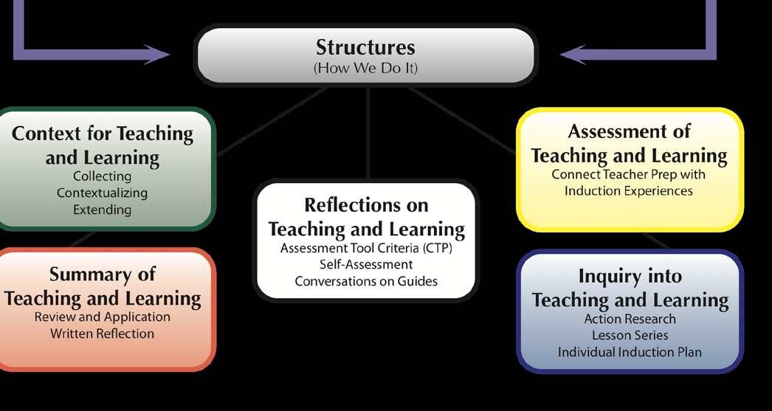

Slide 7
The Importance of Effective Teaching
Research tells us that the role of the teacher is the single greatest factor on student learning.(Sanders & Horn, 1998) .
Research also tells that one of the greatest factors central office [administrators] can contribute is to maintain a singular focus on improving instruction. (Marzano and Waters, 2009)
Research tells us that an improved focus on teacher evaluation and professional development will improve retention of teachers S.M. Johnson, J.H. Berg, M.L. Donaldson. (2005).

Slide 8
Showing Evidence: Using Standards to Promote Excellence in Your Teaching
Looking at the “Desired Results of Effective Teacher Evaluation “ as advanced by Danielson and Marzano, what do you see as important in showing evidence of your professional craft as a teacher?
Accountability
Growth
A Culture of Learning
Skilled Observation and Evaluation
Involvement of Teachers in the Design of the Process
Link To Student Learning

Slide 9
References
Danielson, C. (2007) Handbook on the Framework for Professional Development. Arlington VA: ASCD.
Marzano , R. and Waters, T. (2009) District Leadership That Works: Striking the Right Balance. Bloomington, IN: Solution Tree.
Sanders, W.L. & Horn, S.P. (1998). Research Findings from the Tennessee Value-Added Assessment System (TVAAS) Database:
Implications for Educational Evaluation and Research. Journal of Personnel Evaluation in Education,12(3),247-256.
SandersW. L, (2004) A summary of conclusions drawn from longitudinal analysis of student achievement data over the past 22 years. Paper presented to Governors Education Symposium, Ashville, NC.http://www.sas.com/govedu/edu/hunt_summary.pdf
S.M. Johnson, J.H. Berg, M.L. Donaldson. (2005, January).
Who Stays in Teaching and Why: A Review of the Literature on Teacher Retention. The Project on the Next Generation of Teachers, Harvard Graduate School of Education. http://assets.aarp.org/www.aarp.org_/articles/NRTA/Harvard_report.pdf

