Slide 1
The Olmec Civilization

Slide 2
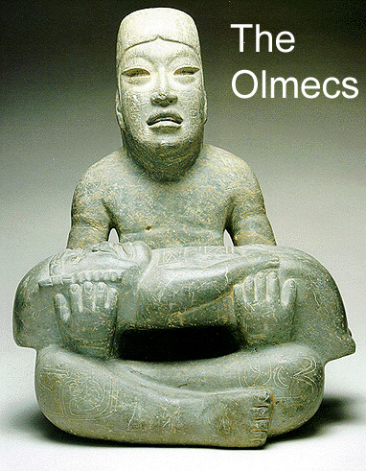
First Civilization of the Americas; The Olmecs
The first Civilization was established in Mesoamerica
Approximately between 1200-400 B.C.E
The Olmec influence the Mayan people
Produce high quality crafts

Slide 3
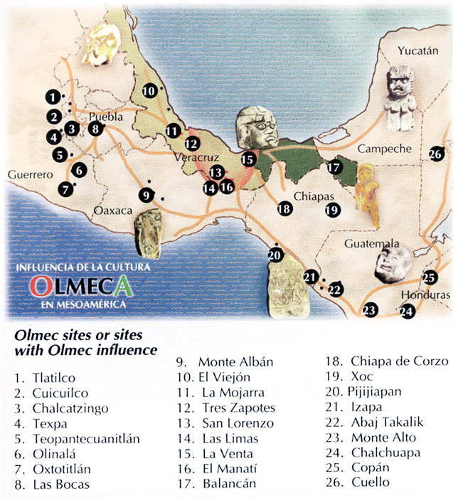
Mesoamerica
Located between central Mexico
The center of Olmec civilization was between what is now the states of Veracruz and Tabasco
Earthquakes and volcanoes eruptions
Tropical weather
Very hot and humid
Rich in minerals such as jade, obsidian and quartz

Slide 4
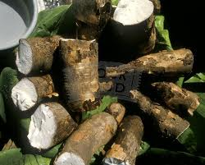
Diet
Corn (maiz)
Beans
Squash
Fishing
Manioc (a calorie rich crop)

Slide 5
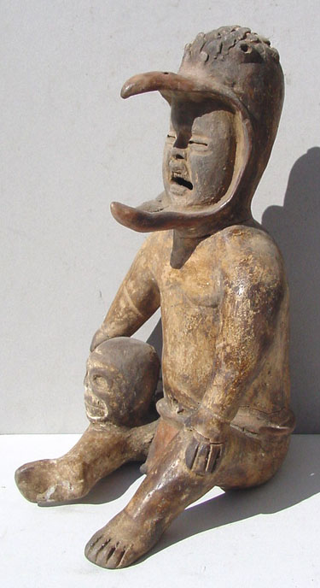
RELIGION
Polytheistic – the belief in more than one deity
Most of their deities had both male and female natures
Human and animal characteristics were also blended
The believed that humans had the ability to transform into an animal such as jaguars, snakes and crocodiles
Rulers were especially associated with Jaguars
The elite used many crituals to control this scociety

Slide 6
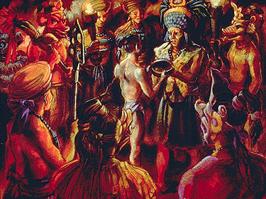
Shamans
Shamans-Individuals who claim the ability to make direct contact with supernatural powers
They were attach to the elite
organize religious life
Provided advice about the rain(for agriculture purpose)
Used the stars to guide them
They were probably responsible for developing a form of writing

Slide 7
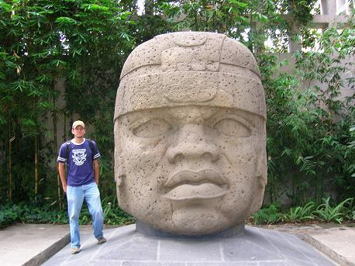
Olmec Heads
Olmec society were probably ruled by kings
It is believed that the heads represent individual rulers, warriors or ball players
Sixteen heads have been found
The largest one that has been found is 11 feet tall

