Slide 1
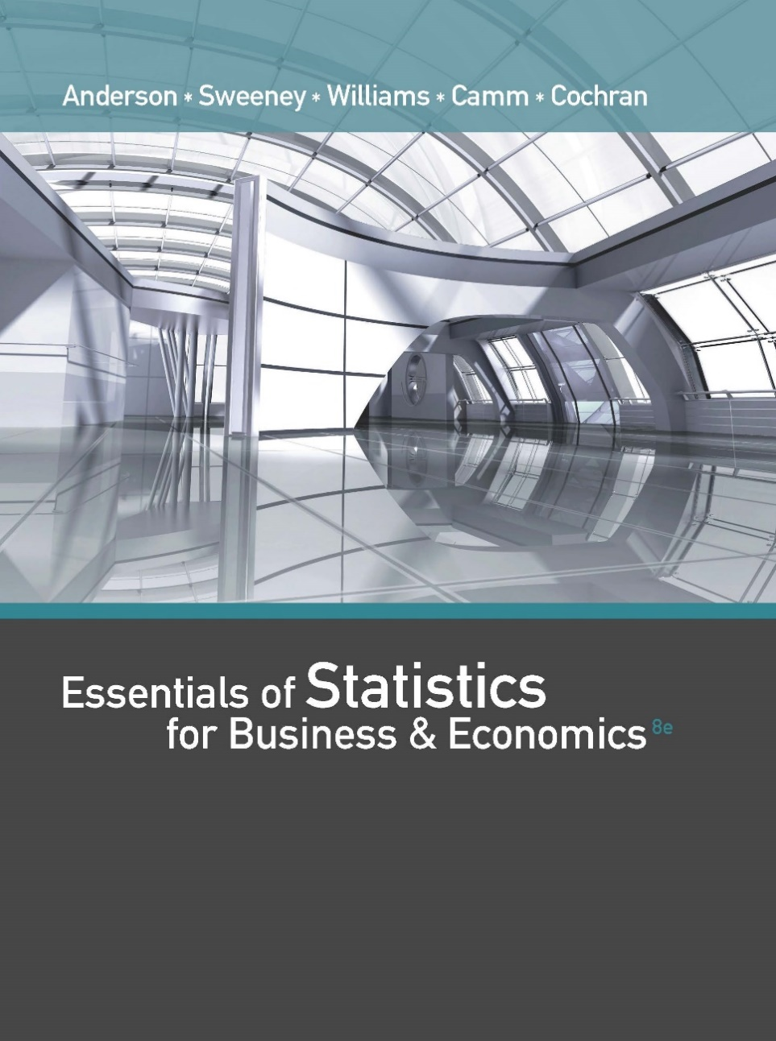
Essentials of Statistics for Business and Economics (8e)
Anderson, Sweeney, Williams, Camm, Cochran
© 2018 Cengage Learning

Slide 2
Chapter 15 Multiple Regression
Multiple Regression Model
Least Squares Method
Multiple Coefficient of Determination
Model Assumptions
Testing for Significance
Using the Estimated Regression Equation for Estimation and Prediction
Categorical Independent Variables
Residual Analysis
Logistic Regression

Slide 3
Multiple Regression
In this chapter we continue our study of regression analysis by considering situations involving two or more independent variables.
This subject area, called multiple regression analysis, enables us to consider more factors and thus obtain better estimates than are possible with simple linear regression.

Slide 4
Multiple Regression Model
Multiple Regression Model
The equation that describes how the dependent variable y is related to the independent variables x₁, x₂, . . . x_{p} and an error term is:
y = β₀ + β₁x₁ + β₂x₂ + . . . + β_{p}x_{p} + ε
where:
β₀, β₁, β₂, . . . , β_{p} are the parameters, and
ε is a random variable called the error term

Slide 5
Multiple Regression Equation
Multiple Regression Equation
The equation that describes how the mean value of y is related to x₁, x₂, . . . x_{p} is:
E(y) = β₀ + β₁x₁ + β₂x₂ + . . . + β_{p}x_{p}

Slide 6
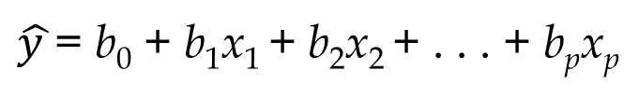
Estimated Multiple Regression Equation
Estimated Multiple Regression Equation
$\hat{y }$= b₀ + b₁x₁ + b₂x₂ + . . . + b_{p}x_{p}
A simple random sample is used to compute sample statistics b₀, b₁, b₂, . . . , b_{p} that are used as the point estimators of the parameters β₀, β₁, β₂, . . . , β_{p}.

Slide 7
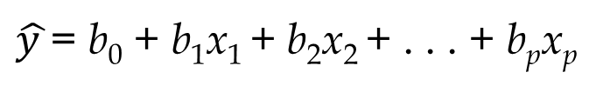
Estimation Process
Multiple Regression Model
E(y) = β₀ + β₁x₁ + β₂x₂ +. .+ β_{p}x_{p} + ε
Multiple Regression Equation
E(y) = β₀ + β₁x₁ + β₂x₂ +. . .+ β_{p}x_{p}
Unknown parameters are
β₀, β₁, β₂, . . . , β_{p}
Sample Data:
x₁ x₂ . . . x_{p} y
. . . .
. . . .
Estimated Multiple
Regression Equation
Sample statistics are
b₀, b₁, b₂, . . . , b_{p}
b₀, b₁, b₂, . . . , b_{p}
provide estimates of
β₀, β₁, β₂, . . . , β_{p}
$\hat{y }$= b₀ + b₁x₁ + b₂x₂ + . . . + b_{p}x_{p}

Slide 8
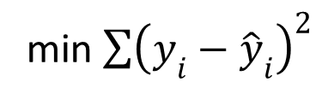
Least Squares Method
Least Squares Criterion
min $\sum{{\left(y_{i}−{\hat{y}}_{i}\right)}^{2}}$
Computation of Coefficient Values
The formulas for the regression coefficients b₀, b₁, b₂, . . . b_{p} involve the use of matrix algebra. We will rely on computer software packages to perform the calculations.
The emphasis will be on how to interpret the computer output rather than on how to make the multiple regression computations.

Slide 9
Multiple Regression Model
Example: Programmer Salary Survey
A software firm collected data for a sample of 20 computer programmers. A suggestion was made that regression analysis could be used to determine if salary was related to the years of experience and the score on the firm’s programmer aptitude test.
The years of experience, score on the aptitude test, and corresponding annual salary ($1000s) for a sample of 20 programmers is shown on the next slide.

Slide 10
Multiple Regression Model
Exper.
(Yrs.)
Test
Score
Salary
($1000s)
Exper.
(Yrs.)
Test
Score
Salary
($1000s)
4
7
1
5
8
10
0
1
6
6
78
100
86
82
86
84
75
80
83
91
24.0
43.0
23.7
34.3
35.8
38.0
22.2
23.1
30.0
33.0
9
2
10
5
6
8
4
6
3
3
88
73
75
81
74
87
79
94
70
89
38.0
26.6
36.2
31.6
29.0
34.0
30.1
33.9
28.2
30.0

Slide 11
Multiple Regression Model
Suppose we believe that salary (y) is related to the years of experience (x₁) and the score on the programmer aptitude test (x₂) by the following
regression model:
y = β₀ + β₁x₁ + β₂x₂ + ε
where
y = annual salary ($1000s)
x₁ = years of experience
x₂ = score on programmer aptitude test

Slide 12
Solving for the Estimates of β₀, β₁, β₂
Least Squares
Output
Input Data
x₁ x₂ y
4 78 24
7 100 43
. . .
. . .
3 89 30
Computer
Package
for Solving
Multiple
Regression
Problems
b₀ =
b₁ =
b₂ =
R² =
etc.

Slide 13
Solving for the Estimates of β₀, β₁, β₂
Regression Equation Output
Predictor
Coef
SE Coef
T
p
Constant
3.17394
6.15607
0.5156
0.61279
Experience
1.4039
0.19857
7.0702
1.9E-06
Test Score
0.25089
0.07735
3.2433
0.00478

Slide 14
Estimated Regression Equation
SALARY = 3.174 + 1.404(EXPER) + 0.251(SCORE)
(Note: Predicted salary will be in thousands of dollars.)

Slide 15
Interpreting the Coefficients
In multiple regression analysis, we interpret each regression coefficient as follows:
b_{i} represents an estimate of the change in y corresponding to one unit increase in x_{i} when all other independent variables are held constant.

Slide 16
Interpreting the Coefficients
b₁ = 1.404
Salary is expected to increase by $1,404 for each additional year of experience (when the variable score on programmer attitude test is held constant).

Slide 17
Interpreting the Coefficients
b₂ = 0.251
Salary is expected to increase by $251 for each additional point scored on the programmer aptitude test (when the variable years of experience is held constant).

Slide 18
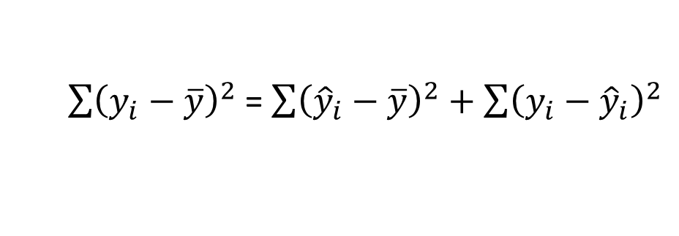
Multiple Coefficient of Determination
Relationship Among SST, SSR, SSE
SST = SSR + SSE
$\sum{{\left(y_{i}−\overline{y}\right)}^{2}}$ = $\sum{{\left({\hat{y}}_{i}−\overline{y}\right)}^{2}+\sum{{\left(y_{i}−{\hat{y}}_{i}\right)}^{2}}}$
where:
SST = total sum of squares
SSR = sum of squares due to regression
SSE = sum of squares due to error

Slide 19
Multiple Coefficient of Determination
ANOVA Output
Analysis of Variance
SOURCE
DF
SS
MS
F
P
Regression
2
500.3285
250.164
42.76
0.000
Residual Error
17
99.45697
5.850
Total
19
599.7855

Slide 20
Multiple Coefficient of Determination
R² = SSR/SST
R² = 500.3285/599.7855 = .83418

Slide 21
Adjusted Multiple Coefficient of Determination
Adding independent variables, even ones that are not statistically significant, causes the prediction errors to become smaller, thus reducing the sum of squares due to error, SSE.
Because SSR = SST – SSE, when SSE becomes smaller, SSR becomes larger, causing R² = SSR/SST to increase.
The adjusted multiple coefficient of determination compensates for the number of independent variables in the model.

Slide 22
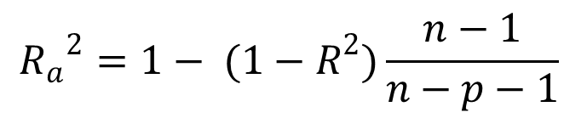
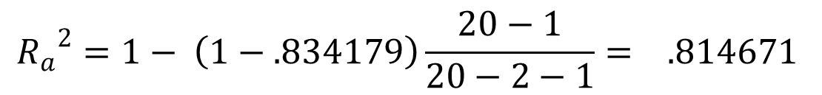
Adjusted Multiple Coefficient of Determination
$${R_{a}}^{2}=1− (1−R^{2})\frac{n−1}{n−p−1}$$
$${R_{a}}^{2}=1− \left(1−.834179\right)\frac{20−1}{20−2−1}= .814671$$

Slide 23
Assumptions About the Error Term ε
The error ε is a random variable with mean of zero.
The variance of ε , denoted by σ ², is the same for all values of the independent variables.
The values of ε are independent.
The error ε is a normally distributed random variable reflecting the deviation between the y value and the expected value of y given by β₀ + β₁x₁ + β₂x₂ + . . + β_{p}x_{p}.

Slide 24
Testing for Significance
In simple linear regression, the F and t tests provide the same conclusion.
In multiple regression, the F and t tests have different purposes.

Slide 25
Testing for Significance: F Test
The F test is used to determine whether a significant relationship exists between the dependent variable and the set of all the independent variables.
The F test is referred to as the test for overall significance.

Slide 26
Testing for Significance: t Test
If the F test shows an overall significance, the t test is used to determine whether each of the individual independent variables is significant.
A separate t test is conducted for each of the independent variables in the model.
We refer to each of these t tests as a test for individual significance.

Slide 27
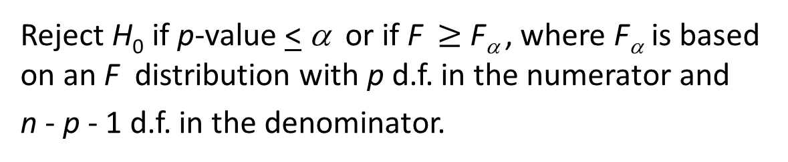
Testing for Significance: F Test
Hypotheses
H₀: β₁ = β₂ = . . . = β_{p} = 0
H_{a}: One or more of the parameters is not equal to zero
Test Statistics
F = MSR/MSE
Rejection Rule
Reject H₀ if p-value < α or if F $≥$ F_{α} , where F_{α} is based on an F distribution with p d.f. in the numerator and
n - p - 1 d.f. in the denominator.

Slide 28
F Test for Overall Significance
Hypotheses
H₀: β₁ = β₂ = 0
H_{a}: One or both of the parameters is not equal to zero.
For α = .05 and d.f. = 2, 17; F_{.05} = 3.59
Reject H₀ if p-value < .05 or F > 3.59
Rejection Rule

Slide 29
F Test for Overall Significance
ANOVA Output
Analysis of Variance
SOURCE
DF
SS
MS
F
P
Regression
2
500.3285
250.164
42.76
0.000
Residual Error
17
99.45697
5.850
Total
19
599.7855
p-value used to test for
overall significance

Slide 30
F Test for Overall Significance
Test Statistics
F = MSR/MSE
= 250.16/5.85 = 42.76
Conclusion
p-value < .05, so we can reject H₀.
(Also, F = 42.76 > 3.59)

Slide 31
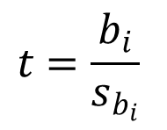
Testing for Significance: t Test
Hypotheses
H₀: β_{i} = 0
H_{a}: β_{i} ≠ 0
$$t=\frac{b_{i}}{s_{b_{i}}}$$
Test Statistics
Rejection Rule
Reject H₀ if p-value < α or if t < -t_{α/2} or t > t_{α/2}
where t_{α/2} is based on a t distribution with n - p – 1
degrees of freedom.

Slide 32
t Test for Significance of Individual Parameters
Hypotheses
H₀: b_{i} = 0
H_{a}: b_{i} ≠ 0
Rejection Rule
For α = .05 and d.f. = 17, t_{.025} = 2.11
Reject H₀ if p-value < .05, or if t < -2.11 or t > 2.11

Slide 33
t Test for Significance of Individual Parameters
Regression Equation Output
Predictor
Coef
SE Coef
T
p
Constant
3.17394
6.15607
0.5156
0.61279
Experience
1.4039
0.19857
7.0702
1.9E-06
Test Score
0.25089
0.07735
3.2433
0.00478

Slide 34
t Test for Significance of Individual Parameters
Regression Equation Output
Predictor
Coef
SE Coef
T
p
Constant
3.17394
6.15607
0.5156
0.61279
Experience
1.4039
0.19857
7.0702
1.9E-06
Test Score
0.25089
0.07735
3.2433
0.00478
t statistic and p-value used to test for
the individual significance of “Test Score”

Slide 35
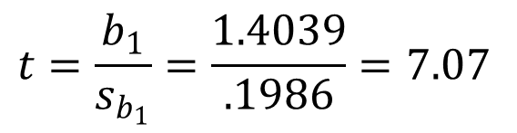
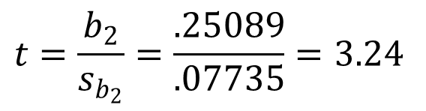
t Test for Significance of Individual Parameters
$$t=\frac{b_{1}}{s_{b_{1}}}=\frac{1.4039}{.1986}=7.07$$
Test Statistics
$$t=\frac{b_{2}}{s_{b_{2}}}=\frac{.25089}{.07735}=3.24$$
Conclusions
Reject both H₀: β₁ = 0 and H₀: β₂ = 0.
Both independent variables are significant.

Slide 36
Testing for Significance: Multicollinearity
The term multicollinearity refers to the correlation among the independent variables.
When the independent variables are highly correlated (say, |r |> .7), it is not possible to determine the separate effect of any particular independent variable on the dependent variable.

Slide 37
Testing for Significance: Multicollinearity
If the estimated regression equation is to be used only for predictive purposes, multicollinearity is usually not a serious problem.
Every attempt should be made to avoid including independent variables that are highly correlated.

Slide 38
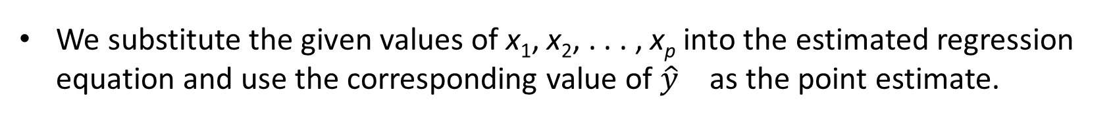
Using the Estimated Regression Equation for Estimation and Prediction
The procedures for estimating the mean value of y and predicting an individual value of y in multiple regression are similar to those in simple regression.
We substitute the given values of x₁, x₂, . . . , x_{p} into the estimated regression equation and use the corresponding value of ${\hat{y}}_{}$ as the point estimate.

Slide 39
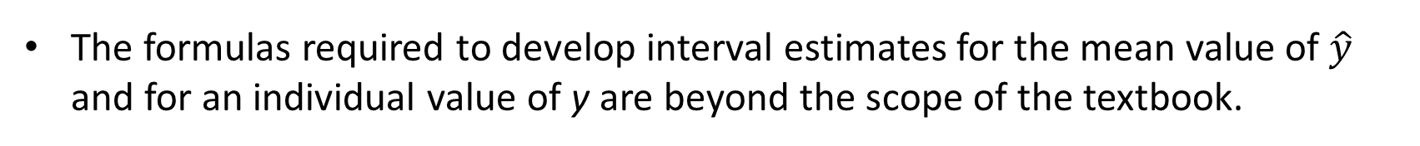
Using the Estimated Regression Equation for Estimation and Prediction
The formulas required to develop interval estimates for the mean value of $\hat{y}$ and for an individual value of y are beyond the scope of the textbook.
Software packages for multiple regression will often provide these interval estimates.

Slide 40

Residual Analysis
For simple linear regression the residual plot against $\hat{y}$and the residual plot against x provide the same information.
In multiple regression analysis it is preferable to use the residual plot against $\hat{y}$ to determine if the model assumptions are satisfied.

Slide 41
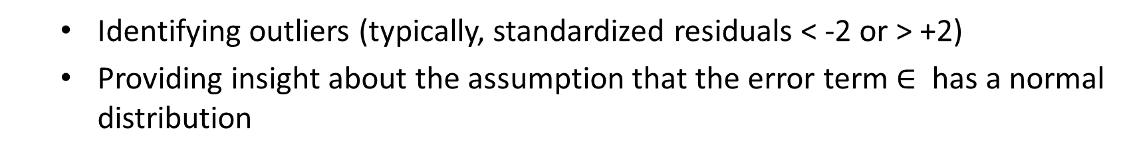
Standardized Residual Plot Against$\hat{y}$
Standardized residuals are frequently used in residual plots for purposes of:
Identifying outliers (typically, standardized residuals < -2 or > +2)
Providing insight about the assumption that the error term $∈$ has a normal distribution
The computation of the standardized residuals in multiple regression analysis is too complex to be done by hand.
Excel’s Regression tool can be used.

Slide 42
Standardized Residual Plot Against$\hat{y}$
Residual Output
Observation
Predicted Y
Residuals
Standard Residuals
1
27.89626
-3.89626
-1.771707
2
37.95204
5.047957
2.295406
3
26.02901
-2.32901
-1.059048
4
32.11201
2.187986
0.994921
5
36.34251
-0.54251
-0.246689

Slide 43
Standardized Residual Plot Against$\hat{y}$
Standardized Residual Plot
3
2
1
Standard
Residuals
0
0
10
20
30
40
50
-1
-2
-3
Predicted Salary

Slide 44
Categorical Independent Variables
In many situations we must work with categorical independent variables such as gender (male, female), method of payment (cash, check, credit card), etc.
For example, x₂ might represent gender where x₂ = 0 indicates male and x₂ = 1 indicates female.
In this case, x₂ is called a dummy or indicator variable.

Slide 45
Categorical Independent Variables
Example: Programmer Salary Survey
As an extension of the problem involving the computer programmer salary survey, suppose that management also believes that the annual salary is related to whether the individual has a graduate degree in computer science or information systems.
The years of experience, the score on the programmer aptitude test, whether the individual has a relevant graduate degree, and the annual salary ($1000) for each of the sampled 20 programmers are shown on the next slide.

Slide 46
Categorical Independent Variables
Exper.
(Yrs.)
Test
Score
Salary
($1000)
Exper.
(Yrs.)
Test
Score
Salary
($1000)
Degr.
Degr.
4
7
1
5
8
10
0
1
6
6
78
100
86
82
86
84
75
80
83
91
No
Yes
No
Yes
Yes
Yes
No
No
No
Yes
24.0
43.0
23.7
34.3
35.8
38.0
22.2
23.1
30.0
33.0
9
2
10
5
6
8
4
6
3
3
88
73
75
81
74
87
79
94
70
89
Yes
No
Yes
No
No
Yes
No
Yes
No
No
38.0
26.6
36.2
31.6
29.0
34.0
30.1
33.9
28.2
30.0

Slide 47
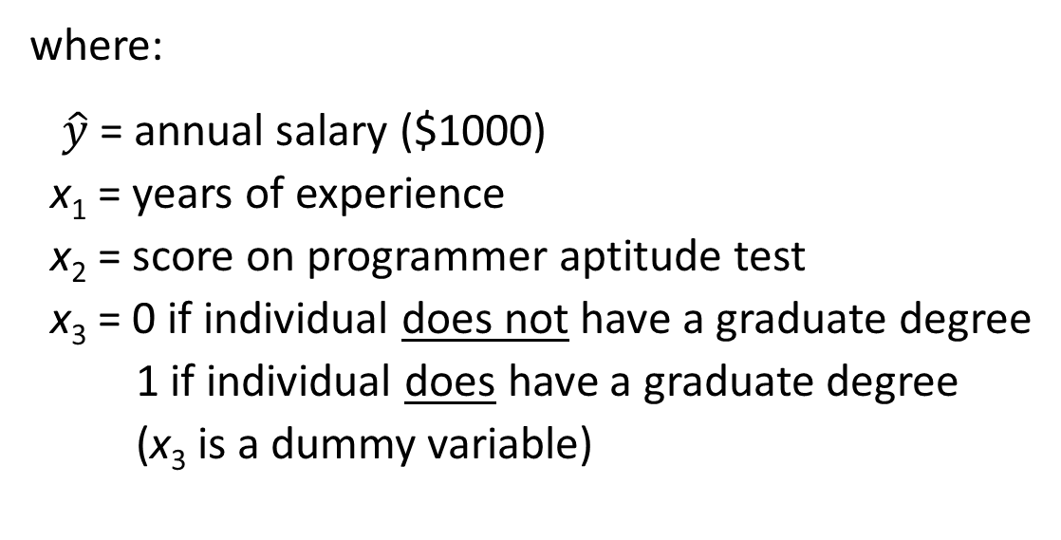
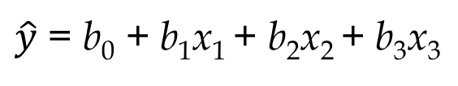
Categorical Independent Variables
Regression Equation Output
$\hat{y}$ = b₀ + b₁x₁ + b₂x₂ + b₃x₃
where:
$\hat{y}$= annual salary ($1000)
x₁ = years of experience
x₂ = score on programmer aptitude test
x₃ = 0 if individual does not have a graduate degree
1 if individual does have a graduate degree
(x₃ is a dummy variable)

Slide 48
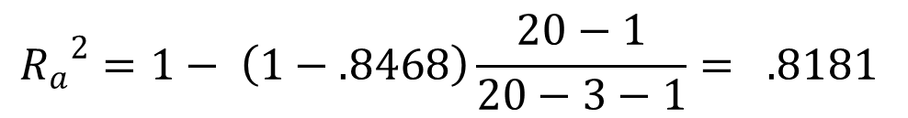
Categorical Independent Variables
ANOVA Output
Analysis of Variance
SOURCE
DF
SS
MS
F
P
Regression
3
507.8960
269.299
29.48
0.000
Residual Error
16
91.8895
5.743
Total
19
599.7855
R² = 507.896/599.7855 = .8468
Previously, R² = .8342
$${R_{a}}^{2}=1− \left(1−.8468\right)\frac{20−1}{20−3−1}= .8181$$
Previously, Adjusted
R² = .815

Slide 49
Categorical Independent Variables
Regression Equation Output
Predictor
Coef
SE Coef
T
p
Constant
7.945
7.382
1.076
0.298
Experience
1.148
0.298
3.856
0.001
Test Score
0.197
0.090
2.191
0.044
Grad. Degr.
2.280
1.987
1.148
0.268
Not significant

Slide 50
More Complex Categorical Variables
If a categorical variable has k levels, k - 1 dummy variables are required, with each dummy variable being coded as 0 or 1.
For example, a variable with levels A, B, and C could be represented by x₁ and x₂ values of (0, 0) for A, (1, 0) for B, and (0, 1) for C.
Care must be taken in defining and interpreting the dummy variables.

Slide 51
More Complex Categorical Variables
For example, a variable indicating level of education could be represented by x₁ and x₂ values as follows:
Highest
Degree x₁ x₂
Bachelor’s 0 0
Master’s 1 0
Ph.D. 0 1

Slide 52
Modeling Curvilinear Relationships
Example: Sales of Laboratory Scales
A manufacturer of laboratory scales wants to investigate the relationship between the length of employment of their salespeople and the number of
scales sold.
The table on the next slide gives the number of months each salesperson has been employed by the firm (x) and the number of scales sold (y) by 15
randomly selected salespersons.

Slide 53
Modeling Curvilinear Relationships
Example: Sales of Laboratory Scales
Months
Sales
Months
Sales
41
106
76
104
22
12
85
111
275
296
317
376
162
150
367
308
40
51
9
12
6
56
19
189
235
83
112
67
325
189

Slide 54
Modeling Curvilinear Relationships
Excel’s Chart tools can be used to develop a scatter diagram and fit a straight line to bivariate data.
The estimated regression equation and the coefficient of determination for simple linear regression can also be developed.
The results of using Excel’s Chart tools to fit a line to the data are shown on the next slide.

Slide 55
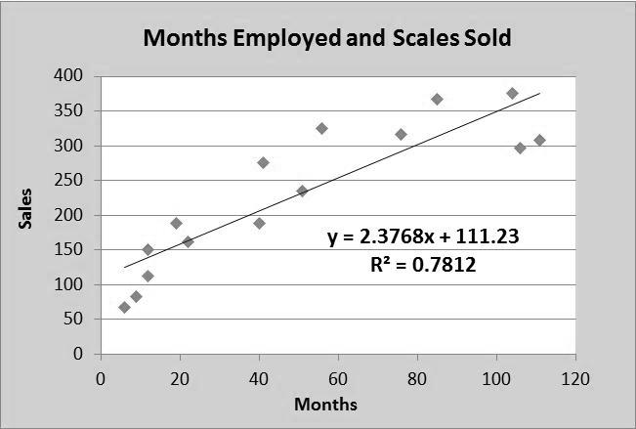
Modeling Curvilinear Relationships
Chart Tools Output

Slide 56
Modeling Curvilinear Relationships
The scatter diagram indicates a possible curvilinear relationship between the length of time employed and the number of scales sold.
So, we develop a multiple regression model with two independent variables: x and x².
y = b₀ + b₁x + b₂x² + ε
This model is often referred to as a second-order polynomial or a quadratic model.

Slide 57
Modeling Curvilinear Relationships
Excel’s Chart tools can be used to fit a polynomial curve to the data. (Dialog box is on next slide.)
To get the dialog box, position the mouse pointer over any data point in the scatter diagram and right-click.
The estimated multiple regression equation and multiple coefficient of determination for this second-order model are also obtained.

Slide 58
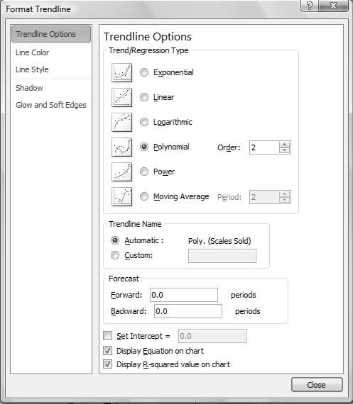
Modeling Curvilinear Relationships
Chart Tools
Dialog Box

Slide 59
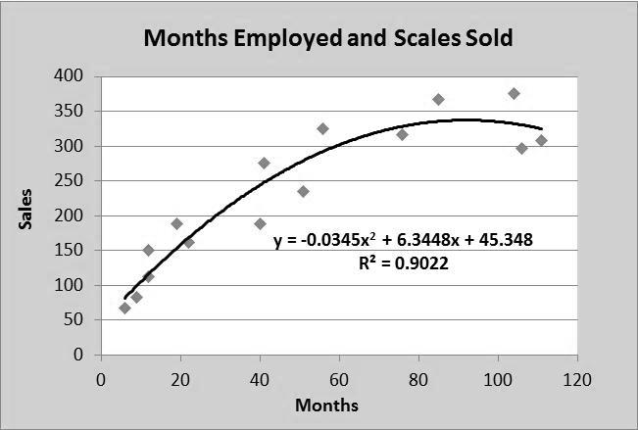
Modeling Curvilinear Relationships
Chart Tools Output

Slide 60
Modeling Curvilinear Relationships
Excel’s Chart tools output does not provide any means for testing the significance of the results, so we need to use Excel’s Regression tool.
We will treat the values of x² as a second independent variable (called MonthSq on the next slide).

Slide 61
Modeling Curvilinear Relationships
Second Independent Variable (MonthSq) Added
Months
MonthsSq
Sales
Months
MonthsSq
Sales
41
106
76
104
22
12
85
111
1681
11236
5776
10816
484
144
7225
12321
275
296
317
376
162
150
367
308
40
51
9
12
6
56
19
1600
2601
81
144
36
3136
361
189
235
83
112
67
325
189

Slide 62
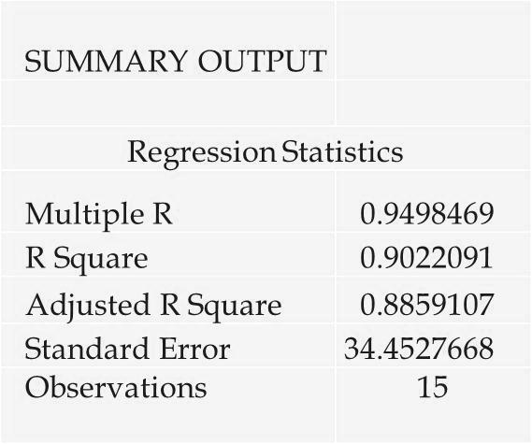
Modeling Curvilinear Relationships
Excel’s Regression Tool Output
We should be pleased with the fit provided by
the estimated multiple regression equation.

Slide 63
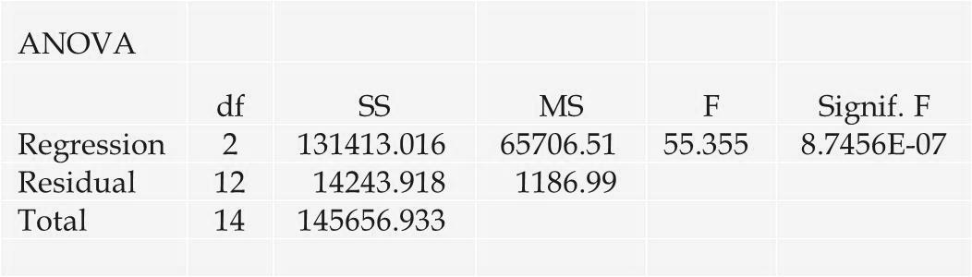
Modeling Curvilinear Relationships
Excel’s Regression Tool Output
The overall model is significant (p-value for the F test is 8.75E-07)

Slide 64
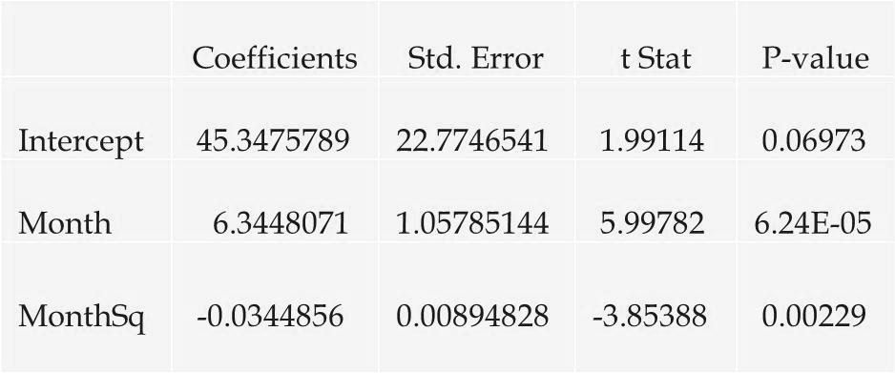
Modeling Curvilinear Relationships
Excel’s Regression Tool Output
We can conclude that adding MonthsSq to the model is significant.

Slide 65
End of Chapter 15

