Slide 1
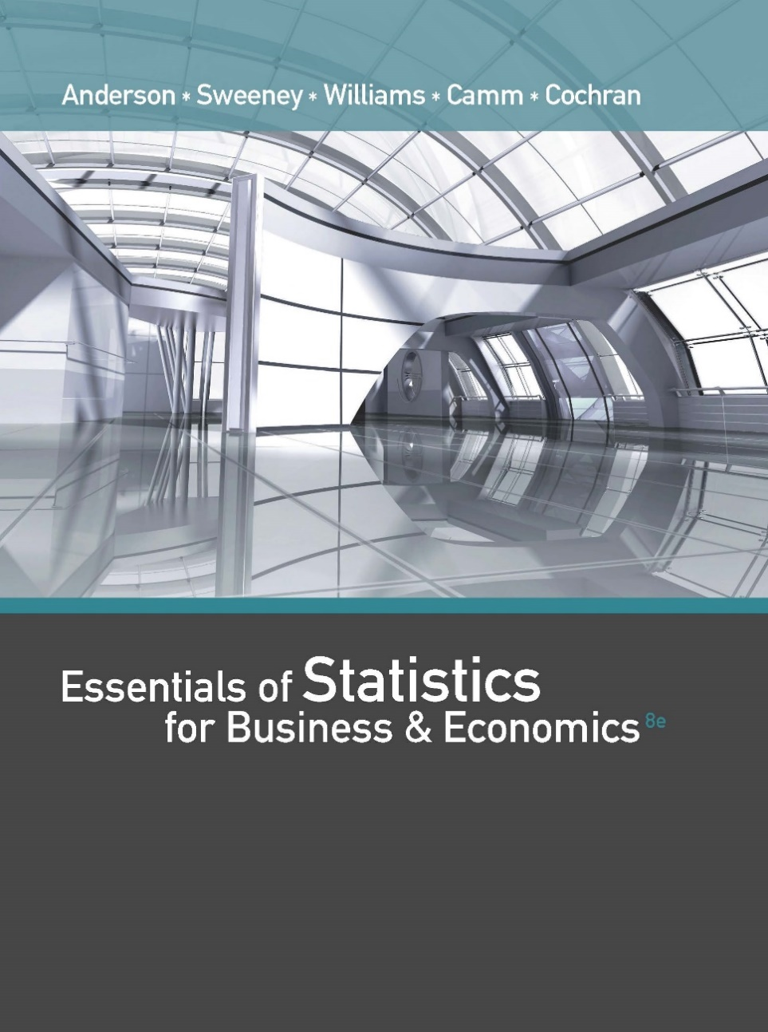
Essentials of Statistics for Business and Economics (8e)
Anderson, Sweeney, Williams, Camm, Cochran
© 2018 Cengage Learning

Slide 2
Chapter 12 Comparing Multiple Proportions, Test of Independence and Goodness of Fit
Testing For Equality of Three or More Population Proportions
Test of Independence
Goodness of Fit Test

Slide 3
Tests of Goodness of Fit, Independence, and Multiple Proportions
In this chapter we introduce three additional hypothesis-testing procedures.
The test statistic and the distribution used are based on the chi-square (χ²) distribution.
In all cases, the data are categorical.

Slide 4
Testing the Equality of Population Proportions
for Three or More Populations
Using the notation
p₁ = population proportion for population 1
p₂ = population proportion for population 2
p_{k} = population proportion for population k
The hypotheses for the equality of population proportions for k > 3 populations are as follows:
H₀: p₁ = p₂ = . . . = p_{k}
H_{a}: Not all population proportions are equal

Slide 5
Testing the Equality of Population Proportions
for Three or More Populations
If H₀ cannot be rejected, we cannot detect a difference among the k population proportions.
If H₀ can be rejected, we can conclude that not all k population proportions are equal.
Further analyses can be done to conclude which population proportions are significantly different from others.

Slide 6
Testing the Equality of Population Proportions
for Three or More Populations
Example: Finger Lakes Homes
Finger Lakes Homes manufactures three models of prefabricated homes, a two-story colonial, a log cabin, and an A-frame. To help in product-line planning, management would like to compare the customer satisfaction with the three home styles.
p₁ = proportion likely to repurchase a Colonial for the population of Colonial owners
p₂ = proportion likely to repurchase a Log Cabin for the population of Log Cabin owners
p₃ = proportion likely to repurchase an A-Frame for the population of A-Frame owners

Slide 7
Testing the Equality of Population Proportions
for Three or More Populations
We begin by taking a sample of owners from each of the three populations.
Each sample contains categorical data indicating whether the respondents are likely or not likely to repurchase the home.

Slide 8
Testing the Equality of Population Proportions
for Three or More Populations
Observed Frequencies (sample results)
Home Owner
Colonial Log A-Frame Total
Likely to Yes 97 83 80 260
Repurchase No 38 18 44 100
Total 135 101 124 360

Slide 9
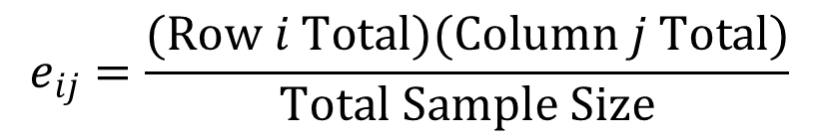
Testing the Equality of Population Proportions
for Three or More Populations
Next, we determine the expected frequencies under the assumption H₀ is correct.
Expected Frequencies
Under the Assumption H₀ is True
$$e_{ij}=\frac{(Row i Total)(Column j Total)}{Total Sample Size}$$
If a significant difference exists between the observed and expected frequencies, H₀ can be rejected.

Slide 10
Testing the Equality of Population Proportions
for Three or More Populations
Expected Frequencies (computed)
Home Owner
Colonial Log A-Frame Total
Likely to Yes 97.50 72.94 89.56 260
Repurchase No 37.50 28.06 34.44 100
Total 135 101 124 360

Slide 11
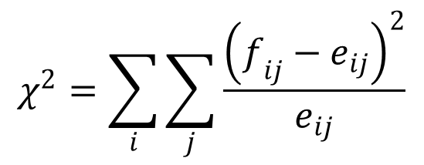
Testing the Equality of Population Proportions
for Three or More Populations
Next, compute the value of the chi-square test statistic.
$$χ^{2}=\sum_{i}{\sum_{j}{\frac{{\left(f_{ij}−e_{ij}\right)}^{2}}{e_{ij}}}}$$
where:
f_{ij} = observed frequency for the cell in row i and column j
e_{ij} = expected frequency for the cell in row i and column j
under the assumption H₀ is true
Note: The test statistic has a chi-square distribution with k – 1 degrees of freedom, provided the expected frequency is 5 or more for each cell.

Slide 12
Testing the Equality of Population Proportions
for Three or More Populations
Computation of the Chi-Square Test Statistic.
 |  | Obs. | Exp. |  | Sqd. | Sqd. Diff. /
Likely to | Home | Freq. | Freq. | Diff. | Diff. | Exp. Freq.
Repurchase | Owner | f_{ij} | e_{ij} | (f_{ij} - e_{ij}) | (f_{ij} - e_{ij})² | (f_{ij} - e_{ij})²/e_{ij}
Yes | Colonial | 97 | 97.50 | -0.50 | 0.2500 | 0.0026
Yes | Log Cab. | 83 | 72.94 | 10.06 | 101.1142 | 1.3862
Yes | A-Frame | 80 | 89.56 | -9.56 | 91.3086 | 1.0196
No | Colonial | 38 | 37.50 | 0.50 | 0.2500 | 0.0067
No | Log Cab. | 18 | 28.06 | -10.06 | 101.1142 | 3.6041
No | A-Frame | 44 | 34.44 | 9.56 | 91.3086 | 2.6509
 | Total | 360 | 360 |  | χ² = | 8.6700

Slide 13
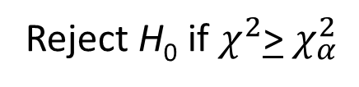
Testing the Equality of Population Proportions
for Three or More Populations
Rejection Rule
p-value approach:
Reject H₀ if p-value < α
Critical value approach:
Reject H₀ if $χ^{2}$> $χ_{α}^{2}$
where α is the significance level and there are k - 1 degrees of freedom

Slide 14
Testing the Equality of Population Proportions
for Three or More Populations
Rejection Rule (using α = .05)
Reject H₀ if p-value < .05 or χ² > 5.991
With α = .05 and
k - 1 = 3 - 1 = 2
degrees of freedom
Do Not Reject H₀
Reject H₀
χ²
5.991

Slide 15
Testing the Equality of Population Proportions
for Three or More Populations
Conclusion Using the p-Value Approach
Area in Upper Tail .10 .05 .025 .01 .005
χ² Value (df = 2) 4.605 5.991 7.378 9.210 10.597
Because χ² = 8.670 is between 9.210 and 7.378, the area in the upper tail of the distribution is between .01 and .025.
The p-value < α . We can reject the null hypothesis.
(Actual p-value is .0131)

Slide 16
Testing the Equality of Population Proportions
for Three or More Populations
We have concluded that the population proportions for the three populations of home owners are not equal.
To identify where the differences between population proportions exist, we will rely on a multiple comparisons procedure.

Slide 17
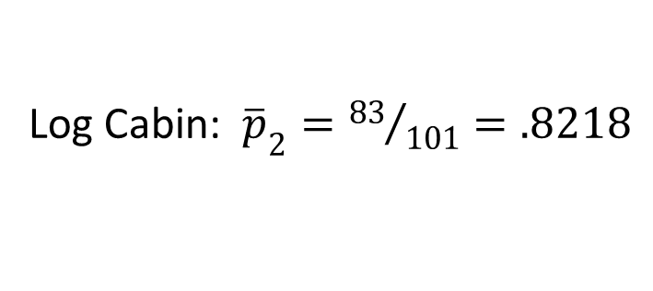
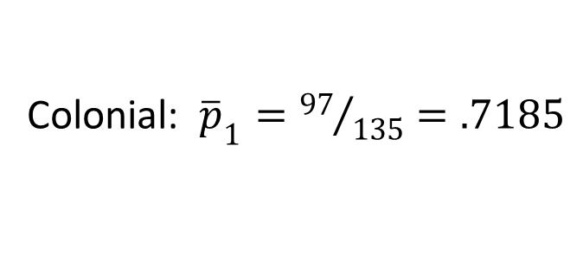
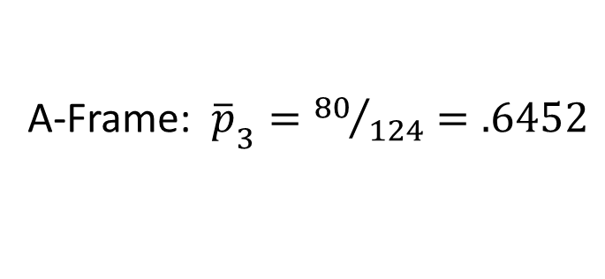
Multiple Comparisons Procedure
We begin by computing the three sample proportions.
Colonial: ${\overline{p}}_{1}={97}/{135}=.7185$
Log Cabin: ${\overline{p}}_{2}={83}/{101}=.8218$
A-Frame: ${\overline{p}}_{3}={80}/{124}=.6452$
We will use a multiple comparison procedure known as the Marascuilo procedure.

Slide 18
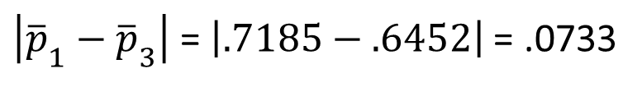
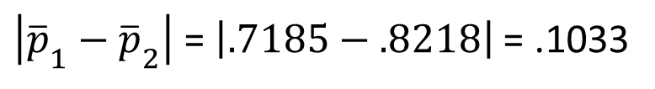
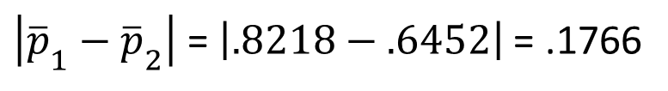
Multiple Comparisons Procedure
Marascuilo Procedure
We compute the absolute value of the pairwise difference between sample proportions.
Colonial and Log Cabin:
$\left|{\overline{p}}_{1}−{\overline{p}}_{2}\right|$ = $\left|.7185−.8218\right|$= .1033
Colonial and A-Frame:
$\left|{\overline{p}}_{1}−{\overline{p}}_{3}\right|$ = $\left|.7185−.6452\right|$= .0733
Log Cabin and A-Frame:
$\left|{\overline{p}}_{1}−{\overline{p}}_{2}\right|$ = $\left|.8218−.6452\right|$= .1766

Slide 19
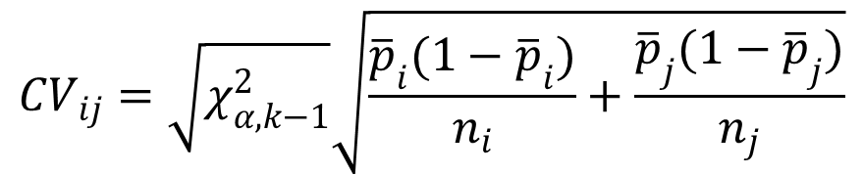
Multiple Comparisons Procedure
Critical Values for the Marascuilo Pairwise Comparison
For each pairwise comparison compute a critical value as follows:
$${CV}_{ij}=\sqrt{χ_{α,k−1}^{2}}\sqrt{\frac{{\overline{p}}_{i}(1−{\overline{p}}_{i})}{n_{i}}+\frac{{\overline{p}}_{j}(1−{\overline{p}}_{j})}{n_{j}}}$$
For α = .05 and k = 3: χ² = 5.991

Slide 20


Multiple Comparisons Procedure
Pairwise Comparison Tests
Significant if
Pairwise Comparison
$$\left|{\overline{p}}_{i}−{\overline{p}}_{j}\right|$$
CV_{ij}
$$\left|{\overline{p}}_{i}−{\overline{p}}_{j}\right|$$
> CV_{ij}
.1033
.0733
.1766
.1329
.1415
.1405
Not Significant
Colonial vs. Log Cabin
Colonial vs. A-Frame
Not Significant
Log Cabin vs. A-Frame
Significant

Slide 21
Goodness of Fit Test:
Multinomial Probability Distribution
1. State the null and alternative hypotheses.
H₀: The population follows a multinomial distribution with specified probabilities for each of the k categories
H_{a}: The population does not follow a multinomial distribution with specified probabilities for each of the k categories

Slide 22
Goodness of Fit Test:
Multinomial Probability Distribution
2. Select a random sample and record the observed frequency, f_{i} , for each of the k categories.
3. Assuming H₀ is true, compute the expected frequency, e_{i} , in each category by multiplying the category probability by the sample size.

Slide 23
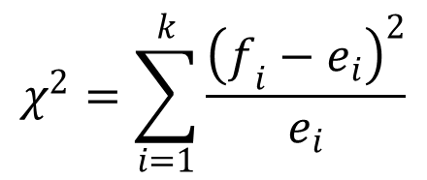
Goodness of Fit Test:
Multinomial Probability Distribution
4. Compute the value of the test statistic.
$$χ^{2}=\sum_{i=1}^{k}{\frac{{\left(f_{i}−e_{i}\right)}^{2}}{e_{i}}}$$
where:
f_{i} = observed frequency for category i
e_{i} = expected frequency for category i
k = number of categories
Note: The test statistic has a chi-square distribution with k – 1 df provided that the expected frequencies are 5 or more for all categories.

Slide 24
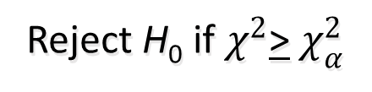
Goodness of Fit Test:
Multinomial Probability Distribution
5. Rejection rule:
p-value approach:
Reject H₀ if p-value < a
Critical value approach:
Reject H₀ if $χ^{2}$> $χ_{α}^{2}$
where α is the significance level and there are k - 1 degrees of freedom

Slide 25
Multinomial Distribution Goodness of Fit Test
Example: Finger Lakes Homes (A)
Finger Lakes Homes manufactures four models of prefabricated homes, a two-story colonial, a log cabin, a split-level, and an A-frame. To help in production planning, management would like to determine if previous customer purchases indicate that there is a preference in the style selected.

Slide 26
Multinomial Distribution Goodness of Fit Test
Example: Finger Lakes Homes (A)
The number of homes sold of each model for 100 sales over the past two years is shown below.
Split- A-
Model Colonial Log Level Frame
# Sold 30 20 35 15

Slide 27
Multinomial Distribution Goodness of Fit Test
Hypotheses
H₀: p_{C} = p_{L} = p_{S} = p_{A} = .25
H_{a}: The population proportions are not
p_{C} = .25, p_{L} = .25, p_{S} = .25, and p_{A} = .25
where:
p_{C} = population proportion that purchase a colonial
p_{L} = population proportion that purchase a log cabin
p_{S} = population proportion that purchase a split-level
p_{A} = population proportion that purchase an A-frame

Slide 28
Multinomial Distribution Goodness of Fit Test
Rejection Rule
Reject H₀ if p-value < .05 or χ² > 7.815.
With α = .05 and
k - 1 = 4 - 1 = 3
degrees of freedom
Do Not Reject H₀
Reject H₀
χ²
7.815

Slide 29
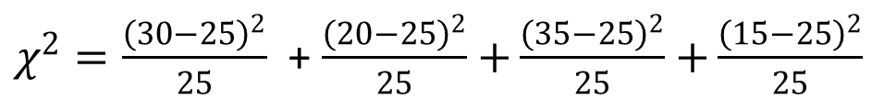
Multinomial Distribution Goodness of Fit Test
Expected Frequencies
Test Statistic
  e₁ = .25(100) = 25 e₂ = .25(100) = 25
e₃ = .25(100) = 25 e₄ = .25(100) = 25
$χ^{2}=\frac{{\left(30−25\right)}^{2}}{25}$ + $\frac{{\left(20−25\right)}^{2}}{25}$ $+\frac{{\left(35−25\right)}^{2}}{25}$ $+\frac{{\left(15−25\right)}^{2}}{25}$
= 1 + 1 + 4 + 4
= 10

Slide 30
Multinomial Distribution Goodness of Fit Test
Conclusion Using the p-Value Approach
Area in Upper Tail .10 .05 .025 .01 .005
χ² Value (df = 3) 6.251 7.815 9.348 11.345 12.838
Because χ² = 10 is between 9.348 and 11.345, the area in the upper tail of the distribution is between .025 and .01.
The p-value < α . We can reject the null hypothesis.

Slide 31
Multinomial Distribution Goodness of Fit Test
Conclusion Using the Critical Value Approach
χ² = 10 > 7.815
We reject, at the .05 level of significance, the assumption that there is no home style preference.

Slide 32
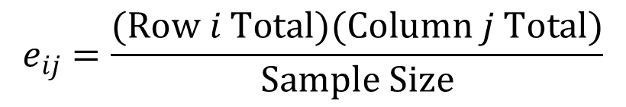
Test of Independence
1. Set up the null and alternative hypotheses.
H₀: The column variable is independent of the row variable
H_{a}: The column variable is not independent of the row variable
2. Select a random sample and record the observed frequency, f_{ij} , for each cell of the contingency table.
3. Compute the expected frequency, e_{ij} , for each cell.
$$e_{ij}=\frac{(Row i Total)(Column j Total)}{Sample Size}$$

Slide 33

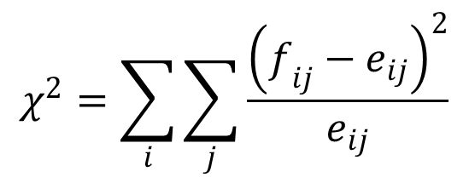
Test of Independence
4. Compute the test statistic.
$$χ^{2}=\sum_{i}{\sum_{j}{\frac{{\left(f_{ij}−e_{ij}\right)}^{2}}{e_{ij}}}}$$
5. Determine the rejection rule.
Reject H₀ if p -value < a or $χ^{2}$> $χ_{α}^{2}$.
where α is the significance level and, with n rows and m columns, there are (n - 1)(m - 1) degrees of freedom.

Slide 34
Test of Independence
Example: Finger Lakes Homes (B)
Each home sold by Finger Lakes Homes can be classified according to price and to style. Finger Lakes’ manager would like to determine if the
price of the home and the style of the home are independent variables.

Slide 35
Test of Independence
Example: Finger Lakes Homes (B)
The number of homes sold for each model and price for the past two years is shown below. For convenience, the price of the home is listed as either less than $200,000 or more than or equal to $200,000.
Price Colonial Log Split-Level A-Frame
< $200,000 18 6 19 12
> $200,000 12 14 16 3

Slide 36
Test of Independence
Hypotheses
H₀: Price of the home is independent of the style of the home that is purchased
H_{a}: Price of the home is not independent of the style of the home that is purchased

Slide 37
Test of Independence
Expected Frequencies
Price Colonial Log Split-Level A-Frame Total
< $200K
> $200K
Total
18 6 19 12 55
12 14 16 3 45
30 20 35 15 100

Slide 38
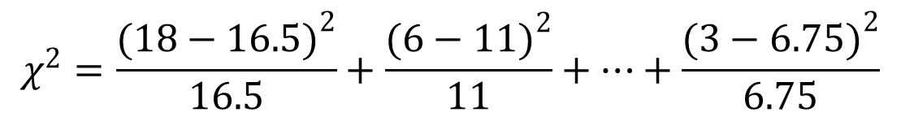
Test of Independence
Rejection Rule
With α = .05 and (2 - 1)(4 - 1) = 3 d.f., $χ_{α}^{2}=7.815$
Reject H₀ if p-value < .05 or χ² > 7.815
Test Statistic
$$χ^{2}=\frac{{(18−16.5)}^{2}}{16.5}+\frac{{(6−11)}^{2}}{11}+…+\frac{{(3−6.75)}^{2}}{6.75}$$
= .1364 + 2.2727 + . . . + 2.0833 = 9.149

Slide 39
Test of Independence
Conclusion Using the p-Value Approach
Area in Upper Tail .10 .05 .025 .01 .005
χ² Value (df = 3) 6.251 7.815 9.348 11.345 12.838
Because χ² = 9.145 is between 7.815 and 9.348, the area in the upper tail of the distribution is between .05 and .025.
The p-value < α . We can reject the null hypothesis.
(Actual p-value is .0274)

Slide 40
Test of Independence
Conclusion Using the Critical Value Approach
χ² = 9.145 > 7.815
We reject at the .05 level of significance, the assumption that the price of the home is independent of the style of home that is purchased.

Slide 41
Testing the Equality of Population Proportions
for Three or More Populations
Using the notation
p₁ = population proportion for population 1
p₂ = population proportion for population 2
p_{k} = population proportion for population k
The hypotheses for the equality of population proportions for k > 3 populations are as follows:
H₀: p₁ = p₂ = . . . = p_{k}
H_{a}: Not all population proportions are equal

Slide 42
Testing the Equality of Population Proportions
for Three or More Populations
If H₀ cannot be rejected, we cannot detect a difference among the k population proportions.
If H₀ can be rejected, we can conclude that not all k population proportions are equal.
Further analyses can be done to conclude which population proportions are significantly different from others.

Slide 43
Testing the Equality of Population Proportions
for Three or More Populations
Example: Finger Lakes Homes
Finger Lakes Homes manufactures three models of prefabricated homes, a two-story colonial, a log cabin, and an A-frame. To help in product-line planning, management would like to compare the customer satisfaction with the three home styles.
p₁ = proportion likely to repurchase a Colonial for the population of Colonial owners
p₂ = proportion likely to repurchase a Log Cabin for the population of Log Cabin owners
p₃ = proportion likely to repurchase an A-Frame for the population of A-Frame owners

Slide 44
Testing the Equality of Population Proportions
for Three or More Populations
We begin by taking a sample of owners from each of the three populations.
Each sample contains categorical data indicating whether the respondents are likely or not likely to repurchase the home.

Slide 45
Testing the Equality of Population Proportions
for Three or More Populations
Observed Frequencies (sample results)
Home Owner
Colonial Log A-Frame Total
Likely to Yes 97 83 80 260
Repurchase No 38 18 44 100
Total 135 101 124 360

Slide 46
Testing the Equality of Population Proportions
for Three or More Populations
Next, we determine the expected frequencies under the assumption H₀ is correct.
Expected Frequencies
Under the Assumption H₀ is True
$$e_{ij}=\frac{(Row i Total)(Column j Total)}{Total Sample Size}$$
If a significant difference exists between the observed and expected frequencies, H₀ can be rejected.

Slide 47
Testing the Equality of Population Proportions
for Three or More Populations
Expected Frequencies (computed)
Home Owner
Colonial Log A-Frame Total
Likely to Yes 97.50 72.94 89.56 260
Repurchase No 37.50 28.06 34.44 100
Total 135 101 124 360

Slide 48
Testing the Equality of Population Proportions
for Three or More Populations
Next, compute the value of the chi-square test statistic.
$$χ^{2}=\sum_{i}{\sum_{j}{\frac{{\left(f_{ij}−e_{ij}\right)}^{2}}{e_{ij}}}}$$
where:
f_{ij} = observed frequency for the cell in row i and column j
e_{ij} = expected frequency for the cell in row i and column j
under the assumption H₀ is true
Note: The test statistic has a chi-square distribution with k – 1 degrees of freedom, provided the expected frequency is 5 or more for each cell.

Slide 49
Testing the Equality of Population Proportions
for Three or More Populations
Computation of the Chi-Square Test Statistic.
 |  | Obs. | Exp. |  | Sqd. | Sqd. Diff. /
Likely to | Home | Freq. | Freq. | Diff. | Diff. | Exp. Freq.
Repurchase | Owner | f_{ij} | e_{ij} | (f_{ij} - e_{ij}) | (f_{ij} - e_{ij})² | (f_{ij} - e_{ij})²/e_{ij}
Yes | Colonial | 97 | 97.50 | -0.50 | 0.2500 | 0.0026
Yes | Log Cab. | 83 | 72.94 | 10.06 | 101.1142 | 1.3862
Yes | A-Frame | 80 | 89.56 | -9.56 | 91.3086 | 1.0196
No | Colonial | 38 | 37.50 | 0.50 | 0.2500 | 0.0067
No | Log Cab. | 18 | 28.06 | -10.06 | 101.1142 | 3.6041
No | A-Frame | 44 | 34.44 | 9.56 | 91.3086 | 2.6509
 | Total | 360 | 360 |  | χ² = | 8.6700

Slide 50
Testing the Equality of Population Proportions
for Three or More Populations
Rejection Rule
p-value approach:
Reject H₀ if p-value < α
Critical value approach:
Reject H₀ if $χ^{2}$> $χ_{α}^{2}$
where α is the significance level and there are k - 1 degrees of freedom

Slide 51
Testing the Equality of Population Proportions
for Three or More Populations
Rejection Rule (using α = .05)
Reject H₀ if p-value < .05 or χ² > 5.991
With α = .05 and
k - 1 = 3 - 1 = 2
degrees of freedom
Do Not Reject H₀
Reject H₀
χ²
5.991

Slide 52
Testing the Equality of Population Proportions
for Three or More Populations
Conclusion Using the p-Value Approach
Area in Upper Tail .10 .05 .025 .01 .005
χ² Value (df = 2) 4.605 5.991 7.378 9.210 10.597
Because χ² = 8.670 is between 9.210 and 7.378, the area in the upper tail of the distribution is between .01 and .025.
The p-value < α . We can reject the null hypothesis.
(Actual p-value is .0131)

Slide 53
Testing the Equality of Population Proportions
for Three or More Populations
We have concluded that the population proportions for the three populations of home owners are not equal.
To identify where the differences between population proportions exist, we will rely on a multiple comparisons procedure.

Slide 54
Multiple Comparisons Procedure
We begin by computing the three sample proportions.
Colonial: ${\overline{p}}_{1}={97}/{135}=.7185$
Log Cabin: ${\overline{p}}_{2}={83}/{101}=.8218$
A-Frame: ${\overline{p}}_{3}={80}/{124}=.6452$
We will use a multiple comparison procedure known as the Marascuillo procedure.

Slide 55
Multiple Comparisons Procedure
Marascuillo Procedure
We compute the absolute value of the pairwise difference between sample proportions.
Colonial and Log Cabin:
$\left|{\overline{p}}_{1}−{\overline{p}}_{2}\right|$ = $\left|.7185−.8218\right|$= .1033
Colonial and A-Frame:
$\left|{\overline{p}}_{1}−{\overline{p}}_{3}\right|$ = $\left|.7185−.6452\right|$= .0733
Log Cabin and A-Frame:
$\left|{\overline{p}}_{1}−{\overline{p}}_{2}\right|$ = $\left|.8218−.6452\right|$= .1766

Slide 56
Multiple Comparisons Procedure
Critical Values for the Marascuillo Pairwise Comparison
For each pairwise comparison compute a critical value as follows:
$${CV}_{ij}=\sqrt{χ_{α,k−1}^{2}}\sqrt{\frac{{\overline{p}}_{i}(1−{\overline{p}}_{i})}{n_{i}}+\frac{{\overline{p}}_{j}(1−{\overline{p}}_{j})}{n_{j}}}$$
For α = .05 and k = 3: χ² = 5.991

Slide 57
Multiple Comparisons Procedure
Pairwise Comparison Tests
Significant if
Pairwise Comparison
$$\left|{\overline{p}}_{i}−{\overline{p}}_{j}\right|$$
CV_{ij}
$$\left|{\overline{p}}_{i}−{\overline{p}}_{j}\right|$$
> CV_{ij}
.1033
.0733
.1766
.1329
.1415
.1405
Not Significant
Colonial vs. Log Cabin
Colonial vs. A-Frame
Not Significant
Log Cabin vs. A-Frame
Significant

Slide 58
End of Chapter 12

