Slide 1
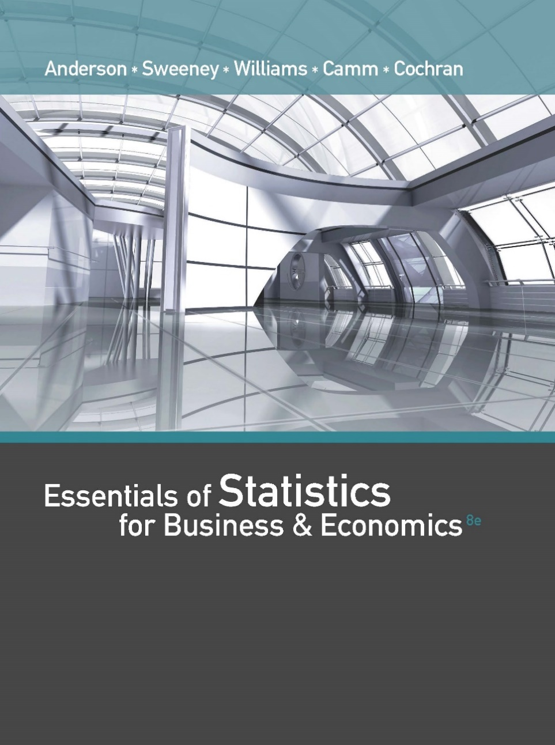
Essentials of Statistics for Business and Economics (8e)
Anderson, Sweeney, Williams, Camm, Cochran
© 2018 Cengage Learning

Slide 2
Chapter 10, Part B
Inference About Means and Proportions with Two Populations
Inferences About the Difference Between Two Population Proportions

Slide 3
Inferences About the Difference Between Two Population Proportions
Interval Estimation of p₁ - p₂
Hypothesis Tests About p₁ - p₂

Slide 4
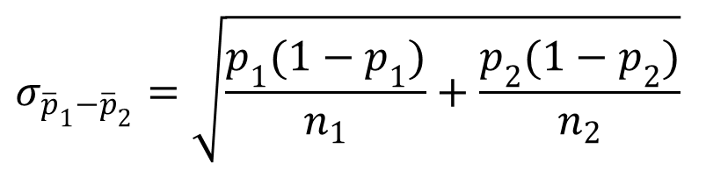

Sampling Distribution of ${\overline{p}}_{1}−{\overline{p}}_{2}$
Expected Value
$$E\left({\overline{p}}_{1}−{\overline{p}}_{2}\right)=p_{1}−p_{2}$$
Standard Deviation (Standard Error)
$$σ_{{\overline{p}}_{1}−{\overline{p}}_{2}}=\sqrt{\frac{p_{1}(1−p_{1})}{n_{1}}+\frac{p_{2}(1−p_{2})}{n_{2}}}$$
where: n₁ = size of sample taken from population 1
n₂ = size of sample taken from population 2

Slide 5

Sampling Distribution of ${\overline{p}}_{1}−{\overline{p}}_{2}$
If the sample sizes are large, the sampling distribution of ${\overline{p}}_{1}−{\overline{p}}_{2}$ can be approximated by a normal probability distribution.
The sample sizes are sufficiently large if all of these conditions are met:
n₁p₁ > 5 and
n₁(1 - p₁) > 5
n₂p₂ > 5 and
n₂(1 - p₂) > 5

Slide 6

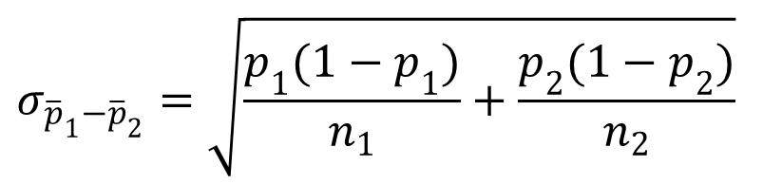
Sampling Distribution of ${\overline{p}}_{1}−{\overline{p}}_{2}$
$$σ_{{\overline{p}}_{1}−{\overline{p}}_{2}}=\sqrt{\frac{p_{1}(1−p_{1})}{n_{1}}+\frac{p_{2}(1−p_{2})}{n_{2}}}$$
$${\overline{p}}_{1}−{\overline{p}}_{2}$$
p₁ – p₂

Slide 7
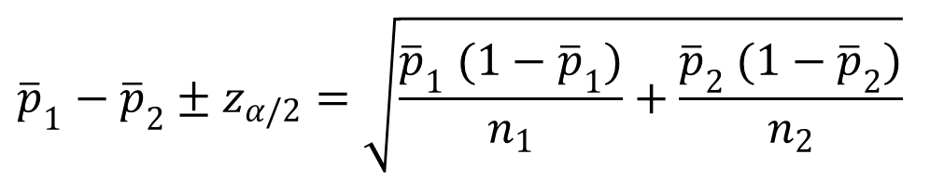
Interval Estimation of p₁ - p₂
Interval Estimate
$${\overline{p}}_{1}−{\overline{p}}_{2}±z_{α/2}=\sqrt{\frac{{\overline{p}}_{1} (1−{\overline{p}}_{1})}{n_{1}}+\frac{{\overline{p}}_{2} (1−{\overline{p}}_{2})}{n_{2}}}$$

Slide 8
Interval Estimation of p₁ - p₂
Example: Market Research Associates
Market Research Associates is conducting research to evaluate the effectiveness of a client’s new advertising campaign. Before the new campaign began, a telephone survey of 150 households in the test market
area showed 60 households “aware” of the client’s product.
The new campaign has been initiated with TV and newspaper advertisements running for three weeks.

Slide 9
Interval Estimation of p₁ - p₂
Example: Market Research Associates
A survey conducted immediately after the new campaign showed 120 of 250 households “aware” of the client’s product. Does the data support the position that the advertising campaign has provided an increased awareness of the client’s product?

Slide 10
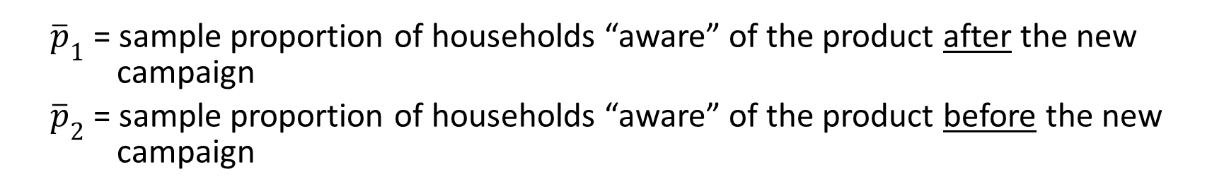
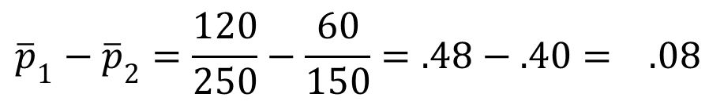
Point Estimator of the Difference Between Two Population Proportions
p₁ = proportion of the population of households “aware” of the product after the new campaign
p₂ = proportion of the population of households “aware” of the product before the new campaign
${\overline{p}}_{1}$= sample proportion of households “aware” of the product after the new campaign
${\overline{p}}_{2}$= sample proportion of households “aware” of the product before the new campaign
$${\overline{p}}_{1}−{\overline{p}}_{2}=\frac{120}{250}−\frac{60}{150}=.48−.40= .08$$

Slide 11
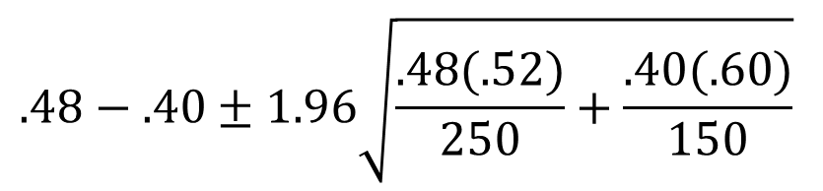
Interval Estimation of p₁ - p₂
For α = .05, z_{.025} = 1.96:
$$.48−.40±1.96\sqrt{\frac{.48(.52)}{250}+\frac{.40(.60)}{150}}$$
.08 + 1.96(.0510)
.08 + .10
Hence, the 95% confidence interval for the difference in
before and after awareness of the product is -.02 to +.18.

Slide 12
Hypothesis Tests about p₁ - p₂
Hypotheses
We focus on tests involving no difference between
the two population proportions (i.e. p₁ = p₂)
H₀: p₁ – p₂ > 0
H₀: p₁ – p₂ < 0
H₀: p₁ – p₂ = 0
H_{a}: p₁ – p₂ < 0
H_{a}: p₁ – p₂ > 0
H_{a}: p₁ – p₂ ≠ 0
Left-tailed
Right-tailed
Two-tailed

Slide 13

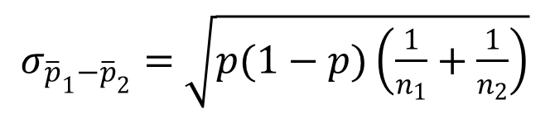
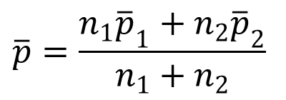
Hypothesis Tests about p₁ - p₂
Standard Error of ${\overline{p}}_{1}−{\overline{p}}_{2}$ when p₁ = p₂ = p
$σ_{{\overline{p}}_{1}−{\overline{p}}_{2}}=$ $\sqrt{p(1−p)\left(\frac{1}{n_{1}}+\frac{1}{n_{2}}\right)}$
Pooled Estimator of p when p₁ = p₂ = p
$$\overline{p}=\frac{n_{1}{\overline{p}}_{1}+n_{2}{\overline{p}}_{2}}{n_{1}+n_{2}}$$

Slide 14
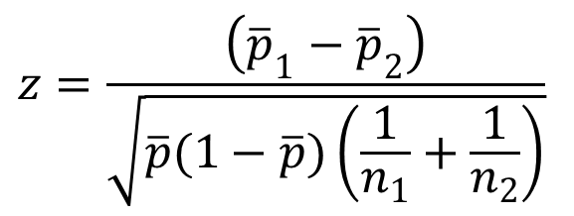
Hypothesis Tests about p₁ - p₂
Test Statistic
$$z=\frac{\left({\overline{p}}_{1}−{\overline{p}}_{2}\right)}{\sqrt{\overline{p}(1−\overline{p})\left(\frac{1}{n_{1}}+\frac{1}{n_{2}}\right)}}$$

Slide 15
Hypothesis Tests about p₁ - p₂
Example: Market Research Associates
Can we conclude, using a .05 level of significance, that the proportion of households aware of the client’s product increased after the new advertising campaign?

Slide 16
Hypothesis Tests about p₁ - p₂
p -Value and Critical Value Approaches
1. Develop the hypotheses.
H₀: p₁ - p₂ < 0
H_{a}: p₁ - p₂ > 0
p₁ = proportion of the population of households
“aware” of the product after the new campaign
p₂ = proportion of the population of households
“aware” of the product before the new campaign

Slide 17
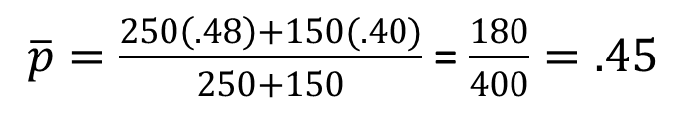
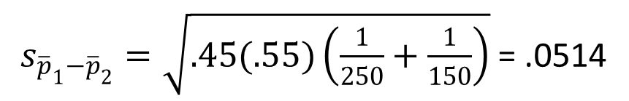
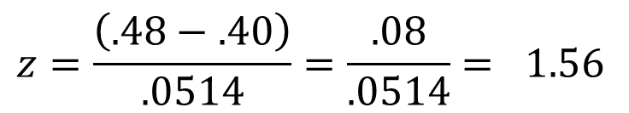
Hypothesis Tests about p₁ - p₂
p -Value and Critical Value Approaches
2. Specify the level of significance.
α = .05
3. Compute the value of the test statistic.
$\overline{p}=\frac{250\left(.48\right)+150(.40)}{250+150}$ = $\frac{180}{400}=.45$
$s_{{\overline{p}}_{1}−{\overline{p}}_{2}}=\sqrt{.45(.55)\left(\frac{1}{250}+\frac{1}{150}\right)}$ = .0514
$$z=\frac{\left(.48−.40\right)}{.0514}=\frac{.08}{.0514}= 1.56$$

Slide 18
Hypothesis Tests about p₁ - p₂
p –Value Approach
4. Compute the p –value.
For z = 1.56, the p–value = .0594
5. Determine whether to reject H₀.
Because p–value > α = .05, we cannot reject H₀.
  We cannot conclude that the proportion of households
  aware of the client’s product increased after the new
  campaign.

Slide 19
Hypothesis Tests about p₁ - p₂
Critical Value Approach
4. Determine the critical value and rejection rule.
For α = .05, z_{.05} = 1.645
Reject H₀ if z > 1.645
5. Determine whether to reject H₀.
Because 1.56 < 1.645, we cannot reject H₀.
  We cannot conclude that the proportion of households
  aware of the client’s product increased after the new
  campaign.

Slide 20
End of Chapter 10, Part B

