Slide 1
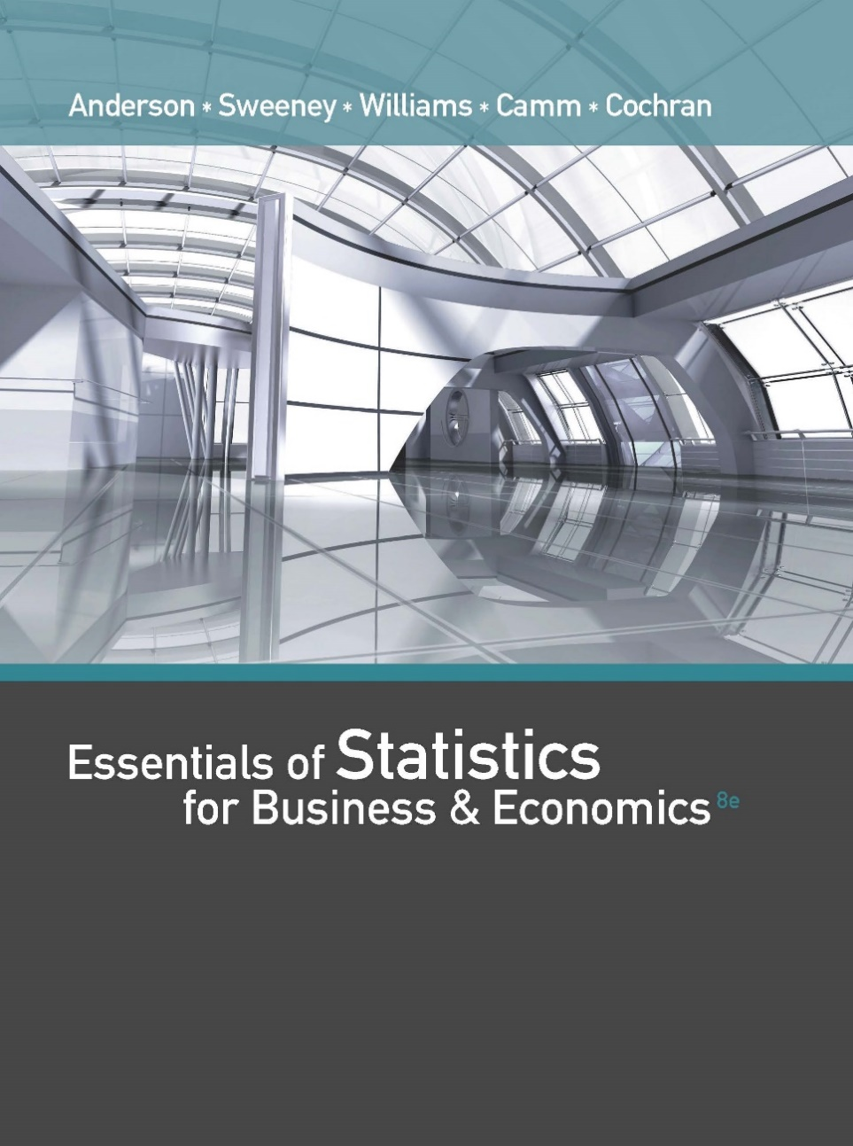
Essentials of Statistics for Business and Economics (8e)
Anderson, Sweeney, Williams, Camm, Cochran
© 2018 Cengage Learning

Slide 2
Chapter 10, Part A Inference About Means and Proportions with Two Populations
Inferences About the Difference Between Two Population Means: σ ₁ and σ ₂ Known
Inferences About the Difference Between Two Population Means: σ ₁ and σ ₂ Unknown
Inferences About the Difference Between Two Population Means: Matched Samples

Slide 3
Inferences About the Difference Between Two Population Means: σ ₁ and σ ₂ Known
Interval Estimation of μ ₁ – μ ₂
Hypothesis Tests About μ ₁ – μ ₂

Slide 4
Estimating the Difference Between Two Population Means
Let μ₁ equal the mean of population 1 and μ₂ equal the mean of population 2.
The difference between the two population means is μ₁ − μ₂.
To estimate μ₁ − μ₂, we will select a simple random sample of size n₁ from population 1 and a simple random sample of size n₂ from population 2.
Let ${\overline{x}}_{1}$ equal the mean of sample 1 and ${\overline{x}}_{2}$ equal the mean of sample 2.
The point estimator of the difference between the means of the populations 1 and 2 is ${\overline{x}}_{1}−{\overline{x}}_{2}$.

Slide 5
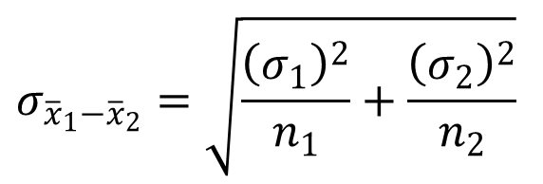
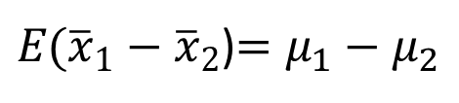
Sampling Distribution of ${\overline{x}}_{1}−{\overline{x}}_{2}$
Expected Value
$E({\overline{x}}_{1}−{\overline{x}}_{2}$)$=μ_{1}−μ_{2}$
Standard Deviation (Standard Error)
$$σ_{{\overline{x}}_{1}−{\overline{x}}_{2}}=\sqrt{\frac{{\left(σ_{1}\right)}^{2}}{n_{1}}+\frac{{\left(σ_{2}\right)}^{2}}{n_{2}}}$$
where: σ₁ = standard deviation of population 1
σ₂ = standard deviation of population 2
n₁ = sample size from population 1
n₂ = sample size from population 2

Slide 6
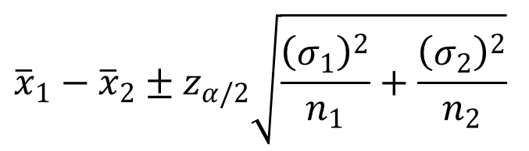
Interval Estimation of μ₁ - μ₂: σ ₁ and σ ₂ Known
Interval Estimate
$${\overline{x}}_{1}−{\overline{x}}_{2}±z_{α/2}\sqrt{\frac{{\left(σ_{1}\right)}^{2}}{n_{1}}+\frac{{\left(σ_{2}\right)}^{2}}{n_{2}}}$$
where: 1 - α is the confidence coefficient.

Slide 7
Interval Estimation of μ₁ - μ₂: σ ₁ and σ ₂ Known
Example: Par, Inc.
Par, Inc. is a manufacturer of golf equipment and has developed a new golf ball that has been designed to provide “extra distance.”
In a test of driving distance using a mechanical driving device, a sample of Par golf balls was compared with a sample of golf balls made by Rap, Ltd., a competitor. The sample statistics appear on the next slide.

Slide 8
Interval Estimation of μ₁ - μ₂: σ ₁ and σ ₂ Known
Example: Par, Inc.
Sample #1
Par, Inc.
Sample #2
Rap, Ltd.
Sample Size
120 balls 80 balls
Sample Mean
295 yards 278 yards
Based on data from previous driving distance tests, the two population standard deviations are known with σ ₁ = 15 yards and σ ₂ = 20 yards.

Slide 9
Interval Estimation of μ₁ - μ₂: σ ₁ and σ ₂ Known
Example: Par, Inc.
Let us develop a 95% confidence interval estimate of the difference between the mean driving distances of the two brands of golf ball.

Slide 10

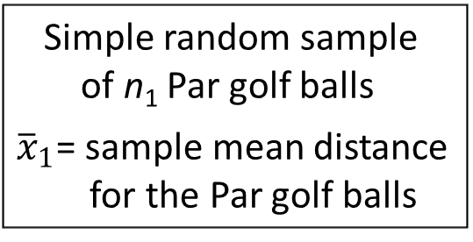
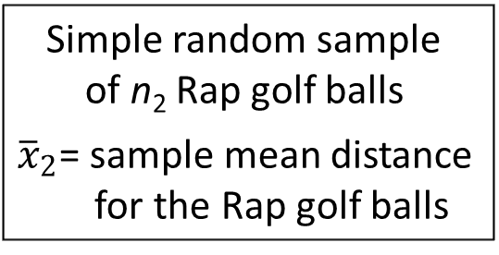
Estimating the Difference Between Two Population Means
Population 1
Par, Inc. Golf Balls
μ₁ = mean driving
distance of Par
golf balls
Population 2
Rap, Ltd. Golf Balls
μ₂ = mean driving
distance of Rap
golf balls
μ₁ – μ₂ = difference between
the mean distances
Simple random sample
of n₁ Par golf balls
${\overline{x}}_{1}$= sample mean distance
for the Par golf balls
Simple random sample
of n₂ Rap golf balls
${\overline{x}}_{2}$= sample mean distance
for the Rap golf balls
${\overline{x}}_{1}−{\overline{x}}_{2}$= Point Estimate of μ₁ – μ₂

Slide 11
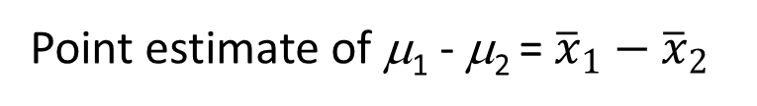
Point Estimate of μ₁ - μ₂
Point estimate of μ₁ - μ₂ = ${\overline{x}}_{1}−{\overline{x}}_{2}$
= 295 - 278
= 17 yards
where:
μ₁ = mean distance for the population
of Par, Inc. golf balls
μ₂ = mean distance for the population
of Rap, Ltd. golf balls

Slide 12
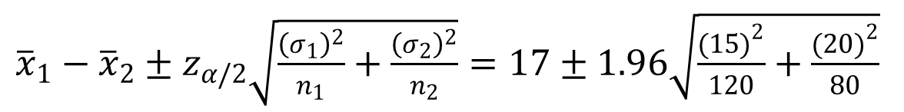
Interval Estimation of μ₁ - μ₂: σ ₁ and σ ₂ Known
${\overline{x}}_{1}−{\overline{x}}_{2}±z_{α/2}\sqrt{\frac{{\left(σ_{1}\right)}^{2}}{n_{1}}+\frac{{\left(σ_{2}\right)}^{2}}{n_{2}}}=17±1.96\sqrt{\frac{{(15)}^{2}}{120}+\frac{{(20)}^{2}}{80}}$
17 + 5.14 or 11.86 yards to 22.14 yards
We are 95% confident that the difference between
the mean driving distances of Par, Inc. balls and Rap,
Ltd. balls is 11.86 to 22.14 yards.

Slide 13
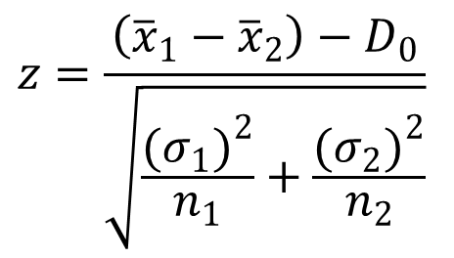
Hypothesis Tests About μ₁ - μ₂: σ₁ and σ₂ Known
Hypotheses
H₀: μ₁ – μ₂ > D₀
H₀: μ₁ – μ₂ < D₀
H₀: μ₁ – μ₂ = D₀
H_{a}: μ₁ – μ₂ < D₀
H_{a}: μ₁ – μ₂ > D₀
H_{a}: μ₁ – μ₂ ≠ D₀
Left-tailed
Right-tailed
Two-tailed
Test Statistic
$$z=\frac{\left({\overline{x}}_{1}−{\overline{x}}_{2}\right)−D_{0}}{\sqrt{\frac{{(σ_{1})}^{2}}{n_{1}}+\frac{{(σ_{2})}^{2}}{n_{2}}}}$$

Slide 14
Hypothesis Tests About μ₁ - μ₂: σ₁ and σ₂ Known
Example: Par, Inc.
Can we conclude, using α = .01, that the mean driving distance of Par, Inc. golf balls is greater than the mean driving distance of Rap, Ltd. golf balls?

Slide 15
Hypothesis Tests About μ₁ - μ₂: σ₁ and σ₂ Known
p –Value and Critical Value Approaches
1. Develop the hypotheses.
H₀: μ₁ - μ₂ < 0
H_{a}: μ₁ - μ₂ > 0
(right-tailed test)
where:
μ₁ = mean distance for the population of Par, Inc. golf balls
μ₂ = mean distance for the population of Rap, Ltd. golf balls
2. Specify the level of significance.
α = .01

Slide 16
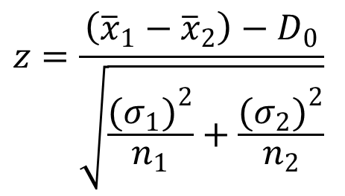
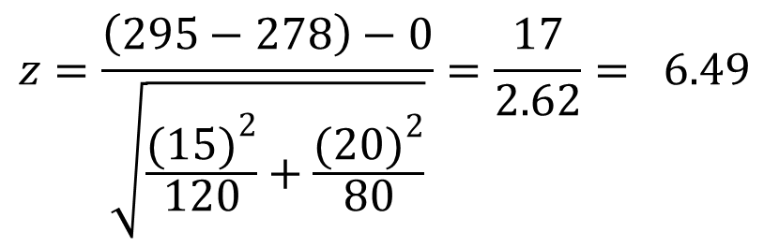
Hypothesis Tests About μ₁ - μ₂: σ₁ and σ₂ Known
p –Value and Critical Value Approaches
3. Compute the value of the test statistic.
$$z=\frac{\left({\overline{x}}_{1}−{\overline{x}}_{2}\right)−D_{0}}{\sqrt{\frac{{(σ_{1})}^{2}}{n_{1}}+\frac{{(σ_{2})}^{2}}{n_{2}}}}$$
$$z=\frac{\left(295−278\right)−0}{\sqrt{\frac{{(15)}^{2}}{120}+\frac{{(20)}^{2}}{80}}}=\frac{17}{2.62}= 6.49$$

Slide 17
Hypothesis Tests About μ₁ - μ₂: σ₁ and σ₂ Known
p –Value Approach
4. Compute the p–value.
For z = 6.49, the p –value < .0001.
5. Determine whether to reject H₀.
Because p–value < α = .01, we reject H₀.
At the .01 level of significance, the sample evidence
indicates the mean driving distance of Par, Inc. golf
balls is greater than the mean driving distance of Rap,
Ltd. golf balls.

Slide 18
Hypothesis Tests About μ₁ - μ₂: σ₁ and σ₂ Known
Critical Value Approach
4. Determine the critical value and rejection rule.
For α = .01, z_{.01} = 2.33
Reject H₀ if z > 2.33
5. Determine whether to reject H₀.
Because z = 6.49 > 2.33, we reject H₀.
The sample evidence indicates the mean driving
distance of Par, Inc. golf balls is greater than the mean
driving distance of Rap, Ltd. golf balls.

Slide 19
Inferences About the Difference Between Two Population Means: σ ₁ and σ ₂ Unknown
Interval Estimation of μ₁ – μ₂
Hypothesis Tests About μ₁ – μ₂

Slide 20
Interval Estimation of μ₁ - μ₂: σ₁ and σ₂ Unknown
When σ ₁ and σ ₂ are unknown, we will:
use the sample standard deviations s₁ and s₂ as estimates of σ ₁ and σ ₂ , and
replace z_{α/2} with t_{α/2}.

Slide 21
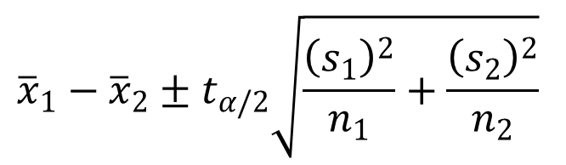
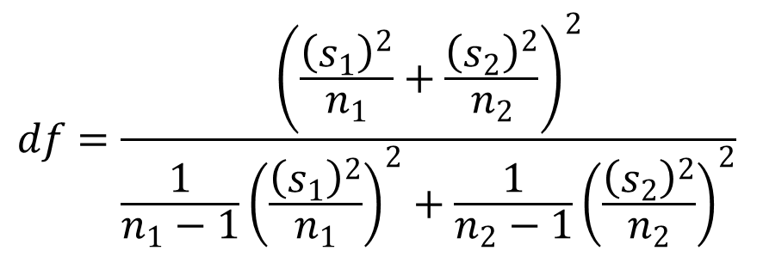
Interval Estimation of μ₁ - μ₂: σ₁ and σ₂ Unknown
Interval Estimate
$${\overline{x}}_{1}−{\overline{x}}_{2}±t_{α/2}\sqrt{\frac{{\left(s_{1}\right)}^{2}}{n_{1}}+\frac{{\left(s_{2}\right)}^{2}}{n_{2}}}$$
where the degrees of freedom for t_{α/2} are:
$$df=\frac{{\left(\frac{{\left(s_{1}\right)}^{2}}{n_{1}}+\frac{{\left(s_{2}\right)}^{2}}{n_{2}}\right)}^{2}}{\frac{1}{n_{1}−1}{\left(\frac{{\left(s_{1}\right)}^{2}}{n_{1}}\right)}^{2}+\frac{1}{n_{2}−1}{\left(\frac{{\left(s_{2}\right)}^{2}}{n_{2}}\right)}^{2}}$$

Slide 22
Difference Between Two Population Means: σ ₁ and σ ₂ Unknown
Example: Specific Motors
Specific Motors of Detroit has developed a new Automobile known as the M car. 24 M cars and 28 J cars (from Japan) were road tested to compare miles-per-gallon (mpg) performance. The sample statistics are shown on the next slide.

Slide 23
Difference Between Two Population Means: σ ₁ and σ ₂ Unknown
Example: Specific Motors
Sample #1
M Cars
Sample #2
J Cars
24 cars 28 cars
Sample Size
29.8 mpg 27.3 mpg
Sample Mean
2.56 mpg 1.81 mpg
Sample Std. Dev.

Slide 24
Difference Between Two Population Means: σ ₁ and σ ₂ Unknown
Example: Specific Motors
Let us develop a 90% confidence interval estimate of the difference between the mpg performances of the two models of automobile.

Slide 25
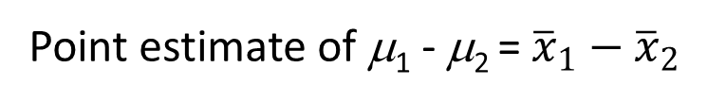
Point Estimate of μ₁ - μ₂
Point estimate of μ₁ - μ₂ = ${\overline{x}}_{1}−{\overline{x}}_{2}$
= 29.8 - 27.3
= 2.5 mpg
where:
μ₁ = mean miles-per-gallon for the population of M cars
μ₂ = mean miles-per-gallon for the population of J cars

Slide 26
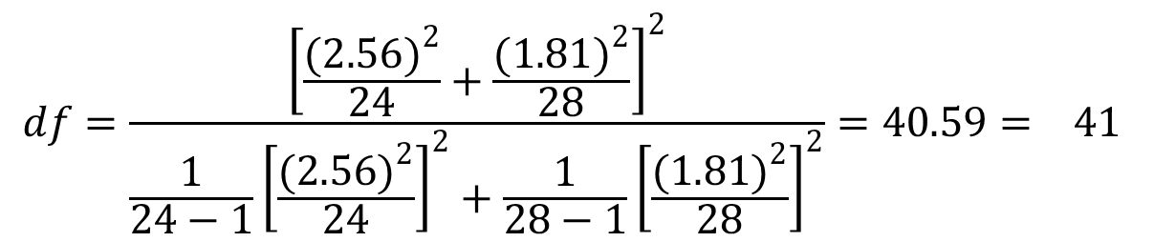
Interval Estimation of μ₁ - μ₂: σ₁ and σ₂ Unknown
The degrees of freedom for t_{α/2} are:
$$df=\frac{{\left[\frac{{(2.56)}^{2}}{24}+\frac{{(1.81)}^{2}}{28}\right]}^{2}}{\frac{1}{24−1}{\left[\frac{{(2.56)}^{2}}{24}\right]}^{2}+\frac{1}{28−1}{\left[\frac{{(1.81)}^{2}}{28}\right]}^{2}}=40.59= 41$$
with α/2 = .05 and df = 41, t_{α/2} = 1.683

Slide 27
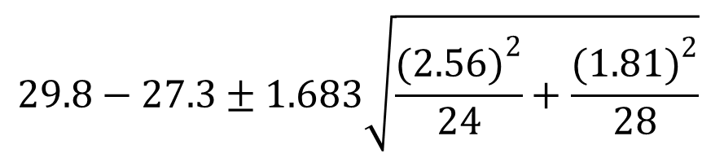
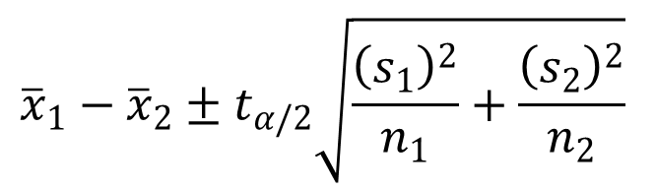
Interval Estimation of μ₁ - μ₂: σ₁ and σ₂ Unknown
$${\overline{x}}_{1}−{\overline{x}}_{2}±t_{α/2}\sqrt{\frac{{\left(s_{1}\right)}^{2}}{n_{1}}+\frac{{\left(s_{2}\right)}^{2}}{n_{2}}}$$
$$29.8−27.3±1.683\sqrt{\frac{{(2.56)}^{2}}{24}+\frac{{(1.81)}^{2}}{28}}$$
2.5 + 1.051 or 1.449 to 3.551 mpg
We are 90% confident that the difference between
the miles-per-gallon performances of M cars and J cars
is 1.449 to 3.551 mpg.

Slide 28
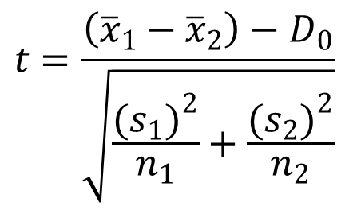
Hypothesis Tests About μ₁ - μ₂: σ₁ and σ₂ Unknown
Hypotheses
H₀: μ₁ – μ₂ > D₀
H₀: μ₁ – μ₂ < D₀
H₀: μ₁ – μ₂ = D₀
H_{a}: μ₁ – μ₂ < D₀
H_{a}: μ₁ – μ₂ > D₀
H_{a}: μ₁ – μ₂ ≠ D₀
Left-tailed
Right-tailed
Two-tailed
Test Statistic
$$t=\frac{\left({\overline{x}}_{1}−{\overline{x}}_{2}\right)−D_{0}}{\sqrt{\frac{{(s_{1})}^{2}}{n_{1}}+\frac{{(s_{2})}^{2}}{n_{2}}}}$$

Slide 29
Hypothesis Tests About μ₁ - μ₂: σ₁ and σ₂ Unknown
Example: Specific Motors
Can we conclude, using a .05 level of significance, that the miles-per-gallon (mpg) performance of M cars is greater than the miles-per-gallon performance of J cars?

Slide 30
Hypothesis Tests About μ₁ - μ₂: σ₁ and σ₂ Unknown
p –Value and Critical Value Approaches
1. Develop the hypotheses.
H₀: μ₁ - μ₂ < 0
H_{a}: μ₁ - μ₂ > 0
(right-tailed test)
where:
μ₁ = mean mpg for the population of M cars
μ₂ = mean mpg for the population of J cars

Slide 31
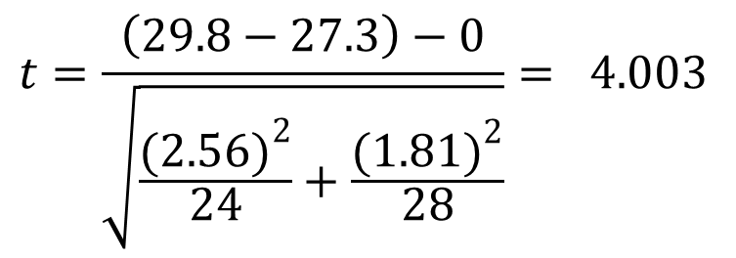
Hypothesis Tests About μ₁ - μ₂: σ₁ and σ₂ Unknown
p –Value and Critical Value Approaches
2. Specify the level of significance.
α = .05
3. Compute the value of the test statistic.
$$t=\frac{\left(29.8−27.3\right)−0}{\sqrt{\frac{{(2.56)}^{2}}{24}+\frac{{(1.81)}^{2}}{28}}}= 4.003$$

Slide 32
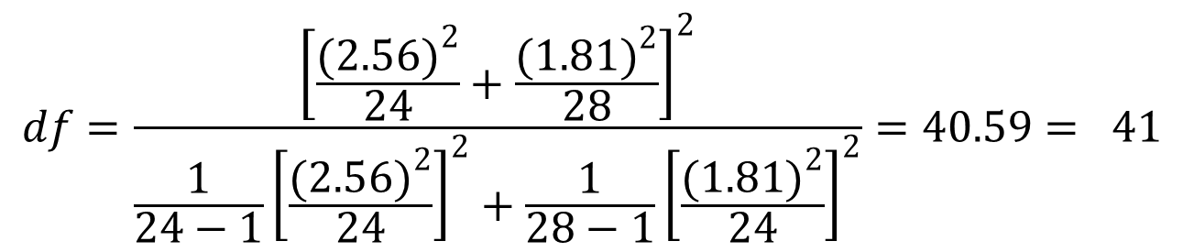
Hypothesis Tests About μ₁ - μ₂: σ₁ and σ₂ Unknown
p –Value Approach
4. Compute the p –value.
The degrees of freedom for t_{α} are:
$$df=\frac{{\left[\frac{{(2.56)}^{2}}{24}+\frac{{(1.81)}^{2}}{28}\right]}^{2}}{\frac{1}{24−1}{\left[\frac{{(2.56)}^{2}}{24}\right]}^{2}+\frac{1}{28−1}{\left[\frac{{(1.81)}^{2}}{24}\right]}^{2}}=40.59= 41$$
Because t = 4.003 > t_{.05} = 1.683, the p–value < .05.
(In fact, the p–value < .005.)

Slide 33
Hypothesis Tests About μ₁ - μ₂: σ₁ and σ₂ Unknown
p –Value Approach
5. Determine whether to reject H₀.
Because p–value < α = .05, we reject H₀.
We are at least 95% confident that the miles-per-gallon (mpg) performance of M cars is greater than the miles-per-gallon performance of J cars.

Slide 34
Hypothesis Tests About μ₁ - μ₂: σ₁ and σ₂ Unknown
Critical Value Approach
4. Determine the critical value and rejection rule.
For α = .05 and df = 41, t_{.05} = 1.683
Reject H₀ if t > 1.683
5. Determine whether to reject H₀.
Because 4.003 > 1.683, we reject H₀.
We are at least 95% confident that the miles-per-gallon (mpg) performance of M cars is greater than the miles-per-gallon performance of J cars.

Slide 35
Inferences About the Difference Between Two Population Means: Matched Samples
With a matched-sample design each sampled item provides a pair of data values.
This design often leads to a smaller sampling error than the independent-sample design because variation between sampled items is eliminated as a source of sampling error.

Slide 36
Inferences About the Difference Between Two Population Means: Matched Samples
Example: Express Deliveries
A Chicago-based firm has documents that must be quickly distributed to district offices throughout the U.S. The firm must decide between two delivery services, UPX (United Parcel Express) and INTEX (International Express), to transport its documents.

Slide 37
Inferences About the Difference Between Two Population Means: Matched Samples
Example: Express Deliveries
In testing the delivery times of the two services, the firm sent two reports to a random sample of its district offices with one report carried by UPX and
the other report carried by INTEX. Do the data on the next slide indicate a difference in mean delivery times for the two services? Use a .05 level of
significance.

Slide 38
Inferences About the Difference Between Two Population Means: Matched Samples
Delivery Time (Hours)
District Office
UPX
INTEX
Difference
Seattle
Los Angeles
Boston
Cleveland
New York
Houston
Atlanta
St. Louis
Milwaukee
Denver
32
30
19
16
15
18
14
10
7
16
25
24
15
15
13
15
15
8
9
11
7
6
4
1
2
3
-1
2
-2
5

Slide 39
Inferences About the Difference Between Two Population Means: Matched Samples
p –Value and Critical Value Approaches
1. Develop the hypotheses.
H₀: μ_{d} = 0
H_{a}: μ_{d} ≠ 0
Let μ_{d} = the mean of the difference values for the
two delivery services for the population
of district offices

Slide 40
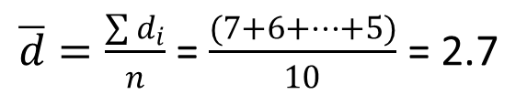
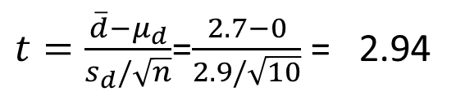
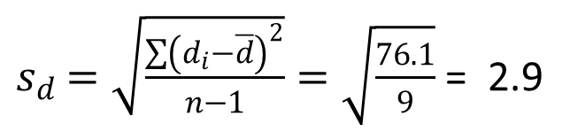
Inferences About the Difference Between Two Population Means: Matched Samples
p –Value and Critical Value Approaches
2. Specify the level of significance.
α = .05
3. Compute the value of the test statistic.
$\overline{d}=\frac{\sum{d_{i}}}{n}$ = $\frac{(7+6+…+5)}{10}$ = 2.7
$s_{d}$ $=\sqrt{\frac{\sum{{\left(d_{i}−\overline{d}\right)}^{2}}}{n−1}}=\sqrt{\frac{76.1}{9}}$ = 2.9
$t=\frac{\overline{d}−μ_{d}}{s_{d}/\sqrt{n}}$=$\frac{2.7−0}{2.9/\sqrt{10}}$ = 2.94

Slide 41
Inferences About the Difference Between Two Population Means: Matched Samples
p –Value Approach
4. Compute the p –value.
For t = 2.94 and df = 9, the p–value is between .02 and .01. (This is a two-tailed test, so we double the upper-tail areas of .01 and .005.)
5. Determine whether to reject H₀.
Because p–value < α = .05, we reject H₀.
We are at least 95% confident that there is a difference in mean delivery times for the two services.

Slide 42
Inferences About the Difference Between Two Population Means: Matched Samples
Critical Value Approach
4. Determine the critical value and rejection rule.
For α = .05 and df = 9, t_{.025} = 2.262.
Reject H₀ if t > 2.262
5. Determine whether to reject H₀.
Because t = 2.94 > 2.262, we reject H₀.
We are at least 95% confident that there is a difference in mean delivery times for the two services.

Slide 43
End of Chapter 10, Part A

