Slide 1
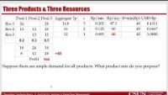
Capacity- Product Mix Multi-Product Flow Ardavan Asef-Vaziri

Slide 2
Three Products & Three Resources
https://youtu.be/Dtsh2yVP7rw
=40
Suppose there are ample demand for all products. What product mix do you propose?

Slide 3
Product Mix: Three Products & Three Resources
Three Products (Prod-1, Prod-2, and Prod-3) go through three resource pools (Res-1, Res-2, Res-3).
Currently the product mix is Prod-1: 20%, Prod-2: 30%, and Prod-3: 50%.
The profit margins are Prod-1=$10, Prod-2=$24, and Prod-3=$30.
There are 3 resource units in the first resource pool, 2 resource units in the second resource pool, and 1 resource in the third resource pool. Each resource unit has 480 minutes per day.
Where is the bottleneck?
Compute the capacity in term of the aggregate product.
Compute the optimal product mix.
Compute the total net profit.
The time required by each product at each resource pool in minute is given below.

Slide 4
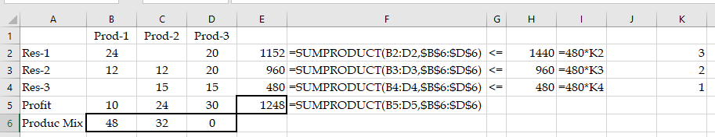
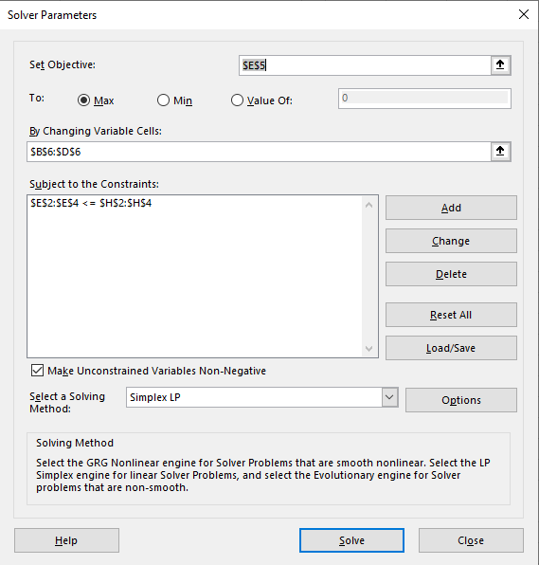
Three Products & Three Resources- LP Implementation
Product mix is 48, 32, and 0.
Prod-1= 48/(48+32)= 60%
Prod-2=40%
Prod-3=0%
Total Profit = $1248
Increase in Profit $1248-$968= $280/day

Slide 5
How Much for One Additional Hour Res-1, Res-2, and Res-3.
Sh-Price-Res-1 = 0/ hour, Sh-Price-Res-2 = 50/ hour, Sh-Price-Res-3 = 56/ hour
This analysis, however, is valid only for limited ranges.

Slide 6
Demand for Prod-2 is 30 units- How much Do You Pay to Increase
If we could have sold 32 units, profit was 1248. The market is limited to 30 units, and the new profit is $1.33 less. Therefore, it worth to spend up to $1.33/2 = $0.66 to increase the sales of product-1 by one unit.

