Slide 1
Magnolia Science Academy 7 School Garden Project
Samuel Benji and Raimundo Lee
CSUN and NASA JPL Environmental Literacy Grant

Slide 2
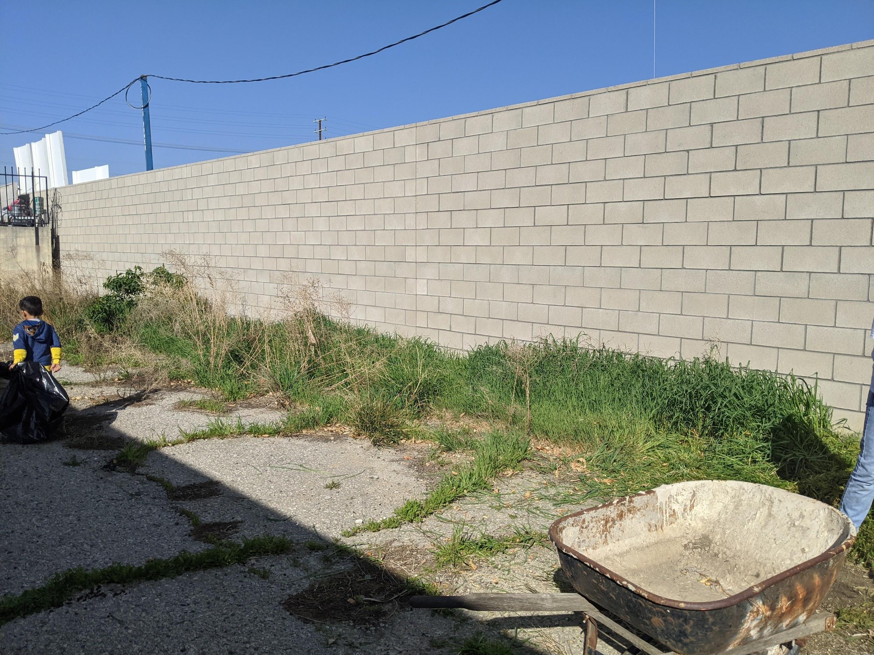
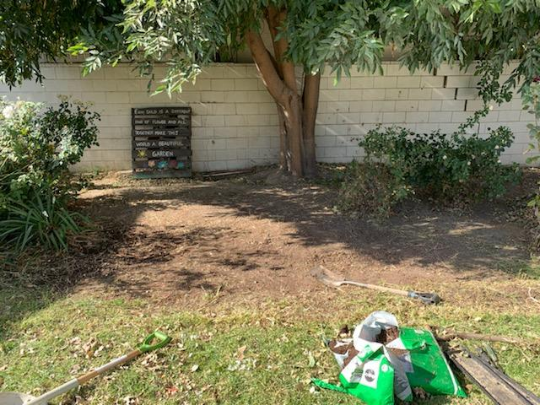
Welcome to Our Garden Locations
We have taken on two areas at our school to turn into a garden. Both of these areas needed a massive face lift!

Slide 3
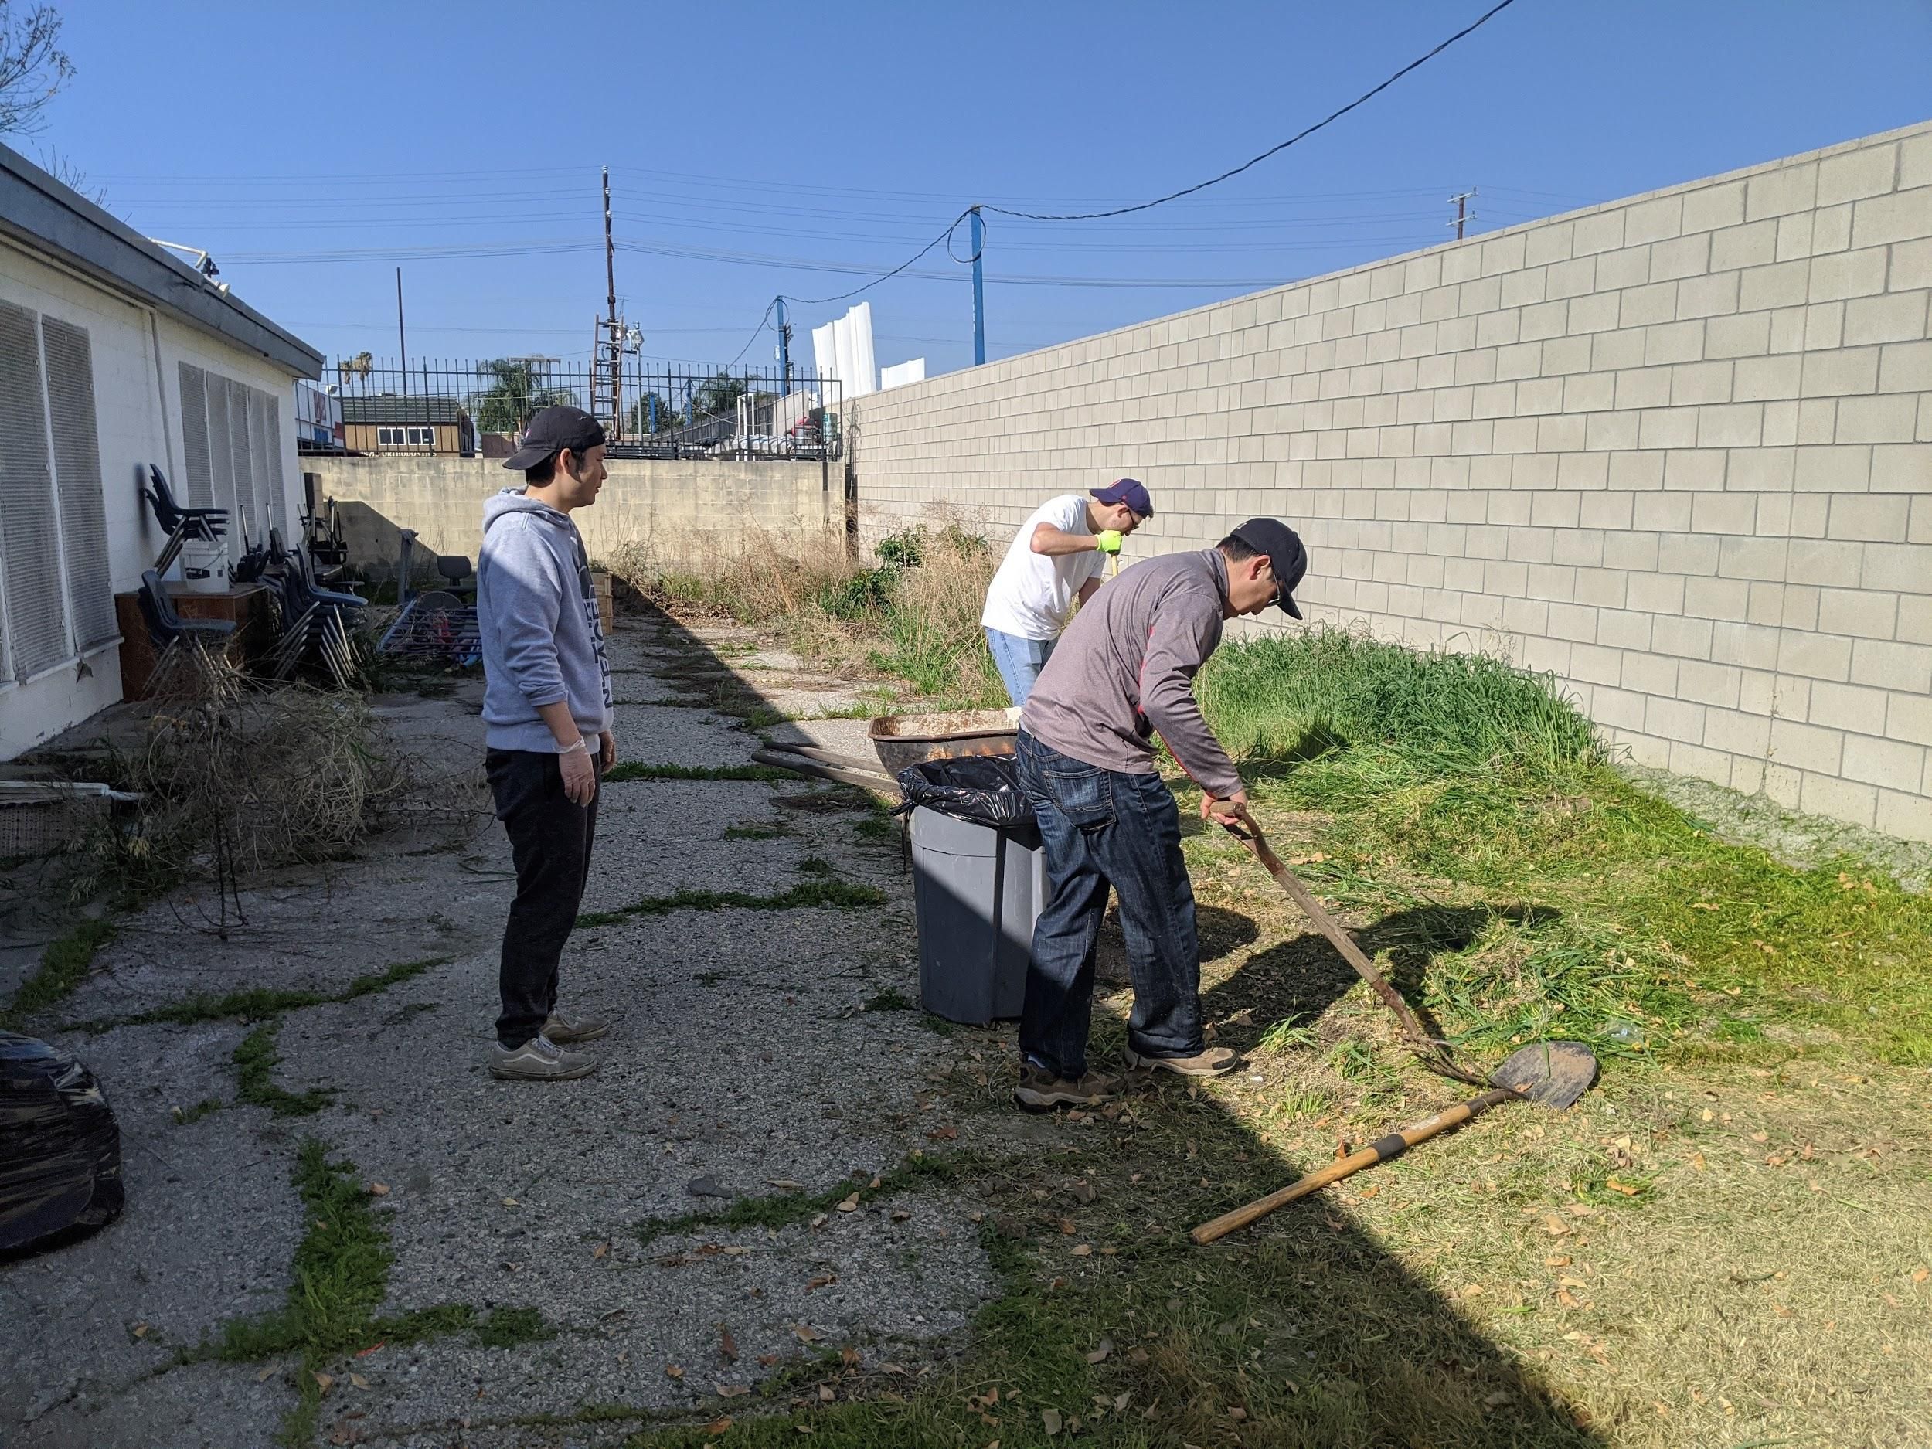
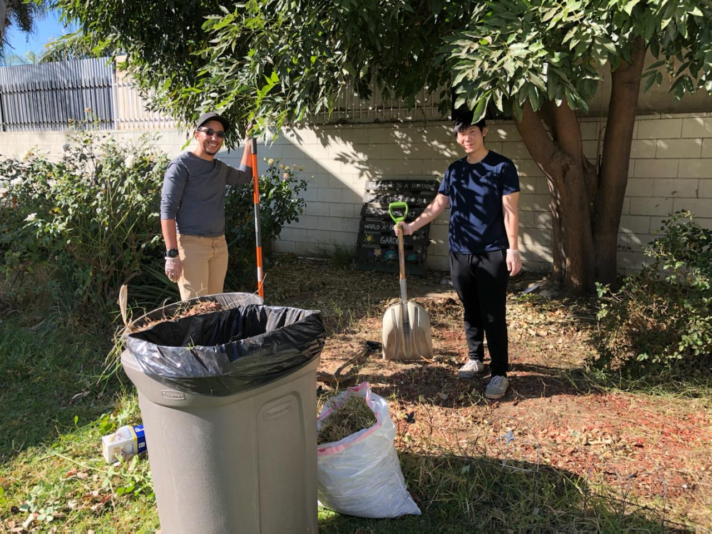
Campus Beautification Day
Over 50 volunteers from 5 local communities came to help with that face lift! They worked on many rundown areas throughout our campus.

Slide 4
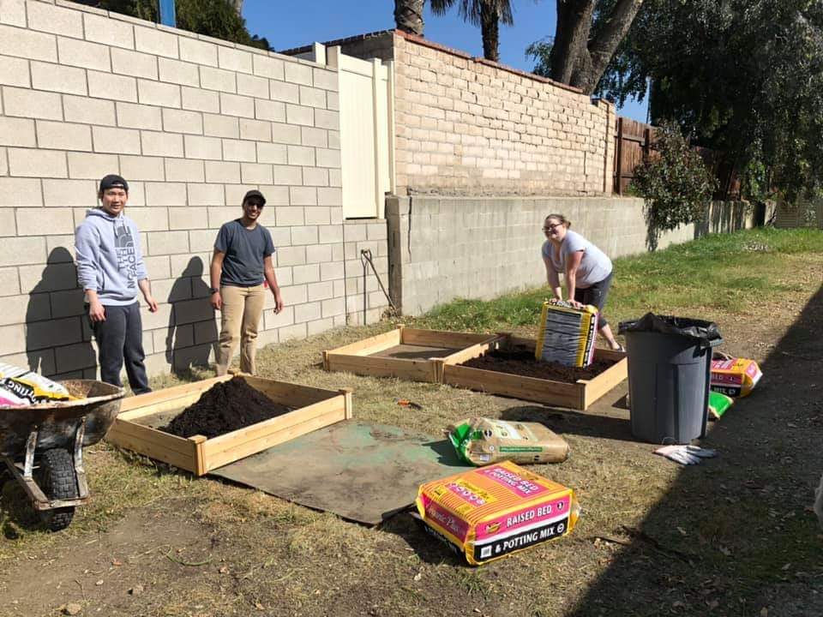
Planting Our Seeds
We prepped our planters for the new vegetation.
Gardening lessons were taught to students by one of our teachers.

Slide 5
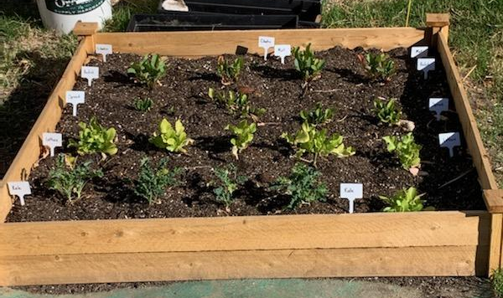
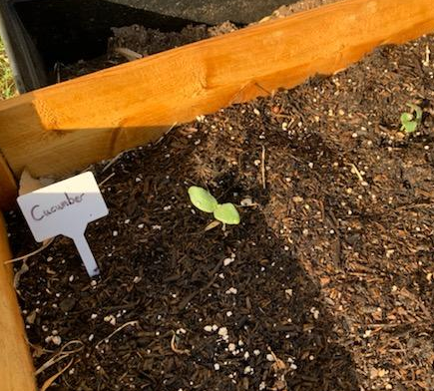
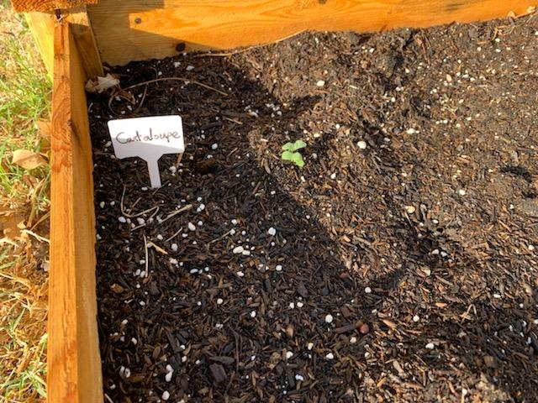
Fruits and Vegetables Growing
We have plants!

Slide 6
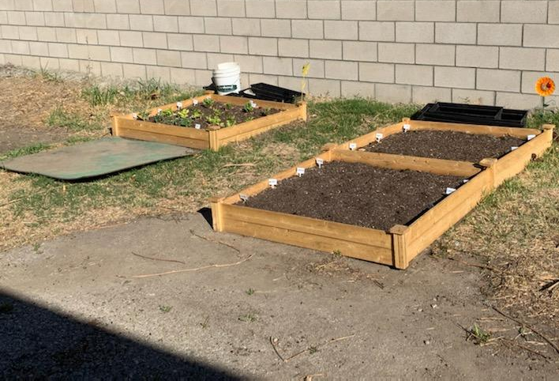
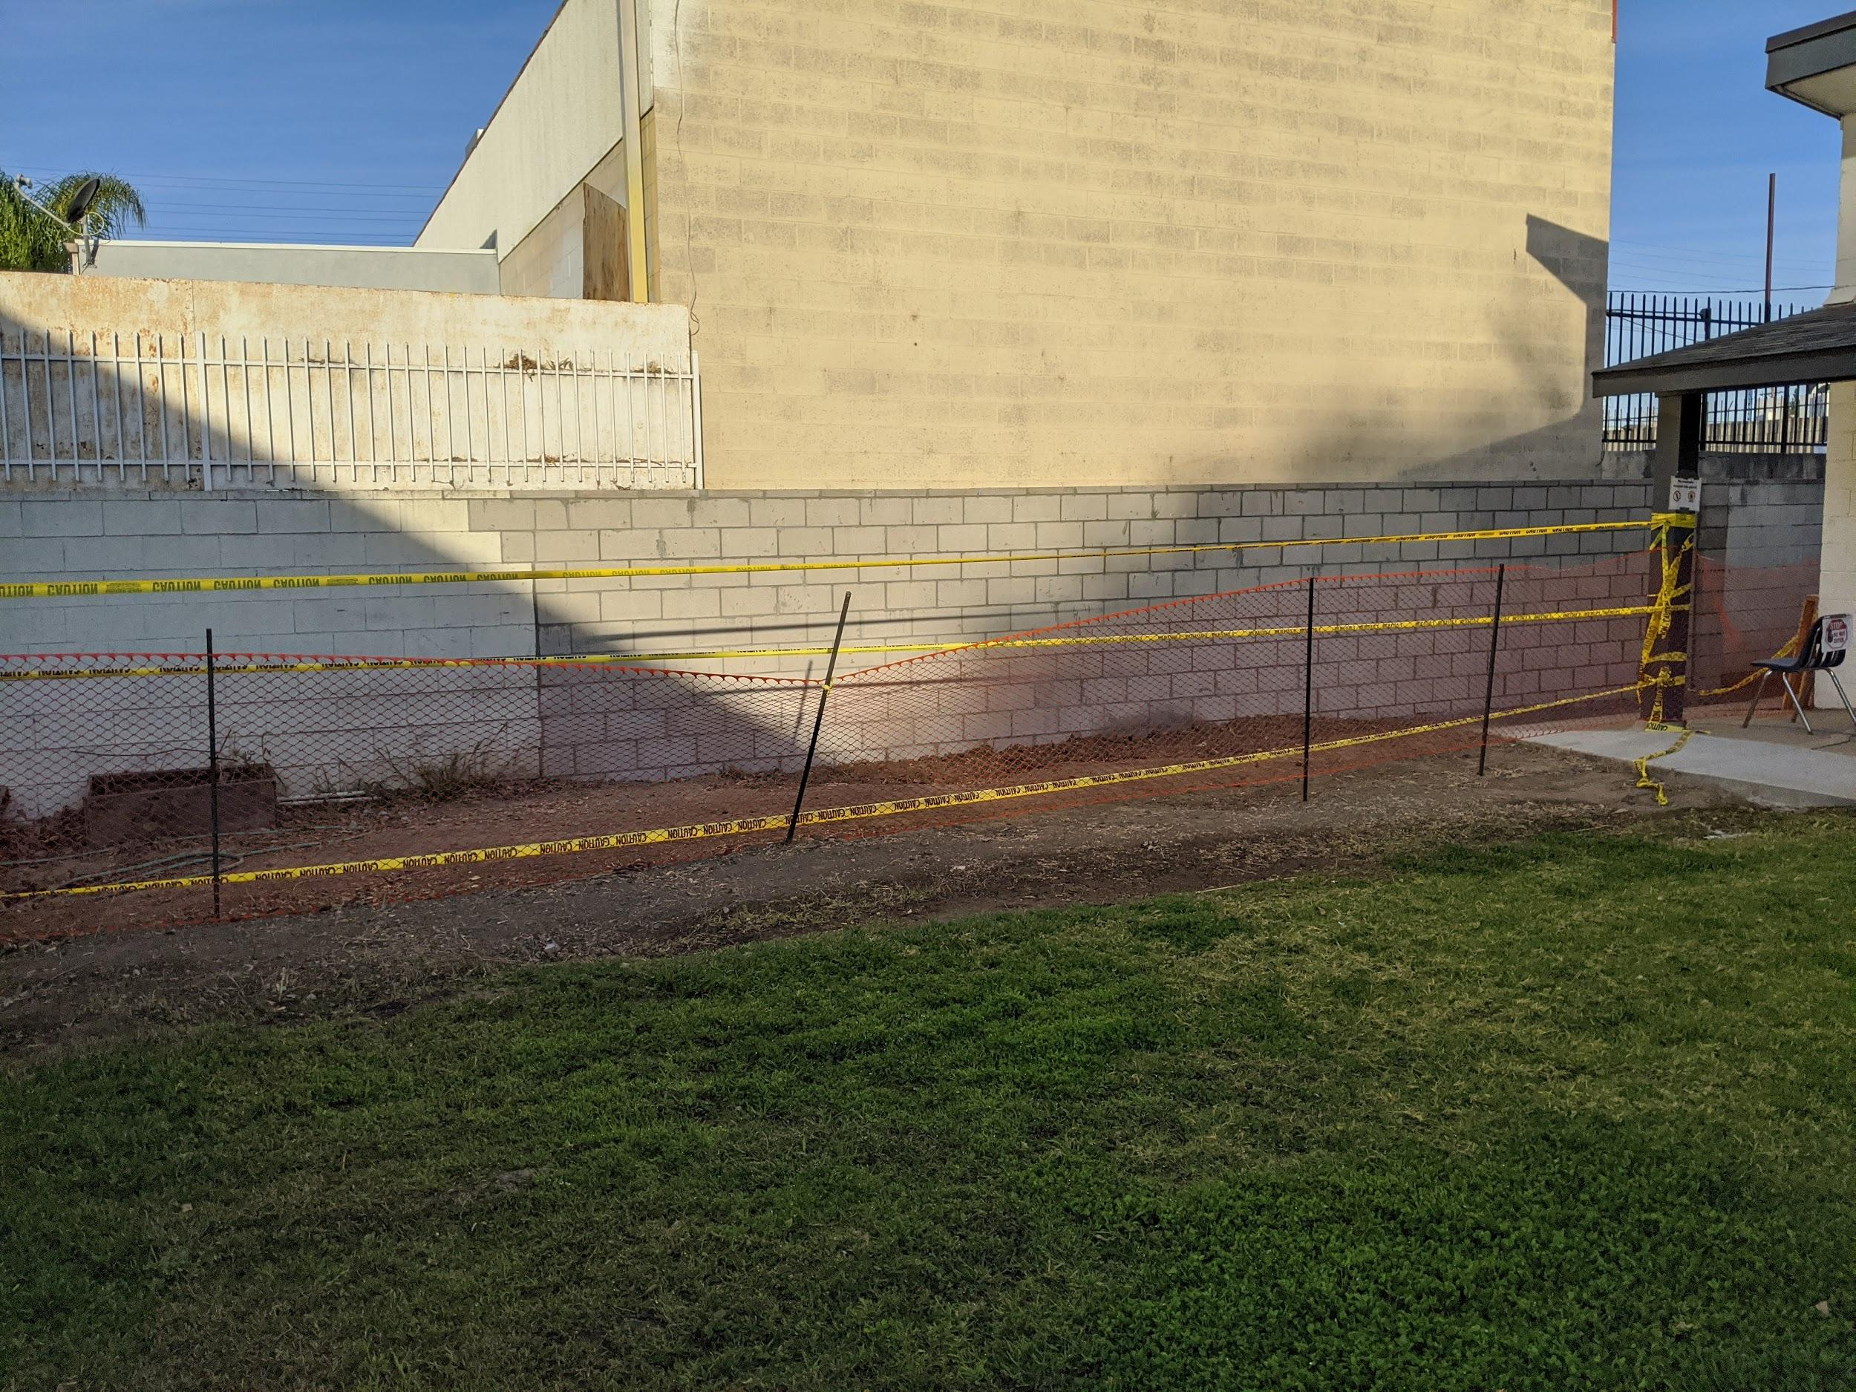
Future Plans
Continue educational lessons about plants and gardening with students.
Further improve our fruit and vegetable garden areas by adding more planter boxes.
Create a flower garden in our second garden location.

