Slide 1
Gender Dimorphism
Sandra Sandoval and Prisella Vallin

Slide 2

Theory
Behavioral Disorders and Intellectual Disabilities
Checklist -> Facilitating a conversation with a Professional
Kahoot
Over Diagnoses

Slide 3
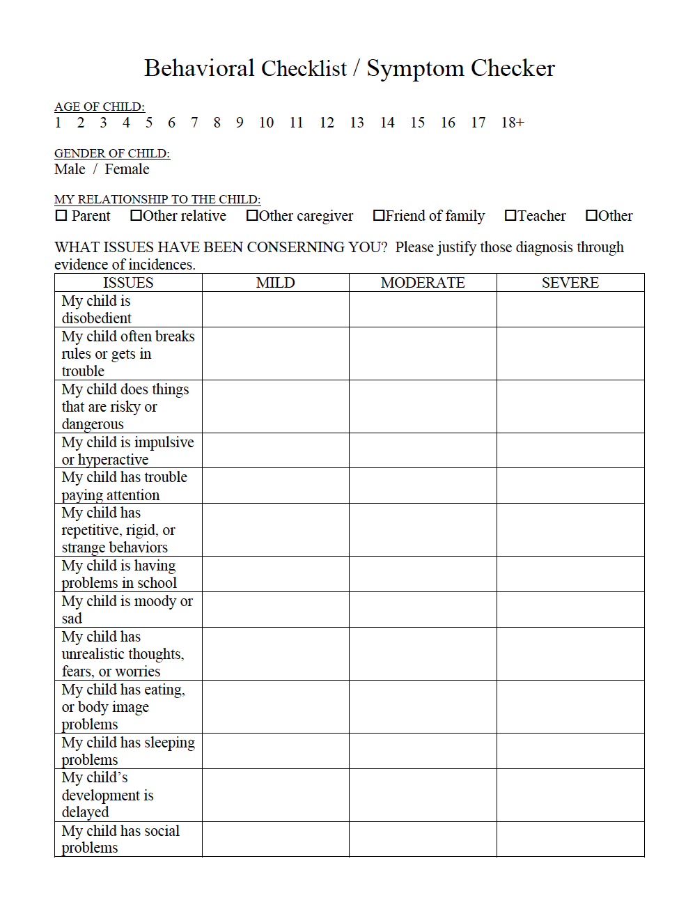

Slide 4
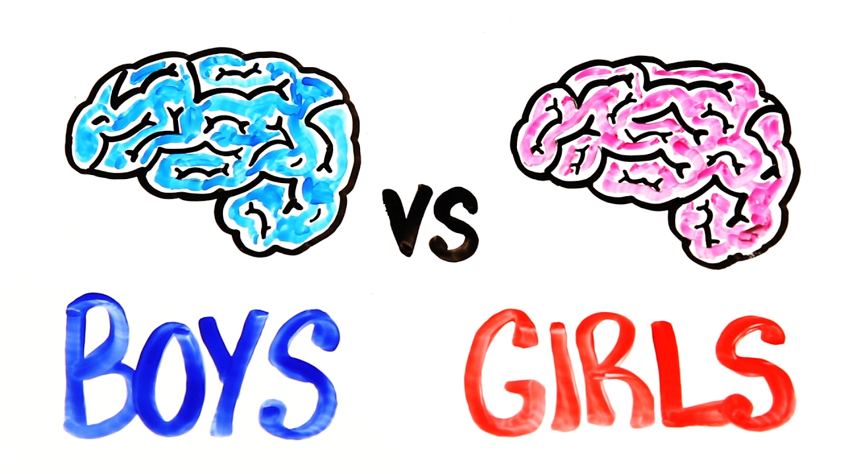
Growth development
Brief Overview of Growth & Development
Socio-cultural Constructs & Social Norms

Slide 5
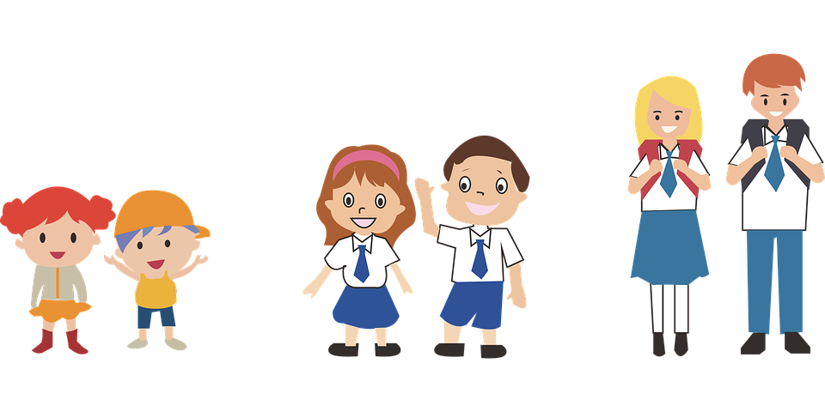
Educational Awareness
Whole Child & STEM
  Treatment in school
  Role of Educator
Kahoot
In the classroom

Slide 6

Questions

Slide 7
Reference
Daniel, H., Creese, A., Hey, V., Leonard, D. and Smith, M. Gender and learning: Equity, equality, and pedagogy. Support for Learning, 16(3), 112-116.
Eliot, L. (2009). Pink brain blue brain. New York, NY: Houghton Mifflin Harcourt.
Making the case for educating the whole child. (2012). Alexandria, Virginia: ASCD.
Moll, K., Kunze, S., Newhoff, N., Bruder, J., and Schulte-Korne, G. (2014). Specific learning disorder: Prevalence and gender differences. PLoS ONE, 9(7), E103537.
Rao, A., & Seaton, M. (2009). The way of boys: Raising healthy boys in a challenging and complex world. New York, NY: HarperCollins Publishers.

