Slide 1
E ED 480 Science and Social Studies Curriculum Methods
Spring 2019
Dr. Susan Belgrad
WEEK TWO
SESSION TWO

Slide 2
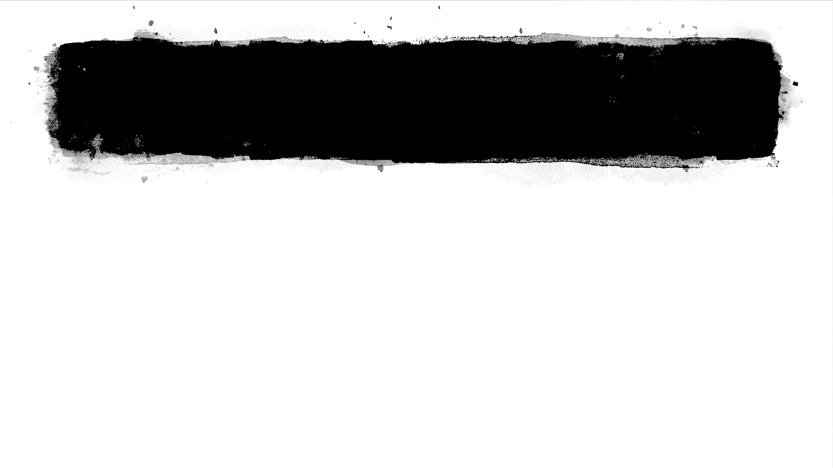
Review of the Syllabus and Agenda
Please read the assessment section carefully
to learn about
the ways in which your performance in the course will be both self-assessed and evaluated.
Class sessions will be led to respect the norms of learning that have developed within your cohort while models for pro-social classroom learning
environments will be presented.
As a contributing member of your cohort you are expected to complete the assigned readings and assignments so your peers
may benefit in class activities.

Slide 3
Assignment to a Base Group
Group | Name | Name | Name
# 1
#2
#3
#4
#5
#6
#7
#8

Slide 4
Assignment to a Base Group
Class sessions will be led in ways that respect the norms of learning that have previously developed within your cohort.
In addition, we will be learning about advanced forms of cooperative learning. Throughout the semester we will be working in home (base) groups of three; formal task groups of three and informal task groups of four or more.

Slide 5
Reflection Journals and Session Logs
Promoting Student Engagement through Developmentally-Appropriate Teaching and Learning Practices
Embracing the important role of the elementary educator in teaching the whole child—challenging today’s students to become the next generation of “audacious scientists, engineers and advocates/activists.”

Slide 6
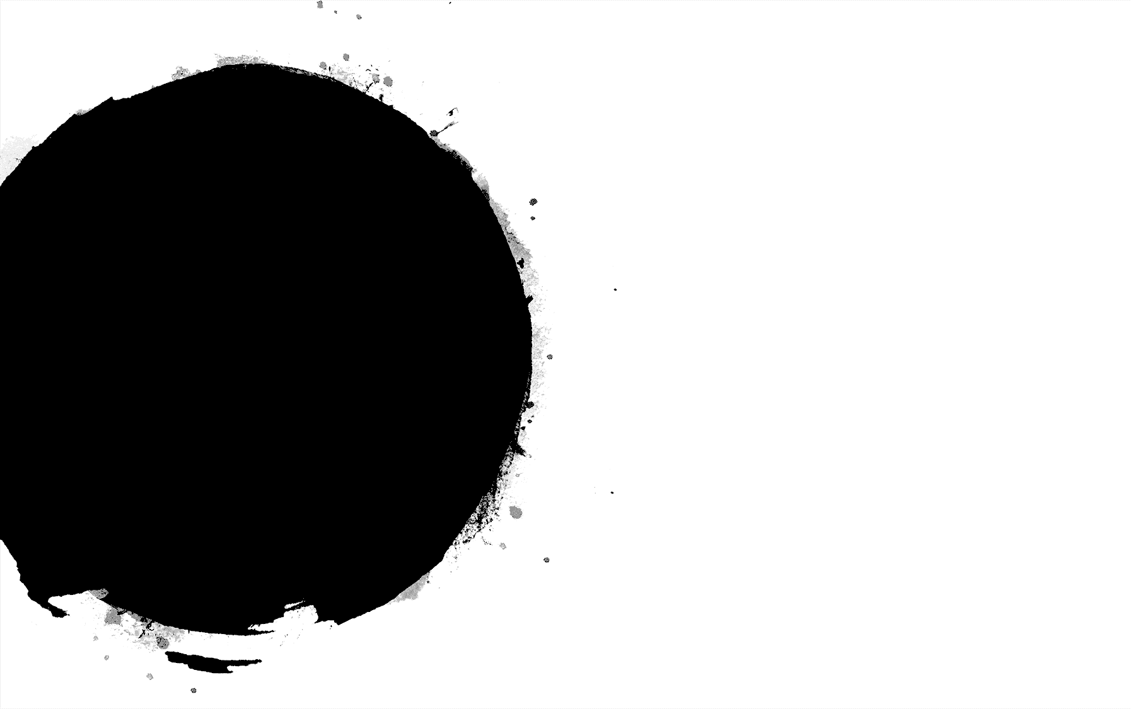

About the NGSS-CCSS-CTE Placemat
The placemat presents the Next Generation Science Standards the Career Technical Standards; and the Common Core State Standards. At the close of this session, we will consider the way in which active student learning assures they can meet these.

Slide 7
The Amazing Egg Drop
An Engaged Learning STEM-Workshop
THE AMAZING EGG DROP
Learning about Constructivist Practices by Engaging in NGSS-aligned science activities

Slide 8

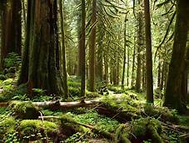

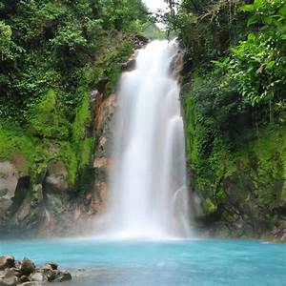
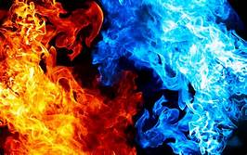
THE FOUR ELEMENTS F NATURE
EARTH | AIR | WATER | FIRE

Slide 9
PROCESSING THE ACTIVITY
NGSS | CCSS | CSSS | LEARNING COMMUNITY

Slide 10
About the NGSS-CCSS-CTE Placemat
The placemat presents the Next Generation Science Standards the Career Technical Standards; and the Common Core State Standards. At the close of this session, we will consider the way in which active student learning assures they can meet these.

Slide 11
Tools Used This Session
Informal Task-Group Assignments
Cooperative-Learning Role Assignments
Hands-On Science and Engineering
Soft-Skills Assessment
Formal Content Assessment
Informal Content Assessment
NGSS Placemat Tool
Others??
On Your Own (OWO-Optional)
1. Study the elemental property of “gravity”
2. How did humans learn to escape Earth’s Gravity? (Historical references in eastern and western civilizations)
3. How can you teach young children about gravity and human endeavors to fly? Junior Test Flight Pilot School

Slide 12

Contacting Dr. Belgrad
The best way to contact Dr. Belgrad is via email
susan.belgrad@csun.edu
You may also leave a voicemail at campus phone
#818-677-4901
You may also arrange for an individual meeting in Dr. Belgrad's Office ED 4901 or during office hours—2-3:30 PM Mondays and Wednesdays

