Slide 1
Investments and Financial Planning for the Next Generation
CSUN Students have “hands on” experiences developing powerful professional skills.

Slide 2
Center for Financial Planning and Investment (CFP&I) & Department of Finance, Real Estate, and Insurance
College of Business and Economics
California State University, Northridge

Slide 3
Undergraduate training in financial planning & investments
BS in Finance
BSBA with an option in Insurance and Financial Services
One of about 30 Society of Financial Service Professionals “University Partners” programs globally
The CSUN program is in the candidate registration process with the “Certified Financial Planner Board of Registry” (a professional accreditation group)

Slide 4
We also provide extensive GE offerings in financial planning
Up to 500 students per semester take a practical personal financial planning course which focuses on creating individual financial plans, identifying long term goals, correcting financial problems, and developing a personal investment strategy. (Fin302)
A new offering (Fin102) will provide international and lower division students with the framework and practical knowledge to establish a solid financial foundation as they begin their college experience.
We provide opportunities for peer mentoring, actively participate in campus life programs, and maintain a walk-in service for Fin102 and Fin302 students to meet with experienced MBA students and financial planning faculty.

Slide 5
The CFP&I promotes Investment and Financial Planning Research and Education
Works in conjunction with the Business Honors Program and degree programs of the Department of Finance, Real Estate, and Insurance
Provides support for General Education Personal Finance Classes (Fin302 and the new Fin102)
Provides support for the Undergraduate Student Investment Portfolio (Fin437BH)
Provides continuing education speakers to the Southern California financial planning & investment community

Slide 6
www.CFPIonline.org
A centralized location for financial planning education resources for all ages
Links to databases available for CSUN students and faculty
References to CFP&I associated research
CFP&I Faculty are active scholars in the area of wealth management, financial planning, and investment
CFP&I Faculty are also frequently invited to be speakers at meetings across the nation

Slide 7
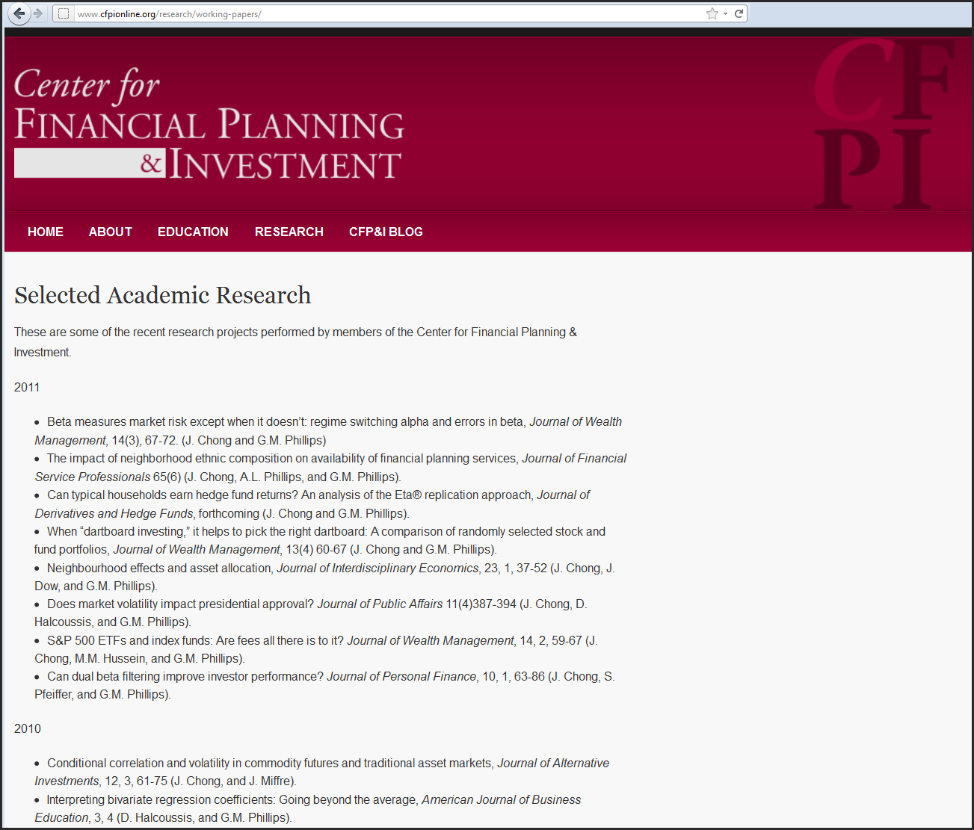

Slide 8
Undergraduate Portfolio Management: Fin437BH
Limited to 12 high achieving students per semester who apply for the class
Most, but not all, are Business Honors students
Most, but not all, are Finance majors
Most are seniors

Slide 9
Focus is on PORTFOLIO Management
Not an “Investment Club”
Invests University Corporation funds
Started with $500,000 in 1993
In 2007, $500,000 was removed
Current Undergraduate portfolio value is about $1,250,000
Current Undergraduate portfolio has 33 holdings

Slide 10
Current Guidelines
Stocks, ADRs, and ETFs
Long positions only
No options or direct derivative plays
Actively changing portfolio to a “low volatility” portfolio
Actively seeking a Southern California presence in the portfolio
Reinvest approximately 20% each semester

Slide 11
Portfolio Analysis, Part 1
Begin learning how to do fundamental analysis of investments.
Students analyze each current holding and discuss whether any experienced materially adverse changes in financial position or fundamental valuation so that they should be sold from the portfolio.
Students usually work in three groups of 4.

Slide 12
Portfolio Analysis, Part 2
Students then identify and present potential new investments, which are placed in a “buylist” for consideration.
Candidates are identified based on their fundamental valuation, future outlook, and risk characteristics.
In a typical semester, more than 100 firms are identified as buylist candidates. There were 111 this semester.

Slide 13
Portfolio Analysis, Part 3
Students become skilled at using professional databases and optimization tools including:
SEC Edgar
Morningstar/Hemscott Fundamental Data
Mergent
MacroRisk Analytics

Slide 14
Portfolio Analysis, Part 4
After the portfolio is analyzed, initial sales are identified, and the buylist is created, the MacroRisk Analytics optimizer is used to identify any additional sales to reach 20% of the portfolio and to identify appropriate purchases from the buylist given the optimization goal.
During the past few semesters, the portfolio was optimized with an “aggressive” outlook.
At this point, the portfolio is being optimized to reflect a “low volatility”, “conservative” outlook.

Slide 15
Portfolio Analysis, Part 5
In practice, multiple optimizations are computed and students are able to see how different portfolio goals would generate different suggested “buys and sells”.
Note that typically only a few of the buylist stocks are identified for inclusion in the portfolio.
This semester, 7 positions were closed and 5 were purchased.

Slide 16
Additional Activities
In the portfolio class, students are able to interact with investment and business professionals as guest speakers.
In the spring semester, the students attend an international student investment fund conference (RISE Conference) held in Dayton, Ohio. There, they network with industry professionals, other students, and hear top investment speakers.

Slide 17
Continuing Experiences…
In the portfolio class, students are able to interact with investment and business professionals as guest speakers.
In the spring semester, the students attend an international student investment fund conference (RISE Conference) held in Dayton, Ohio. There, they network with industry professionals, other students, and hear top investment speakers.

Slide 18
Spring 2011’s Portfolio vs. SP500 (Spring 2011 is the starting portfolio for the fall semester’s 20% rebalancing)

Slide 19
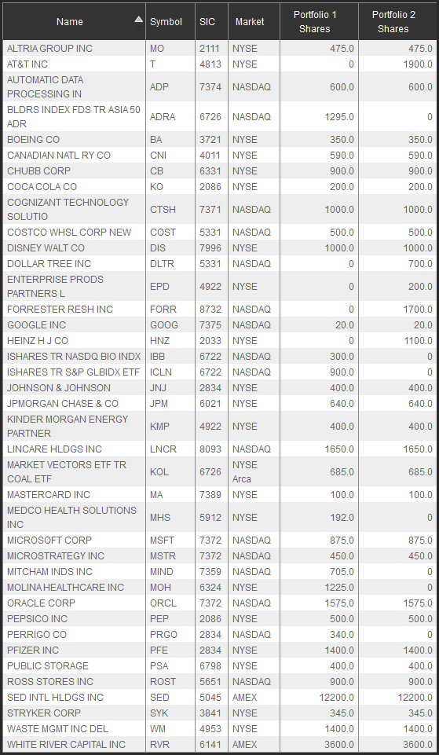
Undergraduate Portfolio comparison Spring 2011 vs. Fall 2011
New purchases include:
ATT (T)
Dollar Tree (DLTR)
Enterprise Prod. Partners (EPD)
Forrester Research (FORR)
H. J. Heinz Co. (HNZ)

Slide 20
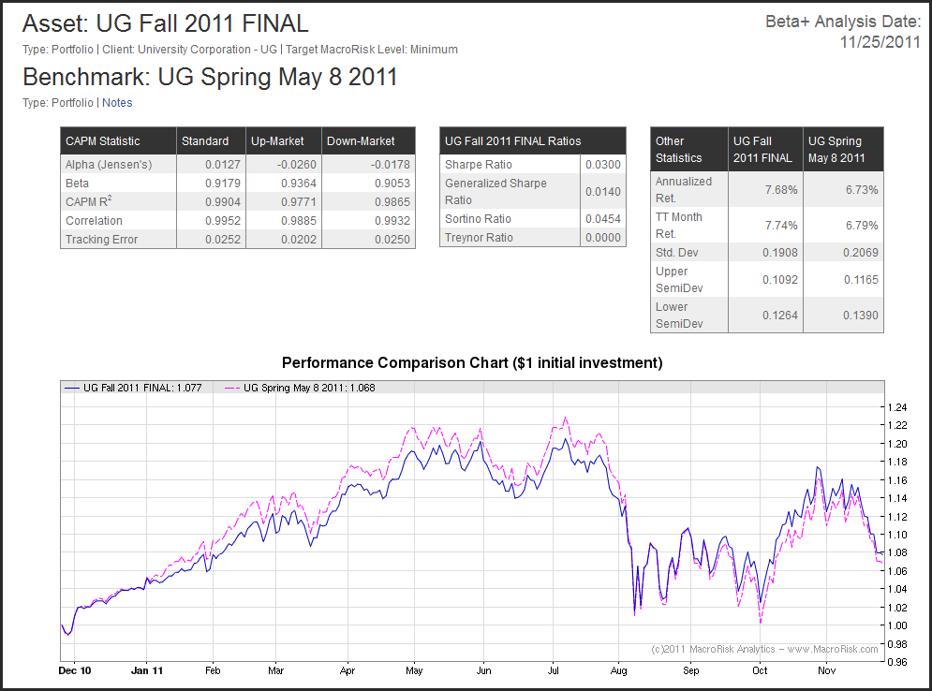
Fall portfolio shows lower down-market sensitivity compared to Spring portfolio

Slide 21
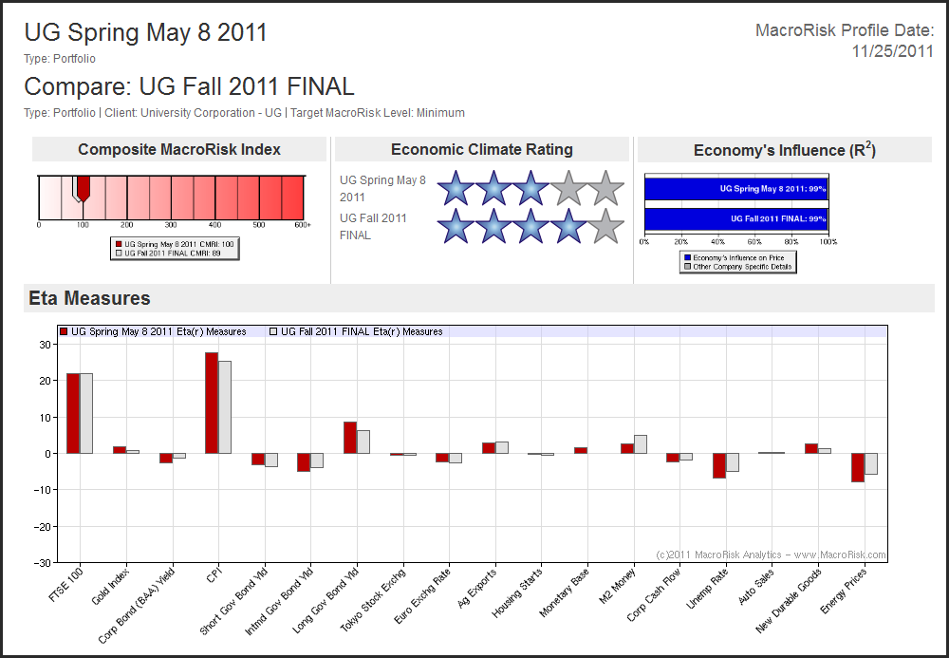
Some comparison measures (intrinsic value risk)

Slide 22
Employers of our financial planning and investment graduates include
Hedge funds
Investment advisors
Insurance companies
Financial Planners
Banks
Our better students are also successful in entering Ph.D. programs in financial planning and investments.

Slide 23
The CFP&I, Dept. of Finance, and BHP could not succeed without the generous time and financial support of the community. Thank you.
Classroom visits & “Professional Shadowing”
Internships
Student scholarships
Conference & travel expenses
Database & software expenses
Research & curriculum development support

