Slide 1
Workers Comp
Careers Pathways
In
Workers Compensation :
Tyrone Spears

Slide 2
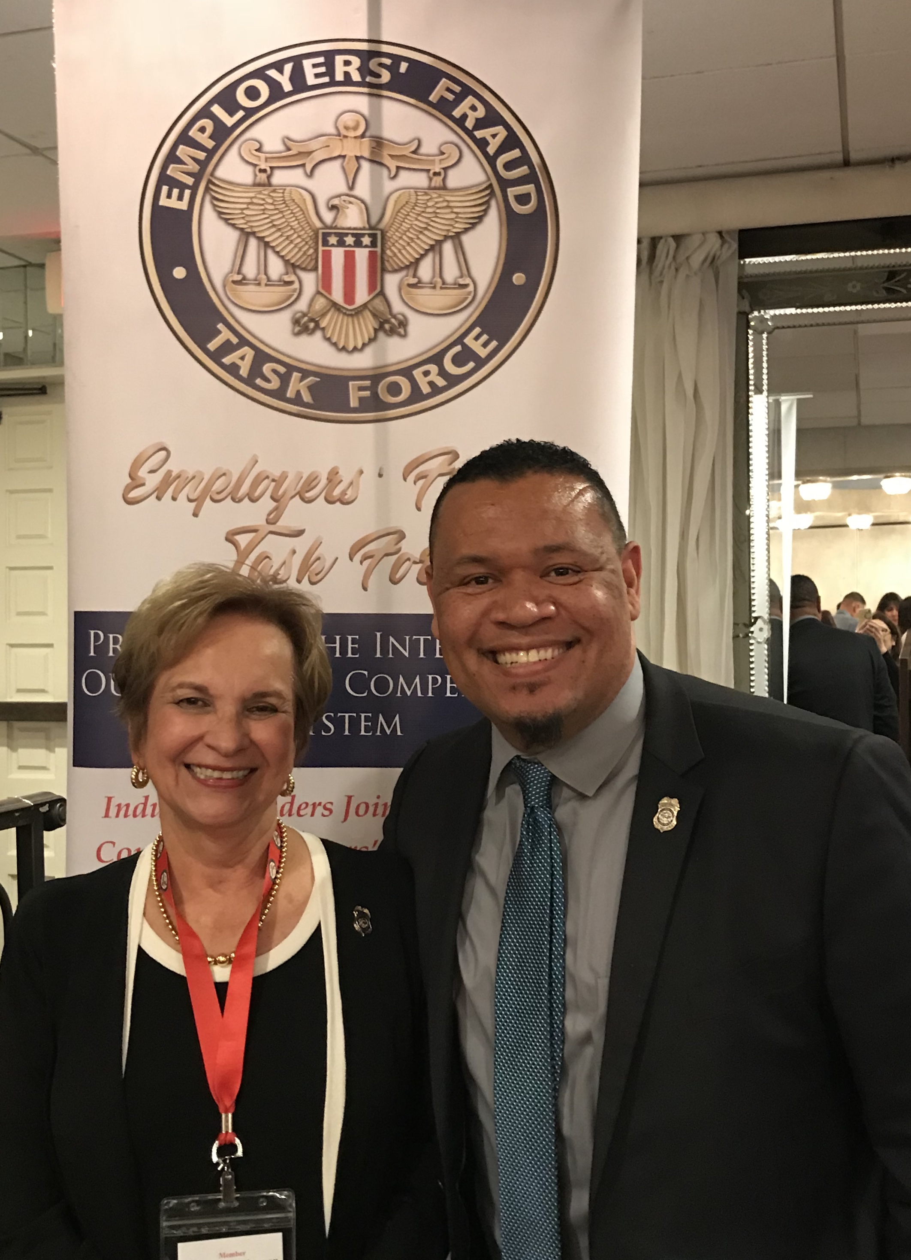
About Me and My journey

Slide 3
Jobs within workers’ compensation
Claims Adjuster
Premium Auditor
Investigator
Marketing and Sales
Policy Researcher
Compliance Analyst
Social Media Investigator
Subrogation Analyst
Risk Control Specialist

Slide 4
Day in the life of a workers’ compensation claims professional

Slide 5
The fun and not so fun stuff

