Slide 1
CSUN Risk and Insurance Professor for a Day
October 25, 2019
Northridge, CA

Slide 2
Commercial Insurance’s Place in the Market
3.1% of GDP (Banking is 2.9%)
Last to Forego
Complex, Relationship Based Sales
Industry Values Talent and Performance

Slide 3
My Journey
Field Engineer: 1994-1996
Account Engineer: 1996-1998
Account Manager (Sales/Und.): 1998-2001
District Manager: 2001-2006
Area Manager: 2006-2013
Regional Manager: 2013-Present

Slide 4
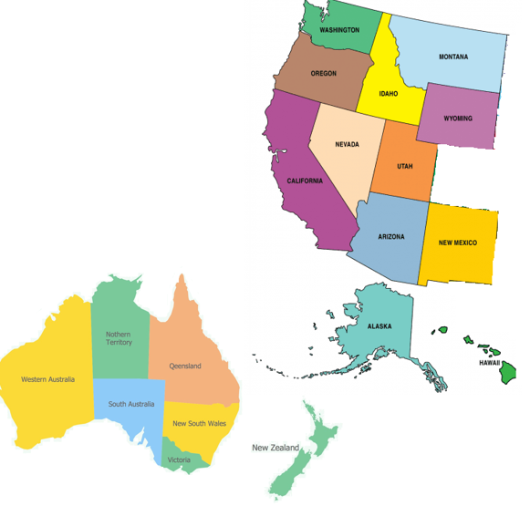
My Role
Budget: $300M
Corporate Governance
70 People
Growth
Profit
Profit
$
$
$500M Authority
Profit
$

Slide 5
The Commercial Market & Our Place In It
Risk
Management
Upper Middle Market
Middle Market
Main Street
Personal Lines

Slide 6
Risk Management and Upper Middle Market Property Insurance
Biggest Volatility and Balance Sheet Exposure
Complex Arrangements
Technical and Interpersonal Expertise
Littlest Litigation and Lack of “Long Tail”
Innovation and Adaptability Protect Model

Slide 7
Innovation Threats (and Responses)
Technology Will Commoditize Insurance Offerings
Alternative Risk (Hedge Funds) Will Drive Off Profit
New Perils Will Destroy Balance Sheet
Continuing Mergers Will Reduce Need for Capital Protection

Slide 8
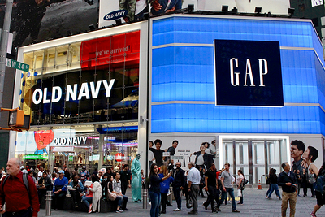
Notes:
Gap, Old Navy, Banana Republic

Slide 9
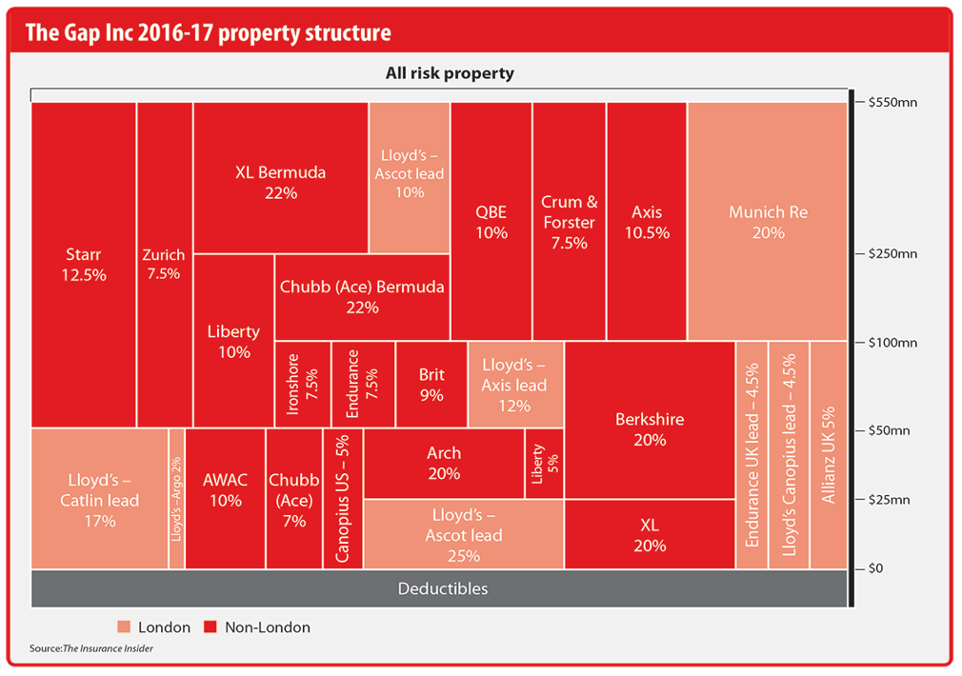
Program Structure

Slide 10
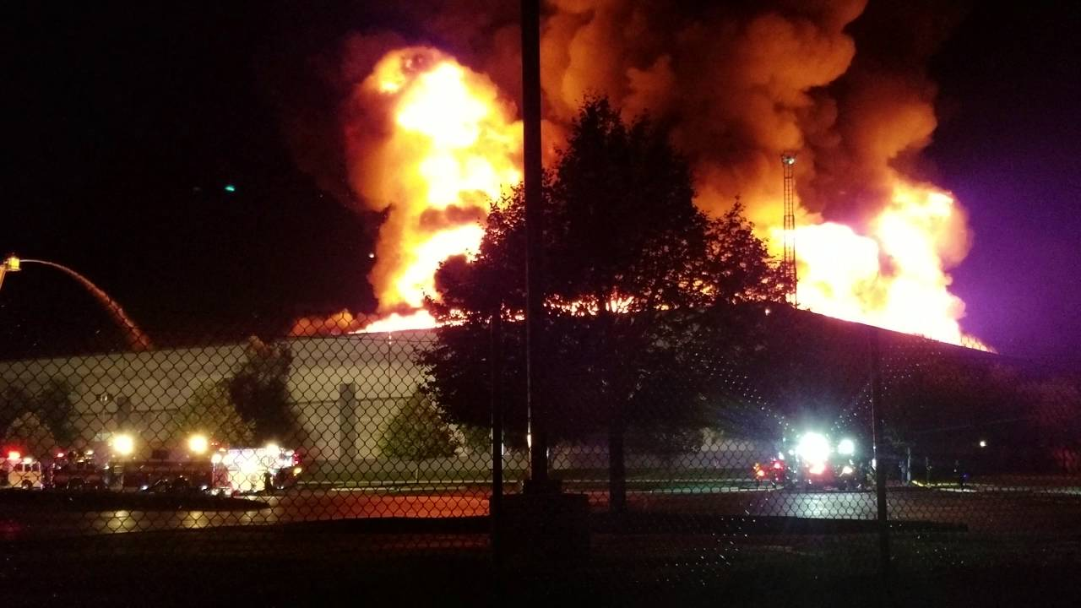
Fishkill, New York Fire

Slide 11
General Career Advice
Be Mindful of Education and Experience
Interview: SHARE and Activities
Balance Autonomy and Association
Be Deliberate in Your Brand
Notes:
They may be concern about you taking or staying in a entry position, willing to do low-level work, feeling of entitlement
S – working on a project, H – not everyone doing their part, A – assigned work to members, R – good work, E – learned to be organized
Good to be able to talk about responsibility and autonomy, but attachment to noteworthy accounts and business is good (mutual fund experience)
Brand – “last in, first out”, “entitled”, “ask good questions, ask same questions”, “doesn’t ask for help.” “only concerned about what the company is doing for them”, 7 jobs a bit of a misnomer

Slide 12
Any questions?
Sean Bishoff

