Slide 1
Inequality is the Problem: What’s Our Response?
ADAM GAMORAN
William T. Grant Foundation

Slide 2
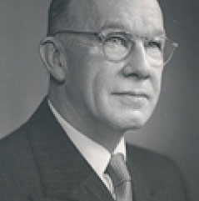
1930’s
1940’s
Founded in 1936
Committed to understanding human behavior through research.
The most pressing challenges confronting young people change over time.
1950’s
1960’s
1970’s
1980’s
1990’s
2000’s
2010’s

Slide 3
Current Research Priorities

Slide 4
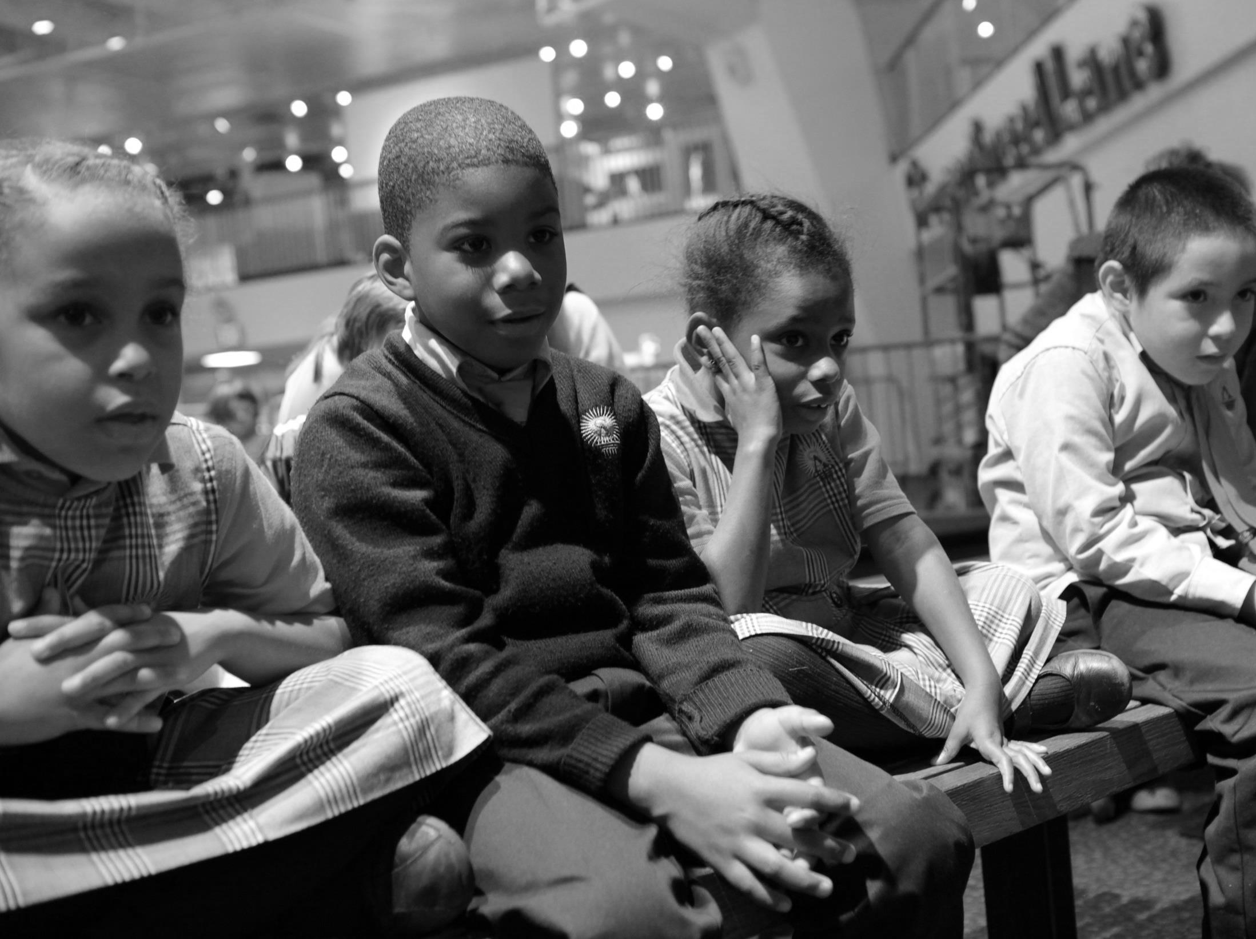
Use of Research Evidence
Quality of research evidence has improved
Yet when it comes to decisions, research is rarely consulted
Why?
We support studies of how research evidence is used in policy and practice

Slide 5
Reducing Inequality
We know much about the sources of inequality by economic, race/ethnic, & immigrant origins
Ways to reduce inequality are less well understood
We support research on programs, policies, and practices that reduce inequality in youth outcomes
Academic, social, behavioral, and economic outcomes

Slide 6
Reducing Inequality
“Inequality” has two meanings
Overall dispersion of an outcome
Group differences in an outcome
We’d like to reduce the first and eliminate the second

Slide 7
Reducing Inequality
Fighting poverty is an important part of reducing inequality, but not all there is to it
We’d like to reduce inequality across the spectrum
One can “reduce inequality” by elevating those lower down or holding back those who are on top
Only the former is of interest

Slide 8
Inequality is the Problem
Levels of inequality are exceptionally high
High inequality causes economic and social harm
Social policies can combat inequality
We need research to identify effective policies, programs, and practices

Slide 9
Inequality is the Problem
Levels of inequality are exceptionally high
High inequality causes economic and social harm
Social policies can combat inequality
We need research to identify effective policies, programs, and practices

Slide 10
Inequality in the Headlines

Slide 11
Levels of Inequality are
Exceptionally High
Income inequality has expanded dramatically

Slide 12
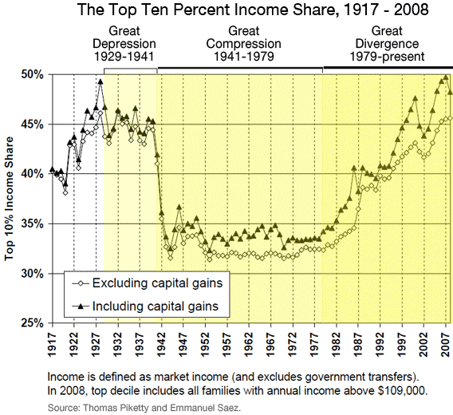
SOURCES: PIKETTY & SAEZ, 2009
KRUGMAN, 2007
NOAH, 2012

Slide 13
Levels of Inequality are
Exceptionally High
Income inequality has expanded dramatically
Effects of inequality on child outcomes have grown
Reardon: Achievement gap between 10th & 90th income percentiles now larger than black-white gap

Slide 14
Levels of Inequality are
Exceptionally High
Compared to other countries, U.S. performance seems mediocre
Achievement and attainment in the middle of the pack
Mediocre averages obscure large inequalities
Geographic, economic, and race/ethnic differences

Slide 15
Average 2011 TIMSS Scores, Grade 4 Math
Source: Provasnik et al. (2012)

Slide 16
Average 2011 TIMSS Scores, Grade 4 Math
Source: Provasnik et al. (2012)

Slide 17
Average 2011 TIMSS Scores, Grade 4 Math
Source: Provasnik et al. (2012)

Slide 18
Average 2011 TIMSS Scores, Grade 4 Math
Source: Provasnik et al. (2012)

Slide 19
Levels of Inequality are
Exceptionally High
About 42% of U.S. young people earn college degrees (A.A. or B.A.)
Once the highest proportion in the world, the U.S. is now 14th
But this obscures inequality
54% in MA, 38% in CA, 29% in AR
MA would be 1st in the world, AR would be 28th!
Also large gaps by SES, race/ethnicity
“Once a Leader, U.S. Lags in College Degrees”

Slide 20
Levels of Inequality are
Exceptionally High
OECD study of adult literacy
US: Below-average performance, highest inequality
US: A high school dropout whose parents dropped out is 10 times more likely to have low literacy than a graduate whose parents also graduated
Twice the international average gap
Whether our gaze is international or historical, inequality in the US is exceptionally high

Slide 21
Levels of Inequality are
Exceptionally High
High inequality is getting worse, not better
Spotlight on education, the gateway to mobility
In 2001, I predicted that black-white inequality would decline while socioeconomic inequality would persist
In fact, black-white inequality has made little progress and socioeconomic inequality has gotten worse

Slide 22
Trends in Educational Inequality
Black-White Gap in High School and College Completion, 1970-2010
Percentage Point Difference
Source: Digest of Educational Statistics 2012, Table 9.

Slide 23
Trends in Educational Inequality
NAEP Trends in Math at Age 13
NAEP Score Gap
Source: Digest of Educational Statistics 2013, Table 222.85.

Slide 24
Trends in Educational Inequality
Summary of Recent Trends
Black-white gaps in high school completion and college enrollment have narrowed, but the gap in college completion has widened
Recent declines in racial achievement gaps have not made up for earlier expansion of gaps
Socioeconomic gaps have remained steady in some areas (attainment) and gotten worse in others (test scores)

Slide 25
Inequality is the Problem
Levels of inequality are exceptionally high
High inequality causes economic and social harm
Social policies can combat inequality
We need research to identify effective policies, programs, and practices

Slide 26
Inequality is Harmful
Is inequality a drag on productivity?
Some inequality may be necessary to motivate performance
Countries with more inequality tend to have lower productivity
Recent S&P study: US inequality causes slower growth
Comparative and US historical evidence

Slide 27
Inequality is Harmful
Unequal opportunity means wasted talent
“Purely from an economic perspective – leaving aside important questions of social equity – opportunity is being lost on a large scale” (Belfield & Levin, 2012).
“Inequality is the enemy of economic growth” (Reich, 2013).

Slide 28
Inequality is Harmful
Inequality is also socially divisive
Unequal education means schooling fails to provide a common socialization experience
In an unequal society, social networks are fragmented rather than integrated
As education becomes stratified by social origins, mobility prospects decline
How much harm? Still debated
No question that young people born into social and economic disadvantage have fewer opportunities

Slide 29
Inequality is the Problem
Levels of inequality are exceptionally high
High inequality causes economic and social harm
Social policies can combat inequality
We need research to identify effective policies, programs, and practices

Slide 30
Policy Can Address Inequality
In today’s rhetoric, inequality seems inevitable
Piketty: Returns to capital exceed income growth
Yet inequality also responds to institutions
Institutions are amenable to policy

Slide 31
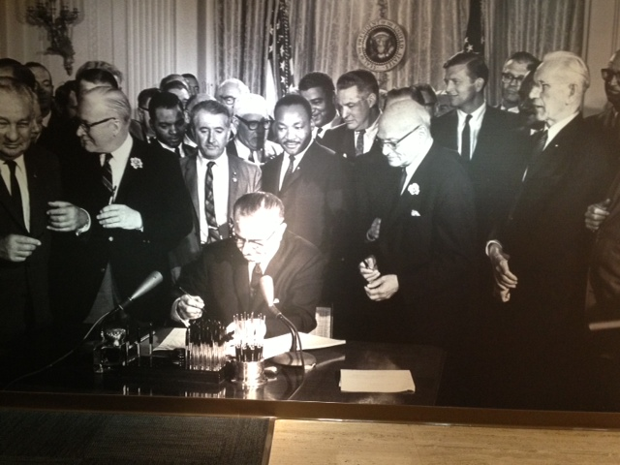
Policy Can Address Inequality
War on Poverty
Has not been won
Poverty would be worse without it
Food stamps, school lunches, earned income tax credit, housing & unemployment assistance

Slide 32
Policy Can Address Inequality
Other programs, policies, and practices have reduced the effects of inequality on children
High-quality early childhood programs
Programs that promote healthy parenting
Family-school engagement programs
Small classes in early elementary grades
Social-psychological interventions
Financial aid assistance
Constraints of disadvantage are not unbreakable

Slide 33
Policy Can Address Inequality
If all these programs work, why the growth in inequality?
Effective responses have emerged, but they are modest compared to the scope of the problem
Programs take time to have effects
School reforms take 3-5 years to work
Early child care effects emerge a decade later
Need for multiple efforts across multiple spheres
Family, health, neighborhood, school, workforce
Programs, policies, practice work differently in different contexts and for different individuals
Implementation, implementation, impleme…

Slide 34
Inequality is the Problem
Levels of inequality are exceptionally high
High inequality causes economic and social harm
Social policies can combat inequality
We need research to identify effective policies, programs, and practices

Slide 35
Inequality in the Headlines
“Research may be able to provide evidence on which public policies are most helpful in building an economy in which people are poised to get ahead. Conversely, it would also be beneficial to understand whether any policies may hold people back or discourage upward mobility.”

Slide 36
Need for Research on Reducing Inequality
High-quality social science research on youth development can play a key role
The William T. Grant Foundation wants to help stimulate and support this work
Not just in education
The justice system
Child welfare
Workforce transition
Immigration

Slide 37
Need for Research on Reducing Inequality
Hallmarks of our approach
Focus on young people (ages 5 to 25)
In the long run, research we support will lead to action
Build, understand, test, and improve programs, policies, and practices
No single study will be transformative
Results will accumulate to guide policy and practice
Support for tools that benefit many researchers
Interdisciplinary portfolio
We seek researchers to answer this call

