Slide 1
Fall 2023 Student hiring & processing Webinar
presented by Erick Cuevas
Wednesday, August 2nd, 2023
via Zoom
Notes:
\

Slide 2
Agenda
Introduction
NEW – Student Hire Process Change
Wrapping up Summer
Student Hiring
Choosing the right Job Code
Action/Reasons
Module Entries
Q & A
Contacts/Resources

Slide 3
New - STUDENT Hire PROCESS CHANGE
All new student assistant hires should be hired into the 1870 classification unless they are 1150 hires or Work-Study
All students should have an end date of 05/24/2024 upon hire
These changes are effective immediately due to an upcoming technical letter from the Chancellor’s Office
Notes:
HR to handle position changes internally
EAD’s will not be tracked in PS, HR customer service will use i9 tracker
Refer to AY calendar for end date.
Other changes resulting from CO tech letter will be handled internally by HR.

Slide 4
Wrapping up summer
All active 1874s will be automatically separated effective August 2nd.
If you had a student in this classification who will continue working, please hire/rehire them as 1870 effective August 2nd and beyond.
1874 code, when used for the summer transition, is meant only for the summer months of June and July.
August 2, 2023 is the first day students can begin to earn their 2023-2024 Federal Work-Study (FWS) award through an authorized FWS job.
Notes:
Please use CSU Salary Schedule
Exceptions for 1874s working during AY term are to be evaluated on a case by case basis.

Slide 5
Wrapping up summer
1870s who are under half-time enrollment during summer can work up to 40 hours per week until August 19th
Summer Sessions 1 and 3
Under 6 units if undergraduate level
Under 4 units if graduate level
If enrolled at half-time or more, then 20 hour max still applies throughout Summer Session
Fall semester begins Wednesday, August 23rd
August 20, 2023 to August 26, 2023 is a split week. Students may work up to a maximum of 28 hours during this period.
Notes:
Please use CSU Salary Schedule

Slide 6
Split week
When the academic semester starts in the middle of a work week
For example, when the beginning of the semester is on a Wednesday, the 1st two days of week are still in the "Break" time period can be full-time, while the remaining days of the week would be under the restriction to work half- time.
Example:
Monday = 8 hours Tuesday = 8 hours Wednesday = 4 hours Thursday = 4 hours Friday = 4 hours
Total hours that can be worked in this “split” week scenario is 28 hours. The actual hours per day worked in that week can be in any combination resulting in the slightly higher than 20 hours per week cap.
Notes:
Please use CSU Salary Schedule

Slide 7
Student Module
Job Codes used in the Student Module:
1870 - Student Assistants
1871, 1872 - Work-Study
1868 – Student Employee
J-1 and F-1 Visa students only
1874 - Taxable (based on student enrollment)
Usually reserved only for summer session
Use during academic semesters is case by case basis
1150 - Instructional Student Assistants
1151, 1153 Work Study
1152 - Off Campus
Notes:
Please use CSU Salary Schedule
HR will be evaluating current 1868 records for visa category

Slide 8
Background Check – Student Workers
Student Assistants, Instructional Student Assistants
Teaching Associates, Graduate Assistants
only required to undergo a background check if required by law
working with minors
Sworn CSU Police Personnel
Police Officer Cadets & Dispatchers
positions with access to stored criminal offender record information, patients, drugs or medication
cash handling responsibilities
Questions regarding the background check process should be directed to backgroundchecks@csun.edu
Notes:
All new hires = temporary, probationary, intermittent, and at-will employees.

Slide 9
Sign-in Process
All student workers will need to sign in if it is their first appointment, or they haven’t worked at CSUN in 18 months.
Sign-Ins are conducted by appointment only
contact HR at hrcustomerservice@csun.edu
Please attach a copy of New Employee Sign in Form to email
HR Customer Service will respond within 48 hours, Monday-Friday
Visit our website for more info:
https://www.csun.edu/hr/new-student-employees
https://www.csun.edu/hr/virtual-hr
Notes:
All new hires = temporary, probationary, intermittent, and at-will employees.
Exceptions in signing in: if two appts in separate depts, both 1870.

Slide 10
Student Module
1870 Student Assistants
Once the student is hired, they can be terminated and rehired based on department’s need
Best practices:
Notify the student!
Ensure all hours worked are entered and approved
Enter separation one day after last hours reported
Notify your payroll tech!
Effective 01/01/2023, minimum wage is now $15.50 per hour
Notes:
Summer issue
Approver deadline
May - June
Tell students self-reporters “transition period” stop reporting hours for June until all position, log in paper until the depts give the ok,
Problem: reported on wrong timesheet
1874
Best practice: student separations
Notify the student
Ensure all hours worked are entered and approved via TL (timesheet)
Enter the student separation one day > last hours reported.
Notify your payroll tech (heads up is appreciated because we’re obligated by labor law to provide final monies timely)

Slide 11
Student Module
1870 Student Assistants
Action/Reasons available:
HIR/CON: Hire/Concurrent Job
TER/END: Termination/End Temporary Appointment
effective date = last day worked + one calendar day!
only after all hours are entered & approved in timesheet
REH/REH: Rehire/Rehire
PAY/SPC: Pay Rate Change/Student Pay Change
for merit increases
Notes:
the most common mistake is that terminate with last day worked, verify that last day matches with timesheet
PAY/SPC done on Student EE Job Data Change Form, internal form
Correct end date
Pay Rate Changes- must be beginning of pay period (Payroll system issue)

Slide 12
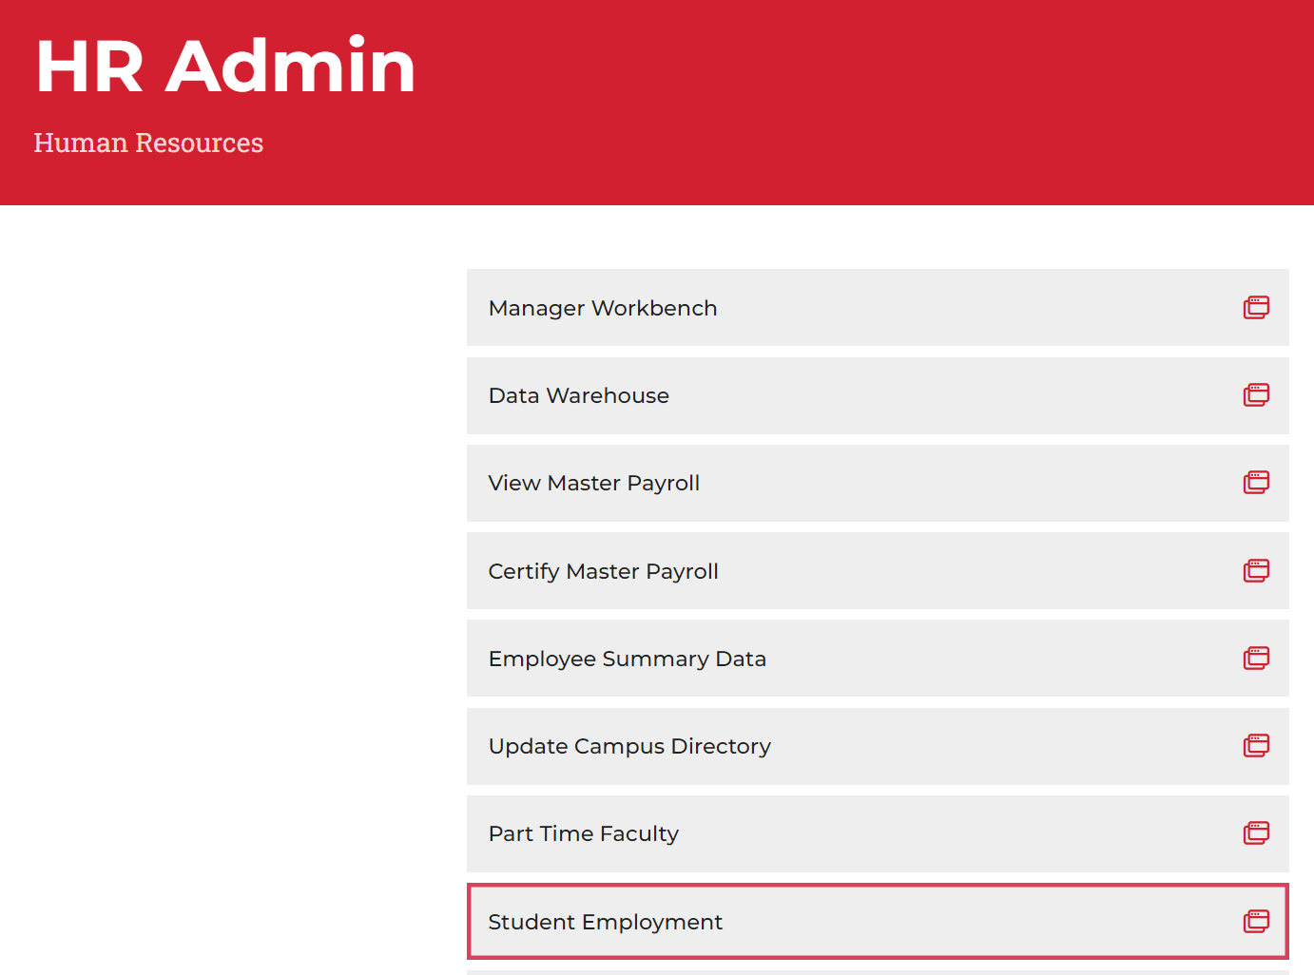
Student Module
In CSUN portal, under HR, Select “HR Admin” and then “Student Employment”
Please note: your options may vary

Slide 13
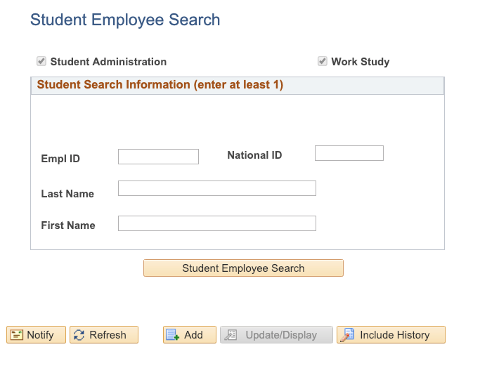
Student Module
Search for the student you would like to hire, or update.

Slide 14
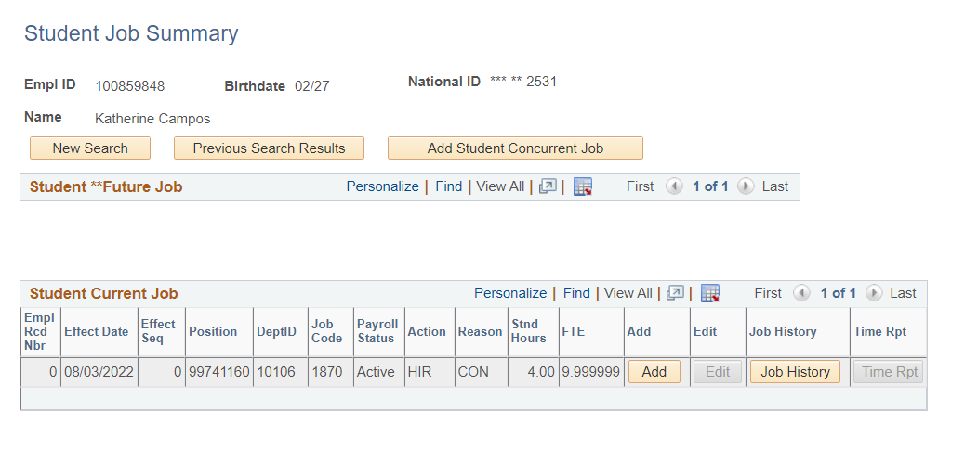
Student Module
After searching for the employee, you will be directed to the “Student Job Summary” page
Add a concurrent job (used for new hires)
add a row to an existing job

Slide 15
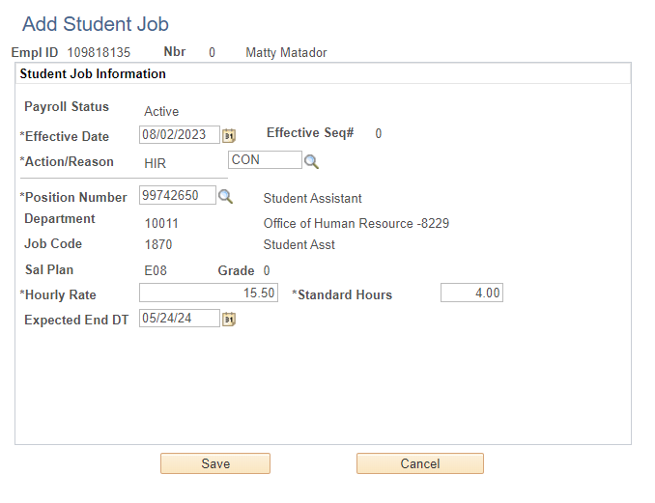
Hiring an 1870 student
Notes:
1. Effective Date
• Auto-populates to today’s date. Make sure to
change the effective Date if you need to.
• The Effective Date should be the student’s
first day of work.
2. Action/Reason
• Action: defaults to Hire “HIR”
• Reason: type “CON” or select “CON” from the
options provided from the magnifying glass
3. Position Number
• Enter the Position Number, or click on the
magnifying glass to view your options
• Search with DeptID and Job Code
4. Hourly Rate
5. Expected End Date
• must be entered for all job codes
• Click “Save”

Slide 16
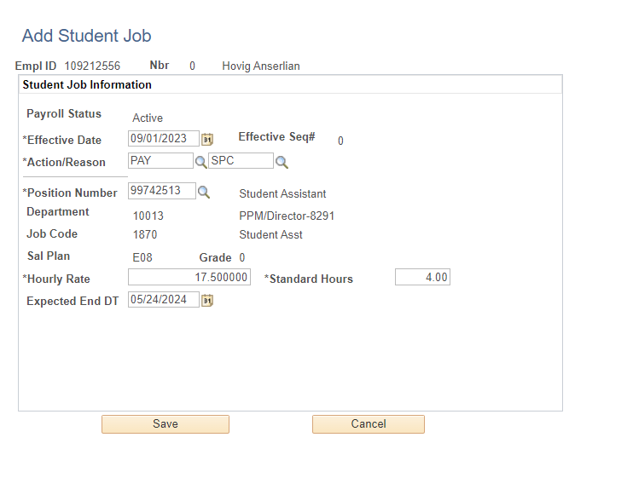
Pay increase for an 1870 student
Notes:
Add Student Job
• To change the pay rate for 1870,
1871, 1872:
• Select “Effective Date” at the
start of a pay period:
- ex. 03/01/2020
• Use Action/Reason “PAY/SPC”
• Update “Hourly Rate”

Slide 17
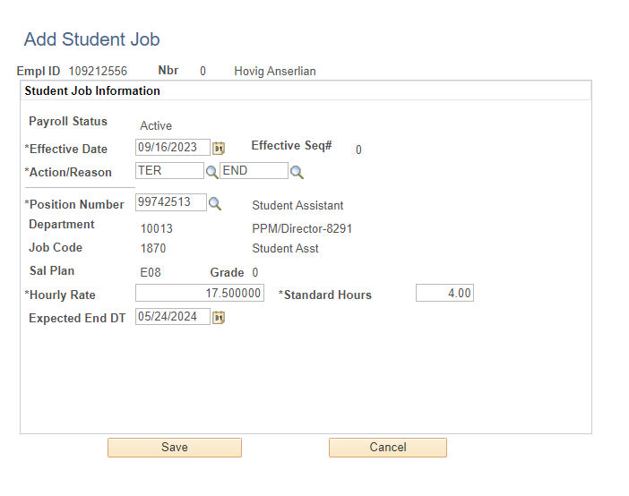
Separating an 1870 student
This means that the last day worked was 09/15/23
Notes:
this day means the first day they are on separation status

Slide 18
Student Module
1150 Instructional Student Assistants
Academic Student Employees (R11)
same union as Teaching Associates & Graduate Assistants
have appointment letters generated to stipulate the job’s duration, job duties, etc.
Please default end date to end of academic year 05/24/24
no gaps between continuing appts.
As of 01/01/2023, 1150 minimum is $16.20
Notes:
JM to handle appt letter inquiries for individuals

Slide 19
Student Module
1150 Instructional Student Assistants
Action/Reasons:
HIR/CON: Hire Concurrent Job
TER/END: Termination/End Temporary Appointment
effective date = last day worked + 1 calendar day
use only after all hours are entered and approved
REH/REH: Rehire/Rehire
DTA/APT: Data Change/New Temporary Appointment
Used for extensions or pay rate changes

Slide 20
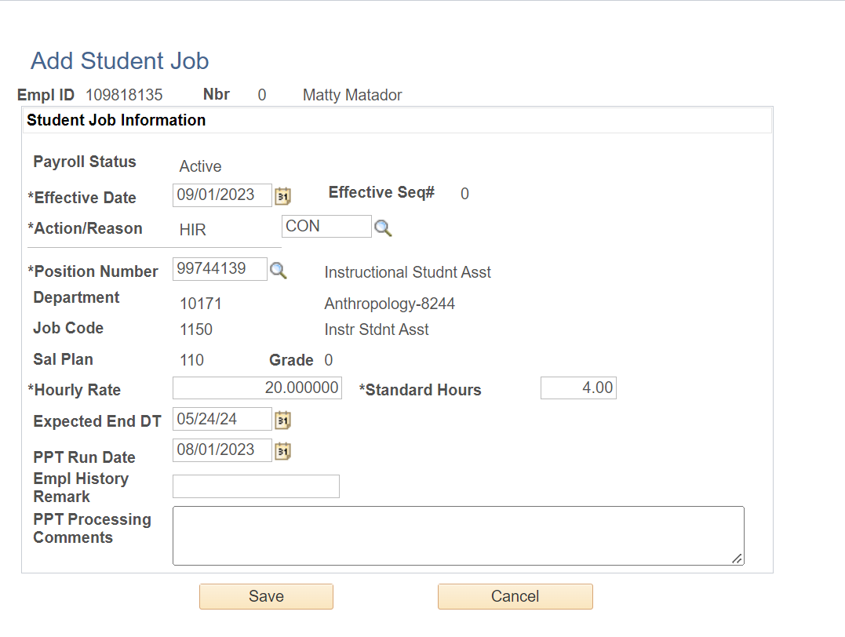
Hiring an 1150 student
Notes:
Hint on End Dates:
1868, 1150 = end of the academic period
1871, 1151 = Work-Study end date, May 15th

Slide 21
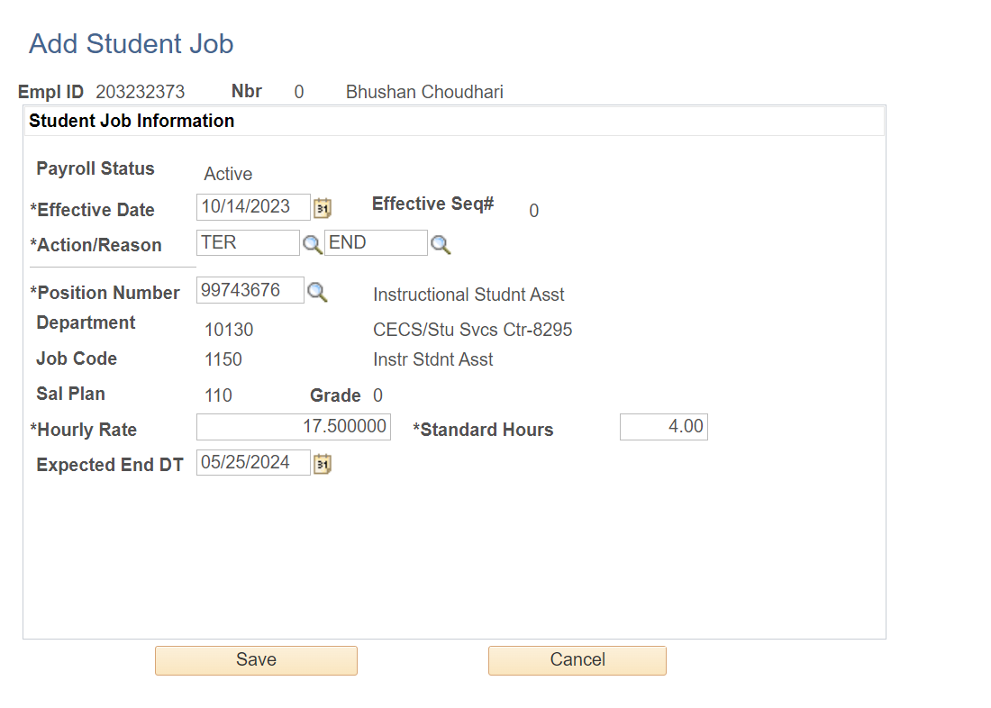
Separating an 1150 Student
This means that the last day worked was 10/13/23

Slide 22
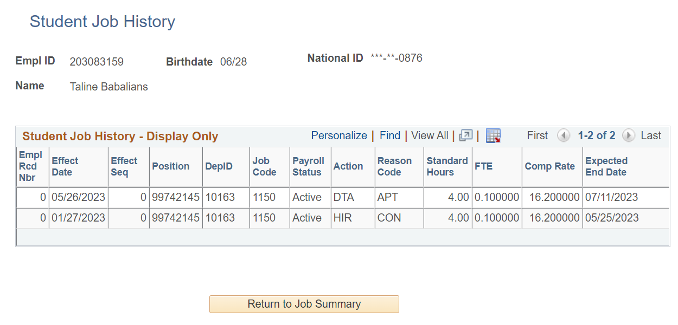
Checking Job History
Notes:
Add Student Job
• To change the pay rate
for 1150, 1151, or 1868:
• Use Action/Reason
“DTA/APT”
• Check Expected End Date to be sure the appointment hasn’t expired

Slide 23
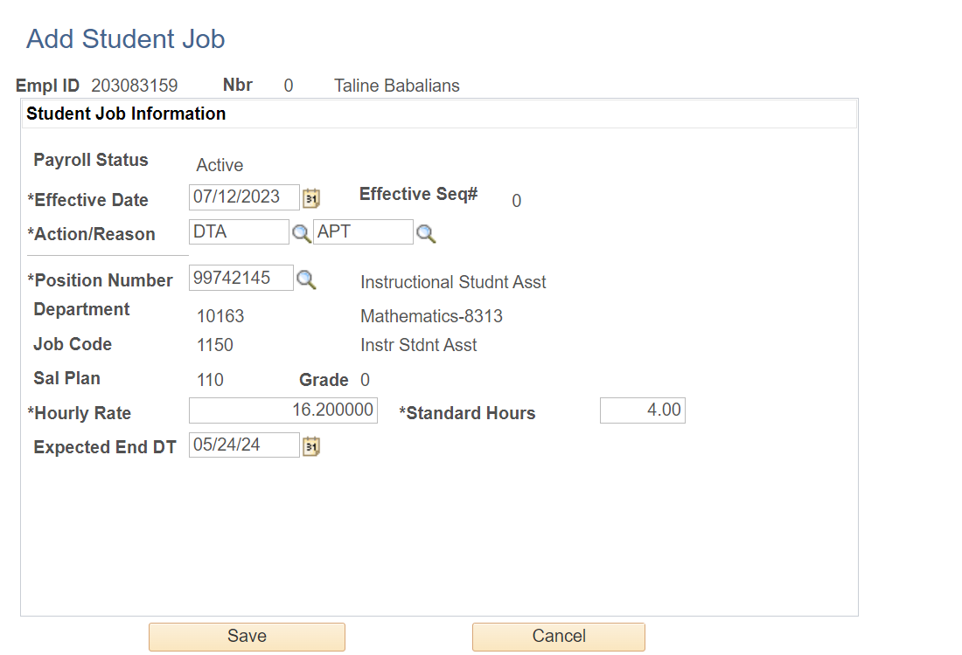
Extending an 1150 student
This means the previous appt. end date was 07/11/23
Remember, no gaps between appointments!
Notes:
Add Student Job
• To change the pay rate
for 1150, 1151, or 1868:
• Use Action/Reason
“DTA/APT”
• Check Expected End Date to be sure the appointment hasn’t expired

Slide 24
Breaks and holidays
Non-academic period from December 25, 2023 to January 16, 2024. During that period, a student may work a maximum of 40 hours per week for all student jobs combined. In no circumstance can student employees work more than 40 hours in a work week.
Under no circumstances are students to work overtime.
Campus holidays for the Fall semester are observed on September 4, November 23-24, and December 25-31. Student Assistants are not expected to work on those days.
Notes:
Best Practice: Schedule your student hours accordingly during campus observed holidays. Under no circumstances are students to work OT.

Slide 25
Additional info
During the academic semester, student employees may work up to, but no more than 20 hours per week in all positions combined.
The work week begins on Sunday and ends on Saturday. The 20-hour restriction is applicable regardless if the week falls in a single pay period or includes a portion of another pay period.
If a student has multiple jobs, it is their responsibility to coordinate all work schedules with their supervising managers.
Self-reporters – those responsible for entering their own time directly in the system -- must only report time worked after the work has been performed.
Advance time entry is not allowed. Students who are not self-reporters must record time on the paper Timesheet and submit the document to their department(s).

Slide 26
Contacts
For hiring & processing questions, contact the appropriate HR Operations technician for your department
Human Resources & Financial Aid Contact | Contact Information
Joe Medina Academic Personnel & Payroll Operations Manager | joe.medina@csun.edu (818) 677-6687
Robyn McKibbon Classification & Compensation Specialist | hrclass-comp@csun.edu (818) 677-7596
Diana Medina FA Counselor/FWS Coordinator | work.study@csun.edu (818) 677-2373

Slide 27
Resources
HR Toolkit: www.csun.edu/hr/hr-toolkit
CSU Salary Schedule: https://www.calstate.edu/hradm/salaryschedule/salary.aspx
Payroll Calendar: https://www.csun.edu/payroll/payroll-calendars-schedules
Student Assistant Federal Work-Study Compensation Plan https://www.csun.edu/careers/student-assistant-compensation-plan
Academic Student Employee (R11) contract: https://www.uaw4123.org/unit-11-contract

Slide 28
Questions?

Slide 29
THANK YOU!

