Slide 1
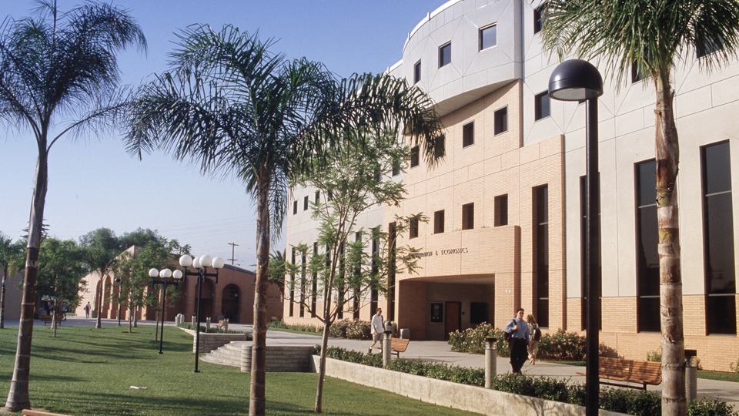
Step 1: Submit your Planning Form
Step 2: Submit your Preliminary Thesis/Grad Project/Dissertation
Step 3: Submit your Final Thesis/Grad Project/Dissertation

Slide 2
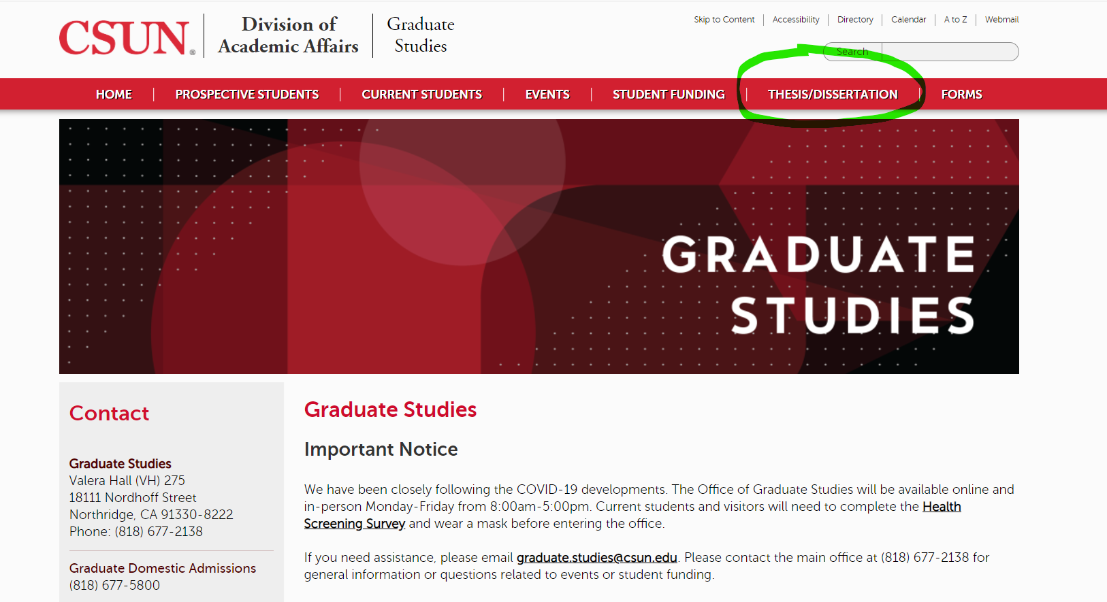
Where to locate, ETD
The link for ETD can be found on the Graduate Studies site https://www.csun.edu/graduate-studies

Slide 3
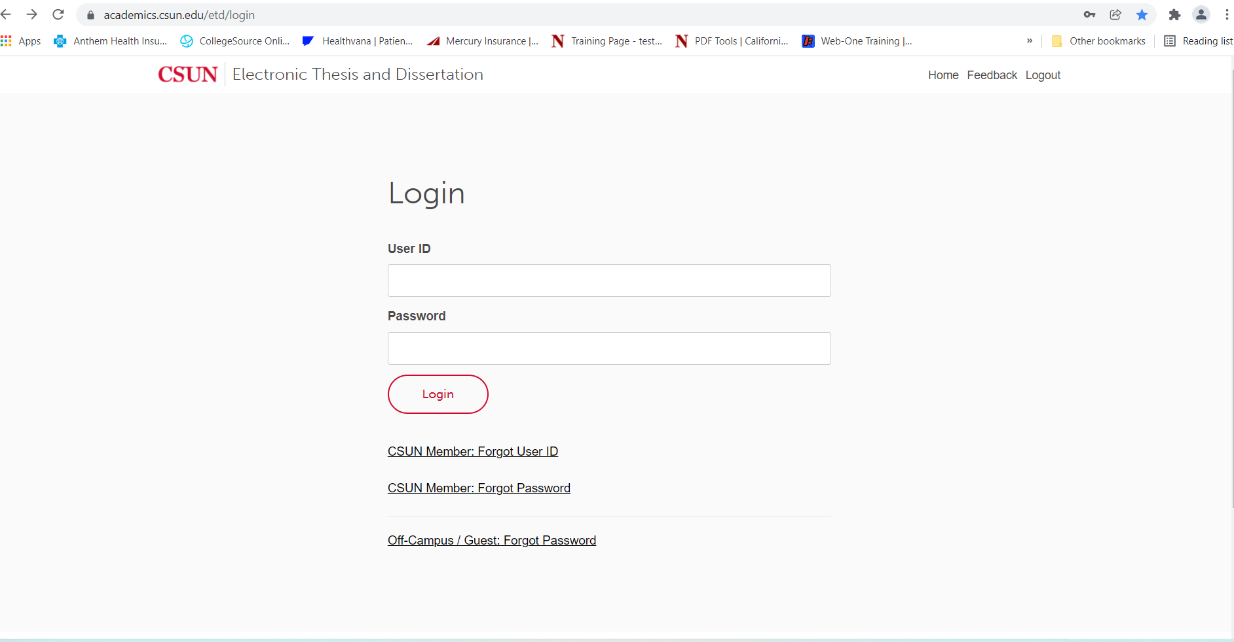
Step 1: Log into ETD go to: https://academics.csun.edu/etd/login
Use your CSUN SOLAR Credentials to Log in

Slide 4
Submitting your Planning Form

Slide 5
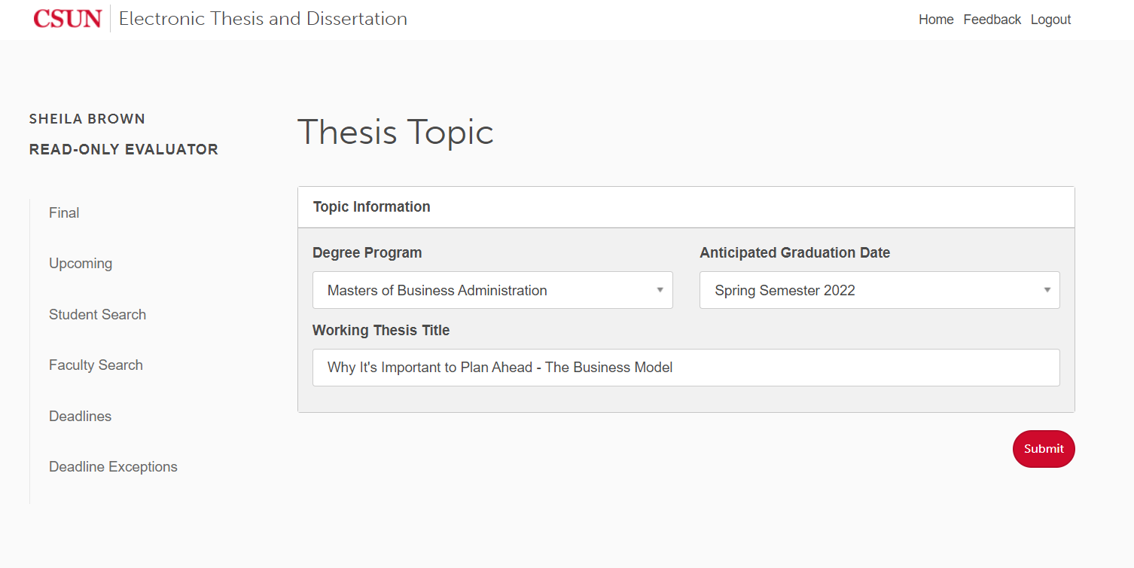
Create your Planning Form in ETD
Click on Submit Button to Select Your Committee

Slide 6
Selecting Your Committee
Remember to Click Submit

Slide 7
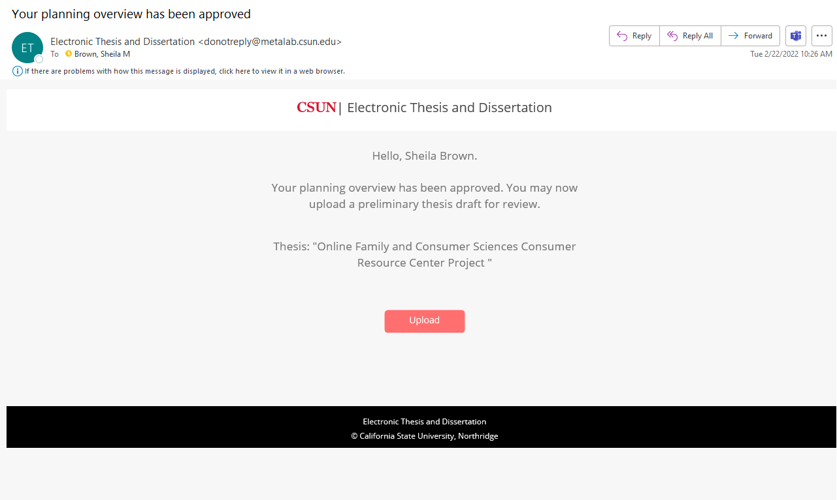
How do I know if my Planning Form has been approved?
Once your Graduate Coordinator and Committee have approved, you will get an email that looks like this

Slide 8
Submit your Preliminary Thesis/Grad Project/Dissertation

Slide 9
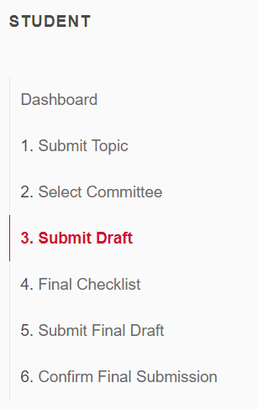
Submit Preliminary Draft for Approval
Remember to convert your file to pdf
Remember to click Submit

Slide 10
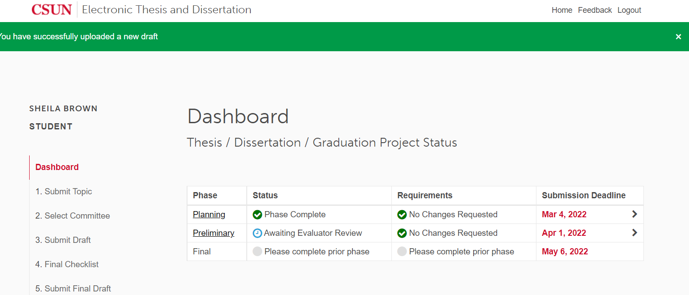
Status of Preliminary Draft
If submitted successfully your status will show “Awaiting Evaluator Review”
ETD Dashboard

Slide 11
Watch Your Emails or ETD Dashboard
Regarding changes you need to make from the Graduate Studies Evaluator
Once the evaluator reviews your preliminary draft you will receive an email informing you if it has been approved or rejected.
If approved your status on your ETD Dashboard will read “Phase Complete”
Double check for minor changes requested by evaluator you will need to make before you submit your final graduate project
If rejected your status on our ETD Dashboard will read “Changes Required in Preliminary Draft
Required changes need to be made and resubmitted to ETD within in 2 days

Slide 12
What it Looks like in ETD
Preliminary Draft Approved
Preliminary Draft Rejected

Slide 13
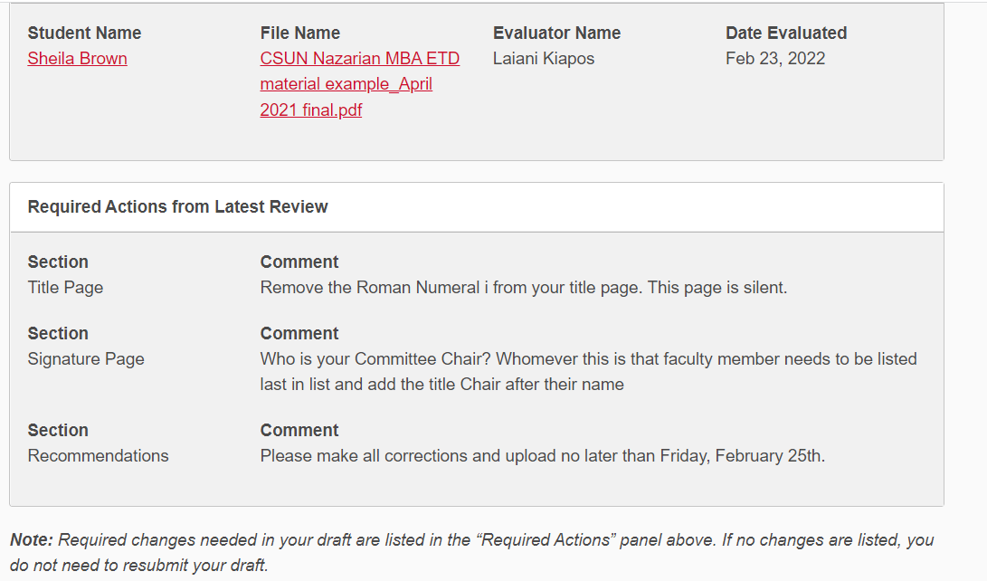
Rejected
Scroll down to view changes needed to be made
Click Here to Review Changes
Remember…
You have only two days to make the changes and upload to ETD
Preliminary submission is only a review of your graduate project format
Content changes from your committee members are outside of ETD through email

Slide 14
Upload Your Rejected Preliminary Draft Changes in ETD
Step 1: Click on Submit Draft
Step 2: Upload PDF revised version
Step 3: Click on Submit

Slide 15
Submit your Final Thesis/Grad Project/Dissertation

Slide 16
Things to Keep In Mind…When submitting your Final Graduate Project
Your preliminary draft must be approved by Graduate Studies before you can submit your final graduate project submission
Your content must be approved prior to uploading your final graduate thesis/ graduate project/dissertation submission
No content changes will be allowed after you submit your final graduate project

Slide 17
Submitting Final Checklist in ETD
This is the information that will be used by the university library
Enter keywords that pertain to your graduate project if someone was looking it up
Click on the License Agreement to give CSUN non-exclusive right to store your work
Don’t forget to click Save

Slide 18
Keyword/Search Terms
After you type your Key Words, click Enter
Once you click Enter, it will look like this

Slide 19
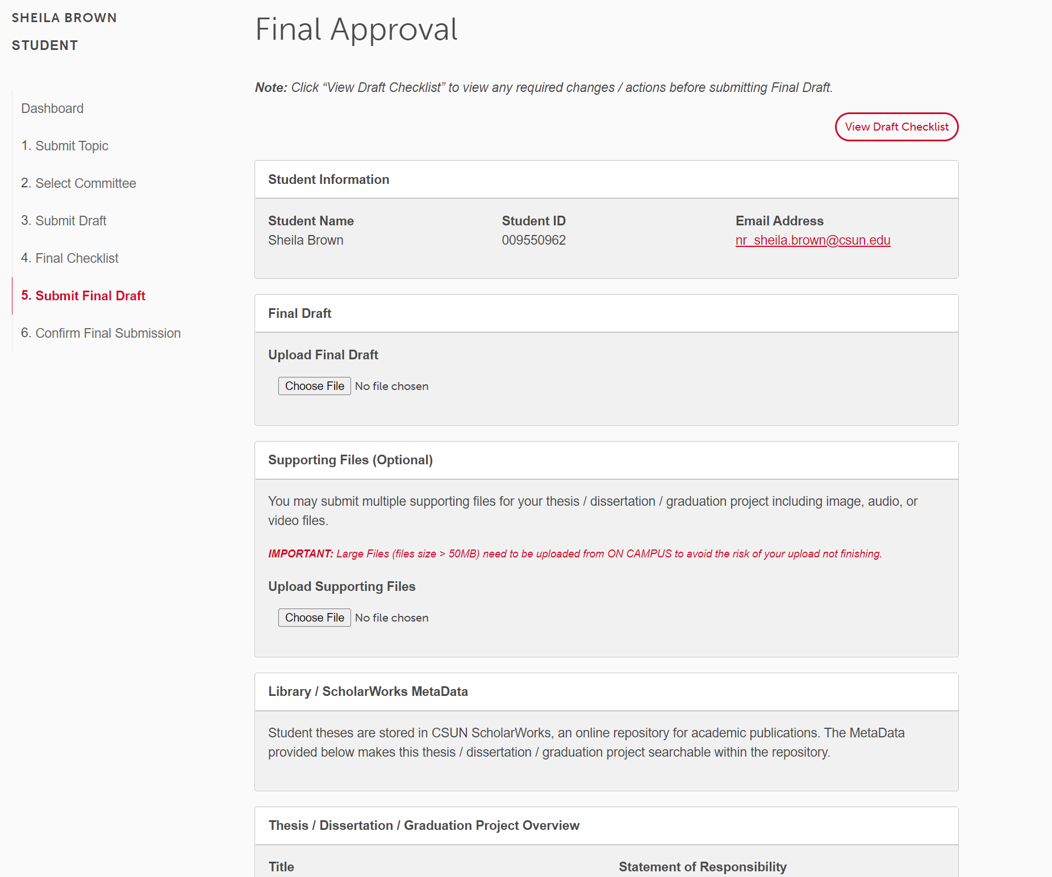
Submitting Your Final Graduate Project
Step 2: Upload Final as a PDF
Step 1: Click on Final

Slide 20
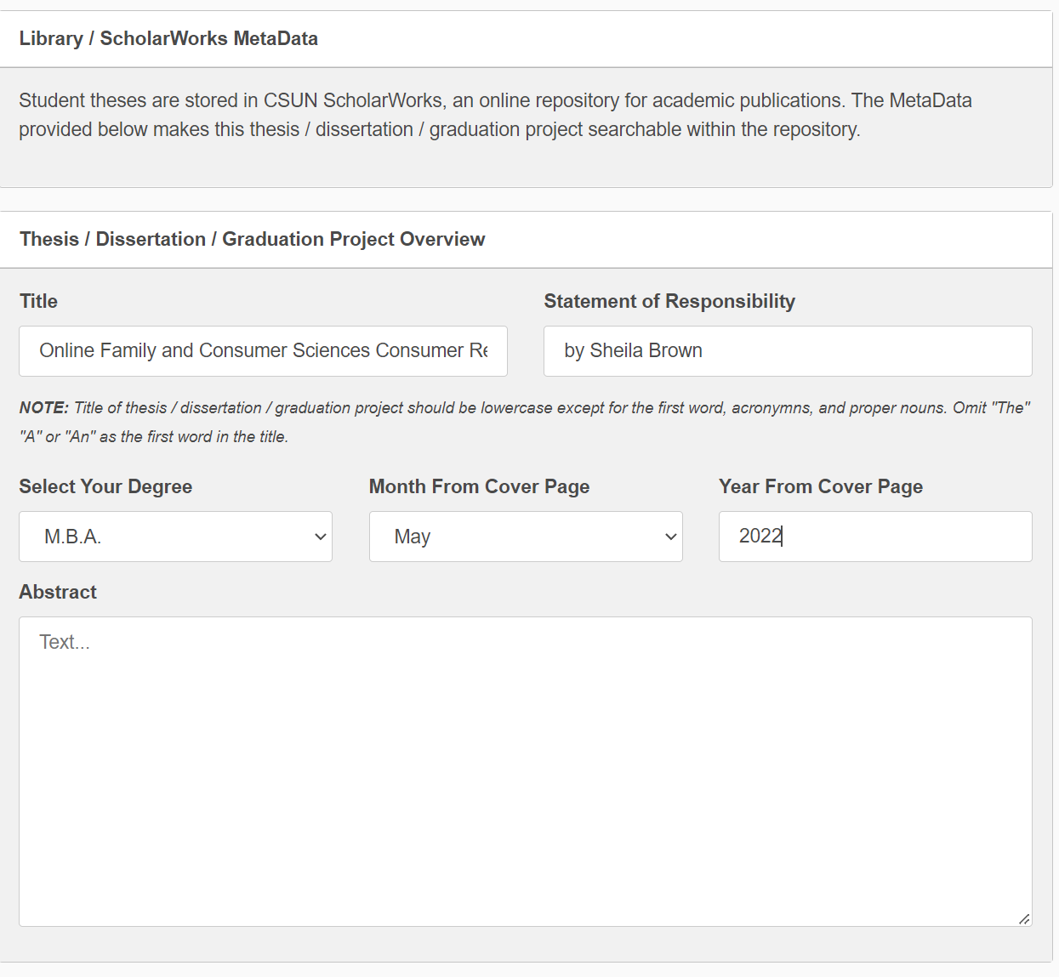
Submitting Your Final Graduate Project
Remember:
If you are graduating in Spring indicate, May, 2022
If you are graduating Summer indicate, August 2022
Include text from your abstract

Slide 21
Submitting Your Final Graduate Project
How many pages are you uploading?
Click on Save

Slide 22
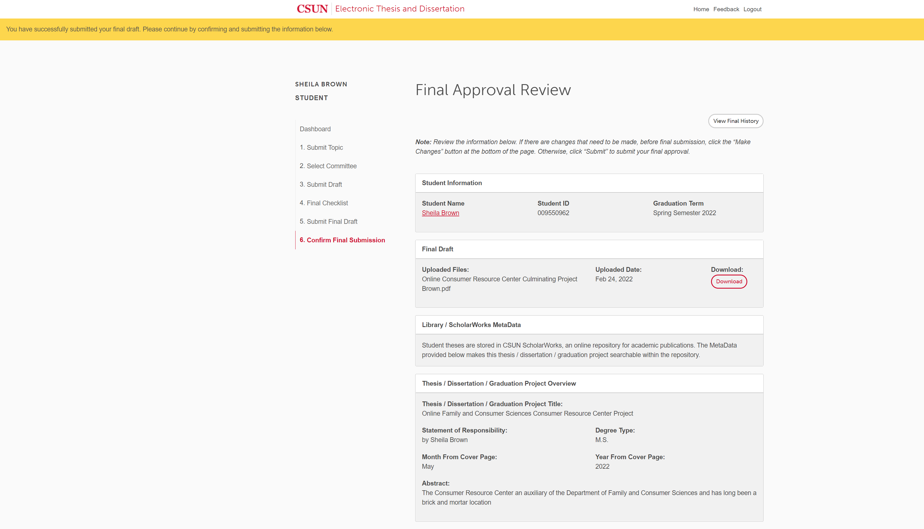
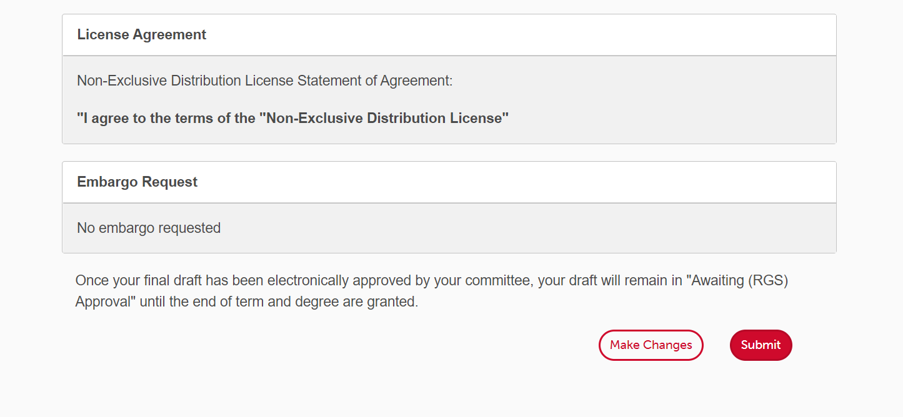
Submitting Your Final Graduate Project
Step 1: Review what you submitted
Step 2: Either Click on Make Changes if Step 1 wasn’t right or Click on Submit

Slide 23
If you submitted successfully you will see this below

Slide 24
Watch Your Emails or ETD Dashboard Notifications
Once your committee reviews your final project they will approve
Once approved by committee, it will go the to Graduate Studies Evaluator
If rejected by the Evaluator, you will have 24 hours to make the changes required.

Slide 25
What it Looks like in ETD
Final Approved
Final Rejected

Slide 26
Rejected
Look for Changes Required
Click on Formatting Changes Required
You have 24 hours to make all changes required and resubmit

Slide 27
Make Changes and Resubmit Final Project
Step 1: Click on Submit Final Draft
Step 2: Click on Submit Final Draft
Remember:
To include all the information again regarding: Degree Type, Abstract and Pagination, and click Save

Slide 28
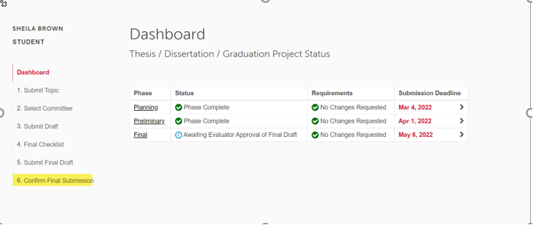
Resubmitting a Rejected Final Draft
This is what it should look like
Once you click Submit, make sure you are at the Confirm Final Submission Step

Slide 29
Congratulations! You have completed your submission to ETD

