Slide 1
Interview for Success
Before, During and After the Interview
By Devorah Torres

Slide 2
Find Opportunities
Linkedin.com
GreatInsuranceJobs.com
Indeed.com
Ziprecruiter.com
College Career Center

Slide 3
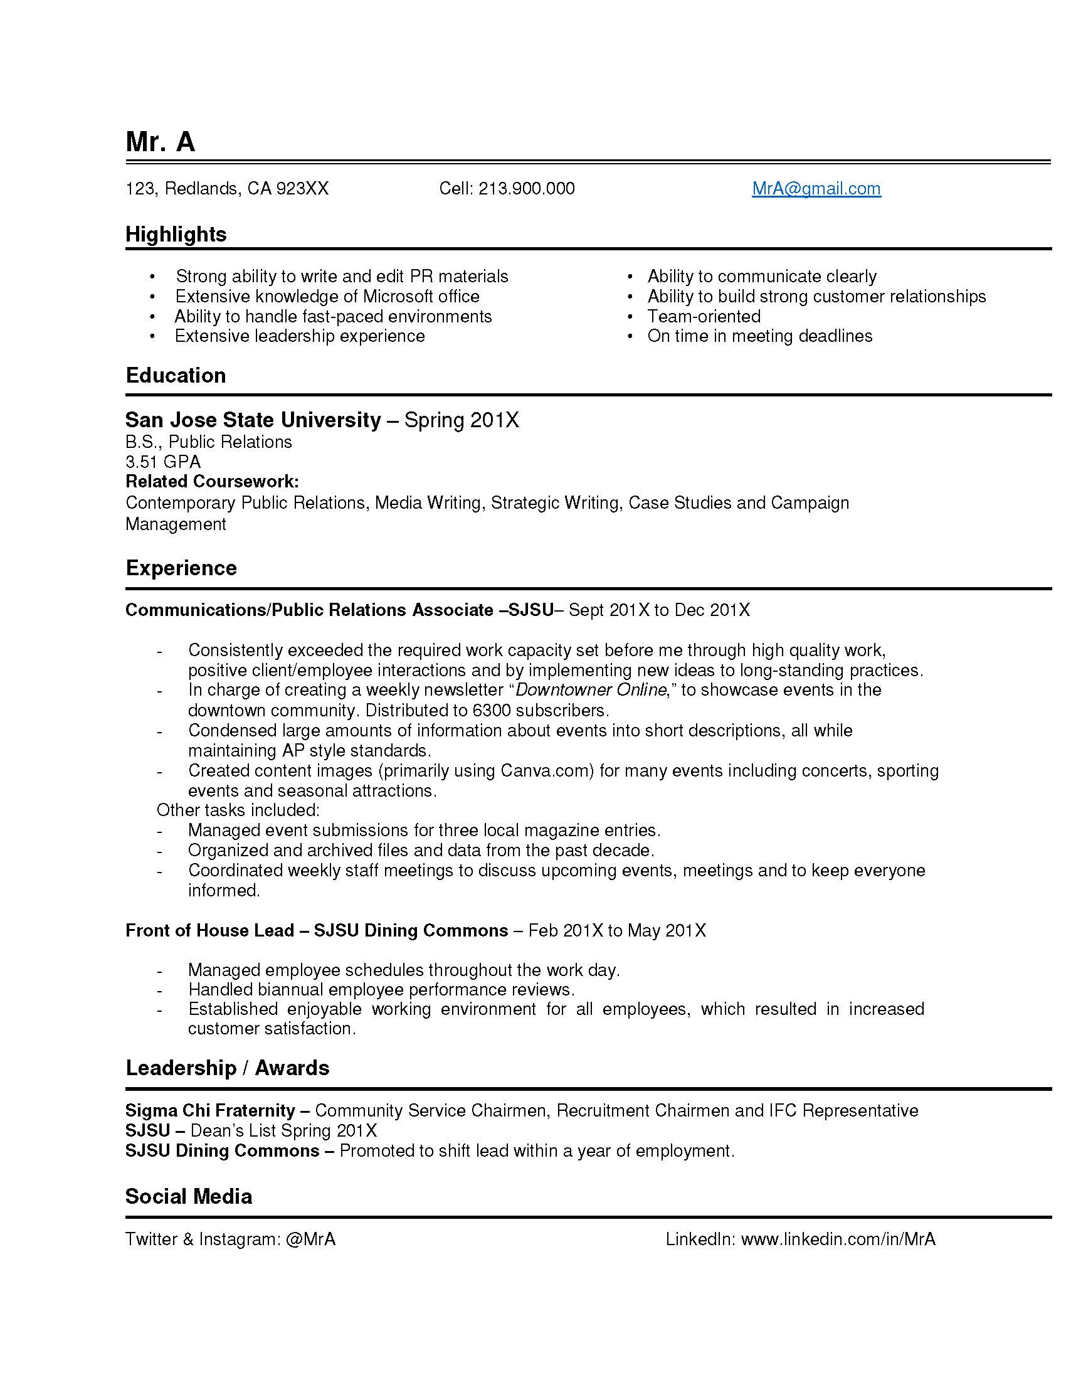

Slide 4
Prepare for the Interview
Research the Company
Research the Interviewer
Complete the Application
Dress Professionally

Slide 5
90 Seconds to Make an Impression
Good Firm Handshake
Two Copies of your Resume
Clean clothes, shoes, hair and nails
Never be late

Slide 6
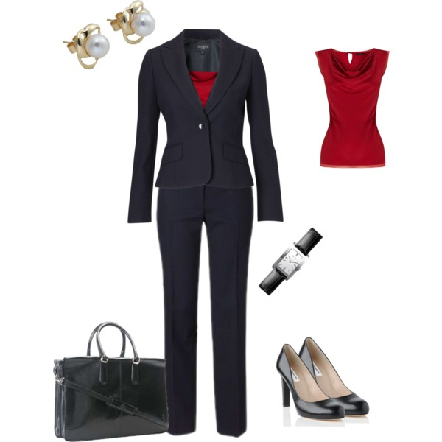
Proper Interview Attire for Women

Slide 7
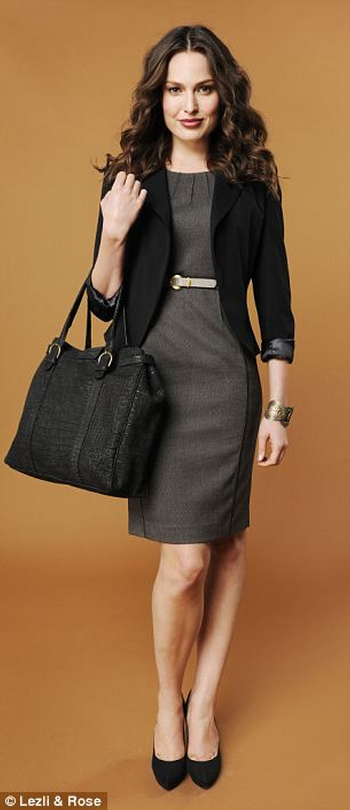
PERFECTION

Slide 8
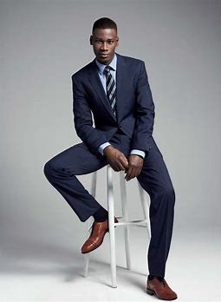
Interview Attire for Men

Slide 9

PERFECTION

Slide 10
Types of Interviews
One on One
One to Group
Phone Interview
Online Webcam Interview

Slide 11
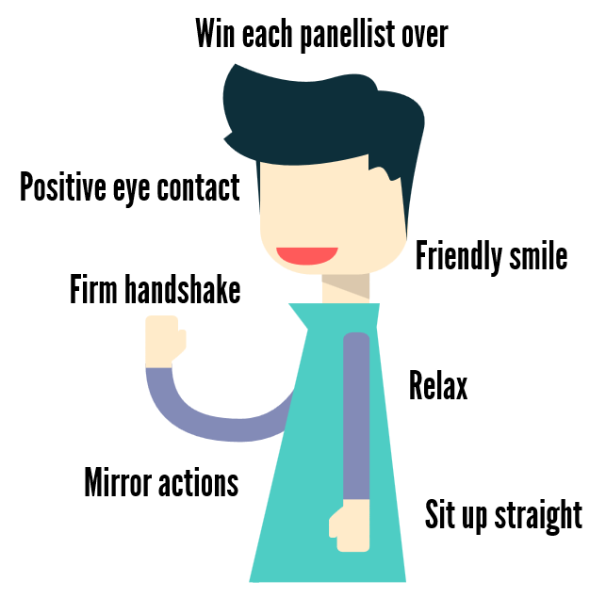
Interview Body Language

Slide 12

Body Language

Slide 13

Poor Body Language

Slide 14

Never Slouch

Slide 15
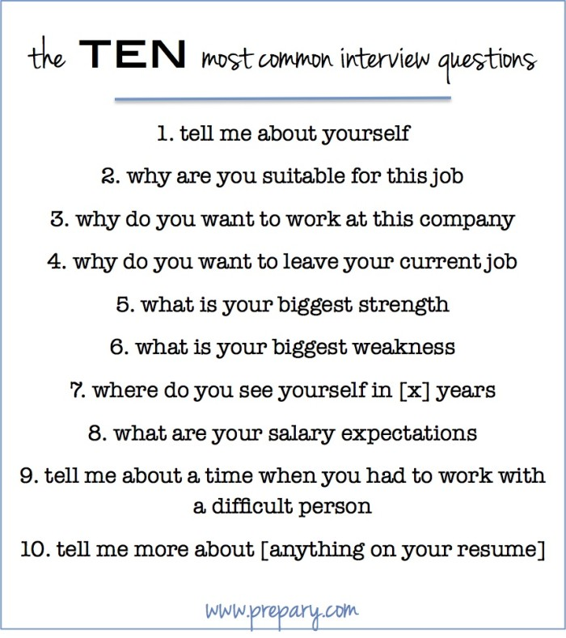

Slide 16
Questions to Ask the Interviewer
What's the most important thing I should accomplish in the first ninety days?
What is the best part of working for this company?
How would you describe the responsibilities of the position?
How would you describe a typical day in this position?
What is the company's management style?
How many people work in this office/department?
What are the prospects for growth and advancement?
Exactly how does one advance in the company?
Are there any examples of a career path beginning with this position?

Slide 17
Closing Questions
What can I clarify for you about my qualifications?
Are there any other questions I can answer for you?
Do you have any reservations about my qualifications?

Slide 18
After the Interview
Ask for a Business Card
Always End the Interview with a Handshake
Send a Thank You Email or Card if Appropriate
Many Employers Will Only Respond if you are the Selected Employee
Interviewing is a Skill. The More You Interview the Better You Will Be

Slide 19
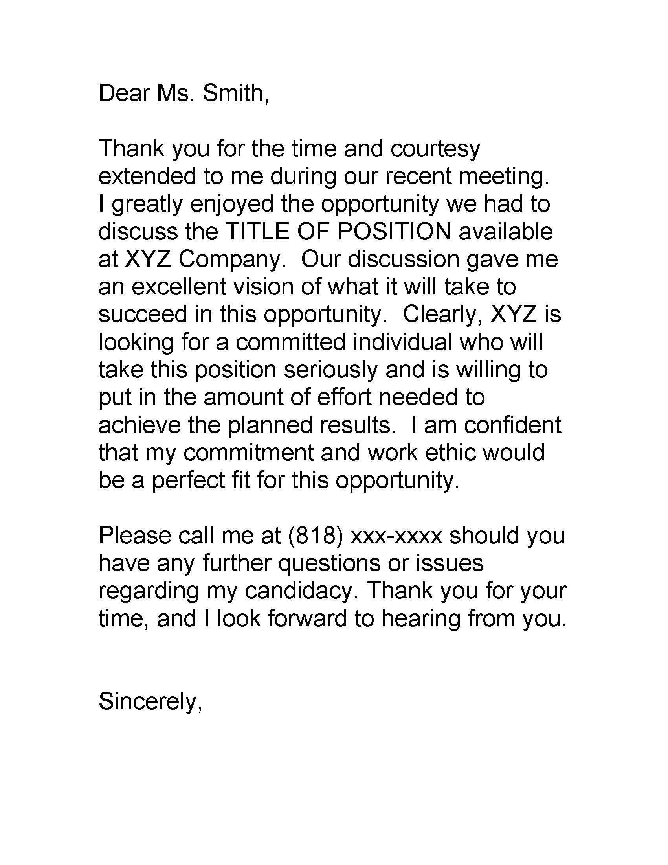
THANK YOU NOTE

Slide 20
QUESTIONS????????
Presentation Link
https://www.clearslide.com/view/new/mail?iID=gHfVJ6r4qDVQtBsH7RFF

