Slide 1



Risk Manager in Residence Program
Sponsored by
Spencer Educational Foundation
Notes:
Prepare but hide flip chart in advance with the following (for slide 27)
Risk = an UNCERTAIN future outcome that will improve OR worsen our position.
Inherent characteristics of risk:
Probabilistic
Symmetrical
Change
Welcome attendees. Go over facility logistics – location of restrooms, emergency exits, etc.

Slide 2

Risk & Insurance Industry Trends,
Challenges and Opportunities
Risk Manager in Residence
California State University Northridge
October 2018

Slide 3
Risk Manager Responsibilities
The traditional risk manager is typically responsible for:
Ensuring that assigned areas of loss are managed
Developing, organizing & managing the direct and indirect risk teams
Leveraging the RM department’s placement in the organizational structure
Influencing management and governance
Designing, Developing and Advocating for the risk mission and strategy
Developing, aligning and optimizing the RM team
Notes:
The modern risk manager is typically responsible for:
Ensuring that assigned areas of loss are managed
May have a duty to leverage opportunity
Developing, organizing & managing the internal and external risk teams
Leveraging the RM department’s placement in the organizational structure
Influencing management and governance
Risk culture & corporate culture
Advocating for the risk mission and strategy
Developing, aligning and optimizing the team
Direct vs indirect

Slide 4
Evolution of the Risk Manager
Insurance Buyers
Hazard Risk Managers
Risk Managers
Buried in Org Chart
Elevation to Management
Elevation to Directors and Officers
Strategic Risk Managers
Selected elevation to C-Suite
19 50’s – 60’s 1970’s – 80’s 1990’s 21st Century
Notes:
Talking Points:
The role of the risk manager has changed:
Insurance Buyers- The 1950s and 1960s.
Risk was defined in terms of what was insurable
Insurance focus
Buried in the org chart
Hazard Risk Managers-The 1970s and 1980s.
New tools in loss control and financing were used to quantify and treat hazard risks
Alignment of insurance with loss prevention and control
Elevation to management
Risk Managers-The 1990s
Shift beyond insurable risk
Alignment with selected risk stakeholders
Elevation to directors and officers
Risk Managers – 21st Century
Shift to all risk focus
Alignment/integration with all risk stakeholders
Selected elevation to C suite

Slide 5
Key Expertise in Risk Management
Safety/Loss Prevention
Insurance
Alternative Risk Financing
Claims
Risk Technology
Risk Subject Matter Experts (SMEs)

Slide 6
Risk Management Department Functions
Traditional Risk Management Functions
Insurance
Loss Control
Optional Risk Management Functions
Security
Claims
Risk Reporting & Technology
Business Continuity
Benefits
Quality Assurance
Compliance
What else?
Notes:
A traditional risk manager should have responsibilities for a minimum set of functions, including:
Insurance. Risk retention and transfer.
Loss Control. Loss prevention, mitigation, and safety.
Claims. Handling in-house responsibilities.
Risk Reporting/Technology. Using an RMIS effectively
Optional Functions:
Security. Protection of personnel and assets.
Business Continuity
Benefits
Quality Assurance
Compliance
Other?

Slide 7
Maturing Risk Management Practices
Good corporate governance includes managing risks
Integrating risk management functions improves performance, is more cost effective and over time is strategic
Managing risks across the enterprise requires common methods and processes
Enterprise Risk Management
Focus: Strategic and Operational Risks
Scope: Support Business Objectives/Consistent, Systematic Risk Management Practices/Risk as a Differentiator
Value
Advanced Risk Management
Focus: Individual Business Risks
Scope: Mitigation of Controllable Risks/Manage Risk as an Expense
Defensive Risk Management
Focus: Hazard and Casualty Risks
Scope: Risk Transfer/Insurance/Loss Prevention or Mitigation of Insurable Risks
Strategy
Changing business need perspective
Management
Operations
Financial
Time
Notes:
In what ways can an organization that incorporates ERM into its strategic planning process improve its decision making?
Address potentially devastating threats
Exploit opportunities by incorporating them into its current business model or completely reinventing a new model that will successfully carry it into the future
Process to manage unwanted variations from expectations
Others?
This workshop will approach enterprise risk management as a strategic discipline and process tool to be used within the strategic planning process, not an end to itself. Our focus will be more on strategic planning than on the risk management process itself. That said, strategic planning that incorporates ERM can help enable the continuation and success of the organization in creating and capturing value.

Slide 8
Risk Leader Responsibilities
The modern Risk Leader is often responsible for:
Leading the Central Risk Team
Influencing leaders within the business units
Leading a central coordinating committee
Overseeing distributed ownership of risks
Acting as the risk conduit to the C-suite and/or the board
Acting as a key resource in meeting third party risk related requirements
Appointing representatives throughout business units
Notes:
Role of the Chief Risk Officer (CRO)
A comprehensive, higher level leader role
No single role definition
Common in financial services
Emerging in non-financial services
CRO can be:
a leader of a central risk team
sit within the business units
Lead a central coordinating committee
Own all risks or oversee distributed ownership a resource
The risk conduit to the the C suite and/or board
Responsible for all risks or a selected set of key risks
Usually central to the business
Simply a figurehead to meet third party requirements

Slide 9
What is ERM?
Enterprise Risk Management is a strategic business discipline that supports the achievement of an organization’s objectives by addressing the full spectrum of its risks and managing the combined impact of those risks as an interrelated risk portfolio.ERM represents a significant evolution beyond previous approaches to risk management in that it:
Encompasses all areas of organizational exposure to risk (financial, operational, reporting, compliance, governance, strategic, reputational, etc.);
Prioritizes and manages those exposures as an interrelated risk portfolio rather than as individual “silos”;
Evaluates the risk portfolio in the context of all significant internal and external environments, systems, circumstances, and stakeholders;
Recognizes that individual risks across the organization are interrelated and can create a combined exposure that differs from the sum of the individual risks;
Provides a structured process for the management of all risks, whether those risks are primarily quantitative or qualitative in nature;
Views the effective management of risk as a competitive advantage; and
Seeks to embed risk management as a component in all critical decisions throughout the organization.

Slide 10
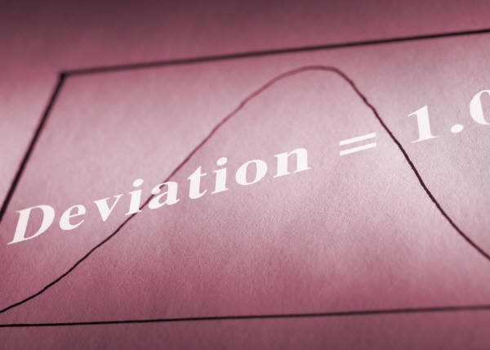
ERM’s Purpose & Value
PURPOSE?
  Offense:
  Advanced reconnaissance
  Measured alignment
  Required return
  Defense:
  Prevention
  Risk Financing
  Contingency plans
VALUE?
  Consistent Revenue & Earnings Growth (PERFORMANCE)
  Reduced “Cost of Risk”

Slide 11
Summary Key Elements of an ERM Function
Enterprise Risk Management
Embedded Risk Culture
Appropriate Risk measurement and Economic Capital Models
Key Risk Discussions included in Operational and Strategic Planning
Corporate Performance Based on Ability to Manage Risks to Achieve Objectives
Effective Risk Control Processes
Extreme Event Management Through focus on Key Risks

Slide 12
Financial Crisis Inquiry Conclusions
Final Report of the Nat’l Commission on the Causes of the Financial and Economic Crisis in the U.S.:
Financial Crisis was Avoidable
Dramatic failures of corporate governance and risk management was a key cause
Rating Agencies relied inappropriately on risk models & “were essential cogs in wheel of financial destruction”
Risk management too often became risk justification
Excessively risky investments and a lack of transparency were key
Government ill prepared for crisis and inconsistent response exacerbated the crisis
There was a systemic breakdown in accountability and ethics

Slide 13

Why aren’t ERM Programs More Successful?
Many ERM Programs:
are STILL built with a “Compliance” focus
don’t design to the need
have unreliable measures
don’t play a material role in performance management, planning, budgeting or strategy
have a Mis-aligned scope and focus
are Not a “day-to-day” part of decision making
have not translated a provable value proposition
BUT THESE ARE ALL FIXABLE
Notes:
Most ERM Programs are built on “Governance” or “Compliance”
(a Mountain of Documentation)
Value: “Did we do it? Good.”
Measures are rarely in $$
Not a KEY role in performance management, planning, budgeting and strategy formation
Limited in scope and focus
Not a “day-to-day” part of decision making; across the board

Slide 14
A Strong Migration Toward Strategic Influence
& Ultimate Success
High Performance Risk Mgmt
Focus: Long term success
Scope: Consistent, Targeted Support for Mission Accomplish.; Embedded Risk Management Practices/Risk as a Differentiator; Risk>Innovation
Advanced Risk Management
Value
Focus: Short term success
Scope: Mitigation of Controllable Risks/Manage Risk as an Expense
Traditional Risk Management
Focus: Insuring the bad things
Scope: Risk Transfer/Insurance/Loss Prevention/Mitigation of
Insurable Risks
Strategic
Specific Business Needs
Operational Success
Enhanced & Broadened
Fundamentals
Time
14
Notes:
In what ways can an organization that incorporates ERM into its strategic planning process improve its decision making?
Address potentially devastating threats
Exploit opportunities by incorporating them into its current business model or completely reinventing a new model that will successfully carry it into the future
Process to manage unwanted variations from expectations
Others?
This workshop will approach enterprise risk management as a strategic business discipline and process tool to be used within an organization’s existing culture and objectives, not an end to itself. Our focus will be how to implement a robust and value-added ERM framework. That said, incorporating ERM can help enable the continuation and success of the organization in creating and capturing organizational value.

Slide 15

Do some risks matter more than
others?
15
Notes:
.

Slide 16
The Risk Type Spectrum
Strategic
Operations
Financial
Acquisitions
Business Model
Competition
Demographic
Market.
Customer service
Infrastructure
Disruptive innovation
Processes
System capabilities
Talent
Capital
Cash flow
Credit
Debt obligations
Liquidity
External
Economy
Environment
Regulatory
Tax policies
Weather events
Foreign exchange
Technology
Etc.
Etc.
Geopolitical
Brand
AN ENTERPISE RISK MANAGEMENT SPECTRUM
Notes:
.

Slide 17
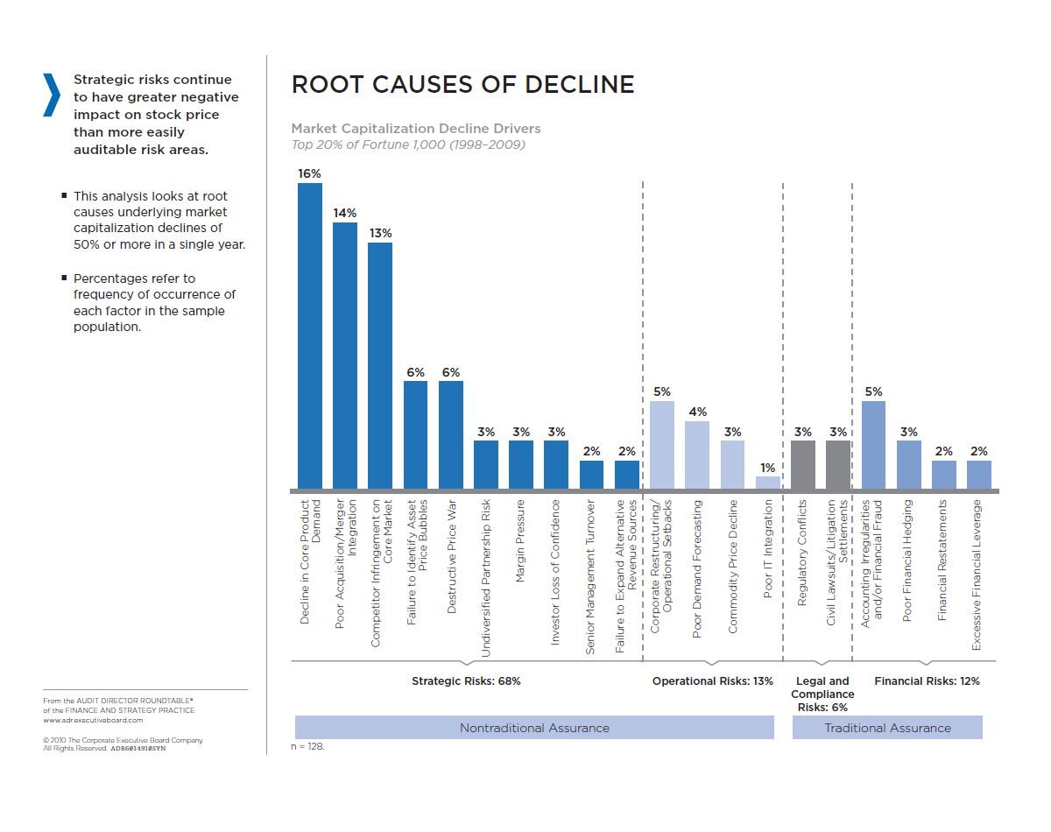
The Strategic Risk Dilemma: Beyond Insurable Risks
Source: Corporate Executive Board

Slide 18
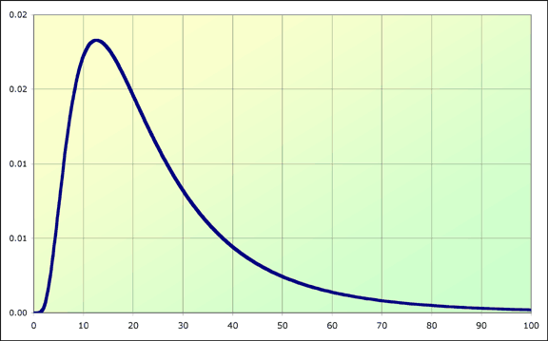
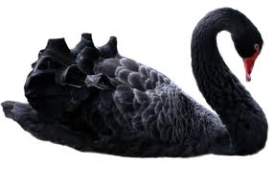
High Performance and the Loss Curve
X Expected Losses
FREQUENCY/LIKELIHOOD
Typically Uninsurable
Typically
Insurable
SEVERITY/IMPACT

Slide 19
Value Preservation to Value Creation
The discipline of risk management has evolved from strictly a value preservation-based focus to a balanced focus between protecting assets and creating or enhancing value.
Risk Appetite and Culture
Operational Risks
Financial Risks
Effective Risk
Management?
A flexible and dynamic risk management discipline is uniquely positioned to quickly adapt to change and identify opportunistic risk to create new streams of revenue and increase value
Regulatory Risks
Strategic Risks
Risk Tolerances, Ownership
and Accountability
TO COMPETE YOU GROW; TO GROW YOU INNOVATE; TO INNOVATE YOU MUST TAKE RISK

Slide 20

What’s Your Risk Appetite?

Slide 21
Why Care About Risk Appetite?
Securities regulators want increasing disclosure and transparency
Credit rating agencies are increasingly focused on ERM effectiveness
Institutional Investors are increasingly interested in evidence that board risk oversight is carried out effectively
Internal auditors are obligated to assess and report on the effectiveness of risk management processes
Various sources of board risk oversight expectations are impacting board directors “duty of care” obligations
EFFECTIVE RISK APPETITE MANAGEMENT IS AN INCREASING EXPECATION

Slide 22
Key Questions Addressing Risk Appetite
How much risk are we taking?
How much risk can we take?
How much risk do we prefer to take?
How much risk do we need to take to reach our strategic goals?
Which risks do we want to take and which risks are unacceptable to take and why?
What is the gap between capacity and need?
What actions can we take to close the gap to align with needs and stay within legal limits and preferences?
If the gap is large between need and capacity, how and which strategies need to be modified?
AN ORGANIZATION’S ABILITY TO TAKE RISK IS FUNCTION OF FINANCIAL STRENGTH WHILE
ITS WILLINGNEESS IS A FUNCTION OF TOLERANCE FOR UNCERTANNTY

Slide 23

emerging risks: critical to the strategic plan horizon and mission accomplishment

Slide 24
The VUCA World
Volatile: nature, dynamics and speed of change
Uncertain: Lack of predictability, subject to surprises
Complex: Multiplex of forces, confounding issues, chaos and confusion
Ambiguous: Haziness of reality, mixed meanings, potential for misreads

Slide 25
What is an Emerging Risk?
Those issues hat have not manifested themselves sufficiently to be managed using the tools commonly applied to more developed exposures. They are “those risks an organization has not yet recognized or those which are known to exist, but are not well understood
RIMS’ “Emerging Risks and ERM
A condition, situation or trend that could significantly impact the Company’s financial strength, competitive position or reputation within the next 5 years. Emerging risks involve a high degree of uncertainty. It is unclear where an emerging risk will land on the loss curve.
Anonymous actuary

Slide 26
Traits of Emerging Risks
Emerging Risks
High Level of Uncertainty
Lack of Consensus
Uncertain relevance
Difficult to Communicate
Difficult to Assign Ownership
Systemic or “business practice” issues
Source: RIMS Executive Report Emerging Risks and Enterprise Risk Management © 2010 RIMS
Notes:
Let the attendees know that the six characteristics of emerging risks shown on the page may not be exhaustive. However, these are a pretty good basis for consideration of emerging risks. Let’s spend a little time going through each of these characteristics.

Slide 27
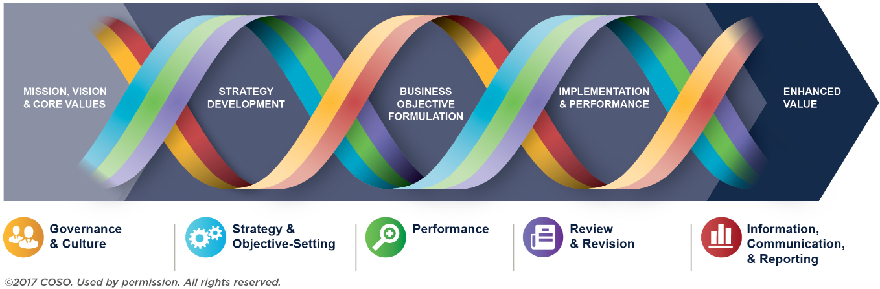
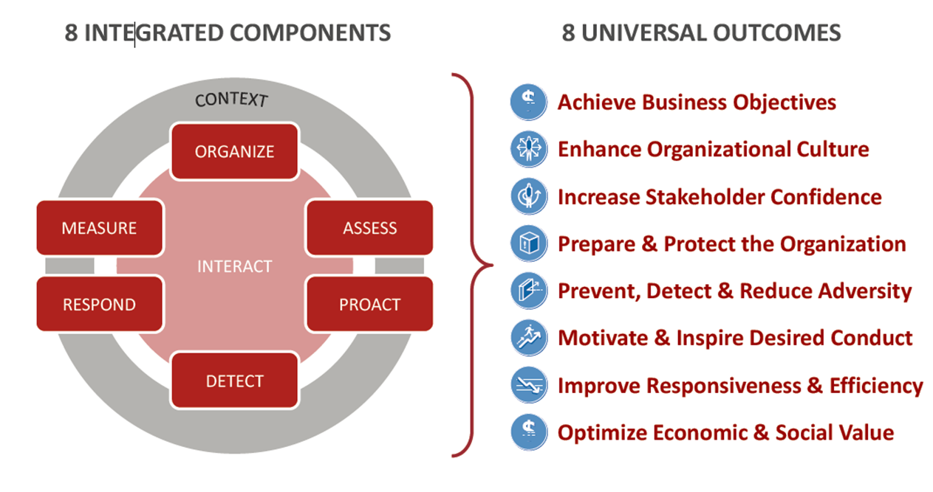
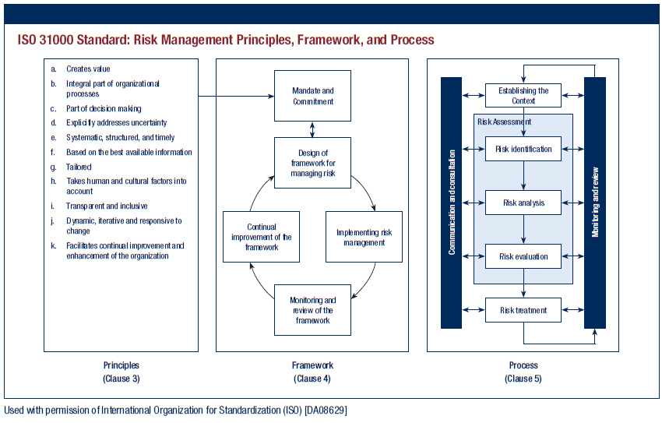
Are Standards/Frameworks Required?

Slide 28
HPRM Book
Objective: Documenting what HPRM looks like across a variety of organizations
Foundation and Key Issues
Profile of Various HPRM organizations
Opinions of a Variety of Subject Matter Experts
Future State

Slide 29
Performance Criteria
Top quartile TCOR (from Advisen benchmark report) performance
Evidence of superior claim management programs/strategies via outcomes
Evidence of superior workplace safety
Evidence of innovation in risk management initiatives
Recognition by others such as Risk Manager of the Year and other awards and recognition

Slide 30
More Criteria
  Evidence of unique and impactful initiatives within their organization, that can be objectively validated
  Evidence of “trusted advisory” type influence among the risk manager’s sr management and/or board
  Evidence that the organization’s risk profile is aggressively managed
  Evidence that the way risk is viewed/addressed, reflects directly and/or indirectly in organizational performance

Slide 31
Profile of a Major U.S. University
2nd Largest employer in its state; $50B in TIV
Similar in size to 10 medium sized cities
200k employee; 250k students; 40k volunteers
5 medical centers; 3 affiliated national labs
Key Risks: people; prof liab; cyber; property
CRO reports to CFO; 50 mbr staff; 7 contractors
ERM program; EHS; Business Cont; Insurance
$1B+ captive insurance with 23 policies
Strategy: continuous risk assessment
Priority emphasis: system-wide safety initiatives

Slide 32
HPRM at a University
Viewed as the department of “yes”
Viewed as collaborative and accommodating
Direct access to Chancellor who is engaged
Trains for all to be “risk managers”
Process and emphasis on emerging risks
$100m+ saved from captive strategy
Aligned with Planning function and process
Funding 9 FTEs in legal with risk allocation
Developed software for BIC lab safety/selling
Collaboration with risk owners is key to success

Slide 33
Profile of Major US Real Estate Co
F500 Commercial real estate co. - $13B revenue
80,000 employees; contracts in 120 countries
CRO leader since 2010; 11 years with Co’s RMD
5 ERM staff; BC; Global Security; reports to Legal
Risk Framework combines COSO and ISO
EHS function – 10 direct FTEs – 400 indirect FTEs
$130M TCOR - 8 staff dedicated to ins. prog.
Exec. risk com. with broad C-suite membership
Risk “aware” culture with qualitative leaning
Risk accountability from top down

Slide 34
HPRM in this Real Estate Co.
Brand enhanced/competitive advantage via ERM
Training and education on acceptable risk taking
On-line risk education playbook
EHS and Cyber risk dashboards
Better than average TCOR
In-house dedicated claim team
Safety-claim collaboration emphasized
BC & Claim Mgt are considered competitive advantage
Annual global risk mgmt conference w/ recognition
Increasing evidence of “pull” for risk mgmt guidance

Slide 35
The Experts

Slide 36
Norman Marks – Risk Evangelist
Norman Marks – Risk Evangelist
Early career in prof acctg, internal audit and IT
Migrated to project RM; CAE by ‘91, adding CRO ‘06
Author of “World-class Risk Management” 2015
“Risk Mgmt and Managing Risk” are not the same
For most, risk management is subconscious
All risks are or should be taken for a reason
Dilemma: most execs still see ERM as compliance activity without meaning impact on success
Continuing over-emphasis on loss vs value creation
All risks have multiple effects; standards are more singular in focus
Risk aversion creates “organizational drag”

Slide 37
More Marks
• All risk decisions involve trade-offs or pros/cons
• Mgrs cannot be effective w/o considering risk in decisions
• Dedicated sr risk leader may NOT be required; someone must
– Drive risk communication consistency
– Meaningful risk reporting process
– Facilitate cross functional discussions
– Mentor/train new leaders on risk strategy/philosophy
– Train and communicate relative to desired behaviors
• Mgt must be willing to change strategies when risk cannot be mitigated/leveraged to target
• HPRM is achieved when the board and mgmt have reasonable assurance that good, informed decisions are taken throughout the organization

Slide 38
Tim Leach
Tim Leech – Risk Oversight Solutions
Background audit and control evolved into ERM
Developed 1st IA/ERM software; sold to KPMG
Insists risk mgt must be objective centric & integrated
ERM derailed by SOX in 2002
Resistance to ERM continues from internal audit
Risk mgrs. persist with risk registers and lists
Focus must be on LT value creation and robust RA
“HPRM focuses on the top objectives to LT success & the key risks that can impede them”
Key Outcomes:
Succinct report to Leaders on risk related to top objectives
Identifying the key risks that are not being managed effectively
Focus on residual risks and their relation to appetite and tolerances

Slide 39
Jim DeLoach - Protiviti
Risk Practice Leader
300+ articles;
2000 book “Linking Risk & Opportunity”
40 yrs exp; Consulted 100’s Co’s in 300 countries
____________________________________________________
Many practitioners stuck in 20th century
Analog approach in a digital age
ERM is elevating risk to strategic line of sight
  Integrating risk and strategy
  Linking risk to performance outcomes
  Driving a risk culture and governance a critical enabler
Tying risk-reward to decision making
Focus must be on critical risks to the strategy

Slide 40
More DeLoach
Keys to Leader engagement
  A robust escalation process
  Focused, refined view of most significant risks
  Focus on exceptions, not the routine
  Must be forward looking & ahead of emerging risks
Important to link KRIs to KPIs
Metrics should tell the “whole story

Slide 41
The Most Critical Elements of Your Business Case for ERM
Clearly articulate the value of your proposed program – what benefits will it bring, how & when?
Articulate roles – who will do what to bring it to life and maintain effectiveness. Review corporate governance and ERM handout
Don’t forget key risk stakeholder interests and engagement – who? Their priorities? Their contributions?
Address resource requirements and expected estimated costs – compare to expected benefits
Address timelines for component parts and scheduled deliverables – what, when and how?

Slide 42
Deploying or Redeploying a Robust Risk Plan
Ensure there’s a mandate for robust risk management
Leverage the discipline of a global standard like ISO31000
Drive a consensus on risk appetite and tolerances
Design a risk culture that aligns with your ideal risk profile
Design and Implement an Emerging Risk Process
Close resource gaps to address risks effectively & efficiently
Build resiliency and sustainability into the business model
Leverage risks that lend themselves to exploitation for value creation
Test, improve, re-test and continuously improve as things inevitably change
Leverage all of this for competitive advantage

Slide 43


The Way We Were?
High appetite
for risk
Image makers
Adventuresome visionaries
Sales
Strategist
CEO
Marketing
Line Executive
Risk profile
Controller
CFO
CIO
Internal Auditor
CRO
COO
Risk Manager
Low tolerance
for risk
Daily operators
Operational leaders
Tactical
Strategic
Organizational mind-set
Source: IBM Global Business Services, The Global CFO Study 2008
Notes:
Have the participants review this chart. There is an obvious and wide perception divide between the risk manager and the strategist.
Note the perception of risk as a tactical function with a low tolerance for risk. Does the CFO’s (and by extension, the organization’s) perception of enterprise risk roles create any obstacles to communicating about and acting on risks?
If risk managers and CROs are perceived as daily operators or straddling the tactical/strategic fence (i.e., not strategic) and having a relatively low tolerance for risk, how do you build the necessary credibility to partner with the strategist–the visionaries with a high appetite for risk?
How do you overcome the mindset? How do you begin to build the relationship? Ask for ideas or experiences from the participants.
Once you’ve gained the strategists’ confidence, you can begin to talk about uncertainties in the organization’s base strategy.

Slide 44
What really matters in Risk Management
Leadership?
  Influence & Gumption
  Consistency in approach
  Process Rigor
  Data Interpretability
  Communication Clarity
  Reliable Measure-ability
  Downside protection as Job 1
  Value creation as Job 2
  Embedded risk culture
  Managing to appetite & capacity
  Aligning, if not integrating with strategy and objectives
Copyright Excellence in Risk Management, LLC , Chris Mandel, President

Slide 45
Components of HPRM Risk Management
$$
Standard Guided Governance & Accountability
Risk Appetite & Tolerances Defined
Risk Taking Knowledge
Informed Decisions
Risk Taking Communications
Including these key elements in your Risk Management Strategy will support High Performance Risk Management & Drive Results
Notes:
These six elements are the buiding blocks to a successful risk program and strategy. It begins with a tie to a framework that will dictate the process elements and how they would be designed and what would be inlcuded
It includes ensuring that there is consistent accountability for those involved and a cross enterprise governance structure that helps drive that accountability
Providing knowledge necessary for all who play to succeed and help you succeed comes through good training and awareness elements
Getting everyone on the same page and keeping them engaged requires a good solid communications strategy – developed in conjunction with that used for other corporate messaging
Ultimately tying risk and risk management to both short term and long decision making is where the rubber meets the road for risk managers.

Slide 46
Rating Agency Focus on ERM
Well defined and understood risk profile
Consistent view across all risks
Capability to assess trade-offs between
different risk types
Assessment of risk adjusted returns
Strategic investment allocation
Setting goals tied to risk adjusted returns
Risk view in product pricing
Comprehensive ERM program
Board & top mgmt commitment to ERM
Establishment of emerging risk criteria

Slide 47

Capability, maturity & the future of risk management

Slide 48
Key Challenges for the Future State
Risk challenges are increasingly priorities for execs and boards, including:
  Understanding what risks are most threatening to mission accomplishment
  Connecting actionable risk information to goals & strategy
  Managing critical risk interdependencies
  Getting ahead of emerging risks
  Controlling risks brought to the firm by third parties
  Fostering a strong ethics and risk culture
  Addressing low-frequency, high-impact risks proactively
  Providing timely information on key risks not effectively mitigated
ADDRESSING THESE CHALLENGES WILL ENSURE ORGANIZTIONAL RESILIENCY
Notes:
In developing a risk program, you’ll want to be aware of what sr management, boards,regulators and other stakeholders are concerned with and what emerging and constantly changing issues may likely impact your level of success in both short and long term execution. Some of current challenges for risk managers include these elements:
Understanding what risks are most threatening to mission accomplishment
Connecting actionable risk information to goals & strategy
Managing critical risk interdependencies
Getting ahead of emerging risks
Controlling risks brought to the firm by third parties
Fostering a strong ethics and risk culture
Addressing low-frequency, high-impact risks proactively
Providing timely information on key risks not effectively mitigated
Developing your risk programs based on a specific framework
or standard can be instrumental in addressing these and other challenges

Slide 49

Attributes of “Risk Intelligence”
_{Built into decision-making}
Conformance with enterprise risk management processes is incentivized
_{Intelligent risk taking}
_{Sustainable}
“Risk management is everyone’s job”
Integrated response to adverse events
_{Performance linked metrics}
_{Rapid escalation}
Cultural transformation underway
_{Bottom-up}
_{Proactive}
_{Tone set at the top}
Policies, procedures, risk authorities defined and communicated
_{Business function}
_{Primarily qualitative}
_{Reactive}
Reaction to adverse events by specialists
Discrete roles established for small set of risks
Typically finance, insurance, compliance
Ad-hoc/chaotic; depends primarily on individual heroics, capabilities and verbal wisdom
_{1. Tribal & Heroic}
_{2. Specialist Silos}
_{3. Top-Down}
_{4. Systematic}
_{5. Risk Intelligent}
_{Un-Rewarded Risk}
_{Rewarded Risk}
_{Source: Deloitte}

Slide 50
RIMS Risk Maturity Model
Adopt ERM Approach
ERM Process Management
Risk Appetite Management
Degree of accountability for (1) defining acceptable boundaries 2) calculating and articulating risk tolerance 3) developing a risk portfolio 4) considering scenarios, and 5) attacking gaps between perceived and actual risks.
Denotes the degree of executive support for an ERM-based approach within the corporate culture. Activities cut across all processes, functions, business lines, roles and geographies.
Degree that a repeatable and scalable risk management process is integrated into business and resource/support units, using a sequential series of steps that support uncertainty reduction and promote opportunity exploitation.
Root Cause Discipline
Degree of discipline applied to measuring root cause by: 1) determining sources 2) understanding impacts 3) identifying trends, and 4) measuring effectiveness of controls .

Slide 51
RIMS Risk Maturity Model
Uncovering Risks
Degree of quality and coverage (penetration) throughout the organization for uncovering uncertainties related to organizational goals achievement.
Performance Management
Degree to which organizations are able to execute on vision and strategy in tandem with risk management activities.
Business Resiliency and Sustainability
Extent to which an organization integrates business resiliency and sustainability aspects for its operational planning into its ERM process.

Slide 52
Two Further Considerations
InsurTech while important and potentially transformative will morph into or evolve to RiskTech
The digitization of the Risk Profile is and will continue to challenge risk leaders and transform their jobs

Slide 53
Questions and Principles to Consider
Why would you invest in and prioritize risk management if it didn’t directly affect the success of organizations?
I’m not sure a risk with an “expected value” is really a “risk” when you consider that risk is ultimately defined as uncertainty.
Risk managers don’t own risk but enable risk owners to effectively manage their risks.
Emerging risks may or may not be black swans, however, they should be on the radar of every senior leader.
Risk leaders need to be telling senior leaders about what they don’t know, not what is so often obvious and perfunctory to them.
A risk is not a risk unless it affects decision-making.

Slide 54
Questions and Principles to Consider
All decisions entail some element of risk; the difference is only a matter of degree.
Innovation is critical to success in today’s global economy; you can’t innovate without taking risk.
While insurance is an important element to successfully transacting business, uninsurable risks are actually the most potentially destructive to organizational value.
Organizational resilience and enabled innovation should be the highest goals of risk management.
The disruptive nature of today’s business world will regularly redefine the risk landscape.
The digitization of the organizational risk profile will be risk leader’s biggest challenge going forward.

Slide 55
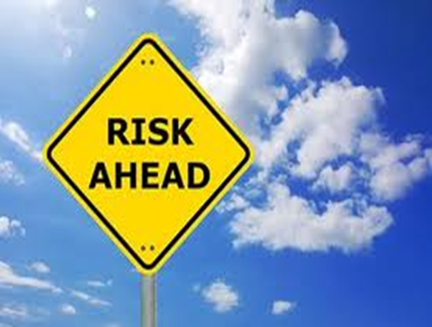
Key Take-a-ways
There is no one right way to manage risk
HPRM can be realized differently from one organization to another
Best in class and world class risk management may not be HPRM for your org
HPRM should always tie to what drives organizational success & its priorities
With that, the only variable should be the extent that it contributes to organizational success

Slide 56

Parting Thought
“A decision that doesn’t involve risk probably isn’t a decision.” - Peter Drucker

Slide 57

57

Slide 58

Contact information
Chris Mandel, RF, RIMS-CRMP
SVP Strategic Solutions, Sedgwick
& Director, the Sedgwick Institute
Chris.Mandel@sedgwickinstitute.com
210-845-5804
www.sedgwickcms.com
www.sedgwickinstitute.com

Slide 59
Sedgwick CMS
The leader in innovative claims and productivity management solutions
Sedgwick Claims Management Services, Inc. is the leading North American provider of innovative claims and productivity management solutions. Sedgwick and its affiliated companies deliver cost-effective claims, productivity, managed care, risk consulting, and other services to clients through the expertise of more than 21,000 colleagues in 900 offices located in 65 countries. The company specializes in workers’ compensation; disability, FMLA and other employee absence; managed care; general, automobile and professional liability; warranty and credit card claims services; fraud and investigation; structured settlements; and Medicare compliance solutions. Sedgwick and its affiliates design and implement customized programs based on proven practices and advanced technology that exceed client expectations. For eight years in a row, Sedgwick has been awarded the distinguished Employer of Choice® certification, the only third-party administrator (TPA) to receive this designation. In 2011 and 2012, the company was named the Best Overall TPA by buyers of risk services through an independent survey conducted by Business Insurance. For more see www.sedgwick.com.
© 2018, Sedgwick Claims Management Services, Inc. applies to all content except where otherwise noted

Slide 60
Sedgwick Institute
Vision
The Sedgwick Institute will serve as an incubator for some of the best and brightest minds to advance the conversations that affect all the players in our industry, including injured and ill members of the workforce, insurance carriers, employers, property owners, third party claims administrators, brokers, lawmakers and medical providers. The institute’s thought leaders will work individually and collaboratively to examine selected complex challenges facing the various stakeholders in our space and propose innovative options and solutions to improve public and private decision making on these issues.
Purpose
The Sedgwick Institute is an interdisciplinary community of thought leaders dedicated to helping drive dialogue and action around issues affecting the risk and benefits industry.
Who
To fulfill its evolving agenda, the Sedgwick Institute will leverage both full- and part-time expertise from business, government, academia and other industry sources, through visiting or full-time fellow positions. While no specific minimum criteria are anticipated for appointment, related decisions about institute appointments will be primarily a function of the issues selected to populate the agenda as it develops and evolves.
Visit us at: www.sedgwickinstitute.com

Slide 62
Industry Solutions

Slide 63
Meeting the recruitment challenge
What is the big challenge in attracting young people to the industry?
  Insurance, in general, isn’t “sexy”
  Compensation is not high enough compared to other business careers
  Young people perceive they will be too “tied to a desk”
  Young people are interested in the insurance industry but are not exposed enough to the industry.

Slide 64
Meeting the challenge
How should the industry talent shortage be addressed?
a. By domicile and industry organizations working
together to attract more people into the industry
b. By individual companies working on their own to
attract more people into the industry
c. By risk and insurance groups
working together to attract more people to the
industry
d. It is not a problem that needs to be addressed

Slide 65
Strategies
Given the industry’s expected talent shortage in the near future, which of the following are you doing to attract more talent?
  a. Spending more on advertising to attract talent?
  b. Spending more on visits to college campuses?
  c. Preparing to spend more on initial salaries/benefits?
  d. Trying to create a work environment more favorable to
  millennials?
  e. Trying to create a faster “ladder of success”?

Slide 66
Fixing Engagement Deficits
Engaging employees:
  Salary only comes 9th of 11 reasons why someone would leave their job
  Work-life balance is more important
Making people feel valued:
  Listening, understanding and supporting employees
  Engagement is as important as managing the numbers
Fit for purpose technology;
  Implementing technology to remove manual processes and provide control
Technology that ﬁts the internet generation and ﬂexible working
  Simplifying the working day
  Reducing admin to focus on core tasks gives greater job satisfaction
  Allow them to communicate, collaborate and take control
ULTIMATE RESULT IS DELIVERING VALUE ENGAGEMENT IS A TWO-WAY PROCESS. EMPLOYEES WANT TO WORK FOR BUSINESSES THAT UNDERSTAND, LISTEN AND EMPOWER; EMPLOYERS MUST TREAT THEIR PEOPLE AS ASSETS, NOT AS COSTS. THE POTENTIAL REWARDS OF DOING LITTLE THINGS WELL ARE HUGE.

Slide 67
Recruiting Millennials
Enhance Brand
Offer Flexible
Boost organizations reputation to facilitate better recruits
Establish media presence
  video engagement
  employees testimonials
Flexible work environments are more suited to millennials taste
  Location
  Work from home
  Flex time/ PTO

Slide 68
Recruiting Millennials
Provide Career Pathing
Promote Corporate citizenship
may lack skill, but have a strong work ethic
Personalized development plans
Encourage professional development
Create opportunities and promote within
Distribute leadership
61% of millennials consider community commitment when making a job decision
64% of young professionals want to make a difference

Slide 69
Embrace New Technologies
Product development, marketing, and IT will see a growth in demand and need for skills such as data analytics, machine learning, development of algorithms.
Operation positions will see a decrease in full time employments.

Slide 70
Key Take-a-Ways
Make advocating for the equitable interests of the injured worker a priority.
Smooth the interaction of injured/ill workers with often complex processes they will encounter.
Utilize a responsive model of care by matching injured employees with the best and most appropriate providers.
Engage all participants in the WC program - claims management team; medical providers; employer/leaders - to understand the goals.
Understand & leverage the non-traditional available resources for employees - mental health/EAP; health and wellness; social safety nets.

Slide 71
Current Trends and
The State
of the “Industry”

Slide 72
Current TRends

Slide 73
2018 Global Workforce Trends
Leaders encourage more human interaction
The next wave of learning credentials
Companies focus on upskilling and retraining current workers
AI becomes embedded in the workplace
Financial and mental wellness get prioritized
Employee burnout causes more turnover
Workforce decisions away consumer behavior
Companies take diversity more seriously
The deregulation of labor laws
The aging of the workforce
Source: Forbes and Dan Schawbel’s “Promote Yourself and Me”

Slide 74
Work Force Environment
Change Drivers
Increased consolidation among insurance firms due to desire to expand capabilities and diversify risks.
Companies striving towards diverse and inclusive teams to create better economic and social outcomes.
20% of workforce will be contractors or temporary workers by 2022.
Driverless cars and the sharing economy creating new exposures for insurance industry,
Notes:
https://www.pwc.com/us/en/insurance/publications/assets/pwc-2017-insurance-top-issues.pdf

Slide 75
Emerging (disruptive) Workplace Issues
Advancing Technology
Increased use of analytics , AI & robotics
Succession Planning
Planning for loss of aging staff
Workforce Environment
Diversity, inclusion and work place flexibility

Slide 76

Robotics: Creating and Replacing
Over the past 10 years automation has displaced 22.7 million jobs and created 13.6 million new jobs.
Artificial intelligence will create 2 million new jobs by 2025.
47 percent of jobs currently done by people in the United States will be done by machines and software within one to two decades.
Notes:
http://riskandinsurance.com/robot-revolution/
https://www2.deloitte.com/content/dam/Deloitte/us/Documents/process-and-operations/us-cons-how-robotics-and-cognitive-automation-will-transform-the-insurance-industry.pdf

Slide 77
Acceleration in Technology
Recent adoption of advanced AI algorithms triggered by access to big data and better hardware & processing
Blue & collar impacts: Entry level employees need a higher skillset
Difficulty replacing middle and upper level management
Only 40% of demand for technical and managerial talent are being met
Advancements in technology are changing the nature of jobs.
At the cusp of the 5th industrial revolution

Slide 78
The Future of Automation
By 2023 9% of labor demand will come from occupations that do not exist today
Highest risk categories being taken over by automation
  Underwriting
  Claims/ policy personal
  Claims adjusters
  Examiners / investigators
Notes:
https://www2.deloitte.com/content/dam/Deloitte/us/Documents/process-and-operations/us-cons-how-robotics-and-cognitive-automation-will-transform-the-insurance-industry.pdf

Slide 79
What Are the Key Challenges Faced in the Industry?
Unique/specialized skills not often taught to undergrads
  Statutory accounting
  Insurance portfolio management
  Insurance contract technicalities
Perceptions of the “industry”
  Boring and staid
  Limited earnings potential
  Lacking innovation
  It’s all about “selling” (“life insurance or used cars?)

Slide 80
More Challenges
Impacts from mergers and acquisitions
Providing upward mobility
Small team hurdles
Limited understanding of the value and use of social media
Generational differences
Engendered loyalty
Compensation plan limitations

Slide 81
Succession Planning
62%
OF INSURERS DO NOT HAVE CEO SUCCESSION PLANS IN PLACE.
58%
OF ORs WITH SUCCESSION PLANS REVISIT THEM ANNUALLY.
Results indicate that 67 percent of companies do not have a plan in place immediately following an emergency that impacts senior leadership.
82 percent of firms have not developed a relationship with an executive search firm to assist in the succession planning process.
Source: The Jacobson Group and Carrier Management Succession Planning Survey, 2016

Slide 82

Industry
Perceptions
Negative Image
  Insurance is tied second to last with defense industry in overall public image
Boring Profession
  Less than one in ten your professionals are interested in working in insurance
Limited Opportunities
  Eight in ten millennials are unfamiliar with insurance as a career path
Notes:
https://www.nlc.org/sites/default/files/users/user118/PDF%20Milkint%20Changing%20Workforce%20Trends.pdf

Slide 83
Employment
Insurance Industry
All Sectors
Unemployment Rate: 2.0%
Turnover rate: 12.2%
Employees (US): 28 billion
Unemployment Rate: 4.4%
Turnover rate: 16.7%
Employees (US): 151 billion
Notes:
http://riskandinsurance.com/talent-crisis-remains-challenge/

Slide 84

Aging Work Force
Fewer young people coming in to the industry
By 2018, over 25% of workforce will be close to retirement
Only 28% of employees are under 35
Notes:
http://riskandinsurance.com/talent-crisis-remains-challenge/

Slide 85
Unemployment Rate
Source: Bureau of Labor Statistics (BLS)

Slide 86
Insurance Employment
Since April 2011, the insurance industry
has added 79,600 new jobs.
+7.50%
April 2011
Present
1,420,500
1,527,600
Source: Bureau of Labor Statistics (BLS)

Slide 87
Job Openings
Present
262,000
2009
121,000
Source: Bureau of Labor Statistics (BLS)

Slide 88
Recruiting Difficulty
Positions rated 5
or above are
considered moderate
or difficult to fill.
Source: The Jacobson Group and Ward Group, Semi-Annual Insurance Labor Outlook Study, July 2016

Slide 89
Growing Talent Crisis
The industry needs to fill 400,000
positions by 2020 to remain
fully staffed.
Graduates from risk and insurance
programs meet only 10-15 percent
of industry need.
Source: propertycasualty360.com, University of Hawaii

Slide 90

Succession Planning
Insurance graduates only fulfill 15% of staffing need
Five most difficult areas to recruit:
  analytics,
  Executives
  actuarial,
  technology
  underwriting
Notes:
https://www.nlc.org/sites/default/files/users/user118/PDF%20Milkint%20Changing%20Workforce%20Trends.pdf

Slide 91
Engaging and Retaining the Next Generation

Slide 92
Generational Snapshot
TRADITIONALISTS
BABY
BOOMERS
GENERATION X
MILLENNIALS
GENERATION Z
1900 – 1945
Value work and jobs
Possess a strong work ethic
Place duty before pleasure
Reluctant to technology changes
1946 – 1964
Find sense of self in their work
Sometimes resistant to change
Place emphasis on competition
Possess strong work ethic
1965 – 1979
Independent and entrepreneurial
Productive and energetic
Technically competent
Work-to-live centric
1980 – 1994
Collaborative and energetic
High employer expectations
Technologically savvy
Impact-driven
1995 – 2012
Value sense of predictability
Possess a strong work ethic
Focused on technology
Adept at multi-tasking

Slide 93
Industry Challenges
Eight out of ten Millennials are unfamiliar with insurance as a career path.
Insurance?
Less than one in ten young professionals are interested in working in insurance.
Insurance is tied second to last with the defense industry in terms of overall public image.
Source: The Institutes, PwC

Slide 94
Engaging Millennials and Generation Z
Target the key benefits Millennials and Gen Z
are looking for, including:
Collaborative and energetic workplace
Guidance and mentoring
Open communication
Stretch Opportunities
Updated technology
Flexible scheduling
Provide personalized professional development opportunities and
give Millennial employees ownership of the process.

Slide 95

Chris Mandel, RIMS-CRMP, RF, CPCU, ARMe
SVP, Strategic Solutions, Sedgwick &
Director, Sedgwick Institute
All content copyright Sedgwick Institute, 2017
All rights reserved

Slide 96
The Opportunity for Risk Managers
Best practices for Emerging Risks:
Uncover the unknown or poorly understood threats to businesses
Bringing resources to bear to address the risks efficiently
Building resiliency and sustainability
Include those to opportunities that lend themselves to exploitation
Leveraging emerging risk processes for competitive advantage

