Slide 1
CSBS Fourth Friday Faculty Workshop 1: Cost-sharing
CSBS: Frances Solano
TUC: Georg Jahn
2/27/2015
Notes:
With help from our ORSP friends!

Slide 2
Today’s Agenda
Welcome and Announcements
Upcoming CSBS Faculty Workshops
Introductions and CSUN Contacts
Cost-sharing presentation by Georg Jahn

Slide 3
Spring 2015: Fourth Friday Faculty Workshops Fall 2015: Third Friday Faculty Workshops
The spring semester will be focused on post-award management.
Friday, February 27, 2:00 – 3:00 pm
Friday, March 27, 2:00 – 3:00 pm
WEDNESDAY, April 1, 11:30 am – 1:30 pm
Friday, April 24, 9:00 – 10:00 am
Friday, May 22, 2:00 – 3:00 pm
The fall semester will focus on pre-award -- finding funding, proposal development and submission.
Friday, August 21, 3:00 – 4:00 pm
Friday, September 18, 3:00 – 4:00 pm
Friday, October 16, 3:00 – 4:00 pm
Friday, November 20, 3:00 – 4:00 pm
Friday, December 18, 3:00 – 4:00 pm
All workshops to be held in the Whitsett Room, Sierra Hall, 4th floor.

Slide 4
CSUN Contacts
CSBS (College of Social & Behavioral Sciences)
Frances Solano, Grants & Contracts Officer (ext. 6135)
Anne Robison, External Relations & Programs Liaison (ext. 7738)
Tracy Baum, Director of Development (ext. 7129)
Pam Simon, Manager of Academic Resources (MAR) (ext. 2378)
ORSP (Office of Research & Sponsored Projects)
Scott Perez, Director, ORSP (ext. 2901)
Stefanie Friesen, Grant Coordinator (ext. 2901)
Jennifer Reifsneider, Grant Coordinator (ext. 2901)
Kat Sohn, Compliance Officer (IRB), (ext. 2901)
TUC (The University Corporation)
Georg Jahn, Director, Sponsored Programs (ext. 2698)
Stacey Lord, Sponsored Projects Liaison (ext. 7289)
Maryann Camarillo, Accounting (ext. 3061)
Angie Alvarado, Compliance Analyst (ext. 3498)
Mahyar Sadri, Compliance Analyst (ext. 6414)

Slide 5
The University Corporation Cost Sharing Sponsored Programs
The University Corporation Research, Investments and Commercial Services California State University, Northridge


Slide 6
The University Corporation
Cost Sharing
Sources of Information
Sponsored Programs Website
http://www.csun.edu/sponsoredprograms/cost-sharing
Sponsored Programs Administrative Compliance Analysts
Mahyar Sadri (x 6414, mahyar.sadri@csun.edu)
Angelica Alvarado (x 3498, angelica.alvarado@csun.edu)
Sponsored Programs Liaison for your College
Federal Regulations
(OMB) Circular A-110 Subpart C, Section .23

Slide 7
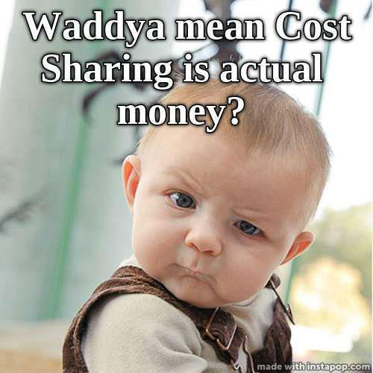
The University Corporation
Cost Sharing
Definition

Slide 8
The University Corporation
Cost Sharing
Definition
Cost Sharing
Funds expended for the project
From own resources or third-party
That would be allowable, as if federal funds would be expanded
Cost Matching
Specific Form of Cost Sharing
In some proportion (%-age) of the provided funds

Slide 9
The University Corporation
Cost Sharing
Definition – Continued
Committed Cost Sharing
Funds required/agreed as per accepted award documents
Voluntary Committed Cost Sharing
Funds initially not required by the granting agency, but offered by the grant recipient and agreed on by accepting the award document
=> CSUN provides ‘Voluntary Committed Cost Sharing’, in only very few exceptional circumstances
Voluntary Uncommitted Cost Sharing
Funds not required by the granting agency, and not agreed on in the award document, but offered by the grant recipient
=> CSUN does NOT provide ‘Voluntary Uncommitted Cost Sharing’,
since it negatively affects our Indirect Cost Recovery

Slide 10
The University Corporation
Cost Sharing
CSUN Cost Sharing Policy
Cost Sharing will only be provided:
if required by the sponsor
and then
only to the extent necessary to meet the specific requirements of the sponsored project.

Slide 11
The University Corporation
Cost Sharing
Criteria for Cost Sharing Sources
Verifiable from the recipient's record
Not be included as contributions for any other federally assisted project or programs
Be necessary and reasonable for proper and efficient completion of the project or program objectives
Be allowable under the applicable cost principles (OMB Circular A-21, or other sponsor regulations, if non-federal)
Not be paid by the federal government under another award, except where authorized by federal statute to be used for cost sharing or matching

Slide 12
The University Corporation
Cost Sharing
Allowable Cost Sharing Expenses
All Cost Sharing expenses must meet the same criteria for allowability then the regular (federally funded) project expenses:
Reasonable
Allocable
Be within the project time period

Slide 13
The University Corporation
Cost Sharing
Allowable Elements
Salaries
Fringe benefit
Direct costs, (e.g. supplies, travel, non-capitalized assets)
Project costs financed by cash contributions by the recipient, or by cash from third parties
Contributions of services and property donated (by recipient or third parties values are established in accordance with applicable cost principles)
Indirect costs foregone (waived IDC), (less than the federally approved IDC-Rate)

Slide 14
The University Corporation
Cost Sharing
Non-Allowable Elements
Expenses covered by Indirect Costs
(On Campus Office Space, Office Supplies, Utilities, Cost of Administrative Support, etc.)
Expenses not directly expended on behalf of the project (unrelated expenses)
Unallowable Expenses
outside the project period
Not verifiable (no or insufficient documentation)
unreasonable
Expenses already used as Cost Sharing for another project
Expenses funded through another federal program

Slide 15
The University Corporation
Cost Sharing
Third Party - Cash Contribution
Apply for Agency Account at TUC (Approval CSUN-AVP Finance & Accounting)
Transfer funds to /deposit third party check in Agency Account
Expend funds the same way as project expenses
(PO, Check Request, Timesheet, etc.)

Slide 16
The University Corporation
Cost Sharing
Third Party – In Kind Contribution
Types:
Volunteer Services (Employee Time, Student Time)
Expandable Property (Supplies, Materials, etc.)
Non-Expendable Property (Use of Space, Land, Buildings)
Challenges:
Documentation (Timesheets, Receipts, etc.)
Evaluation (Hourly Rate, Comparable Rents, Market Value)

Slide 17
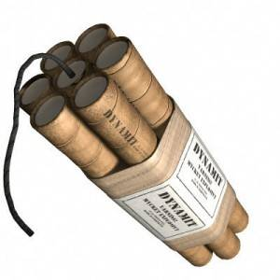
The University Corporation
Cost Sharing
Subrecipient’s Cost Sharing
As recipient of an award CSUN/TUC is fully responsible for the cost sharing of a subrecipient.

Slide 18
The University Corporation
Cost Sharing
Risk
Disallowance of Cost Sharing Expenses:
50% of missing/unallowable cost-share must be returned in funded awards
Example:
Disallowed Cost Sharing Expenses: $500k
Funds to be returned to Granting Agency: $250k

Slide 19
The University Corporation
Cost Sharing
New Cost Sharing Procedure
Key Elements
Dean (or designee) certifies correctness of expenses used for cost sharing
PI is responsible to provide certified cost-share documentation to TUC
TUC maintains cost-share documentation and monitors expenses
Advantages:
Centralized responsibility
TUC ensures allowability of costs
Correct/complete accounting

Slide 20
The University Corporation
Cost Sharing
New Procedure - Role of the Dean (or Designee)
Proposal Submission
Determine if sufficient allowable funds for cost sharing for project are available
‘Pre-encumber’ assigned funds
Approve cost sharing as part of proposal
(The approval commits college to provide necessary cost sharing and the required documentation, if granting agency awards project)

Slide 21
The University Corporation
Cost Sharing
New Procedure - Role of the Dean (or Designee)
Award of Grant
Receive ‘Cost Share Budget’ form from TUC
Clearly identify and ‘encumber’ release time and other costs, preventing them for being used for another project
Verify college’s cost share commitment, sign ‘Cost Share Budget’ form and return to TUC

Slide 22
The University Corporation
Cost Sharing
New Procedure - Role of the Dean (or Designee)
During the Project:
1. Certification of Release Time as Cost Share
Receive ‘Faculty Cost Share Effort’ form from TUC after each semester
Review/Correct ‘Faculty Cost Share Effort’ form
Certify that release time:
is cost sharing paid by CSUN for the listed project(s)
has not been reimbursed by any other sponsored program
has not been used as cost sharing in any other project.
Maintain adequate records of the release time used for cost sharing

Slide 23
The University Corporation
Cost Sharing
New Procedure - Role of the Dean (or Designee)
During the Project:
2. Certification of Operating Expenditures as Cost Sharing
Work with PI to determine allowable expenses used for cost sharing
Stamp copy/verify receipt/supporting documentation:
Documents represent a true copy of the original documentation, which is kept in the college or at CSUN
The expenditures are made by the college as cost sharing in support of the particular project
The expenditures have not been used as cost sharing for any other project
Send stamped copy to TUC

Slide 24
The University Corporation
Cost Sharing
Example of ‘Perfect’ Cost Sharing Documentation

