Slide 1
Assessing Critical Thinking across the Disciplines
Bonnie Paller, context
Joel Krantz, CTVA
Marquita Pellerin, PAS
Kristina Meshelski, Philosophy
Weimin Sun, Philosophy

Slide 2
Building Critical Thinking Assignment Prompts
Bonnie Paller
AALC Retreat 2014
May 9, 2014

Slide 3
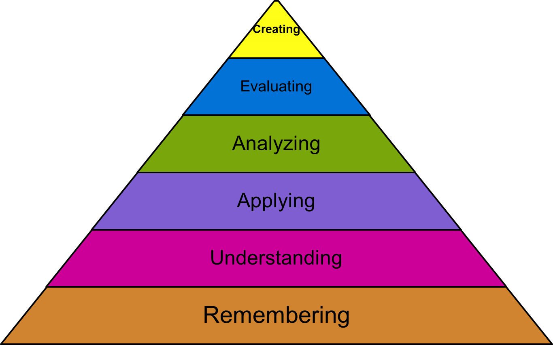
At what levels does critical thinking occur?

Slide 4
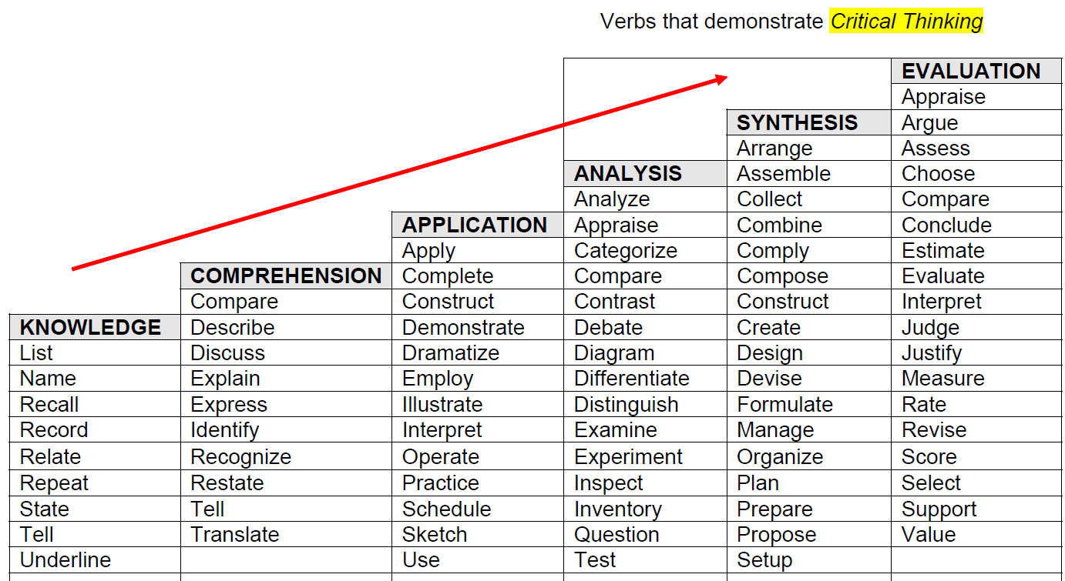
Bloom’s Verbs

Slide 5
The assignment prompt design
  What level of Bloom’s are you targeting?
Is the assignment at the appropriate cognitive level:
  For the course?
  For its place in the semester?
  For its place in the program?
How much scaffolding is assumed by the assignment?
How will this assignment sequence to the next assignment or course?

Slide 6
Sustainability
The nation is facing a variety of ecological problems that have the following general form: an established practice, whether on the part of business and industry or on the part of the public, is contributing to serious health problems for a large number of people. At the same time it would be costly to modify the practice so as to reduce the health problem.
People often say that the answer is one of achieving a "balance" between the amount of money we spend to correct the problem and the number of lives we would save by that expenditure.
Develop a point of view and some plausible criteria for telling how one would determine this "balance." Make sure you address any dilemmas inherent in your strategy for solving such problems.

Slide 7
What makes this assignment a ‘good’ one?
Critical thinking assignments identify a context and have a task description.
Critical thinking assignments should identify and require students to use cognitive skills associated with critical thinking.
Critical thinking assignments should ask questions requiring reasoned judgment within conflicting systems or complex questions requiring evidence and reasoning within one system.
Critical thinking assignments should ask students to think about their thinking (meta-cognition).

Slide 8
Political Science
There is a growing number of Americans who do not vote in national and local elections. Many of them explain their non-participation by saying that their vote would not make a difference.
Some go on to argue that this is true because "money plays such a large role in elections that the candidate with the highest paid, and the highest quality, media campaign wins." Most people agree that money sometimes plays an inappropriate role in determining the outcome of elections.
Develop a proposed solution to this problem that takes into account the view that people and organizations with money have a right to use that money to advance political causes they believe in. If you like, you may decide to develop a position to the effect that there is no solution to the problem and that we have no choice but to accept the status quo.

Slide 9
Joel Krantz
Mike Curb College of Arts, Media, and Communication
Department of Cinema and Television Arts

Slide 10
Film Studies Critical Writing Prompt
This semester, you learned that most films follow a “Three-act structure”, meaning that a film can be divided into three separate parts: Setup, Confrontation, and Resolution. Select one of the films screened in class this semester, and then write a critical essay which examines the film’s adherence to the “Three-act structure”.

Slide 11
Assignment Prompt Help
While the topic of the essay requires you to recount the story of the film, you should not stop at mere summary. Instead, explain how each event fits into the underlying structure of the film. The paper must offer analysis, not just summary.
Your conclusion should place the thesis of the paper in a larger context, showing that despite the apparent rigidity of the “Three-act structure”, the structure still leaves room for variation.

Slide 12
Connection to Bloom’s Taxonomy
The film studies critical writing assignment has a direct connection to Bloom’s Taxonomy by requiring:
Analyzing: Examination
Creating: Conclusion

Slide 13
CTVA Film Studies Grading Rubric for Critical Thinking
(4 points) The paper offers plentiful, detailed, subtle and strongly relevant evidence/film analysis.
(3 Points) The paper offers substantial evidence/film analysis to support the argument.
(2 Points) The paper offers evidence/film analysis, but it could be more complete or relevant.
(1 Point) The paper offers thoughts, opinions and hearsay, but no solid evidence or film analysis.

Slide 14
Teaching Critical Thinking
Dr. Marquita Pellerin
Assistant Professor
Pan African Studies

Slide 15
Written Critical Thinking
Critical Response Paper
Assignment Prompt- Sample 1:
  Students are to submit critical responses of 5 pages typed (double-spaced, font size-12), addressing a course reading from the current week (Student’s Choice). A total of 5 Reading Response papers are to be submitted. [Late papers are not accepted]

Slide 16
Critical Response Paper: Evaluation Rubric
Assessment Criteria | 0 | 1 | 2 | 3 | 4 | 5
Summary of author’s central argument | Lack of articulation of author’s central argument showing no ability to identify and summarize main points. | Poor articulation of author’s central argument showing lack of ability to identify and summarize main points. | Limited articulation of author’s central argument showing fair ability to identify and summarize main points. | Good articulation of author’s central argument showing good ability to identify and summarize main points. | Very good articulation of author’s central argument showing high ability to identify and summarize main points. | Outstanding articulation of author’s central argument showing excellent ability to identify and summarize main points.
Thesis | Lack of applications of original assessment of author’s work demonstrating no ability to analyze in order to form new arguments.ck of | Poor applications of original assessment of author’s work demonstrating lack of ability to analyze in order to form new arguments. | Limited applications of original assessment of author’s work demonstrating fair ability to analyze in order to form new arguments. | Good applications of original assessment of author’s work demonstrating good ability to analyze in order to form new arguments. | Very good applications of original assessment of author’s work demonstrating high ability to analyze in order to form new arguments. | Outstanding applications of original assessment of author’s work demonstrating excellent ability to analyze in order to form new arguments.
Claims | Lack of development of original claims showing no ability to critically examine and challenge the author’s central argument. | Poor development of original claims showing lack of ability to critically examine and challenge the author’s central argument. | Limited development of original claims showing fair ability to critically examine and challenge the author’s central argument. | Good development of original claims showing good ability to critically examine and challenge the author’s central argument. | Very good development of original claims showing high ability to critically examine and challenge the author’s central argument. | Outstanding development of original claims showing excellent ability to critically examine and challenge the author’s central argument.
Evidence/ Support | Lack of use of examples/illustrations from the author’s text that demonstrate no ability to synthesize evidence in analytical way to formulate clear conclusions. | Poor use of examples/illustrations from the author’s text that demonstrate lack of ability to synthesize evidence in analytical way to formulate clear conclusions. | Limited use of examples/illustrations from the author’s text that demonstrate fair ability to synthesize evidence in analytical way to formulate clear conclusions. | Good use of examples/illustrations from the author’s text that demonstrate good ability to synthesize evidence in analytical way to formulate clear conclusions. | Very good use of examples/illustrations from the author’s text that demonstrate high ability to synthesize evidence in analytical way to formulate clear conclusions. | Outstanding use of examples/illustrations from the author’s text that demonstrate excellent ability to synthesize evidence in analytical way to formulate clear conclusions.
Implications | Lack of discussion of the implications demonstrating no ability to support new arguments. | Poor discussion of the implications demonstrating lack of ability to support new arguments. | Limited discussion of the implications demonstrating fair ability to support new arguments. | Good discussion of the implications demonstrating good ability to support new arguments. | Very good discussion of the implications demonstrating high ability to support new arguments. | Outstanding discussion of the implications demonstrating excellent ability to support new arguments.

Slide 17
Critical Response Sample Paper #1
Does the phrase, “innocent before proven guilty” ring a bell? Within chapter two, entitled, The New Jim Crow, Michelle Alexander discusses the difference between the real criminal justice system and the made for TV criminal justice system and how both of them function totally different from one another.
The criminal justice system that has been enforced in real life is actually not a pleasant one “Full-blown trials of guilt or innocence rarely occur; many people never even meet with an attorney; witnesses are routinely paid and coerced by the government; police regularly stop and search people for no reason whatsoever; penalties for many crimes are so severe that innocent people plead guilty, accepting plea bargains to avoid harsh mandatory sentences; and children, even as young as fourteen, are sent to adult prisons.”(pg.59 ) with this being stated, it almost as if television gives an illusion of the real life criminal world. It’s unfortunate that the treatment of black males is very poor when it comes to the criminal justice system.

Slide 18
Written Critical Thinking
Critical Response Paper
Assignment Prompt-Sample 2:
  Students must provide a 5-page critically evaluation of one of the weekly reading. Students must identify and summarize the main points of the article. Critically examine and analyze the author’s central argument in order to develop an original thesis. Introduce major claims that support your thesis and provide examples that support your claim. Students must also discuss how the implications of their claims impact the African American community. Finally, provide a clear conclusion.

Slide 19
Sample Critical Response Paper #2
Welch (2007) discusses the impact of the stereotyping effect on racial profiling of Black Americans as criminal offenders. Through a content analysis, Welch explains this phenomenon through a critical analysis of previous research that sampled African Americans throughout American History. This research attempts to understand how Black criminal stereotypes have been used to justify racial profiling. The researcher found that while Blacks are indeed disproportionally arrested for crimes, the public sentiment does not accurately reflect African Americans involvement in criminal activity. These findings reveal that there exists an embedded assumption about Black Americans which directly leads to Blacks being stereotyped as criminals, and may in turn cause law enforcement to unfairly target African Americans. Although Welch was able to provide an analysis of previous research to support her claim that Black criminal stereotypes lead to racial profiling, she failed to adequately link these stereotypes to the racism embedded in American society, which if left unaddressed will aid in the continuation of profiling Blacks as criminals.
Even though Welch identifies the fact that since the Civil Rights era a link between crime and African Americans was developed, she neglects the role of the pre-Civil Rights era of Jim Crow in creating these stereotypes in the first place. The stereotyping of Blacks as criminals is historically rooted in the 19th century race-based notions of Blackness. According to Michelle Alexander, in The New Jim Crow, this era placed African Americans in position of second-class citizenship in the same way that mass incarceration currently places those convicted of felonies. Yet, Welch fails to mention this connection. Instead, Welch focuses on the role that the media plays in perpetuating these ideas linking Blacks to criminal activity . According to Welch, “the media provide readily accessible depictions of criminality, which may help to shape perceptions about crime and subsequent justice practices” (281). While this may be true, any accurate discussion of the role of the media must take into consideration that from which media has adopted these concepts. Given Welch’s argument that the common stereotype of Blacks as criminals has erroneously served as a subtle rationale for the unofficial policy and practice of racial profiling by criminal justice practitioners, it is vitally important that research connect these practices to the historical foundations of race in America in order to challenge and ultimately change these systems.

Slide 20
Oral Critical Thinking:
Debate Presentations
Assignment Prompt:
Each student will need to select a debate topic and there will be 3 pro and 3 con slots available for each debate . The debate presentations will follow an 18 minute format and this format will include a 3 minute introduction, 3 minute rebuttal, and a 3 minute closing for each debate group. The only material that each debater can use is one 3 by 5 note card . At least two class readings and two outside sources must be used to support the debaters claims. Students are required to develop a three part argument for or against their topic that explore s and critically analyzes the issue in relation to its impact on the African American community. Students are expected to incorporate quantitative evidence to support their claims. Students must analyze and respond to the opposing team’s argument. Your debate group will be expected to answer questions from the audience after your presentation. Students must turn in a list of references used in the debate.

Slide 21
Oral Critical Thinking: Evaluation Rubric
Criteria | 1 Point (each) | 2 Points (each) | 15 Points
Presentation | Unclear & Poor time management . | Timely but limited clarity in argument. | Presented a timely clear debate.
Argument | Poor synthesis of evidence resulting in weak argument. | Limited synthesis of evidence leading to fair support for argument. | Synthesized evidence in analytical way to formulate clear argument.
Addressing Opposing Argument | Poor critique of opposing argument & no use of sources. | Limited evidence for challenging opposing argument. | Critically examined and challenged the opposing argument with evidence
Addressing Audience Questions | Relied too heavily on opinions and not authorities. | Limited use of authorities in response to questions. | Accurately relied on authorities in response to questions.
Sources | Lacked empirical evidence to support claims. | Limited use of empirical research . | Incorporate d quantitative data to support claims.

Slide 22
Oral Critical Thinking
Student Evaluation Form:
Your group’s debate presentation was evaluated on the five categories listed below. Each category is worth three points. The debate presentation is worth a total of 15 points. Comments at the bottom of the evaluation will provide further clarity for your group’s score.
Presentation
Time ________
Flow ________
Clarity ________
Argument
Support for Claims ________
Accuracy ________
Strength ________
Addressing Opposing points
Use of Sources ______
Strength _______
Clarity _______
Addressing the audience questions
Answer questions _______
Incorporate quantitative support __
Clarity of Response ________
Sources
List of References ________
Empirical Research _________
Validity of Sources _________
Total Points Earned _______
Comments:

Slide 23
Sequenced revisions of an assignment prompt
Weimin Sun, Philosophy
Assignment 1
After listening to Dr. A & B’s talks and reading the accompanying pieces, what parts did you find clever and why, or what parts didn't hold water for you and why? You may also comment on other student's comments. At the very least, give a dissection of part of someone's argument, pointing out premises and conclusions.

Slide 24
Reasons to revise assignment 1
This is the first assignment for this critical thinking course. The initial assignment 1 did not give specific details on what we look for from students’ critical responses, and we get varied responses from students.
As a result, we revised the assignment to make sure that students would think critically about the issues.

Slide 25
Assignment 1 --revised
We just had two great lectures. In your critical response, please address the following questions.
  1. What did the speakers try to argue for? That is, what are their main theses? Try to state as clearly and precisely as you can.
  2. Detail some arguments that the speakers used to support their main idea.
  3. Are there any differences between Dr. A and Dr. B's views on human nature? If so, what are their differences?

Slide 26
The assignment revised again - students are asked to apply more critical thinking tools (e.g. argument evaluation and argument development):
  Both Prof. A and B’s talks are very stimulating, and are nice topics for your critical review. Try to answer to the following questions in your critical review, and analyze them in a deeper way.
    1.What is Prof. A’s main thesis in her talk? (That is, what does she try to argue for?) How does she support her thesis?
    2. Do you agree with Prof. A’s position or her arguments? Is there anything that you think needs to be better clarified or supported?
    3. What is Prof. B’s main thesis in his talk? (What does he try to argue for in his talk?) And how did Prof. B argue for his main position?
    4. Do you agree with Prof. B’s position or his arguments? Why or why not? Give some detailed reasons to support your own position.

Slide 27
Kristina Meshelski, Philosophy
“Can a machine think? Discuss Turing and Searle in your paper.”
  Bloom’s Taxonomy: Evaluate

Slide 28
Helpful Hints

Slide 30
What do you think?
Utilizing the above information, and the Affective, Cognitive, and Behavioral Components
from The Critical Thinking Process document, answer the following questions and submit your written response in essay form to the Judicial Affairs office, srhoten@fullerton.edu, by 5:00 PM on the date specified on your Administrative Review form. Your essay must be 2-3 pages: typed, double-spaced, 12-point type, properly cited, with appropriate language, grammar and spelling.
1. Identify the issues which caused you to be referred to the Judicial Affairs Office.
2. Analyze the facts about the incident and explain how you made your decisions.
3. Evaluate your actions and assess how you now see how you used information to make your decisions.
4. What conclusions can you make about how you made your decisions?
5. Explain the assumptions that you had that caused you to take these actions. Why were these assumptions faulty? What information did you fail to consider?
6. How did your behavior impact other members of the community?
7. What have you learned from this incident and completion of this exercise?
8. What will you do differently in the future in terms of the decisions you make?

Slide 31
Want to work on an assignment prompt?
Contact:
Krantz, Joel joel.krantz@csun.edu
Meshelski, Kristina kristina.meshelski@csun.edu
Pellerin, Marquita M marquita.pellerin@csun.edu
Sun, Weimin weimin.sun@csun.edu

