Slide 1
The GE Assessment Pilot: Comparative Cultural Studies
Gigi Hessamian
Mintesnot Woldeamanuel
Beth Lasky
Anu Thakur

Slide 2
Strategic Planning
Summer Institute at CSU Chancellor’s Office
Planning for GE Assessment
GE Learning Outcomes
Pilot with Comparative Cultural Studies
Recertification in Fall’14

Slide 3
The Team
Questionnaires to department chairs
Responses from faculty teaching CCS
Faculty who agreed to participate in the assessment
Selection of 5 members:
Different colleges and departments
Tenured, tenure-track, full-time lecturer, part-time lecturer
Ashley Samson, Kinesiology
Beto Gutierrez, Chicana/o Studies
Gigi Hessamian, Communication Studies
Mintesnot Woldeamanuel, Urban Studies and Planning
Nina Golden, Business Law

Slide 4
The Team’s Strategic Plan
Discuss classes and assignments
Similar assignments in each of the 5 classes
Reflection papers
Can we use this assignment as a signature assignment?
Discussion of assignments and grading criteria
THE PLAN:
Assess sample reflection papers from each of the five classes using a common CCS rubric

Slide 5
The Process
Developing rubric based on GELO and five professors’ sample rubrics/grading criteria
Calibrate the rubric
Each team member brings 15 assignments
Randomly select 8 papers from each class for a total of 40 papers
Two members apply rubric to each paper
Quantify results and offer recommendations

Slide 6
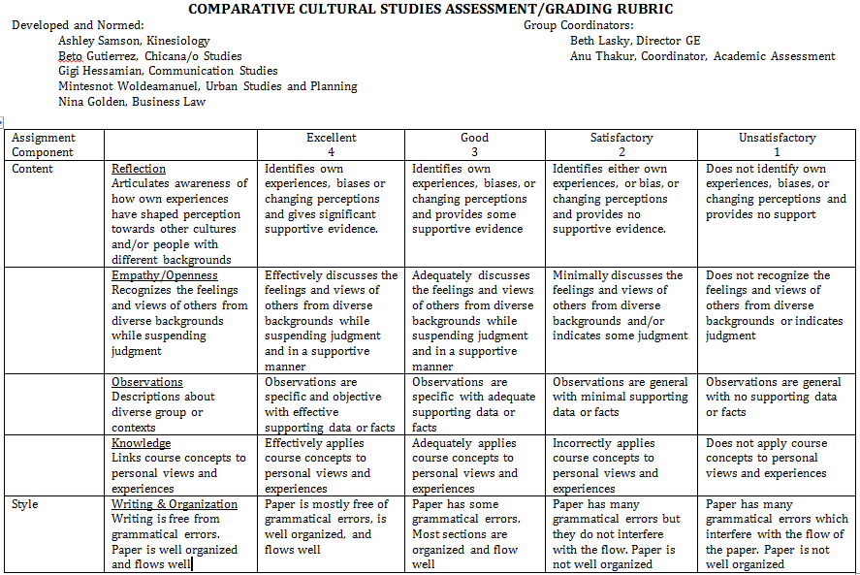
THE RUBRIC

Slide 7
What We Learned
Be specific about what a “reflection” assignment is.
Make sure to have the assignment directions attached to the paper.
Calibration and scoring need to occur the same day.

Slide 8
Next Steps
Meet one last time to discuss and possibly make changes to the rubric based on feedback from team members.
Ask other instructors in CCS to use the rubric.
Ask instructors from other GE areas to use the rubric.

Slide 9
THANK YOU

