Slide 1
Pre and Post rubrics
An example from Biology Masters program
Gini Vandergon

Slide 2
Why?
Often want to see growth
Department goals
  Mastery of students own research
Proposal
Literature
Methods
What do we want to see in our graduates?

Slide 3
Compare and contrast
Time to completion
Contribution
Knowledge
Methodology
Writing
Presentation
Quality
Final prospects

Slide 4
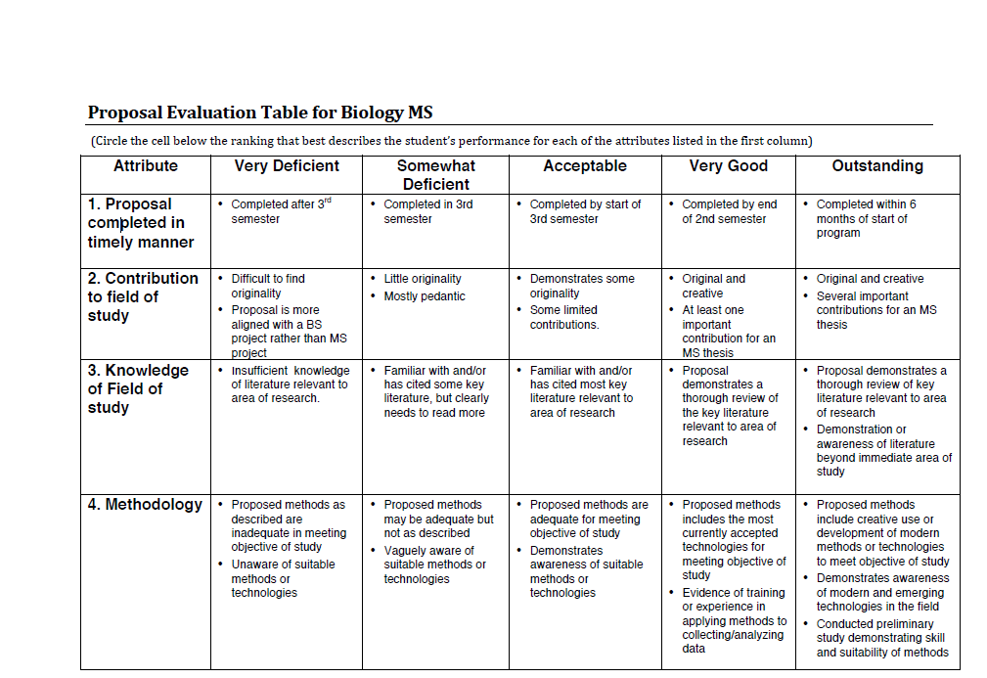

Slide 5
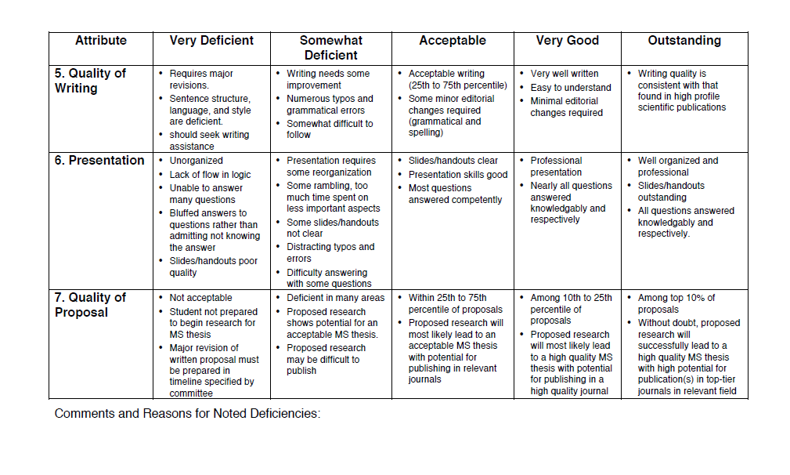

Slide 6
Expectations?
Idea is for growth
Not top necessarily
Next step?

Slide 7
Defense
Culminating experience
Measure writing, presentation, methodology
Not comparing CSUN to CSUN necessarily
Committee plus
  One outside participant

Slide 8
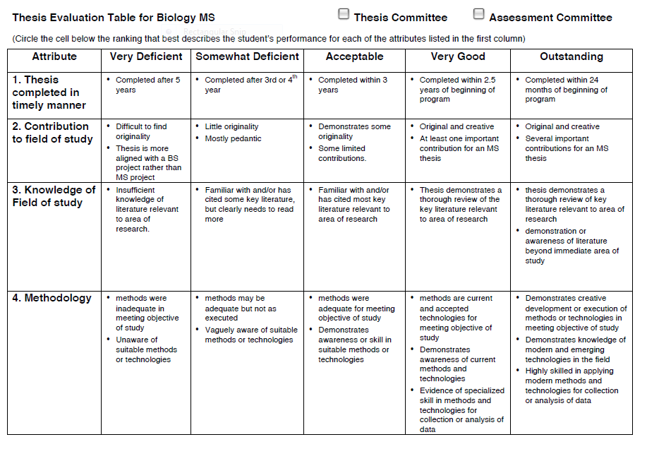

Slide 9
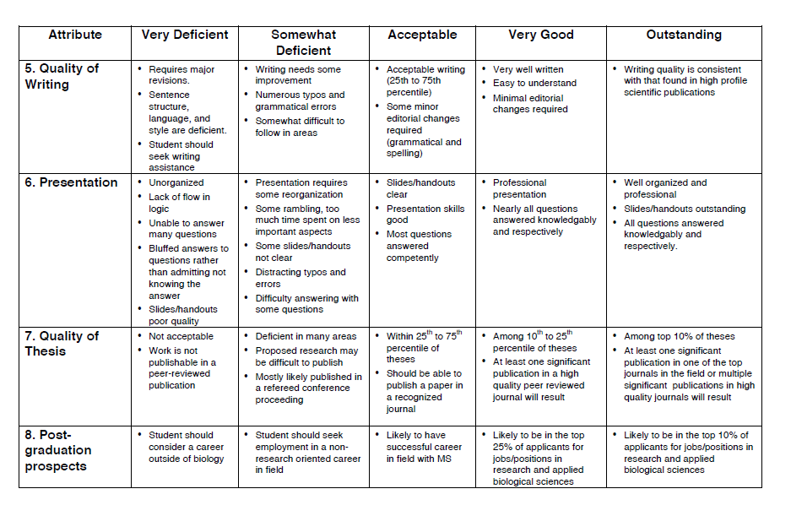

Slide 10
Final product?
Expectation is at least acceptable
Longitudinal look at Masters career

Slide 11
Compare and contrast
Time to completion
Contribution
Knowledge
Methodology
Writing
Presentation
Quality
Final prospects

