Slide 1
Assessment: Where have we been? Where are we Going?
Bonnie Paller
2013 AALC Assessment Retreat

Slide 2
Charge of the Assessment Task Force (2008)
The charge of the Task Force is to identify the abilities and intellectual traits that all students are expected to gain through their educational career at CSUN.
The members of the Task Force were chosen because they have a keen interest in student learning and achievement and an ecumenical view of the university experience and the CSUN mission. Members are tasked to think broadly, beyond discipline boundaries. They are also tasked to engage in discussions with as many of their colleagues as possible so that through wide consultation the views of all members of the campus, students, staff, faculty, are well represented and heard.

Slide 3
Fundamental Learning Competencies
Knowledge of Human Cultures and the Physical and Natural World: CSUN graduates understand the history and scope of human knowledge in the natural and social sciences and appreciate the diversity of aesthetic and cultural achievements throughout the world.
Intellectual and Practical Skills: CSUN graduates can effectively engage in inquiry and problem-solving, critical analysis, and creative thinking; they have quantitative literacy, are information competent and appreciate the role of these as life-long learning skills.
Communication Skills: CSUN graduates can communicate effectively through written, signed or spoken languages, through visual and audio media using text, video, graphics, and quantitative data, both individually and as a member of a team.
Personal and Social Responsibility: CSUN graduates are actively engaged in diverse local and global communities, have multi-cultural knowledge, and use ethical principles in reasoning and action when solving real-world challenges.

Slide 4
The Big 5
Critical Thinking
Information Literacy
Oral communication
Quantitative Literacy
Information Literacy

Slide 5
The big 5 rubric taskforce

Slide 6

Putting our heads together: The Big 5 Rubric Taskforce
Charge: to develop rubrics for the Big 5 Fundamental Learning Competencies – Critical Thinking, Written Communication, Oral Communication, Quantitative Literacy and Information Literacy. The resulting rubrics will identify 3-4 common characteristics deemed central for the competency and will be available for use across the University where competencies are assessed – within disciplinary programs, non-degree programs such as General Education and within individual courses.

Slide 7

Branching out: Critical Thinking across the Disciplines
Business-Information Systems: …apply critical thinking and problem-solving skills when analyzing and solving information system and business problems.
Communication Studies: Demonstrate the ability to analyze and critically evaluate communication practices, structures, messages, and outcomes.
Philosophy: … Students will apply the basic concepts essential to a critical examination and evaluation of argumentative discourse…
Environmental and Occupational Health: Apply mathematical and critical reasoning to understand and incorporate new concepts in the field.
Central American Studies: …develop critical thinking, writing, and reading skills.
Journalism: Acquire expertise in thinking critically and creatively…
Liberal Studies Program: …think critically and creatively.
Psychology: …demonstrate critical thinking skills…
43/67 UNDERGRADUATE PROGRAMS

Slide 8
Performance categories
Use of Evidence
Identification of Assumptions
Evaluation of Conclusions and Implications
Understanding of Inductive, Deductive, and Abductive Reasoning
Understanding of Casual Reasoning
Recognition of Relevant Distinctions
Recognition of Relevant Commonalities
Recognition of Communication of Own Perspective
Consideration of Alternative Perspectives
Synthesis across Diverse Points of View
Problem-solving

Slide 9
Performance categories
Use of Evidence
Identification of Assumptions
Evaluation of Conclusions and Implications
Understanding of Inductive, Deductive, and Abductive Reasoning
Understanding of Casual Reasoning
Recognition of Relevant Distinctions
Recognition of Relevant Commonalities
Recognition of Communication of Own Perspective
Consideration of Alternative Perspectives
Synthesis across Diverse Points of View
Problem-solving

Slide 10
Assessment in the Degree Programs
All 66 programs report gathering evidence through direct and/or indirect assessment
How are the results being used?

Slide 11
Assessment in the Degree Programs
Using the Evidence
Curriculum changes
Revising SLOs
Assessment plan changes
Pedagogical changes
Program Review
Strategic planning
Publications
Advisement changes

Slide 12
H/O/T Assessment
Began 2010
Faculty compare achievement of course learning outcomes across two section types: H/O/T
Improved assessment of O/H courses with the 2012 Course Redesign Institute
Backwards Design and the benefit of alignment templates

Slide 13
Course Alignment Map
Course Name: Course Section: Instructor:
Course Objectives |  |  | 1:
 |  |  | 2:
 |  |  | 3:
 |  |  | 4:
 |  |  | 5:
 |  |  | 6:
Module | Module Objectives | Materials |  | Activities | Assignment | Course Technology | Learner Support | Universal Design for Learning

Slide 14
Assessment Plan for Course or Module_________________________________
Assessment Instrument or Signature Assignment | Learning Activities | Course Learning Outcomes
Notes:
Here is an example of a curriculum map
Use the curriculum map to identify the learning opportunities (e.g., assignments, activities) that produce the course outcomes.
What are some best practices?
Build in practice and multiple learning trials for students: introduce, reinforce, master.
Students will perform best if they are introduced to the learning outcome early in the curriculum and then given sufficient practice and reinforcement before evaluation of their level of mastery takes place.

Slide 15
Module/Course Outcomes | Week of… | Topics | Weekly Readings/Activities | Assessment Tools

Slide 16
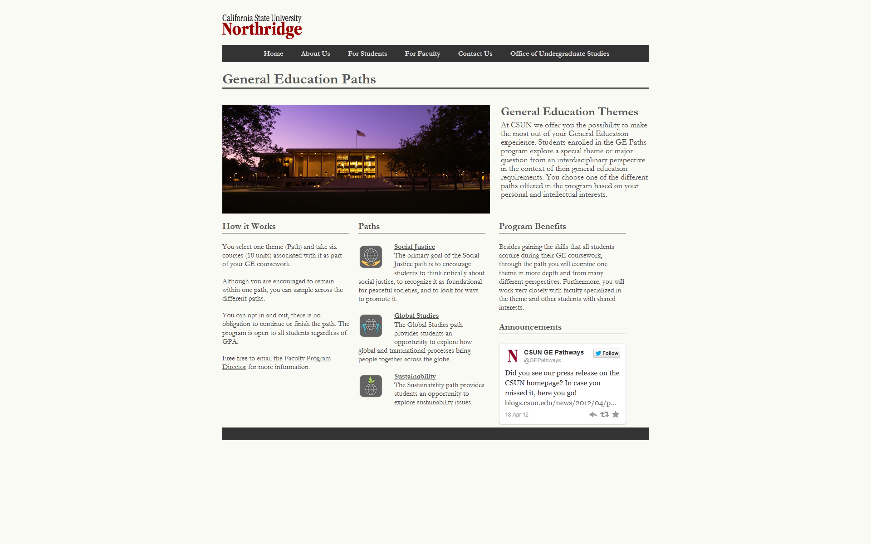
GE Paths Designed with assessment in mind

Slide 17

Social Justice Pathway
The primary goal of the Social Justice Path is to encourage students to think critically about social justice, to recognize it as foundational for peaceful societies, and to look for ways to promote it. Through interdisciplinary studies students will learn about distinct definitions of social justice and explore issues related to it. They will analyze the ways that socially determined beliefs and expectations associated with race, ethnicity, nation, religion, developmental challenges, gender, and/or sexuality become institutionalized and facilitate and/or limit people’s ability to exercise and enjoy equal social, political, and economic rights. Finally, students will develop insight into the interrelationship between cultural recognition and economic justice and the importance of both for ensuring that people are treated equally.
Student Learning Outcomes
Students will be able to compare the distinct definitions of social justice.
Students will be able to recognize and critically analyze the inter-relationship between cultural recognition and economic justice.
Students will be able to identify and practice the methods people use to fight for social justice at local, national, and international levels.
Students will be able to identify and analyze the ways injustices are institutionalized in social, political, and economic structures.
Students will be able to recognize and connect the ways individuals and institutions may be beneficiaries and/or victims of social injustice.

Slide 18
Wait – There’s More
GE Assessment – Cultural Studies
myCSUNtablet
Decentralizing Assessment – piloting a new way to communicate and facilitate

Slide 19
Thank you—
Bonnie Paller
Bonnie.paller@csun.edu

