Slide 1
Challenges
Getting everyone to perform their duties, faculty buy-in
Faculty meeting to talk about assessment so common understanding of importance
Different types of assessment that are valid and address complex skills in different types of assignments
Efficiency of faculty time not doing busy work but collecting valuable data
Closing the loop, analyzing the data
Time
Orientation for liaisons, transitions between

Slide 2
5 word poster
Make a poster describing the challenge
  BUT you can only use 5 words the rest has to be drawings, figures etc
LUNCH grab and work ☺
Next we will hang posters and we will walk around with suggestions to solve these challenges using the post-its to write your suggestions
Wrap-up

Slide 3
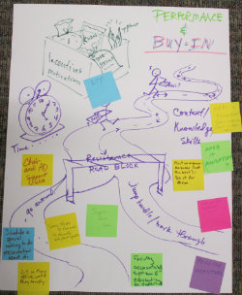
Challenges
Getting everyone to perform their duties, faculty buy-in
Responses/Suggestions from activity:
  Visible support from Chair and Associate Dean
  Schedule a special meeting to do presentations about it
  Some form of reward/incentive to faculty who participate
  Address only what is essential
  Make it mandatory
  Faculty accountability systems and education by department
  Make part of the evaluation process
  Most common response from outside faculty: “Assessment liaison should do it for them”
  RTP

Slide 4
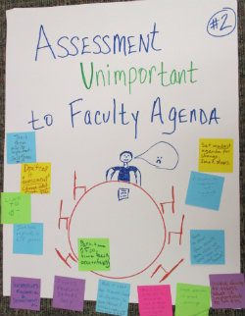
Challenges
Faculty meeting : assessment important/unimportant to agenda
Responses/Suggestions from activity:
  Teach faculty why it’s important/sell it to them
  Emphasize importance not uniformity
  Discuss how to show them results—make clear it’s about the students, not them
  Involve faculty in assessing what’s important to them
  Part-time and full-time faculty accountability
  Make it about how to make faculty’s lives easier (concern about the workload)
  Discuss how assessment can demonstrate need for change which can lead to funding for more resources
  Couple assessment with other meetings
  Set modest agenda for change- target small steps
  Incentives-financial and departmental
  Assess problem issues only
  Include explicitly in RTP process

Slide 5
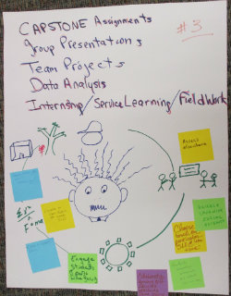
Challenges
Different types of valid assessment that address complex skills
Responses/Suggestions from activity:
  Capstone assignments
  Group presentations
  Evaluate competitive assignments and select better ones
  Data analysis
  Choose based on particular SLO at the time
  Internship/service learning/fieldwork
  Share rubrics within assessment community
  Create a clear rubric for each SLO
  Create a custom rubric
  Engage students and part time faculty
  Collaboration among different faculty teaching same course to have equal assignments
  Assess elsewhere
  Team projects

Slide 6
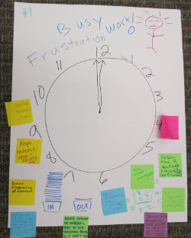
Challenges
Efficiency of faculty time
Responses/Suggestions from activity:
  Shorter meetings (50 minutes) and consolidate department and university
  Reduce frequency of assessment
  Make assessment an integral part of the teaching process so it wont add extra work
  Focus assessment on known problem areas/key issues
  Convince faculty to gather data relevant to student learning vs. just requiring assessment
  Decide as a department what’s important to collect and make it as easy as possible
  Keep release time-I.D. key meeting

Slide 7
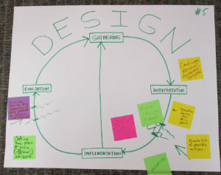
Challenges
Closing the loop, analyzing the data
Responses/Suggestions from activity:
  Convince faculty of the relevance of data gathering to program improvement
  Define plan and officially train liaisons
  Very important to link to student success
  Prioritize key issues to address
  Create form for interpretation
  Create a possible list of actions between implementation and interpretation
  Incentives
  Continue personal assistance with projects

Slide 8
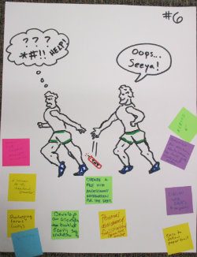
Challenges
Orientation for liaisons/transitions
Responses/Suggestions from activity:
  Moodle site for each program/department so information isn’t lost
  2 liaisons for the transitional semester
  Overlapping terms (although costly)
  Apprenticeship
  Create a file with assessment information for the department
  Develop an orientation booklet and early semester orientation
  Personal assistance/facilitation/committee overlap
  Develop electronic database to hold all assessment data
  Liaison webpages and resources
  Easy to follow paper trail

