Slide 1
Chapter 3:
The Enhanced E-R Model
Modern Database Management
12th Edition
Jeff Hoffer, Ramesh Venkataraman,
Heikki Topi

Slide 2
Objectives
Define terms
Understand use of supertype/subtype relationships
Use specialization and generalization techniques
Specify completeness and disjointness constraints
Develop supertype/subtype hierarchies for realistic business situations
Develop entity clusters
Explain universal (packaged) data model
Describe special features of data modeling project using packaged data model

Slide 3
Supertypes and Subtypes
Enhanced ER model: extends original ER model with new modeling constructs
Subtype: A subgrouping of the entities in an entity type that has attributes distinct from those in other subgroupings (“siblings” from the same parents)
Supertype: A generic entity type that has a relationship with one or more subtypes
Attribute Inheritance:
  Subtype entities inherit values of all attributes of the supertype (“children” inherit from “parents”)
  An instance of a subtype is also an instance of the supertype
“Subtype = Supertype + Uniqueness”
Uniqueness: Attributes with domains

Slide 4
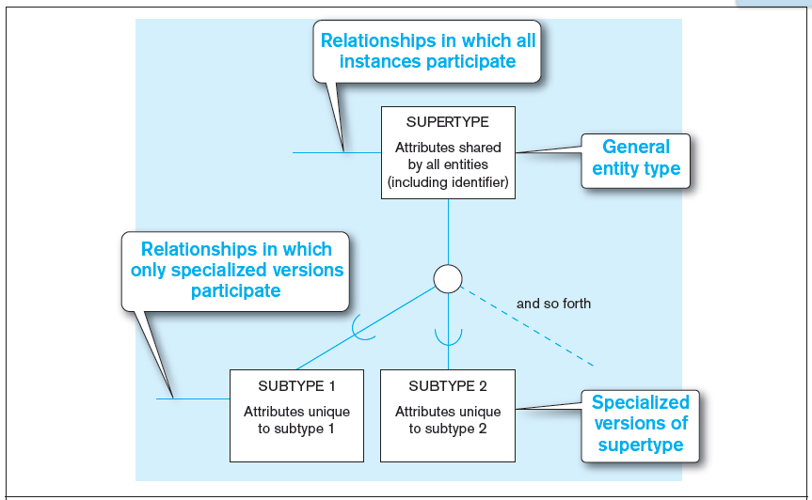
Figure 3-1 Basic notation for supertype/subtype notation
a) EER notation
Every member of subtype 1 is also a member of the supertype; the same can be said of subtype 2
Notes:
This is only one possible notation for EER. In other figures we will see Microsoft Visio notation, which is similar but not identical.

Slide 5
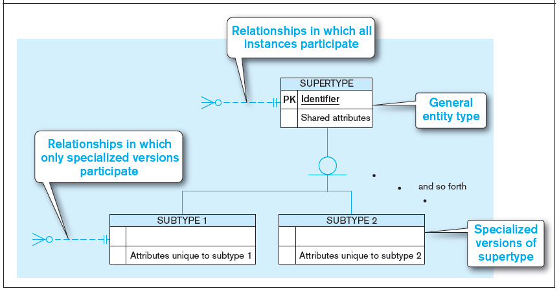
Figure 3-1 Basic notation for supertype/subtype notation (cont.)
b) Microsoft Visio Notation
Different modeling tools may have different notation for the same modeling constructs.

Slide 6
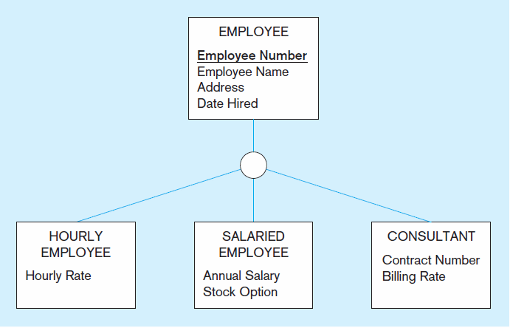
Figure 3-2 Employee supertype with three subtypes
DEPARTMENT
Has
All employee subtypes will have employee number, name, address, and date hired
Works_for
Each employee subtype will also have its own UNIQUE attributes

Slide 7
Relationships and Subtypes
Relationships at the supertype level indicate that all subtypes will participate in the relationship
The instances of a subtype may participate in a relationship unique to that subtype.
  In this situation, the relationship is shown at the subtype level

Slide 8
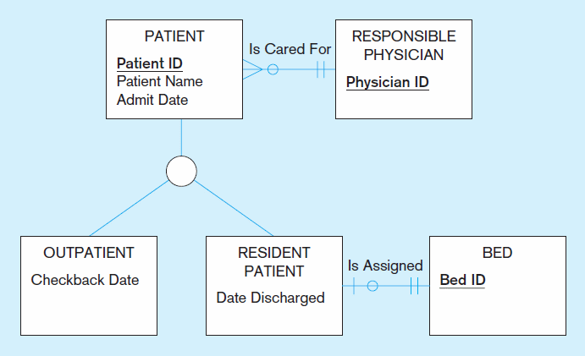
Figure 3-3 Supertype/subtype relationships in a hospital
Both outpatients and resident patients are cared for by a responsible physician
Attributes for ALL types
Relationship for all types
Only resident patients are assigned to a bed
Unique relationship for one subtype
Unique attributes for each subtype

Slide 9
Generalization and Specialization
Generalization: The process of defining a more general entity type from a set of more specialized entity types. BOTTOM-UP
  From specific to general – “extract commonalities”
Specialization: The process of defining one or more subtypes of the supertype and forming supertype/subtype relationships. TOP-DOWN
  From general to specific – “add uniquenesses”

Slide 10
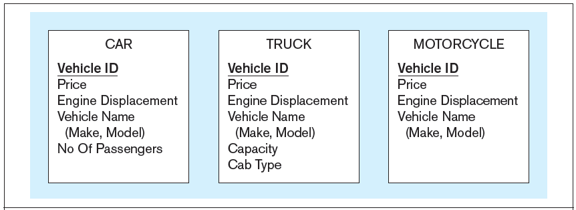
Figure 3-4 Example of generalization
a) Three entity types: CAR, TRUCK, and MOTORCYCLE
All these types of vehicles have common attributes
“Subtype = Supertype + Uniqueness”
CAR = AUTO + Num-passengers (2 or 4)
SUV = AUTO + All-wheel-drive (Yes or No)
Notes:
Sometimes during the conceptual modeling process, we begin to recognize common themes among several entity types. For example they may all share many of the same attributes, such as in this example. Here, cars trucks and motorcycles all have prices, engine displacements and vehicle makes and models.

Slide 11
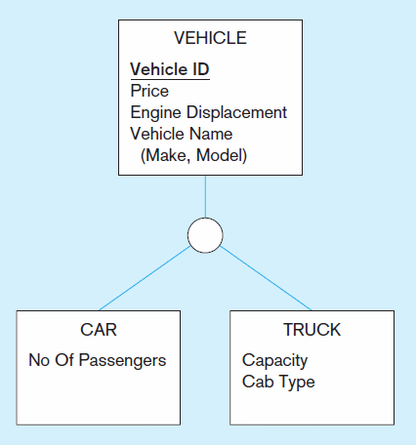
Figure 3-4 Example of generalization (cont.)
b) Generalization to VEHICLE supertype
REGISTRATION
(for example)
So we put the shared attributes in a supertype
Note: no subtype for motorcycle, since it has no unique attributes

Slide 12
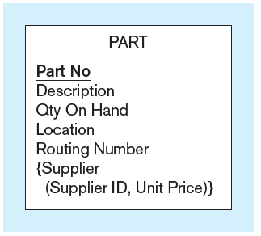
Figure 3-5 Example of specialization
a) Entity type PART
Only applies to manufactured parts
Applies only to purchased parts
Notes:
Sometimes during conceptual modeling we discover that certain attributes (or relationships) apply only to a subset of the entities in a given entity type. In this example, we have a manufacturing firm that may manufacture some of its own parts and purchase others. If the part is manufactured by the firm itself, it has a routing number, but if purchased it does not. If purchased, it comes from a supplier, but if manufactured it does not.
Note the representation of supplier as a composite multivalued attribute in this diagram.

Slide 13
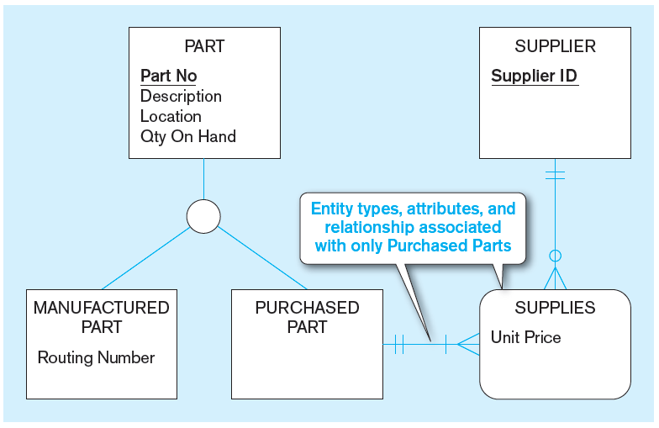
Figure 3-5 Example of specialization (cont.)
b) Specialization to MANUFACTURED PART and PURCHASED PART
Created 2 subtypes
Note: multivalued composite attribute was replaced by an associative entity relationship to another entity
Notes:
When we fine a situation like this, it makes sense to do “specialization”. In this case, we created two subtypes of Part, one for manufactured parts and one for purchased part. All parts have part numbers, descriptions, locations, and quantity. But only manufactured parts have routing numbers, and only purchased parts have suppliers.
Note that unlike the previous slide, the concept of supplier is now represented as a separate entity, and an associative entity represents a M:N relationship between purchased part and supplier, with unit price being an attribute of the associative entity.
This provides information that was not explicit in the previous figure. A multivalued attribute does not explicitly describe a M:N relationship. It could also convey a 1:N relationship. But when you represent the supplier as a separate entity, you can explicitly show the cardinality of relationship.
For an example of a multivalued attribute that implies a 1:N relationship, refer to figure 2.19 from chapter 2. Here we have time stamps of price history changes. For a given product, there may be many price history items, but each price history item belongs to only one product. That’s different from what we have here with parts and suppliers, where a part can have many suppliers and a supplier could supply many parts.

Slide 14
Constraints in Supertype/SUBTYPE RELATIONSHIPS
Completeness Constraints: Whether an instance of a supertype must also be a member of at least one subtype
  Total Specialization Rule: Yes (double line)
  Partial Specialization Rule: No (single line)
    An instance of the supertype does NOT have to be member of a subtype
Notes:
There are two types of constraints in supertype/subtype relationships. One is called a completeness constraint, and indicates whether there must be an explicit subtype for each possible instance of the supertype. The other is called a disjointness constraint, which indicates whether a particular instance of a supertype could also be more than one of the subtypes.

Slide 15
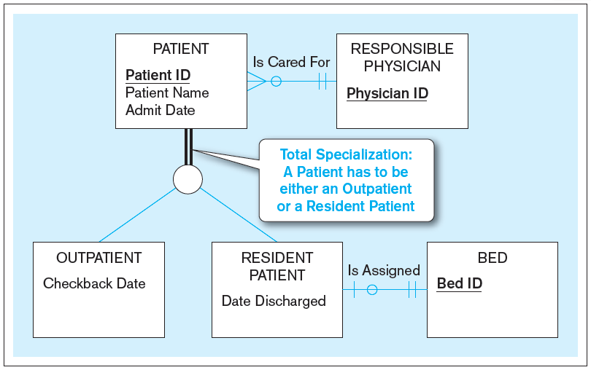
Figure 3-6 Examples of completeness constraints
a) Total specialization rule
Notes:
In this case, a patient MUST either be an outpatient or a resident patient. There is no other possibility. This particular completeness constraint is called total specialization, and is represented by double lines coming down from the supertype entity type.

Slide 16
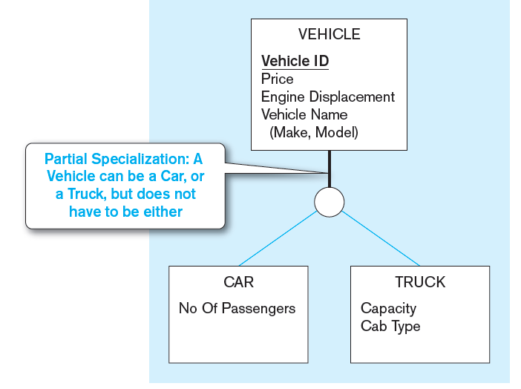
Figure 3-6 Examples of completeness constraints (cont.)
b) Partial specialization rule
Notes:
We already saw this example from earlier. This is partial specialization, because some vehicles are motorcycles, which is not explicitly represented as a subtype entity.
Question: going back to figure 2-5, do you think the division of PART into manufactured vs. purchased parts implies total specialization or partial specialization ?
Answer: probably total specialization . Either a part is manufactured in-house or purchased from an external supplier. There is probably no other option.

Slide 17
Constraints in Supertype/ Disjointness constraint
(when a member of the suupertype is a member of some subtype(s)) – “exclusiveness”
Disjointness Constraints: Whether an instance of a supertype may simultaneously be a member of two (or more) subtypes
  Disjoint Rule: An instance of the supertype can be only ONE of the subtypes (“Exclusive-OR”)
    If you are in subtype 1 you _____________ in subtype 2
  Overlap Rule: An instance of the supertype could be more than one of the subtypes (“Inclusive-OR”)
    If you are in subtype 1 you _____________ in subtype 2

Slide 18
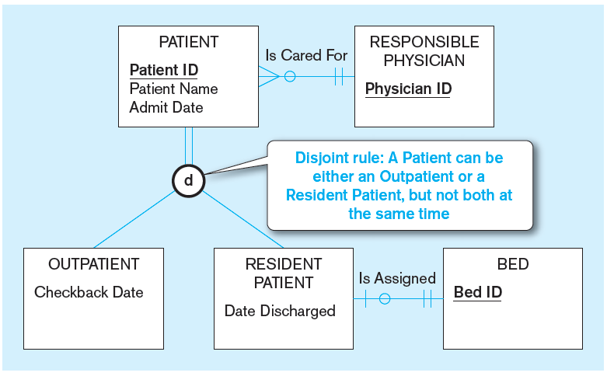
Figure 3-7 Examples of disjointness constraints
a) Disjoint rule
Notes:
Here we see a disjoint (not overlap) rule regarding patients. A patient can’t be both a resident and an outpatient, at least not at the same time. Of course it’s possible for a patient to be a resident for a period of time and then change to an outpatient (or vice versa), but the patient cannot be both simultaneously.

Slide 19
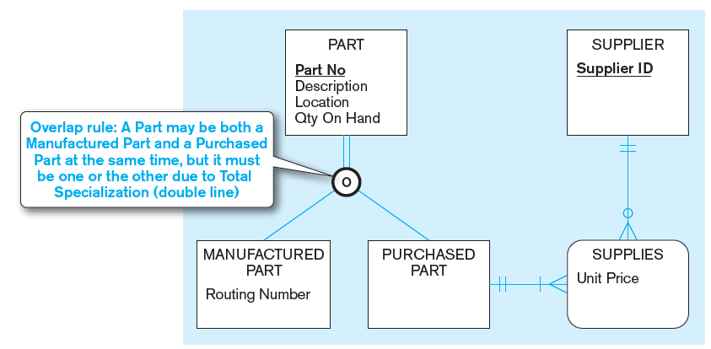
Figure 3-7 Examples of disjointness constraints (cont.)
b) Overlap rule
Notes:
Here is an overlap rule. Some kinds of parts could be manufactured in-house and also purchased from external suppliers. Note the total specialization rule, which we discussed earlier.

Slide 20
Constraints in Supertype/ Subtype Discriminators
Subtype Discriminator: An attribute of the supertype whose values determine the target subtype(s)
  Disjoint – a simple attribute
    with alternative values to indicate the possible subtypes
  Overlapping – a composite attribute
    whose subparts pertain to different subtypes.
    Each subpart contains a Boolean value to indicate whether or not the instance belongs to the associated subtype

Slide 21
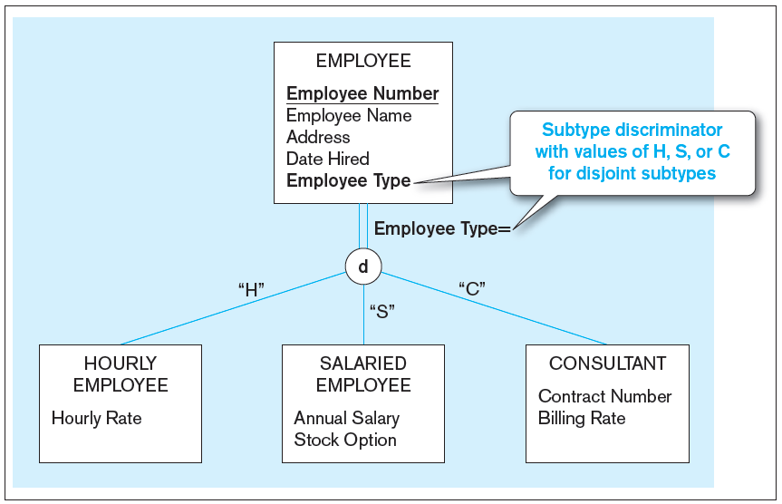
Figure 3-8 Introducing a subtype discriminator (disjoint rule)
The subtype discriminator has only ONE value
Notes:
Here, for the disjoint rule we have Employee Type as the subtype discriminator, and it can have three possible values, one for each subtype.
Going back to figure 3-7, what would be a possible subtype discriminator, and what would its values be?

Slide 22
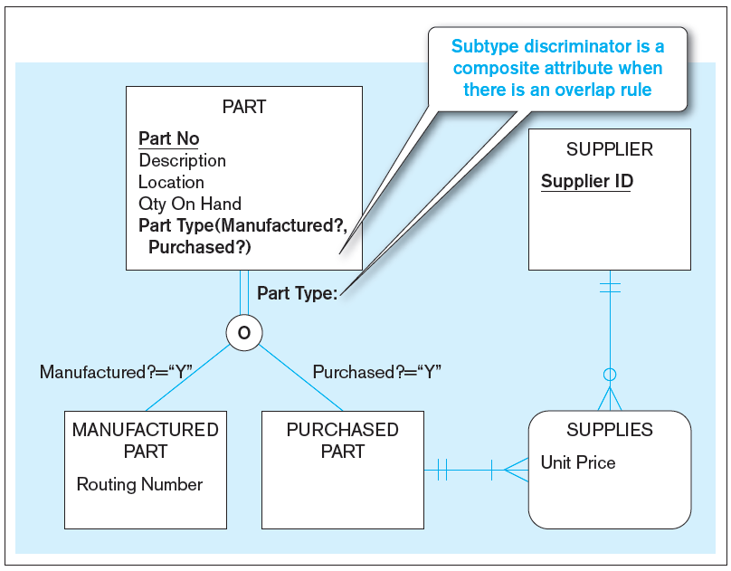
Figure 3-9 Subtype discriminator (overlap rule)
This is a part number which may have thousands of pieces, not “a piece” which one can touch
Notes:
Note the requirement for a composite subtype discriminator here. So, there are three possible scenarios:
Manufactured = “Y” and Purchased = “Y”
Manufactured = “Y” and Purchased = “N”
Manufactured = “N” and Purchased = “N”
Note that it is impossible for this scenario to occur: Manufactured = “N” and Purchased = “N”. Why is this not possible?
Answer: because of the total specialization rule. At least one of these have to be “Y”.

Slide 23
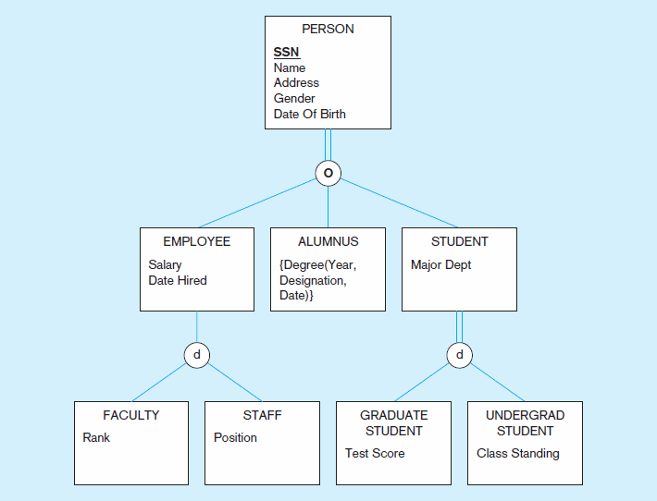
Figure 3-10 Example of supertype/subtype hierarchy
Compare 1
Compare 2

Slide 24
Supertype & Subtype: BOTH are entities
Do not confuse attributes for subtypes
The title says it all –
  In past semesters there were students treated attributes as subtypes, or EVEN (!) values of attributes as subtypes
Logical example (example of mistakes):
  Supertype: Autos
  Subtype: sedan, SUV, truck, MPH, Tank volume, Mecedez, BMW, Accord
  What are right and what are wrong?
  Among the wrong ones, which ones are of what types of mistakes?
Supertype and sub-type are same “type” of things

Slide 25
YouTube resources
Chapter 3: Data models - EER model (~7:30)
  https://www.youtube.com/watch?v=Bn9uB--RwAw&t=618s
EER Diagram Example & Solution (6:38)
  https://www.youtube.com/watch?v=SWv84bMUBuo
EER to Relational Translation Techniques (~4:40)
  https://www.youtube.com/watch?v=0ZOFZ-Hh664

Slide 26
Entity Clusters
EER diagrams are difficult to read when there are too many entities and relationships
Solution: Group entities and relationships into entity clusters
Entity cluster: Set of one or more entity types and associated relationships grouped into a single abstract entity type
“Taking a step back”; Enable to see the “Big Picture”

Slide 27
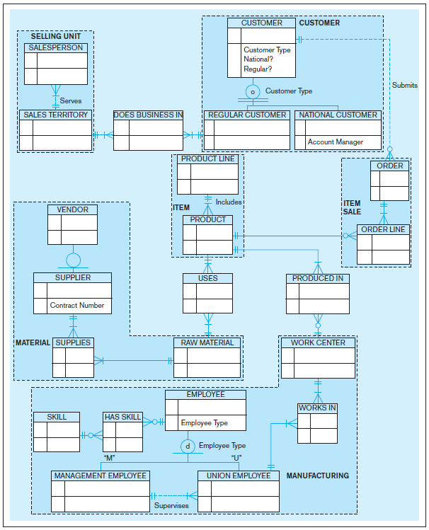
Figure 3-13a Possible entity clusters for Pine Valley Furniture in Microsoft Visio
Related groups of entities could become clusters
Notes:
Here we see 22 entities. That’s a lot, and can be difficult to read and make sense of at an aggregate, summary level.

Slide 28
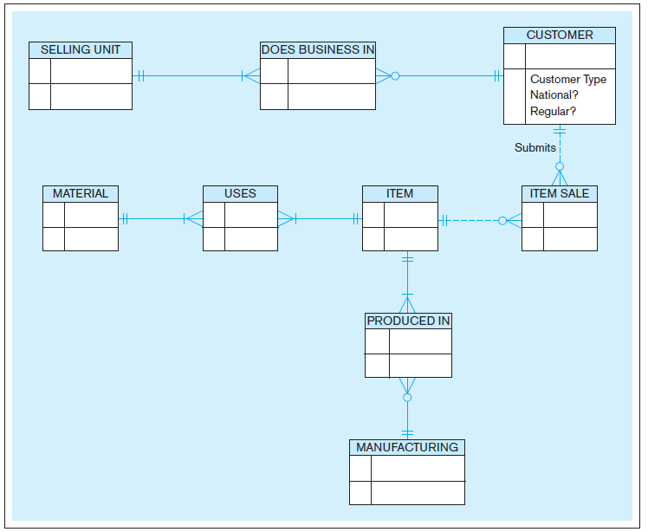
Figure 3-13b EER diagram of PVF entity clusters
More readable, isn’t it?
Notes:
Here, we clustered these 22 entities into eight clusters. The relationships between clusters occur if there are relationships between entities within the individual clusters. For example, since there is a 1:N relationship between the Customer entity and the Order entity, this implies a 1:N relationship between the Customer cluster and the Item Sale cluster.
Note that the associative entities often stand apart from the clusters and provide linkages between them.

Slide 29
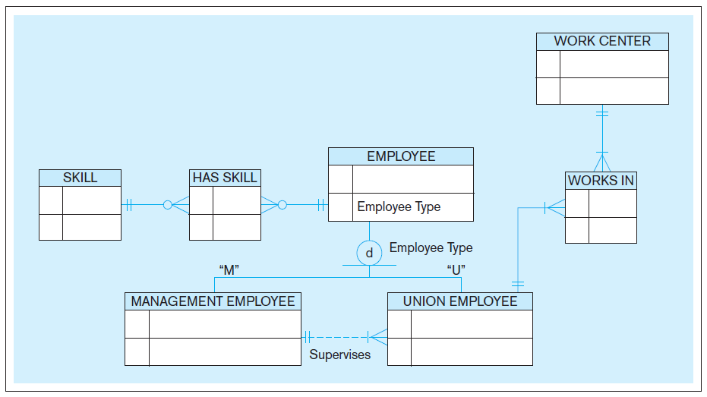
Figure 3-14 Manufacturing entity cluster
Detail for a single cluster
Notes:
You can imagine the entity cluster diagram to be a “bird’s eye view” model. The modeler can the “drill down” to see detailed views of individual clusters.

Slide 30
Packaged Data Models
Predefined data models
Could be universal or industry-specific
Universal data model = a generic or template data model that can be reused as a starting point for a data modeling project (also called a “pattern”)

Slide 31
Advantages of Packaged Data Models
Use proven model components
Save time and cost
Less likelihood of data model errors
Easier to evolve and modify over time
Aid in requirements determination
Easier to read
Supertype/subtype hierarchies promote reuse
Many-to-many relationships enhance model flexibility
Vendor-supplied data model fosters integration with vendor’s applications
Universal models support inter-organizational systems

Slide 32
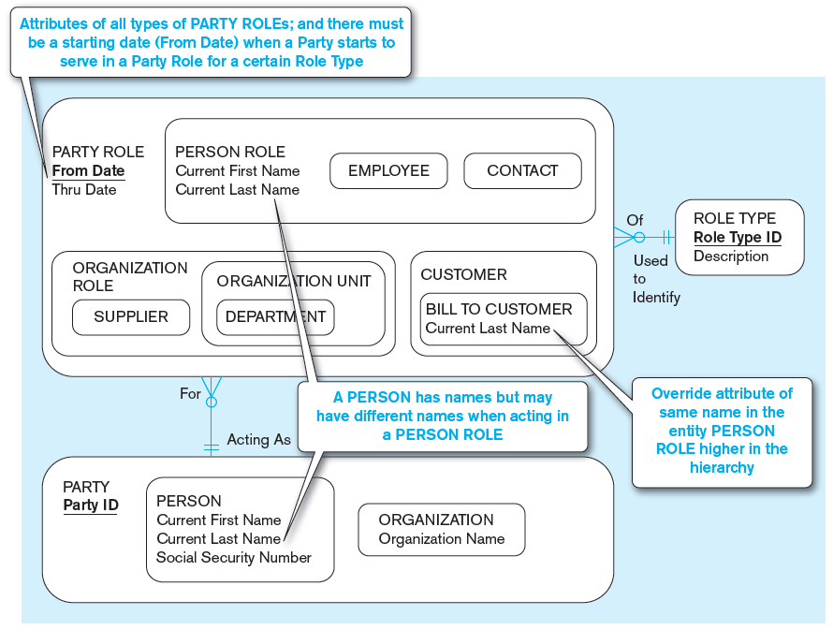
Figure 3-15 PARTY, PARTY ROLE, and ROLE TYPE in a universal data model
(a) Basic PARTY universal data model
Packaged data models are generic models that can be customized for a particular organization’s business rules.
Notes:
Universal and packaged data models are useful because they are reusable and customizable. This is a good example. Most companies will have entities similar to people, employees, contacts, suppliers, departments, bills, etc. If this is given to you from the beginning, you don’t have to “reinvent the wheel”, and can instead tweak it to your specific needs.

Slide 33
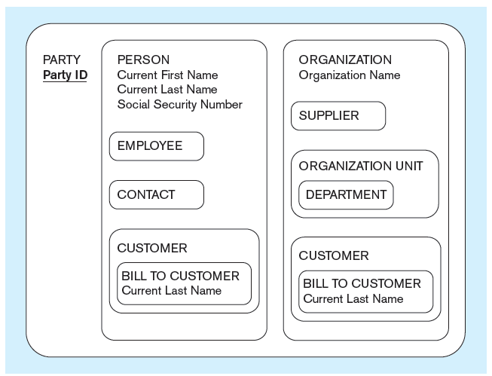
Figure 3-15 PARTY, PARTY ROLE, and ROLE TYPE in a universal data model
(b) PARTY supertype/subtype hierarchy
Notes:
Here we see an alternative notation for supertype/subtype representations. E-R and EER models have various ways they can be represented in diagrams. But conceptually they are all pretty similar.

