Slide 1
12
Customer Relationship Management

Slide 2
Defining Customer Relationship Management
Operational Customer Relationship Management Systems
Analytical Customer Relationship Management Systems
Other Types of Customer Relationship Management Systems

Slide 3
Identify the primary functions of both customer relationship management (CRM) and collaborative CRM strategies.
Describe how businesses might utilize applications of each of the two major components of operational CRM systems.
Discuss the benefits of analytical CRM systems to businesses.

Slide 4
Explain the advantages and disadvantages of mobile CRM systems, on-demand CRM systems, and open-source CRM systems.

Slide 5
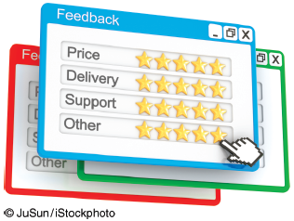
Rating Online
Customer Service
  Why is it so valuable for
  an online retailer to be
  able to post
  StellaService’s seal of
  approval on its Web site and advertising materials?
  Why doesn’t StellaService provide the same service for bricks-and-mortar retailers?

Slide 6
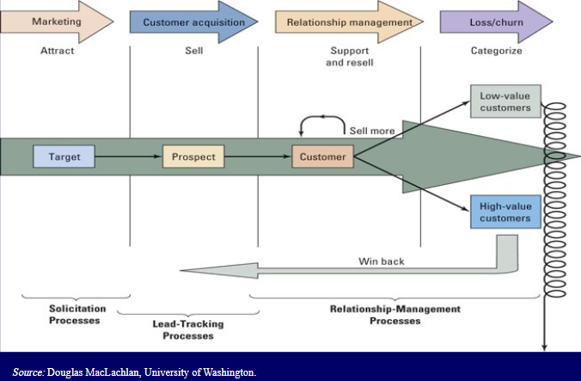
Customer Life Cycle

Slide 7
12.1
Defining Customer Relationship Management
Customer Touch Points
Data Consolidation
Notes:
Customer Touch Points: the numerous and diverse interactions organizations have with their customers including traditional customer touch points such as telephone contact, direct mailings, and actual physical interactions with customers during their visits to a store and the additional touch points that occur through organizational CRM systems such as e-mail, Web sites, and communications via smartphones.
Data Consolidation: the organization’s CRM systems must manage customer data effectively with modern interconnected systems built around a data warehouse to make all customer-related data available to every unit of the business.
360° Data View Customer: complete data set on each customer that allows a company can enhance its relationship with its customers and ultimately make more productive and profitable decisions.
-----------------
Data consolidation and the 360° view of the customer enable the organization’s functional areas to readily share information about customers which leads to collaborative CRM.
Collaborative CRM Systems: provide effective and efficient interactive communication in all aspects of marketing, sales, and customer support with the customer throughout the entire organization.

Slide 8

’S ABOUT BUSINESS 12.1
Amazon: Truly
Superb Customer
Service
  Describe the advantages
  that Amazon has over bricks-and-mortar retailers.
  Describe the many facets of Amazon’s relentless focus on customer relationship management.

Slide 9
What Is CRM?
A true CRM integrates corporate strategy, business methodology, and technology to accomplish a myriad of goals for companies that want to operate in a customer-driven environment.
No business can survive without understanding its customers and having a positive relationship with them.
CRM provides support for the front-end customer facing functionality (e.g., marketing, sales, and customer service), which are usually not available in traditional ERP systems.

Slide 10
CRM Evolution
In the 1980s through the mid-1990s companies started using IT to automate customer processes with discrete customer-centric applications.
Late 1990s, companies started integrating these discrete systems into what is now known as CRM.
CRM began in response to a changing market environment as mass marketing gave way to focused segment marketing, and finally to target marketing an individual.
Enabled by new technologies that collected consumer data, companies progressed to focused segment marketing.

Slide 11
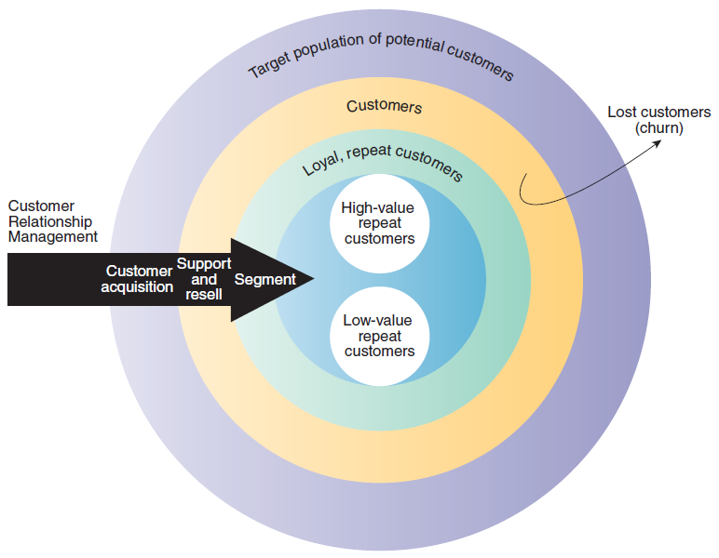
Figure 12.1: CRM Process

Slide 12
Customer Relationship Processes
A good CRM should provide support for the following functions.
  Capture and maintain customer needs, motivations, and behaviors over the lifetime of the relationship.
  Facilitate the use of customer experiences for continuous improvement of this relationship.
  Integrate marketing, sales, and customer support activities measuring and evaluating the process of knowledge acquisition and sharing.

Slide 13
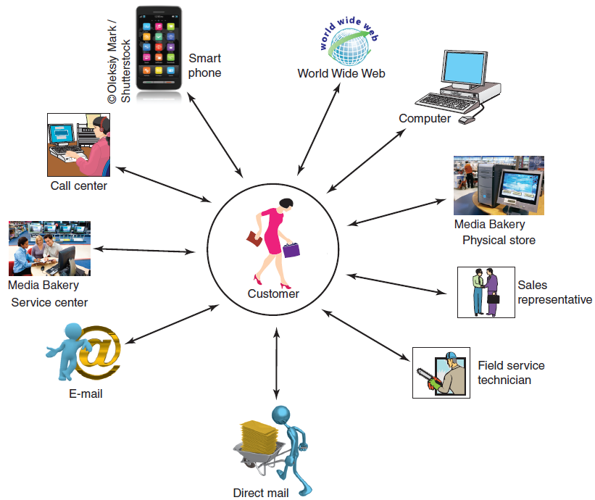
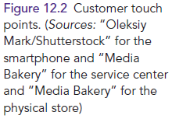
Figure 12.2: Customer Touchpoints

Slide 14
12.2
Operational Customer Relationship Management System
Customer-Facing Applications
Customer-Touching Applications
Notes:
Operational CRM: systems that support front-office business processes.
Front-Office Processes: those processes that directly interact with customers (i.e., sales, marketing, and service).
Customer-Facing Applications: allow an organization’s sales, field service, and customer interaction center representatives interact directly with customers through customer service and support, sales force automation, marketing, and campaign management.
Customer-Touching Applications: (or electronic CRM e-CRM) customer self-help applications/technologies.
-----------------
Two Major Components of Operational CRM:
Customer-Facing Applications
Customer-Touching Applications
-------------------

Slide 15
Customer Facing Applications
Customer Service and Support
Sales Force Automation
  Salesforce.com
Marketing
Campaign Management
Notes:
Customer-Facing Applications: allow an organization’s sales, field service, and customer interaction center representatives interact directly with customers through customer service and support, sales force automation, marketing, and campaign management.
Sales Force Automation (SFA): the component of an operational CRM system that automatically records all of the components in a sales transaction process.
Marketing: CRM Marketing applications use data mining to sift through volumes of customer data
Campaign Management: applications that help organizations plan campaigns that send the right messages to the right people through the right channels (e.g., avoid targeting people who have opted out of receiving marketing communications).

Slide 16
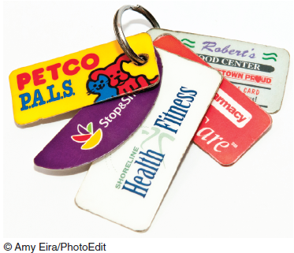
Customer Facing Applications: Customer Service & Support
Customer Interaction Centers (CIC)
Call Center
Oubound Telesales
Inbound Teleservice
  Knowledge base
Information Help Desk
Live Chat
  Natural language processing
Notes:
Customer-Facing Applications: allow an organization’s sales, field service, and customer interaction center representatives interact directly with customers through customer service and support, sales force automation, marketing, and campaign management.
--------------
Customer Service and Support: systems that automate service requests, complaints, product returns, and requests for information.
Customer Interaction Centers (CIC): where organizational representatives use multiple channels such as the Web, telephone, fax, and face-to-face interactions to communicate with customers.
Call Center: a centralized office set up to receive and transmit a large volume of requests by telephone.
Oubound Telesales: the CIC generates a call list for the sales team, whose members contact sales prospects.
Inbound Teleservice: customers communicate directly with the CIC to initiate a sales order, inquire about products and services before placing an order, and obtain information about a transaction they have already made.
Information Help Desk: assists customers with their questions concerning products or services, and it also processes customer complaints.
Live Chat: allows customers to connect to a company representative and conduct an instant messaging session enabling the participants to share documents and photos.

Slide 17
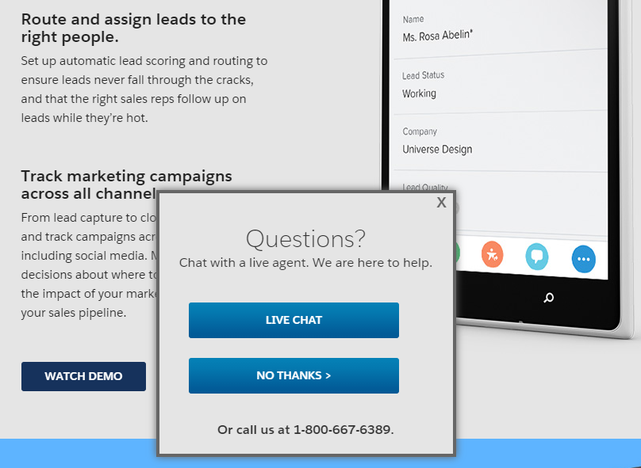
Live Chat

Slide 18
Customer Facing Applications: Sales Force Automation
Contact Management System
  No redundant calls
Sales Lead Tracking System
  ID cust who are likely to purchase a pdt
Sales Forecasting System
Product Knowledge System
Configurator
  “Build your own (PC; NIKE; …)”
Notes:
Customer-Facing Applications: allow an organization’s sales, field service, and customer interaction center representatives interact directly with customers through customer service and support, sales force automation, marketing, and campaign management.
--------------
Sales Force Automation (SFA): the component of an operational CRM system that automatically records all of the components in a sales transaction process.
Contact Management System: tracks all communications between the company and the customer, the purpose of each communication, and any necessary follow-up which eliminates duplicated contacts and redundancy, which in turn reduces the risk of irritating customers.
Sales Lead Tracking System: lists potential customers or customers who have purchased related products; that is, products similar to those that the salesperson is trying to sell to the customer.
Sales Forecasting System: a mathematical technique for estimating future sales.
Product Knowledge System: a comprehensive source of information regarding products and services.
Configurator: an online product-building feature that enables customers to model the product to meet their specific needs.

Slide 19
Customer Facing Applications: Marketing
Data Mining
Cross-Selling
Upselling
Bundling
Notes:
Customer-Facing Applications: allow an organization’s sales, field service, and customer interaction center representatives interact directly with customers through customer service and support, sales force automation, marketing, and campaign management.
--------------
Marketing: CRM Marketing applications use data mining to sift through volumes of customer data
Data Mining: develops a purchasing profile or snapshot of a consumer’s buying habits that may lead to additional sales through cross-selling, upselling, and bundling.
Cross-Selling: the marketing of additional related products to customers based on a previous purchase.
Upselling: a strategy in which the salesperson provides customers with the opportunity to purchase related products or services of greater value in place of, or along with, the consumer’s initial product or service selection.
Bundling: is a form of cross-selling in which a business sells a group of products or services together at a lower price than their combined individual prices.

Slide 20
Customer Facing Applications: Campaign Management
Campaign Planning
  Right messages
  Right people Analytical CRM
  Right channels
  Marketing communications opt-out
Notes:
Customer-Facing Applications: allow an organization’s sales, field service, and customer interaction center representatives interact directly with customers through customer service and support, sales force automation, marketing, and campaign management.
--------------
Campaign Management: applications that help organizations plan campaigns that send the right messages to the right people through the right channels (e.g., avoid targeting people who have opted out of receiving marketing communications).

Slide 21
Customer Touching Applications
Search & Comparison Capabilities
Technical and Other Information and Services
Customized Products and Services
Mass Customization
Personalized Web Pages
Frequently Asked Questions (FAQs)
E-mail and Automated Response
Loyalty Programs
Customers can use these to help themselves
Notes:
Customer-Touching Applications: (or electronic CRM e-CRM) customer self-help applications/technologies.
-----------------
Search and Comparison Capabilities: search and comparison capabilities offered to customers by online stores, online malls, and independent comparison Web sites.
Technical and Other Information and Services: personalized experiences offered by organizations to induce customers to make purchases or to remain loyal (e.g., allowing customers to download product manuals; providing detailed technical information, maintenance information, and replacement parts to customers).
Customized Products and Services: offering customers the ability to custimize products, view account balances, check shipping status of an order, etc.
Mass Customization: a process in which customers can configure their own products (e.g., customized computer systems from Dell).
Personalized Web Pages: organizations permit their customers to create personalized Web pages used to record purchases and preferences, as well as problems and requests.
Frequently Asked Questions (FAQs): a simple tool for answering repetitive customer queries and when customers find the information they need by using FAQs the need to communicate with an actual person is eliminated.
E-mail and Automated Response: the most popular tool for customer service, inexpensive, fast, and companies use e-mail not only to answer customer inquiries but also to disseminate information, send alerts and product information, and conduct correspondence on any topic.
Loyalty Programs: programs that recognize customers who repeatedly use a vendor’s
products or services.

Slide 22
12.3
Analytical Customer Relationship Management (CRM) Systems
Analytical CRM Systems Analyze Customer Data for:
Targeted marketing campaigns
Increasing customer acquisition, cross-selling, and upselling
Products and services decision support
Financial forecasting
Customer profitability analysis
Notes:
Analytical CRM: provide business intelligence by analyzing customer behavior and perceptions providing information concerning customer requests and transactions, as well as customer responses to the organization’s marketing, sales, and service initiatives. These systems also create statistical models of customer behavior and the value of customer relationships over time, as well as forecasts about acquiring, retaining, and losing customers.
Analytical CRM Systems Analyze Customer Data for:
Designing and executing targeted marketing campaigns
Increasing customer acquisition, cross-selling, and upselling
Providing input into decisions relating to products and services (e.g., pricing and product development)
Providing financial forecasting and customer profitability analysis

Slide 23
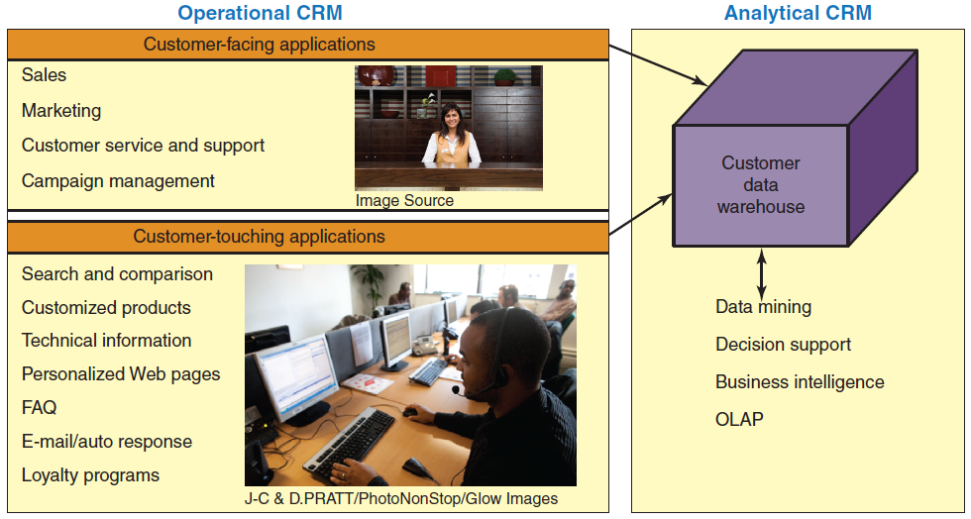
Figure 12.3: Relationship Between Operational CRM & Analytical CRM
What’s missing here?

Slide 24
12.4
Other Types of Customer Relationship Management Systems
On-Demand CRM Systems
Mobile CRM Systems
Open-Source CRM Systems
Social CRM
Comment: the title of this section
Notes:
On-Demand CRM Systems: systems hosted by an external vendor in the vendor’s data center which spares the organization the costs associated with purchasing the system, maintenance, and employees need to know only how to access and utilize it. Also known as utility computing or soft ware-as-a-service (SaaS).
Mobile CRM Systems: an interactive system that enables an organization to conduct communications related to sales, marketing, and customer service activities through a mobile medium for the purpose of building and maintaining relationships with its customers.
Open-Source CRM Systems: the source code for open-source software is available at no cost.
Social CRM: the use of social media technology and services to enable organizations to engage their customers in a collaborative conversation in order to provide mutually beneficial value in a trusted and transparent manner.

Slide 25
On-Demand CRM Systems
On-Premise CRM Systems versus On-Demand CRM Systems
Benefits of On-Demand CRM Systems
Potential Problems with On-Demand CRM Systems
Notes:
On-Premise CRM Systems: systems are purchased from a vendor and then installed them on site.
On-Demand CRM Systems: systems hosted by an external vendor in the vendor’s data center which spares the organization the costs associated with purchasing the system, maintenance, and employees need to know only how to access and utilize it. Also known as utility computing or soft ware-as-a-service (SaaS).
Potential Problems with On-Demand CRM:
Unreliable vendors
Hosted software difficult to modify
Upgrades only available through the vendor
Difficult to integrate with organization’s existing software
Information security and privacy risks

Slide 26
On-Demand CRM Systems: Benefits
Reduced cost when compared to purchasing the system
Reduced maintenance costs
Employees only need to know how to access and utilize the system
Notes:
On-Premise CRM Systems: systems are purchased from a vendor and then installed them on site.
On-Demand CRM Systems: systems hosted by an external vendor in the vendor’s data center which spares the organization the costs associated with purchasing the system, maintenance, and employees need to know only how to access and utilize it. Also known as utility computing or soft ware-as-a-service (SaaS).

Slide 27
On-Demand CRM Systems: Potential Problems
Unreliable vendors
Hosted software difficult to modify
Upgrades only through the vendor
Difficult integration with organization’s existing software
Information security & privacy risks
Notes:
On-Premise CRM Systems: systems are purchased from a vendor and then installed them on site.
On-Demand CRM Systems: systems hosted by an external vendor in the vendor’s data center which spares the organization the costs associated with purchasing the system, maintenance, and employees need to know only how to access and utilize it. Also known as utility computing or soft ware-as-a-service (SaaS).
Potential Problems with On-Demand CRM:
Unreliable vendors
Hosted software difficult to modify
Upgrades only available through the vendor
Difficult to integrate with organization’s existing software
Information security and privacy risks

Slide 28
Open-Source CRM Systems
Benefits of Open-Source CRM Systems
Disadvantages of Open-Source CRM Systems
Examples
Notes:
Open-Source CRM Systems: the source code for open-source software is available at no cost.
Benefits of Open-Source CRM:
source code is available to developers and users
Provide the same features or functions as other CRM
Implemented either on-premise or on-demand
Favorable pricing
Wide variety of applications
Easy to customize
Updates and bug (software error) fixes rapidly distributed
Extensive support information available for free
Open-Source CRM Disadvantages:
Risk related to quality control
Company IT platform must match development platform of open-source CRM system
Examples:
SugarCRM (www.sugarcrm.com)
Concursive (www.concursive.com)
Vtiger (www.vtiger.com)

Slide 29
Open-Source CRM Systems: Benefits
Favorable pricing
Wide variety of applications
Easy to customize
Updates and bug (software error) fixes rapidly distributed
Extensive support information available for free
Notes:
Open-Source CRM Systems: the source code for open-source software is available at no cost.
Benefits of Open-Source CRM:
source code is available to developers and users
Provide the same features or functions as other CRM
Implemented either on-premise or on-demand
Favorable pricing
Wide variety of applications
Easy to customize
Updates and bug (software error) fixes rapidly distributed
Extensive support information available for free

Slide 30
Open-Source CRM Systems: Disadvantages
Risk related to quality control
Company’s IT platform must match development platform of open-source CRM system
Notes:
Open-Source CRM Systems: the source code for open-source software is available at no cost.
Open-Source CRM Disadvantages:
Risk related to quality control
Company IT platform must match development platform of open-source CRM system

Slide 31
Open-Source CRM Systems: Examples
SugarCRM
  (www.sugarcrm.com)
Concursive
  (www.concursive.com)
Vtiger
  (www.vtiger.com)
Notes:
Open-Source CRM Systems: the source code for open-source software is available at no cost.
Examples:
SugarCRM (www.sugarcrm.com)
Concursive (www.concursive.com)
Vtiger (www.vtiger.com)

Slide 32
Social CRM
Provides two-way communication between organization & customers
Organizations monitor social media sites and respond accordingly
Customers obtain faster, better customer service
Notes:
Social CRM: the use of social media technology and services to enable organizations to engage their customers in a collaborative conversation in order to provide mutually beneficial value in a trusted and transparent manner.
In social CRM, organizations monitor services such as Facebook, Twitter, and LinkedIn (among many others) for relevant mentions of their products, services, and brand, and they respond accordingly.
Social media allow customers to obtain faster, better customer service.

Slide 33
’S ABOUT BUSINESS 12.2
uShip Benefits from SugarCRM
  Describe the advantages provided to uShip by the SugarCRM system.
  Describe the business needs of uShip that led to the company’s decision to implement a CRM system.

Slide 34

’S ABOUT BUSINESS 12.3
Morton’s Steakhouse
Surprises a
Customer
  Explain how Morton’s
  monitoring of social media
  illustrates how CRM is reviving personal marketing.
  Do you see any disadvantages in such close monitoring of social media? Provide specific examples to support your answer.

