Slide 1
7
Information Security

Slide 2
Introduction to Information Security
Unintentional Threats to Information Systems
Deliberate Threats to Information Systems
What Organizations Are Doing to Protect Information Resources
Information Security Controls

Slide 3
Identify the five factors that contribute to the increasing vulnerability of information resources, and provide a specific example of each one.
Compare and contrast human mistakes and social engineering, and provide a specific example of each one.
Discuss the 10 types of deliberate attacks.

Slide 4
Define the three risk mitigation strategies, and provide an example of each one in the context of owning a home.
Identify the three major types of controls that organizations can use to protect their information resources, and provide an example of each one.

Slide 5
7.1
Introduction to Information Security
Information Security
Threat
Exposure
Vulnerability
Five Key Factors Increasing Vulnerability
Cybercrime
Notes:
Security: the degree of protection against criminal activity, danger, damage, and/or loss.
Information Security: all of the processes and policies designed to protect an organization’s information and information systems (IS) from unauthorized access, use, disclosure, disruption, modification, or destruction.
Threat: any danger to which a system may be exposed.
Exposure: of an information resource is the harm, loss, or damage that can result if a threat compromises that resource.
Vulnerability: the possibility that the system will be harmed by a threat.
Cybercrime: refers to illegal activities conducted over computer networks, particularly the Internet. iDefense (http://labs.idefense.com), a company that specializes in providing security information to governments and Fortune 500 companies, maintains that groups of well-organized criminal organizations have taken control of a global billiondollar crime network.

Slide 6
Primary Goals of Security
(“CIA”)
General Security Goals
Confidentiality
  Protection of data from unauthorized disclosures of customers and proprietary data → simply put:
  Attackers cannot access or understand protected info
Integrity
  Assurance that data have not been altered or destroyed → simply put:
  If attackers change messages, this will be detected
Availability
  Providing continuous operations of hardware and software so that parties involved can be assured of uninterrupted service → simply put:
  System is available to serve users

Slide 7
Five Key Factors Increasing Vulnerability
The newer edition of Rainer’s book took away my discussion! ☺
Today’s interconnected, interdependent, wirelessly networked business environment
Smaller, faster, cheaper computers and storage devices
Decreasing skills necessary to be a computer hacker
International organized crime taking over cybercrime
Lack of management support

Slide 8

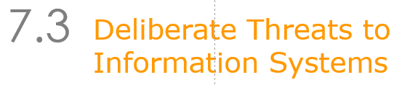
Whom are we protecting our IS against?
What is missing here?
The most powerful and ALL MIGHTY?!
- YES:

Slide 9
The Mother Nature
The “nature of threat from Mother Nature”:
  Large scale
  Extent of damage
  Difficult to fully protected against
Solution: Backup
Things to note and watch about backups:

Slide 10
The Mother Nature (cont)
Backup:
  Location
  Frequency
  Types of backup sites
    Cold, Warm, Hot
Policy, procedure, drill!!!

Slide 11
7.2
Unintentional Threats to Information Systems
Human Errors
Social Engineering
Notes:
Unintentional Threats: acts performed without malicious intent that nevertheless represent a serious threat to information security.

Slide 12
Human Errors
Higher employee levels = higher levels of security risk
Most Dangerous Employees:
Human Mistakes

Slide 13
Dangerous Employees
Two organizational areas pose the greatest risk
  Human Resources
  Information Systems
Janitors and Guards Frequently Overlooked

Slide 14
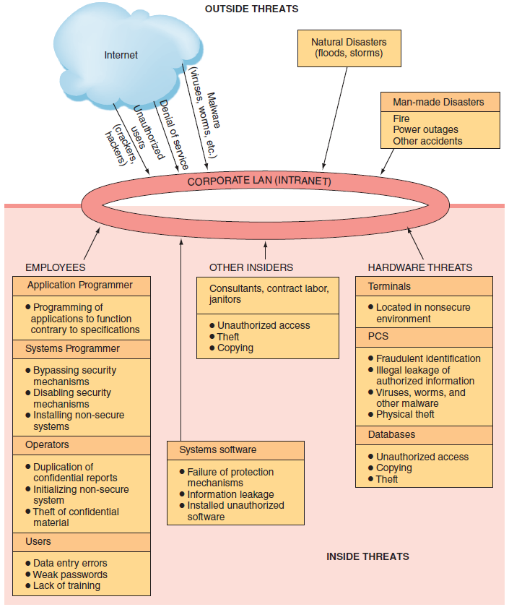
Figure 7.1
Security
Threats:

Slide 15
Human Mistakes
Carelessness with laptops
  http://www.pcworld.com/article/3021316/security/why-stolen-laptops-still-cause-data-breaches-and-whats-being-done-to-stop-them.html
Carelessness with computing devices
Opening questionable e-mails
Careless Internet surfing
Poor password selection and use
Carelessness with one’s office

Slide 16
Human Mistakes (continued)
Carelessness using unmanaged devices
Carelessness with discarded equipment
Careless monitoring of environmental hazards
  The “dropped USB test”

Slide 17
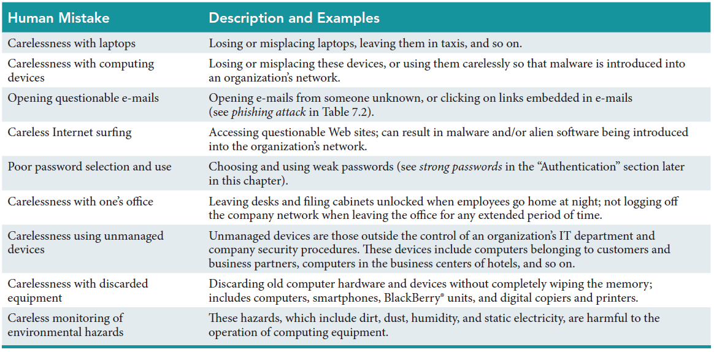
Table 7.1: Human Mistakes

Slide 18
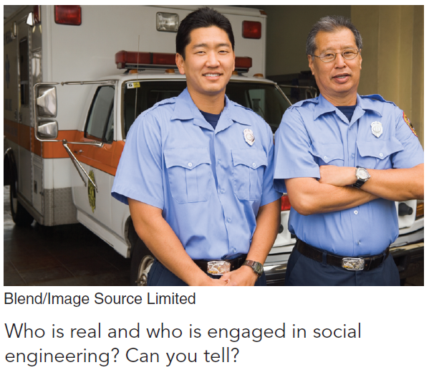
Social
Engineering
Social
Engineering:
  an attack in which the perpetrator uses social skills to trick or manipulate legitimate employees into providing confidential company information such as passwords.
Notes:
Social Engineering: an attack in which the perpetrator uses social skills to trick or manipulate legitimate employees into providing confidential company information such as passwords. The most common example of social engineering occurs when the attacker impersonates someone else on the telephone, such as a company manager or an information systems employee.

Slide 19
7.3
Deliberate Threats to Information Systems
Espionage or Trespass
Information Extortion
Sabotage or Vandalism
Theft of Equipment or Information
Identity Theft
Compromises to Intellectual Property
Notes:
Espionage or Trespass: occurs when an unauthorized individual attempts to gain illegal access to organizational information.
Information Extortion: occurs when an attacker either threatens to steal, or actually steals, information from a company. The perpetrator demands payment for not stealing the information, for returning stolen information, or for agreeing not to disclose the information.
Sabotage and Vandalism: deliberate acts that involve defacing an organization’s Web site, potentially damaging the organization’s image and causing its customers to lose faith.
Theft of Equipment or Information: Computing devices and storage devices are becoming smaller yet more powerful with vastly increased storage and as a result these devices are becoming easier to steal and easier for attackers to use to steal information.
Dumpster Diving: rummaging through commercial or residential trash to fi nd discarded information.
Identity Theft: is the deliberate assumption of another person’s identity, usually to gain access to his or her fi nancial information or to frame him or her for a crime.
Compromises to Intellectual Property:
Trade Secret: an intellectual work, such as a business plan, that is a company secret and is not based on public information.
Patent: an official document that grants the holder exclusive rights on an invention or a process for a specifi ed period of time.
Copyright: a statutory grant that provides the creators or owners of intellectual property with ownership of the property, also for a designated period.
Intellectual Property: the property created by individuals or corporations that is protected under trade secret, patent, and copyright laws.

Slide 20
7.3
Deliberate Threats to Information Systems (continued)
Software Attacks
Alien Software
Supervisory Control and Data Acquisition (SCADA) Attacks
  Live Free Or Die Hard
Cyberterrorism and Cyberwarfare
Notes:
7. Software Attacks
8. Alien Software: clandestine soft ware that is installed on your computer through duplicitous methods.
9. SCADA: refers to a large-scale, distributed measurement and control system. SCADA systems are used to monitor or to control chemical, physical, and transport processes such as those used in oil refineries, water and sewage treatment plants, electrical generators, and nuclear power plants.
10. Cyberterrorism and Cyberwarfare: refer to malicious acts in which attackers use a target’s computer systems, particularly via the Internet, to cause physical, real-world harm or severe disruption, often to carry out a political agenda.

Slide 21
Compromises to Intellectual Property
Intellectual Property
Trade Secret
Patent
Copyright
Notes:
Compromises to Intellectual Property:
Trade Secret: an intellectual work, such as a business plan, that is a company secret and is not based on public information.
Patent: an official document that grants the holder exclusive rights on an invention or a process for a specifi ed period of time.
Copyright: a statutory grant that provides the creators or owners of intellectual property with ownership of the property, also for a designated period.
Intellectual Property: the property created by individuals or corporations that is protected under trade secret, patent, and copyright laws.

Slide 22
Software Attacks: Three Categories
Remote Attacks Requiring User Action
  Virus
  Worm
  Phishing Attack
  Spear Phishing
    Examples:
Notes:
(1) Remote Attacks Requiring User Action
Virus: Segment of computer code that performs malicious actions by attaching to another computer program.
Worm: Segment of computer code that performs malicious actions and will replicate, or spread, by itself (without requiring another computer program).
Phishing Attack: Phishing attacks use deception to acquire sensitive personal information by masquerading as official-looking e-mails or instant messages.
Spear Phishing: Phishing attacks target large groups of people. In spear phishing attacks, attack the perpetrators find out as much information about an individual as possible to improve their chances that phishing techniques will obtain sensitive, personal information

Slide 23
Software Attacks: Three Categories (continued)
Remote Attacks Needing No User Action
  Denial-of-Service Attack
  Distributed Denial-of-Service Attack
    http://makeagif.com/x300Ym
    http://www.engadget.com/2013/10/16/akamai-state-of-the-internet-q2-2013/
Notes:
(2) Remote Attacks Needing No User Action
Denial-of-Service Attack: An attacker sends so many information requests to a target computer system that the target cannot handle them successfully and typically crashes (ceases to function).
Distributed Denial-of-Service Attack: An attacker first takes over many computers, typically by using malicious soft ware. These computers are called zombies or bots. The attacker uses these bots—which form a botnet—to deliver a coordinated stream of information requests to a target computer, causing it to crash.

Slide 24
Software Attacks: Three Categories (continued)
Attacks by a Programmer Developing a System
  Trojan Horse
  Back Door
  Logic bomb
Notes:
(3) Attacks by a Programmer Developing a System
Trojan Horse: Software programs that hide in other computer programs and reveal their designed behavior only when they are activated.
Back Door: Typically a password, known only to the attacker, that allows him or her to access a computer system at will, without having to go through any security procedures (also called a trap door).
Logic bomb: A segment of computer code that is embedded within an organization’s existing computer programs and is designed to activate and perform a destructive action at a certain time or date.

Slide 25
’S ABOUT BUSINESS 7.1
Stealing Cash from ATMs with Text Messages
  Other than the ones mentioned in this case, what countermeasures could banks take to defend against ATM hacks such as these?
  Why are some banks still using Windows XP on their ATMs, when newer, more secure operating systems are available?

Slide 26
Alien Software
Adware
Spyware
Spamware
Spam
Cookies
Notes:
. Alien Software: clandestine soft ware that is installed on your computer through duplicitous methods.
Adware: software that causes pop-up advertisements to appear on your screen.
Spyware: soft ware that collects personal information about users without their consent. Two common types of spyware are keystroke loggers and screen scrapers.
Spamware: pestware that uses your computer as a launch pad for spammers.
Spam: unsolicited e-mail, usually advertising for products and services
Cookies: small amounts of information that Web sites store on your computer, temporarily or more or less permanently

Slide 27
’S ABOUT BUSINESS 7.2
The Mask
  Discuss the implications of the targeted nature of the Careto malware.
  Analyze the statement: “Nations use malware such as Careto when their only alternative is to go to war.”
  Discuss the impacts that such sophisticated malware could have on all of us.

Slide 28
7.4
What Organizations Are Doing to Protect Information Resources
Risk
Risk Management
Risk Analysis
Risk Mitigation
Notes:
Risk: the probability that a threat will impact an information resource.
Risk Management: identifies, controls, and minimizes the impact of threats. In other words, risk management seeks to reduce risk to acceptable levels.
Risk Analyses: ensures IS security programs are cost effective.
Risk Mitigation: the organization takes concrete actions against risks which has two functions:
implementing controls to prevent identified threats from occurring
developing a means of recovery if the threat becomes a reality

Slide 29
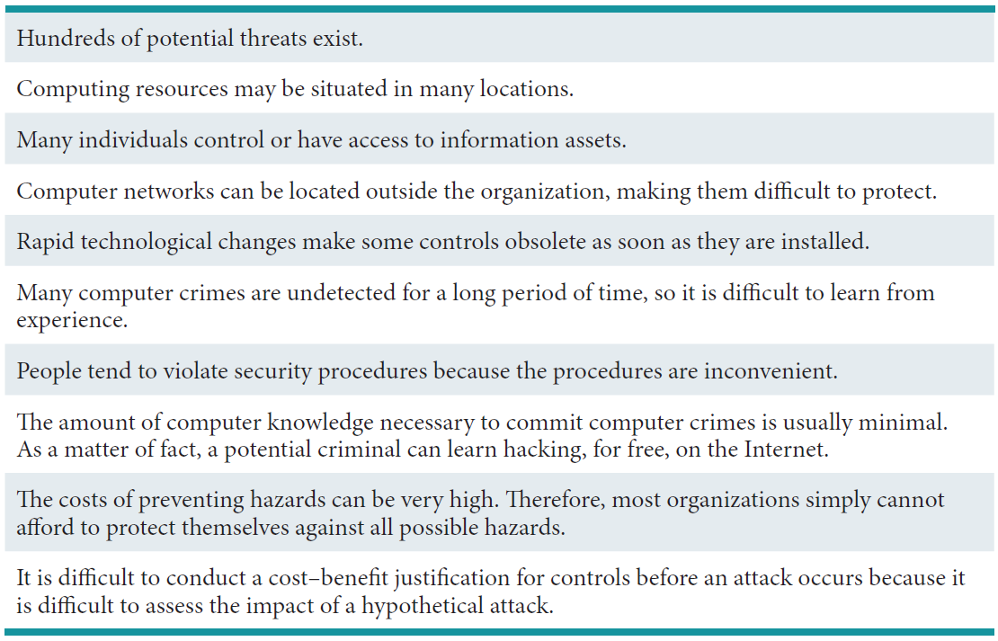
Table 7.3: The Difficulties in Protecting Information Resources

Slide 30
Risk Management
Three Processes of Risk Management:
  risk analysis
  risk mitigation
  controls evaluation
Notes:
Risk Management: identifies, controls, and minimizes the impact of threats. In other words, risk management seeks to reduce risk to acceptable levels.
Three Processes of Risk management:
risk analysis
risk mitigation
controls evaluation
Risk Analyses: ensures IS security programs are cost effective.
Three Steps of Risk Analysis:
assessing the value of each asset being protected
estimating the probability that each asset will be compromised
comparing the probable costs of the asset’s being compromised with the costs of protecting that asset
In risk mitigation, the organization takes concrete actions against risks. Risk mitigation
has two functions: (1) implementing controls to prevent identifi ed threats from occurring,
and (2) developing a means of recovery if the threat becomes a reality. Th ere are several
risk mitigation strategies that organizations can adopt. Th e three most common are risk
acceptance, risk limitation, and risk transference.

Slide 31
Risk Analysis
Three Steps of Risk Analysis
assessing the value of each asset being protected
estimating the probability that each asset will be compromised
comparing the probable costs of the asset’s being compromised with the costs of protecting that asset
Notes:
Risk Analyses: ensures IS security programs are cost effective.
Three Steps of Risk Analysis:
assessing the value of each asset being protected
estimating the probability that each asset will be compromised
comparing the probable costs of the asset’s being compromised with the costs of protecting that asset

Slide 32
Risk Mitigation
Risk Acceptance
Rick Limitation
Risk Transference
Risk avoidance
  Note: it is not “how we will shield the risks” – that is risk reduction/removal – “Limitation”!
Notes:
Risk Mitigation: the organization takes concrete actions against risks which has two functions:
implementing controls to prevent identified threats from occurring
developing a means of recovery if the threat becomes a reality
----------------------
Risk acceptance: Accept the potential risk, continue operating with no controls, and absorb any damages that occur.
Risk limitation: Limit the risk by implementing controls that minimize the impact of the threat.
Risk transference: Transfer the risk by using other means to compensate for the loss, such as by purchasing insurance.

Slide 33
7.5
Information Security Controls
Physical Controls
Access Controls
Communications Controls
Business Continuity Planning
Information Systems Auditing
Notes:
Physical Controls: prevent unauthorized individuals from gaining access to a company’s facilities. Common physical controls include walls, doors, fencing, gates, locks, badges, guards, and alarm systems.
Access Controls: restrict unauthorized individuals from using information resources and involve two major functions: authentication and authorization.
Communication Controls (also called network controls): secure the movement of data across networks and consist of firewalls, anti-malware systems, whitelisting and blacklisting, encryption, virtual private networks (VPNs), secure socket layer (SSL), and employee monitoring systems.

Slide 34
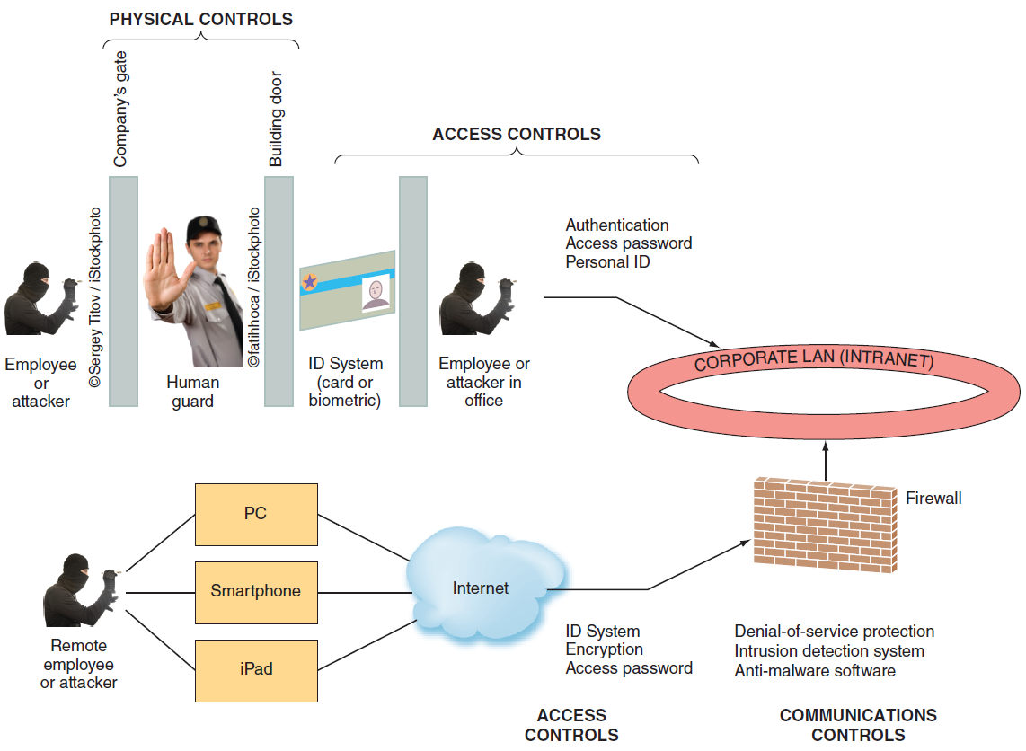
Figure 7.2: Where Defense Mechanisms are Located.

Slide 35
Physical Controls
Walls
Doors
Fencing
Gates
Locks
Badges
Guards
Alarm Systems
Notes:
Physical Controls: prevent unauthorized individuals from gaining access to a company’s facilities. Common physical controls include walls, doors, fencing, gates, locks, badges, guards, and alarm systems.

Slide 36
Access Controls
Authentication
Authorization
  Something the user is
  Something the user has
  Something the user does
  Something the user knows
Notes:
Access Controls: restrict unauthorized individuals from using information resources and involve two major functions: authentication and authorization.
Authentication: confirms the identity of the person requiring access.
Authorization: determines which actions, rights, or privileges the person has, based on his or her verifi ed identity.
Authentication:
Something the user is: also known as biometrics, is an authentication method that examines a person’s innate physical characteristics (e.g., fingerprint scans, palm scans, retina scans, iris recognition, and facial recognition).
Something the user has: is an authentication mechanism that includes regular identifi cation (ID) cards, smart ID cards, and tokens.
Something the user does: is an authentication mechanism that includes voice and signature recognition.
Something the user knows: is an authentication mechanism that includes passwords and passphrases.

Slide 37
Communications Controls
Firewall
Anti-malware Systems
Whitelisting
Blacklisting
Encryption
Virtual Private Network (VPN)
Notes:
Communication Controls (also called network controls): secure the movement of data across networks and consist of firewalls, anti-malware systems, whitelisting and blacklisting, encryption, virtual private networks (VPNs), secure socket layer (SSL), and employee monitoring systems.
Firewall: a system that prevents a specific type of information from moving between untrusted networks, such as the Internet, and private networks, such as your company’s network.
Anti-malware Systems (or antivirus software): software packages that attempt to identify and eliminate viruses and worms, and other malicious software.
Whitelisting: a process in which a company identifies the soft ware that it will allow to run on its computers and permits acceptable soft ware to run, and it either prevents any other soft ware from running or lets new soft ware run only in a quarantined environment until the company can verify its validity.
Blacklist: includes certain types of software that are not allowed to run in the company environment.
Encryption: the process of converting an original message into a form that cannot be read by anyone except the intended receiver.
Virtual Private Network: a private network that uses a public network (usually the Internet) to connect users. VPNs essentially integrate the global connectivity of the Internet with the security of a private network and thereby extend the reach of the organization’s networks. VPNs are called virtual because they have no separate physical existence.

Slide 38
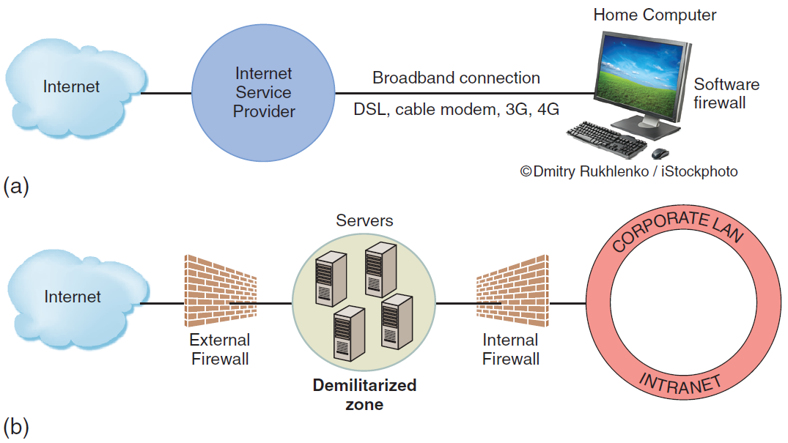
Figure 7.3: (a) Basic Firewall for Home Computer. (b) Organization with Two Firewalls and Demilitarized Zone
Notes:
Firewall: a system that prevents a specific type of information from moving between untrusted networks, such as the Internet, and private networks, such as your company’s network.
Demilitarized Zone (DMZ): located between the two firewalls. Messages from the Internet must first pass through the external firewall. If they conform to the defined security rules, they are then sent to company servers located in the DMZ.

Slide 39
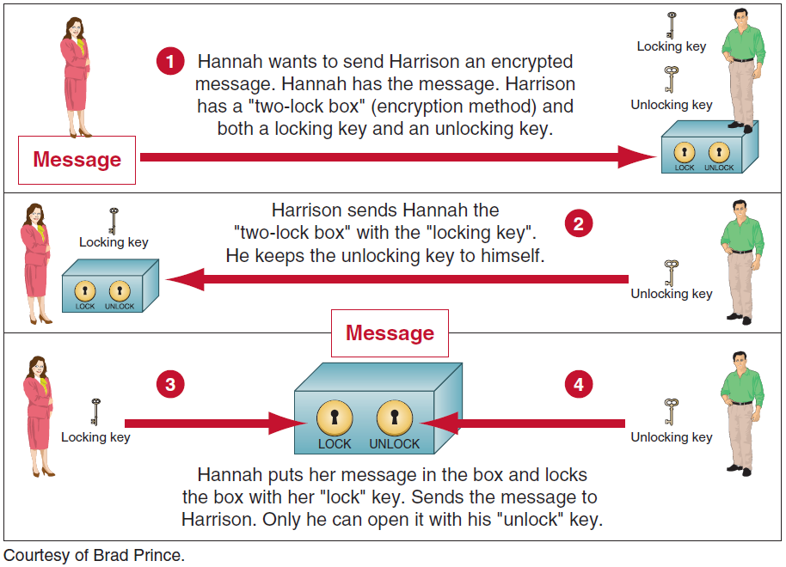
Figure 7.4: How Public-key Encryption Works
Notes:
Encryption: the process of converting an original message into a form that cannot be read by anyone except the intended receiver.
Virtual Private Network: a private network that uses a public network (usually the Internet) to connect users. VPNs essentially integrate the global connectivity of the Internet with the security of a private network and thereby extend the reach of the organization’s networks. VPNs are called virtual because they have no separate physical existence.

Slide 40
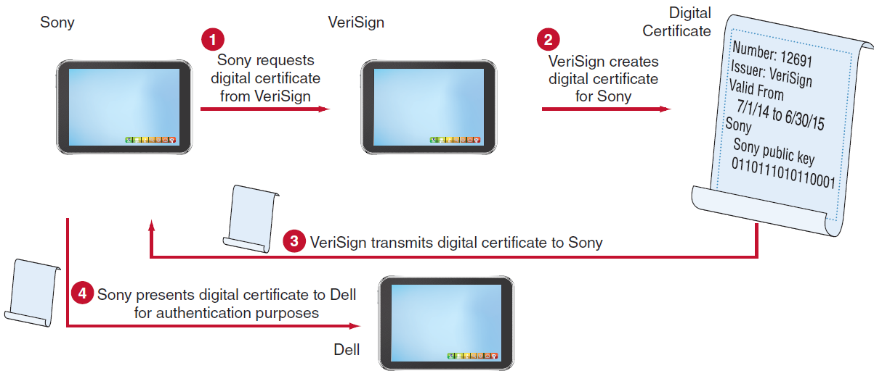
Figure 7.5: How Digital Certificates Work.

Slide 41
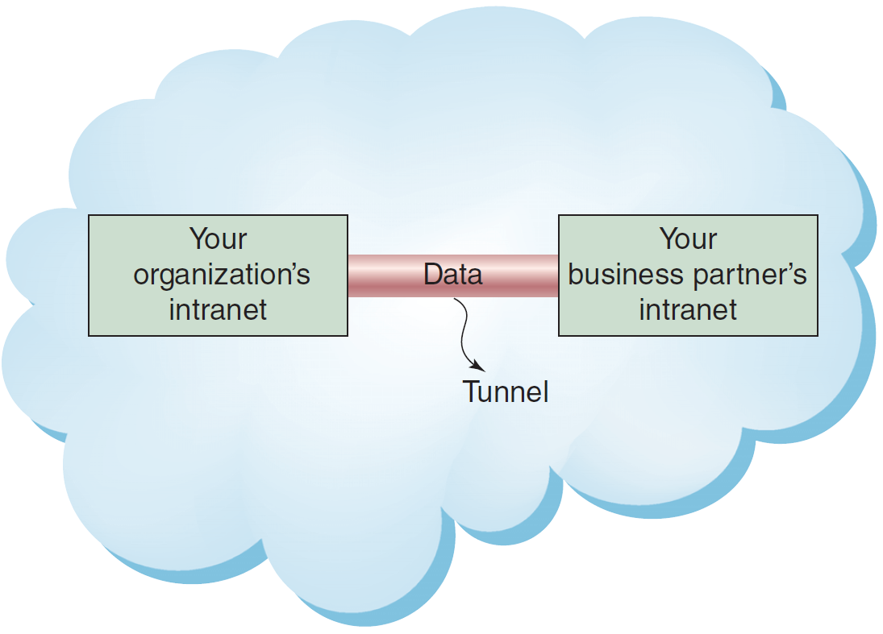
Figure 7.6: Virtual Private Network (VPN) and Tunneling

Slide 42
’S ABOUT BUSINESS 7.3
A Tale of Two Cybersecurity Firms
  Describe why it was so important for law enforcement officials to capture all 96 Rustock command servers at one time.
  If the perpetrators of Rustock are ever caught, will it be possible to prove that they were responsible for the malware? Why or why not? Support your answer.
  Mandiant has stated that it has no definitive proof that Chinese hackers are behind the numerous attacks on U.S. companies and government agencies. Is such proof even possible to obtain? Why or why not? Support your answer. If such proof were possible to obtain, would it matter? Why or why not? Support your answer.
  Discuss the advantages for FireEye of purchasing Mandiant. Then, discuss the benefits that Mandiant obtained from the sale.

Slide 43
Business Continuity Planning
Business Continuity (BC)
Business Continuity Plan (BC)
Incident response (IR)
  Stopping
  Containment
  Report
  Identify/trace
  Prosecute/penalty/compensation
Notes:
Business Continuity: the chain of events linking planning to protection and to recovery.
Business Continuity Plan: purpose is to provide guidance to people who keep the business operating aft er a disaster occurs.

Slide 44
The Six Stages of Incident Response
http://www.darkreading.com/vulnerabilities-and-threats/the-six-stages-of-incident-response/d/d-id/1059365?
Preparation: Be ready with the tools and training for incidents before they happen.
Identification: Identify incidents thoroughly.
Containment: Contain the incident immediately to prevent possible collateral damage.
  This may mean revoking user accounts, blocking access at the firewall or updating antivirus rules to catch the malicious code.
Eradication: Get rid of the malicious code, unauthorized account, or bad employee that caused the incident.
Recovery: Make sure the system meets company standards or baselines, before returning it to service.
Lessons Learned: Put together a report detailing what happened, why it happened, what could have prevented it, and what you’ll be doing to prevent it from happening again.

Slide 45
Information Systems Auditing
Internal Audits
External Audits
Three Categories of IS auditing procedures
  Auditing Around the Computer
  Auditing Through the Computer
  Auditing With the Computer
Notes:
Audit: an examination of information systems, their inputs, outputs, and processing.
Two Types of Auditors and Audits:
Internal Audits
External Audits
IS auditing procedures fall into three categories:
Auditing Around the Computer: means verifying processing by checking for known outputs using specific inputs. This approach is most effective for systems with limited outputs.
Auditing Through the Computer: auditors check inputs, outputs, and processing. They review program logic, and they test the data contained within the system.
Auditing With the Computer: means using a combination of client data, auditor soft ware, and client and auditor hardware. This approach enables the auditor to perform tasks such as simulating payroll program logic using live data.

