Slide 1
6
Ethics and Privacy

Slide 2
Ethical Issues
Privacy

Slide 3
Define ethics, list and describe the three fundamental tenets of ethics, and describe the four categories of ethical issues related to information technology.
Identify three places that store personal data, and for each one, discuss at least one potential threat to the privacy of the data stored there.

Slide 4
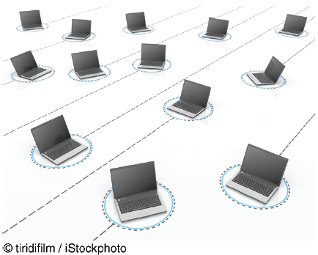
Tapad Can Track
You Across Devices
  Is Tapad’s business model
  ethical? Why or why not?
  What is the relationship
  between Tapad’s business
  model and your privacy? Provide specific examples to support your answer.

Slide 5
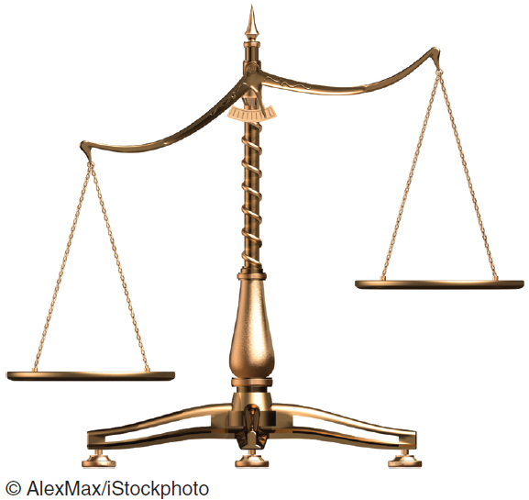
6.1
Ethical Issues
Ethical Frameworks
Ethics in the Corporate Environment
Ethics and Information Technology

Slide 6
Ethical Frameworks
Utilitarian Approach
  Provide the most good, or do the least harm
Rights Approach
  Protect and respect the moral rights of the affected parties
Fairness Approach
  Treat all human beings equally
Common Good Approach
  Basis for ethical actions: respect and comparison of all others
Five Steps of the General Ethical Framework ➔➔➔
Notes:
Utilitarian Approach: states that an ethical action is the one that provides the most good or does the least harm.
Rights Approach: maintains that an ethical action is the one that best protects and respects the moral rights of the affected parties.
Fairness Approach: posits that ethical actions treat all human beings equally, or, if unequally, then fairly, based on some defensible standard.
Common Good Approach: highlights the interlocking relationships that underlie all societies. This approach argues that respect and compassion for all others is the basis for ethical actions.

Slide 7
Five Steps of the General Ethical Framework (P. 170)
Recognize the Issue
Get the Facts
Evaluate Alternative Actions
Make a Decision and Test It
Act and Reflect on the Outcome of Your Decision
Notes:
Recognize an ethical issue:
• Could this decision or situation damage someone or some group?
• Does this decision involve a choice between a good and a bad alternative?
• Does this issue involve more than simply legal considerations? If so, then in what way?
Get the facts:
• What are the relevant facts of the situation?
• Do I have suffi cient information to make a decision?
• Which individuals and/or groups have an important stake in the outcome?
• Have I consulted all relevant persons and groups?
Evaluate alternative actions:
• Which option will produce the most good and do the least harm? (the utilitarian approach)
• Which option best respects the rights of all stakeholders? (the rights approach)
• Which option treats people equally or proportionately? (the fairness approach)
• Which option best serves the community as a whole, and not just some members? (the common good approach)
Make a decision and test it:
• Considering all the approaches, which option best addresses the situation?
Act and reflect on the outcome of your decision:
• How can I implement my decision with the greatest care and attention to the concerns of all stakeholders?
• How did my decision turn out, and what did I learn from this specifi c situation?

Slide 8
Ethics in the Corporate Environment
Fundamental
Tenets of Ethics (P. 171)
  Responsibility
  Accountability
  Liability
  Difference between 1 and 2?
Notes:
Fundamental Tenets of Ethics:
Responsibility: means that you accept the consequences of your decisions and actions.
Accountability: refers to determining who is responsible for actions that were taken.
Liability: a legal concept that gives individuals the right to recover the damages done to them by other individuals, organizations, or systems.

Slide 9

’S ABOUT BUSINESS 6.1
Cheating Is Risky
for Business
Students
  As the Turnitin database expands rapidly by incorporating a growing number of papers and essays, what will be the impact on subsequent papers submitted to it?
  Discuss the ethical implications of writing a paper yourself that you know contains some plagiarized material and then using Turnitin’s service yourself.

Slide 10
Ethics and Information Technology
Privacy Issues
  Collecting, storing, and disseminating info about individuals
Accuracy Issues
  Authenticity, fidelity, and correctness of info that is collected & processed
Property Issues
  Ownership and value of info
Accessibility Issues
  Who should have access to info
Notes:
Ethics and Information Technology:
Privacy Issues: involve collecting, storing, and disseminating information about individuals.
Accuracy Issues: involve the authenticity, fidelity, and correctness of information that is collected and processed.
Property Issues: involve the ownership and value of information.
Accessibility Issues: revolve around who should have access to information and whether they should pay a fee for this access.

Slide 11
6.2
Privacy
Electronic Surveillance
Personal Information in Databases
Information on Internet Bulletin Boards, Newsgroups, and Social Networking Sites
Privacy Codes and Policies
International Aspects of Privacy
Notes:
Privacy: the right to be left alone and to be free of unreasonable personal intrusions.
Information Privacy: the right to determine when, and to what extent, information about you can be gathered and/or communicated to others.

Slide 12
Threats to privacy:
Electronic Surveillance
See "The State of Surveillance" article in BusinessWeek
See the surveillance slideshow
And you think you have privacy? -
  Ordering pizza in 2015
Notes:
The BusinessWeek article is an interesting look at the state of surveillance today.
The surveillance slideshow accompanies the BusinessWeek article.
The additional surveillance slides show modern surveillance equipment.
The video is a tongue-in-cheek look at how little privacy all of us have left. The video is a great example of the
impacts that data aggregators, digital dossiers, and profiling might have in the very near future.
Sense-through-the-Wall is a technology by Oceanit (www.oceanit.com) that allows you to see if anyone
is in a building, prior to entering, by detecting a person’s heartbeat and respiration. Clicking on the link will
show a brief animation of this technology.

Slide 13
Threats to privacy:
Electronic Surveillance
Digital dossier: “All the tracks of information you leave behind on your internet life.”
  http://digitaltattoo.ubc.ca/learn/your-digital-dossier/
  https://prezi.com/npxfintoxbhm/what-is-a-digital-dossier/
Profiling:
Notes:
The BusinessWeek article is an interesting look at the state of surveillance today.
The surveillance slideshow accompanies the BusinessWeek article.
The additional surveillance slides show modern surveillance equipment.
The video is a tongue-in-cheek look at how little privacy all of us have left. The video is a great example of the
impacts that data aggregators, digital dossiers, and profiling might have in the very near future.
Sense-through-the-Wall is a technology by Oceanit (www.oceanit.com) that allows you to see if anyone
is in a building, prior to entering, by detecting a person’s heartbeat and respiration. Clicking on the link will
show a brief animation of this technology.

Slide 14
Privacy: Two Rules
Court decisions in many countries have generally followed two rules
  The right to privacy is not absolute
  The public’s right to know supersedes the individual’s right to privacy.

Slide 15
Electronic Surveillance
ACLU – Electronic surveillance is rapidly increasing
Emerging Technologies increase monitoring of human activity
Facial Recognition
Geotagging
Photo tagging
Notes:
Electronic Surveillance: conducted by employers, the government, and other institutions. Surveillance cameras track you at airports, subways, banks, and other public venues. Inexpensive digital sensors are now incorporated into laptop webcams, video-game motion sensors, smartphone cameras, utility meters, passports, employee ID cards high-resolution photographs taken from the air or from the street by Google or Microsoft , your license plates will be recorded and time-stamped as you drive down a city street, cross a toll bridge, or park at a shopping mall.

Slide 16
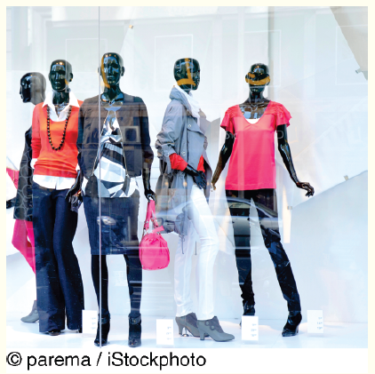
’S ABOUT BUSINESS 6.2
Those Mannequins
Are Watching You
  Is using EyeSee mannequins in
  stores an ethical practice? Why
  or why not? Support your answer.
  If stores notify people that they
  may be filmed, do the stores have to indicate how they might be filmed (i.e., by mannequins)? What are the ethical implications of how stores make these notifications?
  Would knowing that the mannequins may be watching you change your shopping behavior? Why or why not? Explain your answer.
  What are the privacy implications of the EyeSee mannequins, given that stores already have security cameras placed in strategic locations?

Slide 17
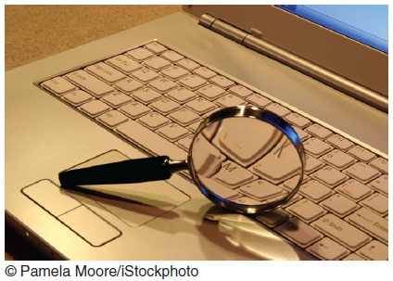
Personal Information in Databases
Major Concerns:
  Do you know where the records are?
  Are the records accurate?
  Can you change inaccurate data?
  How long will it take to make a change?
  Under what circumstances will the personal data be released?

Slide 18
Personal Information in Databases (continued)
Major Concerns:
  How are the data used?
  To whom are the data given or sold?
  How secure are the data against access by unauthorized people?
Privacy policy ➔➔➔ Table 6.2

Slide 19
Information on Internet Bulletin Boards, Newsgroups, and Social Networking Sites
Weblog
Free Speech versus Privacy
Notes:
Every day we see more and more electronic bulletin boards, newsgroups, electronic discussions such as chat rooms, and social networking sites. These sites appear on the Internet, within corporate intranets, and on blogs.
Blog (Web Log): an informal, personal journal that is frequently updated and is intended for general public reading.
Conflict between free speech and privacy than the Internet. Many Web sites contain anonymous, derogatory information on individuals, who typically have little recourse in the matter. The vast majority of the U.S. firms use the Internet in examining job applications, including searching on Google and on social networking sites (see closing case 1 in Chapter 8).

Slide 20
’S ABOUT BUSINESS 6.3
Google Glass: Big Brother Really Is Watching You
  Apply the general framework for ethical decision making to Google Glass.
  Do you feel that the functionality offered by Google Glass outweighs the potential loss of privacy that the technology could create? Why or why not? Support your answer.
  Would you use Google Glasses? Why or why not? Support your answer.
  If you were at a party or at a bar, would you be comfortable speaking to someone who was wearing Google Glasses? Would you be comfortable just being in the room with someone wearing Google Glasses? Why or why not? Support your answer.

Slide 21

Privacy Codes and Policies (179)
Consumer’s choices regarding business practices related to privacy
  Opt-in Model
  Opt-out Model
    TRUSTe
Notes:
Privacy Policies (or Privacy Codes): an organization’s guidelines for protecting the privacy of its customers, clients, and employees.
Opt-Out Model of Informed Consent: permits the company to collect personal information until the customer specifically requests that the data not be collected.
Opt-In Model of Informed Consent: Privacy advocates prefer this model, which prohibits an organization from collecting any personal information unless the customer specifically authorizes it.
Platform for Privacy Preferences (P3P): a protocol that automatically communicates privacy policies between an electronic commerce Web site and visitors to that site. P3P enables visitors to determine the types of personal data that can be extracted by the sites they visit.

Slide 22
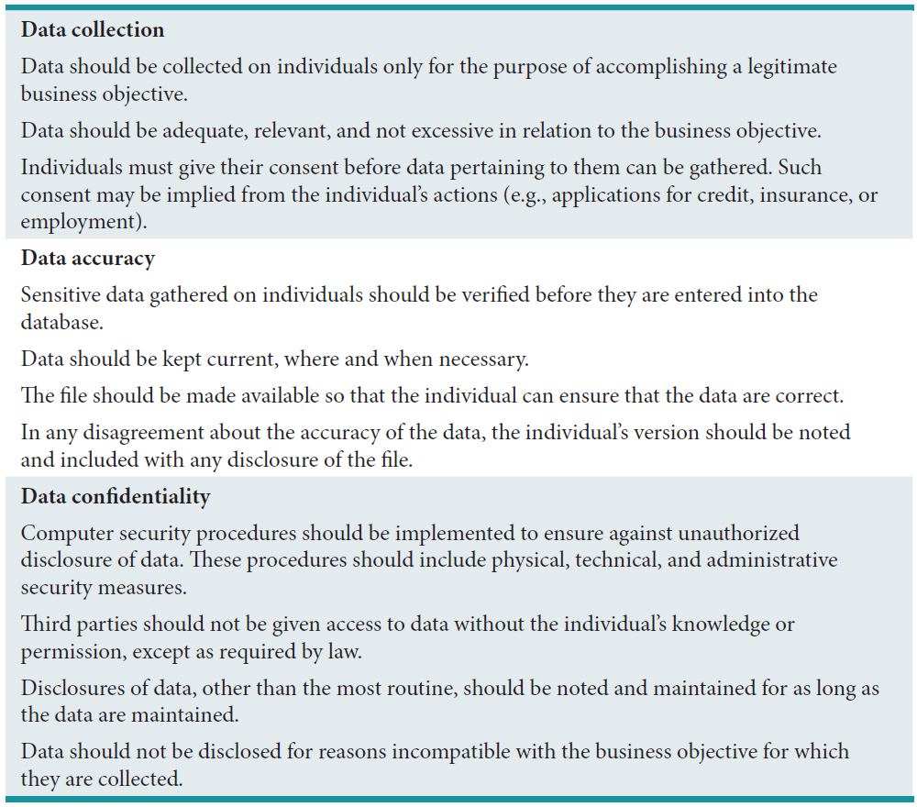
Table 6.2: Privacy Policy Guidelines: A Sampler

Slide 23
International Aspects of Privacy
Inconsistent Privacy and Security Laws
Transborder data flow
European Community Commission
Safe Harbor framework for European citizen personal data
Notes:
Safe Harbor: The U.S. Department of Commerce, in consultation with the European Union, developed a “safe harbor” framework to regulate the way that the U.S. companies export and handle the personal data (e.g., names and addresses) of European citizens.
The European Community Commission (ECC) (1998): issued guidelines to all of its member countries regarding the rights of individuals to access information about themselves. The EU data protection laws are stricter than the U.S. laws and therefore could create problems for the U.S.-based multinational corporations, which could face lawsuits for privacy violations.

