Slide 1
2
Organizational Strategy, Competitive Advantage, & Information Systems

Slide 2
Business Pressures, Organizational Responses, and Information Technology Support
Competitive Advantage and Strategic Information Systems
Using IS does not just make small parts inside business faster/better: IS helps to increase competitiveness

Slide 3
Identify effective IT responses to different kinds of business pressures.
Describe the strategies that organizations typically adopt to counter Porter’s five competitive forces.

Slide 4
2.1
Business Pressures, Organizational Responses, and IT Support
Competitive Advantage
Business Environment
Business Pressures
Organizational Responses
Notes:
Competitive Advantage: any assets that provide an organization with an edge against its competitors in some measure such as cost, quality, or speed. It also helps an organization to control a market and to accrue larger-than-average profits.
Business Environment: the combination of social, legal, economic, physical, and political factors in which businesses conduct their operations. Significant changes in any of these factors are likely to create Business Pressures on organizations.
Organizations Responses: Organizations respond to the various pressures by implementing Information Technology (IT) such as strategic systems, customer focus, make-to-order and mass customization, and e-business.

Slide 5
Business Pressures
Market Pressures
Technology Pressures
Societal/Political/Legal Pressures
Notes:
Market Pressures: business pressures generated by the global economy, intense competition, the changing nature of the workforce, and powerful customers.
Technology Pressures: business pressures caused by technological innovation and information overload.
Societal/Political/Legal Pressures: business pressures related to social responsibility, government regulation/deregulation, spending for social programs, spending to protect against terrorism, and ethics.

Slide 6
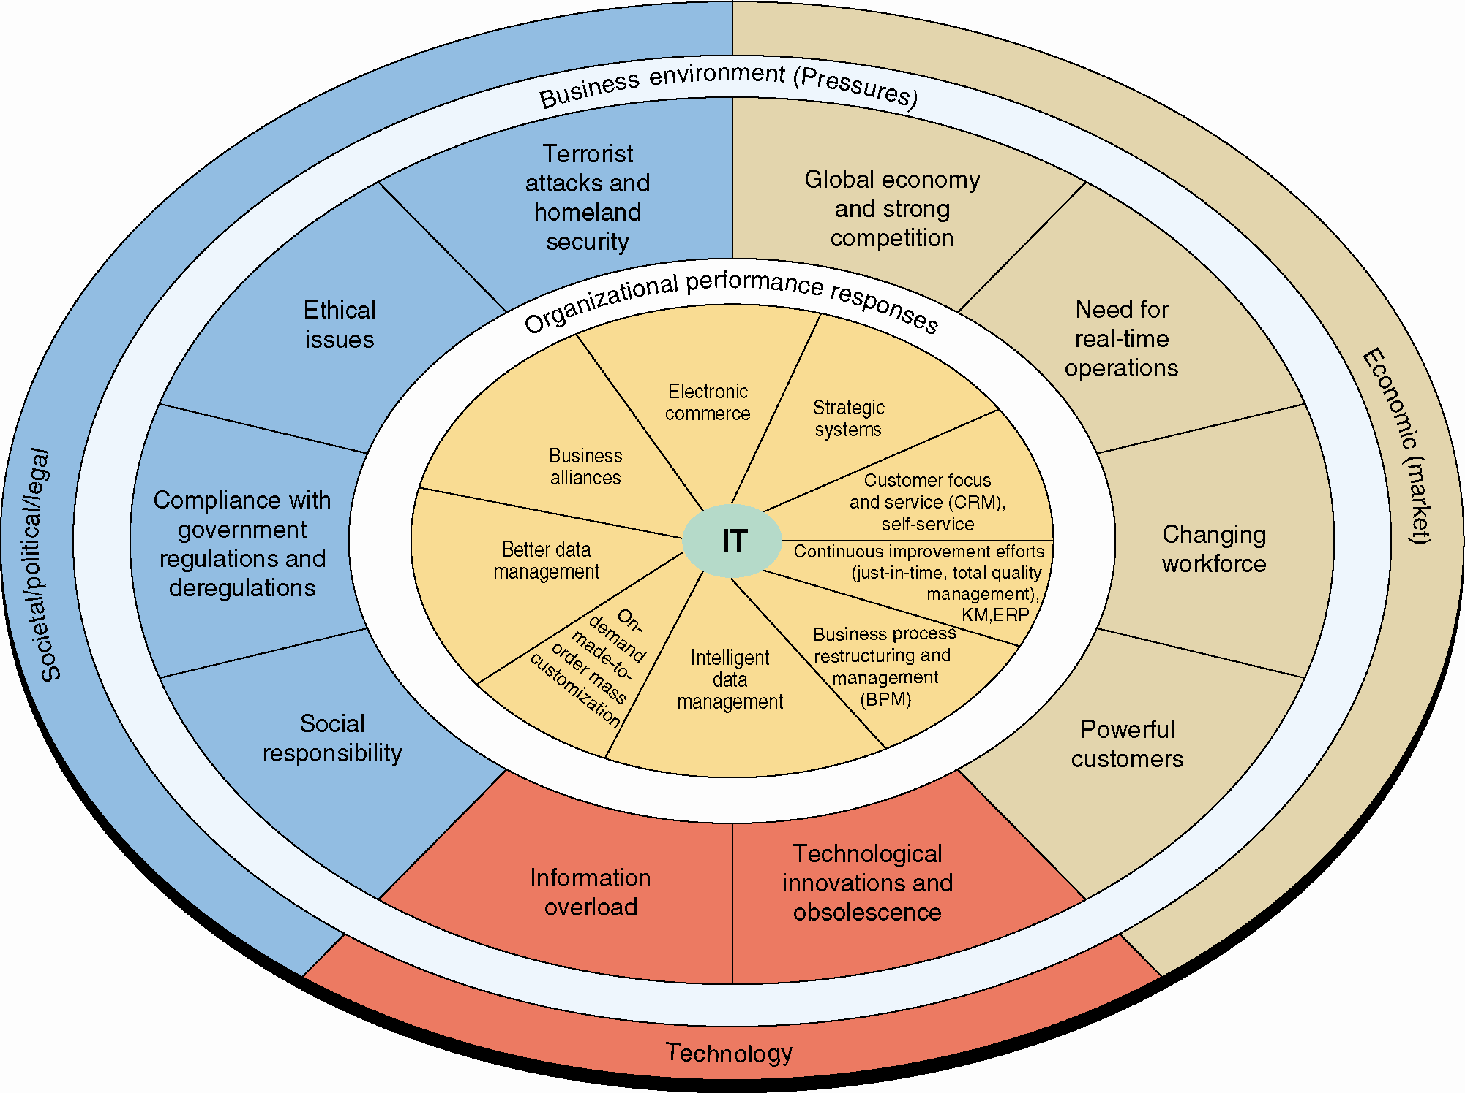
Figure 2.1: Business Pressures, Organizational Performance & Responses, and IT Support

Slide 7
Market Pressures
Globalization
  Competition from afar
Powerful Customers
  Informed
  Connected and “united”
  Freer/easier to switch
Changing Nature of the Workforce
  Diversity
  Work mode
Notes:
Globalization: the integration and interdependence of economic, social, cultural, and ecological facets of life, made possible by rapid advances in information technology.
Changing Nature of the Workforce: The workforce, particularly in developed countries, is becoming more diversified. Increasing numbers of women, single parents, minorities, and persons with disabilities are now employed in all types of positions.
Powerful Customers: consumer sophistication and expectations increase as customers become more knowledgeable about the products and services they acquire. Customers can use the Internet to find detailed information about products and services, to compare prices, and to purchase items at electronic auctions.

Slide 8
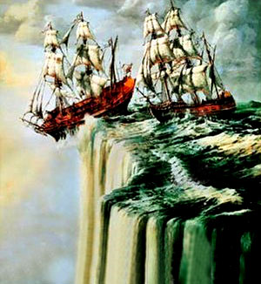
Globalization
Stages of Globalization
Thomas Friedman – The World is Flat
  Globalization 1.0 (from 1492 to 1800)
  Globalization 2.0 (from 1800 to 2000)
  Globalization 3.0 (from 2000 to the present)
Notes:
Thomas Friedman --> Three eras of globalization:
Globalization 1.0:
Timeframe: 1492 to 1800
Distinct Focus: Countries
Driver: Brute Force, Braun
Globalization 2.0:
Timeframe: 1800 to 2000
Distinct Focus: International Companies
Driver:
-- first half of this period --> Falling Transportation Costs (Steam Engine/Railroads)
-- second half of this period --> Falling Telecommunication Costs (Telegraph, Telephone, Computer, Satellite, Fiber Optics, Internet)
Globalization 3.0:
Timeframe: 2000 to Present
Distinct Focus: Groups and Individuals
Driver: Convergence of 10 forces (or Flatteners)

Slide 9
Globalization
Thomas Freidman: Ten Flatteners
Fall of the Berlin Wall on 11/9/1989
Netscape goes public on 8/9/1995
Development of workflow software
Uploading
Outsourcing
Offshoring
Supply chaining
Insourcing
Informing
The Steroids
Notes:
Fall of the Berlin Wall on November 9, 1989:
Shifted the world toward free-market economies and away from centrally planned economies.
Led to the emergence of the European Union and early thinking about the world as a single, global market.
Netscape goes public on August 9, 1995:
Popularized the Internet and the World Wide Web.
Development of workflow software:
Enabled computer applications to work with one another without human intervention.
Enabled faster, closer collaboration and coordination among employees, regardless of their location.
Uploading:
Empowered all Internet users to create content and put it on the Web.
Led the transition from a passive approach to content to an active, participatory, collaborative approach.
Outsourcing:
Contracting with an outside company to perform a specifi c function that your company was doing itself and then integrating their work back into your operation; for example, moving customer call centers to India.
Offshoring:
Relocating an entire operation, or certain tasks, to another country; for example, moving an entire manufacturing operation to China.
Supply chaining:
Technological revolution led to the creation of networks composed of companies, their suppliers, and their customers, all of which could collaborate and share information for increased efficiency.
Insourcing:
Delegating operations or jobs within a business to another company that specializes in those operations; for example, Dell hires FedEx to “take over” Dell’s logistics process.
Informing:
The ability to search for information, best illustrated by search engines.
The Steroids (computing, instant messaging and fi le sharing, wireless technologies, Voice over Internet Protocol, videoconferencing, and computer graphics):
Technologies that amplify the other flatteners.
Enable all forms of computing and collaboration to be digital, mobile, and personal.

Slide 10

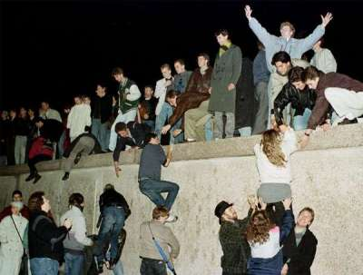
Globalization
Flattener #1: Fall of the Berlin Wall
HR “poured in” from “the other world”
Markets open up in “the other world”
November 9, 1989.
Walls between the two “camps” collapsed
➔No barriers against trade, exchange of personnel, flow of info

Slide 11

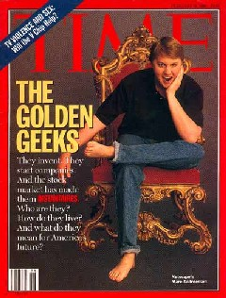
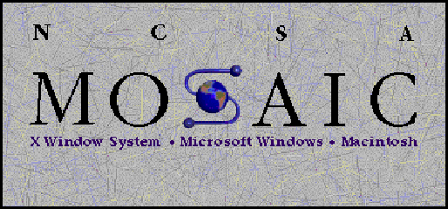
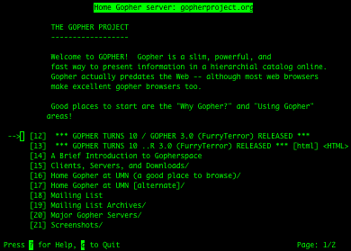
Globalization
Flattener #2: Netscape Goes Public
– Aug 9, 1995
Explosion of online consumer population
April 22, 1993
“Prehistoric time”: Gopher (U Minnesota)
Marc Andreessen [then at U Illinois] (wrote Mosaic browser and later Netscape browser)

Slide 12




Globalization
Flattener #4: Uploading
What can we say about
the manner of info flow with uploading?
Notes:
Clicking on the Blogger, Wikipedia, or YouTube logos on this slide will take you to
their respective home pages.
12

Slide 13

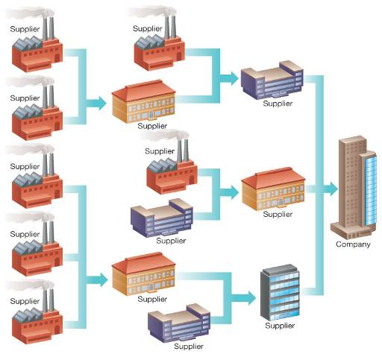
Globalization
Flattener #7: Supply Chaining

Slide 14

Globalization
Flattener #9: Informing
It’s not just
Individuals have access to massive amounts of information
– Q: more than just the amount?
Notes:
Search; 2. From everywhere; 3. In “any” language
Enable/help individuals to be informed, organized, related, enlightened, to discover, to invent
Alan Cohen: P.185
14

Slide 15
And the result of all this?
See the Power of Technology
Notes:
This is the latest video in the “Did You Know” series.

Slide 16


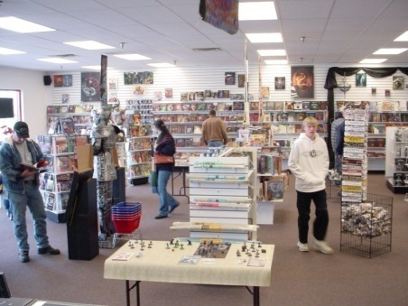
Market Pressures
The Global Economy and
Strong Competition
The Changing Nature of the Workforce
Powerful Customers

Slide 17
Technology Pressures
Technological Innovation and Obsolescence
Information Overload
Notes:
Technological Innovation and Obsolescence: Few and improved technologies rapidly create or support substitutes for products, alternative service options, and superb quality. As a result, today’s state-of-the-art products may be obsolete tomorrow.
Information Overload: Internet and other telecommunications networks are bringing a flood of information to managers. To make decisions effectively and efficiently, managers must be able to access, navigate, and utilize these vast stores of data, information, and knowledge.

Slide 18
’S ABOUT BUSINESS 2.1
“Bring Your Own Device” Can Cause Problems
  What are the advantages of allowing employees to use any mobile device to connect to the corporate network? The disadvantages?
  Why is it necessary to be able to erase corporate data when a mobile device is lost or stolen?

Slide 19
Societal/Political/Legal Pressures
Social Responsibility
  ➔ ➔ ➔
Compliance with Government Regulations
  EPA; Sarbanes-Oxley; HIPAA; …
Protection Against Terrorist Attacks
Ethical Issues
  Privacy; Intellectual property rights; …
Notes:
Social Responsibility: Social issues that affect businesses and individuals range from the state of the physical environment, to company and individual philanthropy, to education. Some corporations and individuals are willing to spend time and/or money to address various social problems. These efforts are known as organizational social responsibility or individual social responsibility.
Compliance with Government Regulations: government regulations regarding health, safety, environmental protection, and equal opportunity. Businesses tend to view government regulations as expensive constraints on their activities. In general, government deregulation intensifies competition. In the wake of 9/11 and numerous corporate scandals, the U.S. government passed many new laws, including the Sarbanes–Oxley Act, the USA PATRIOT Act, the Gramm–Leach–Bliley Act, and the Health Insurance Portability and Accountability Act (HIPAA).
Protection Against Terrorist Attacks: Since September 11, 2001, organizations have been under increased pressure to protect themselves against terrorist attacks. In addition, employees who are in the military reserves have been called up for active duty, creating personnel problems. Information technology can help protect businesses by providing security systems and possibly identifying patterns of behavior associated with terrorist activities, including cyberattacks.
Ethical Issues: Ethics relates to general standards of right and wrong. Information ethics relates specifically to standards of right and wrong in information processing practices. Ethical issues are very important because, if handled poorly, they can damage an organization’s image and destroy its employees’ morale.

Slide 20
Social Responsibility
IT Assists “Go Green” Efforts in Three Areas:
  Facilities design and management
  Carbon management
  International and U.S. environmental laws
Digital Divide
To deal with all the above
Notes:
IT is instrumental in organizational efforts to “go green” in three areas:
Facilities design and management
Carbon management
International and U.S. environmental laws
Digital Divide: refers to the wide gap between those individuals who have access to information and communications technology and those who do not.

Slide 21
Organizational Responses
Strategic Systems
  What are them?
Customer Focus
Make-to-Order and Mass Customization
E-Business and E-Commerce
Notes:
Strategic Systems: provide organizations with advantages that enable them to increase their market share and/or profits, to better negotiate with suppliers, and to prevent competitors from entering their markets.
Customer Focus: Organizational attempts to provide superb customer service can make the difference between attracting and retaining customers versus losing them to competitors. Numerous IT tools and business processes have been designed to keep customers happy.
Make-to-Order: a strategy of producing customized (made to individual specifications) products and services.
Mass Customization: a company produces a large quantity of items, but it customizes them to match the needs and preferences of individual customers. Mass customization is essentially an attempt to perform make-to-order on a large scale (Example: Bodymetrics <www.bodymetrics.com>).
E-Business and E-Commerce: Conducting business electronically is an essential strategy for companies that are competing in today’s business environment.
Electronic commerce (EC or e-commerce): describes the process of buying, selling, transferring, or exchanging products, services, or information via computer networks, including the Internet.
E-business: a somewhat broader concept than EC that includes servicing customers, collaborating with business partners, and performing electronic transactions within an organization.

Slide 22
IT enables business strategy
Ten IT-enabled business trends for the decade ahead | McKinsey
  1. Joining the social matrix
  2. Competing with ‘big data’ and advanced analytics
  3. Deploying the Internet of All Things (IOT)
    https://www.youtube.com/watch?v=mzy84Vb_Gxk (@ 5’45” & 8’)
    Li-Fi, 100X Faster than Wi-Fi https://www.youtube.com/watch?v=wqH9KX9o0vg
    Li-Fi, What Is It and How Does It Work https://www.youtube.com/watch?v=g-Gy8g5jD3w
  7. Charting experiences where digital meets physical
    https://www.oculus.com/
    https://www.youtube.com/watch?v=H9ZOpQzjukY (@ 7’30”)

Slide 23
2.2
Competitive Advantage and Strategic IS’s
Porter’s Competitive Forces Model
Porter’s Value Chain Model
Strategies for Competitive Advantage
Business – Information Technology Alignment

Slide 24
Porter’s Five Forces Model
The threat of new competitors
The bargaining power of suppliers
The bargaining power of customers (buyers)
The threat of substitute products or services
The rivalry among existing firms in the industry
Notes:
Threat of Entry of New Competitors: The threat that new competitors will enter your market is high when entry is easy and low when there are significant barriers to entry.
Bargaining Power of Suppliers: Supplier power is high when buyers have few choices from whom to buy and low when buyers have many choices.
Bargaining Power of Customers (Buyers): Buyer power is high when buyers have many choices from whom to buy and low when buyers have few choices.
Threat of Substitute Products or Services: If there are many alternatives to an organization’s products or services, then the threat of substitutes is high. If there are few alternatives, then the threat is low.
Rivalry Among Existing Firms: The threat from rivalry is high when there is intense competition among many firms in an industry. The threat is low when the competition is among fewer firms and is not as intense.
---------------------
Barrier to Entry: a product or service feature that customers have learned to expect from organizations in a certain industry. A competing organization must offer this feature in order to survive in the marketplace (e.g., legal requirements such as admission to the bar to practice law).
Switching Costs: the costs, in money and time, imposed by a decision to buy elsewhere (e.g., contracts with smartphone providers).

Slide 25
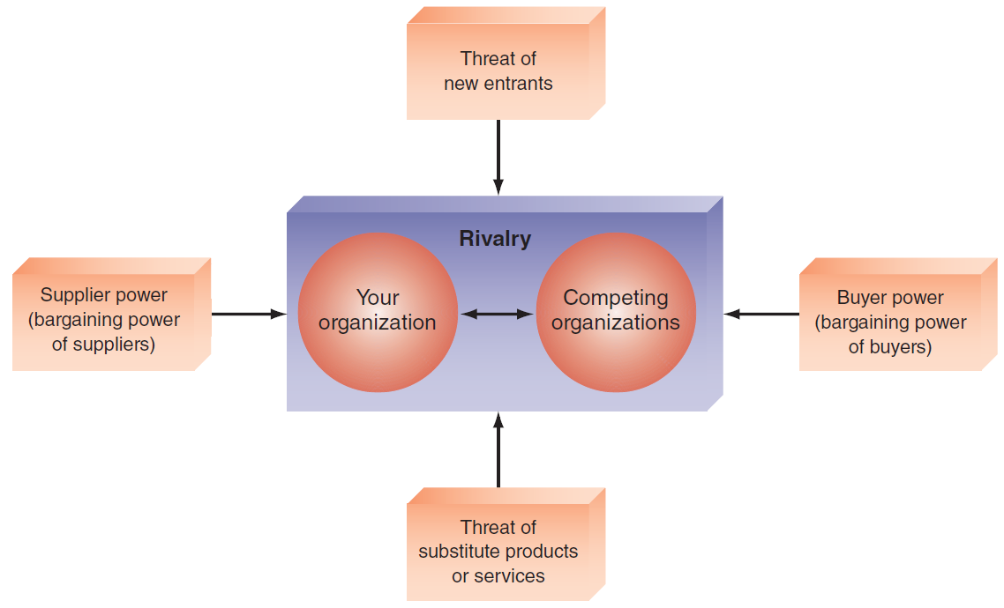
Figure 2.2: Porter’s Competitive Forces Model
Zhang’s graphical model showing logical relationship
25

Slide 26
Competitive Forces
(Graphical representation developed by Yüe Zhang)
Suppliers
Company
Customers
Substitutes
Competitors
New entrants
Figure © 1997-2018, Yüe “Jeff” Zhang

Slide 27
Internet Age competition (Model proposed by Yüe Zhang)
Company
Customer
Attention
Substitutes
Competitors
New entrants
© 2016-2018, Yüe “Jeff” Zhang

Slide 28
Internet Age competition – “From the Cloud” (Model proposed by Yüe Zhang)
Customer
Attention
Competitors
Substitutes
© 2016-2017, Yüe “Jeff” Zhang

Slide 29
Porter’s Value Chain Model
Value Chain
Two Categories of Organization Activities in the Value Chain
  Primary Activities
  Support Activities
Notes:
Value Chain: a sequence of activities through which the organization’s inputs, whatever they are, are transformed into more valuable outputs, whatever they are.
Value System: includes the suppliers that provide the inputs necessary to the firm along with their value chains. After the firm creates products, these products pass through the value chains of distributors (which also have their own value chains), all the way to the customers. All parts of these chains are included in the value system.
-------------------
Two Categories of Organization Activities in the Value Chain:
Primary Activities: relate to the production and distribution of the firm’s products and services. These activities create value for which customers are willing to pay.
Support activities: contribute to the firm’s competitive advantage by supporting the primary activities, but do not add value directly to the firm’s products or services.

Slide 30
Primary Activities
Inbound logistics
Operations
Outbound logistics
Marketing and sales
Services
Notes:
Five Sequenced Primary Activities of Typical Manufacturing Companies:
Inbound logistics (inputs)
Operations (manufacturing and testing)
Outbound logistics (storage and distribution)
Marketing and sales
Services

Slide 31
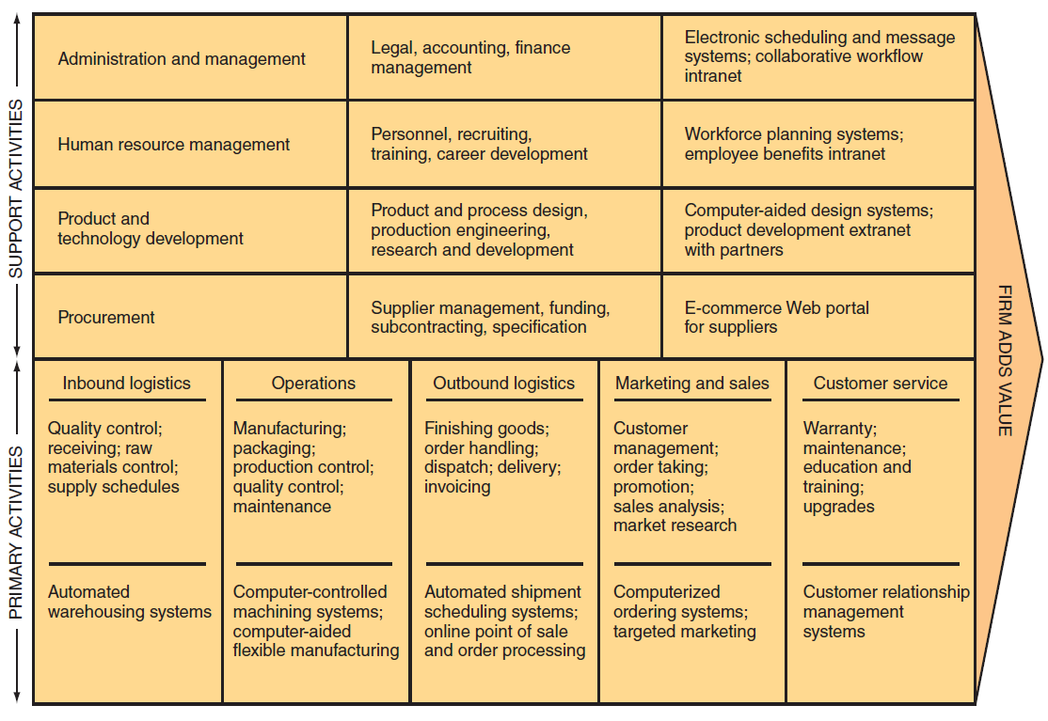
Figure 2.3: Porter’s Value Chain Model

Slide 32
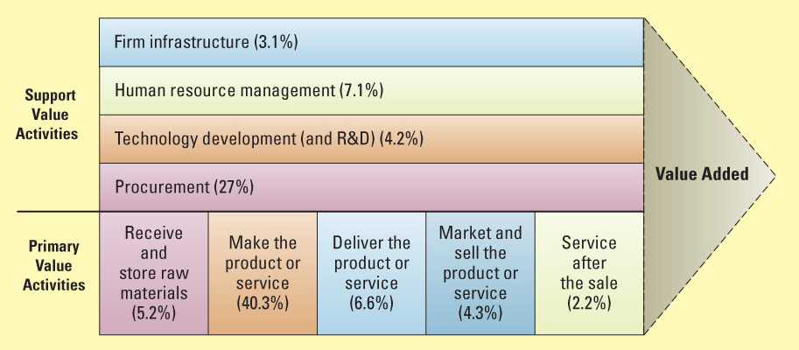
VALUE CHAIN ANALYSIS – EXECUTING BUSINESS STRATEGIES
Porter’s Value Chain
31

Slide 33
Support Activities
The Firm’s Infrastructure
Human Resources Management
Product and Technology Development
Procurement
Notes:
Value Chain Support Activities Typically Include:
The firm’s infrastructure (accounting, finance, management)
Human resources management
Product and technology development (R&D)
Procurement

Slide 34
Strategies for Competitive Advantage
Cost leadership strategy
Differentiation strategy
Innovation strategy
Operational effectiveness strategy
Customer orientation strategy
Notes:
Competitive Advantage Strategies:
Cost leadership strategy: Produce products and/or services at the lowest cost in the industry (e.g., Walmart’s automatic inventory replenishment system).
Differentiation Strategy: Offering different products, services, or product features than your competitors (e.g., Southwest Airlines has differentiated itself as a low-cost, short-haul, express airline).
Innovation Strategy: Introduce new products and services, add new features to existing products and services, or develop new ways to produce them (Classic Example: the first introduction of automated teller machines (ATMs) by Citibank).
Operational Effectiveness Strategy: Improve the manner in which a firm executes its internal business processes so that it performs these activities more effectively than its rivals. Such improvements increase quality, productivity, and employee and customer satisfaction while decreasing time to market.
Customer Orientation Strategy: Concentrate on making customers happy. Web-based systems are particularly effective in this area because they can create a personalized, one-to-one relationship with each customer.

Slide 35
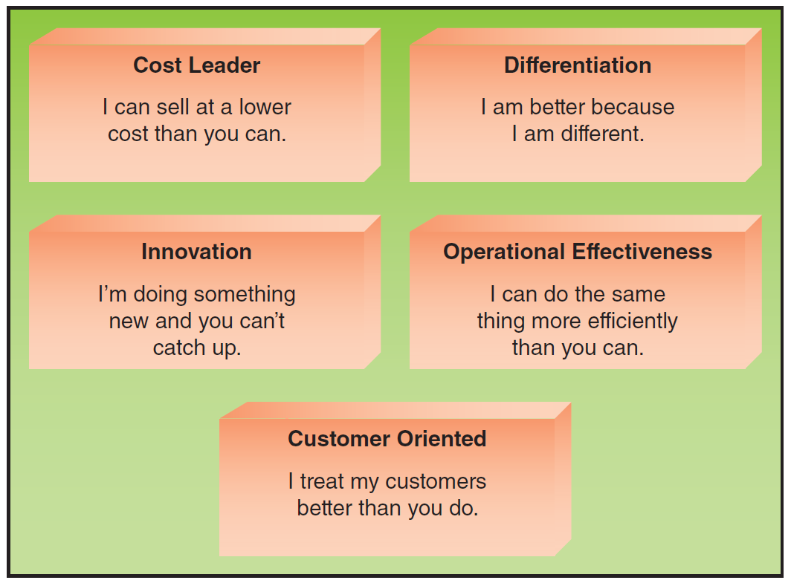
Figure 2.4: Strategies for Competitive Advantage

Slide 36
IS Impact on Competitive forces (compiled by Zhang) (Think about your own examples)
Comp Forces | Implication for Firm | Use of IS to combat force
Traditional rivals | Comp in price, product distribution, and service | ERP→ reduce cost, act quickly; Web→ service
Customer power | reduced price, increased qual, demand for more services | CRM → serve better; CAD/CAM → improved quality
Supplier power | Price raised, reduced quality | Net → closer ties; relate w new suppliers far away
New entrants | increased cap, reduced price, decreased market share | Web → reach, differentiate product; inv ctrl sys → lower costs
Substitutes | Returns; decreased market share; losing customers | DSS & customer purchase DB → trends & needs; CAD → redefine products
CAD – computer-aided design; CAM - com-aid manufacturing; DB - database

Slide 37
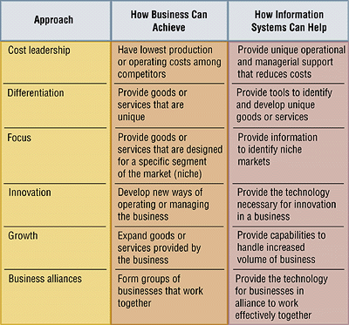
Strategic approaches to cope w competitive forces [Nickerson]
1
2
3
4
5
6
35

Slide 38






Strategies for Competitive Advantage
(Think about your own examples)
Cost Leadership
Differentiation
Innovation
Operational Effectiveness
Customer-orientation
36
Notes:
38
Cost Leadership. Produce products and/or services at the lowest cost in the industry.
Differentiation. Offer different products, services or product features.
Innovation. Introduce new products and services, add new features to existing products and services or develop new ways to produce them.
Operational Effectiveness. Improve the manner in which internal business processes are executed so that a firm performs similar activities better than its rivals.
Customer-orientation. Concentrate on making customers happy.

Slide 39
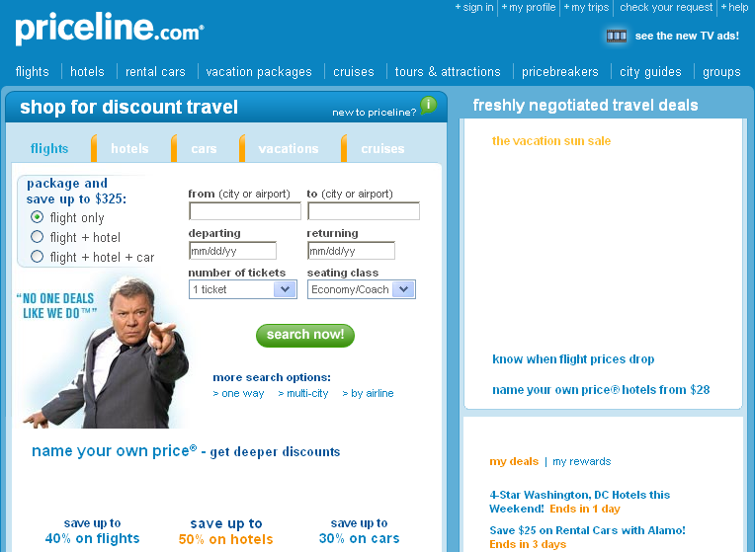
Priceline.com: “Name your own price”

Slide 40
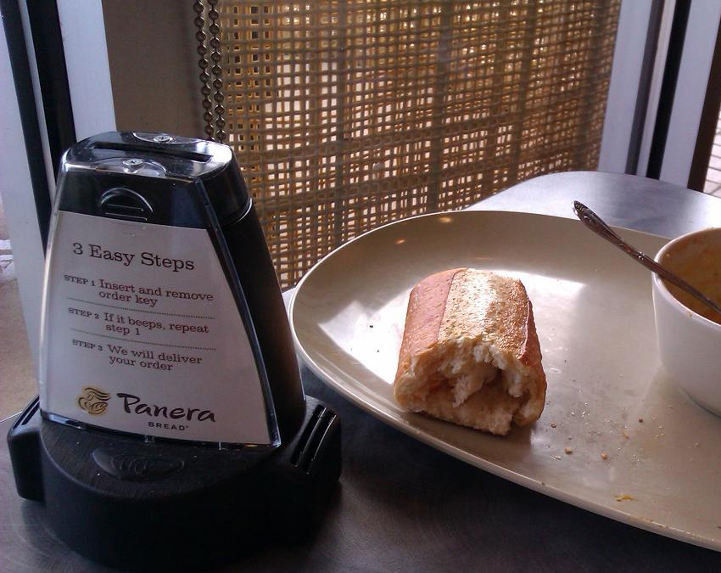
Panera Bread – what approach?

Slide 41
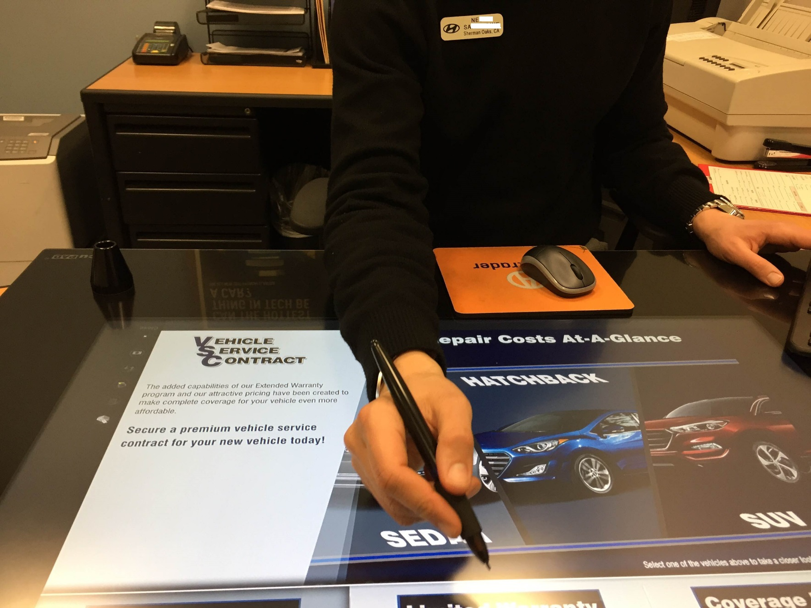
Touch Table at Keyes Woodland Hills Hyundai

Slide 42
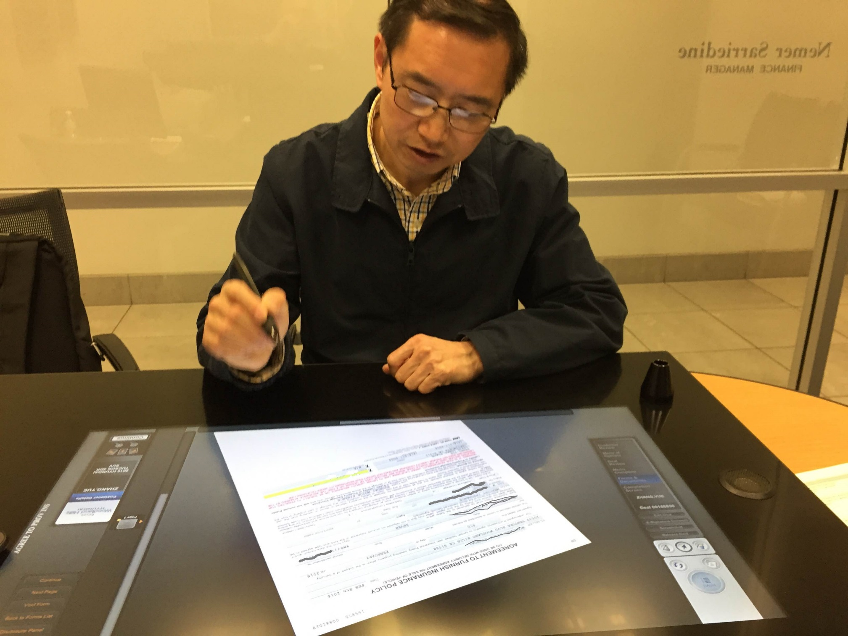

Slide 43
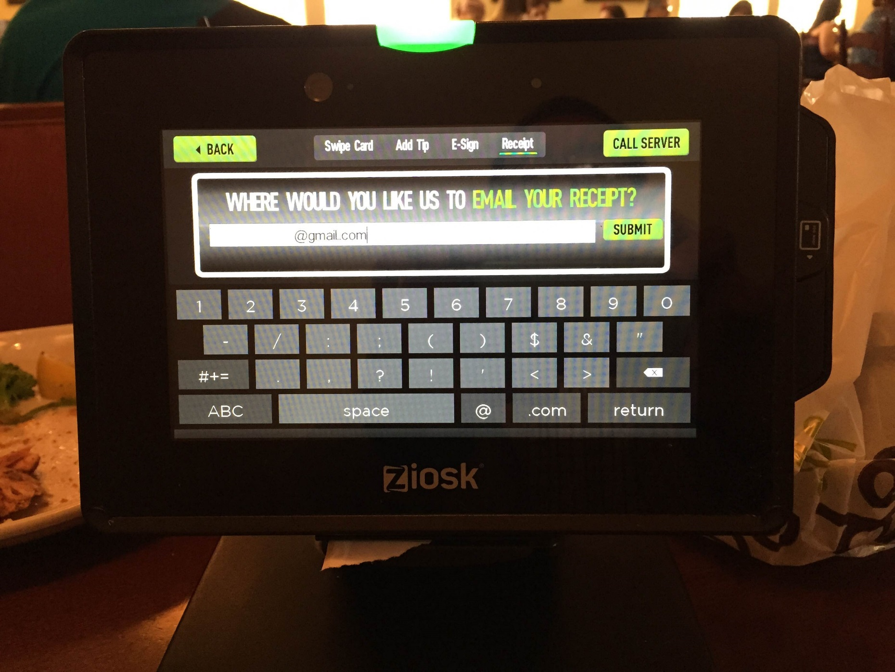
Olive Garden’s mobile kiosk

Slide 44
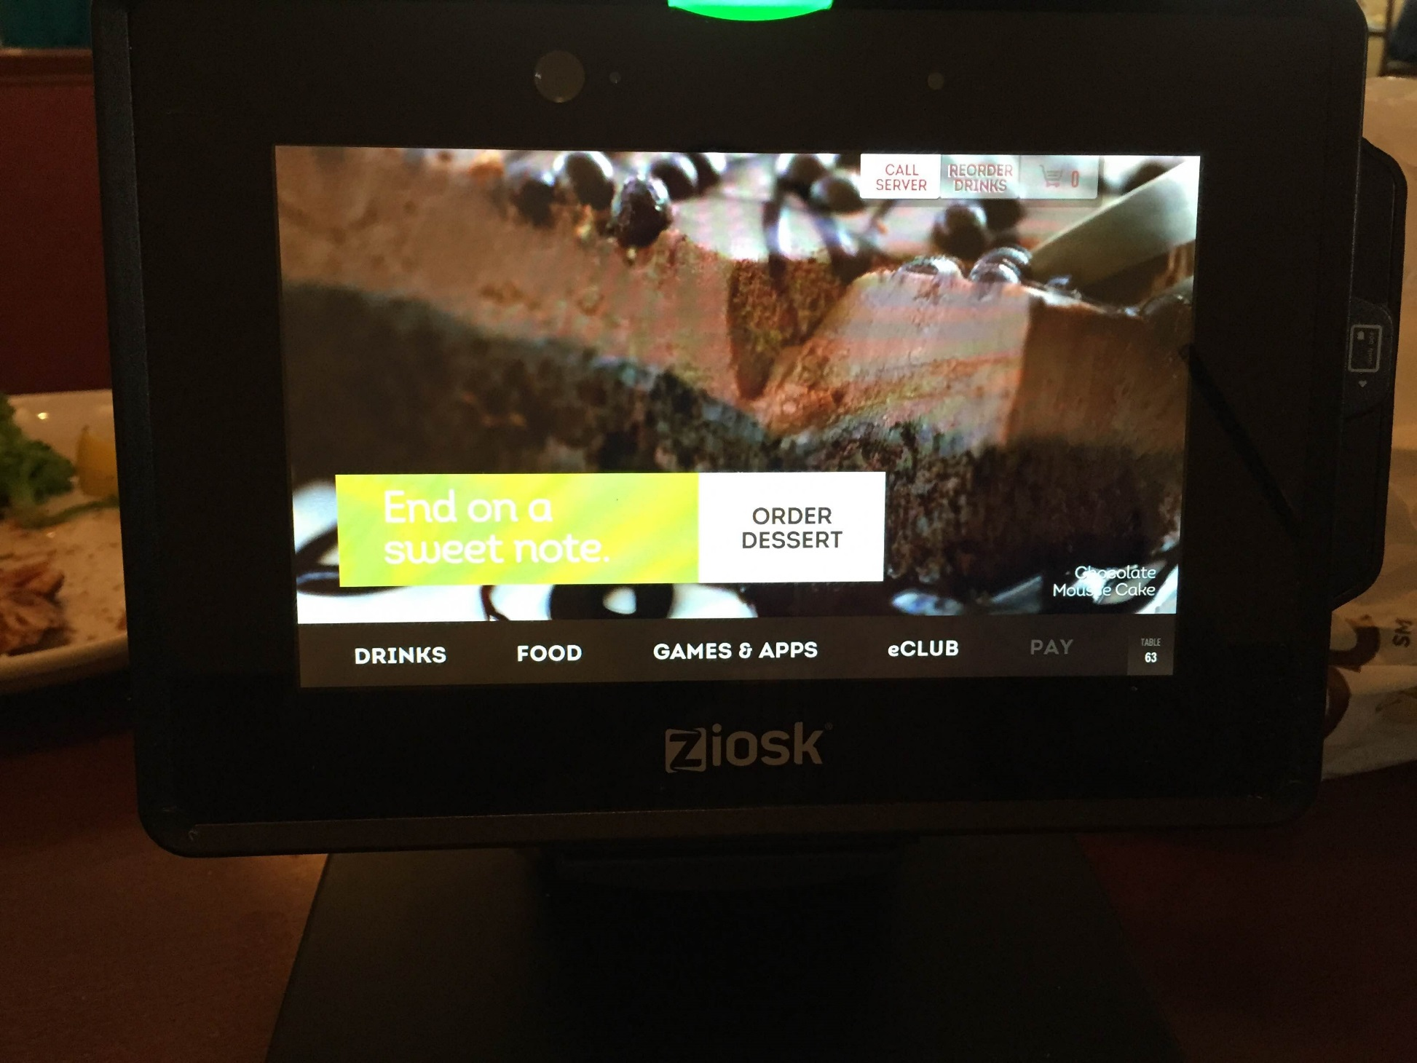

Slide 45
Business-Information Technology Alignment
Business–Information Technology Alignment
Six Characteristics of Excellent Business-IT Alignment:
Notes:
Business–Information Technology Alignment: IT function directly supports the business objectives of the organization through the tight integration of the IT function with the organization’s strategy, mission, and goals.

Slide 46
Six Characteristics of Excellent Business-IT Alignment
Enabler
Organizations view IT as an engine of innovation that continually transforms the business, often creating new revenue streams.
Organizations view their internal & external customers & their customer service function as supremely important.
Notes:
Six Characteristics of Excellent Business-IT Alignment:
Organizations view IT as an engine of innovation that continually transforms the business, often creating new revenue streams.
Organizations view their internal and external customers and their customer service function as supremely important.
Organizations rotate business and IT professionals across departments and job functions.
Organizations provide overarching goals that are completely clear to each IT and business employee.
Organizations ensure that IT employees understand how the company makes (or loses) money.
Organizations create a vibrant and inclusive company culture.

Slide 47
Six Characteristics of Excellent Business-IT Alignment (continued)
Organizations rotate business & IT professionals across departments and job functions.
Organizations provide overarching goals that are completely clear to each IT and business employee.
Goals cascade: Slide 51
Notes:
Six Characteristics of Excellent Business-IT Alignment:
Organizations view IT as an engine of innovation that continually transforms the business, often creating new revenue streams.
Organizations view their internal and external customers and their customer service function as supremely important.
Organizations rotate business and IT professionals across departments and job functions.
Organizations provide overarching goals that are completely clear to each IT and business employee.
Organizations ensure that IT employees understand how the company makes (or loses) money.
Organizations create a vibrant and inclusive company culture.

Slide 48
Six Characteristics of Excellent Business-IT Alignment (continued)
Organizations ensure that IT employees understand how the company makes (or loses) money.
Organizations create a vibrant and inclusive company culture.
Notes:
Six Characteristics of Excellent Business-IT Alignment:
Organizations view IT as an engine of innovation that continually transforms the business, often creating new revenue streams.
Organizations view their internal and external customers and their customer service function as supremely important.
Organizations rotate business and IT professionals across departments and job functions.
Organizations provide overarching goals that are completely clear to each IT and business employee.
Organizations ensure that IT employees understand how the company makes (or loses) money.
Organizations create a vibrant and inclusive company culture.

Slide 49
Efficiency and effectiveness metrics to measure the impact of IT
Speed
Throughput
Performance 【Suggest: reliability】
Scalability
Net Present Value (NPV)
Return on Investment (ROI)
Total Cost of Ownership (TCO)
Indicators;
measures
Notes:
Measure: Immediate; Short-run; Long-run

Slide 50
IT as enabler of business
Enabler: Making it possible to take a business endeavor/initiative
that would not have been possible without the IT support or facilitation
E-commerce
Online banking
Envelope-free check deposit
Wireless applications
Real-time flight info updates
… 【Scan address plate to find out LBS】
Read: IT Should be an Enabler to the Business http://www.information-management.com/blogs/IT_business-10015571-1.html

Slide 51
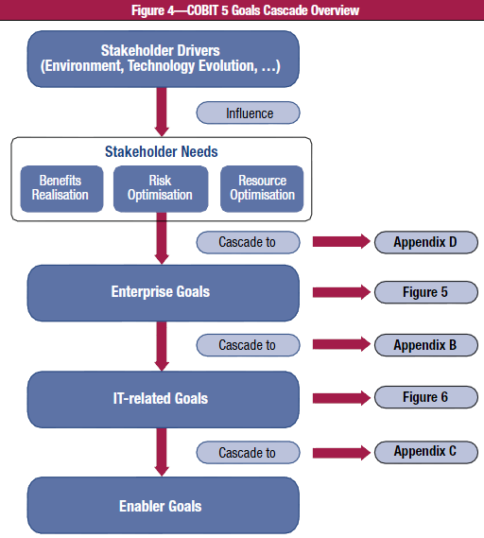
COBIT 5’s
Goals Cascade

