Slide 1
1
Introduction to Information Systems
#35-37 to be picked up Wk 2

Slide 2
Why Should I Study Information Systems (IS)?
Overview of Computer-Based Information Systems (IS)
How Does IT Impact Organizations?
Importance of Information Systems (IS) to Society

Slide 3
Identify the reasons why being an informed user of IS is important in today’s world.
Describe the various types of computer-based information systems in an organization.
Discuss ways in which information technology can affect managers and non-managerial workers.
Identify positive and negative societal effects of the increased use of information technology.

Slide 4
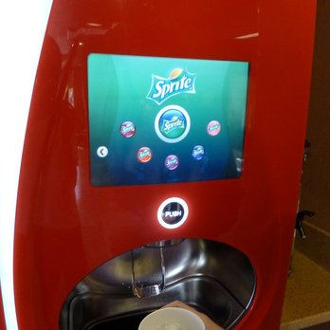
Ordering drinks at Jack in the Box

Slide 5
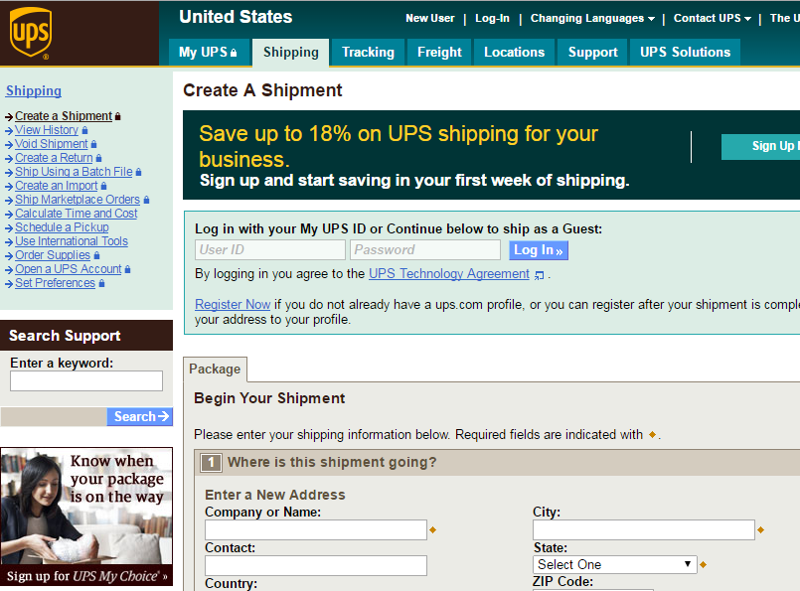
Create a shipment with UPS

Slide 6
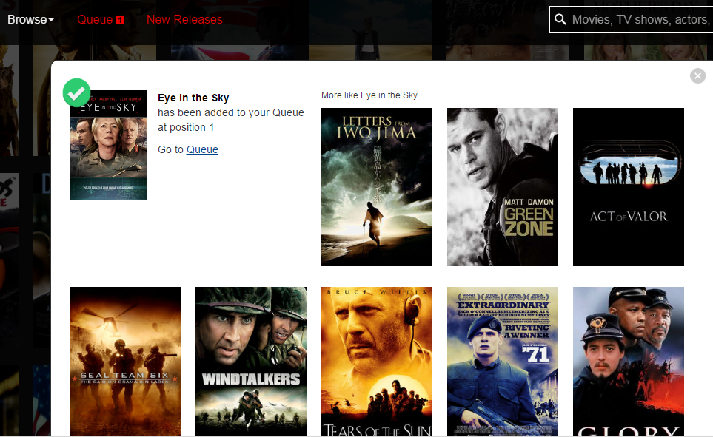
Choosing videos on Netflix

Slide 7

Figuring out savings for retirement

Slide 8
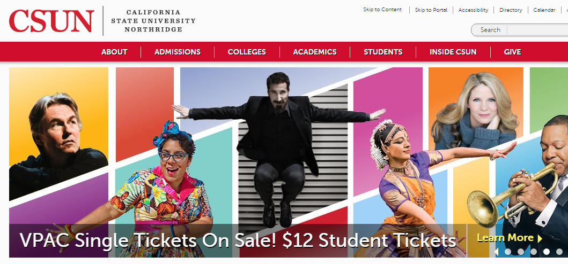
CSUN Homepage

Slide 9
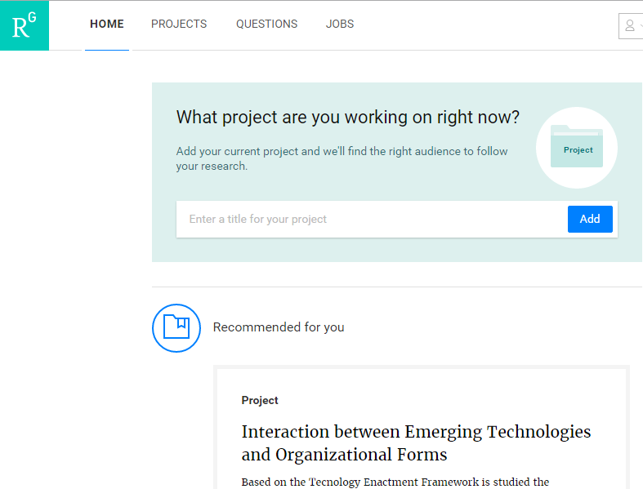
Peers’ research project recommendation at ResearchGate

Slide 10

1.1
Why Should I Study Information Systems
The Informed
User – You!
IT Offers Career
Opportunities
Managing
Information Resources
Notes:
Information Technology (IT): any computer-based tool that people use to work with information and to support the information and information-processing needs of an organization.
Information System (IS): collects, processes, stores, analyzes, and disseminates information for a specific purpose.
Informed User: A person knowledgeable about information systems and information technology

Slide 11
Definition of IT & IS (P.3)
Information technology (IT) refers to any computer-based tool that people use
  to work w information and
  to support the info and info-processing needs of an organization
An info sys (IS)
  Collects, Processes, Stores, Analyzes, and Disseminates
Information for a specific purpose

Slide 12
MANAGEMENT
INFORMATION SYSTEMS
Management Information Systems (MIS) –
A business function,
    like accounting and human resources,
which moves information about people, products, and processes across the company
to facilitate
  Operation (running biz)
  decision-making and problem-solving
And connects people for
  Org culture, and
  Generation of new ideas
Refer to first few slides
of this chapter for examples

Slide 13
Reasons Why You Should Be An Informed User…
You will benefit more from your organization’s IT applications
  because you will understand what is “behind” those applications.
Your input can enhance your organization’s IT applications.
  Biz user input to IT design/config/implemtn
As you advance in the organization you can participate in selecting the IT applications your organization will use.

Slide 14
Reasons Why You Should Be An Informed User (con’t)…
You will aware of both new ITs and rapid developments in existing technologies.
You will understand how using IT can improve your organization’s performance.
  4 and 5: Leveraging IT as strategic advantage – “Enablers”; more in Ch 2
If you are entrepreneurial minded, you can use IT to start your own business.

Slide 15
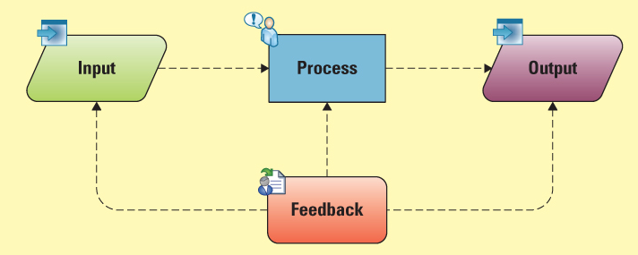
INFORMATION SYSTEMS
Systems thinking – A way of monitoring the entire system by viewing multiple inputs being processed or transformed to produce outputs while continuously gathering feedback on each part

Slide 16
INFORMATION SYSTEMS
Systems thinking – Zhang compiled:
  Components are interrelated
  System has an objective; components work together to achieve system’s objective
  “1+1>2” – system’s output is larger than the sum of the outputs of its components
  Pursuing system’s optimal output precedes the output of some components
Note: These added contents (usually in Brown Color) are not in the textbook but will be included in exams/quizzes. So please do not ignore them.

Slide 17
Key Concepts I Hope You Establish
Businesses today rely heavily on IS
  Systems have objectives and structure
IS allows companies to remain competitive
  Tech supports existing strategy – “alignment”
  Emerging tech leads to new strategic directions
Organizations must adapt to tech advances to keep pace w changing environment
Companies should have a solid business reason for implementing technology
http://www.youtube.com/watch?v=zIEIvi2MuEk

Slide 18

IT Offers Career Opportunities
Chief Information
Officer (CIO)
Substantial Demand for IT Staff
  Programmers
  Business Analysts
  System Analysts
  Designers
$115,000 is the median salary for IS Managers (US Dept of Labor)
DBAs
Network admins
Info sys security professionals (ISSP)
New: IT Auditor – ISACA certs
Notes:
CIO: The executive who is in charge of the IS function

Slide 19
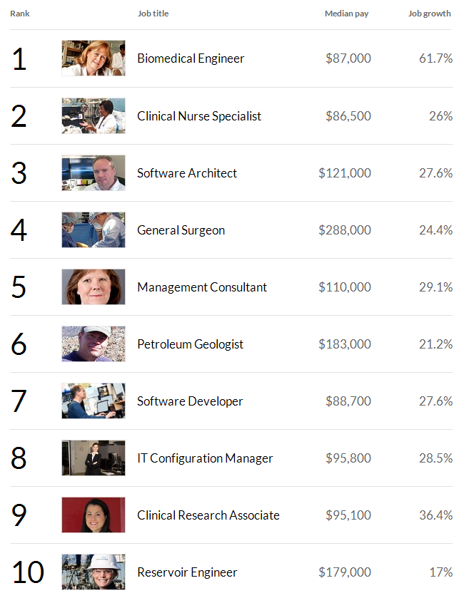
“Top Jobs” in America
Money Magazine 2013
Four of the top ten jobs relate to MIS

Slide 20
Managing Information Resources
Managing information systems (IS) is difficult and complex
Contributing Factors:
  Strategic value of IS’s
  Acquiring, operating, and maintaining IS’s is very expensive
  Evolution of the IS Function: …
  Power of IS’s calls for careful governance/mgmt/control ➔ ethical issues
Chaps 1, 2, 7, PI7
Notes:
Evolution of the IS Function….
Traditional Functions of the MIS Department:
• Managing systems development and systems project management
• Managing computer operations, including the computer center
• Staffing, training, and developing IS skills
• Providing technical services
• Infrastructure planning, development, and control
New (Consultative) Functions of the MIS Department
• Initiating and designing specific strategic information systems
• Incorporating the Internet and electronic commerce into the business
• Managing system integration including the Internet, intranets, and extranets
• Educating the non-MIS managers about IT
• Educating the MIS staff about the business
• Partnering with business-unit executives
• Managing outsourcing
• Proactively using business and technical knowledge to seed innovative ideas about IT
• Creating business alliances with business partners

Slide 21
’S ABOUT BUSINESS 1.1
Information Technology Supports Students in Georgia
  Describe how the University System of Georgia manages its information resources vis-à-vis the individual universities in the system.
  What are the advantages of central management of information systems in the University System of Georgia?
  What are the disadvantages of central management of information systems in the University System of Georgia?

Slide 22
1.2
Overview of Computer-Based IS’s
Data – Information – Knowledge
Computer-Based Information System (CBIS)
Types of Computer-Based Information Systems (CBIS)
Notes:
Computer-Based Information Systems (CBIS): an information system that uses computer technology to perform some or all of the its intended tasks.

Slide 23
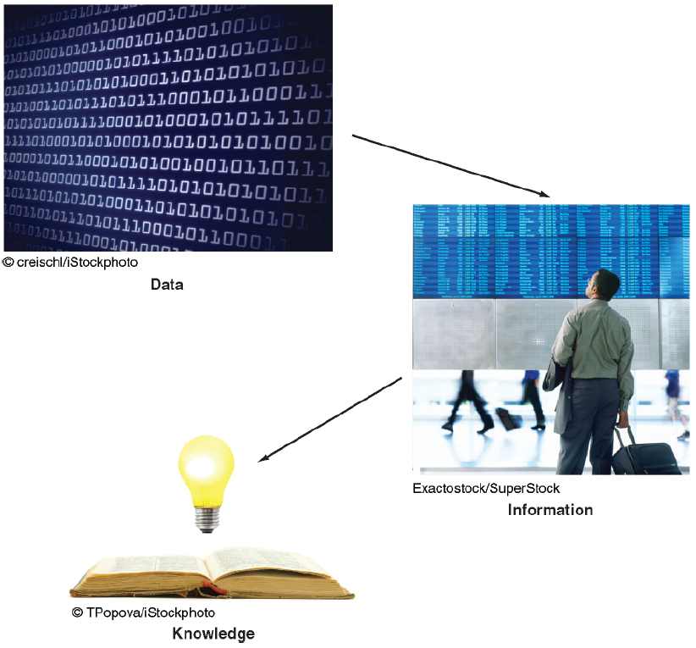
Data – Information – Knowledge
Chap 3, PI3
Examine from:
Level of organization
Depth of processing
Richness/Amount of contents
Value to biz

Slide 24
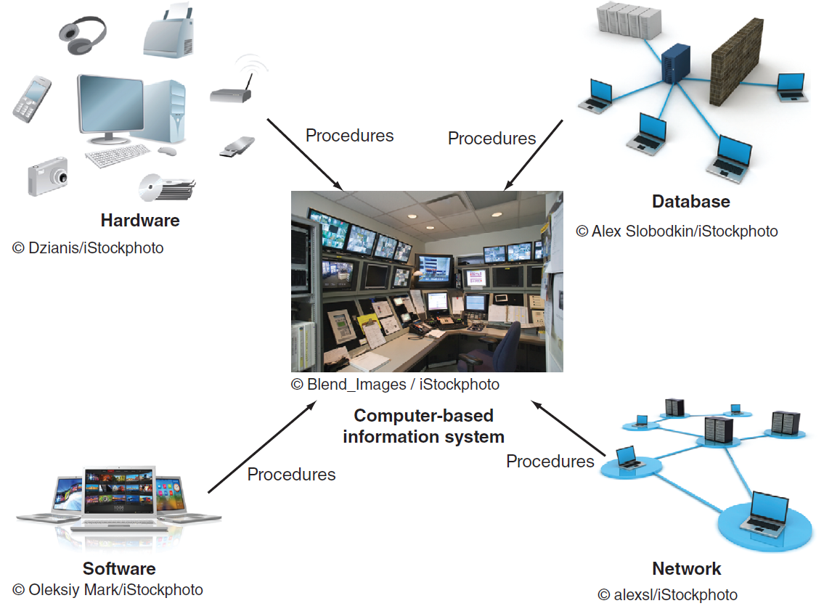
Data versus Information versus Knowledge
Notes:
Data Items: an elementary description of things, events, activities, and transactions that are recorded, classified, and stored but are not organized to convey any specific meaning.
Information: refers to data that have been organized so that they have meaning and value to the recipient.
Knowledge: consists of data and/or information that have been organized and processed to convey understanding, experience, accumulated learning, and expertise as they apply to a current business problem.

Slide 25
Capabilities of Information Systems
Table 1.3
Perform high-speed, high-volume numerical computations
Provide fast, accurate communication and collaboration within and among organizations
Store huge amounts of information in small space
Allow quick, inexpensive access to vast amounts of information worldwide
Interpret vast amounts of data quickly and efficiently
Increase effectiveness and efficiency of people working in groups in one place or around the world
Automate semiautomatic business process and manual tasks

Slide 26
Components of a CBIS
Hardware (PI2)
Software (PI2)
Database (Ch 3, PI3)
Network (Ch 4)
Procedures
People
Figure showing logical relationship
Most chapters
Notes:
Hardware: consists of devices such as the processor, monitor, keyboard, and printer.
Software: a program or collection of programs that enable the hardware to process data.
Database: a collection of related fi les or tables containing data.
Network: a connecting system (wireline or wireless) that permits different computers to share resources.
Procedures: are the instructions for combining the above components to process information and generate the desired output.
People: individuals who use the hardware and software, interface with it, or utilize its output.

Slide 27
Components of IS; IS in Business
(Figure by Zhang)
Corp
Strategy
Information System
People
Procedure
Use
Software
Data
Hardware
Hardware
Network
© 1997-2017, Yüe “Jeff” Zhang

Slide 28
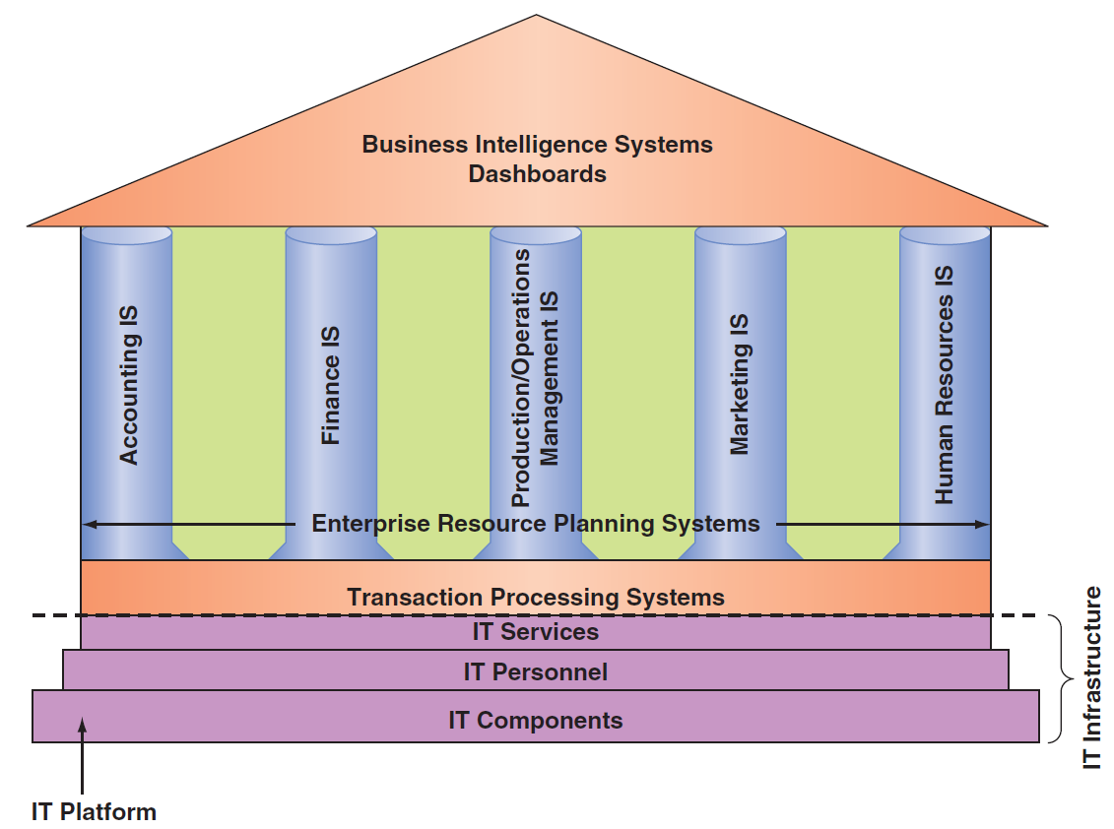
Computer-Based Information Systems (CBIS)
FAIS –
Slide #31;
Chap 11
Notes:
IT Components: Hardware, Software, a database, a network, procedures, and people.
IT Services: IT Personnel use IT Components to develop IS’s, oversee security & risk, and manage data.
IT Infrastructure: The IT components and IT services.
Application: A program designed to support a specific task or business process.
Functional Area Information Systems (FAIS) : a collection of application programs in a single department or functional area.

Slide 29
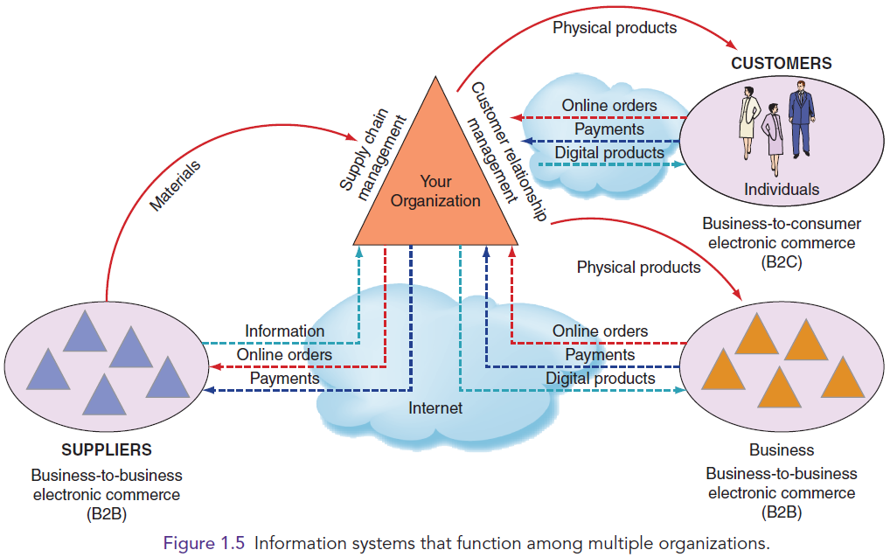
Figure 1.5: IS that function among multiple organizations

Slide 30
Types of Computer Based Information Systems (CBIS)
Breadth of Support for Information Systems (IS)
Support for Organizational Employees

Slide 31
Breadth of Support for Information Systems (IS)
Chaps 11, 12, 13
Transaction Processing Systems (TPS)
E-Commerce Systems
Functional Area Information Systems (FAIS) -- “Pillars” Slide #28
Enterprise Resource Planning Systems (ERP) – integration of FAIS; @CSUN: ___
Inter-organizational (Information) Systems (IOS)
Notes:
Functional Area Information Systems (FAIS) : a collection of application programs in a single department or functional area.
Enterprise Resource Planning (ERP): systems are designed to correct a lack of communication among the functional area IS.
Transaction Processing System (TPS): systems that support the monitoring, collection, storage, and processing of data from the organization’s basic business transactions, each of which generates data.
Interorganizational Information systems (IOSs): Information systems that connect two or more organizations.
Electronic Commerce (e-commerce) Systems: an interorganizational information system that enable organizations to conduct transactions, called business-to-business (B2B) electronic commerce, and customers to conduct transactions with businesses, called business-to-consumer (B2C) electronic commerce.

Slide 32
Support for Organizational Employees
Chap 5
Knowledge Workers (KW)
Office Automation Systems (OASs)
Business Intelligence (BI) Systems
Expert Systems (ES)
Dashboards ➔ Executives (EIS; ESS)
Notes:
Knowledge Workers: professional employees that are experts in a particular subject area (e.g., financial and marketing analysts, engineers, lawyers, and accountants.).
Office Automation Systems (OASs): typically support the clerical staff, lower and middle managers, and knowledge workers (e.g., word processing and desktop publishing software).
Business Intelligence (BI) Systems: systems that provide computer-based support for complex, nonroutine decisions, primarily for middle managers and knowledge workers.
Expert Systems (ES): systems that attempt to duplicate the work of human experts by applying reasoning capabilities, knowledge, and expertise within a specific domain.
Dashboards: a special form of IS that support all managers of the organization by providing rapid access to timely information and direct access to structured information in the form of reports.

Slide 33
1.3
How Does IT Impact Organizations?
IT Reduces the Number of Middle Managers
  W.r.t. the traditional “pyramid”:
IT Change’s the Manager’s Job
  Less _____, more _____
Will IT Eliminate Jobs?
  “New eco system”:
IT Impacts Employees at Work
  Your own experience?

Slide 34
Info Sys wrt/along w Biz Evolution
Business
Early info sys:
Modern info sys:
Current IS characteristics:
  Degree of connection
  Types of connection
  Variety of tools
  Specialty vs integration
  New issues:…?
Evolves with
Rides,
Drives
Info Sys

Slide 35
Traditional Major IS Functions
Managing systems development and systems project management
Managing computer operations
Staffing, training, developing IS skills
Providing technical services
Infrastructure planning, development, control

Slide 36
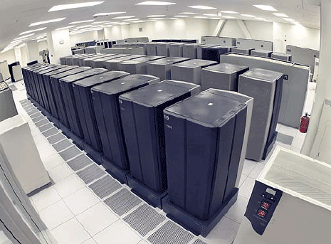

Traditional Functions of MIS Department
Consultative Functions of MIS Department
Example: manage data center
Example: create business alliances

Slide 37
New (Consultative) IS Functions
Initiating and designing strategic information systems
Incorporating the Internet and e-commerce into the business
Managing system integration
Educating non-IS managers about IT
Educating IS staff about the business
Supporting end-user computing
Partnering with executives
Managing outsourcing
Innovate
Ally with vendors and IS departments in other organizations

Slide 38
IT Impacts Employees at Work
IT Impacts Employees’ Health and Safety
  How?
IT Provides Opportunities for People with Disabilities
  Fairly obvious?

Slide 39
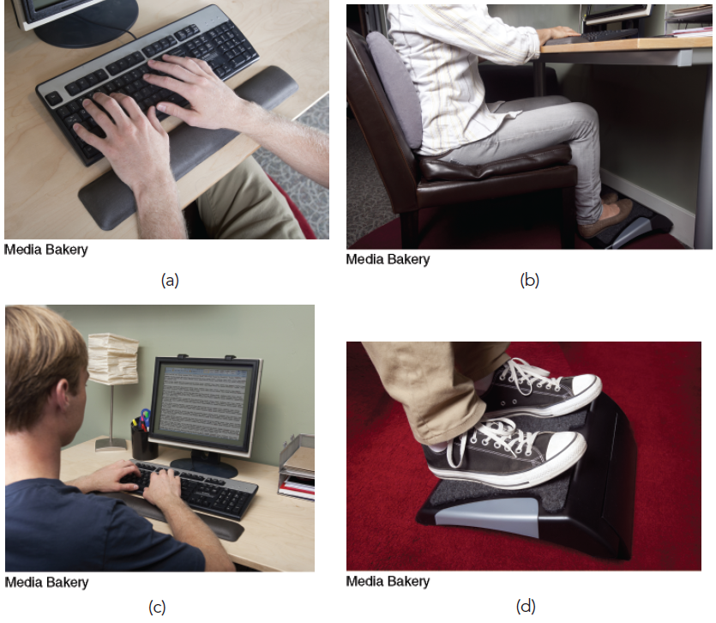
Figure 1.6: Ergonomic products protect computer users.

Slide 40
1.4
Importance of IS to Society
IT Affects Our Quality of Life
  How? + / -?
The Robot Revolution is Here Now
  Google robot dogs:
  https://www.youtube.com/watch?v=EuThIK-X2gU
Improvements in Healthcare

Slide 41
’S ABOUT BUSINESS 1.2
Different Types of Robots
  Discuss some disadvantages of (a) telepresence robots, (b) autonomous cars, and (c) drones.
  Would you be willing to ride in an autonomous car? Why or why not?
  Which occupations are most at risk from a widespread adoption of autonomous cars? Support your answer.
  Debate the privacy issues associated with domestic use of drones by law enforcement agencies.

Slide 42

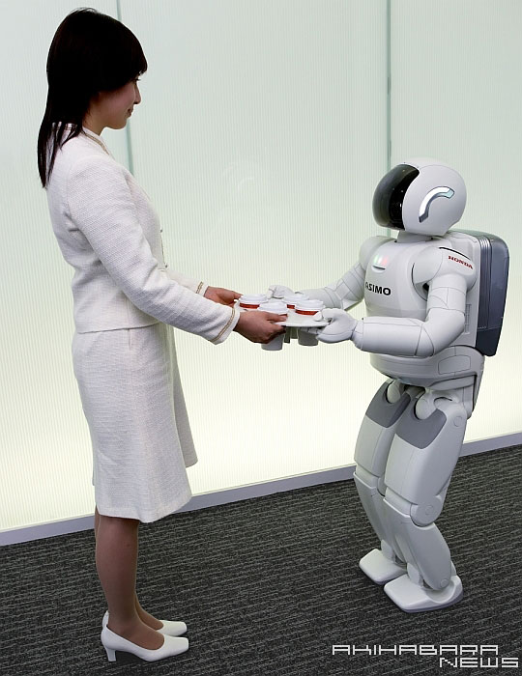
The Robot Revolution (continued)
Honda’s ASIMO robot
See video of ASIMO in action

Slide 43
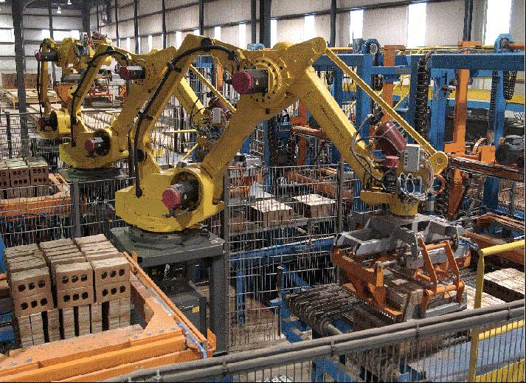
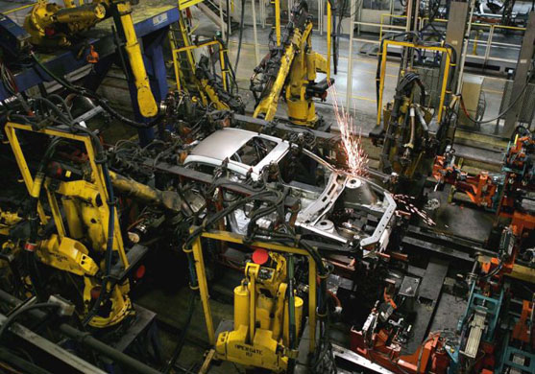
Industrial Robots
See video of warehouse robots at work

