Slide 1
5
Intelligent
Systems

Slide 2
Introduction to intelligent systems
Expert Systems
Neural Networks
Fuzzy Logic
Genetic Algorithms
Intelligent Agents

Slide 3
Explain the potential value and the potential limitations of artificial intelligence.
Provide examples of the benefits, applications, and limitations of expert systems.
Provide examples of the use of neural networks.
Provide examples of the use of fuzzy logic.

Slide 4
Describe the situations in which genetic algorithms would be most useful.
Describe the use case for several major types of intelligent agents.

Slide 5
PI5.1
Introduction to Intelligent Systems
Intelligent Systems
Artificial Intelligence (AI)
Intelligent Behavior
Algorithm
Notes:
Intelligent systems: information systems that can make decisions by themselves. The term describes the various commercial applications of artificial intelligence (AI).
Artificial Intelligence: behavior by a machine that, if performed by a human being, would be considered intelligent. It is a subfield of computer science that studies the thought processes of humans and re-creates the effects of those processes via machines, such as computers and robots.
Intelligent Behavior: learning or understanding from experience, making sense of ambiguous or contradictory messages, and responding quickly and successfully to new situations.
Algorithm: a problem-solving method expressed as a finite sequence of steps.

Slide 6
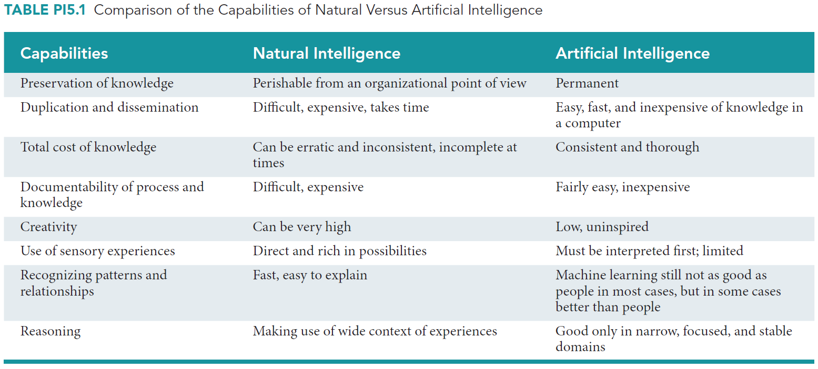
Natural versus Artificial Intelligence (AI)
Notes:
Natural Intelligence: Human Intelligence
Artificial Intelligence (AI): behavior by a machine that, if performed by a human being, would be considered intelligent. It is a subfield of computer science that studies the thought processes of humans and re-creates the effects of those processes via machines, such as computers and robots.
Intelligent Behavior: learning or understanding from experience, making sense of ambiguous or contradictory messages, and responding quickly and successfully to new situations.

Slide 7
PI5.2
Expert Systems (ES)
Expertise
Expert System
Four Activities of Expertise Transfer
The Components of Expert Systems
Applications, Benefits, and Limitations of Expert Systems

Slide 8
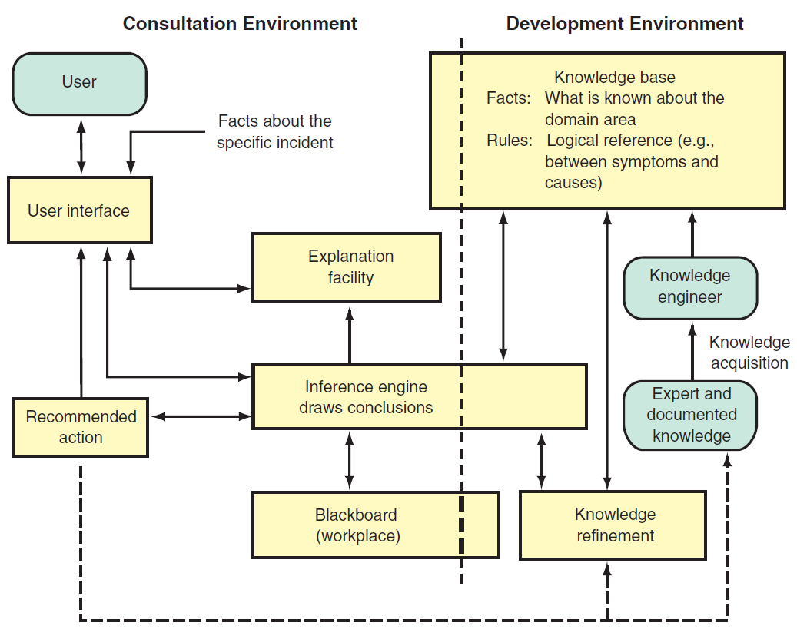
Structure and Process of an Expert System (Figure PI5.1)

Slide 9
Four Activities of Expertise Transfer from an Expert to a Computer
Knowledge Acquisition
  Expert; knowledge engineer
Knowledge Representation
  Rules
  Cases
  Decision trees
Knowledge Inferencing
  Backward-chaining, forward-chaining
Knowledge Transfer
Notes:
1. Knowledge acquisition: Knowledge is acquired from domain experts or from documented sources.
2. Knowledge representation: Acquired knowledge is organized as rules or frames (object-oriented) and stored electronically in a knowledge base.
3. Knowledge inferencing: The computer is programmed so that it can make inferences based on the stored knowledge.
4. Knowledge transfer: The inferenced expertise is transferred to the user in the form of a recommendation.

Slide 10
Components of Expert Systems (ES)
Knowledge Base
  Rules
  Cases
Inference Engine
User Interface
Blackboard (workspace)
Explanation Subsystem (justifier)
Notes:
Knowledge Base: contains knowledge necessary for understanding, formulating, and solving problems. It comprises two basic elements: (1) facts, such as the problem situation, and (2) rules that direct the use of knowledge to solve specific problems in a particular domain.
Inference Engine: a computer program that provides a methodology for reasoning and formulating conclusions. It enables the system to make inferences based on the stored knowledge. It is considered the “brain” of the ES.
User Interface: enables users to communicate with the computer. Communication is carried out in a natural language, usually a question-and-answer format, and in some cases is supplemented by graphics. Dialogue between the user and the computer triggers the inference engine to match the problem symptoms with the knowledge contained in the knowledge base and then generate advice.
Blackboard: is an area of working memory set aside for the description of a current problem, as specified by the input data. Thus, it is a kind of database.
Explanation Subsystem (or justifier): explains ES recommendations and interactively answers questions such as the following: Why did the ES ask a certain question? How did the ES reach a particular conclusion? What is the plan to reach the solution? This type of evaluation is necessary in computerized learning as well so that the program can be improved by analyzing the reasons for its success or failure. This component is currently being developed in experimental systems and is not available for commercial applications at the present time.

Slide 11
Components of ES explained
Knowledge base
  Rule-based Expert System (ES): human knowledge modeled as rules [typically 100-10,000 rules]
  Case-based ES: … stored as cases
Inference Engine: the component of an ES that performs the reasoning function – the “brain” of ES

Slide 12
Types of Expert Systems – 1 (Zhang)
Rule-based:
  IF temperature > 130 C AND pressure > 780 mmHg THEN stop the process
  IF weight_loss > (1/4)*weight_12month_ago AND on_diet IS ‘No’ AND exercise IS (‘Low’ OR ‘No’) THEN check for cancer
  if Investment Goal = RETIREMENT and
  Number Of Years To Retirement < 10
  then Category Of Fund = CONSERVATIVE GROWTH
  https://courses.csail.mit.edu/6.871/Assignment2/RBSSim.pdf

Slide 13
Types of Expert Systems – 2 (Zhang)
Case-based:
record the characteristics of past cases that have known behavior/results,
compare the corresponding characteristics of the new cases of interest,
compute “similarity” and
determine the possible outcome and solutions

Slide 14
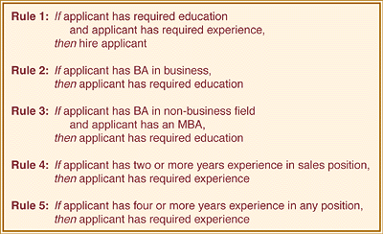
Example of a rule base
An Example of a Small Rule Base [From Nickerson]

Slide 15
Application of Expert Systems (ES)
Ten Generic Categories of ES’s
  Diagnosis
  Debugging
  Repair
  Design
  Monitoring
  Control
  Prediction
  Planning
  Interpretation
  Instruction
Notes:
1. Interpretation: Inferring situation descriptions from observations
2. Prediction: Inferring likely consequences of given situations
3. Diagnosis: Inferring system malfunctions from observations
4. Design: Configuring objects under constraints
5. Planning: Developing plans to achieve goal(s)
6. Monitoring: Comparing observations to plans, flagging exceptions
7. Debugging: Prescribing remedies for malfunctions
8. Repair: Executing a plan to administer a prescribed remedy
9. Instruction: Diagnosing, debugging, and correcting student performance
10. Control: Interpreting, predicting, repairing, and monitoring systems behavior

Slide 16
Benefits of Expert Systems (ES)
Increased output and productivity
Increased quality
Capture and dissemination of scarce expertise
Operation in hazardous environments
Notes:
1. Increased output and productivity: ESs can configure components for each custom order, increasing production capabilities.
2. Increased quality: ESs can provide consistent advice and reduce error rates.
3. Capture and dissemination of scarce expertise: Expertise from anywhere in the world can be obtained and used.
4. Operation in hazardous environments: Sensors can collect information that an ES interprets, enabling human workers to avoid hot, humid, or toxic environments.
5. Accessibility to knowledge and help desks: ESs can increase the productivity of help desk employees, or even automate this function.
6. Reliability: ESs do not become tired or bored, call in sick, or go on strike. They consistently pay attention to details.
7. Ability to work with incomplete or uncertain information: Even with an answer of “don’t know,” an ES can produce an answer, although it may not be a definite one.
8. Provision of training: The explanation facility of an ES can serve as a teaching device and a knowledge base for novices.
9. Enhancement of decision-making and problem-solving capabilities: ESs allow the integration of expert judgment into analysis (e.g., diagnosis of machine malfunction and even medical diagnosis).
10. Decreased decision-making time: ESs usually can make faster decisions than humans working alone.
11. Reduced downtime: ESs can quickly diagnose machine malfunctions and prescribe repairs.

Slide 17
Benefits of Expert Systems (ES) (continued)
Accessibility to knowledge and help desks
Reliability; consistency
Ability to work with incomplete or uncertain information
Provision of training
Notes:
1. Increased output and productivity: ESs can configure components for each custom order, increasing production capabilities.
2. Increased quality: ESs can provide consistent advice and reduce error rates.
3. Capture and dissemination of scarce expertise: Expertise from anywhere in the world can be obtained and used.
4. Operation in hazardous environments: Sensors can collect information that an ES interprets, enabling human workers to avoid hot, humid, or toxic environments.
5. Accessibility to knowledge and help desks: ESs can increase the productivity of help desk employees, or even automate this function.
6. Reliability: ESs do not become tired or bored, call in sick, or go on strike. They consistently pay attention to details.
7. Ability to work with incomplete or uncertain information: Even with an answer of “don’t know,” an ES can produce an answer, although it may not be a definite one.
8. Provision of training: The explanation facility of an ES can serve as a teaching device and a knowledge base for novices.
9. Enhancement of decision-making and problem-solving capabilities: ESs allow the integration of expert judgment into analysis (e.g., diagnosis of machine malfunction and even medical diagnosis).
10. Decreased decision-making time: ESs usually can make faster decisions than humans working alone.
11. Reduced downtime: ESs can quickly diagnose machine malfunctions and prescribe repairs.

Slide 18
Benefits of Expert Systems (ES) (continued)
Enhancement of decision-making and problem-solving capabilities
Decreased decision-making time
Reduced downtime
Notes:
1. Increased output and productivity: ESs can configure components for each custom order, increasing production capabilities.
2. Increased quality: ESs can provide consistent advice and reduce error rates.
3. Capture and dissemination of scarce expertise: Expertise from anywhere in the world can be obtained and used.
4. Operation in hazardous environments: Sensors can collect information that an ES interprets, enabling human workers to avoid hot, humid, or toxic environments.
5. Accessibility to knowledge and help desks: ESs can increase the productivity of help desk employees, or even automate this function.
6. Reliability: ESs do not become tired or bored, call in sick, or go on strike. They consistently pay attention to details.
7. Ability to work with incomplete or uncertain information: Even with an answer of “don’t know,” an ES can produce an answer, although it may not be a definite one.
8. Provision of training: The explanation facility of an ES can serve as a teaching device and a knowledge base for novices.
9. Enhancement of decision-making and problem-solving capabilities: ESs allow the integration of expert judgment into analysis (e.g., diagnosis of machine malfunction and even medical diagnosis).
10. Decreased decision-making time: ESs usually can make faster decisions than humans working alone.
11. Reduced downtime: ESs can quickly diagnose machine malfunctions and prescribe repairs.

Slide 19
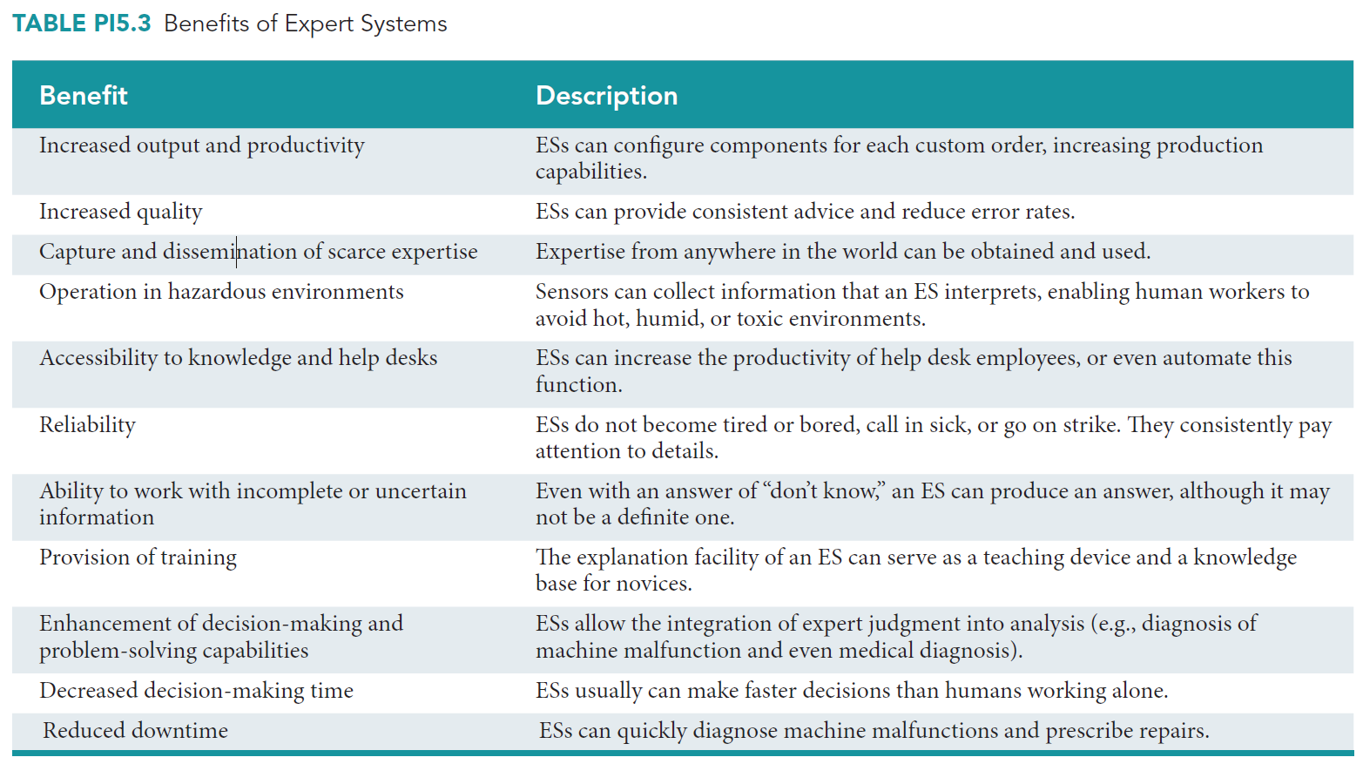
Benefits of Expert Systems (ES)

Slide 20
Limitations of Expert Systems (ES)
Transferring domain expertise from human experts to the expert system can be difficult
Automating the reasoning process of domain experts may not be possible
Potential liability from the use of expert systems
Notes:
Transferring domain expertise from human experts to the expert system can be difficult: because people cannot always explain how they know what they know. Often they are not aware of their complete reasoning process.
Automating the reasoning process of domain experts may not be possible: Even if the domain experts can explain their entire reasoning process, automating that process may not be possible. The process might be either too complex or too vague, or it might require too many rules.
Potential liability from the use of expert systems. Humans make errors occasionally, but they are generally “let off the hook” if they took reasonable care and applied generally accepted methods. An organization that uses an expert system, however, may lack this legal protection if problems arise later. The usual example of this issue is medical treatment, but it can also arise if a business decision driven by an expert system harms someone financially.

Slide 21
PI5.3
Neural Networks
A Neural network
Machine Learning Systems
  Arthur Samuel defined machine learning as a "Field of study that gives computers the ability to learn without being explicitly programmed“ (1959)
Notes:
-------------------
Neural Network: a system of programs and data structures that simulates the underlying functions of the biological brain. Neural networks are particularly adept at recognizing subtle, hidden, and newly emerging patterns within complex data, as well as interpreting incomplete inputs.
Examples :
-- The Bruce nuclear facility in Ontario, Canada: it has eight nuclear reactors, making it the largest facility in North America and the second largest in the world. The plant uses a neural network in its checkpoint X-ray screening system to detect weapons concealed in personal belongings. The system also identifies biologically dangerous liquids.
-- Research into diseases: like Alzheimer’s, Parkinson’s, and epilepsy. Researchers build robots with simulated rat brains that mimic the rats’ neural activity. The researchers then can study the brain’s function and its reaction to stimuli.
-- Investor Forecasting: forecasting the performance of stock index futures, currencies, natural gas, and oil stocks, T-bond futures, gold stocks, and other major investments.
-- Detecting Fraud in Banking Systems: fraud detection in credit card transactions and insurance claims, fight crime, and gauge customer satisfaction.
-------------------
Machine Learning Systems: artificial intelligence systems that learn from data. For instance, a machine learning system can be trained on e-mail messages to learn to distinguish between spam and non-spam messages.
Examples :
-- Optical character recognition: Printed, handwritten characters are recognized automatically based on previous examples.
-- Face recognition: Identify faces in images.
-- Topic identification: Categorize news articles as to whether they are about politics, sports, entertainment, and so on.
-- Fraud detection: Identify credit card transactions that may be fraudulent.
-- Customer segmentation: Identify which customers may respond positively to a particular promotion.

Slide 22
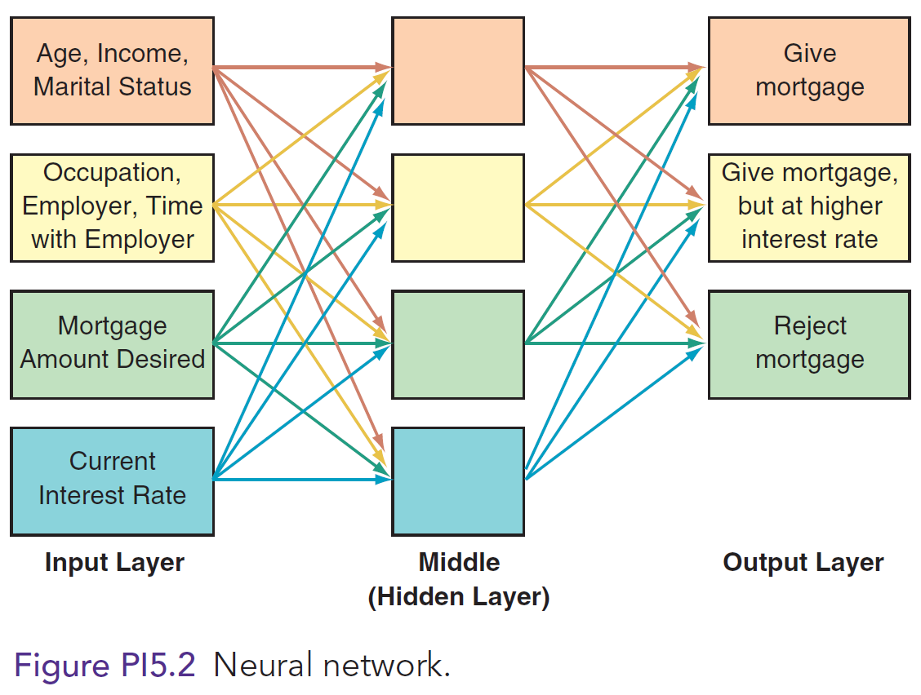
Neural Network
Weights at every node

Slide 23
Application of Neural Networks
Bruce Nuclear Facility in Ontario
Disease research
Investor forecasting
Detecting fraud in banking systems
Notes:
-------------------
Neural Network: a system of programs and data structures that simulates the underlying functions of the biological brain. Neural networks are particularly adept at recognizing subtle, hidden, and newly emerging patterns within complex data, as well as interpreting incomplete inputs.
Examples :
-- The Bruce nuclear facility in Ontario, Canada: it has eight nuclear reactors, making it the largest facility in North America and the second largest in the world. The plant uses a neural network in its checkpoint X-ray screening system to detect weapons concealed in personal belongings. The system also identifies biologically dangerous liquids.
-- Research into diseases: like Alzheimer’s, Parkinson’s, and epilepsy. Researchers build robots with simulated rat brains that mimic the rats’ neural activity. The researchers then can study the brain’s function and its reaction to stimuli.
-- Investor Forecasting: forecasting the performance of stock index futures, currencies, natural gas, and oil stocks, T-bond futures, gold stocks, and other major investments.
-- Detecting Fraud in Banking Systems: fraud detection in credit card transactions and insurance claims, fight crime, and gauge customer satisfaction.

Slide 24
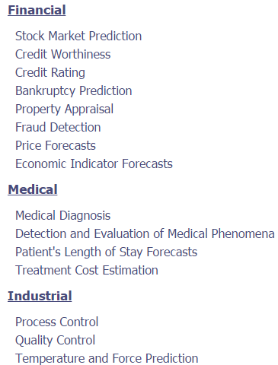
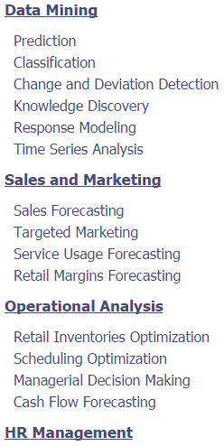
Application of Neural Networks
Notes:
-------------------
Neural Network: a system of programs and data structures that simulates the underlying functions of the biological brain. Neural networks are particularly adept at recognizing subtle, hidden, and newly emerging patterns within complex data, as well as interpreting incomplete inputs.
Examples :
-- The Bruce nuclear facility in Ontario, Canada: it has eight nuclear reactors, making it the largest facility in North America and the second largest in the world. The plant uses a neural network in its checkpoint X-ray screening system to detect weapons concealed in personal belongings. The system also identifies biologically dangerous liquids.
-- Research into diseases: like Alzheimer’s, Parkinson’s, and epilepsy. Researchers build robots with simulated rat brains that mimic the rats’ neural activity. The researchers then can study the brain’s function and its reaction to stimuli.
-- Investor Forecasting: forecasting the performance of stock index futures, currencies, natural gas, and oil stocks, T-bond futures, gold stocks, and other major investments.
-- Detecting Fraud in Banking Systems: fraud detection in credit card transactions and insurance claims, fight crime, and gauge customer satisfaction.

Slide 25
Application of Machine Learning Systems
Optical character recognition
Face recognition
Topic identification
Fraud detection
Customer segmentation
Notes:
Machine Learning Systems: artificial intelligence systems that learn from data. For instance, a machine learning system can be trained on e-mail messages to learn to distinguish between spam and non-spam messages.
Examples :
-- Optical character recognition: Printed, handwritten characters are recognized automatically based on previous examples.
-- Face recognition: Identify faces in images.
-- Topic identification: Categorize news articles as to whether they are about politics, sports, entertainment, and so on.
-- Fraud detection: Identify credit card transactions that may be fraudulent.
-- Customer segmentation: Identify which customers may respond positively to a particular promotion.

Slide 26
Approaches of Machine Learning (Wikipedia)
4.1Decision tree learning
4.2Association rule learning
4.3Artificial neural networks
4.4Deep Learning
4.5Inductive logic programming
4.6Support vector machines
4.7Clustering
4.8Bayesian networks
4.9Reinforcement learning
4.10Representation learning
4.11Similarity and metric learning
4.12Sparse dictionary learning
4.13Genetic algorithms
4.14Rule-based machine learning
4.15Learning Classifier Systems

Slide 27
PI5.4
Fuzzy Logic
Fuzzy Logic
Examples of Applied Fuzzy Logic
  Bank loan application approval
  Financial analysis
  Internet search engines
Well-known examples:
  Tokyo subway
  Your washer; rice cooker
Notes:
Fuzzy logic: is a branch of mathematics that deals with uncertainties by simulating the processes of human reasoning. A computer programmed to use fuzzy logic precisely defines subjective concepts that humans do not define precisely. For example, for the concept “income,” descriptive terms such as “high” and “moderate” are subjective and imprecise. Using fuzzy logic, however, a computer could define “high” incomes as those exceeding $200,000 per year, and “moderate” incomes as those ranging from $150,000 to $200,000 per year.
Examples:
-- Bank loan application approval
-- Financial analysis
-- Internet search engines (Google uses fuzzy logic to locate answers to your search terms, based on your perception of the topic as refl ected in how you phrase your query, which determines the relevance of the Web pages that Google delivers to you.

Slide 28
Fuzzy Logic Applications
Aerospace: Altitude control
Automotive: Automatic transmission; intelligent highway systems
Business: Decision support; personnel evaluation
Chemical Industry: Control of pH; drying; distillation processes
Defense: Underwater target recognition; hypervelocity interceptor
Electronics: washing machine timing, microwave ovens, vacuum cleaners
Marine: Autopilot for ships; optimal route selection
Medical: diagnostic support system; control of arterial pressure during anesthesia; radiology diagnoses

Slide 29
PI5.5
Genetic Algorithms
Three functional characteristics
  Selection, Crossover, & Mutation
Examples
  Boeing, design of aircraft parts
  Retailers, inventory management and display optimization
  Air Liquide, Operations optimization
Notes:
Genetic Algorithm: mimics the evolutionary “survival-of-the-fittest” process to generate increasingly better solutions to a problem. That is, a genetic algorithm is an optimizing method that finds the combination of inputs that produces the best outputs.
Genetic algorithms are best suited to decision-making environments in which thousands or millions of solutions are possible. Genetic algorithms can find and evaluate solutions intelligently, and they can process many more possibilities more thoroughly and quickly than a human can.
Three functional Characteristics of Genetic Algorithms:
Selection: (survival of the fittest) The key to selection is to give preference to better and better outcomes.
Crossover: Combining portions of good outcomes in the hope of creating an even better outcome.
Mutation: Randomly trying combinations and evaluating the success (or failure) of an outcome.
Examples of Applied Genetic Algorithms:
Boeing for Design: uses genetic algorithms to design aircraft parts such as the fan blades on its 777 jet.
Inventory Management by Retailers: Retailers such as Marks and Spencer, a British chain with 320 stores, use genetic algorithms to manage their inventories more effectively and to optimize their store displays.
Air Liquide to Optimize Operations: Air Liquide a producer of industrial gases, uses genetic algorithms to fi nd optimal production schedules and distribution points in its supply chain. Th e company, which has 40 plants and 8,000 client sites, must consider factors such as power prices and projections of customer demand, as well as the power costs and efficiency of each plant.

Slide 30
Genetic algorithm explained
Code the alternative solutions in the way of 0-1 strings
  A three-station production line
  Inspect - 1, no inspect – 0;
  100% inspect – 1, 50% inspect – 0; if no inspect - 0
  100011 =
Cross-over: to bring in possibility of change
  Bio science source:
Mutation: to bring in change through uncertainty/probability
  Bio science source:
Notes:
-------------------
Neural Network: a system of programs and data structures that simulates the underlying functions of the biological brain. Neural networks are particularly adept at recognizing subtle, hidden, and newly emerging patterns within complex data, as well as interpreting incomplete inputs.
Examples :
-- The Bruce nuclear facility in Ontario, Canada: it has eight nuclear reactors, making it the largest facility in North America and the second largest in the world. The plant uses a neural network in its checkpoint X-ray screening system to detect weapons concealed in personal belongings. The system also identifies biologically dangerous liquids.
-- Research into diseases: like Alzheimer’s, Parkinson’s, and epilepsy. Researchers build robots with simulated rat brains that mimic the rats’ neural activity. The researchers then can study the brain’s function and its reaction to stimuli.
-- Investor Forecasting: forecasting the performance of stock index futures, currencies, natural gas, and oil stocks, T-bond futures, gold stocks, and other major investments.
-- Detecting Fraud in Banking Systems: fraud detection in credit card transactions and insurance claims, fight crime, and gauge customer satisfaction.

Slide 31
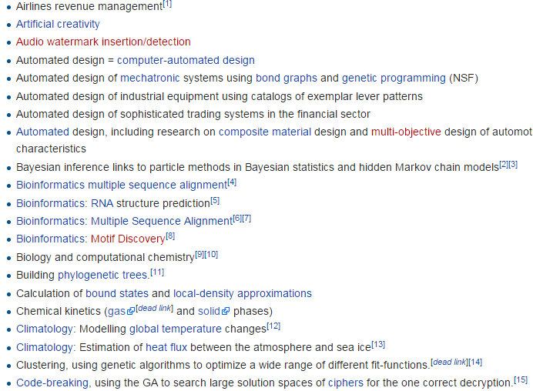
Genetic Algorithm Applications

Slide 32
PI5.6
Intelligent Agents
Information Agents
Monitoring and Surveillance Agents
User Agents
Do you remember our friend Princeline.com? What did they do to help me get my hotel room in Vegas?
Notes:
Information Agents: search for information and display it to users. The best known information agents are buyer agents. A buyer agent, also called a shopping bot, helps customers find the products and services they need on a Web site.
Monitoring and Surveillance Agents: Monitoring and surveillance agents, also called predictive agents, constantly observe and report on some item of interest.
User Agents: User agents, also called personal agents, take action on your behalf.

Slide 33
Application of Information Agents
Amazon.com
Google and Ask.com
Federal Electronic Research and Review Extraction Tool (FERRET)
Notes:
Information Agents: search for information and display it to users. The best known information agents are buyer agents. A buyer agent, also called a shopping bot, helps customers find the products and services they need on a Web site.
Application of Information Agents…
Amazon.com: information agents for Amazon.com display lists of books and other products that customers might like, based on past purchases.
Google and Ask.com: use information agents to find information, and not just when you request it. Google, for example, sends out Googlebots to surf all the Web sites in Google’s index. Th ese bots copy individual pages to Google’s repository, where Google’s soft ware indexes them. Th erefore, whenever you perform a Google search, the search engine builds a list of all the pages that have the keywords you specify, and it presents them to you in PageRank order. Google’s PageRank algorithm sorts Web pages based on the number of links on the Web that point to each page. Th at is, the more the Web links that point to a particular page, the higher that page will be on the list.
Federal Electronic Research and Review Extraction Tool (FERRET): was developed jointly by the Census Bureau and the Bureau of Labor Statistics. You can use FERRET to find information on employment, healthcare, education, race and ethnicity, health insurance, housing, income and poverty, aging, and marriage and the family.

Slide 34
Application of Monitoring and Surveillance Agents
Allstate Insurance, computer network management
Competitor pricing alerts
Stock market environment / rumor alerts
Best prices when shopping online
Notes:
Monitoring and Surveillance Agents: Monitoring and surveillance agents, also called predictive agents, constantly observe and report on some item of interest.
Application of Monitoring and Surveillance Agents…
Allstate, Computer Network Management: uses monitoring and surveillance agents to manage its large computer networks 24/7/365. Every five seconds, the agent measures 1,200 data points. It can predict a system crash 45 minutes before it happens. The agent also watches to detect electronic attacks early so that they can be prevented.
Competitor Pricing Alerts: Monitoring and surveillance agents can watch your competitors and notify you of price changes and special offers.
Stock Market Rumor Alert: Predictive agents can monitor Internet sites, discussion groups, and mailing lists for stock manipulations, insider trading, and rumors that might affect stock prices.
Online Shopping: These agents can search Web sites for updated information on topics of your choice, such as price changes on desired products (e.g., airline tickets).

Slide 35
Application of User Agent
Automated e-mail management
Automatic Online Form Completion
Notes:
User Agents: User agents, also called personal agents, take action on your behalf.
Application of User Agents…
Automated e-mail management: Check your e-mail, sort it according to your priority rules, and alert you when high-value e-mails appear in your in-box.
Automatic Online Form Completion: Automatically fill out forms on the Web for you. They will also store your information for future use.

