Slide 1
Emphases:
6-13; 15-27; 32
3
Fundamentals of Relational Database Operations

Slide 2
Query Languages
Entity–Relationship Modeling
Normalization and Joins - optional

Slide 3
Understand the process of querying a relational database.
Understand the process of entity–relationship modeling.
Understand the process of normalization and the process of joins.

Slide 4
PI3.1
Query Languages
Primary Key
Foreign Key
Structured Query Language (SQL)
Query By Example (QBE)
Notes:
Primary Key: A database field (or group of fields) that uniquely identifies each record so records can be retrieved, updated, and sorted.
Secondary Key: a field within a database table that has some identifying information, but typically does not uniquely identify the record.
Foreign Key: is a field (or group of fields) within a database table that matches the primary key data value of another table. A foreign key is used to establish a relationship and enforce a link between two tables.
Structured Query Language (SQL): allows people to perform complicated searches by using relatively simple statements or keywords. It is a universal, standard query language used to interact with a database.
Query-by-Example (QBE): In QBE, the user fills out a grid or template (also known as a form) to construct a sample or a description of the data desired. Users can construct a query quickly and easily by using drag-and-drop features in a DBMS such as Microsoft Access.

Slide 5
PI3.2
Entity-Relationship Modeling
Entity Relationship Modeling
Entity Relationship Diagram (ERD)
Business Rules
Data Dictionary
Relationships (Unary, Binary, Ternary)
Notes:
Entity Relationship Modeling: an iterative process used by database professionals to plan, design, and create databases using entity–relationship (ER) diagrams as blueprints.
Entity Relationship (ER) Diagram: graphical diagrams of entities, attributes, and relationships that describe the make up of a database similar to the blueprints for a building project.
Business Rules: precise descriptions of policies, procedures, or principles in any organization that stores and uses data to generate information. Business rules are derived from a description of an organization’s operations, and help to create and enforce business processes in that organization.
Data Dictionary: provides information on each attribute, such as its name, if it is a key, part of a key, or a non-key attribute, the type of data expected (alphanumeric, numeric, dates, etc.), and valid values. Data dictionaries can also provide information on why the attribute is needed in the database; which business functions, applications, forms, and reports use the attribute; and how oft en the attribute should be updated.
Relationships: illustrates an association between entities. The degree of a relationship indicates the number of entities associated with a relationship.
Unary Relationship: exists when an association is maintained within a single entity.
Binary Relationship: exists when two entities are associated.
Ternary Relationship: exists when three entities are associated.

Slide 6
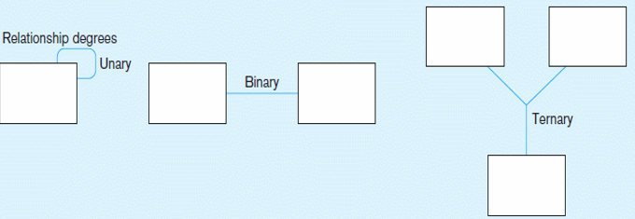
PI3.2
Entity-Relationship Modeling (Continued)
Connectivity: relationship classification
Binary
Ternary
Unary
Cardinality
Mandatory vs optional
One vs many
One-to-one, one-to-many, many-to-many
Attributes
Notes:
Connectivity: established by the business rules of a relationship and describes the relationship classification. Entity relationships may be classified as one-to-one, one-to-many, or many-to-many.
Cardinality: established by the business rules of a relationship, refers to the maximum number of times an instance of one entity can be associated with an instance in the related entity. Cardinality can be mandatory single, optional single, mandatory many, or optional many.
Attributes: Properties that describe the entities characteristics.

Slide 7
Cardinality
Cardinality
Mandatory vs optional (optional)
“Must” or “May”
One vs many
One-to-one: 1-1, or 1:1
One-to-many: 1-M, or 1:M
Many-to-many: M-N, or M:N
Notes:
Connectivity: established by the business rules of a relationship and describes the relationship classification. Entity relationships may be classified as one-to-one, one-to-many, or many-to-many.
Cardinality: established by the business rules of a relationship, refers to the maximum number of times an instance of one entity can be associated with an instance in the related entity. Cardinality can be mandatory single, optional single, mandatory many, or optional many.
Attributes: Properties that describe the entities characteristics.

Slide 8
Cardinality Symbols (Optional content)

Slide 9
One-to-One Relationship
A relationship must be examined from BOTH directions
EACH student may be assigned ONE parking permit;
EACH parking permit is assigned to ONE (and only one) student.

Slide 10
One-to-Many Relationship
A relationship must be examined from BOTH directions
M
1
Prof_ID
Relate two entities with foreign key

Slide 11
Stating 1-M relationship
EACH professor may teach many classes;
(Optional MANY)
Tech interpretation: EACH row in the PROFESSOR table can related to Many rows in the CLASS table
EACH class is (must be taught) by one professor
(Mandatory ONE)
Tech interpretation: EACH row in the CLASS table can related to ONLY ONE row in the PROFESSOR table
The above statements are called “business rules”
Business rules ALWAYS begin with “A/An” or “Each”
Each relationship is described by 2 biz rules
One from entity A to B, the other B to A

Slide 12
LOGICALLY RELATING TABLES
When a table contains a column that is the same as the primary key of another table, the column is called a foreign key
Foreign key - A primary key of one table that appears as an attribute in another file, and acts to provide a logical relationship between the two files {common column to join two tables}
Example: Prim. Key CUSTOMER(Customer Number, First Name, Last Name, Phone Number)
ORDER(Order Number, Customer Number, Order Date)
Refers to
For. key

Slide 13
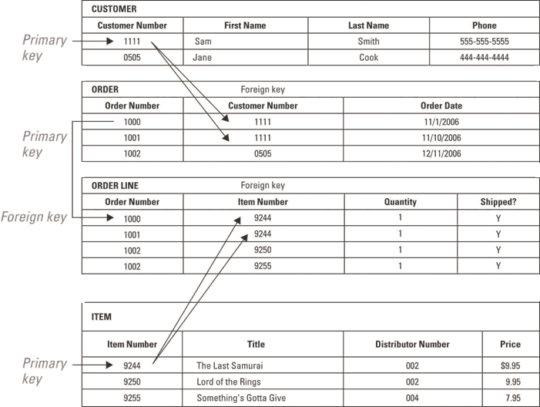
LOGICALLY RELATING TABLES
The use of iden-tifiers repres-ent relation-ships between entities

Slide 14
Many-to-Many Relationship
(Optional content)
Still follow this format:
Each STUDENT can have …;
Each CLASS can have …;
Refer to Slide #28

Slide 15
Type of ATTRIBUTES
There are several types of attributes including:
Simple versus composite
Single-valued versus multi-valued
Stored versus derived
Null-valued
Some attributes canNOT be null
Such as?
Sometimes Null value can be very useful

Slide 16
1. SIMPLE VERSUS COMPOSITE
Composite attributes can be divided into smaller subparts, which represent more basic attributes that have their own meanings
These subparts MUST be stored as respective attributes
Example: Address
Address can be broken down into a number of subparts, such as Street, City, State, Zip Code
Street may be further broken down by Number, Street Name, and Apartment/Unit Number
Attributes that are not divisible into subparts are called simple attributes

Slide 17
2. SINGLE-VALUED VERSUS MULTI-VALUED
Single-valued attribute means having only a single value of each attribute of an entity at any given time
Example:
A CUSTOMER entity allows only one Telephone Number for each CUSTOMER
If a CUSTOMER has more than one Phone Number…? ➔ ➔ ➔

Slide 18
SINGLE-VALUED VERSUS MULTI-VALUED
Multi-valued attribute means having the potential to contain more than one value for an attribute at any given time
Relational databases do not allow multi-valued attributes because they can cause problems:
Confuses the meaning of data in the database
Significantly slow down searching
Place unnecessary restrictions on the amount of data that can be stored
QnA: How to handle N phone numbers?

Slide 19
3. STORED VERSUS DERIVED
If an attribute can be calculated using the value of another attribute, it is called a derived attribute
The attribute that is used to derive the attribute is called a stored attribute
Derived attributes are not stored in the file, but can be derived when needed from the stored attributes
QnA: A person’s age – 【Is it a god idea to store persons’ age in DB?】
Remember this term for the Access component: “Calculated field query”

Slide 20
4. NULL-VALUED
Null-valued attribute – Assigned to an attribute when no other value applies or when a value is unknown
Example: A person who does not have a cell phone - Cell Phone Number value = ?
More practical use of null value:
Sold date of properties – what if null?
Transaction price of items being auctioned
Returned date of library books – what if null?

Slide 21
FROM ENTITIES TO TABLES
The proper notation to use when documenting the name of the table, the column name, and primary key:
CUSTOMER(Customer Number, First Name, Last Name, Phone Number)
Will follow this notation for DB project
Three qualities of all primary keys:
A primary key should contain some value that is highly unlikely to be null
A primary key should never change
Primary key for all rows have distinct values

Slide 22
LOGICALLY RELATING TABLES
The use of iden-tifiers repres-ent relation-ships between entities

Slide 23
Connection w Primary Key-Foreign Key
Slide #39
Primary key and foreign key connect tables
Relationship exists in 1-M
Primary key of the “1-side” must be in the “M-side” to be foreign key
(“Parent-Child”)
Ex: FACULTY : STUDENT = 1 : M
Primary key of FACULTY is FID
FID must be in STUDENT table to be foreign key

Slide 24
Connection w Primary Key-Foreign Key (cont)
Identify: Parent-Child; 1-M
FID | LName | Rank | Office
F11 | Stone | Professor | JH 3214
F20 | Yoon | Assoc Prof | JH 3204
F22 | Zhang | Professor | JH 3218
SID | Lname | FNmae | Major | FID
S031 | Chen | Ming | Accounting | F11
S054 | Miller | Scott | Info Sys | F22
S138 | Smith | John | Accounting | F20
S586 | Williams | Nancy | Accounting | F20

Slide 25
Three Basic Operations in a Relational Database
Project: Extracts subset of columns to create new tables (“views”)
EX: display only last name and GPA
Select: Extracts subset of rows that meet specific criteria
Numeric: salary<40000;
text: city=‘LA’;
date: DOB=#12/12/1972#
Criteria can be combined using AND, OR, etc
Join: Combines relational tables using foreign key when the data needed is not in one table
Next slide shows examples of the three operations → →
25

Slide 26
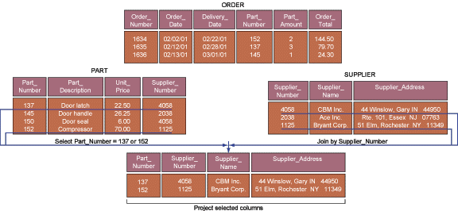
Three Basic Operations in a Relational Database (Laudon)
_{Project}
_{Select}
_{Join}

Slide 27
Creating Database Objects
Four objects: table, query, report, form
Report – a compilation of data from the database that is organized and produced in printed format
Present data in a prescribed format
So data must be obtained from ___?
Changing the report format … changing data?
Relationships between the four objects:
Forms
(Entry, update)
Reports
(Presentation)
Queries (Data Extraction)
Tables (Data storage)
{By Yue Zhang}

Slide 28
DEALING WITH MANY-TO-MANY RELATIONSHIPS
There are problems with many-to-many relationships
The relational data model cannot handle many-to-many relationships directly
It is limited to one-to-one and one-to-many relationships
Many-to-many relationships need to be replaced with a collection of one-to-many relationships
Relationships cannot have attributes
An entity must represent the relationship
➔ ➔ ➔ composite entities
Refer to Slide #14

Slide 29
M-M Relationship (Reproduced from S#14)
(Optional content)
Still follow this format:
Each STUDENT can have …;
Each CLASS can have …;
Refer to Slide #28

Slide 30
COMPOSITE ENTITIES (optional)
Composite entities - Entities that exist to represent the relationship between two other entities,
AKA Intersection entities, or Associative entities
Intersection entities: used in the resolution of a M-M relationship
Example: between an ITEM and an ORDER
An ORDER can contain many ITEM(s) and, over time, the same ITEM can appear on many ORDER(s)

Slide 31
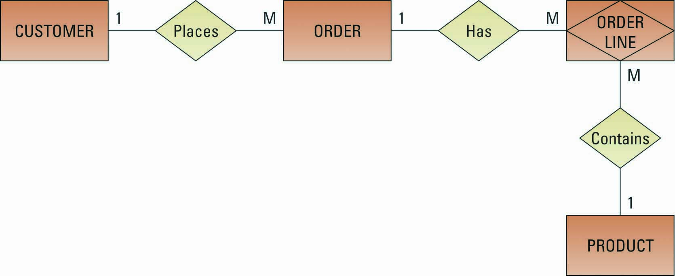
COMPOSITE ENTITIES / Intersection Entities (optional)
Notes:
A composite entity called a LINE ITEM (thinking of it as a line item on a packing slip) is created to represent the relationship between an ORDER and a PRODUCT.

Slide 32
Composite Key – Example (Zhang)
Situation: a customer buys certain products on a certain date
Can customer-ID uniquely identify an order line?
Can product-ID uniquely identify an order line?
Can date uniquely identify an order line?
(Answers: …)
Composite key: C-ID, P-ID, Date

Slide 33
PI3.3
Normalization and Joins (Optional)
Normalization
1st Normal Form
2nd Normal Form
3rd Normal Form
Functional Dependencies
√ Join Operation (Slide #39)
Notes:
Normalization: a method for analyzing and reducing a relational database to its most streamlined form to ensure minimum redundancy, maximum data integrity, and optimal processing performance. Data normalization is a methodology for organizing attributes into tables so that redundancy among the non-key attributes is eliminated.
Functional Dependencies: define associations among the attributes and are a means of expressing that the value of one particular attribute is associated with a specific single value of another attribute.
Join Operation: combines records from two or more tables in a database to obtain information that is located in different tables.

Slide 34
Raw Data Gathered from Pizza Shop Orders

Slide 35
Functional Dependency from Pizza Shop

Slide 36
1st Normal Form for Pizza Shop Database

Slide 37
2nd Normal Form for Pizza Shop Database

Slide 38
3rd Normal Form for Pizza Shop Database

Slide 39
Join Process with Tables of 3rd Normal Form for Pizza Orders

