Slide 1
2
Hardware and Software
(Focus on software, and binary system)
(For hardware, focus on those with )

Slide 2
Introduction to Hardware
Introduction to Software

Slide 3
Discuss strategic issues that link hardware design to business strategy.
Differentiate between the two major types of software.

Slide 4
PI2.1
Introduction to Hardware
Hardware
Strategic Hardware Issues
Computer Hierarchy
Input and Output Technologies
The Central Processing Unit (CPU)
Computer Memory

Slide 5
Hardware
Hardware Consists of:
  Central Processing Unit (CPU)
  Primary Storage
  Secondary Storage
  Input Technologies
  Output Technologies
  Communication Technologies
Notes:
Hardware: the physical equipment used for the input, processing, output, and storage activities of a computer system. Decisions about hardware focus on three interrelated factors: appropriateness for the task, speed, and cost.
Central Processing Unit (CPU): Manipulates the data and controls the tasks performed by the other components.
Primary Storage: Temporarily stores data and program instructions during processing.
Secondary Storage: Stores data and programs for future use.
Input Technologies: Accept data and instructions and convert them to a form that the computer can understand.
Output Technologies: Present data and information in a form people can understand.
Communication Technologies: Provide for the flow of data from external computer networks (e.g., the Internet and intranets) to the CPU, and from the CPU to computer networks.

Slide 6
Strategic Hardware Issues
How do organizations keep up with the rapid price reductions and performance advancements in hardware?
How often should an organization upgrade its computers and storage systems?
Will upgrades increase personal and organizational productivity?
How can you measure productivity increases?

Slide 7
Strategic Hardware Issues
Portable computers and advanced communications technologies have enabled employees to work from home or from anywhere.
Will these new work styles benefit employees and the organization?
How do organizations manage such new work styles?

Slide 8
Strategic Hardware Issues (continued)
How do organizations manage employees who use their own portable devices (e.g., tablets and smartphones) for both personal and work purposes?
That is, how do organizations handle the bring-your-own-device (BYOD) phenomenon?

Slide 9
Computer Hierarchy
Supercomputers
Mainframe Computers
Midrange Computers
Microcomputers
  Desktop PC
  Laptop and Notebook Computers
Thin-client systems
Categorization from:
Application scenario
Computing power (changing)
Price (changing)
Size (changing)
Notes:
Supercomputers: the fastest computers available at any given time. Due to the high cost they are generally used by large organizations to execute computationally demanding tasks involving very large datasets (military, scientific research, national weather service, etc.).
Mainframe Computers: computers at the high end of the performance and reliability scales. Today’s mainframes perform at teraflop (trillions of floating point operations per second) speeds and can handle millions of transactions per day.
Midrange Computers: (or minicomputers) are larger midrange computers that are relatively small, inexpensive, and compact computers that perform the same functions as mainframe computers, but to a more limited extent.
Microcomputers: also known as personal computers (or PCs) are the smallest and least expensive category of general-purpose computers.
Desktop PC: the familiar microcomputer system that has become a standard tool for business and the home. A desktop generally includes a central processing unit—which you will learn about later—and a separate but connected monitor and keyboard.
Thin-client systems: are desktop computer systems that do not offer the full functionality of a PC. Compared to PCs, or fat clients, thin clients are less complex, particularly because they do not have locally installed software. When thin clients need to run an application, they access it from a server over a network instead of from a local disk drive.
Laptop and Notebook Computers: small, easily transportable, lightweight microcomputers that fit comfortably into a briefcase.
Netbooks: a very small, lightweight, low-cost, energy-efficient, portable computer. Netbooks are generally optimized for Internet-based services such as Web browsing and e-mail.
Tablet Computers: a complete computer contained entirely in a flat touchscreen that users operate via a stylus, digital pen, or fingertip instead of a keyboard or mouse.
Wearable Computers: miniature computers that people wear under, with, or on top of their clothing.

Slide 10
Computer Hierarchy (continued)
Netbooks
Tablet Computers
Wearable Computers
Notes:
Supercomputers: the fastest computers available at any given time. Due to the high cost they are generally used by large organizations to execute computationally demanding tasks involving very large datasets (military, scientific research, national weather service, etc.).
Mainframe Computers: computers at the high end of the performance and reliability scales. Today’s mainframes perform at teraflop (trillions of floating point operations per second) speeds and can handle millions of transactions per day.
Midrange Computers: (or minicomputers) are larger midrange computers that are relatively small, inexpensive, and compact computers that perform the same functions as mainframe computers, but to a more limited extent.
Microcomputers: also known as personal computers (or PCs) are the smallest and least expensive category of general-purpose computers.
Desktop PC: the familiar microcomputer system that has become a standard tool for business and the home. A desktop generally includes a central processing unit—which you will learn about later—and a separate but connected monitor and keyboard.
Thin-client systems: are desktop computer systems that do not offer the full functionality of a PC. Compared to PCs, or fat clients, thin clients are less complex, particularly because they do not have locally installed software. When thin clients need to run an application, they access it from a server over a network instead of from a local disk drive.
Laptop and Notebook Computers: small, easily transportable, lightweight microcomputers that fit comfortably into a briefcase.
Netbooks: a very small, lightweight, low-cost, energy-efficient, portable computer. Netbooks are generally optimized for Internet-based services such as Web browsing and e-mail.
Tablet Computers: a complete computer contained entirely in a flat touchscreen that users operate via a stylus, digital pen, or fingertip instead of a keyboard or mouse.
Wearable Computers: miniature computers that people wear under, with, or on top of their clothing.

Slide 11
PURCHASING A COMPUTER

Slide 12
Input Technologies (453-455)
Graphics tablet
Joystick
Touchscreen
Stylus
Digital Pen
Web Camera (Webcam)
Voice Recognition
Gesture-based Input
Wii
Microsoft Connect
Leap Motion Controller
Automated Teller Machine (ATM)
Magnetic Strip Reader
Point-of-sale Terminals
Barcode scanners
Most common in business
POS

Slide 13
Input Technologies (continued)
Optical Mark Reader
Magnetic Ink Character Reader
Optical Character Reader
Sensors
Cameras
Radio-Frequency Identification (RFID)
Internet of
______

Slide 14
Output Technologies (455)
Monitors
Cathode Ray Tubes (CRT)
Liquid Crystal Displays (LCDs)
Flexible Displays
Organic Light-emitting Diodes (OLED)
Retinal Scanning Displays
Heads-up Displays
Printers (laser, Inkjet, Thermal)
Plotters
Voice Output
Electronic Book Reader
Pocket Projector

Slide 15
Central Processing Unit
How the CPU works
Central processing unit (CPU) - The actual hardware that interprets and executes the program (software) instructions and coordinates all the other hardware devices
  Arithmetic-logic unit (ALU) - Performs all arithmetic operations (ex: + and -) and all logic operations (ex: sorting and comparing numbers)
  Control unit - Interprets software instructions and tells the other hardware devices what to do, based on the software instructions
Advances in Microprocessor Design
  Moore’s Law
Mega Hertz (MHz); Giga Hertz (GHz)
Notes:
Central Processing Unit: performs the actual computation or “number crunching” inside any computer. It is a microprocessor (e.g., Intel’s Core i3, i5, and i7 chips with more to come) made up of millions of microscopic transistors embedded in a circuit on a silicon wafer or chip.
-----------------------
How the CPU Works:
-- Inputs from software consisting of data and brief instructions about what to do with the data come into the CPU from random access memory (RAM).
-- Inputs are stored in registers until they are sent to the next step in the processing.
-- The Control Unit directs the flow of data and instructions within the chip.
-- The Arithmetic Processing Unit (ALU) receives the data and instructions from the registers and makes the desired computation.
-- The data in their original form and the instructions are sent to storage registers and then are sent back to a storage place outside the chip, such as the computer’s hard drive. Meanwhile, the transformed data go to another register and then on to other parts of the computer (e.g., to the monitor for display or to storage).
-----------------------
Moore’s Law:
In 1965, Gordon Moore, a cofounder of Intel Corporation, predicted that microprocessor complexity would double approximately every 18 months. The advances predicted from Moore’s law arise mainly from the following changes:
• Producing increasingly miniaturized transistors.
• Placing multiple processors on a single chip. Chips with more than one processor are called multicore chips.
• Intel’s three-dimensional (3D) chips require less power than Intel’s current chips while improving performance.

Slide 16
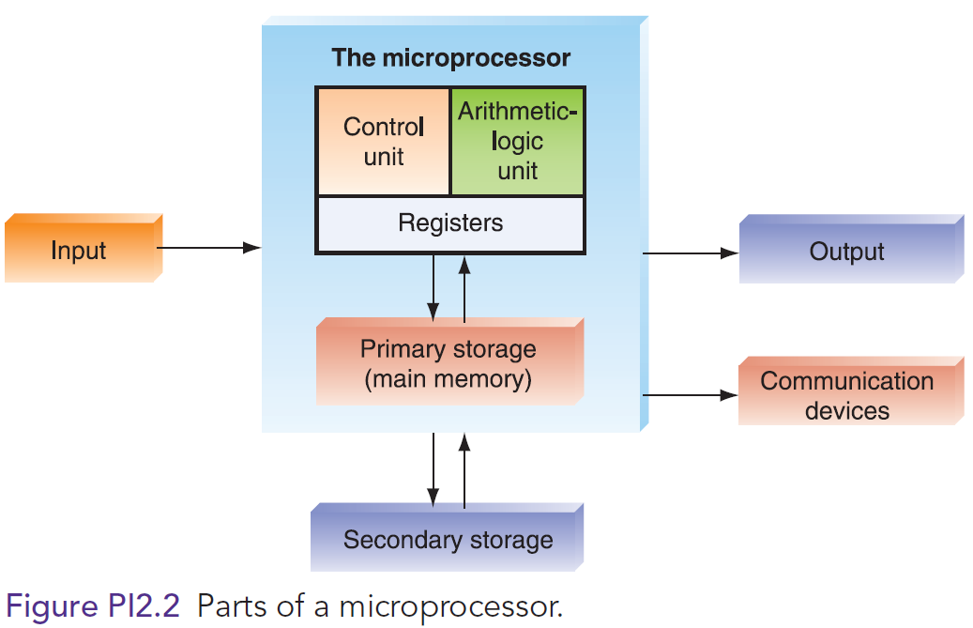
Central Processing Unit

Slide 17
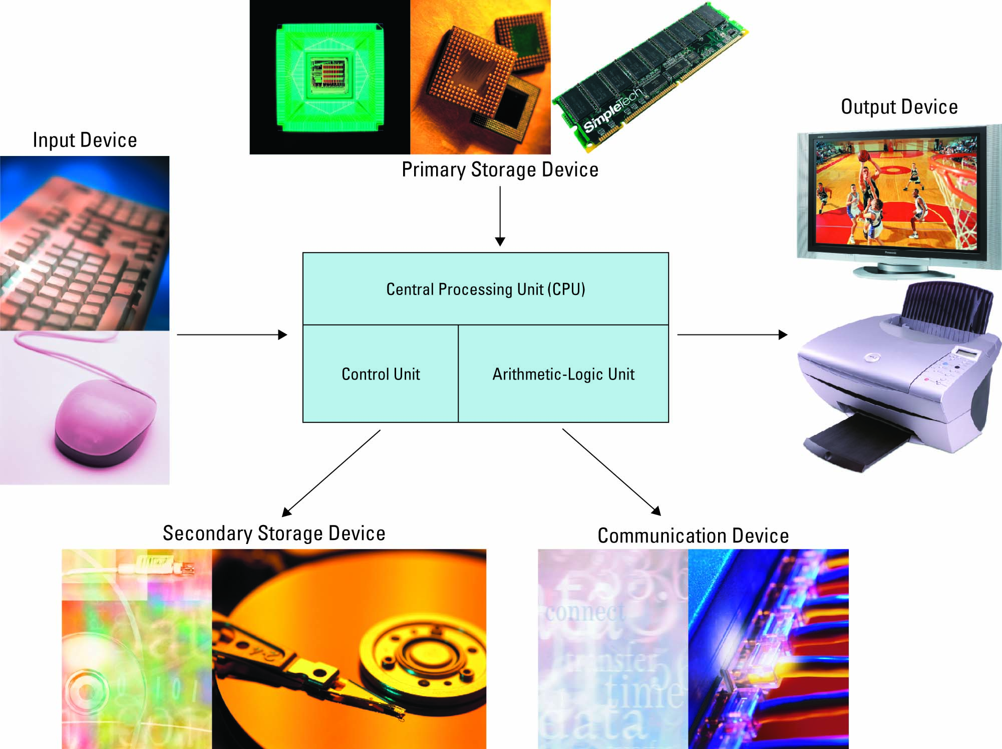
HARDWARE BASICS
Notes:
Apple’s 1984 video (and others) Makes for an excellent discussion on how far we have come with hardware and software
http://www.esm.psu.edu/Faculty/Gray/movies.html

Slide 18
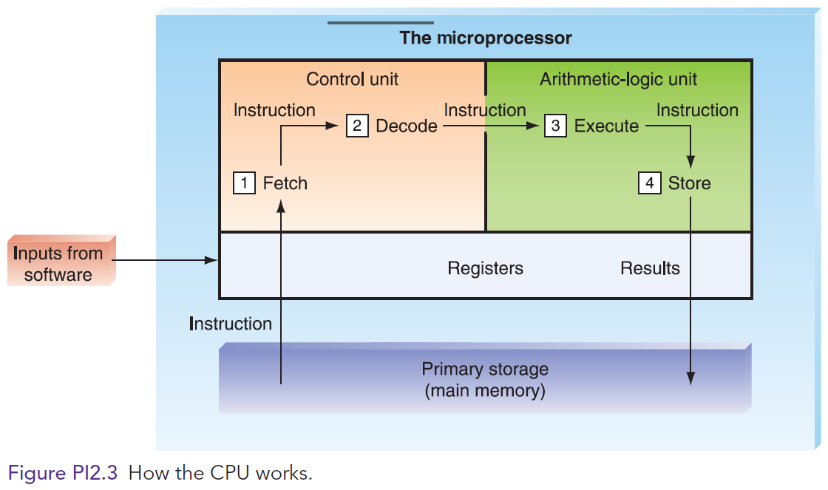
Central Processing Unit

Slide 19
Computer Memory
Memory Capacity
  Byte, KB, MB, GB, TB, PB
  Binary system: two digits – 0, 1
Primary Storage (or Main Memory)
Secondary Storage
Need to be able to understand a binary number: next three slides
Plus: Dr. Zhang’s handout “Information Technology Handout 1: Binary Number System”, posted on class web
Notes:
------------------------------
Memory Capacity
Hierarchy of terms used to describe computer memory capacity:
Bit: A binary unit. A "1" or "0".
Byte: a serious of eight bits representing an alphanumeric character.
Kilobyte: a kilobyte (KB) is approximately 1,000 bytes (1,024 bytes).
Megabyte: a megabyte (MB) is approximately 1 million bytes.
Gigabyte: a gigabyte (GB) is approximately 1 billion bytes.
Terabyte: A terabyte is approximately 1 trillion bytes.
Petabyte: A petabyte is approximately 1,000 terabytes.
Exabyte: An exabyte is approximately 1,000 petabytes.
Zettabyte: A zettabyte is approximately 1,000 exabytes.
------------------------------
Primary Storage (Main Memory): Primary storage takes place in chips mounted on the computer’s main circuit board, called the motherboard. These chips are located as close as physically possible to the CPU chip.
Primary storage stores three types of information for very brief periods of time:
data to be processed by the CPU
instructions for the CPU as to how to process the data
operating system programs that manage various aspects of the computer’s operation
Four main types of primary storage:
Registers: part of the CPU. They have the least capacity, storing extremely limited amounts of instructions and data only immediately before and aft er processing.
Cache memory: is a type of high-speed memory that enables the computer to temporarily store blocks of data that are used more often and that a processor can access more rapidly than main memory (RAM). Cache memory is physically located closer to the CPU than RAM.
Random Access Memory (RAM): is the part of primary storage that holds a software program and small amounts of data for processing.
Read-Only Memory (ROM): is the place—actually, a type of chip—where certain critical instructions are safeguarded. ROM is nonvolatile, so it retains these instructions when the power to the computer is turned off.
------------------------------
Secondary Storage: Stores very large amounts of data for extended periods.
Secondary Storage Characteristics:
It is nonvolatile.
It takes more time to retrieve data from it than from RAM.
It is cheaper than primary storage
It can utilize a variety of media
Types of Secondary Storage:
Magnetic Tape: is kept on a large open reel or in a smaller cartridge or cassette. It is the cheapest storage medium, and it can handle enormous amounts of data. It is also the slowest method for retrieving data because all the data are placed on the tape sequentially.
Solid-State Drives (SSDs): are data storage devices that serve the same purpose as a hard drive and store data in memory chips. Whereas hard drives have moving parts, SSDs do not.
Optical Disks: can store a great deal of information, both on a routine basis and when combined into storage systems. Types of optical disks include compact disk (CD) read-only memory, digital video disk (DVD)(17GB), and dual-layer Blu-ray disks (50 GB).
Flash Memory Devices (or memory cards): nonvolatile electronic storage devices that contain no moving parts and use 30 times less battery power than hard drives. Flash devices are also smaller and more durable than hard drives. One popular flash memory device is the thumb drive (also called memory stick, jump drive, or flash drive).
------------------------------

Slide 20
Bits and Bytes (Zhang)
1 bit has only 2 states, that can be used to represent 0 and 1
2 bits have 2² = 4 states: 00, 01, 10, 11, that can be used to represent 0, 1, 2, 3
Binary System |  |  |  |  | Decimal System
Place value | 2² | 2¹ | 2⁰ |  | 4 | 2 | 1 | Decimal value
One bit |  |  | 0 |  | 1 bit |  | 0 | 0
 |  |  | 1 |  |  |  | 1 | 1
Two bits |  | 0 | 0 |  | 2 bits | 0 | 0 | 0
 |  | 0 | 1 |  |  | 0 | 1 | 1
 |  | 1 | 0 |  |  | 1 | 0 | 2
 |  | 1 | 1 |  |  | 1 | 1 | 3
Notes:
CPU Speed Factors
Clock speed—the speed of the internal clock of a CPU that sets the pace at which operations proceed within the computer’s internal processing circuitry. Clock speed is measured in megahertz (MHz) and gigahertz (GHz). Faster clock speeds bring noticeable gains in microprocessor-intensive tasks, such as recalculating a spreadsheet.
Word length—number of bits (0s and 1s) that can be processed by the CPU at any one time. Computers work in terms of bits and bytes using electrical pulses that have two states: on and off. A binary digit (bit) is the smallest unit of information that a computer can process. A bit can be either a 1 (on) or a 0 (off). A group of eight bits represents one natural language character and is called a byte.
Bus width—the size of the internal electrical pathway along which signals are sent from one part of the computer to another. A wider bus can move more data, hence faster processing.
Chip line width—the distance between transistors on a chip. The shorter the chip line width the faster the chip since more transistors can be placed on a chip and the data and instructions travel short distances during processing.

Slide 21
Bits and Bytes (Zhang)
3 bits have 2³ =__ states: __________, that can be used to represent __________
Place value | 2² | 2¹ | 2⁰ |  | 4 | 2 | 1 | Decimal value
 | 0 | 0 | 0 |  | 0 | 0 | 0 | 0
 | 0 | 0 | 1 |  | 0 | 0 | 1 | 1
 | 0 | 1 | 0 |  | 0 | 1 | 0 | 2
 | 0 | 1 | 1 |  | 0 | 1 | 1 | 3
 | 1 | 0 | 0 |  | 1 | 0 | 0 | 4
 | 1 | 0 | 1 |  | 1 | 0 | 1 | 5
 | 1 | 1 | 0 |  | 1 | 1 | 0 | 6
 | 1 | 1 | 1 |  | 1 | 1 | 1 | 7
Notes:
CPU Speed Factors
Clock speed—the speed of the internal clock of a CPU that sets the pace at which operations proceed within the computer’s internal processing circuitry. Clock speed is measured in megahertz (MHz) and gigahertz (GHz). Faster clock speeds bring noticeable gains in microprocessor-intensive tasks, such as recalculating a spreadsheet.
Word length—number of bits (0s and 1s) that can be processed by the CPU at any one time. Computers work in terms of bits and bytes using electrical pulses that have two states: on and off. A binary digit (bit) is the smallest unit of information that a computer can process. A bit can be either a 1 (on) or a 0 (off). A group of eight bits represents one natural language character and is called a byte.
Bus width—the size of the internal electrical pathway along which signals are sent from one part of the computer to another. A wider bus can move more data, hence faster processing.
Chip line width—the distance between transistors on a chip. The shorter the chip line width the faster the chip since more transistors can be placed on a chip and the data and instructions travel short distances during processing.

Slide 22
Bits and Bytes (cont)
Converting binary to decimal:
Binary 1 0 1 1 =
    1x2³ + 0x2² + 1x2¹ + 1x2⁰ =
Converting decimal to binary:
  Decimal 23 = 1x16 + 0x8 + 1x4 + 1x2 + 1x1 = Binary ________________
Binary numbers in use: numeric web address - IP
Watch colors
See IT Handout 1 for details
Notes:
CPU Speed Factors
Clock speed—the speed of the internal clock of a CPU that sets the pace at which operations proceed within the computer’s internal processing circuitry. Clock speed is measured in megahertz (MHz) and gigahertz (GHz). Faster clock speeds bring noticeable gains in microprocessor-intensive tasks, such as recalculating a spreadsheet.
Word length—number of bits (0s and 1s) that can be processed by the CPU at any one time. Computers work in terms of bits and bytes using electrical pulses that have two states: on and off. A binary digit (bit) is the smallest unit of information that a computer can process. A bit can be either a 1 (on) or a 0 (off). A group of eight bits represents one natural language character and is called a byte.
Bus width—the size of the internal electrical pathway along which signals are sent from one part of the computer to another. A wider bus can move more data, hence faster processing.
Chip line width—the distance between transistors on a chip. The shorter the chip line width the faster the chip since more transistors can be placed on a chip and the data and instructions travel short distances during processing.

Slide 23
Computer Memory
Primary Storage (or Main Memory)
  (Next slide)
Secondary Storage
  (next two slides)
  Solid-state drives (SSD) (P. 459)
Notes:
------------------------------
Memory Capacity
Hierarchy of terms used to describe computer memory capacity:
Bit: A binary unit. A "1" or "0".
Byte: a serious of eight bits representing an alphanumeric character.
Kilobyte: a kilobyte (KB) is approximately 1,000 bytes (1,024 bytes).
Megabyte: a megabyte (MB) is approximately 1 million bytes.
Gigabyte: a gigabyte (GB) is approximately 1 billion bytes.
Terabyte: A terabyte is approximately 1 trillion bytes.
Petabyte: A petabyte is approximately 1,000 terabytes.
Exabyte: An exabyte is approximately 1,000 petabytes.
Zettabyte: A zettabyte is approximately 1,000 exabytes.
------------------------------
Primary Storage (Main Memory): Primary storage takes place in chips mounted on the computer’s main circuit board, called the motherboard. These chips are located as close as physically possible to the CPU chip.
Primary storage stores three types of information for very brief periods of time:
data to be processed by the CPU
instructions for the CPU as to how to process the data
operating system programs that manage various aspects of the computer’s operation
Four main types of primary storage:
Registers: part of the CPU. They have the least capacity, storing extremely limited amounts of instructions and data only immediately before and aft er processing.
Cache memory: is a type of high-speed memory that enables the computer to temporarily store blocks of data that are used more often and that a processor can access more rapidly than main memory (RAM). Cache memory is physically located closer to the CPU than RAM.
Random Access Memory (RAM): is the part of primary storage that holds a software program and small amounts of data for processing.
Read-Only Memory (ROM): is the place—actually, a type of chip—where certain critical instructions are safeguarded. ROM is nonvolatile, so it retains these instructions when the power to the computer is turned off.
------------------------------
Secondary Storage: Stores very large amounts of data for extended periods.
Secondary Storage Characteristics:
It is nonvolatile.
It takes more time to retrieve data from it than from RAM.
It is cheaper than primary storage
It can utilize a variety of media
Types of Secondary Storage:
Magnetic Tape: is kept on a large open reel or in a smaller cartridge or cassette. It is the cheapest storage medium, and it can handle enormous amounts of data. It is also the slowest method for retrieving data because all the data are placed on the tape sequentially.
Solid-State Drives (SSDs): are data storage devices that serve the same purpose as a hard drive and store data in memory chips. Whereas hard drives have moving parts, SSDs do not.
Optical Disks: can store a great deal of information, both on a routine basis and when combined into storage systems. Types of optical disks include compact disk (CD) read-only memory, digital video disk (DVD)(17GB), and dual-layer Blu-ray disks (50 GB).
Flash Memory Devices (or memory cards): nonvolatile electronic storage devices that contain no moving parts and use 30 times less battery power than hard drives. Flash devices are also smaller and more durable than hard drives. One popular flash memory device is the thumb drive (also called memory stick, jump drive, or flash drive).
------------------------------

Slide 24
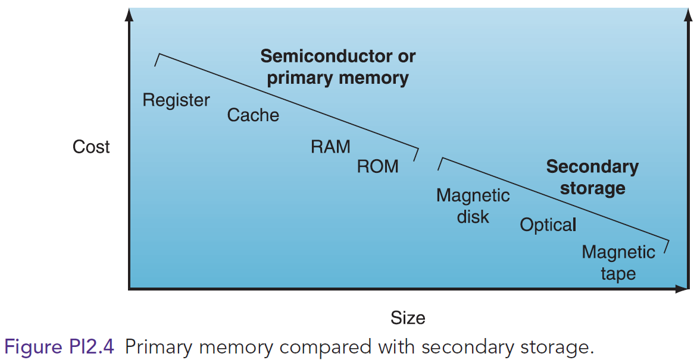
Computer Memory
– cost, speed, capacity
/ Speed
Notes:
------------------------------
Memory Capacity
Hierarchy of terms used to describe computer memory capacity:
Bit: A binary unit. A "1" or "0".
Byte: a serious of eight bits representing an alphanumeric character.
Kilobyte: a kilobyte (KB) is approximately 1,000 bytes (1,024 bytes).
Megabyte: a megabyte (MB) is approximately 1 million bytes.
Gigabyte: a gigabyte (GB) is approximately 1 billion bytes.
Terabyte: A terabyte is approximately 1 trillion bytes.
Petabyte: A petabyte is approximately 1,000 terabytes.
Exabyte: An exabyte is approximately 1,000 petabytes.
Zettabyte: A zettabyte is approximately 1,000 exabytes.
------------------------------
Primary Storage (Main Memory): Primary storage takes place in chips mounted on the computer’s main circuit board, called the motherboard. These chips are located as close as physically possible to the CPU chip.
Primary storage stores three types of information for very brief periods of time:
data to be processed by the CPU
instructions for the CPU as to how to process the data
operating system programs that manage various aspects of the computer’s operation
Four main types of primary storage:
Registers: part of the CPU. They have the least capacity, storing extremely limited amounts of instructions and data only immediately before and aft er processing.
Cache memory: is a type of high-speed memory that enables the computer to temporarily store blocks of data that are used more often and that a processor can access more rapidly than main memory (RAM). Cache memory is physically located closer to the CPU than RAM.
Random Access Memory (RAM): is the part of primary storage that holds a software program and small amounts of data for processing.
Read-Only Memory (ROM): is the place—actually, a type of chip—where certain critical instructions are safeguarded. ROM is nonvolatile, so it retains these instructions when the power to the computer is turned off.
------------------------------
Secondary Storage: Stores very large amounts of data for extended periods.
Secondary Storage Characteristics:
It is nonvolatile.
It takes more time to retrieve data from it than from RAM.
It is cheaper than primary storage
It can utilize a variety of media
Types of Secondary Storage:
Magnetic Tape: is kept on a large open reel or in a smaller cartridge or cassette. It is the cheapest storage medium, and it can handle enormous amounts of data. It is also the slowest method for retrieving data because all the data are placed on the tape sequentially.
Solid-State Drives (SSDs): are data storage devices that serve the same purpose as a hard drive and store data in memory chips. Whereas hard drives have moving parts, SSDs do not.
Optical Disks: can store a great deal of information, both on a routine basis and when combined into storage systems. Types of optical disks include compact disk (CD) read-only memory, digital video disk (DVD)(17GB), and dual-layer Blu-ray disks (50 GB).
Flash Memory Devices (or memory cards): nonvolatile electronic storage devices that contain no moving parts and use 30 times less battery power than hard drives. Flash devices are also smaller and more durable than hard drives. One popular flash memory device is the thumb drive (also called memory stick, jump drive, or flash drive).
------------------------------

Slide 25
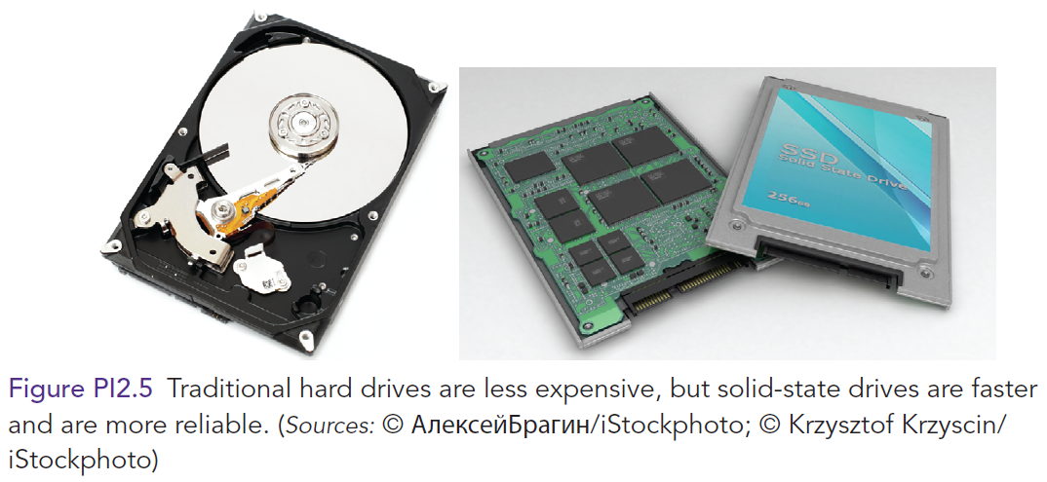
Computer Memory
Notes:
------------------------------
Memory Capacity
Hierarchy of terms used to describe computer memory capacity:
Bit: A binary unit. A "1" or "0".
Byte: a serious of eight bits representing an alphanumeric character.
Kilobyte: a kilobyte (KB) is approximately 1,000 bytes (1,024 bytes).
Megabyte: a megabyte (MB) is approximately 1 million bytes.
Gigabyte: a gigabyte (GB) is approximately 1 billion bytes.
Terabyte: A terabyte is approximately 1 trillion bytes.
Petabyte: A petabyte is approximately 1,000 terabytes.
Exabyte: An exabyte is approximately 1,000 petabytes.
Zettabyte: A zettabyte is approximately 1,000 exabytes.
------------------------------
Primary Storage (Main Memory): Primary storage takes place in chips mounted on the computer’s main circuit board, called the motherboard. These chips are located as close as physically possible to the CPU chip.
Primary storage stores three types of information for very brief periods of time:
data to be processed by the CPU
instructions for the CPU as to how to process the data
operating system programs that manage various aspects of the computer’s operation
Four main types of primary storage:
Registers: part of the CPU. They have the least capacity, storing extremely limited amounts of instructions and data only immediately before and aft er processing.
Cache memory: is a type of high-speed memory that enables the computer to temporarily store blocks of data that are used more often and that a processor can access more rapidly than main memory (RAM). Cache memory is physically located closer to the CPU than RAM.
Random Access Memory (RAM): is the part of primary storage that holds a software program and small amounts of data for processing.
Read-Only Memory (ROM): is the place—actually, a type of chip—where certain critical instructions are safeguarded. ROM is nonvolatile, so it retains these instructions when the power to the computer is turned off.
------------------------------
Secondary Storage: Stores very large amounts of data for extended periods.
Secondary Storage Characteristics:
It is nonvolatile.
It takes more time to retrieve data from it than from RAM.
It is cheaper than primary storage
It can utilize a variety of media
Types of Secondary Storage:
Magnetic Tape: is kept on a large open reel or in a smaller cartridge or cassette. It is the cheapest storage medium, and it can handle enormous amounts of data. It is also the slowest method for retrieving data because all the data are placed on the tape sequentially.
Solid-State Drives (SSDs): are data storage devices that serve the same purpose as a hard drive and store data in memory chips. Whereas hard drives have moving parts, SSDs do not.
Optical Disks: can store a great deal of information, both on a routine basis and when combined into storage systems. Types of optical disks include compact disk (CD) read-only memory, digital video disk (DVD)(17GB), and dual-layer Blu-ray disks (50 GB).
Flash Memory Devices (or memory cards): nonvolatile electronic storage devices that contain no moving parts and use 30 times less battery power than hard drives. Flash devices are also smaller and more durable than hard drives. One popular flash memory device is the thumb drive (also called memory stick, jump drive, or flash drive).
------------------------------

Slide 26
PI2.2
Introduction to Software
Software
Software Issues
System Software
Application Software
Notes:
Software: computer programs or the instructions given to hardware.

Slide 27
Software
Programming
Programmers
Two Types of Software:
  Systems Software
  Application Software
Notes:
Software: computer programs or the instructions given to hardware.
Programming: The process of writing or coding programs.
Programmers: individuals who program.
Systems Software: is a set of instructions that serves primarily as an intermediary between computer hardware and application programs.
Application Software: is a set of computer instructions that provides more specifi c functionality to a user.

Slide 28
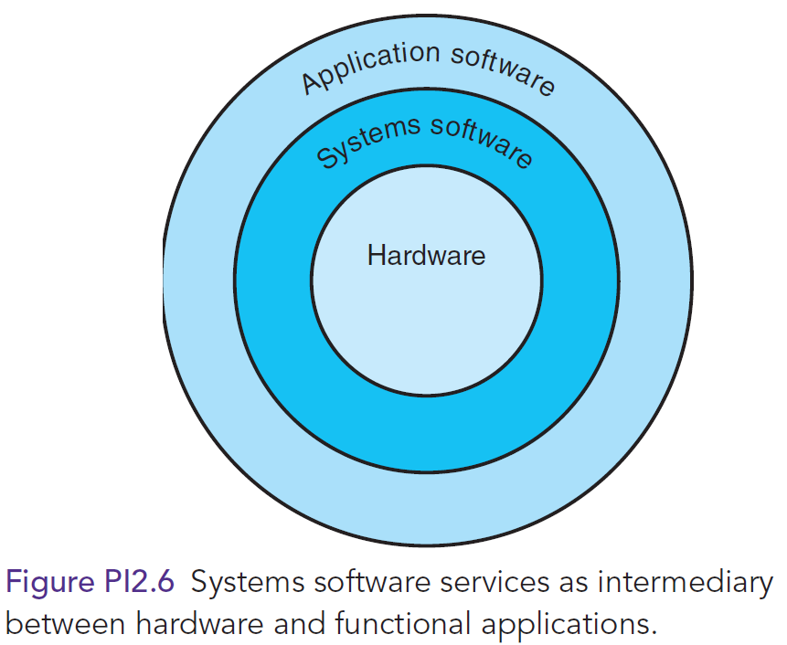
Software
Notes:
Software: computer programs or the instructions given to hardware.
Programming: The process of writing or coding programs.
Programmers: individuals who program.
Systems Software: is a set of instructions that serves primarily as an intermediary between computer hardware and application programs.
Application Software: is a set of computer instructions that provides more specifi c functionality to a user.

Slide 29
Systems Software
Systems Software
Operating System
    Windows, MacOS
    Android, iOS
OS functions: “SAM, com”
Human-Computer Interface
  Graphical User Interface (GUI)
  Social Interface
  Motion Control Gaming Consoles
Notes:
Systems Software: programs contained in systems software control and support the computer system and its information-processing activities.
Operating System (OS): the “director” of your computer system’s operations. It supervises the overall operation of the computer by monitoring the computer’s status, scheduling operations, and managing input and output processes. It also provides an interface between the user and the hardware.
Graphical User Interface (GUI): allows users to directly control the hardware by manipulating visible objects (such as icons) and actions that replace complex commands.
Social Interface: guides the user through computer applications by using cartoon-like characters, graphics, animation, and voice commands.
Motion Control Gaming Consoles: another type of human-computer interface (Example: the Xbox 360 Kinect, the PS3 PlayStation Move, and the Nintendo Wii).

Slide 30
Application Software
Personal Application Software
    Office, email, browser
Enterprise Application Software
    ORACLE, SAP
    Workflow software http://www.capterra.com/workflow-management-software/
In-between:
    FreshBooks, Sage, QuickBooks
    TurboCAD, DesignCAD
    SAS, SPSS
https://en.wikipedia.org/wiki/Application_software#Classification
Notes:
Application Software: consists of instructions that direct a computer system to perform specific information-processing activities and also to provide functionality for users.
Personal Application Software: general-purpose, off -the-shelf application programs designed to help individual users increase their productivity.
Examples of Personal Application Software:
Spreadsheets
Word processing
Desktop publishing
Data management
Presentation
Graphics
Personal information management
Personal finance
Web authoring
Communications

Slide 31
Software Issues
Software Defects
  SEI’s definition of good software (P. 461)
  Ultra-Large Scale Systems (ULS Systems)
Software Licensing
Open Systems
  Interoperability; portability
Proprietary Software, vs
Open-Source Software
Notes:
Software Defects: All too often, computer program code is inefficient, poorly designed, and riddled with errors. The Software Engineering Institute (SEI) at Carnegie Mellon University in Pittsburgh defines good software as usable, reliable, defect free, cost effective, and maintainable.
Software Licensing: Many people routinely copy proprietary soft ware. However, making copies without the manufacturer’s explicit permission—a practice known as piracy—is illegal.
Open Systems: a concept referring to a group of computing products that work together. In an open system, the same operating system with compatible soft ware is installed on all computers that interact within an organization.
Proprietary Software: is purchased soft ware that has restrictions on its use, copying, and modification. The company that develops proprietary software keeps the source code private.
Open-Source Software: the source code for open-source software is available at no cost to both developers and users, and is distributed with license terms that ensure that its source code will always be available.

Slide 32
Trends in Software – not in the book but should know a bit
SaaS: Software as a service
PaaS: Platform as a service
IaaS: Infrastructure as a service
https://apprenda.com/library/paas/iaas-paas-saas-explained-compared/
https://support.rackspace.com/white-paper/understanding-the-cloud-computing-stack-saas-paas-iaas/
https://www.computenext.com/blog/when-to-use-saas-paas-and-iaas/
Notes:
Application Software: consists of instructions that direct a computer system to perform specific information-processing activities and also to provide functionality for users.
Personal Application Software: general-purpose, off -the-shelf application programs designed to help individual users increase their productivity.
Examples of Personal Application Software:
Spreadsheets
Word processing
Desktop publishing
Data management
Presentation
Graphics
Personal information management
Personal finance
Web authoring
Communications

