Slide 1
Principles of Information Systems, Thirteenth Edition
Chapter 1
An Introduction to
Information Systems
Edited by Dr. Yüe “Jeff” Zhang
Lightly covered: Slide #s 40-59
(except 43-45)
Notes:
Principles of Information Systems, Thirteenth Edition
Chapter 1
An Introduction to Information Systems

Slide 2
Objectives
After completing this chapter, you will be able to:
Distinguish data from information and knowledge, and describe the characteristics of quality data
Identify the fundamental components of an information system and describe their function
Identify the three fundamental information system types and explain what organizational complements must be in place to ensure successful implementation and use of the system
Notes:
Objectives
After completing this chapter, you will be able to:
Distinguish data from information and knowledge, and describe the characteristics of quality data
Identify the fundamental components of an information system and describe their function
Identify the three fundamental information system types and explain what organizational complements must be in place to ensure successful implementation and use of the system

Slide 3
Objectives (cont’d):
Identify and briefly describe the role of each component of an organization’s technology infrastructure
Identify the basic types of business information systems, including who uses them, how they are used, and what kinds of benefits they deliver
Describe how organizations are using business intelligence and business analytics to capitalize on the vast amount of data becoming available
Notes:
Objectives
After completing this chapter, you will be able to (cont’d):
Identify and briefly describe the role of each component of an organization’s technology infrastructure
Identify the basic types of business information systems, including who uses them, how they are used, and what kinds of benefits they deliver
Describe how organizations are using business intelligence and business analytics to capitalize on the vast amount of data becoming available

Slide 4
Objectives
Discuss why it is critical for business objectives and IS activities to be well aligned through system planning, development, and acquisition
Identify several major IT security threats as well as some of the legal, social, and ethical issues associated with information systems
Notes:
Objectives
After completing this chapter, you will be able to (cont’d):
Discuss why it is critical for business objectives and IS activities to be well aligned through system planning, development, and acquisition
Identify several major IT security threats as well as some of the legal, social, and ethical issues associated with information systems

Slide 5
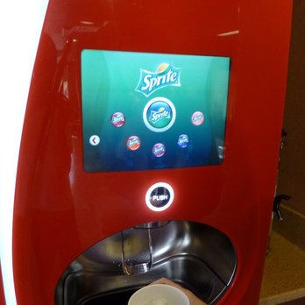
Ordering drinks at Jack in the Box
Operation
(running business; conducting transaction)

Slide 6
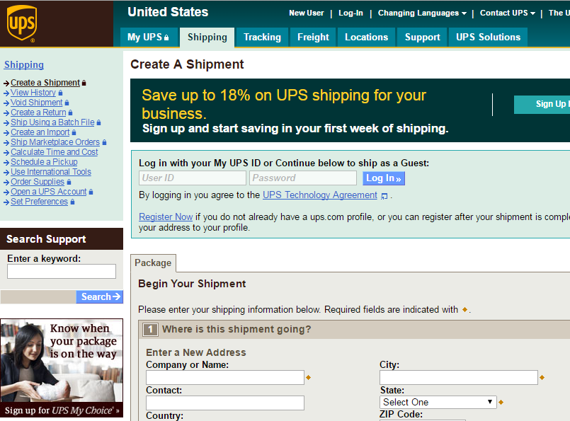
Create a shipment with UPS
Operation
(running business; conducting transaction)

Slide 7
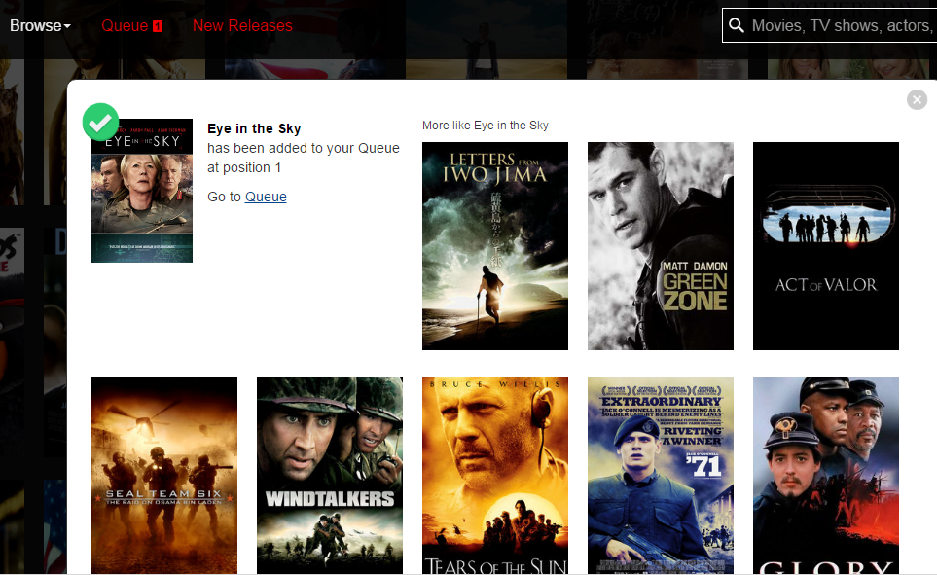
Choosing videos on Netflix
Operation
(running business; conducting transaction)
Make recommendations based on big data

Slide 8
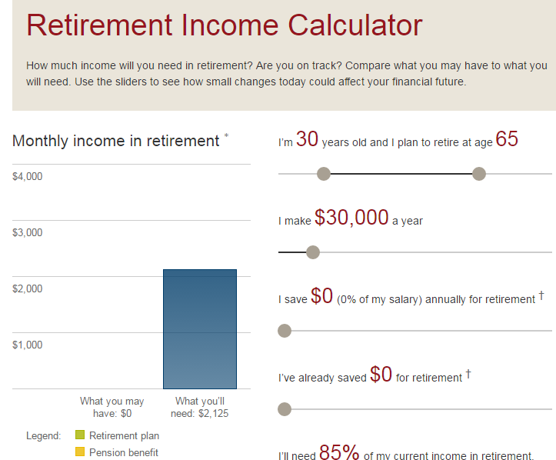
Figuring out savings for retirement
Decision analysis/ Decision support

Slide 9
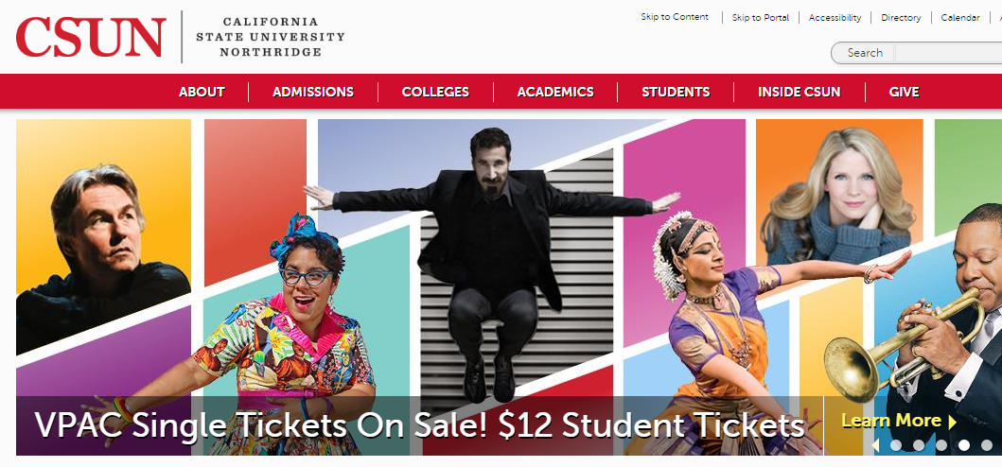
CSUN Homepage
Establish/project the image/culture of the org

Slide 10
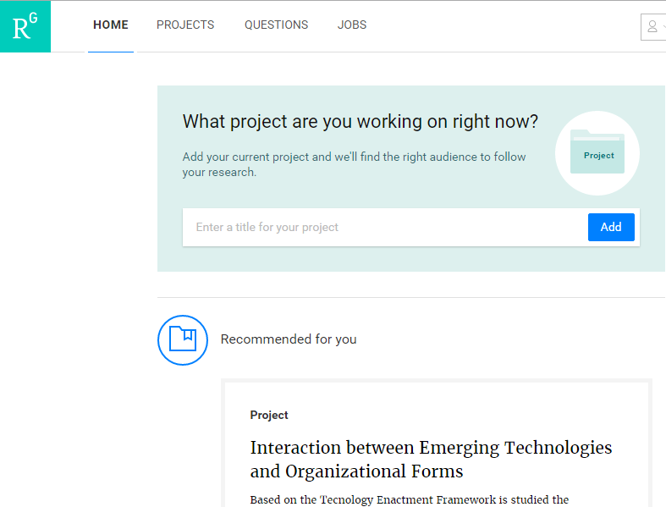
Peers’ research project recommendation at ResearchGate
Establish/maintain community; facilitate collaboration

Slide 11
An Introduction to Information Systems
Information
  One of an organization’s most valuable resources
    Often confused with the term data
  Major functions of business IS: (Examples in previous slides)
  Operation
  Decision support
  Maintain culture / project org image
  Maintain community / facilitate collaboration
Evolution
Notes:
An Introduction to Information Systems
Information
One of an organization’s most valuable resources
Often confused with the term data

Slide 12
Data, Information, and Knowledge
Data: raw facts – un-processed, un-organized
Information: collection of data organized in such a way that they have value beyond the facts themselves
  Process: set of logically related tasks performed to achieve a defined outcome
    Turning data into information is a process
Knowledge: awareness and understanding of a set of information and the ways it can be made useful to support a task
  The process of defining relationships among data to create useful information requires knowledge
Notes:
Data, Information, and Knowledge
Data: raw facts
Information: collection of data organized in such a way that they have value beyond the facts themselves
Process: set of logically related tasks performed to achieve a defined outcome
Turning data into information is a process
Knowledge: awareness and understanding of a set of information and the ways it can be made useful to support a task
The process of defining relationships among data to create useful information requires knowledge

Slide 13
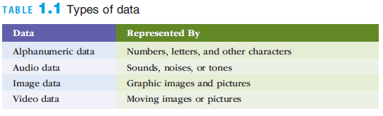
Data, Information, and Knowledge
Notes:
Data, Information, and Knowledge

Slide 14
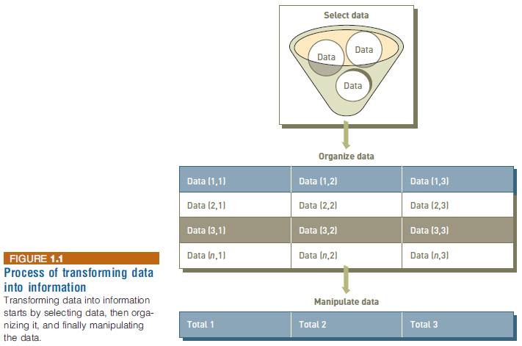
Data, Information, and Knowledge
Notes:
Data, Information, and Knowledge

Slide 15
The Value of Information
Valuable information helps people perform tasks more efficiently and effectively
  Inaccurate data can result in loss of potential new customers and reduced customer satisfaction
  Efficient: Doing things fast (and accurately, economical)
  Effective: Doing the right things (contribute to your goals) – “Business”, “Goal-oriented”
Notes:
The Value of Information
Valuable information helps people perform tasks more efficiently and effectively
Inaccurate data can result in loss of potential new customers and reduced customer satisfaction

Slide 16
Characteristics of Quality Information
If an organization’s information is not accurate or complete:
  People can make poor decisions, costing thousands, or even millions, of dollars
Depending on the type of data you need:
  Some characteristics become more important than others
Accuracy and completeness are critical for data used in accounting for the management of company assets
Notes:
Characteristics of Quality Information
If an organization’s information is not accurate or complete:
People can make poor decisions, costing thousands, or even millions, of dollars
Depending on the type of data you need:
Some characteristics become more important than others
Accuracy and completeness are critical for data used in accounting for the management of company assets

Slide 17
Data quality
Purpose
Usage
“Quality details”
Accurate
Complete
Timely
Consistent
Accessible
Relevant
Concise
Relevant
Complete
Accessible
Timely
Consistent
Accurate
Concise
Notes:
The amount of data increases exponentially over time
Data are scattered throughout organizations
Data are generated from multiple sources (internal, personal, external)
New sources of data (e.g., blogs, podcasts, videocasts, and RFID tags and other wireless sensors)
Data Degradation (e.g., customers move to new addresses, change their names, etc.)
Data Rot
Data security, quality, and integrity are critical
Legal requirements change frequently and differ among countries and industries
Internal Data Sources (e.g., corporate databases and company documents)
Personal Data Sources (e.g., personal thoughts, opinions, and experiences)
External Data Sources (e.g., commercial databases, government reports, and corporate Web sites).
Data Rot: refers primarily to problems with the media on which the data are stored. Over time, temperature, humidity, and exposure to light can cause physical problems with storage media and thus make it difficult to access the data.
Federal regulations:
-- Sarbanes–Oxley Act of 2002 requires that:
(1) public companies evaluate and disclose the effectiveness of their internal fi nancial controls
(2) independent auditors for these companies agree to this disclosure.

Slide 18
What is an Information System?
An information system (IS) is a set of interrelated elements that:
  Collect (input)
  Process (manipulate)
  Store (preserve and protect)
  Disseminate data and information (output)
  Provides a feedback mechanism to monitor and control its operation to make sure it continues to meet its goals and objectives
Notes:
What is an Information System?
An information system (IS) is a set of interrelated elements that:
Collect (input)
Process
Store
Disseminate data and information
Provides a feedback mechanism to monitor and control its operation to make sure it continues to meet its goals and objectives
A computer-based information system (CBIS) is a single set of hardware, software, databases, networks, people, and procedures
That are configured to collect, manipulate, store, and process data into information
An organization’s technology infrastructure includes all the hardware, software, databases, networks, people, and procedures
That are configured to collect, manipulate, store, and process data into information

Slide 19
What is an Computer-Based Information System?
A computer-based information system (CBIS) is a single set of hardware, software, databases, networks, people, and procedures
  That are configured to collect, manipulate, store, and process data into information
An organization’s technology infrastructure includes all the hardware, software, databases, networks, people, and procedures
  That are configured to collect, manipulate, store, and process data into information
  In order to support the decision making and operations to achieve the organization’s strategic goals
Notes:
What is an Information System?
An information system (IS) is a set of interrelated elements that:
Collect (input)
Process
Store
Disseminate data and information
Provides a feedback mechanism to monitor and control its operation to make sure it continues to meet its goals and objectives
A computer-based information system (CBIS) is a single set of hardware, software, databases, networks, people, and procedures
That are configured to collect, manipulate, store, and process data into information
An organization’s technology infrastructure includes all the hardware, software, databases, networks, people, and procedures
That are configured to collect, manipulate, store, and process data into information

Slide 20
Components of IS; IS in Business
(Figure by Zhang)
Corp
Strategy
Information System
People
Procedure
Use
Software
Data
Hardware
Hardware
Network
© 1997-2019, Dr. Yüe “Jeff” Zhang

Slide 21
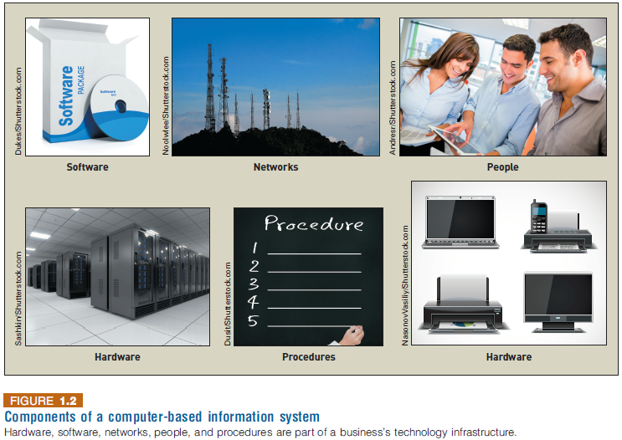
What is an Information System?
Notes:
What is an Information System?

Slide 22
What is an Information System?
Procedure defines the steps to follow to achieve a specific end result
  Such as enter a customer order, pay a supplier invoice, or request a current inventory report
Using a CBIS involves setting and following many procedures, including those for the
  Operation, maintenance, and security of the system
Notes:
What is an Information System?
Procedure defines the steps to follow to achieve a specific end result
Such as enter a customer order, pay a supplier invoice, or request a current inventory report
Using a CBIS involves setting and following many procedures, including those for the
Operation, maintenance, and security of the system

Slide 23
Information Systems in Organizations
Information systems can be divided into three types:
  Personal IS – includes information systems that improve the productivity of individual users
  Group IS –includes information systems that improve communications and support collaboration among members of a workgroup
  Enterprise IS – includes information systems that organizations use to define structured interactions among their own employees and/or external customers, suppliers, government agencies, etc…
IS
212
IS
312
Notes:
Information Systems in Organizations
Information systems can be divided into three types:
Personal IS – includes information systems that improve the productivity of individual users
Group IS –includes information systems that improve communications and support collaboration among members of a workgroup
Enterprise IS – includes information systems that organizations use to define structured interactions among their own employees and/or external customers, suppliers, government agencies, etc…

Slide 24
Information Systems in Organizations
For each type of IS, certain key organizational complements must be in place:
  Well-trained workers
  System support
  Better teamwork
  Redesigned processes
  New decision rights
Next slide: range of info support
Individual
Group
Enterprise
Notes:
Information Systems in Organizations
For each type of IS, certain key organizational complements must be in place:
Well-trained workers
System support
Better teamwork
Redesigned processes
New decision rights

Slide 25
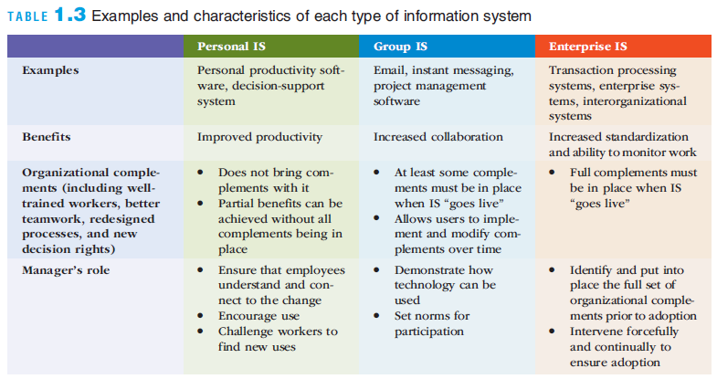
Information Systems in Organizations
Notes:
Information Systems in Organizations

Slide 26
Hardware
Hardware
  Consists of computer equipment used to perform input, processing, storage, and output activities
A trend in the industry is to produce smaller, faster, and more mobile hardware
Innovative new hardware devices include:
  Advanced keyboards
  Laptops and displays that connect wirelessly
  Embedded 3D cameras
  Very-high resolution display devices
Notes:
Hardware and Mobile Devices
Hardware
Consists of computer equipment used to perform input, processing, storage, and output activities
A trend in the industry is to produce smaller, faster, and more mobile hardware
Innovative new hardware devices include:
Advanced keyboards
Laptops and displays that connect wirelessly
Embedded 3D cameras
Very-high resolution display devices

Slide 27
Software
Software
  Consists of the computer programs that govern the operation of a particular computing device
Two types of software:
  System software – oversee basic computer operations such as start-up, controls access to system resources, and manages memory and files
  Application software – allows you to accomplish specific tasks, including editing text documents, creating graphs, and playing games
Notes:
Software and Mobile Applications
Software
Consists of the computer programs that govern the operation of a particular computing device
Two types of software:
System software – oversee basic computer operations such as start-up, controls access to system resources, and manages memory and files
Application software – allows you to accomplish specific tasks, including editing text documents, creating graphs, and playing games

Slide 28
Software
Business application software
  Can be categorized by whether it is intended to be used by an individual, a small business, or a large multinational enterprise
Consumerization of IT
  The trend of consumer technology practices influencing the way business software is designed and delivered
Notes:
Software and Mobile Applications
Business application software
Can be categorized by whether it is intended to be used by an individual, a small business, or a large multinational enterprise
Consumerization of IT
The trend of consumer technology practices influencing the way business software is designed and delivered

Slide 29
Database Systems and Big Data
Organized
Logical
Database: task - storage and manipulation of data
  An organized collection of facts and information, typically consisting of two or more related data files (including tables)
  Can contain facts and information on customers, employees, inventory, sales, online purchases, etc…
  4 types of data entities:
    Things: PRODUCT, INVENTORY, PROPERTY
    Organizations/Places: COMP, UNIV, CITY, STATE
    Persons: CUSTOMER, EMPLOYEE, STUDENT, PATIENT
    Events: MEETING, CONCERT, ACCIDENT, TRANSACTION
Data warehouse
  A database that stores large amount of historical data in a form that readily supports analysis and mgmt dec making
Notes:
Database Systems and Big Data
Database
An organized collection of facts and information, typically consisting of two or more related data files
Can contain facts and information on customers, employees, inventory, sales, online purchases, etc…
Data warehouse
A database that stores large amounts of historical data in a form that readily supports analysis and management decision making

Slide 30
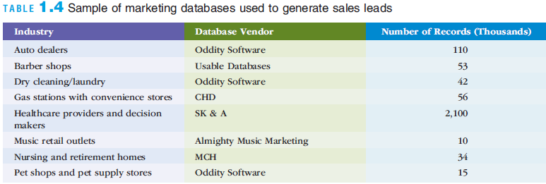
Database Systems and Big Data
Notes:
Database Systems and Big Data

Slide 31
Database Systems and Big Data
Extract-transform-load (ETL) process
  Raw data is extracted from various sources, transformed into a format that will support analysis, and then loaded into the data warehouse
“Big data”
  A term used to describe data collections that are so enormous that traditional data management software, hardware, and analysis processes are incapable of dealing with them
  Also means the NEW (non-traditional) methodology employed to process the big data
Notes:
Database Systems and Big Data
Extract-transform-lead (ETL) process
Raw data is extracted from various sources, transformed into a format that will support analysis, and then loaded into the data warehouse
Big data
A term used to describe data collections that are so enormous that traditional data management software, hardware, and analysis processes are incapable of dealing with them

Slide 32
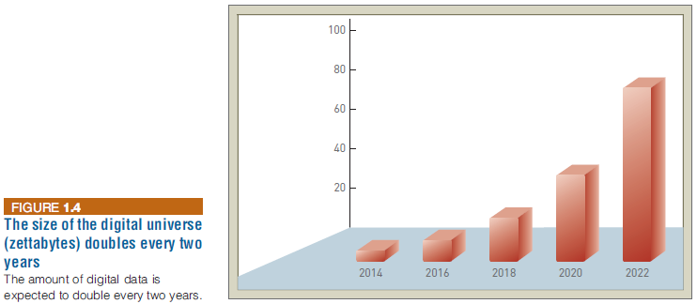
Database Systems and Big Data
Notes:
Database Systems and Big Data

Slide 33
Networks and Cloud Computing
Networks
  Connect computers and equipment across a physical space
      in a room, building, campus, city, or globally
  to enable electronic communication
Internet
  World’s largest computer network (of networks)
Public cloud computing
  A service provider organization owns and manages the hardware, software, networking, and storage devices in order to provide shared resources to users via the Internet
Businesses employ networks to share data, in order to facilitate collaboration and cooperation
Notes:
Networks and Cloud Computing
Networks
Connect computers and equipment in a room, building, campus, city, or globally to enable electronic communication
Internet
World’s largest computer network
Public cloud computing
A service provider organization owns and manages the hardware, software, networking, and storage devices in order to provide shared resources to users via the Internet

Slide 34
Networks and Cloud Computing
Intranet
  Enable communication, collaboration, search functions, and information sharing between member of an organization using a Web browser
Extranet
  A network based on Web technologies that allows selected outsiders to access authorized resources of a company’s intranet
Notes:
Networks and Cloud Computing
Intranet
Enable communication, collaboration, search functions, and information sharing between member of an organization using a Web browser
Extranet
A network based on Web technologies that allows selected outsiders to access authorized resources of a company’s intranet

Slide 35
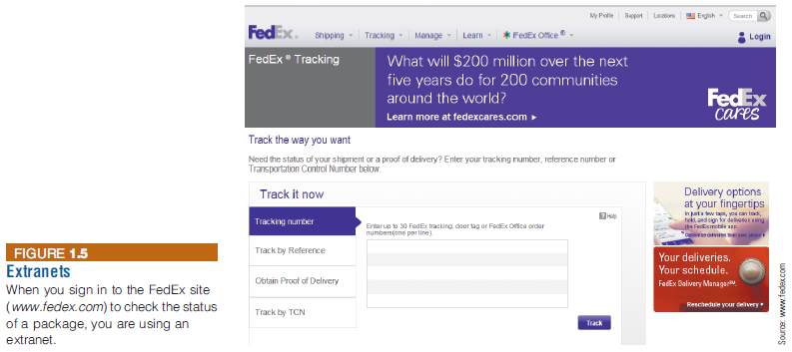
Networks and Cloud Computing
Notes:
Networks and Cloud Computing

Slide 36
Networks and Cloud Computing
Internet of Things (IoT)
  A network of physical objects embedded with sensors, processors, software, and network connectivity capability to enable them to exchange data with the manufacturer of the device, device operators, and other connected devices
Internet of Everything (IoE)
  Encompasses not only machine-to-machine but also people-to-people and people-to-machine connections
Smart-home
Notes:
Networks and Cloud Computing
Internet of Things (IoT)
A network of physical objects embedded with sensors, processors, software, and network connectivity capability to enable them to exchange data with the manufacturer of the device, device operators, and other connected devices
Internet of Everything (IoE)
Encompasses not only machine-to-machine but also people-to-people and people-to-machine connections

Slide 37
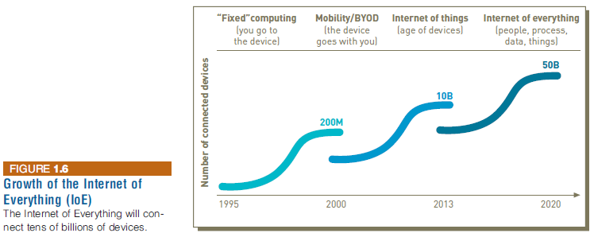
Networks and Cloud Computing
Notes:
Networks and Cloud Computing

Slide 38
Business Information Systems
Information systems are used in all functional areas of business organizations, such as:
  Accounting and finance
  Customer service
  Human resources
  Manufacturing
  Research and development
  Sales and marketing
  AKA “Functional Area Info Sys (FAIS)”
ERP
Notes:
Business Information Systems
Information systems are used in all functional areas of business organizations, such as:
Accounting and finance
Customer service
Human resources
Manufacturing
Research and development
Sales and marketing

Slide 39
Business Information Systems
Information systems are also used in every industry, such as:
  Agriculture
  Finance
  Health care
  Mining
  Professional services
  Retail
Notes:
Business Information Systems
Information systems are also used in nearly every industry, such as:
Agriculture
Finance
Health care
Mining
Professional services
Retail

Slide 40
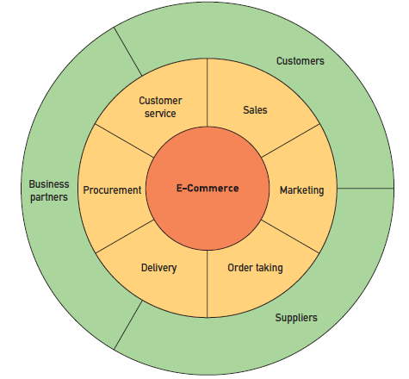

Electronic and Mobile Commerce
E-commerce involves the exchange of money for goods and services over electronic networks
Notes:
Electronic and Mobile Commerce
E-commerce involves the exchange of money for goods and services over electronic networks

Slide 41
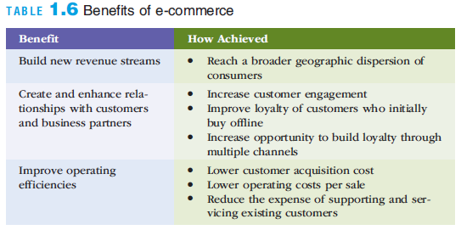
Electronic and Mobile Commerce
Notes:
Electronic and Mobile Commerce

Slide 42
Electronic and Mobile Commerce
Mobile commerce (m-commerce): the use of mobile, wireless devices to place orders and conduct business
  Used to support all forms of e-commerce:
    Business-to-business (B2B)
    Business-to-consumer (B2C)
    Consumer-to-consumer (C2C)
    Government-to-citizen (G2C)
    G2B
E-business: use of information systems and the Internet to perform business-related tasks and functions
Notes:
Electronic and Mobile Commerce
Mobile commerce (m-commerce): the use of mobile, wireless devices to place orders and conduct business
Used to support all forms of e-commerce:
Business-to-business (B2B)
Business-to-consumer (B2C)
Consumer-to-consumer (C2C)
Government-to-citizen (G2C)
E-business: use of information systems and the Internet to perform business-related tasks and functions

Slide 43
Enterprise Systems
Transaction
  Any business-related exchange, such as payments to employees and suppliers and sales to customers
Transaction processing system (TPS)
  An organized collection of people, procedures, software, databases, and devices
  Used to perform and record completed business transactions
Management information system (MIS) – features of MIS:
  Organized collection of people, procedures, software, databases, and devices
  Provides routine information to managers and decision makers
  Focuses on operational efficiency
  Provides standard reports generated with data and information from the TPS or ERP
Notes:
Enterprise Systems
Transaction
Any business-related exchange, such as payments to employees and suppliers and sales to customers
Transaction processing system (TPS)
An organized collection of people, procedures, software, databases, and devices
Used to perform and record completed business transactions
Management information system (MIS)
Organized collection of people, procedures, software, databases, and devices
Provides routine information to managers and decision makers
Focuses on operational efficiency
Provides standard reports generated with data and information from the TPS or ERP

Slide 44
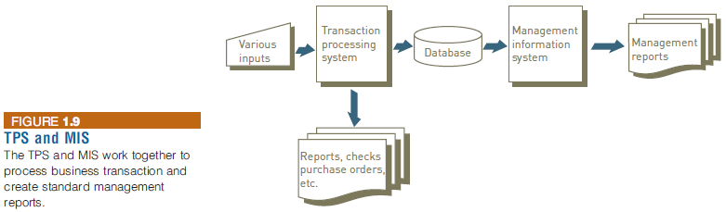
Enterprise Systems
Notes:
Enterprise Systems

Slide 45
Enterprise Systems
What IS 312 will focus & emphasize, in contrast w IS 212
Enterprise resource planning (ERP)
  A set of integrated programs
  Manages the vital business operations for an entire multisite, global organization
Most ERP systems provide integrated software to support manufacturing and finance
  Also provide support for business analytics and e-business
Notes:
Enterprise Systems
Enterprise resource planning (ERP)
A set of integrated programs
Manages the vital business operations for an entire multisite, global organization
Most ERP systems provide integrated software to support manufacturing and finance
Also provide support for business analytics and e-business

Slide 46
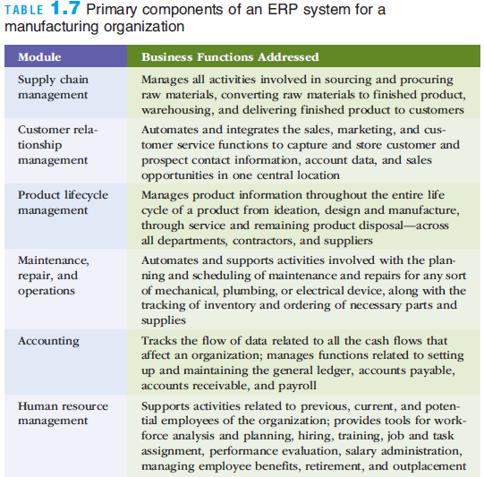
Enterprise Systems
Notes:
Enterprise Systems

Slide 47
Enterprise Systems
ERP system benefits:
  Provide a global view of operational/planning data
  Lower the cost of doing business
  Ensure compliance
  Automate core business operations
  Improve customer service
  Reduce time to market by sharing evolving product data
    Material flow, Monetary flow, Info flow (speed up, streamline)
Notes:
Enterprise Systems
ERP system benefits:
Provide a global view of operational/planning data
Lower the cost of doing business
Ensure compliance
Automate core business operations
Improve customer service
Reduce time to market by sharing evolving product data

Slide 48
Business Intelligence and Analytics
Business intelligence (BI) [more from biz purpose]
  Includes a wide range of applications, practices, and technologies for the extraction, transformation, integration, visualization, analysis, interpretation, and presentation of data to support improved decision making
Business analytics (BA) [more from tech/means/method]
  The extensive use of data and quantitative analysis to support fact-based decision making within organizations
  “Big Data”
The above two should not be seen as parallel: we can say that BA works to achieve BI
Notes:
Business Intelligence and Analytics
Business intelligence (BI)
Includes a wide range of applications, practices, and technologies for the extraction, transformation, integration, visualization, analysis, interpretation, and presentation of data to support improved decision making
Business analytics
The extensive use of data and quantitative analysis to support fact-based decision making within organizations

Slide 49
Knowledge Management and Specialized Information Systems
Knowledge management systems (KMSs)
  (Prevent “reinventing wheels”: “Organizational Learning”)
  An organized collection of people, procedures, software, databases, and devices that:
    Stores and retrieves knowledge
    Improves collaboration
    Locates knowledge sources
    Captures and uses knowledge
    Enhances the knowledge management process
Notes:
Knowledge Management and Specialized Information Systems
Knowledge management systems (KMSs)
An organized collection of people, procedures, software, databases, and devices that:
Stores and retrieves knowledge
Improves collaboration
Locates knowledge sources
Captures and uses knowledge
Enhances the knowledge management process

Slide 50
Planning, Acquiring, and Building Systems
Project
  A temporary endeavor undertaken to create a unique product, service, or result
  Attempts to achieve specific business objectives and is subject to certain constraints (manpower, time, budget, etc)
  The way much of an organization’s work gets done
  In IS 312 this semester, we will cover more (than before) project mgmt
Notes:
Planning, Acquiring, and Building Systems
Project
A temporary endeavor undertaken to create a unique product, service, or result
Attempts to achieve specific business objectives and is subject to certain constraints
They way much of an organization’s work gets done

Slide 51
Strategic Planning and Project Management
Strategic planning
  Used to improve alignment between the needs of the business and the activities of the information systems organization
  Alignment means that the IS organization and its resources are focused on efforts that support the key objectives defined in the strategic plan of business
Notes:
Strategic Planning and Project Management
Strategic planning
Used to improve alignment between the needs of the business and the activities of the information systems organization
Alignment means that the IS organization and its resources are focused on efforts that support the key objectives defined in the strategic plan of business

Slide 52
System Acquisition and Development (Sys Analysis & Design)
System acquisition
  Process used to obtain the information system resources needed to provide the services necessary to meet a specific set of needs
System development
  The activity of building information systems to meet users’ needs
  Projects can range from small to very large
Notes:
System Acquisition and Development
System acquisition
Process used to obtain the information system resources needed to provide the services necessary to meet a specific set of needs
System development
The activity of building information systems to meet users’ needs
Projects can range from small to very large

Slide 53
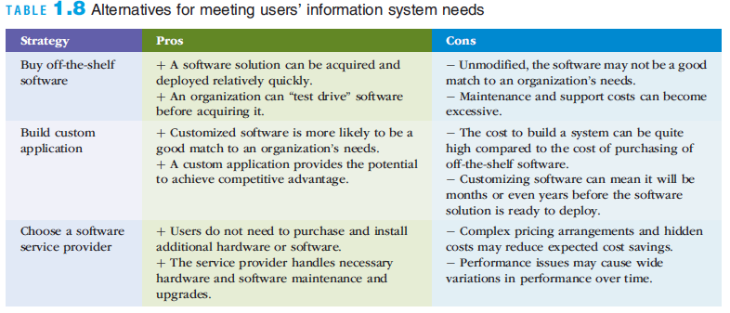
System Acquisition and Development
Notes:
System Acquisition and Development

Slide 54
Information Systems in Business and Society
The speed and widespread use of information systems
  Opens users to a variety of threats from unethical people
  Exposes enterprises & organizations to greater ethical responsibilities and threats
Computer-related attacks can come from individuals, groups, companies, and countries
Notes:
Information Systems in Business and Society
The speed and widespread use of information systems
Opens users to a variety of threats from unethical people
Computer-related attacks can come from individuals, groups, companies, and countries

Slide 55
Cybercrime and Information System Security
Cybercriminals
  Motivated by the potential for monetary gain
  Hack into computers systems to steal
Cyberterrorism
  The intimidation of a government or a civilian population by using information technology to disable critical national infrastructure
  To achieve political, religious, or ideological goals
Notes:
Cybercrime and Information System Security
Cybercriminals
Motivated by the potential for monetary gain
Hack into computers systems to steal
Cyberterrorism
The intimidation of a government or a civilian population by using information technology to disable critical national infrastructure
To achieve political, religious, or ideological goals

Slide 56
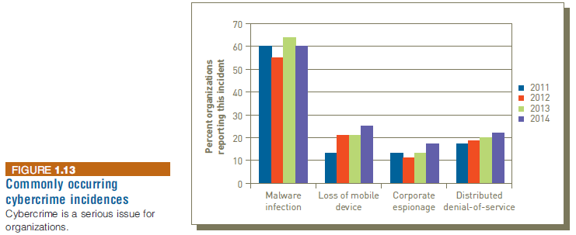
Cybercrime and Information System Security
A great amount of information to be added,
from my involvement with ISACA and ISSA
Notes:
Cybercrime and Information System Security

Slide 57
Ethical, Legal, and Social Issues of Information Systems
Ethics
  A set of beliefs about right and wrong behavior
Ethical behavior
  Conforms to generally accepted social norms
The use of information about people
  Requires balancing the needs of those who want to use the information against the rights and desires of the people whose information may be used
Notes:
Ethical, Legal, and Social Issues of Information Systems
Ethics
A set of beliefs about right and wrong behavior
Ethical behavior
Conforms to generally accepted social norms
The use of information about people
Requires balancing the needs of those who want to use the information against the rights and desires of the people whose information may be used

Slide 58
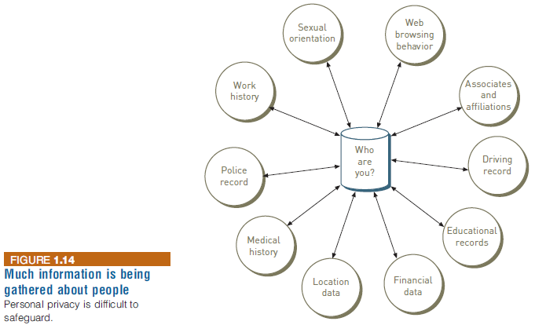
Ethical, Legal, and Social Issues of Information Systems
Notes:
Ethical, Legal, and Social Issues of Information Systems

Slide 59
Ethical, Legal, and Social Issues of Information Systems
Internet censorship
  The control or suppression of the publishing or accessing of information on the Internet
  My experience on China’s Internet platforms
Digital divide
  A term used to describe the gulf between those who do and those who don’t have access to modern information and communications technology
Net neutrality
  The principle that Internet service providers (ISPs) should be required to treat all Internet traffic running over their networks the same
Notes:
Ethical, Legal, and Social Issues of Information Systems
Internet censorship
The control or suppression of the publishing or accessing of information on the Internet
Digital divide
A term used to describe the gulf between those who do and those who don’t have access to modern information and communications technology
Net neutrality
The principle that Internet service providers (ISPs) should be required to treat all Internet traffic running over their networks the same

Slide 60
Info Sys Functions (departments/groups)
in an Org

Slide 61
Traditional Major IS Functions
Managing systems development and systems project management
Managing computer operations
Staffing, training, developing IS skills
Providing technical services
Infrastructure planning, development, control

Slide 62
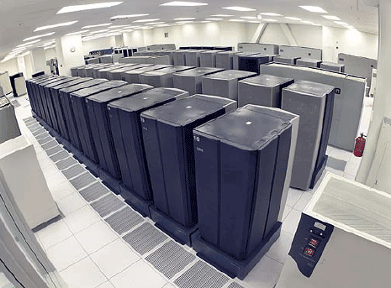

Traditional Functions of MIS Department
Consultative Functions of MIS Department
Example: manage data center
Example: create business alliances

Slide 63
New (Consultative) IS Functions
Initiating and designing strategic information systems
Incorporating the Internet and e-commerce into the business
Managing system integration
Educating non-IS managers about IT
Educating IS staff about the business
Supporting end-user computing
Partnering with executives
Managing outsourcing
Innovate
Ally with vendors and IS departments in other organizations

Slide 64
Alignment of Info Sys Functions with
Organizational Strategy

Slide 65
Six Characteristics of Excellent Business-IT Alignment
Enabler
Organizations view IT as an engine of innovation that continually transforms the business, often creating new revenue streams.
Organizations view their internal & external customers & their customer service function as supremely important.
Organizations rotate business & IT professionals across departments and job functions.
Organizations provide overarching goals that are completely clear to each IT and business employee.
Organizations ensure that IT employees understand how the company makes (or loses) money.
Organizations create a vibrant and inclusive company culture.
Notes:
Six Characteristics of Excellent Business-IT Alignment:
Organizations view IT as an engine of innovation that continually transforms the business, often creating new revenue streams.
Organizations view their internal and external customers and their customer service function as supremely important.
Organizations rotate business and IT professionals across departments and job functions.
Organizations provide overarching goals that are completely clear to each IT and business employee.
Organizations ensure that IT employees understand how the company makes (or loses) money.
Organizations create a vibrant and inclusive company culture.

Slide 66
Efficiency and effectiveness metrics to measure the impact of IT
Speed
Throughput
Performance 【Suggest: reliability】
Scalability
Net Present Value (NPV)
Return on Investment (ROI)
Total Cost of Ownership (TCO)
Indicators;
measures
Notes:
Measure: Immediate; Short-run; Long-run

Slide 67
Summary
The value of information is directly linked to how it helps decision makers achieve the organization’s goals, and to the daily operation of an organization
Information systems are composed of fundamental components that must be carefully assembled and integrated to work well together
Managers have an essential role to play in the successful planning/design, implementation and use of information systems-that role changes depending on which type of IS system is being implemented
Notes:
Summary
The value of information is directly linked to how it helps decision makers achieve the organization’s goals
Information systems are composed of fundamental components that must be carefully assembled and integrated to work well together
Managers have an essential role to play in the successful implementation and use of information systems-that role changes depending on which type of IS system is being implemented

Slide 68
Summary
An organization’s infrastructure technology forms the foundation upon which its systems and applications are built
Organizations employ a variety of information systems to improve the way they conduct business and make fact-based decisions
Strategic planning and project management are keys to ensuring that the organization is working effectively on the right projects
Information systems must be applied thoughtfully and carefully so that society, organizations, and individuals around the globe can reap their enormous benefits
Notes:
Summary
An organization’s infrastructure technology forms the foundation upon which its systems and applications are built
Organizations employ a variety of information systems to improve the way they conduct business and make fact-based decisions
Strategic planning and project management are keys to ensuring that the organization is working effectively on the right projects
Information systems must be applied thoughtfully and carefully so that society, organizations, and individuals around the globe can reap their enormous benefits

