Slide 1
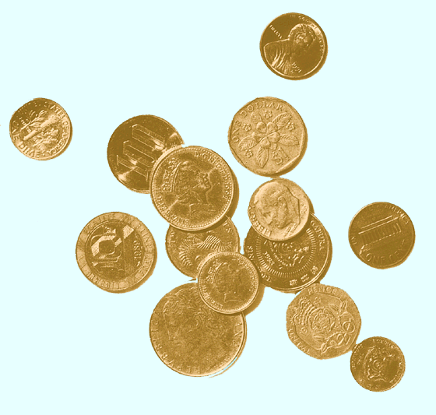
The Market for Foreign Exchange
(Eun and Resnick chapter 5)

Slide 2
FX Market Participants
The FX market is a two-tiered market:
Interbank market (wholesale)
About 100-200 banks worldwide stand ready to make a market in foreign exchange.
Nonbank dealers account for about 40% of the market.
There are FX brokers who match buy and sell orders but do not carry inventory and FX specialists.
Client market (retail)
Market participants include international banks, their customers, nonbank dealers, FX brokers, and central banks.
Why is the trading volume so large in the FOREX market?
Largest in the world: $4 trillion daily

Slide 3
The Spot Market
The spot market involves immediate purchase or sale of foreign exchange
Direct quotation from US perspective
the U.S. dollar equivalent
the price of one unit of the foreign currency in US Dollars
Indirect Quotation from US perspective
the price of a U.S. dollar in the foreign currency
e.g. “you get 100 yen to the dollar”
The direct quote is the reciprocal of the indirect quote

Slide 4
The Bid-Ask Spread
In general, banks do not charge commissions on foreign currency transactions. They profit from bid-ask spread
The bid-ask spread is the difference between the bid and ask prices
The bid price is the price a dealer is willing to pay you for something (our case foreign currency); always listed first
The ask price is the amount the dealer wants you to pay for the thing (our case foreign currency); listed second

Slide 5
The Bid-Ask Spread
Interbank dealer quotes:
- American terms: Euro, British Pound, Australian Dollar
- European terms: all others
Ex: You want to transact with a dealer that gives you the following
quotations: $1.6625(bid) - 1.6635(ask)/£.
The dealer buys (gets) one pound from you for $1.6625
The dealer sells (gives) one pound to you for $1.6635
The bid-ask spread is a function of liquidity of the market, the XR
volatility as well as dealers’ inventory
The retail bid-ask spread is wider than interbank spread

Slide 6
Cross Rates
The cross rate is the rate of exchange between two non-US currencies
Suppose that S(Euro/$) = 1.25 and that S($/Yen) = 110 Yen What must the Euro/Yen cross rate be?
Euro/Yen= ($/Yen)x(Euro/$) = 110x1.25= 137.5
Suppose that S(Euro/$) = 1.25 and that S(AUD/$) = 0.5
What must the Euro/AUD cross rate be?

Slide 7
Currency conversion
A businessman has just completed transactions in Italy and England. He is now holding €250,000 and £500,000 and wants to convert to U.S. dollars.
His currency dealer provides this quotation:
USD/GBP 0.5025 – 76
EUR/USD 1.4739 – 44
What are his proceeds from conversion?
He sells €250,000 at the dealer’s bid price:
€250,000 x
$1.4739
=$368,475
€1.00
He sells £500,000 (BUY USD) at the dealer’s ask price:
£500,000 x
$1.00
=$985,027.58
£.5076
$1,353,502.58

Slide 8
Cross Rates with Bid-Ask Spreads
£10,000
sell £ at bid
$19,712
buy € at ask
€13,371
USD Bank Quotations | American Terms |  | European Terms
 | Bid | Ask | Bid | Ask
Pounds | 1.9712 | 1.9717 | .5072 | .5073
Euros | 1.4738 | 1.4742 | .6783 | .6785
To find the €/£ cross bid rate, consider a retail customer who:
Starts with £10,000, sells £ for $, and buys €:
$1.9712
€.6783
£10,000 ×
×
= €13,370.65
£1.00
$1.00
He has effectively sold £ at a €/£ bid price of €1.3371/£.

Slide 9
Triangular Arbitrage
Bank Quotations | Bid | Ask
Deutsche Bank £:$ | $1.9712 | $1.9717
Credit Lyonnais €:$ | $1.4738 | $1.4742
Credit Agricole £:€ | €1.3310 | €1.3317
“No Arbitrage” £:€ | €1.3371 | €1.3378
Suppose we observe these banks posting these exchange rates. As we have calculated the “no arbitrage” £/€ cross bid and ask rates, we can see that there is an arbitrage opportunity:
$1.9712
€1.00
£1 ×
×
= €1.3371
£1.00
$1.4742

Slide 10
Forward Rate Quotations
The forward market for FX involves agreements to buy and sell foreign currencies in the future at prices agreed upon today.
Bank quotes for 1, 3, 6, 9, and 12 month maturities are readily available for forward contracts.
Longer-term swaps are available.

Slide 11
Forward Rate Quotations
Consider the exchange rates shown to the right. For British pounds, the spot exchange rate is
$1.9717 = £1.00 while the 180-day forward rate is $1.9593 = £1.00
What’s up with that?
Country/currency | in US$ | per US$
UK pound | 1.9717 | .5072
1-mos forward | 1.9700 | .5076
3-most forward | 1.9663 | .5086
6-mos forward | 1.9593 | .5104
Clearly market participants expect that the pound will be worth less in dollars in six months.

Slide 12
Forward Premium
The interest rate differential implied by forward premium or discount.
For example, suppose the € is appreciating from S($/€) = 1.55 to F₁₈₀($/€) = 1.60.
The 180-day forward premium is given by:
F₁₈₀($/€) – S($/€)
360
1.60 – 1.55
f_{180,€v$}
=
×
=
× 2
S($/€)
180
1.55
= 0.0645, or 6.45%

Slide 13
Long and Short Forward Positions
If you have agreed to sell anything (spot or forward), you are “short”.
If you have agreed to buy anything (forward or spot), you are “long”.
If you have agreed to sell forex forward, you are short.
If you have agreed to buy forex forward, you are long.

Slide 14
Payoff Profiles
Payoff from long position in £10,000
profit
Consider the payoffs at maturity to a long position in a six month forward contract on £10,000.
$1,407
Spot exchange in 6 months $/£
$1.90/£
$2.10/£
Country/currency | in US$ | per US$
UK pound | 1.9717 | .5072
1-mos forward | 1.9700 | .5076
3-most forward | 1.9663 | .5086
6-mos forward | 1.9593 | .5104
−$593
$1.9593/£
loss

Slide 15
Profit and losses of forward positions: examples
The following quotations exist for the Australian dollar (AUD):
Present spot rate($/AUD) $0.50
90-day forward rate $0.52
Your expectation of the spot rate in 90days $0.55
If your expectations prove correct, what would be your
US dollar profit or loss from investing $4,000 in the spot market?
If your expectations prove correct, what would be your US dollar
profit or loss from investing $4,000 in the forward market?

Slide 16
The following sections in chapter 5 are not
required for the exam:
Triangular Arbitrage
Spot Foreign Exchange Microstructure
Swap transactions

Slide 17
Learning outcomes
Know the structure of the FX market
Know the difference between wholesale (interbank) market and retail market
Who are the participants in the FX market?
Explain how are foreign exchange transactions between international
banks settled
Know how to read/use spot and forward quotes; direct and indirect method
Calculate currency cross-rates, without bid-ask quotes, when
given two spot or forward FX quotations involving three currencies
Calculate the profit or loss of short and long forward positions
Define and calculate the forward discount or premium, both as the
difference and as an annualized % from the spot
Recommended questions:1, 2, 3, 5, 6, 8
Recommended problems: 1, 2, 3, 6,

