Slide 1
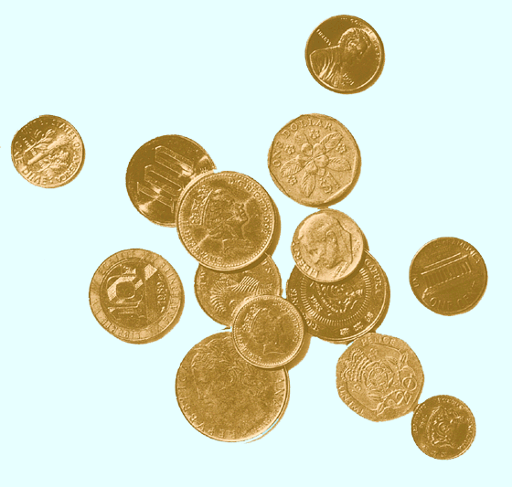
International Portfolio Investment
(Eun and Resnick chapter 15)

Slide 2
International Correlation Structure and Risk Diversification
Security returns are much less correlated across countries than within a country.
  This is true because economic, political, institutional, and even psychological factors affecting security returns tend to vary across countries, resulting in low correlations among international securities.
  Business cycles are often high asynchronous across countries.

Slide 3
International Correlation Structure
Stock Market
AU
FR
GM
JP
NL
SW
UK
US
Australia
.59
France
.29
.58
Relatively low international correlations imply that investors should be able to reduce portfolio risk more if they diversify internationally rather than domestically.
Germany
.18
.31
.65
Japan
.15
.24
.30
.42
Netherlands
.24
.34
.51
.28
.62
Switzerland
.36
.37
.48
.28
.52
.66
United Kingdom
.32
.38
.30
.21
.39
.43
.70
United States
.30
.23
.17
.14
.27
.27
.28
.44
Relatively low international correlations imply that investors should be able to reduce portfolio risk more if they diversify internationally rather than domestically.

Slide 4
Domestic vs. International Diversification
When fully diversified, an international portfolio can be less than half as risky as a purely U.S. portfolio.
A fully diversified international portfolio is only 12 percent as risky as holding a single security.
Portfolio Risk (%)
0.44
Swiss stocks
0.27
U.S. stocks
0.12
International stocks
Number of Stocks
1 10 20 30 40 50

Slide 5
The Optimal International Portfolio
OIP
1.53
JP
UK
US
FR
GM
CN
4.2%

Slide 6
International Correlation Structure and Diversification
Correlations between countries are not stable through time, but have increased during the last decade
Security returns are much less correlated across countries than within a country
Correlations between developed markets are much higher than the correlations between developed and emerging markets
The correlation of the U.S. stock market with the Canadian stock market is 0.7; correlation of the U.S. stock market with the Japanese stock market is 0.24
a U.S. investor would get more diversification from investments in Japan than Canada.

Slide 7
Barriers to International Diversification
sovereign (political) risk
Sovereign governments have the right to regulate the movement of goods, capital, and people across their borders
in general, financial managers and investors incorporate a political risk premium when foreign activities are being evaluated
Ex: ethnic strife in Indonesia; expropriation in Africa and Central America; changes in taxes and regulations;
  liquidity risk: refers to how quickly an asset can be sold without a major price concession
- The equity markets of the developed world tend to be much more liquid than that of emerging markets

Slide 8
Barriers to International Diversification
Information risk: most investors prefer to invest in assets that
are more familiar with
foreign language
limited access to information
lack of disclosure
unfamiliar accounting system
Foreign Exchange Risk: changes in XRs could reduce the profitability of foreign investment
Segmented markets: until few years ago, most the emerging markets restricted the foreign portfolio investment into their country

Slide 9
Effects of Changes in the Exchange Rate on investment performance
The realized dollar return for a U.S. resident investing in a foreign market will depend not only on the return in the foreign market but also on the change in the exchange rate between the U.S. dollar and the foreign currency.

Slide 10
Effects of Changes
in the Exchange Rate
The realized dollar return for a U.S. resident investing in a foreign market is given by
R_{i$} = (1 + R_{i})(1 + e_{i}) – 1
= R_{i} + e_{i} + R_{i}e_{i}
Where
R_{i} is the local currency return in the i^{th} market
e_{i} is the rate of change in the exchange rate between the local currency and the dollar

Slide 11
Effects of Changes
in the Exchange Rate
For example, if a U.S. resident just sold shares in a British firm that had a 15% return (in pounds) during a period when the pound depreciated 5%, his dollar return is 9.25%:
R_{i$} = (1 + .15)(1 – 0.05) – 1 = 0.925
= .15 + –.05 + .15×(–.05) = 0.925

Slide 12
Effects of Changes
in the Exchange Rate
The risk for a U.S. resident investing in a foreign market will depend not only on the risk in the foreign market but also on the risk in the exchange rate between the U.S. dollar and the foreign currency.
Var(R_{i$}) = Var(R_{i}) + Var(e_{i}) + 2Cov(R_{i},e_{i}) + ΔVar
The ΔVar term represents the contribution of the cross-product term, R_{i}e_{i}, to the risk of foreign investment.

Slide 13
International Diversification through International Mutual Funds
A U.S. investor can easily achieve international diversification by investing in a U.S.-based international mutual fund.
The advantages include:
Savings on transaction and information costs.
Circumvention of legal and institutional barriers to direct portfolio investments abroad.
Professional management and record keeping.

Slide 14
International Diversification through Country Funds
Recently, country funds have emerged as one of the most popular means of international investment.
A country fund invests exclusively in the stocks of a single county. This allows investors to:
  Speculate in a single foreign market with minimum cost.
  Construct their own personal international portfolios.
  Diversify into emerging markets that are otherwise practically inaccessible.
Exchange Traded Funds/ iShares

Slide 15
Trading in International Equities
During the 1980s world capital markets began a trend toward greater global integration
Diversification, reduced regulation, improvements in computer and communications technology, increased demand from MNCs for global issuance.
Cross-Listing refers to a firm having its equity shares listed on one or more foreign exchanges.
Foreign stocks often trade on U.S. exchanges as ADRs.
It is a receipt that represents the number of foreign shares that are deposited at a U.S. bank.
The bank serves as a transfer agent for the ADRs

Slide 16
American Depository Receipts
There are many advantages to trading ADRs as opposed to direct investment in the company’s shares:
  ADRs are denominated in U.S. dollars, trade on U.S. exchanges and can be bought through any broker.
  Dividends are paid in U.S. dollars.
  Most underlying stocks are bearer securities, the ADRs are registered.

Slide 17
Home Bias in Portfolio Holdings
As previously documented, investors can potentially benefit a great deal from international diversification.
The actual portfolios that investors hold, however, are quite different from those predicted by the theory of international portfolio investment.
Home bias refers to the extent to which portfolio investments are concentrated in domestic equities.

Slide 18
Why Home Bias in Portfolio Holdings?
Three explanations come to mind:
  Domestic equities may provide a superior inflation hedge.
  Home bias may reflect institutional and legal restrictions on foreign investment.
  Extra taxes and transactions/information costs for foreign securities may give rise to home bias.

Slide 19
Why Home Bias in Portfolio Holdings?
A recent study of the brokerage records of tens of thousands of U.S. individual investors shows that wealthier, more experienced, sophisticated investors are more likely to invest in foreign securities.
Another study shows that when a country is remote and has an uncommon language, foreign investors tend to stay away.

Slide 20
Learning outcomes:
Discuss the correlation between international markets and the benefits of international diversification
Discuss the following risks of or barriers to investing in international markets: sovereign/political, liquidity, foreign exchange , information
Know how to calculate the return on investment in a foreign security
Discuss three ways in which a US investor can diversify internationally (international mutual funds, country funds, ADRs)
Explain what is an ADR and why investors invest in them
Discuss what is Home Bias and the factors that affect it

