Slide 1
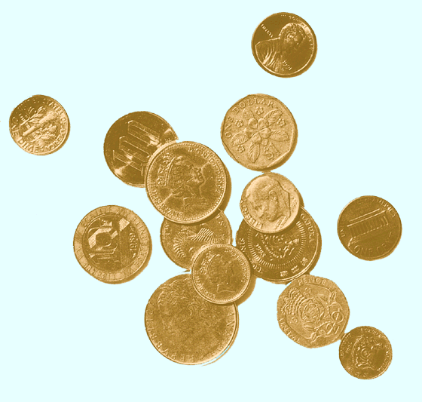
International Equity Markets
(Eun and Resnick chapter 13)

Slide 2
Developed vs Emerging Markets
Factors that are used to classify the world’s financial markets
in developed and emerging markets:
the size and scope of the equity, fixed income and derivatives markets
the sophistication of the local market professionals
liquidity and transaction costs
quality and quantity of financial information
financial regulations, business laws, ethics, investor protection

Slide 3
Market Capitalization
Almost 80% of the total market capitalization of the world’s equity markets is accounted for by the market capitalization of the developed world
Standard & Poor’s Emerging Markets Database classifies a stock market as emerging if it meets at least one of two general criteria:
It is located in a low- or middle-income economy as defined by the World Bank.
Its investable market capitalization is low relative to its most recent GNI figures.

Slide 4
Risks of investing in international markets
sovereign (political) risk
Sovereign governments have the right to regulate the movement of goods, capital, and people across their borders
in general, financial managers and investors incorporate a political risk premium when foreign activities are being evaluated
Ex: ethnic strife in Indonesia; currency controls in Malayasia; expropriation in Africa and Central America; changes in taxes and regulations;

Slide 5
Risks of investing in international markets
liquidity risk: refers to how quickly an asset can be sold without a major price concession
- The equity markets of the developed world tend to be much more liquid than emerging markets
Emerging markets have limited investability
- Emerging markets tend to be much more concentrated than our markets.
That is, a few issues account for a much larger percentage of the overall market capitalization in emerging markets than in the equity markets of the developed world.

Slide 6
Risks of investing in international markets
Information risk: most investors prefer to invest in assets that
are more familiar with
foreign language
limited access to information
lack of disclosure
unfamiliar accounting system

Slide 7
Risks of investing in international markets
Foreign Exchange Risk
- Foreign operations are conducted in foreign currencies.
- When firms and individuals are engaged in cross-border transactions they are exposed to foreign exchange (FX) risk.
- The foreign currency profits, costs, revenues in dollar terms depends on exchange rate movements.
- FX risk affects the cost of capital and the capital structure of a MNC firm
- Capital budgeting decisions are more complex in the international context

Slide 8
Trading in International Equities
During the 1980s world capital markets began a trend toward greater global integration
Diversification, reduced regulation, improvements in computer and communications technology, increased demand from MNCs for global issuance.
Cross-Listing refers to a firm having its equity shares listed on one or more foreign exchanges.
Foreign stocks often trade on U.S. exchanges as ADRs.
It is a receipt that represents the number of foreign shares that are deposited at a U.S. bank.
The bank serves as a transfer agent for the ADRs

Slide 9
Advantages of Cross-Listing
It expands the investor base for a firm.
Very important advantage for firms from emerging market countries with limited capital markets.
Establishes name recognition for the firm in new capital markets, paving the way for new issues.
May offer marketing advantages.
May mitigate possibility of hostile takeovers.

Slide 10
American Depository Receipts
There are many advantages to trading ADRs as opposed to direct investment in the company’s shares:
ADRs are denominated in U.S. dollars, trade on U.S. exchanges and can be bought through any broker.
Dividends are paid in U.S. dollars.
Most underlying stocks are bearer securities, the ADRs are registered.

Slide 11
American Depository Receipts
There are four levels of ADRs:
Level I: - trade over-the-counter (OTC) pink sheets
- minimal SEC disclosure; no GAAP compliance
Level II: - exchange-listed securities; without capital raising
- extensive SEC disclosure; partial GAAP reconciliation
Level III: - exchange-listed securities; capital raising
- full SEC disclosure; full GAAP reconciliation
Rule 144A: - capital raising issues sold to qualified institutional buyers
Level I 55%; 144A: 23%; levels II and III 22%

Slide 12
North American Equity Market Benchmarks

Slide 13
European Equity Market Benchmarks

Slide 14
Asia/ Pacific Rim Equity Market Benchmarks

Slide 15
Learning outcomes:
discuss the characteristics that differentiate the developed from emerging markets
discuss the following risks of investing in international markets: sovereign, liquidity, foreign exchange , information
Know what is/are: primary market; secondary market; market order; limit order; dealer market; over-the-counter market;
explain what is an ADR and why investors invest in them
Discuss the factors affecting international equity returns
End of chapter questions 2, 3, 4, 6; problem 1

