Slide 1
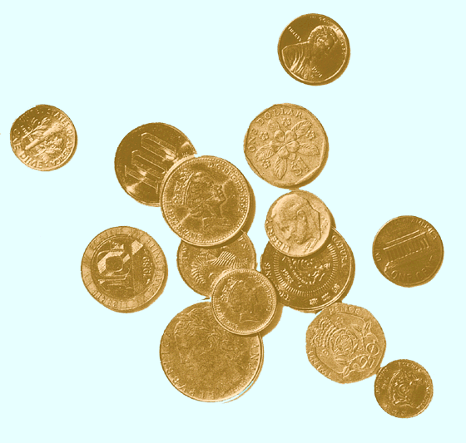
Mutual funds

Slide 2
Types of Investment Organizations
Mutual funds
  Open-End
  Closed-End
  (Stock trades on secondary market; Net asset value (NAV) is determined daily, but market price determined by supply and demand)
  - ETFs (Exchange Traded Funds)
Hedge Funds
Private equity/venture capital funds

Slide 3
Investment Companies
An investment company invests a pool of funds belonging to
many individuals in a portfolio of individual investments such as
stocks and bonds
Benefits:
Diversification
Professional management
Low capital requirement
Reduced transaction costs
Access to illiquid markets
Access to non-traditional trading strategies

Slide 4
Net Asset Value
Used as a basis for valuation of mutual funds.
  Selling new shares
  Redeeming existing shares
Calculation:
Market Value of Assets – Fund Expenses - Liabilities
Shares Outstanding

Slide 5
Mutual Funds: Investment Policies
Money Market
Fixed Income
Equity
Balance & Income
Asset Allocation
Indexed
Specialized Sector

Slide 6
Costs of Investing in Mutual Funds
Fee Structure
  Front-end load
  Back-end load
Operating expenses
12 b-1 charges
  distribution costs paid by the fund
  Alternative to a load
Fees and performance

Slide 7
Mutual funds: Performance
It’s not conclusive
Most of the studies suggest that the average MF underperforms its benchmark
There is some evidence of short-term performance persistence
The evidence show that it’s not easy to find funds that outperform
for a long period of time
Nonetheless, “hot” funds receive a disproportionately amount of
new money

Slide 8
Exchange Traded Funds
Are similar to closed-end funds: traded securities; entails commission costs
Each ETF is a claim on a trust that holds a specified pool of assets (e.g. S&P500 index components)
Examples:SPDRs, ishares,HOLDERS
Advantages:
  Liquidity
  Taxes
  Can be purchased on margin or sell short
ETF are appropriate for short-term investors and the ones who buy in large lots

Slide 9
Alpha
Alpha = mutual fund return – benchmark return
Higher the Alpha better the fund performance

Slide 10
Risk Adjusted Performance: Sharpe
Sharpe Ratio
r_{p} - r_{f}
σ
p
r_{p} = Average return on the portfolio
r_{f} = Average risk free rate
σ
= Standard deviation of portfolio return
p
Higher the Sharper ratio better the fund performance

Slide 11
Morningstar rating
Created in 1984 to provide comprehensive assessment of mutual funds
The star system was not meant to predict future performance
5* - the top 20% of the funds 1* the bottom 20%

Slide 12
Hedge Funds
Considerable confusion exists concerning hedge funds –
  what they are (and are not) and how they work
Hedge funds are privately organized, pooled investment vehicle with no restrictions in terms of investment strategies, asset classes and use of leverage
Many of them registered off-shore for tax and regulatory reasons
Can’t have more than 100 “accredited” investors or 500 “super-accredited” investors
Accredited investor: net worth > 1 million or income of $200,000 in each of the past two years
Super-Accredited investor: net worth > 5 million

Slide 13
Hedge Funds
Are not allowed to advertise broadly and engage in
“ general solicitation” to the investing public
Charge 1-2% of assets under management and 20-25% of profits
First hedge fund on record, Jones Hedge Fund, was established in 1949
He hedged the US equity market risk and focused on stock selection
By 2001, more than 5,000 funds in existence world-wide
Common features:
- shorting
- leverage
- concentration
Do they all hedge?

Slide 14
Hedge Fund Strategies
Long-short equity
Equity market neutral
Fixed-income arbitrage
Convertible arbitrage
Merger arbitrage
Global macro
Special situations

