Slide 1
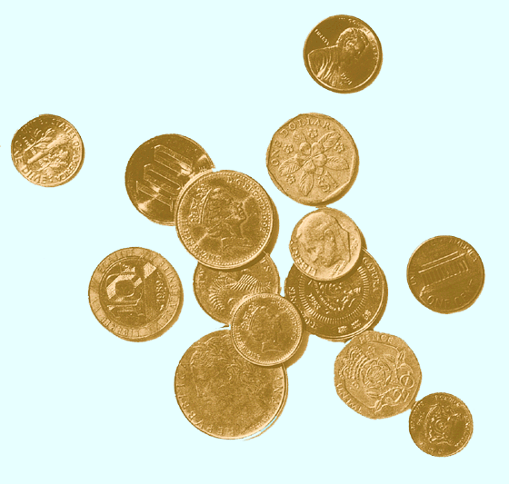
Asset Pricing Models
(chapter 9)

Slide 2
Capital Asset Pricing Model (CAPM)
Elegant theory of the relationship between risk and return
  Used for the calculation of cost of equity and required return
  Incorporates the risk-return trade off
  Very used in practice
  Developed by William Sharpe in 1963, who won the Nobel Prize in Economics in 1990
  Focus on the equilibrium relationship between the risk and expected return on risky assets
  Each investor is assumed to diversify his or her portfolio according to the Markowitz model

Slide 3
CAPM Basic Assumptions
All investors:
  Use the same information to generate an efficient frontier
  Have the same one-period time horizon
  Can borrow or lend money at the risk-free rate of return
No transaction costs, no personal income taxes, no inflation
No single investor can affect the price of a stock
Capital markets are in equilibrium

Slide 4
Borrowing and Lending Possibilities
Risk free assets
  Certain-to-be-earned expected return and a variance of return of zero
  No correlation with risky assets
  Usually proxied by a Treasury security
    Amount to be received at maturity is free of default risk, known with certainty
Adding a risk-free asset extends and changes the efficient frontier

Slide 5
Risk-Free Lending
Riskless assets can be combined with any portfolio in the efficient set AB
  Z implies lending
Set of portfolios on line RF to T dominates all portfolios below it
L
B
E(R)
T
Z
X
RF
A
Risk

Slide 6
Impact of Risk-Free Lending
If w_{RF} placed in a risk-free asset
  Expected portfolio return
  Risk of the portfolio
Expected return and risk of the portfolio with lending is a weighted average of the portfolio and Rf

Slide 7
The New Efficient Set
Risk-free investing and borrowing creates a new set of expected return-risk possibilities
Addition of risk-free asset results in
  A change in the efficient set from an arc to a straight line tangent to the feasible set without the riskless asset
  Chosen portfolio depends on investor’s risk-return preferences

Slide 8
Portfolio Choice
The more conservative the investor the more is placed in risk-free lending and the less borrowing
The more aggressive the investor the less is placed in risk-free lending and the more borrowing
  Most aggressive investors would use leverage to invest more in portfolio T

Slide 9
Market Portfolio
Most important implication of the CAPM
  All investors hold the same optimal portfolio of risky assets
  The optimal portfolio is at the highest point of tangency between RF and the efficient frontier
  The portfolio of all risky assets is the optimal risky portfolio
    Called the market portfolio

Slide 10
Characteristics of the Market Portfolio
All risky assets must be in portfolio, so it is completely diversified
  Includes only systematic risk
All securities included in proportion to their market value
Unobservable but proxied by S&P 500
Contains worldwide assets
  Financial and real assets

Slide 11
Capital Market Line
Line from RF to L is capital market line (CML)
x = risk premium =E(RM) - RF
y =risk =σ_{M}
Slope =x/y
=[E(RM) - RF]/σ_{M}
y-intercept = RF
L
M
E(R_{M})
x
RF
y
σ_{M}
Risk

Slide 12
The Separation Theorem
Investors use their preferences (reflected in an indifference curve) to determine their optimal portfolio
Separation Theorem:
  The investment decision, which risky portfolio to hold, is separate from the financing decision
  Allocation between risk-free asset and risky portfolio separate from choice of risky portfolio, T
All investors
  Invest in the same portfolio
  Attain any point on the straight line RF-T-L by either borrowing or lending at the rate RF, depending on their preferences

Slide 13
The Equation of the CML is:
Slope of the CML is the market price of risk for efficient portfolios, or the equilibrium price of risk in the market
Relationship between risk and expected return for portfolio P (Equation for CML):

Slide 14
Security Market Line (CAPM)
CML Equation only applies to markets in equilibrium and efficient portfolios
The Security Market Line depicts the tradeoff between risk and expected return for individual securities
Under CAPM, all investors hold the market portfolio
  How does an individual security contribute to the risk of the market portfolio?
A security’s contribution to the risk of the market portfolio is based on beta
Equation for expected return for an individual stock

Slide 15
Security Market Line
SML
Beta = 1.0 implies as risky as market
Securities A and B are more risky than the market
  Beta >1.0
Security C is less risky than the market
  Beta <1.0
E(R)
A
k_{M}
B
C
k_{RF}
0
0.5
1.0
1.5
2.0
Beta_{M}

Slide 16
Security Market Line
Beta measures systematic risk
  Measures relative risk compared to the market portfolio of all stocks
  Volatility different than market risk
All securities should lie on the SML
  The expected return on the security should be only that return needed to compensate for systematic risk
Required rate of return on an asset (k_{i}) is composed of
  risk-free rate (RF)
  risk premium (β_{i} [ E(R_{M}) - RF ])
    Market risk premium adjusted for specific security
k_{i} = RF +β_{i} [ E(R_{M}) - RF ]
  The greater the systematic risk, the greater the required return

Slide 17
Using CAPM
Expected Return
  If the market is expected to increase 10% and the risk free rate is 5%, what is the expected return of assets with beta=1.5, 0.75, and -0.5?
    Beta = 1.5; E(R) = 5% + 1.5 × (10% - 5%) = 12.5%
    Beta = 0.75; E(R) = 5% + 0.75 × (10% - 5%) = 8.75%
    Beta = -0.5; E(R) = 5% + -0.5 × (10% - 5%) = 2.5%

Slide 18
CAPM and Portfolios
How does adding a stock to an existing portfolio change the risk of the portfolio?
  Standard Deviation as risk
    Correlation of new stock to every other stock
  Beta
    Simple weighted average:
    Existing portfolio has a beta of 1.1
    New stock has a beta of 1.5.
    The new portfolio would consist of 90% of the old portfolio and 10% of the new stock
    New portfolio’s beta would be 1.14 (=0.9×1.1 + 0.1×1.5)

Slide 19
Estimating Beta
Treasury Bill rate used to estimate RF
Expected market return unobservable
  Estimated using past market returns and taking an expected value
Need
  Risk free rate data
  Market portfolio data
    S&P 500, DJIA, NASDAQ, etc.
  Stock return data
    Interval
      Daily, monthly, annual, etc.
    Length
      One year, five years, ten years, etc.
  Use linear regression R=a+b(Rm-Rf)

Slide 20
Problems using Beta
Which market index?
Which time intervals?
Time length of data?
Non-stationary
  Beta estimates of a company change over time.
  How useful is the beta you estimate now for thinking about the future?
Betas change with a company’s situation
Estimating a future beta
  May differ from the historical beta
Beta is calculated and sold by specialized companies

Slide 21
Learning objectives
Discuss the CAPM assumptions and model;
Discuss the CML and SML
Separation Theorem
Know Beta
Know how to calculate the require return; portfolio beta
Discuss how Beta is estimated and the problems with Beta
p 239 to 247 NOT for the exam
End of chapter questions 9.1 to 9.10, problems 9.1 to 9.5 CFA problems 9.31 to 33

