Slide 1
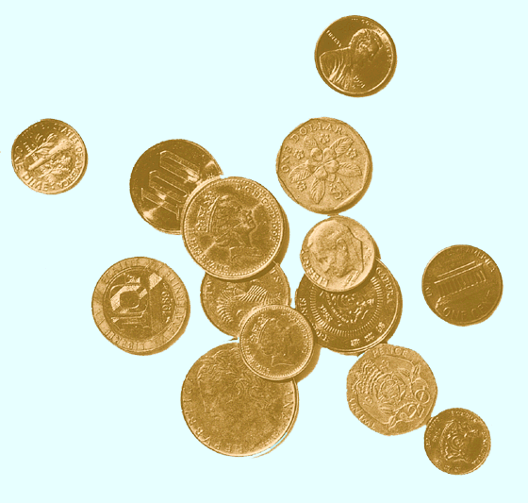
The Returns and Risks From Investing
(chapter 6 Jones )

Slide 2
Risk and Return
The investment process consists of two broad tasks:
security and market analysis
portfolio management

Slide 3
Top Down Asset Allocation
1. Capital Allocation decision: the choice of the
proportion of the overall portfolio to place in risk-free
assets versus risky assets.
2. Asset Allocation decision: the distribution of risky
investments across broad asset classes such as bonds,
small stocks, large stocks, real estate etc.
3. Security Selection decision: the choice of which
particular securities to hold within each asset class.

Slide 4
Risk and Return
Investors are concerned with both
expected return
risk
As an investor you want to maximize the returns for a given level of risk.
The relationship between the returns for assets in the portfolio is important.

Slide 5
Asset Valuation
Value is a function of risk and return
  At the center of security analysis
Historical risk-return relationships useful indicators
  No guarantee future will be like past
  No reason to assume future relative relationships will differ significantly from past
  Historical relationships especially useful in the long-run

Slide 6
Return Components
Returns consist of two elements:
  Periodic cash flows such as interest or dividends (income return)
    “Yield” measures relate income return to a price for the security
  Price appreciation or depreciation (capital gain or loss)
    The change in price of the asset
Total Return =Yield +Price Change

Slide 7
Risk Sources
Interest Rate Risk
  Affects income return
Market Risk
  Overall market effects
Inflation Risk
  Purchasing power variability
Business Risk
Financial Risk
  Tied to debt financing
Liquidity Risk
  Marketability with-out sale prices
Exchange Rate Risk
Country Risk
  Political stability

Slide 8
Risk Types
Two general types:
  Systematic (general) risk
    Pervasive, affecting all securities, cannot be avoided
    Interest rate or market or inflation risks
  Nonsystematic (specific) risk
    Unique characteristics specific to issuer
Total Risk = General Risk + Specific Risk

Slide 9
Measuring Returns
For comparing performance over time or across different securities
Total Return is a percentage relating all cash flows received during a given time period, denoted CFt +(PE - PB), to the start of period price, PB
Ex: CF=Div= $1 PB=$10 PE =$11
TR= (1+11-10)/10=0.2 or 20%

Slide 10
Measuring Returns
Total Return can be either positive or negative
  When cumulating or compounding, negative returns are problem
A Return Relative solves the problem because it is always positive
RR = 1+0.2 =1.2

Slide 11
Cumulative Wealth Index
To measure the level of wealth created by an investment rather than the change in wealth, need to cumulate returns over time
Cumulative Wealth Index, CWI_{n}, over n periods =
Returns are 10%, 8% and -4%
CWI= $1*(1.1×1.08×0.96)=1.14

Slide 12
Measuring International Returns
International returns include any realized exchange rate changes
  If foreign currency depreciates, returns lower in domestic currency terms
Total Return in domestic currency =
RR= return relative= 1+R_{FA} where R_{FA} is return in foreign currency
PB=10Euro; PE=12Euro RR=1.2 ;
XRB= 1.2$ per Euro; XRE= 1.25 $ per Euro
TR in $= 1.2 x (1.25/1.2] -1 = 25%

Slide 13
Measures Describing a
Return Series
TR, RR, and CWI are useful for a given, single time period
What about summarizing returns over several time periods?
Arithmetic mean, or simply mean,

Slide 14
Geometric Mean
Defined as the n-th root of the product of n return relatives minus one or G =
Difference between Geometric mean and Arithmetic mean depends on the variability of returns, s

Slide 15
Computing Returns
Arithmetic average return
  Example 1: (0.10+0.08-0.04)/3 = 0.0467 or 4.67%
  Example 2: (0.50-0.50)/2 = 0 or 0%
Geometric mean return
  Example 1: (1.1×1.08×0.96)^{1/3} – 1 = 0.0448 or 4.48%
  Example 2: (1.5×0.5)^{1/2} – 1 = -0.134 or -13.4%

Slide 16
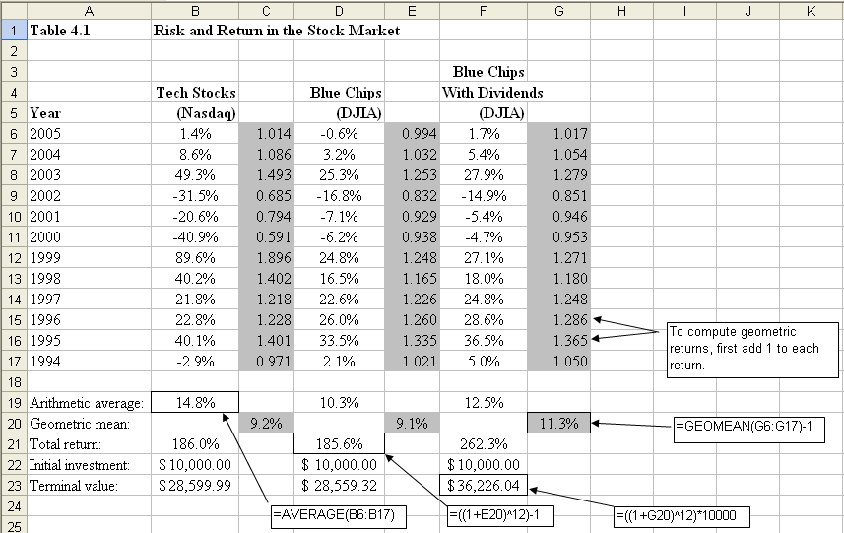

Slide 17
Arithmetic Versus Geometric
Arithmetic mean does not measure the compound growth rate over time
  Does not capture the realized change in wealth over multiple periods
  Does capture typical return in a single period
Geometric mean reflects compound, cumulative returns over more than one period
AM is a better measure of expected return next period
GM is a better measure of change in investment value over time

Slide 18
Annual data, 1926 to 2011
 |  |  | Long-Term | Short-term
 | Large US Common | Small US Common | Treasury | Treasury
 | Stocks | Stocks | Bonds | Bills
Arithmetic mean | 11.8% | 15.2% | 6.1% | 3.6%
Geometric mean | 9.8% | 11.3% | 5.7% | 3.6%
Standard deviation | 20.3% | 29.2% | 9.8% | 3.1%

Slide 19
Measuring Risk
Risk is the chance that the actual outcome is different than the expected outcome
Standard Deviation measures the deviation of returns from the mean

Slide 20
Risk Premiums
Premium is additional return earned or expected for additional risk
  Calculated for any two asset classes
Equity risk premium is the difference between stock and risk-free returns
Equity Risk Premium, ERP, =
For small RF is approximated to TR -RF

Slide 21
Learning objectives
Know the concepts of risk and return.
Know the components of return.
Know how to calculate average and geometric mean
Know how to calculated standard deviation
Total Return in domestic terms of investment in foreign currency
Risk premiums calculation
End of chapter questions 6-1 to 6.14 problems 6.1 and 6.2
NOT on the exam: Cumulative Wealth Indices p 156-159

