Slide 1

Common Stock Valuation
(chapter 10)

Slide 2
Fundamental Analysis
Present value approach
  Capitalization of expected income
  Intrinsic value based on the discounted value of the expected stream of cash flows
Multiple of earnings approach
  Valuation relative to a financial performance measure
  Justified P/E ratio

Slide 3
Present Value Approach
Intrinsic value of a security is
Estimated intrinsic value compared to the current market price
  What if market price is different than estimated intrinsic value?
  If Market Price < Intrinsic Value => BUY
  If Market Price > Intrinsic Value => SELL

Slide 4
Required Inputs
Expected cash flows:
  Size
  Timing
  Measurement
Discount rate
  Required rate of return: minimum expected rate to induce purchase
  The opportunity cost of dollars used for investment

Slide 5
Dividend Discount Model
Current value of a share of stock is the discounted value of all future dividends

Slide 6
Dividend Discount Model
Appropriate for value firms with stable dividend payments
The constant growth rate model
Growth firms are often difficult to value because of the fast and variable growth rates.
  So, return to the more general dividend discount model:

Slide 7
Constant growth stock
A stock whose dividends are expected to grow forever at a constant rate, g.
D₁ = D₀ (1+g)¹
D₂ = D₀ (1+g)²
D_{t} = D₀ (1+g)^{t}
If g is constant, the dividend growth formula converges to:

Slide 8
What happens if g > r_{s}?
If g > k, the constant growth formula leads to a negative stock price, which does not make sense.
The constant growth model can only be used if:
  k> g
  g is expected to be constant forever

Slide 9
If r_{RF} = 7%, r_{M} = 12%, and β = 1.2, what is the required rate of return on the firm’s stock?
Use the SML to calculate the required rate of return (k):
k = r_{RF} + (r_{M} – r_{RF})β
= 7% + (12% - 7%)1.2
= 13%

Slide 10
If D₀ = $2 and g is a constant 6%, What is the stock’s market value?
Using the constant growth model:

Slide 11
What would the expected price today be, if g = 0?
The dividend stream would be a perpetuity.

Slide 12
Dividend Discount Model
Implications of constant growth
  Stock prices grow at the same rate as the dividends
  Stock total returns grow at the required rate of return
    Dividend yield plus growth rate in dividends equals k, the required rate of return
  A lower required return or a higher expected growth in dividends raises prices

Slide 13
Dividend Discount Model
Multiple growth rates: two or more expected growth rates in dividends
  Ultimately, growth rate must equal that of the economy as a whole
  Assume growth at a rapid rate for n periods followed by steady growth

Slide 14
Dividend Discount Model
Multiple growth rates
  First present value covers the period of super-normal (or sub-normal) growth
  Second present value covers the period of stable growth
    Expected price uses constant-growth model as of the end of super- (sub-) normal period
    Value at n must be discounted to time period zero

Slide 15
Supernormal growth:
What if g = 30% for 3 years before achieving long-run growth of 6%?
Can no longer use just the constant growth model to find stock value.
However, the growth does become constant after 3 years.

Slide 16
Valuing common stock with nonconstant growth
0
1
2
3
4
k = 13%
...
gs = 30%
gs = 30%
gs = 30%
gc = 6%
D₀ = 2.00 2.6 3.380 4.394
4.658
2.6/(1+0.13) = 2.301
2.647
3.045
4.658
$
P
=
=
$66.54
66.54/(1+0.13)^3 = 46.114
3
−
0.13
0.06
^
54.107 = P₀

Slide 17
Calculations:
D1 = D0*(1+g1)= 2x(1+0.3)= 2.6
D2 = D1*(1+g1)= 2.6x(1+0.3)= 3.38
D3 = D2*(1+g1)= 3.38x(1+0.3)= 4.394
D4 = D3*(1+g2)= 4.394x(1+0.06) = 4.658
Present Value of D1= 2.6/(1+0.13) = 2.301
Present Value of D2= 3.38/(1+0.13)^2 = 2.647
Present Value of D3= 4.394/(1+0.13)^3 = 3.045

Slide 18
What about Capital Gains?
DDM accounts for capital gains
  Future price reflects expected dividends from that point forward
  DDM assumes price appreciates at “g”
  Valuing only dividends or a combination of dividends and price produces same result
Rearranging DDM shows two components of expected return:

Slide 19
Other Discounted Cash Flows
Free Cash Flow to Equity (FCFE): What could shareholders be paid?
  FCFE = Net Inc. + Depreciation – Change in Noncash Working Capital – Capital Expend. – Debt Repayments + Debt Issuance
Free Cash Flow to the Firm (FCFF): What cash is available before any financing considerations?
  FCFF = EBIT (1-tax rate) + Depreciation – Change in Noncash Working Capital – Capital Expend.
Use per share measures instead of dividends

Slide 20
Other Discounted Cash Flow Approaches: Corporate value model
Also called the free cash flow method. Suggests the value of the entire firm equals the present value of the firm’s free cash flows.
1. Find the market value (MV) of the firm.
  Find PV of firm’s future FCFs
2. Subtract MV of firm’s debt and preferred stock to get MV of common stock.
  MV of = MV of – MV of debt and
  common stock firm preferred
3. Divide MV of common stock by the number of shares outstanding to get intrinsic stock price (value).
  P₀ = MV of common stock / # of shares

Slide 21
Intrinsic Value
“Fair” value based on the capitalization of income process
  The objective of fundamental analysis
If intrinsic value >(<) current market price, hold or purchase (avoid or sell) because the asset is undervalued (overvalued)
  Decision will always involve estimates

Slide 22
P/E Ratio or Earnings Multiplier Approach
Alternative approach often used by security analysts
P/E ratio is the strength with which investors value earnings as expressed in stock price
  Divide the current market price of the stock by the latest 12-month earnings
  Price paid for each $1 of earnings

Slide 23
Multiplier Approach for Valuation
Alternative to discounted cash flow approach
Widely used approach due to ease of interpretation and calculation
Value estimate is the product of two inputs
  Firm financial characteristic
  Estimated price multiple (multiplier)

Slide 24
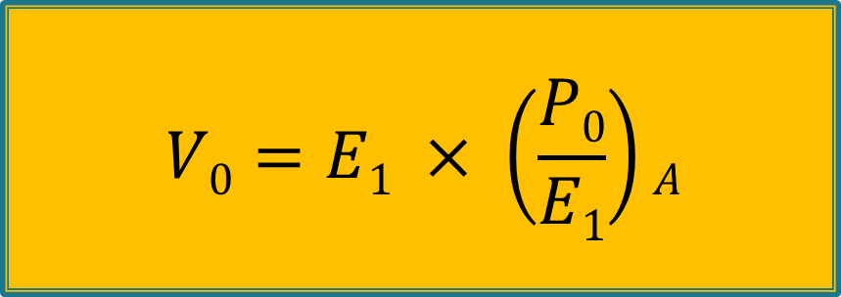
P/E Multiplier Approach
To estimate a stock’s value (V₀), an analyst must forecast next period’s EPS (E₁) and the appropriate current multiplier for next period’s estimated EPS (P₀/E₁)_{A}

Slide 25
Multiplier Approach for Valuation
Used with a variety of price multiples
  P/S, P/B, P/CF, EV/EBITDA
P/E multiple (ratio) is the most commonly considered multiplier
  Reflects price paid for each $1 of earnings
Approach is also used to value other asset types
  Commonly applied to real estate

Slide 26
Relative Valuation
Compare firm to peers, or the market, to assess relative valuation
Most applicable when comparison is between similar type firms
Apply the same multiples as used in the multiplier approach
  P/E, P/B, P/S, P/CF and EV/EBITDA
P/E ratios tend to be emphasized

Slide 27
Which Approach Is Best?
Discounted cash flow is theoretically best
  Application is difficult in some cases
Price multiples serve dual role
  Estimating intrinsic value of stock
  Relative valuation
All methods subject to estimation error
Traditional methods apply to “new economy” stocks: revenues and profits matter

Slide 28
Learning objectives
Know the Dividend Discount Model
Know the Constant Growth Model
Know the Discounted model with two growth rates
Know the discounted cash flow approach
Know the P/E and multiplier approaches
Relative valuation metrics
End of chapter questions 10.1 to 10.5, 10.14;All four demonstration problems; Problems 10.1 to 10.4

